Slide 1
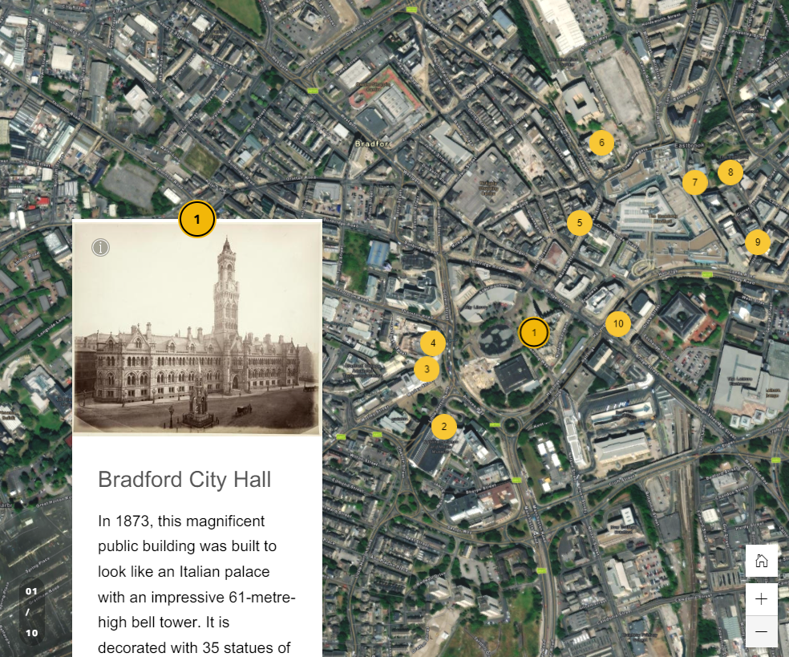
Take 10 Buildings: What can the Bradford City Heritage Trail tell us about the history and importance of Bradford?

Slide 2
Additional resources to support this PowerPoint
Paper Trail Map​
Trail Map – Cut-out and place trail buildings
Interactive Trail StoryMap​
Cut-out models of the 10 trail buildings​
A short history of Bradford

Slide 3

How to use this PPT
This PPT is designed to provide you, the teacher, with all the information you need to teach your pupils about 10 of Bradford's most historic buildings.
The slides in this PPT are intended for use in the classroom. You will find information and discussion slides, as well as activities to do with your class. You can use all, or some of the slides, and you can edit them to meet the needs of your pupils. In the notes section underneath some of the slides, you will find additional information for teachers.
This PPT is intended to be used along with the Bradford City Heritage Trail and digital StoryMap.
Contents
Supporting resources
Learning objectives
Activity – Location, Location, Location
Using the trail
Activity – Choose your favourite
Take 10 buildings – additional facts
Activity – Get creative
Wider context

Slide 4
What can the Bradford City Heritage Trail tell us about the history and importance of Bradford?
History & Geography
To develop our local history skills by using buildings as historical evidence to find out about our area in the past​
To develop our geography skills by using maps to find out about our area in the past​
To investigate why key historical sites in our local area are important
This PPT is part of the Teaching Activity: What can Bradford City Heritage Trail tell us about the history and importance of Bradford?

Slide 5


Activity – Location, Location, Location
All of the buildings pictured above are located in the centre of Bradford.
Do you recognise any of them?
Use a printed out copy of the Bradford City Centre map.
Cut out the little buildings on the bottom of it.
In groups have a go at trying to put the buildings in the right place on the map. It doesn’t matter if you don’t know them all yet. Have a go and try to do as many as you can.
​
Group discussion
Notes:
This is a Starter Activity to find out what the pupils already know – you can repeat it as a plenary activity, when all the pupils will have learnt about the buildings and should be able to place them all

Slide 6
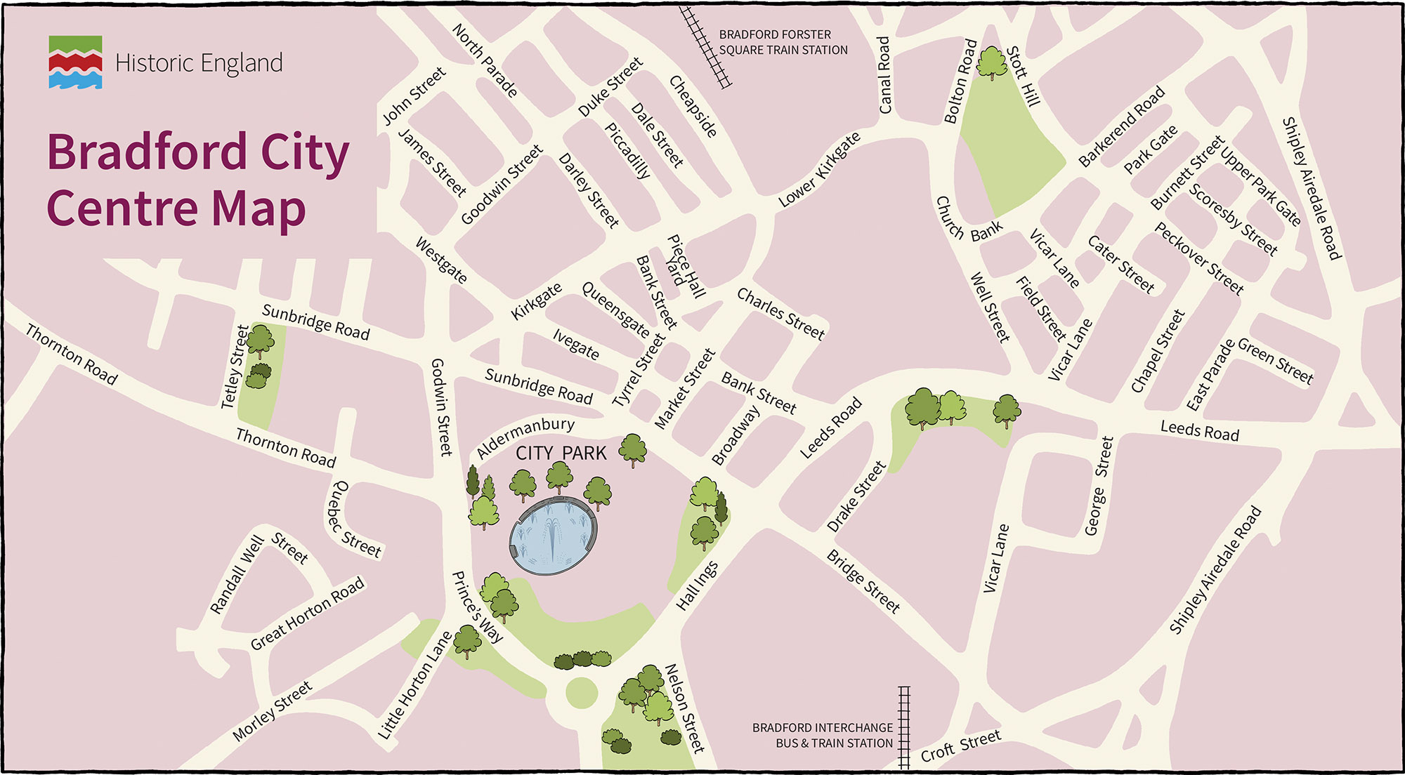
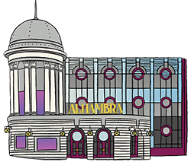
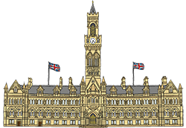
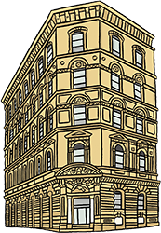
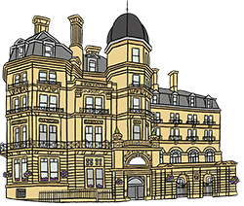
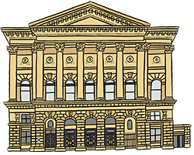

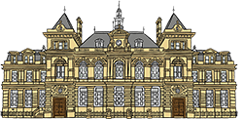

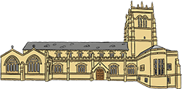
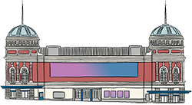
Drag and drop the buildings into the right place
Notes:
Use this digital version instead of/alongside the paper copy of the activity.
© Blackbird Publishing for Historic England

Slide 7
How did you do?
Notes:
Use this now – or at the very end of the session, to show where all of the buildings are.
© Blackbird Publishing for Historic England

Slide 8

Using the trail
Investigate
Download
Discover
Download the PDF version of the trail and take pupils out to explore the buildings on it AND/OR use the online version to virtually explore the buildings and find out about them.
Use these ‘Take 10 Buildings’ slides to discover more about each building, to help pupils choose their favourite building.
Cut out
Context
Pupils use the cut-out and make models of the buildings to create an exhibition. This will allow them to show what they’ve learnt to other pupils/parents.
Use the ‘A short history of Bradford’ PowerPoint to help pupils put their favourite building into the wider context of Bradford’s history.

Slide 9
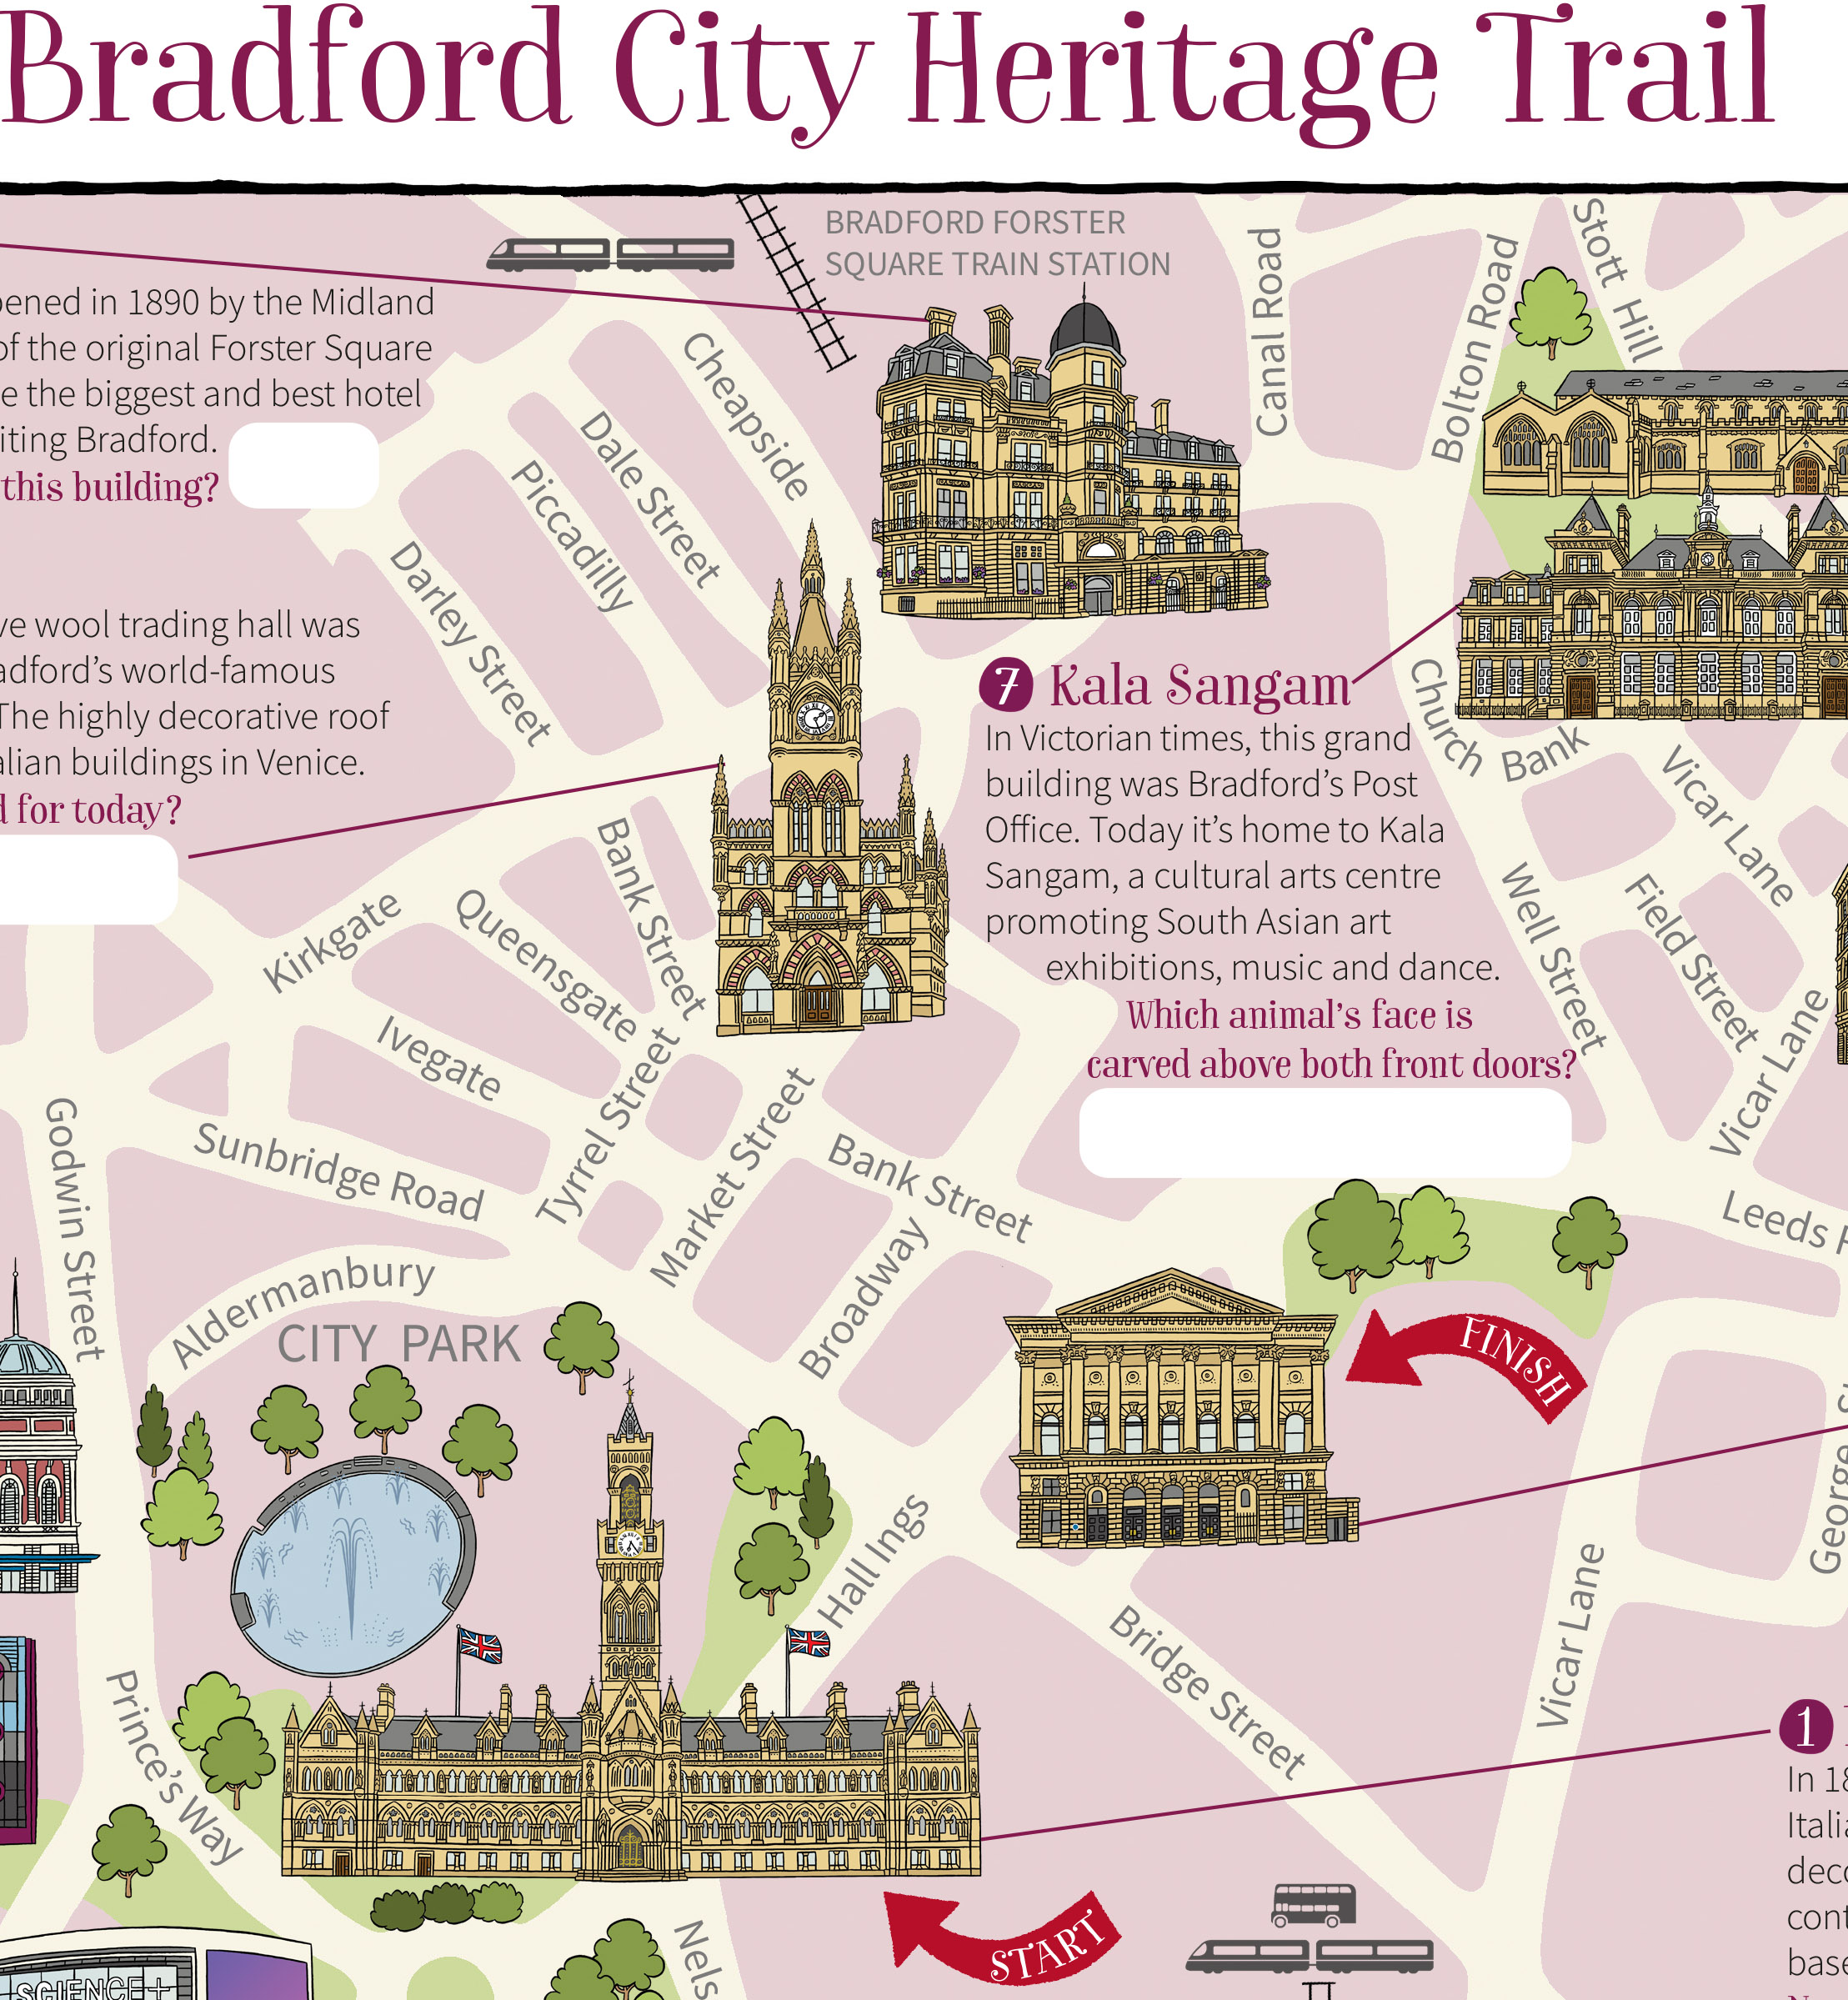
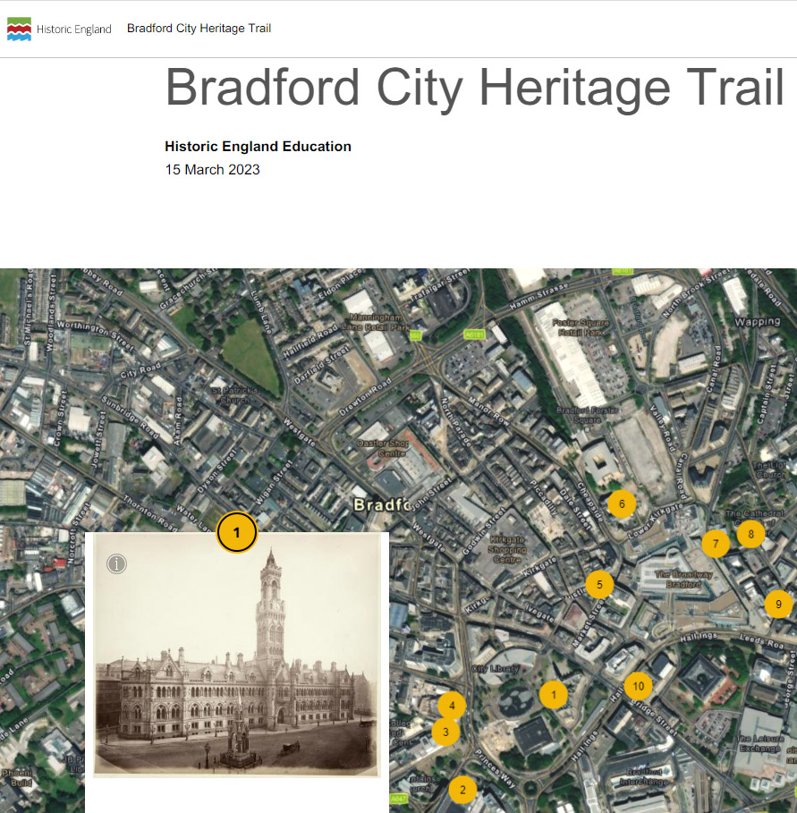
Using the trail
Check out the online trail before, after or instead of doing it in the real world!
Download the trail to take with you and head out to discover Bradford’s amazing buildings!

Slide 10



Activity – Choose your favourite
Now you’ve explored the trail it’s time to find out a bit more about each of the buildings.​
​This will help you to decide which is your favourite building!​
You’ll have to decide:​
Think
What makes my building special is…
It is my favourite because…

Slide 11
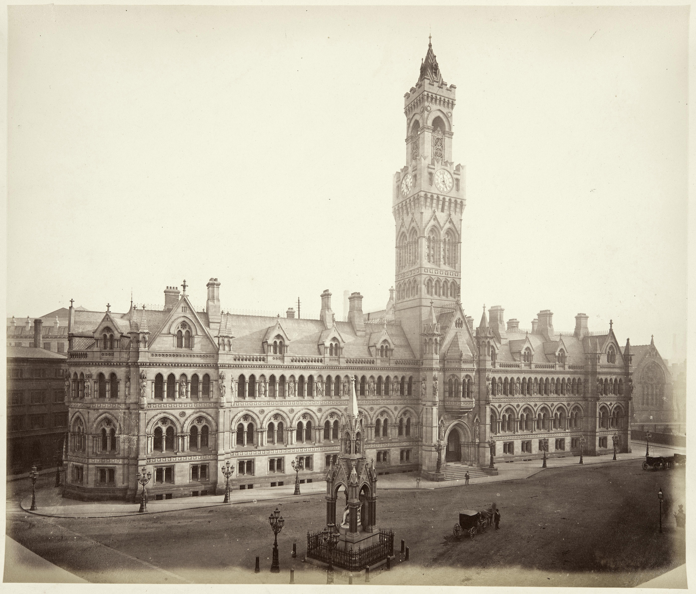
1. City Hall in 1875
Notes:
© Historic England Archive Ref:BL00866, Taken: 1875

Slide 12
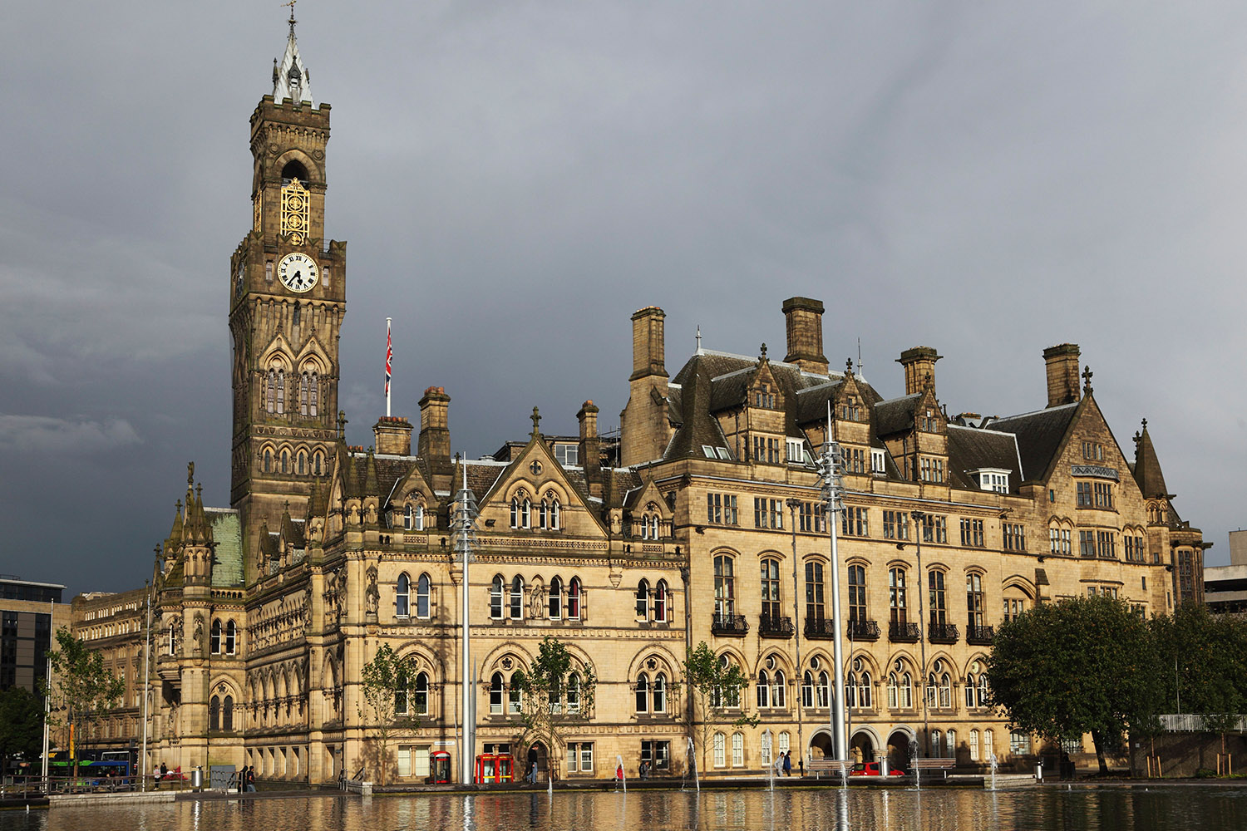
1. City Hall in 2012
Notes:
© Alamy Ref: D1G2TG Date: 29 AUGUST 2012

Slide 13
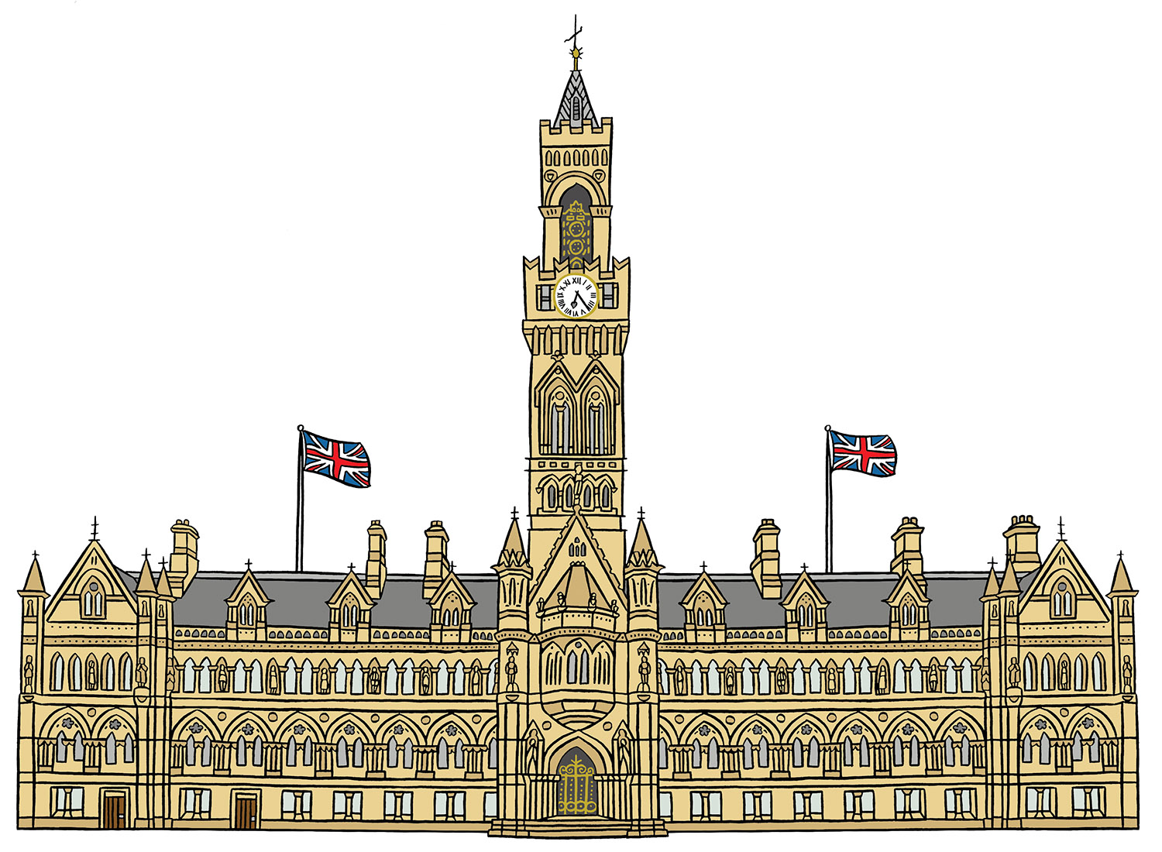
1. Artist’s impression of City Hall
Notes:
© Blackbird Publishing for Historic England

Slide 14





1. City Hall
A competition was held to design it - it had to rival the town halls of Leeds and Halifax! This was called civic pride.
In 1869 a plot of land was bought to build a new Town Hall. It was to replace the old one that just wasn't big enough anymore! ​
It was built by John Ives and Son of Shipley. It opened on 9th September 1873 at a cost of £100,000.
Local architects Lockwood and Mawson won the competition. Their design beat 30 other firms who entered the competition.
There are 35 statues of the Kings and Queens of England on the upper part of the building. These were restored in 2015-17.
It was made bigger in 1905-09. In 1965 it was renamed City Hall, to reflect Bradford’s growing prominence.

Slide 15
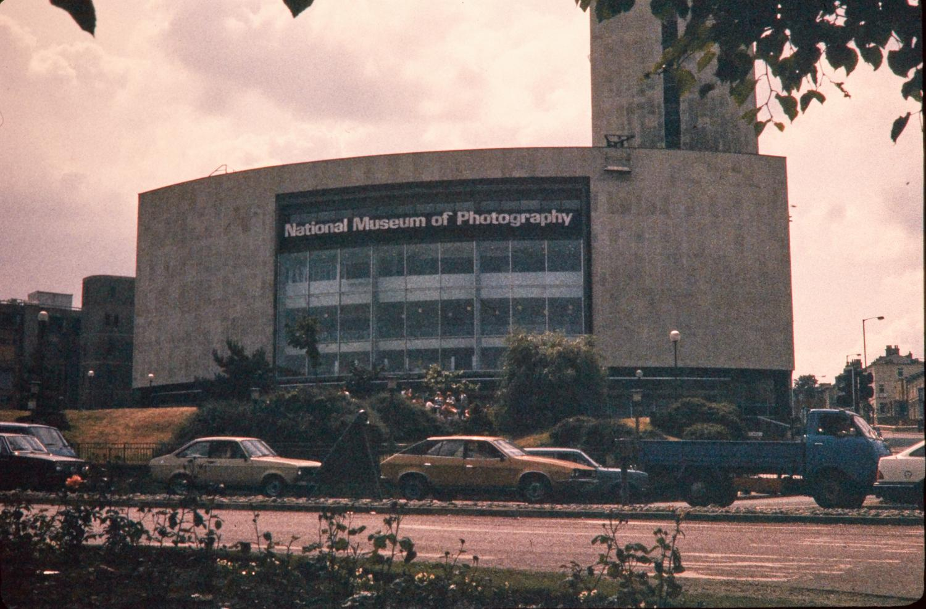
2. National Science and Media Museum in the 1980s
Notes:
© Historic England Archive Ref: NWC01/01/0877 Date: 1983-2006

Slide 16
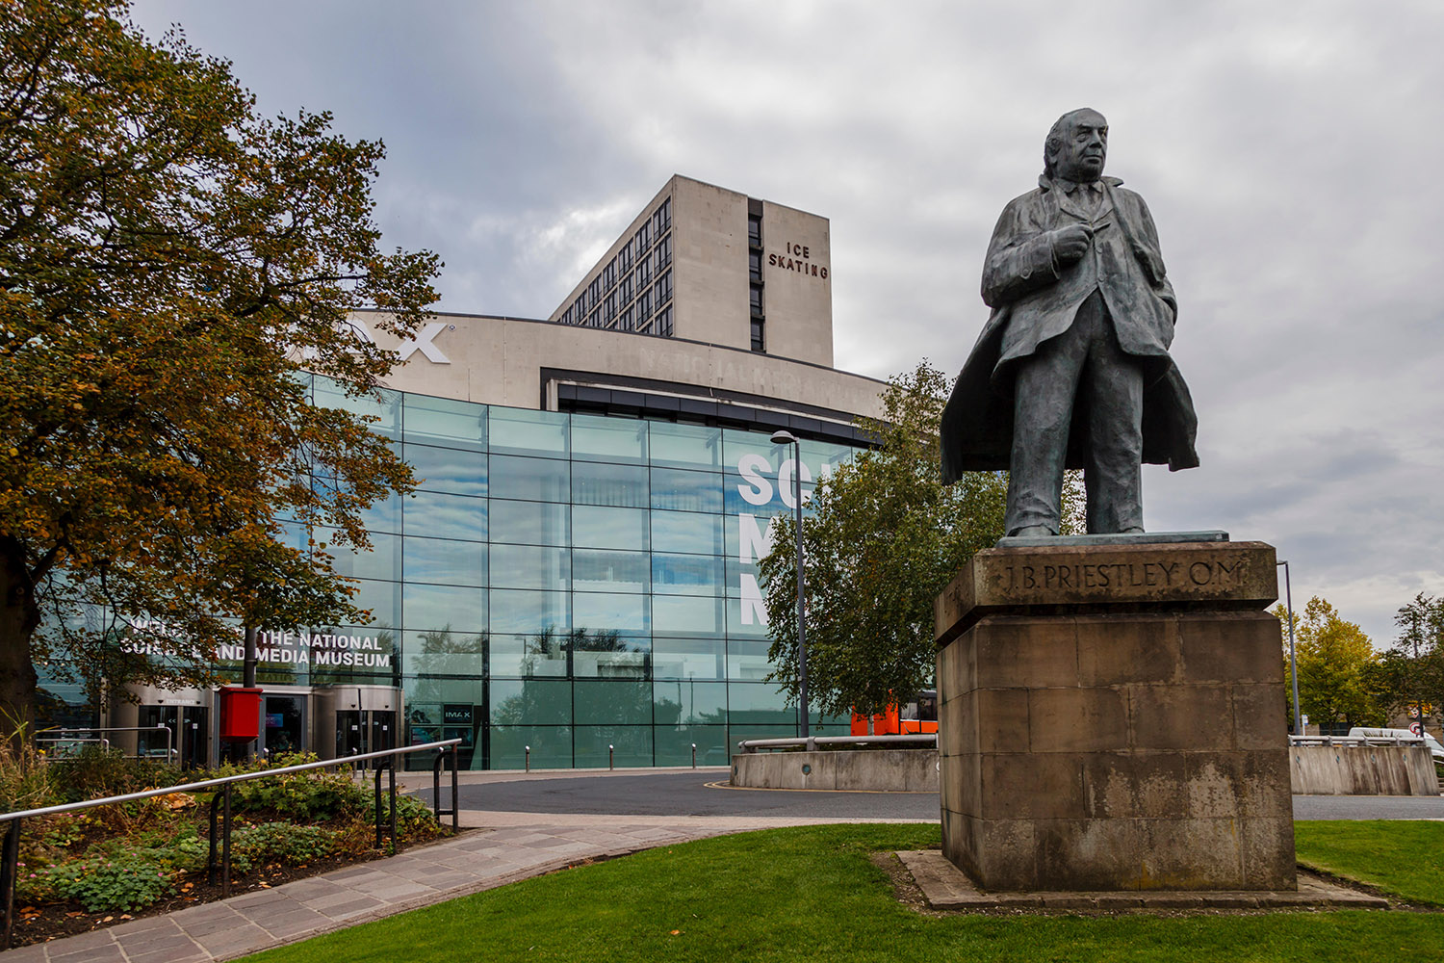
2. National Science and Media Museum in 2018
Notes:
Image © Alamy Ref: W4A6R5 Date: 11 October 2018

Slide 17
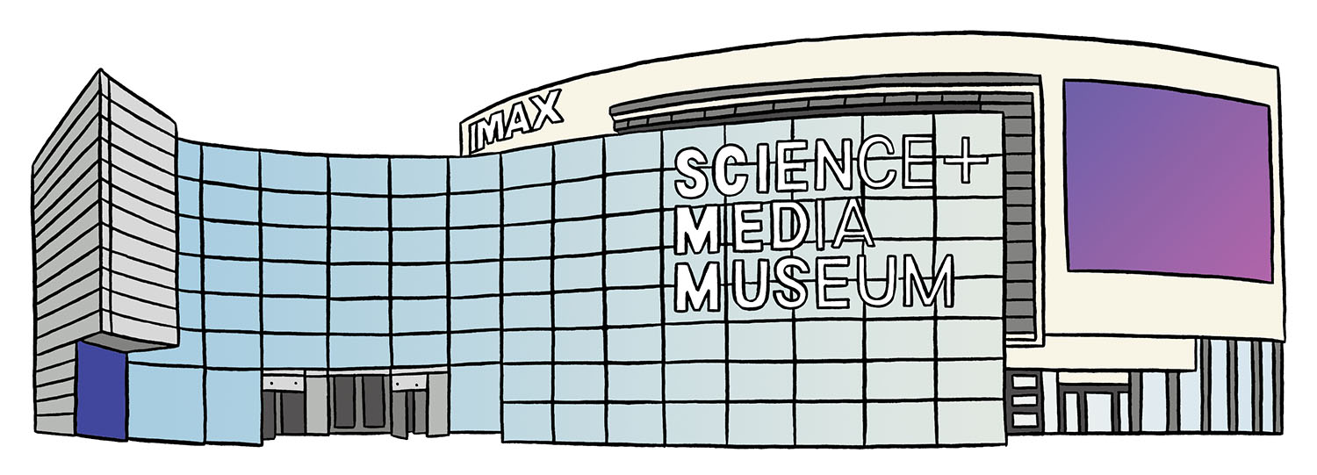
2. Artist’s impression of the National Science and Media Museum
Notes:
© Blackbird Publishing for Historic England

Slide 18
2. National Science and Media Museum
It had Europe’s first IMAX screen, which was five storeys high! There were also interactive tv studios and a gallery telling the story of popular photography.
The National Museum of Photography, Film and Television opened on 16 June 1983. It specialised in the art and science of images and image-making.
On 1 December 2006 it became the National Media Museum, covering digital technology, including video games. It had the world’s first gallery exploring the impact of the Internet!
From 1995 until 2014 the museum hosted the Bradford International Film Festival.
It holds around 3.5 million items, which include the first television footage and the world’s first colour moving pictures.
In 2017 it became the National Science and Media Museum. Over 500,000 people visited in 2017/18, making it the most popular museum outside London. ​

Slide 19
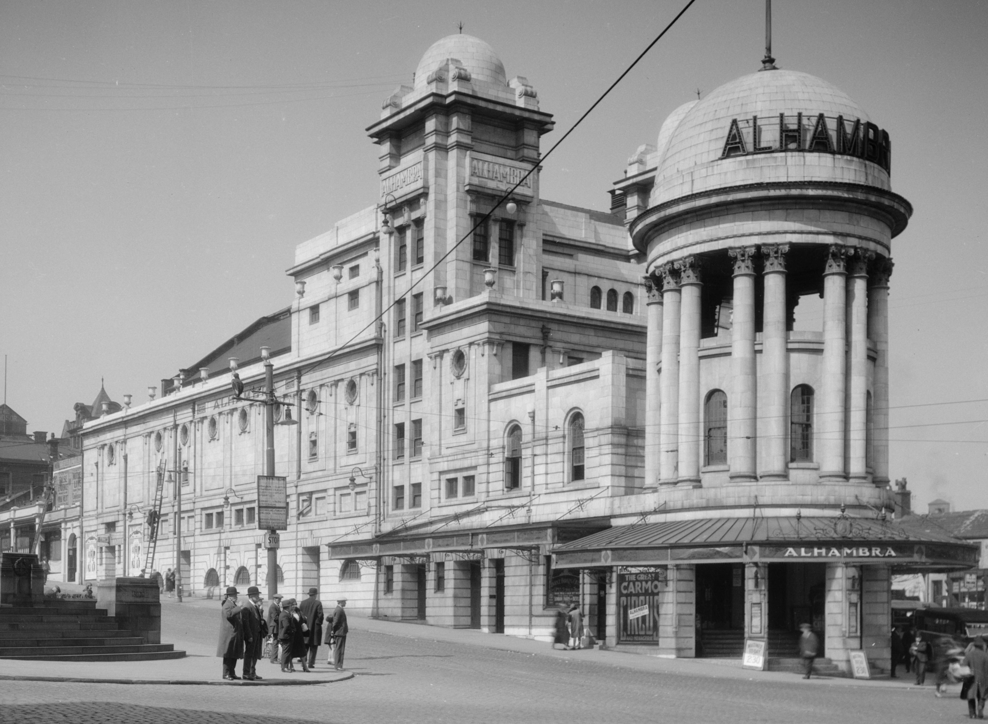
3. Alhambra Theatre in 1925-50
Notes:
© Historic England Archive Ref:WSA01/01/G0410, Taken: 1925-1950

Slide 20
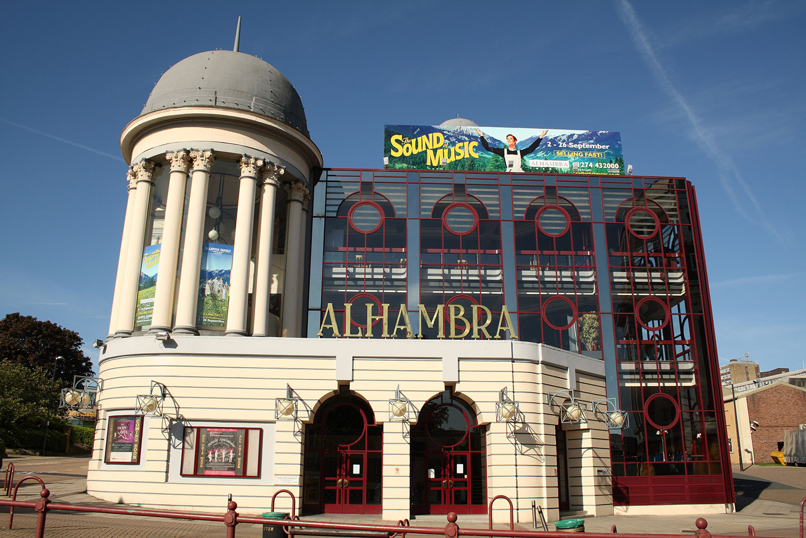
3. Alhambra Theatre in 2005
Notes:
© Alamy Ref: BBB71N Date: 25 May 2009

Slide 21
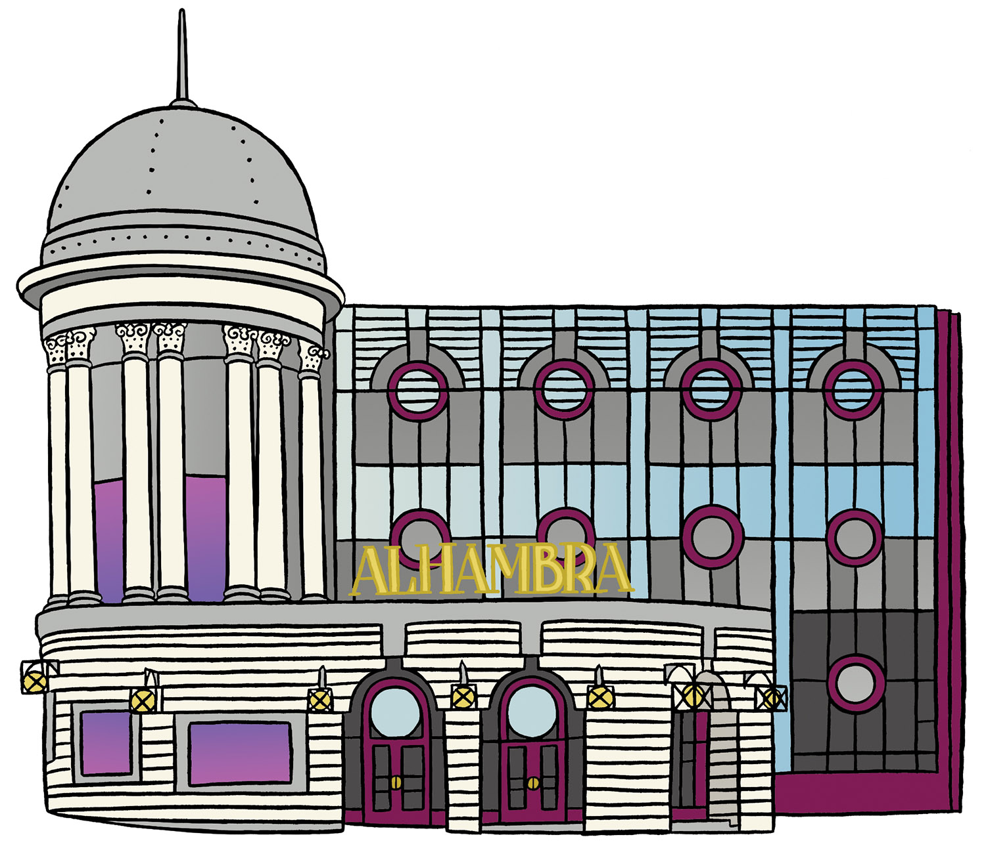
3. Artist’s impression of the Alhambra Theatre
Notes:
© Blackbird Publishing for Historic England

Slide 22
3. Alhambra Theatre
It was built in 1913 at a cost of £20,000 for theatre ‘impresario’ Francis Laidler. It opened on 18 March 1914.
The Alhambra Theatre is named after the Alhambra Palace in Granada, Spain, which was the place of residence of the Emir of the Emirate of Granada.
Francis Laider became known as the King of Pantomime and the Alhambra has hosted 'Pantos' throughout its history - and still does today!
The dressing rooms for the performers had all the latest 'mod-cons' - hot and cold water, as well as gas and electric light!
In 1964, Bradford City Council bought the Alhambra for £78,900. It underwent a major refurbishment in 1986.
Today it is a receiving house for large-scale touring theatre of all types and the main house seats 1,456.

Slide 23
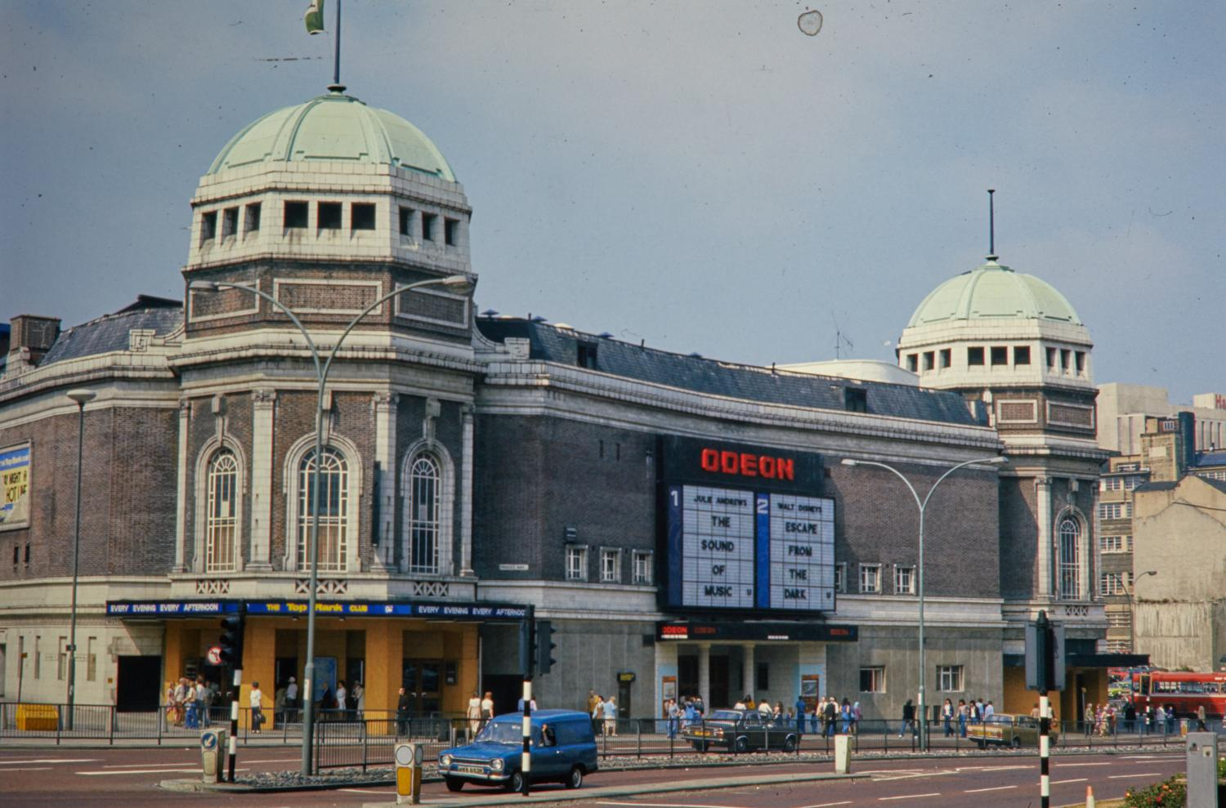
4. Bradford Live in 1976
Notes:
© Historic England Archive Ref: NWC01/01/0916 Date: 1976

Slide 24
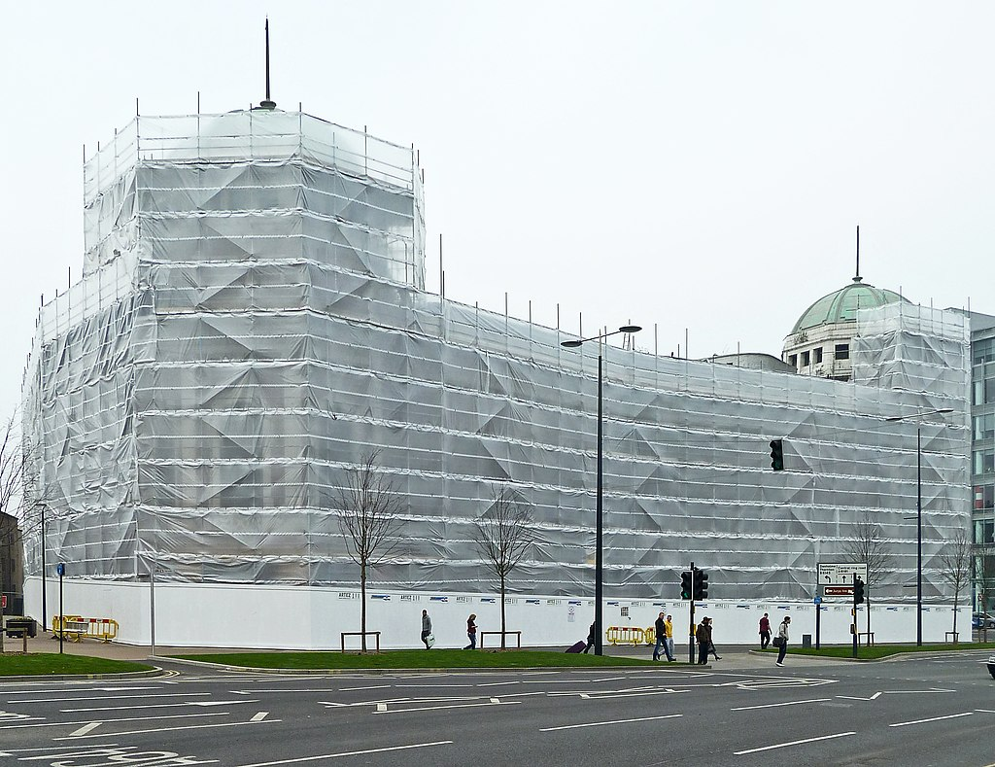
4. Bradford Live in 2012
Notes:
Tim Green from Bradford, CC BY 2.0 <https://creativecommons.org/licenses/by/2.0>, via Wikimedia Commons

Slide 25
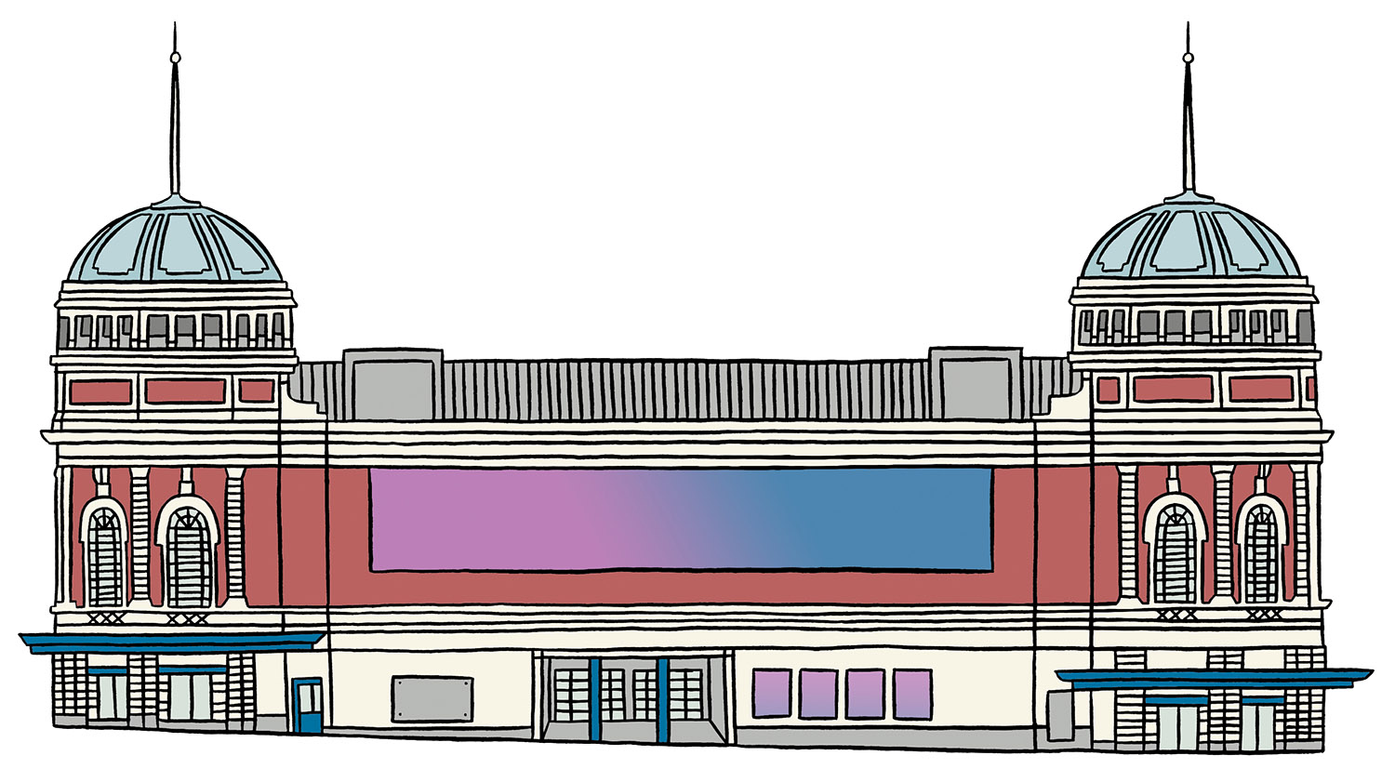
4. Artist’s impression of Bradford Live
Notes:
© Blackbird Publishing for Historic England

Slide 26
4. Bradford Live
Its 3,318 auditorium, 450 square feet ballroom and a 200-seat restaurant made it the largest cinema outside of London!
This building was originally called the New Victoria. It opened in 1930 as a ‘super cinema’ and theatre/concert hall with a ballroom and restaurant.
It was designed by the architect William Illingworth in ‘Classical Renaissance’ style designed to fit in with the nearby Bradford Alhambra. It cost £250,000 to build.
In 1950 it changed its name to Gaumont. It closed in 1968 for a big refurbishment.
It was saved by Bradford Live, a not-for-profit charitable company. They are converting it into a live entertainment venue, which is expected to open in 2024.
The cinemas re-opened on 21 August 1969, under the name ODEON. They closed in July 2000, leaving the building under threat of being demolished. ​

Slide 27
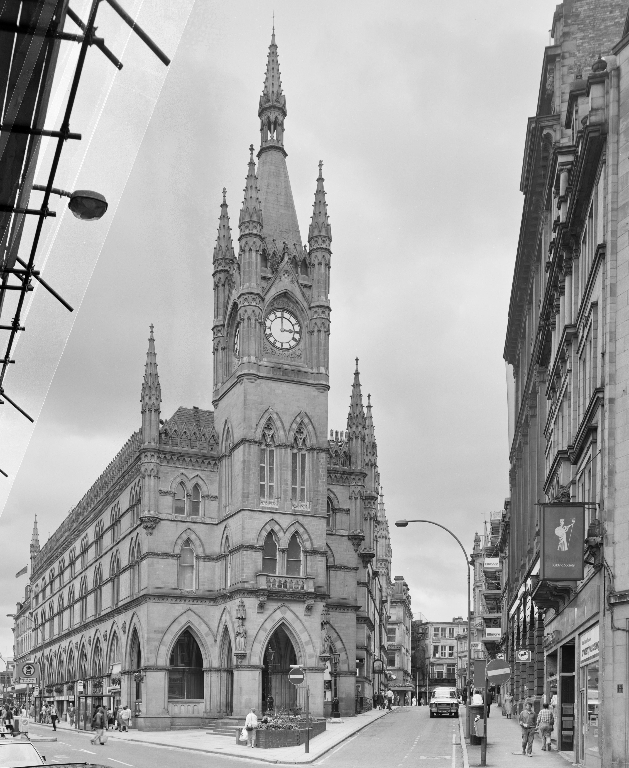
5. Wool Exchange in 1988
Notes:
© Crown Copyright. Historic England Archive Ref: BB89/01721, Taken: Aug 1988

Slide 28
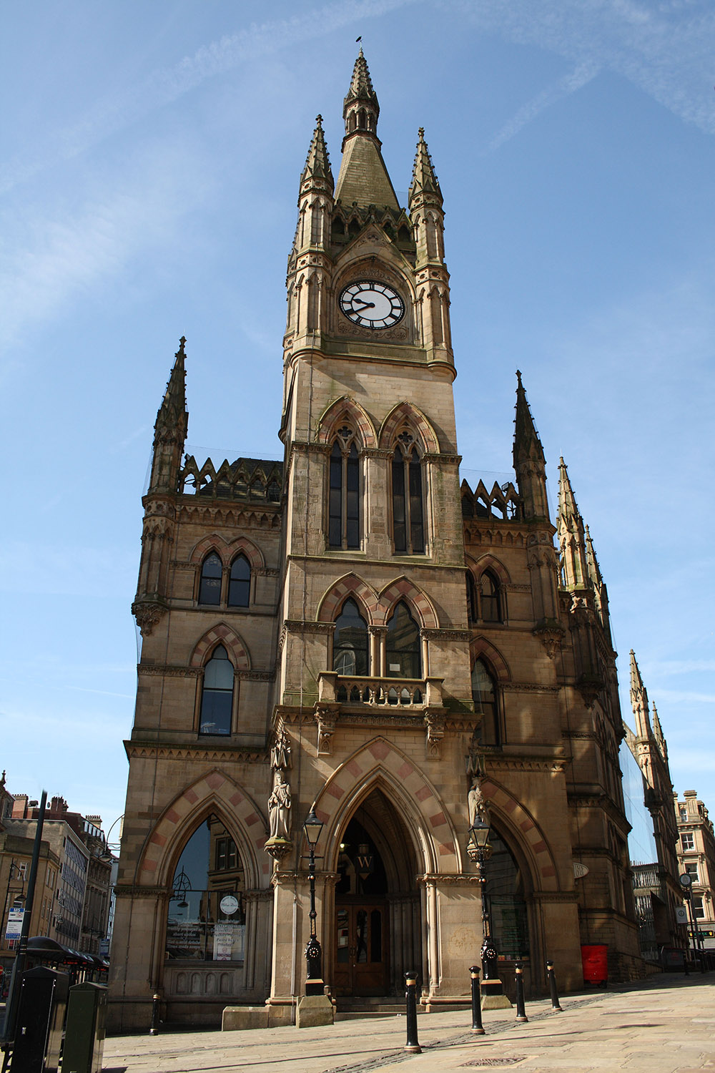
5. Wool Exchange in 2005
Notes:
© Alamy Ref: BBAJ1E Date: 25 May 2009

Slide 29
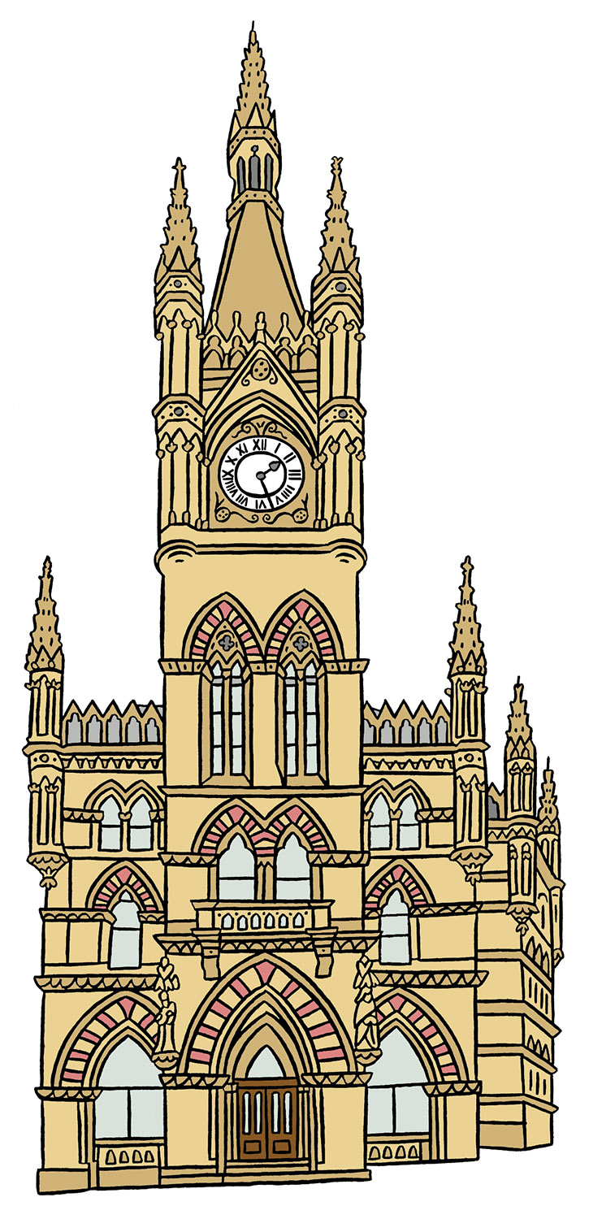
5. Artist’s impression of the Wool Exchange
Notes:
© Blackbird Publishing for Historic England

Slide 30
5. Wool Exchange
Outside, its main feature is the impressive clock tower. Inside it has grand polished granite pillars and an amazing wooden roof - known as a hammerbeam roof.
A competition was held to design the building. Local architects Lockwood and Mawson won. They built it in a ‘Gothic Revival’ style to show off Bradford’s growing wealth and importance.
The Wool Exchange was where merchants went to buy and sell wool. If you were a member of the Wool Exchange you were given a special a ticket by the committee. This was a sign of your status.
The ticket allowed you to trade on the ‘floor’ of the Exchange, where buyers and sellers made verbal agreements based on trust.
‘Unofficial’ deals done elsewhere in the building were riskier - wool was often soaked with water to increase its weight!​
Wool-trading stopped in the early 1970s. Since this time the building has been used for retail, with the trading hall now a Waterstones bookshop.

Slide 31
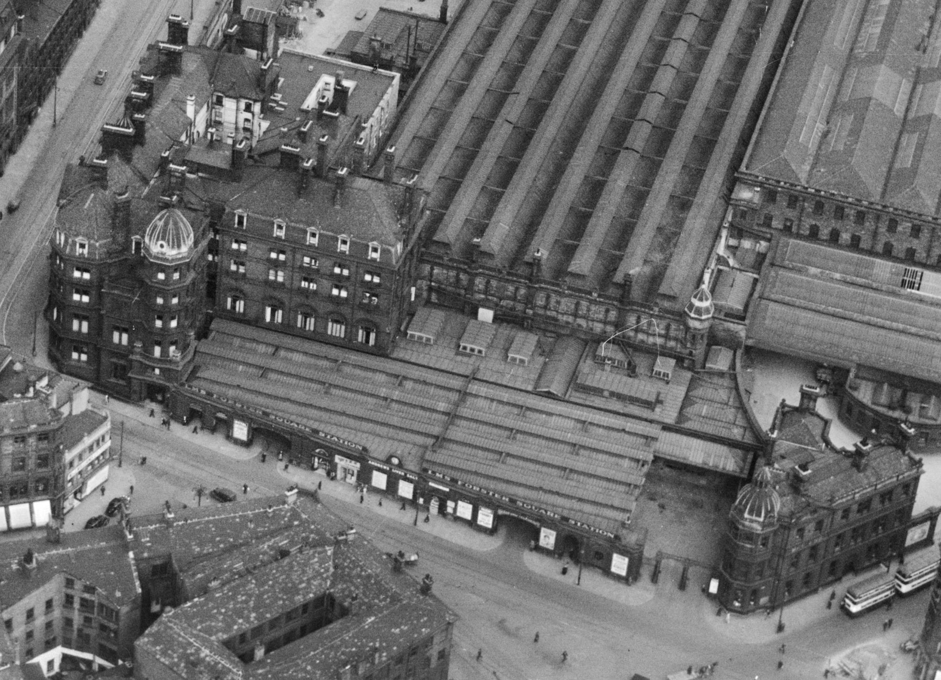
6. Midland Hotel in 1937
Notes:
© Historic England Archive (Aerofilms Collection) Ref: epw054317 Date: 14th July 1937

Slide 32
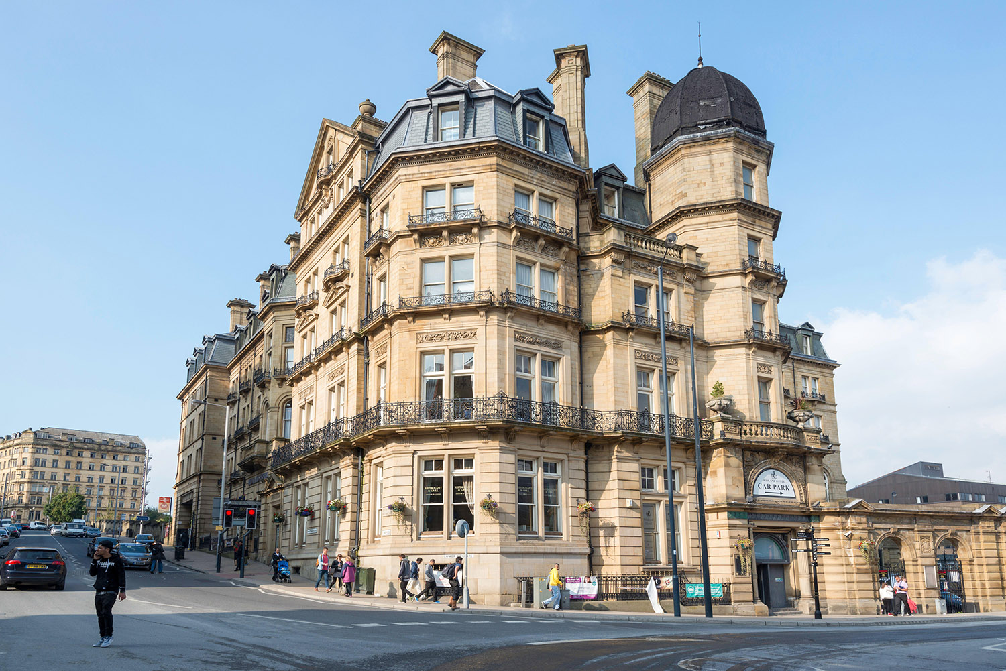
6. Midland Hotel in 2014
Notes:
© Alamy Ref: 2C199FK Date: 16 September 2014

Slide 33
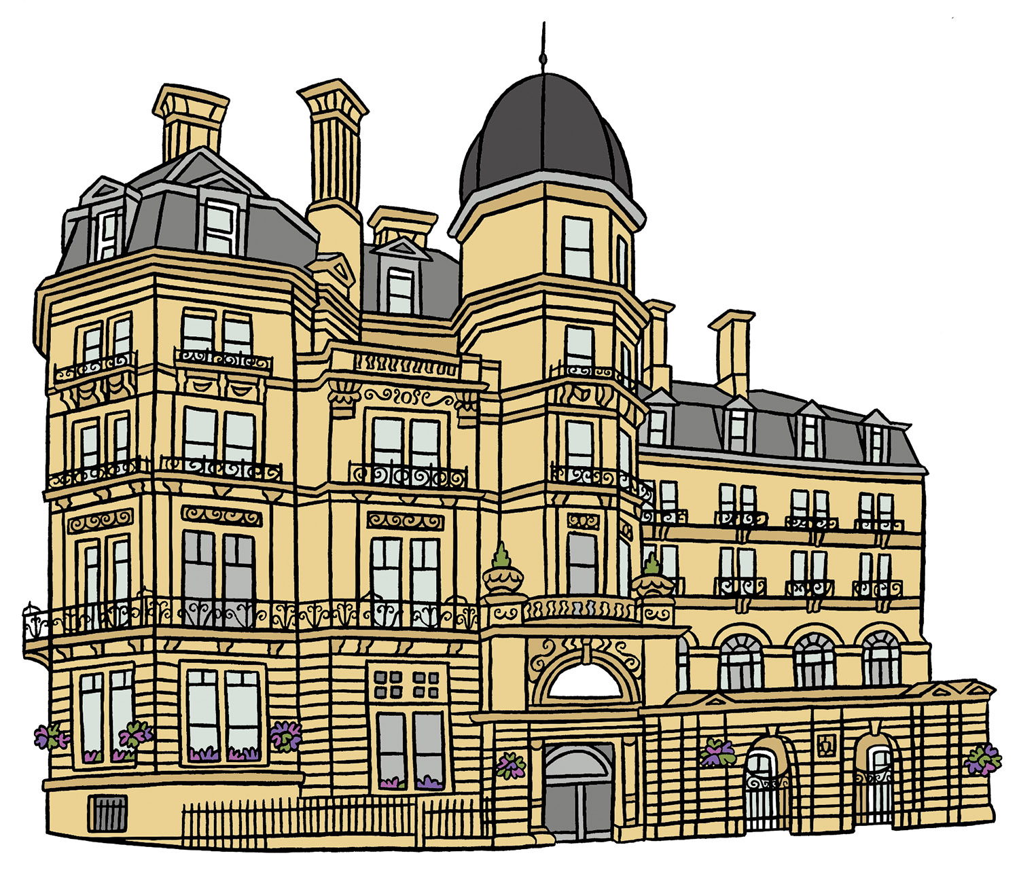
6. Artist’s impression of the Midland Hotel
Notes:
© Blackbird Publishing for Historic England

Slide 34
6. Midland Hotel
From 1885 the Midland Railway completely redesigned and expanded the site. A new passenger station, later known as Foster Square, was built with six platforms.
The Leeds and Bradford Railway opened in 1846. In 1853 the Midland Railway took over the railway and rebuilt the station.
The Midland Hotel was part of this redesign. It opened nearby in 1890 with 115 bedrooms, for travellers on the railway.
Its ‘bold and lavish’ exterior, and 'sumptuous' interior were intended to showcase the company.
The hotel fell into disuse in the 1970s with the decline of the railways. It was restored by Bradford businessman John Pennington in the 1990s.
The hotel attracted the rich and famous, including Laurel and Hardy, Paul Robeson, The Beatles and The Rolling Stones.

Slide 35
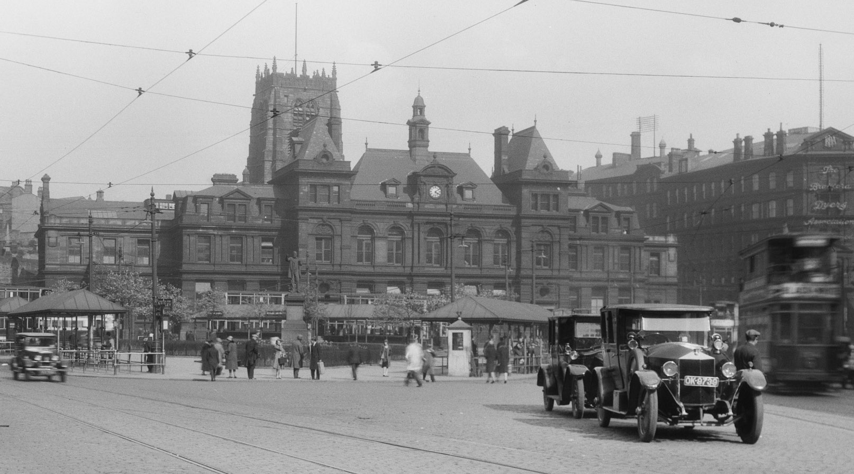
7. Kala Sangam (The Old Post Office) in 1925-40
Notes:
Source: Historic England Archive Ref: WSA01/01/G0419 Date: 1925-40

Slide 36
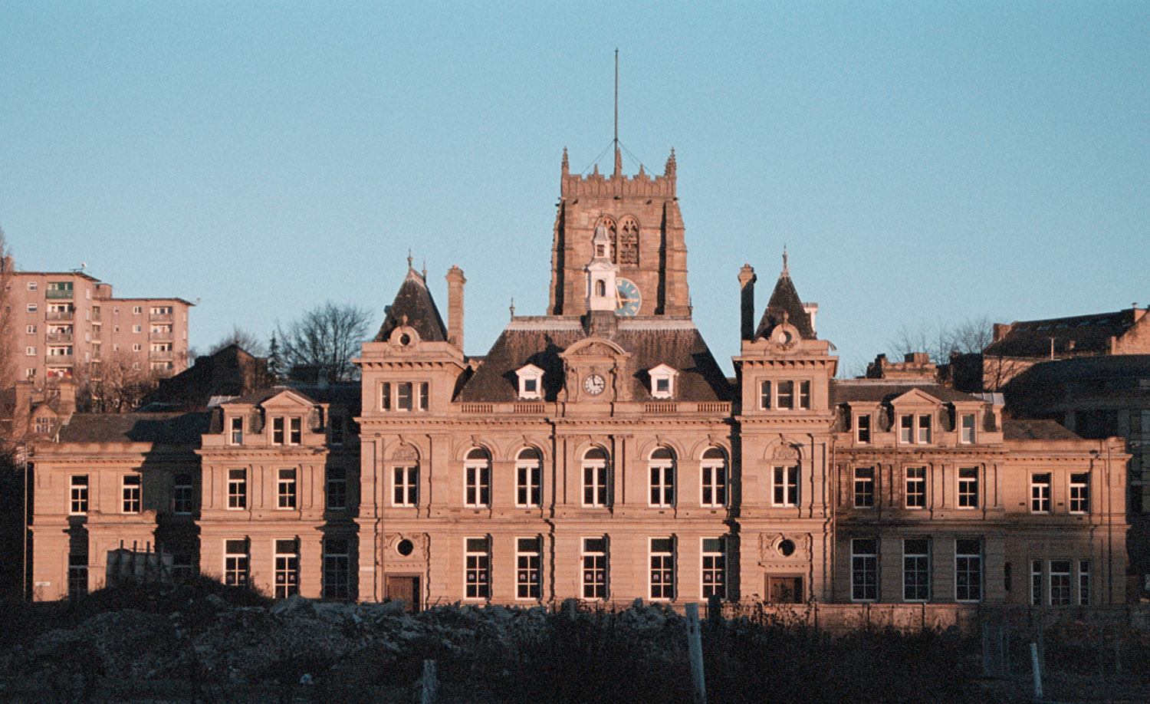
7. Kala Sangam (The Old Post Office) in 2007
Notes:
© Mr Nigel Wood. Source: Historic England Archive Ref: IOE01/17101/07 Date: 10 December 2007

Slide 37
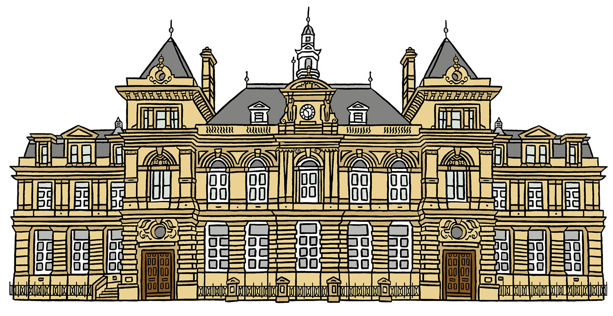
7. Artist’s impression of Kala Sangam (The Old Post Office)
Notes:
© Blackbird Publishing for Historic England

Slide 38
7. Kala Sangam ( The Old Post Office )
This ornate Victorian building began life as Bradford's General Post Office. It was designed by was Sir Henry Tanner (1849-1935) and built in 1886.
Sir Henry Tanner designed lots of Post Offices. His preferred style was 'classical’, often called 'French Renaissance'.
Tanner built several post offices in London and others in Liverpool (1883), York (1885), Bradford, Halifax, Barrow in Furness, Leicester….
……Birmingham (c.1885-1891), Harrogate (1896), Wolverhampton (1895), and Tipton Southend and Nottingham (c.1897).
Kala Sangam is an intercultural arts hub which reflects the diversity of contemporary Britain through the work it presents, the artists it supports and the communities it engages.
The building now houses Kala Sangam a South Asian arts organisation which helps to meet the needs of local South Asians.

Slide 39
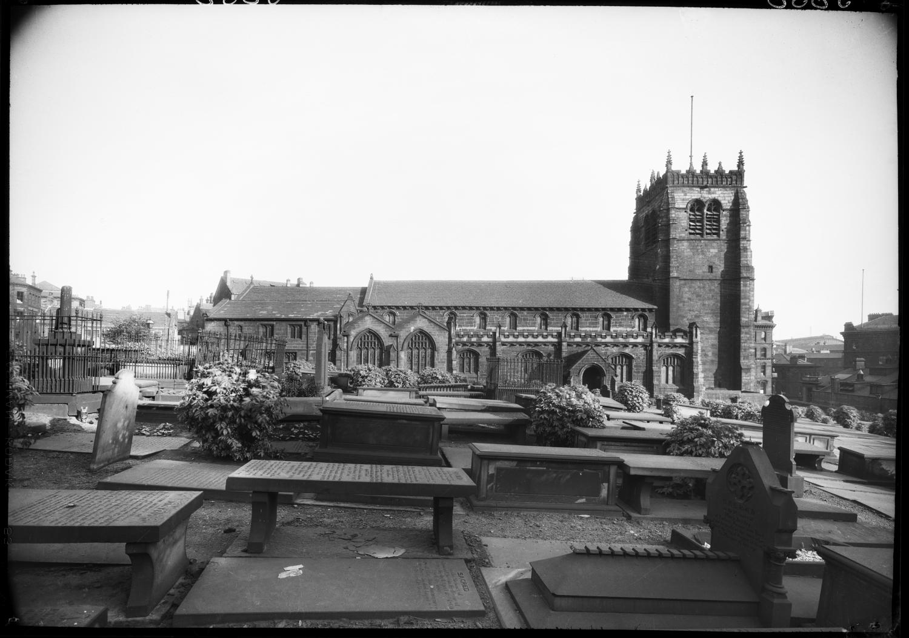
8. Cathedral Church of St Peter in 1924
Notes:
Source: Historic England Archive Ref: WSA01/01/05636 Date: May 1924

Slide 40
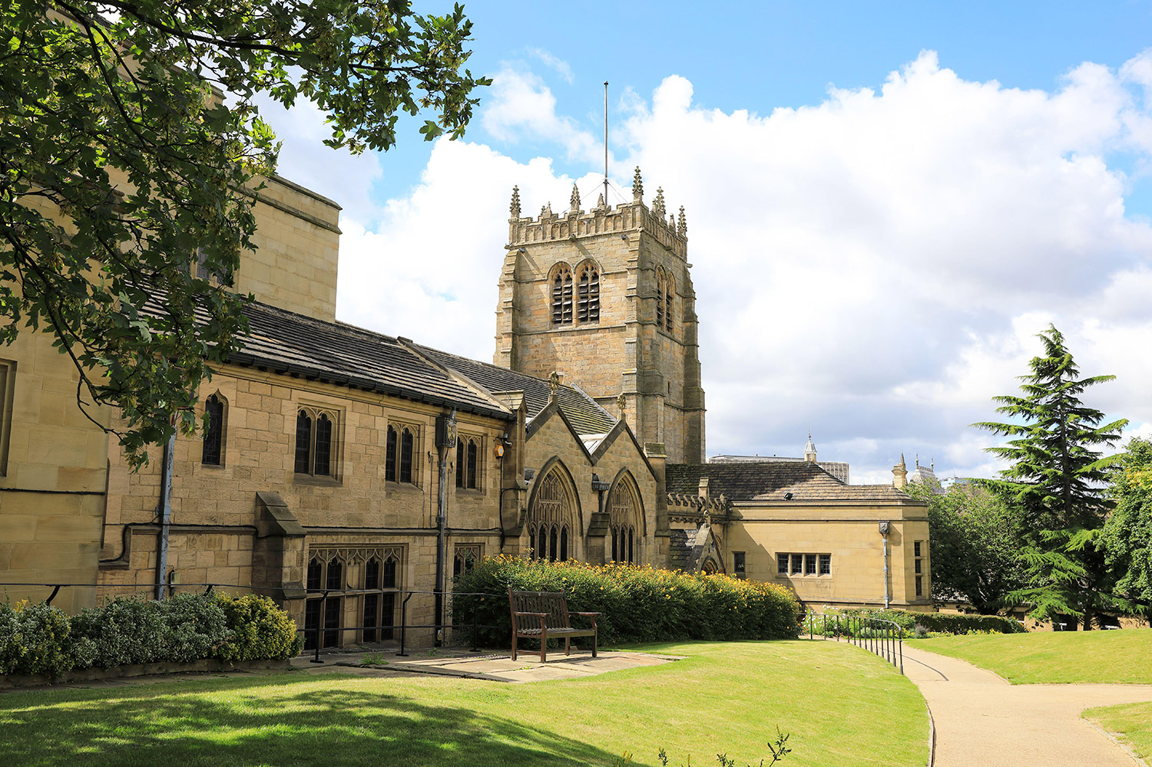
8. Cathedral Church of St Peter in 2022
Notes:
© Alamy Ref: 2JTK80R Date: 5 August 2022

Slide 41
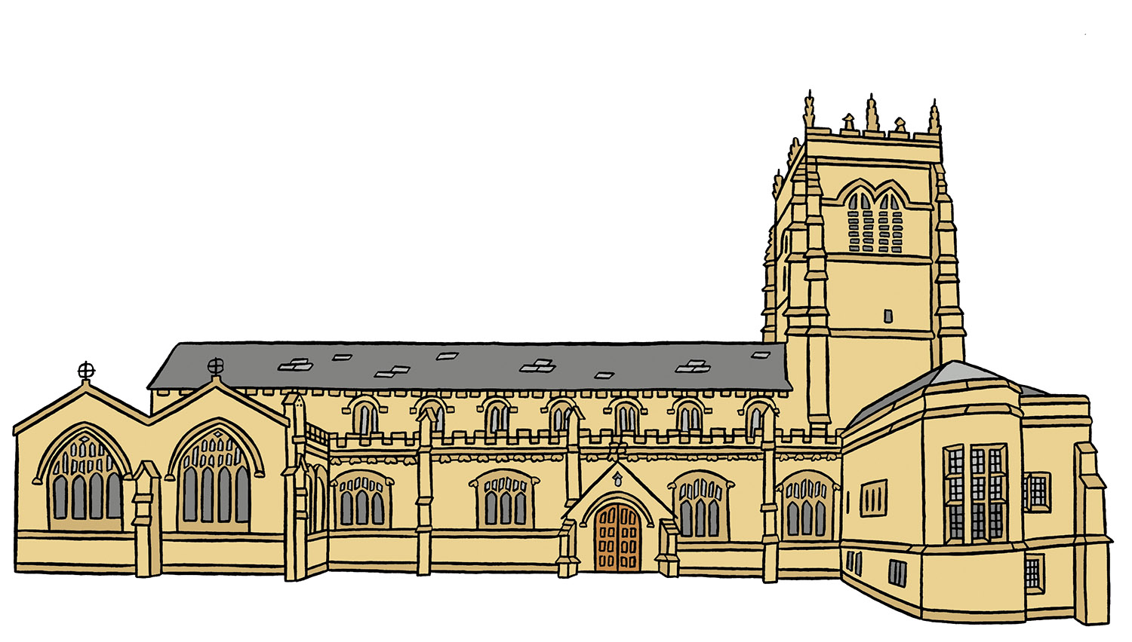
8. Artist’s impression of Cathedral Church of St Peter
Notes:
© Blackbird Publishing for Historic England

Slide 42
8. Cathedral Church of St Peter
It changed several times from the Norman to the Tudor periods. The current building was largely completed by 1458, with the addition of the tower in 1508.
There has been a church on this site for over 1000 years, since Saxon times.
During the 1800s a ‘Gothic’ main porch was added, as well as stained-glass windows by the famous designer William Morris.
In 1642-3, woolsacks were hung from the church tower to protect it from cannon fire during the Civil War!
When the new Diocese of Bradford was created in 1919, to respond to growing population, the church became a cathedral.
It was extended in the 1950s by the architect Edward Maufe. The east end was rebuilt, and wings added to the tower.

Slide 43
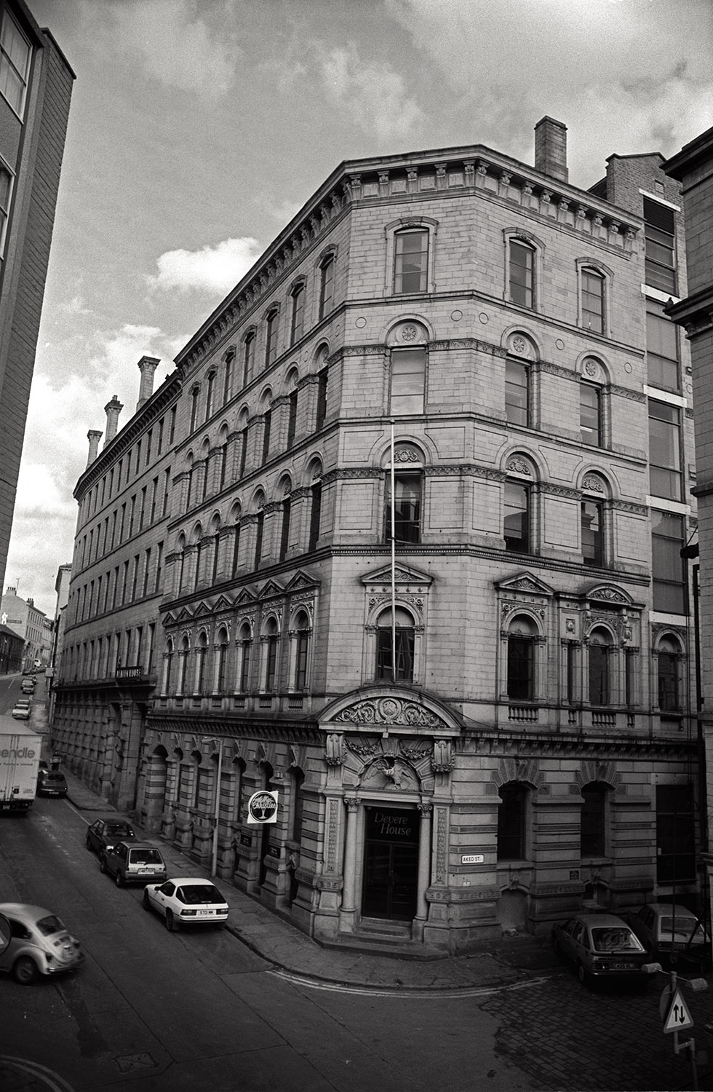
9. Little Germany, 62 Vicar Lane in c1980s
Bradford District Museums & Galleries CBMDC’
Notes:
© 2022 Bradford District Museums and Galleries CBMDC - BHRU 86 081 27

Slide 44
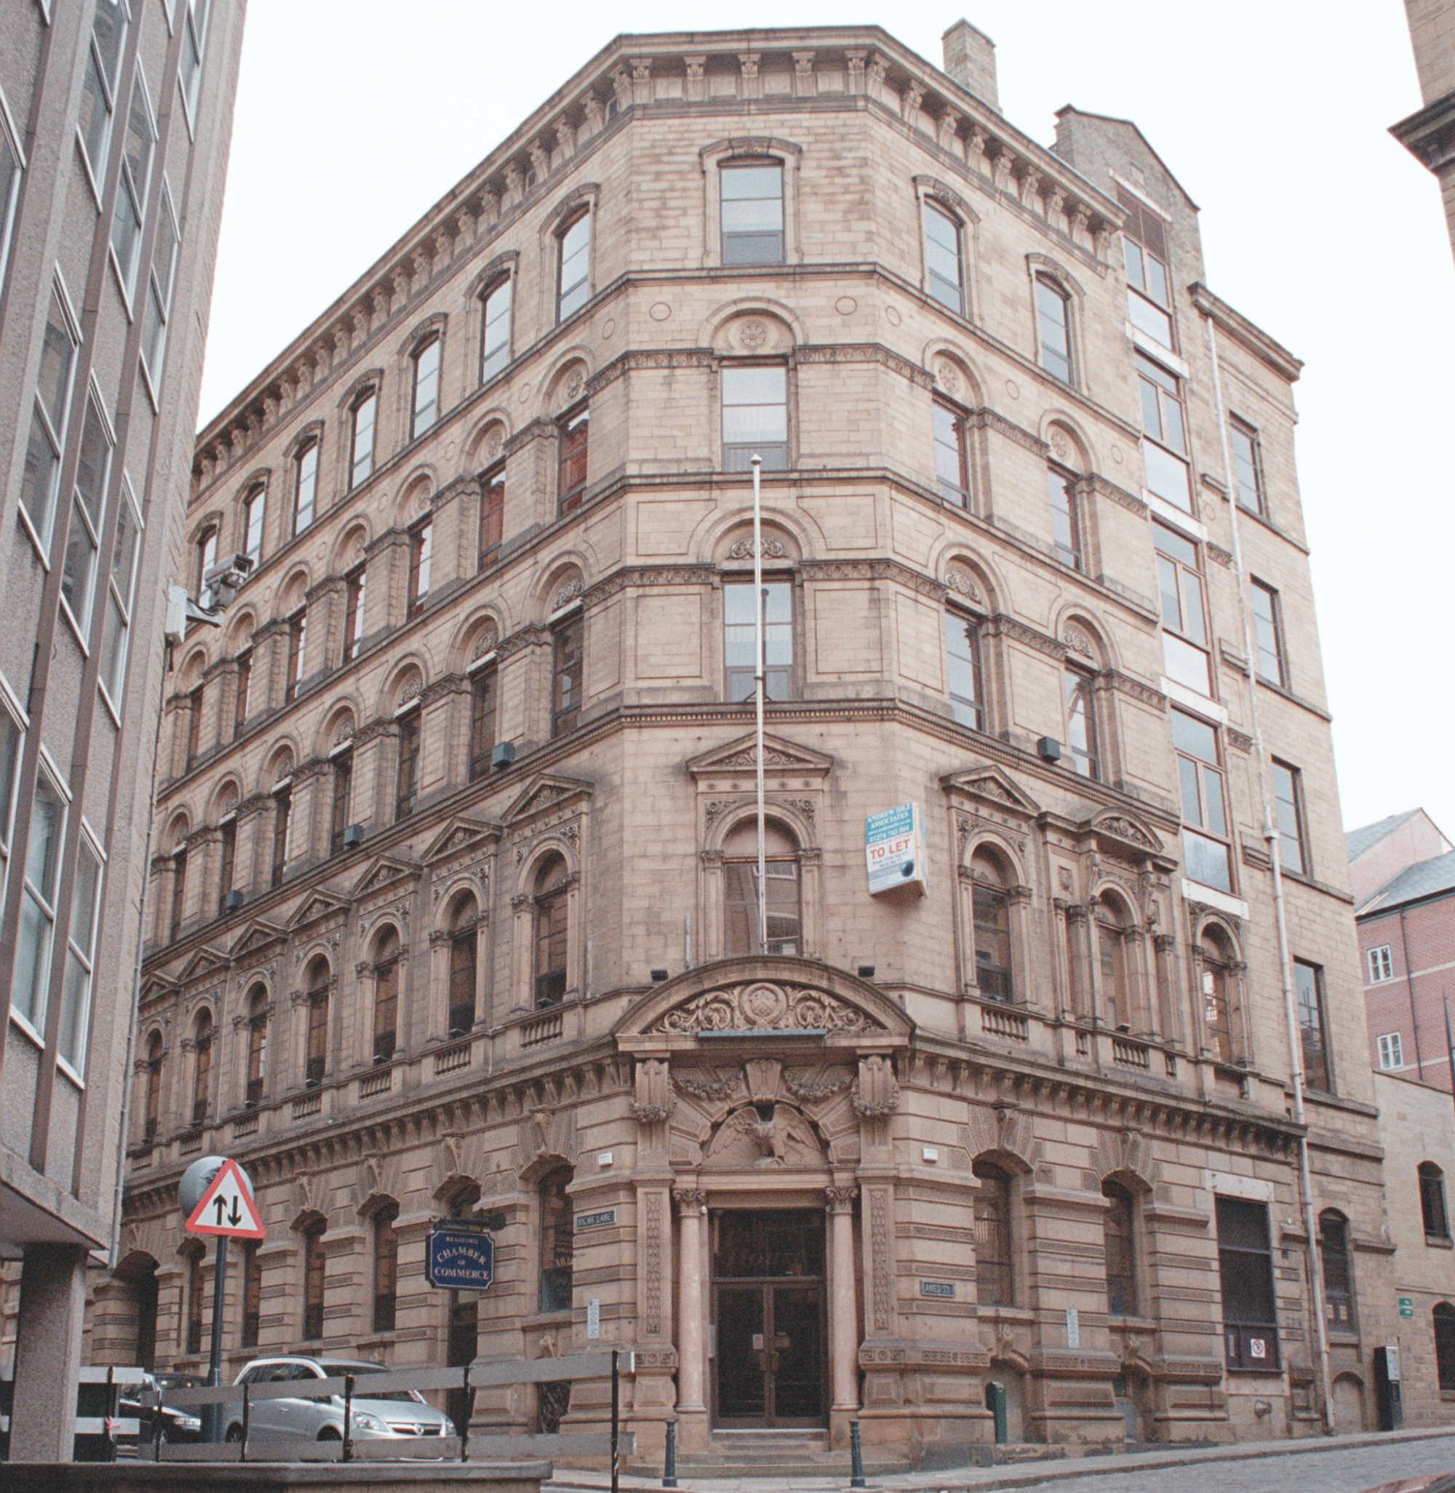
9. Little Germany, 62 Vicar Lane in 2007
Notes:
© Mr Nigel Wood. Source: Historic England Archive Ref: IOE01_16978_04 Date: 1 Nov 2007

Slide 45
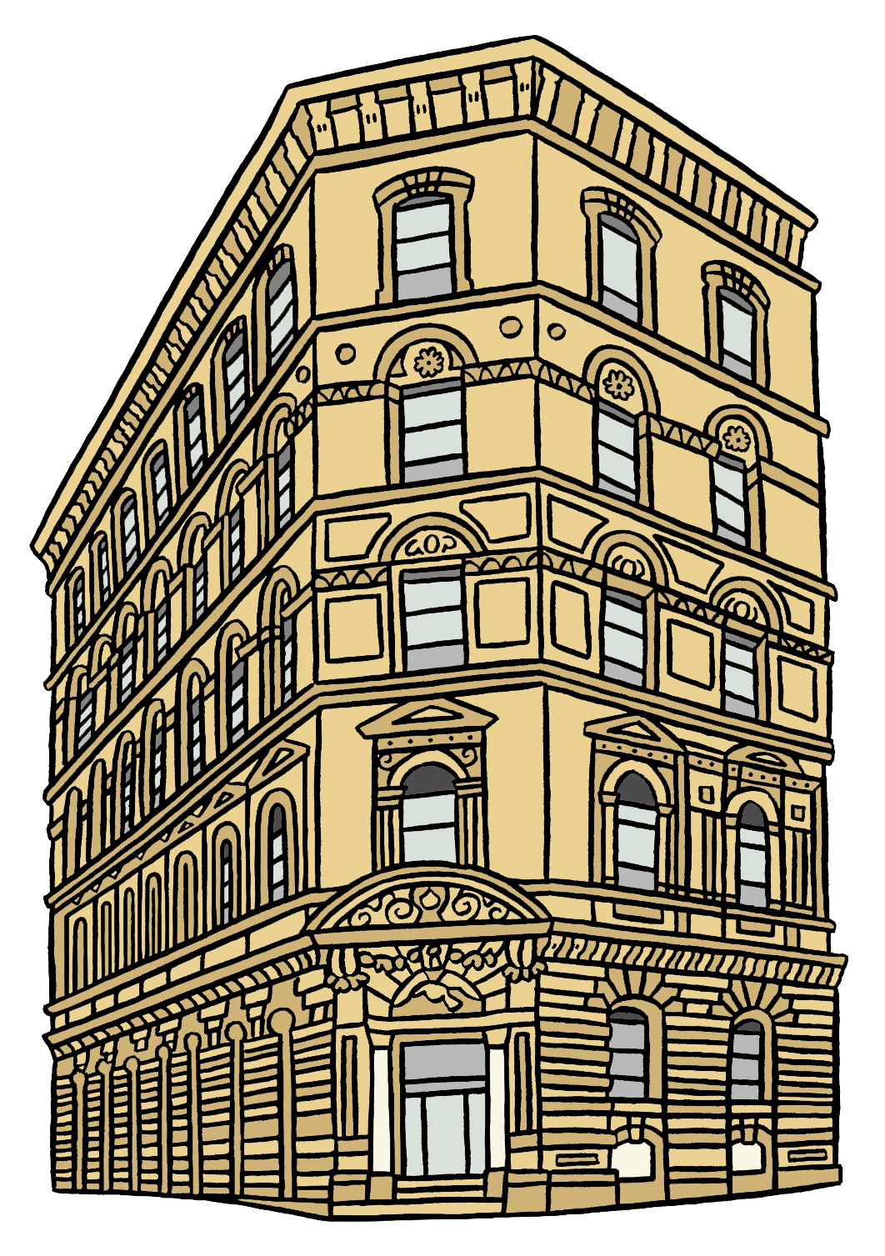
9. Artist’s impression Little Germany,
62 Vicar Lane
Notes:
© Blackbird Publishing for Historic England

Slide 46
9. Little Germany
Jacob Moser was a German merchant who came to live and work in Bradford. He went on to become Lord Mayor of Bradford in 1910. He gave at least £750,000 to local charities!
Bradford emerged as ‘Wool City’ in the 1800s. From 1855 it attracted wool merchants from Germany, especially after the Franco-Prussian War of 1870-1.
The main architect, Eli Milnes of Milnes & France, designed mostly in the ‘Neoclassical Italianate’ style. This has given ‘Little Germany’ its own distinctive character.
Merchants invested large sums of money building offices and warehouses on the steep slope opposite Leeds Road. 62 Vicar Lane is one such building.
Other good examples of this type of building are the American and Chinese Export Warehouse at the corner of Aked Street (now Chambers of Commerce), and the Law Russell Warehouse.
The area was made a ‘conservation area’ and is now used for offices, housing and hotels.

Slide 47
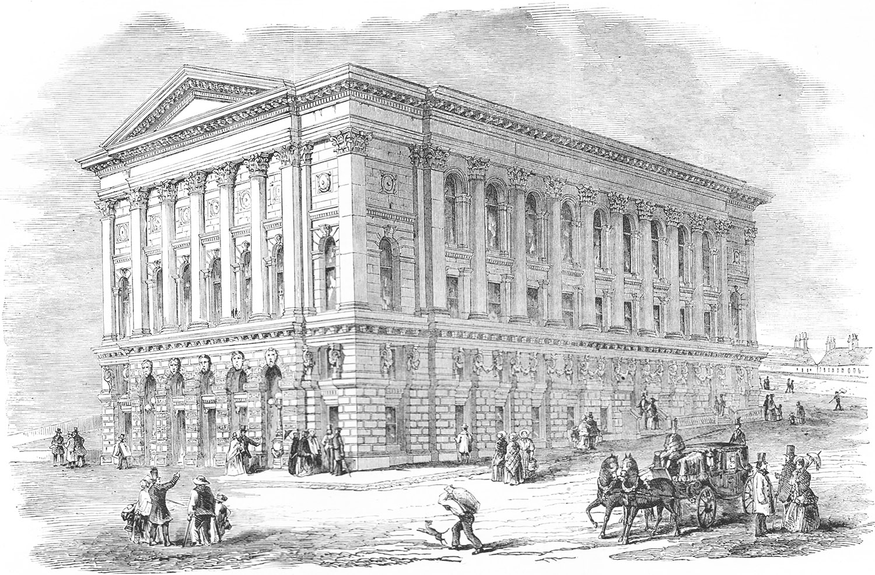
10. Saint George’s Hall in 1853
Notes:
© Alamy Ref: KGX96T Date: 1853

Slide 48
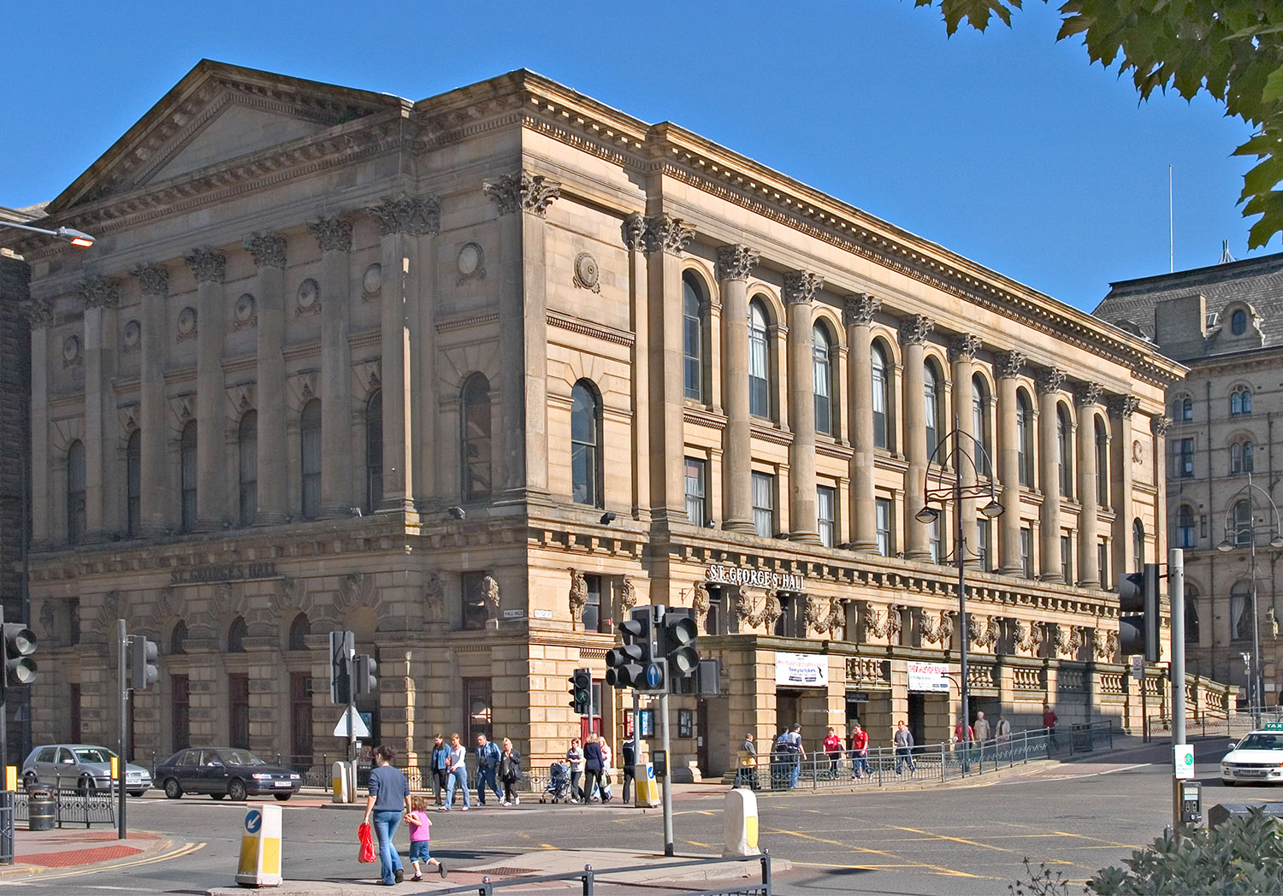
10. Saint George’s Hall in 2004
Notes:
© Alamy Ref: A8T539 Date: September 2004

Slide 49
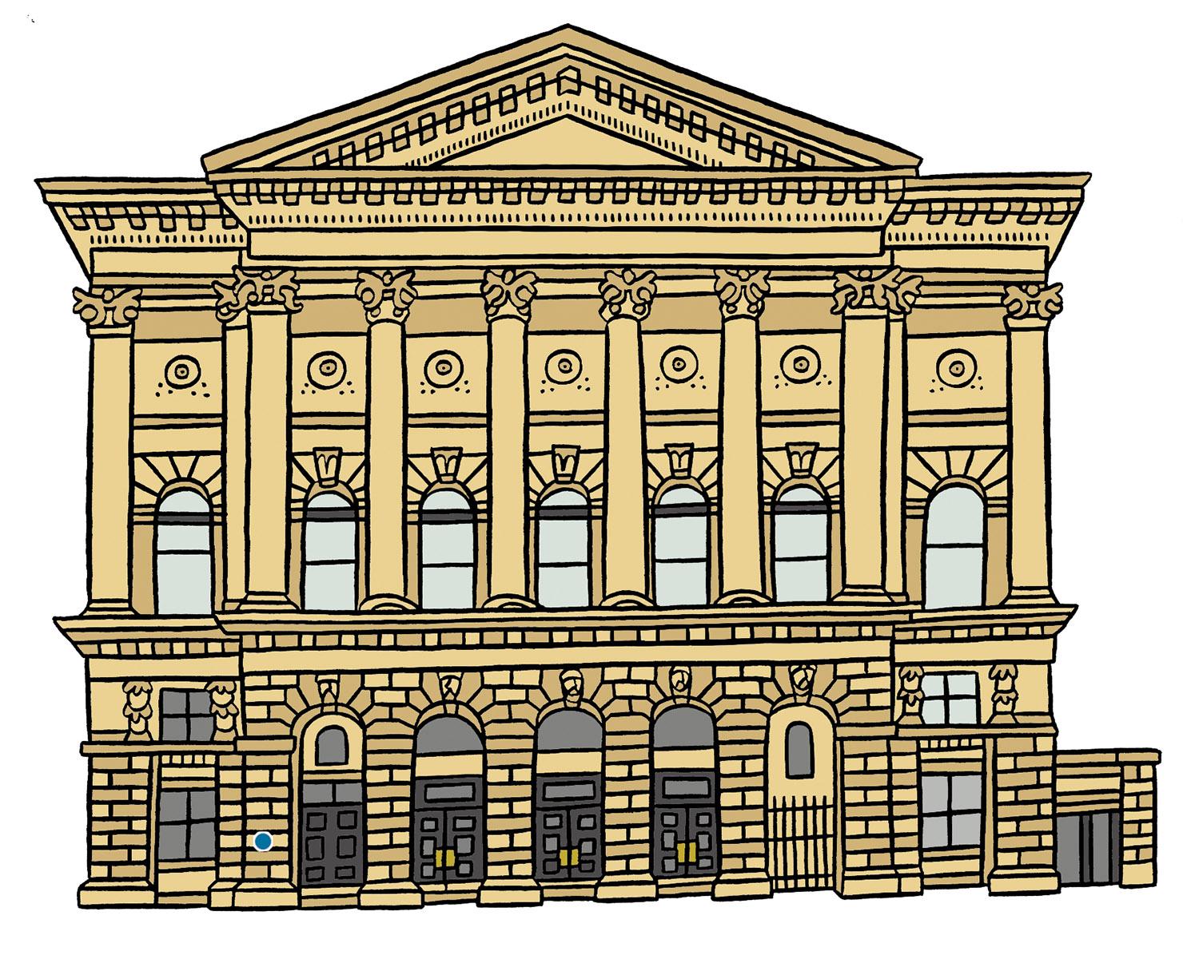
10. Artist’s impression of Saint George’s Hall
Notes:
© Blackbird Publishing for Historic England

Slide 50
10. Saint George’s Hall
Local architects Lockwood and Mawson designed the building in an ‘Italianate’ style, beating over 20 rival bids.
In 1849 Bradford’s Mayor, Samuel Smith, had the idea of creating ‘a large public hall, in which thoroughly good concerts could be provided at a cheap rate.’
In 1873 the African-American Jubilee Singers gave six concerts there.
They were freed slaves who ‘changed the spiritual into an art form and introduced it to the world’.
A public holiday was declared when the foundation stone was laid on 22 September 1851, the building work took two years.
St George's Hall was also used for large public meetings, for example during the Manningham Mills Strike in 1891, by the suffragettes in 1907, and for recruiting meetings for The Bradford Pals from 1914.
As well as classical concerts, St George's Hall has hosted many pop and rock bands. It is one of the oldest concert halls still operating in the UK!

Slide 51



Take 10 buildings
Now you’ve explored the trail and found out more……...​
It’s time to choose!
What makes my building special is…
It is my favourite because…

Slide 52

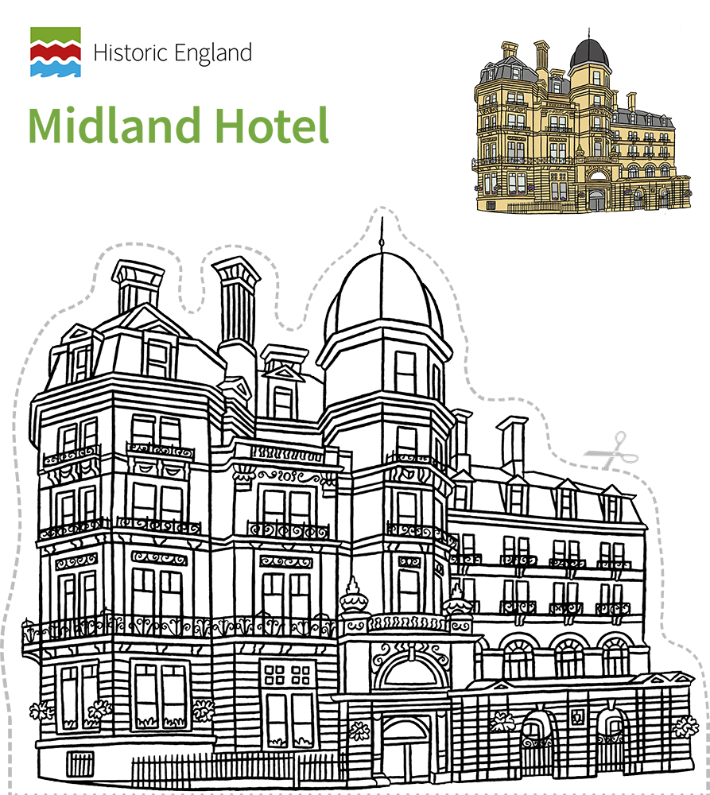
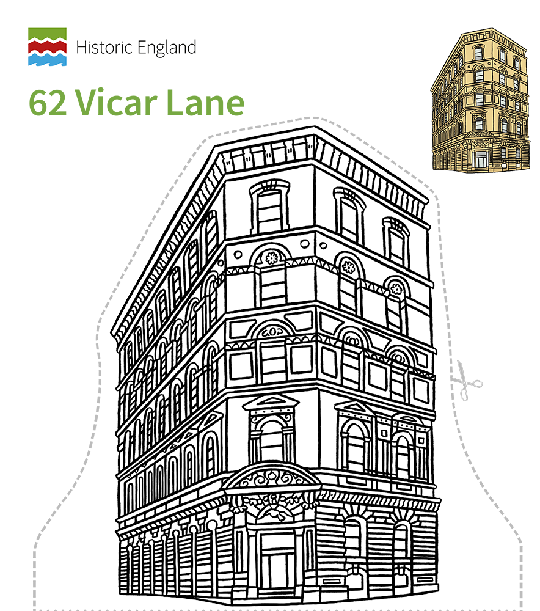
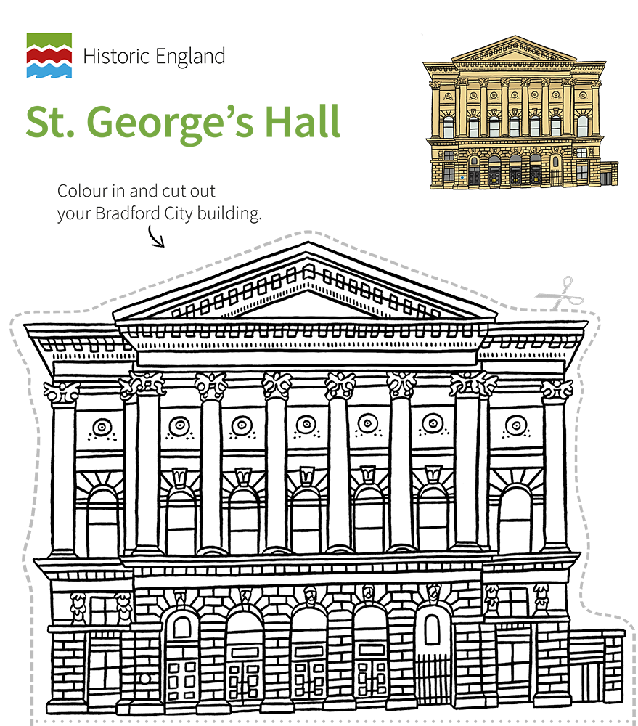
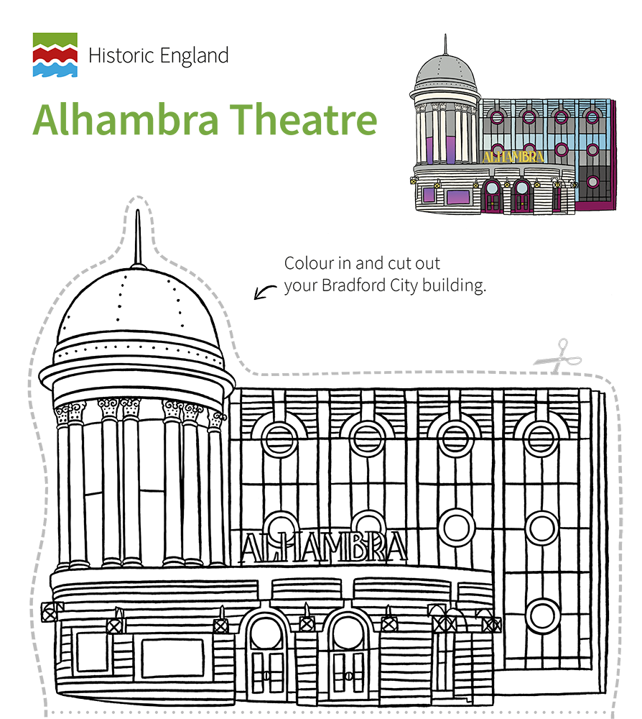


Activity Get Creative
​Use the cut-out and make models of the buildings to create an exhibition.​
​
Find creative ways to show what you’ve learnt to other people.

Slide 53
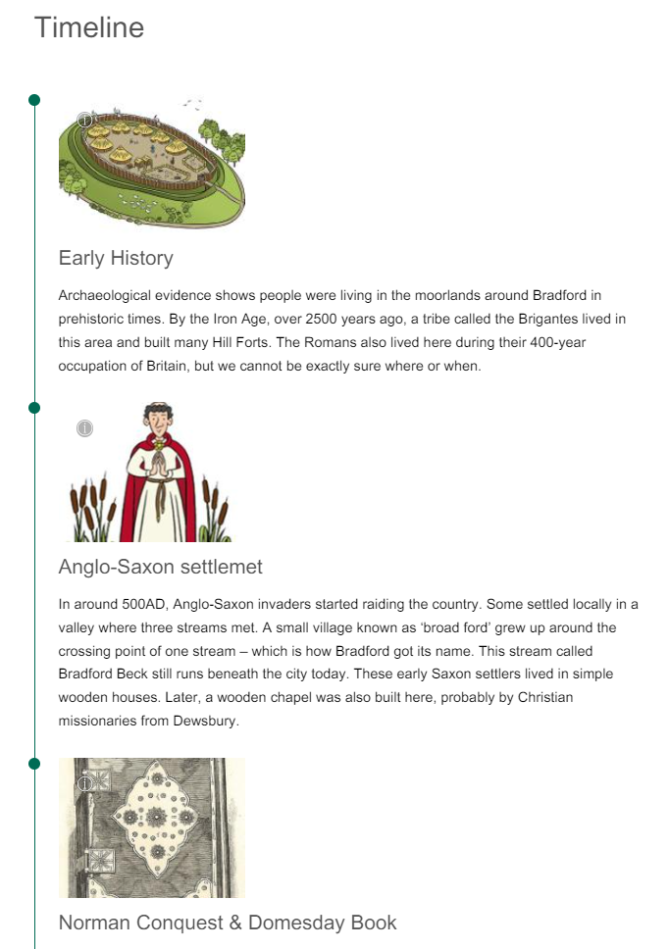


Wider Context
Use the timeline on the online trail and the ‘A short history of Bradford’ PowerPoint to put your favourite building into the wider context of Bradford’s history.​
​After you've found out more, would you still choose the same building as your favourite?

