Slide 1
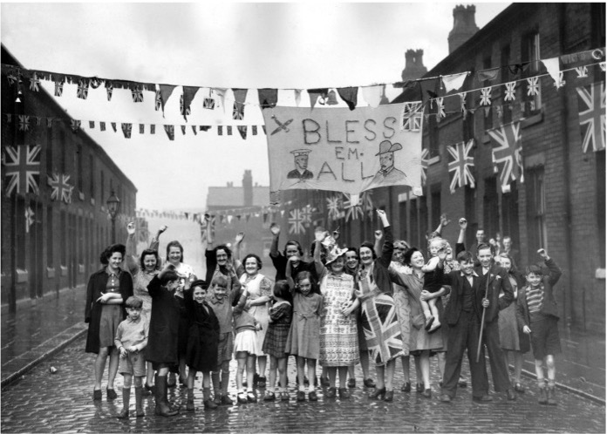
How and why should we celebrate VE day?
How and why should we celebrate VE day?

Slide 2
How and why should we celebrate VE day? 1
Key Stage 2: History
Learning Aims and Outcomes
To develop historical enquiry skills by using photographs as primary sources
To develop a sense of place by using maps to locate the photographs and identify the countries involved in the Second World War
To understand how and why people celebrated and commemorated VE day and the end of the Second World War, locally, nationally and in the wider world
To consider how global events might be remembered and commemorated in the past and how they might be in the future
Notes:
This activity relates to the ‘How and why should we celebrate VE Day?’ Teaching Activity
Notes for teachers:
This resource could be used as an assembly for commemorating the VE Day (May 8th 1945) or as a starting point of a wider study of the Second World War
Some slides have additional information in the notes below the slide, but these notes cannot be seen when viewing the PowerPoint as a slide show
Ideally some of the maps and images should be printed so students can examine them in detail
The maps and images are a high resolution and can be printed out on A4 or A3 without losing any quality

Slide 3
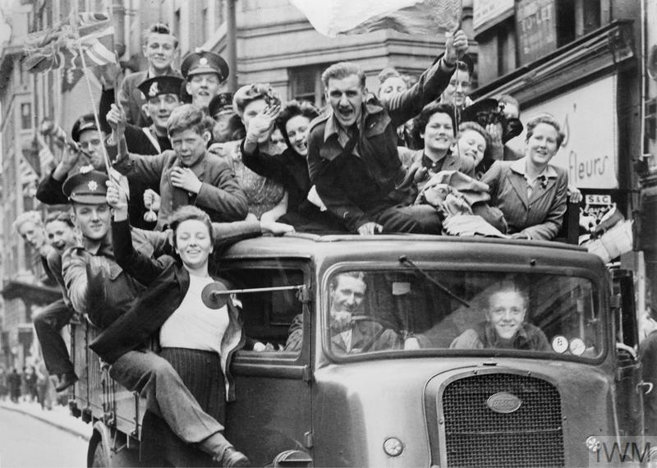

What do you think might be happening in this photograph?
What sort of people can you see?
How do you think they’re feeling & why?
What do their clothes tell you about them ?
Notes:
Ask some additional questions to help them focus their thoughts/suggestions.
What sort of people can you see?
Do their clothes tell you anything about them?
How do you think they’re feeling & why?
Image: © IWM (HU 41808)

Slide 4


8th May 1945 – People celebrating VE Day in London.
VE stands for Victory in Europe
On this day the Allied armies accepted the unconditional surrender of Nazi Germany's armed forces – ending the Second World War in Europe.
Notes:
Tell pupils this photo was taken on 8th May, 1945 and shows people celebrating VE day in London.
Does the date give you any clues about what they might be celebrating – what happened in 1945?
Does anyone know what VE stands for?
What were they celebrating?
It was only the Germans who surrendered on this day, the Second World War didn’t end fully until all other (Axis) counties had surrendered. This day is known as VJ day – Victory in Japan – and happened on 15th August 1945.
Image: © IWM (HU 41808)

Slide 5
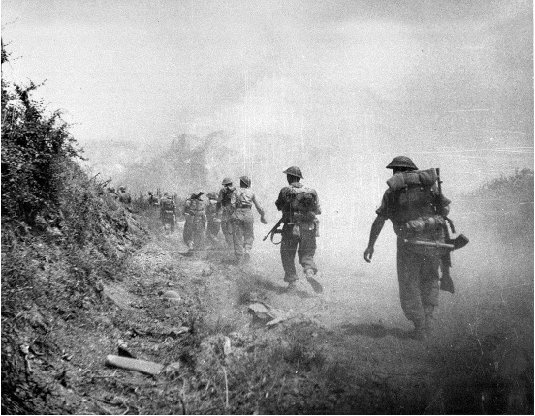
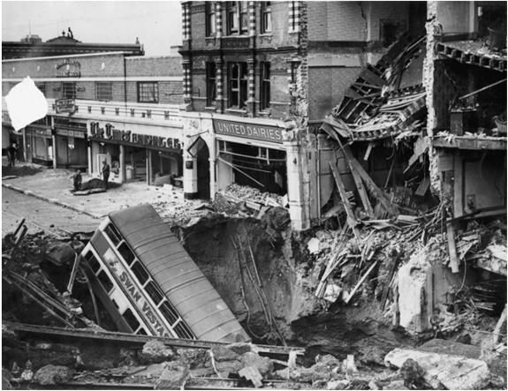
What was the Second World War?
The Second World War started in 1939 and ended in 1945 – six years later.
Do you know anyone who was alive at the time? If so, they might remember the Second World War.
Millions of people around the world died – more than in any other war. Thousands of them were from Britain.
Some died or were badly injured while fighting for their country overseas. Others died when bombs were dropped on towns and cities
In Britain the worst bombing was between 1940 and 1941 during the Blitz.
Men died fighting all over the world. Bombs were dropped all over the world.
Monte Cassino, Italy
Warrington, England
Notes:
Firstly, we need to find out a bit about the Second World War – it’s also known as World War II.
Can anyone tell me anything about it..?
Why do you think people celebrated when it came to an end?
The Second World War started in 1939 and ended in 1945 – six years later.
It ended 76 years ago – do you know anyone who is 76 or maybe older? If so, they might remember the Second World War.
Millions of people around the world died – more than in any other war.
Thousands of them were from Britain.
Some died or were badly injured while fighting for their country.
Others died when bombs were dropped on towns and cities

Slide 6



Which countries were involved in the in Second World War?
North
America
Europe
Asia
Africa
South
America
Can you spot where Britain is?
Oceania
Can you identify all the continents?
Antarctica
Use this map and the information on the next slide to locate the main countries involved in the Second World War
Notes:
It was called the Second WORLD War because it took place on a global scale – countries in nearly every continent around the world were involved or saw fighting at some point during the conflict
Can anyone spot where Britain is..?
Point out some of the continents.
Image: https://commons.wikimedia.org/wiki/Maps_of_the_world#/media/File:Eckert4.jpg

Slide 7

The Allies and the Axis Countries
The war was fought on two sides
The Allies
Britain
France
United States of America (USA)
Soviet Union (USSR)
The Axis
Nazi Germany
Italy
Japan
Many other countries were also involved on one side or the other.
Some countries were neutral.
Notes:
The war was fought on two sides:
The Allies – including Britain, France, the United States of America (USA) and the Soviet Union (USSR)
The Axis – mainly Nazi Germany, Italy and Japan
Many other countries were also involved on one side or the other.

Slide 8
Countries involved in the Second World War
Britain
United States of Soviet Russia
France
Nazi Germany
USA
Japan
Italy
Use a globe, an atlas or Google maps to find the allied and the axis countries and add your own labels to this map.
You can also download free world maps here
Notes:
This map can be copied into a word document and will print well in A4 or A3

Slide 9
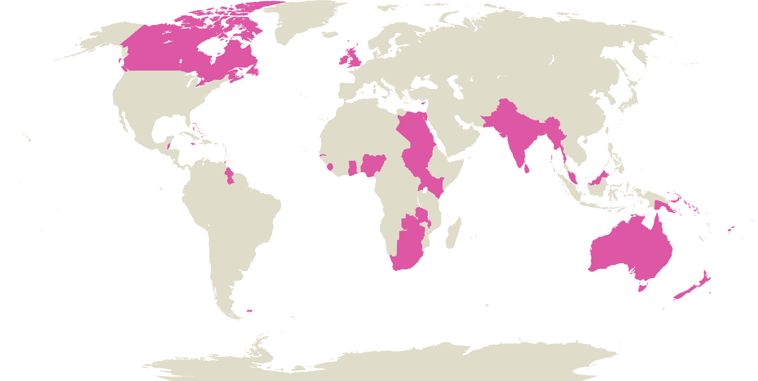

British Empire and Commonwealth Countries 1
In 1939 several countries were still part of the British Empire or were in the Commonwealth.
Men from these countries fought with the Allies.
These countries also contributed materials and resources to help with the war effort.
Can you identify these countries?
Notes:
This map can be copied into a word document and will print well in A4 or A3

Slide 10
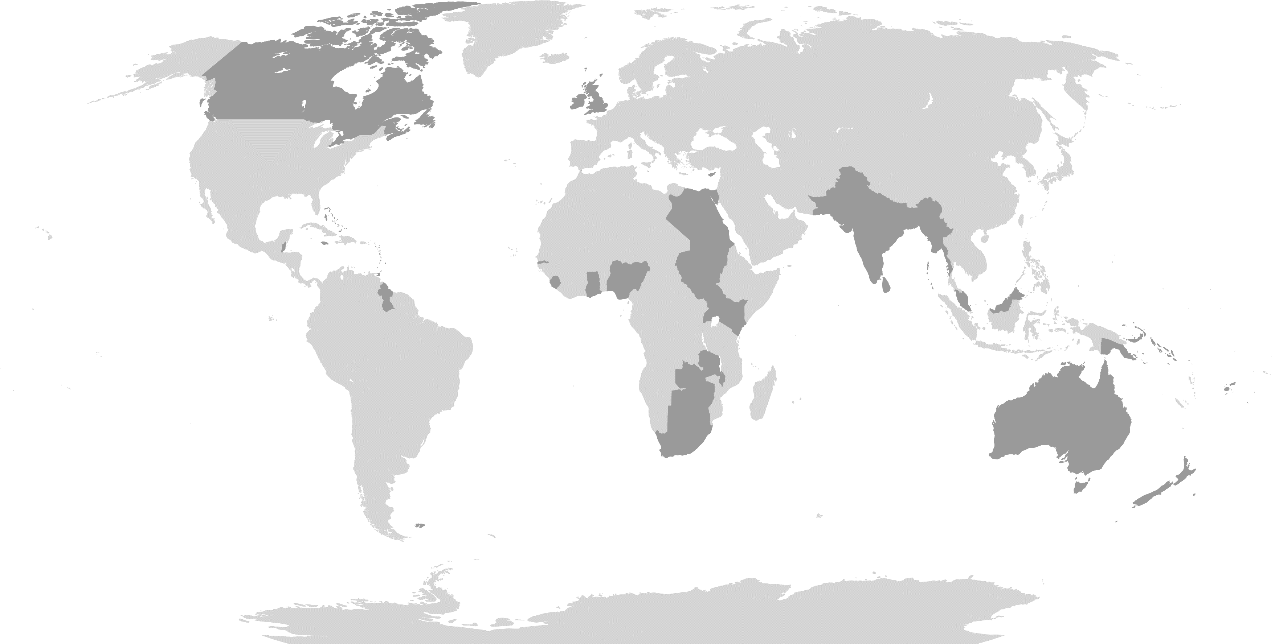
Can you identify these countries?

Slide 11
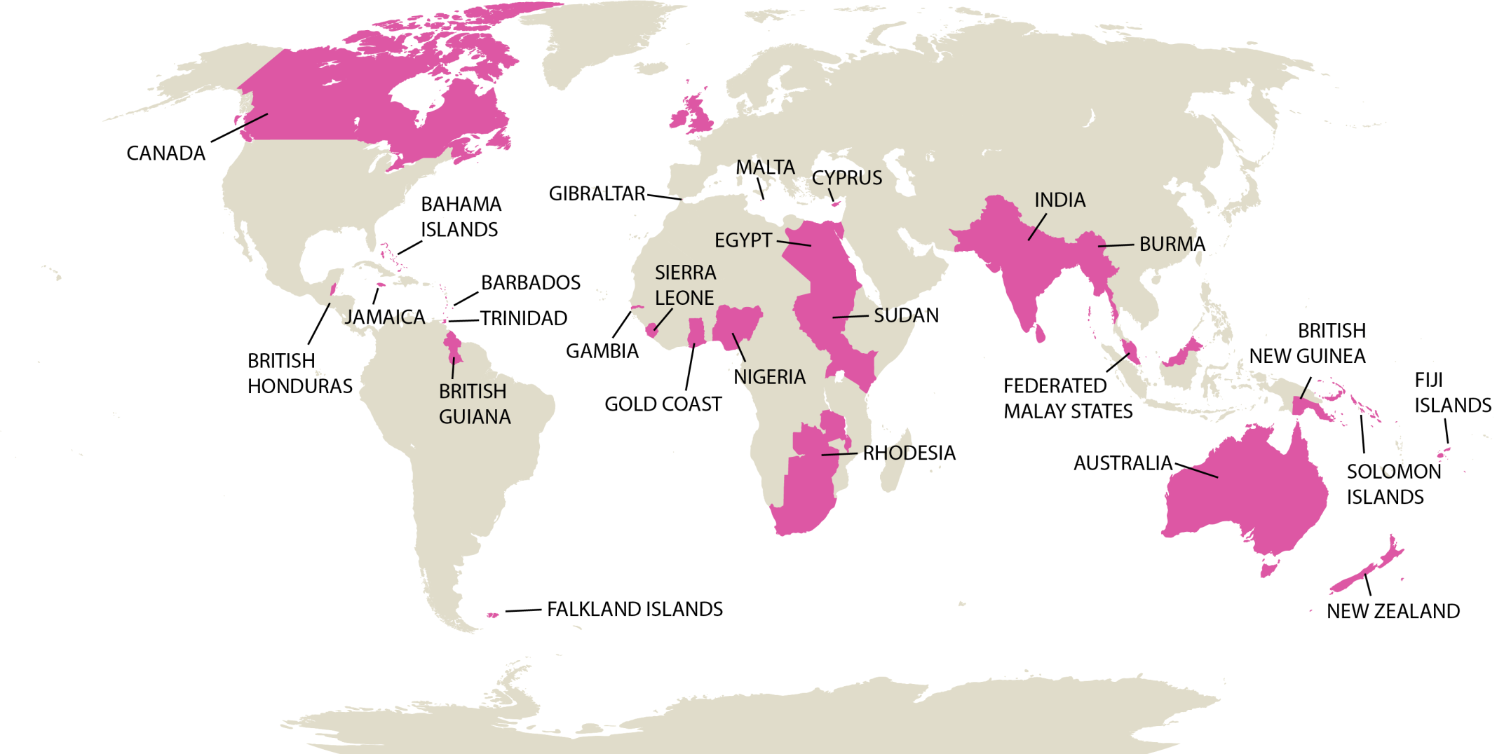

British Empire and Commonwealth Countries 2
Can you find the flags for these countries?
Notes:
This map can be copied into a word document and will print well in A4 or A3
Activity suggestion : research and add the flags for all these countries. Include these flags on bunting if you are holding a VE Day event or make paper flags.
https://www.worldometers.info/geography/flags-of-the-world/

Slide 12
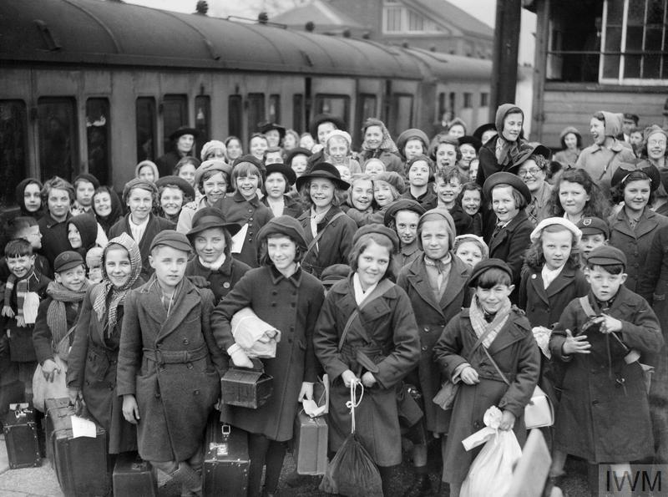
Evacuation in Britain
What do you think is happening in this picture?
What are the children carrying with them?
Where do you think they’re going?
During the War, over a million children and mothers with babies, living in cities, were sent.to live with host families in the countryside.
Why do you think this might have been?
Most evacuated children had returned home well before VE day.
Find out more about Evacuation in the Second World War
Notes:
During the War, over a million children and mothers with babies living in cities were sent to live with host families in the country.
Why do you think this might have been?
Evacuees and their hosts were often surprised to see how each other lived. Some evacuees loved their new lives in the country. Others had a miserable time away from home. Many evacuees from inner-city areas had never seen farm animals before or eaten vegetables.
Image: A group of evacuees from Bristol arrive at Brent railway station near Kingsbridge in Devon during 1940, Imperial War Museum. © IWM (D 2587)

Slide 13
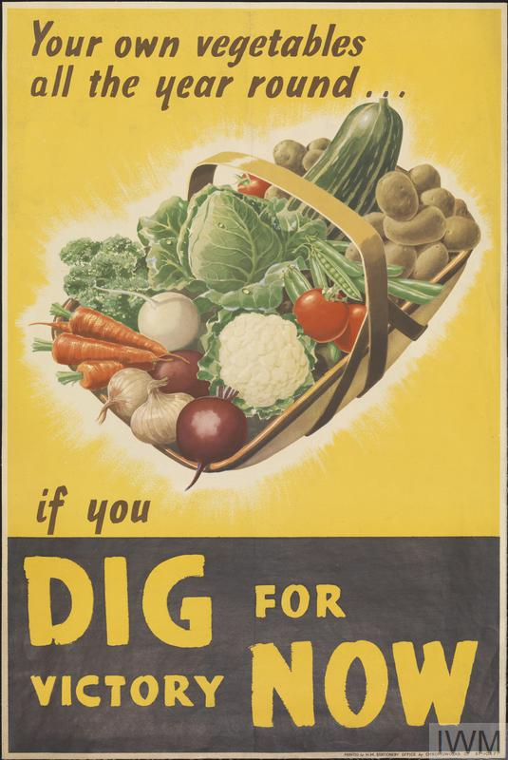
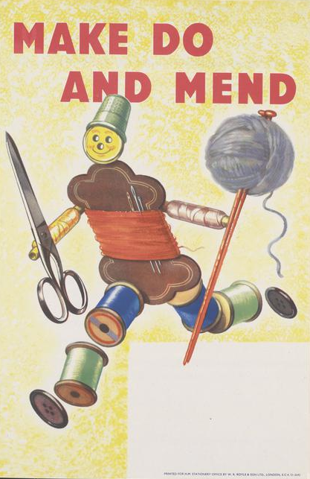
What do you think these posters are about?
During the war it was very difficult to import food from other countries, so people were encouraged to grow their own vegetables. Some food was rationed, so everyone had a fair share.
There was also a shortage of clothing materials, so people were encouraged to repair clothes and recycle fabric.
Notes:
What kinds of vegetables could you grow in your garden?
Can we grow some vegetables in pots in school – or in the school grounds?
Do you know anyone who grows their own vegetables
Do you know anyone who has an allotment?
Why is it a good idea to grow your own vegetables?
Can you sew or knit? What can you make
Images: © IWM Art.IWM PST 17009. © IWM Art.IWM PST 14924

Slide 14
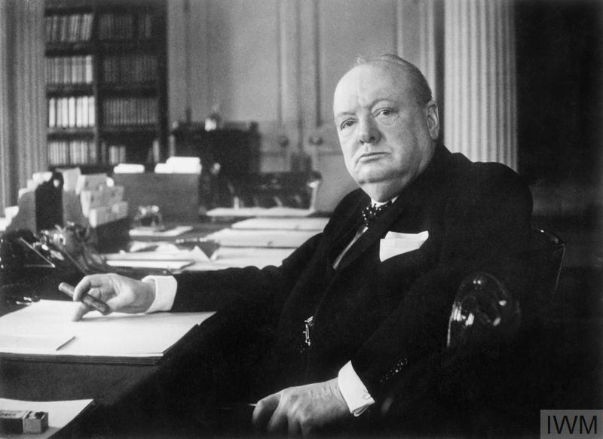
Do you recognise this man?
For most of the Second World War, the Prime Minister of Britain was Winston Churchill.
He was a very popular leader and was well known for making speeches
Who was the leader of the Nazi Germany?
Adolf Hitler was the leader of the German Nazi Party from 1933 -1945
Notes:
For most of the War, the Prime Minister of Britain was Winston Churchill
Image: © IWM (MH 26392)

Slide 15
VE day – Victory in Europe
On 8th May 1945 Hitler and the Nazis surrendered.
That means they agreed to stop fighting and to end the war.
The terrible war was over in Europe.
This became known in Britain as VE day – Victory in Europe.
Notes:
On 8th May 1945 – 76 years ago – Hitler and the Nazis surrendered. That means they agreed to stop fighting and to end the war.
The terrible war was over in Europe.
This became known in Britain as VE day – Victory in Europe.
Image: © IWM (HU 41808)

Slide 16
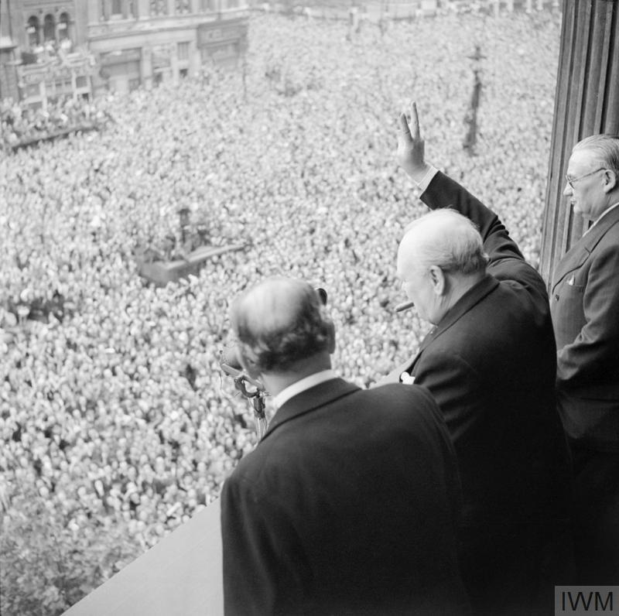
How did people celebrate?
Winston Churchill declared a public holiday.
Thousands of people travelled to London to celebrate.
What sign is Winston Churchill making with his hand? What does it mean?
Notes:
Winston Churchill declared a public holiday.
Thousands of people travelled to London to celebrate.
Winston Churchill makes the V for Victory sign to the crowd
Image: IWM (addressing crowds in Whitehall)
Â© IWM (H 41849)

Slide 17
National Celebrations 8th May 1945
Do you recognise this building?
Do you know who is in this picture?
Huge crowds - with lots of people dressed in red, white and blue - gathered outside Buckingham Palace in London. They cheered as King George VI and his family, including Princess Elizabeth (later queen) and Princess Margaret, came out onto the balcony to greet everybody. Princess Elizabeth and her sister were allowed to leave the palace and celebrate with crowds outside, although they had to do it secretly.
Notes:
Do you know who is in this picture?
Huge crowds - with lots of people dressed in red, white and blue - gathered outside Buckingham Palace in London. They cheered as King George VI and his family, including Princess Elizabeth (the current queen) and Princess Margaret, came out onto the balcony to greet everybody.
Princess Elizabeth and her sister were allowed to leave the palace and celebrate with crowds outside, although they had to do it secretly.
Image: Bridgeman

Slide 18
Crowds outside Buckingham Palace
Why did people flock to Buckingham Palace?
Who did they want to see?
Notes:
People all wanted to celebrate this important day together and wanted to see the Royal Family.
Can you think of any other times when people have gathered around Buckingham Palace to witness a significant National event?
Image: Bridgeman

Slide 19
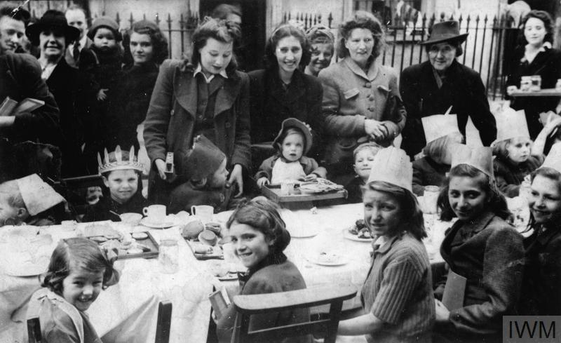
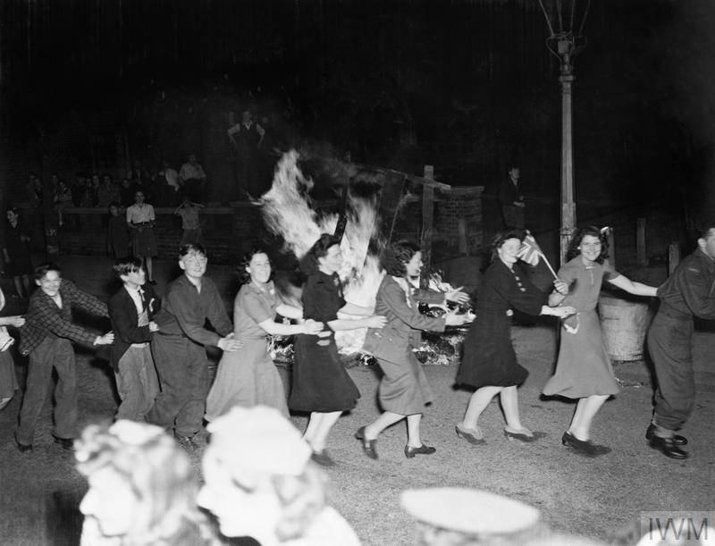
Street parties and celebrations all over the country - London
What are these people doing? What do you notice about their clothes?
What are these children doing? What are they wearing?
Notes:
People held street parties. Children dressed up in fancy dress and people danced in the street.
Images: Women and children at a VE-Day street party in Stanhope Street, London NW1. © IWM (HU 92607). © IWM (EA 65881)

Slide 20
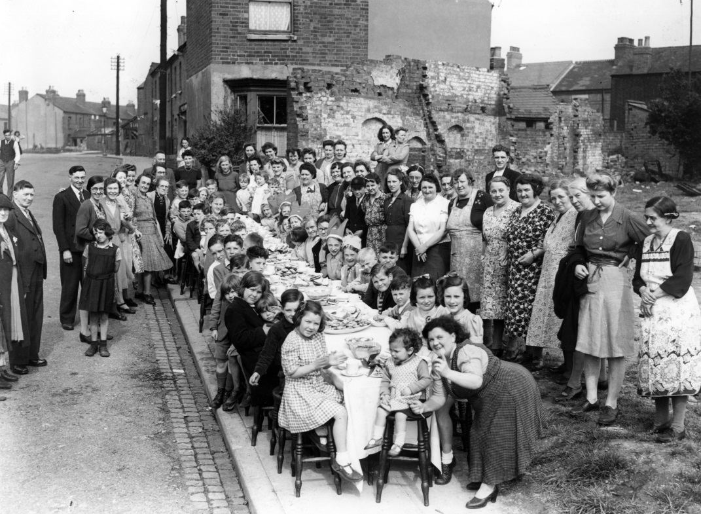
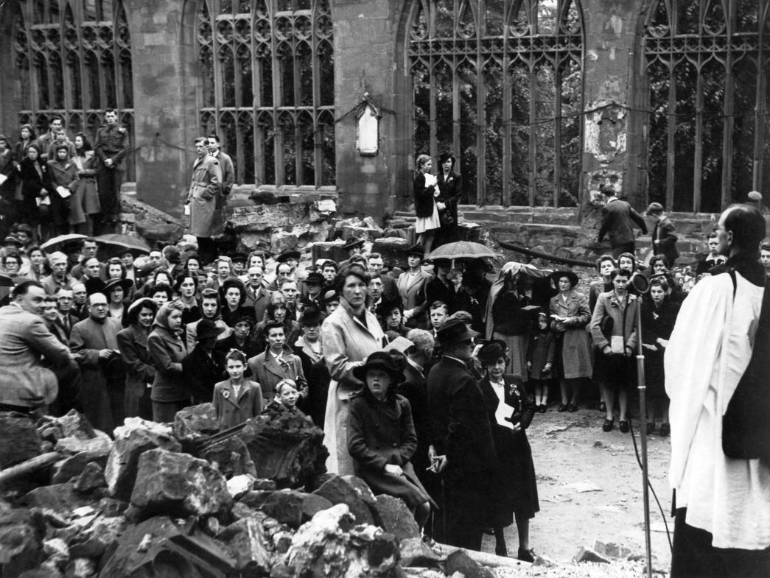
Street parties and celebrations all over the country - West Midlands - Coventry
Special services were held in the ruins of the Coventry Cathedral on VE day. It was visited by thousands of people.
Coventry was bombed heavily during the Second World War. Lots of people were killed and buildings were lost or badly damaged.
What can you see happening in this photograph?
What do you notice about the buildings in the background?
Notes:
What can you see happening in these pictures?
How many clues can you spot that tell you they are old photographs?
Parties were held across the region in streets decked out with red, white and blue bunting and flags.
People built celebration bonfires
In Coventry, there was a special concert and dancing outside the Hippodrome.
Special services were held in the ruins of the cathedral. It was visited by thousands of people. Services, which were conducted by the Provost (the very Rev. R. T. Howard) and the Bishop of Coventry (Dr Neville Gorton), did not end until after midnight. The Cathedral remained open all night. Just as the service started a thunder storm broke over the cathedral.
Images:
Coventry street party in Leicester Causeway, Mirrorpix
Service in the ruins of Coventry Cathedral, Mirrorpix
Permissions: natalie.jones@reachplc.com.

Slide 21
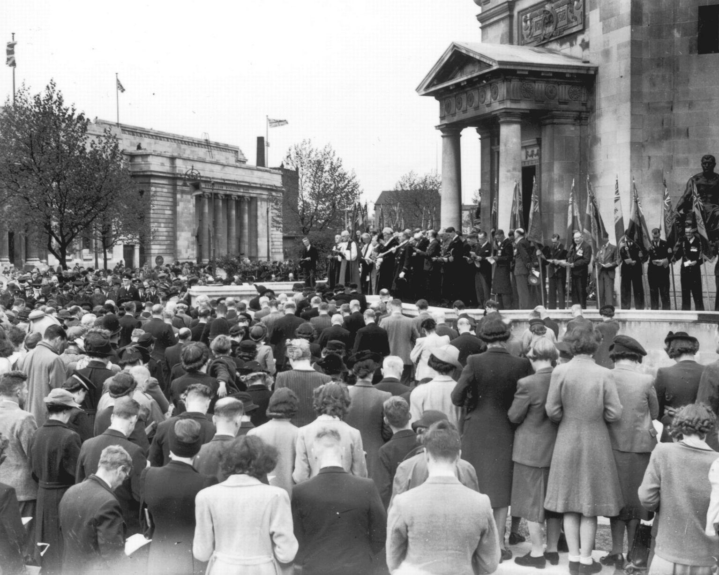
Street parties and celebrations all over the country - West Midlands - Birmingham
A special service was held at the Birmingham Hall of Memory
Why do you think the service is being held on the steps outside?
Notes:
A special service was held at the Birmingham Hall of Memory. People gathered outside because there wasn’t enough room inside.
Image: VE day service at Birmingham Hall of Memory, Birmingham Mail, https://www.birminghammail.co.uk/news/nostalgia/gallery/birminghams-hall-of-memory-9894870

Slide 22
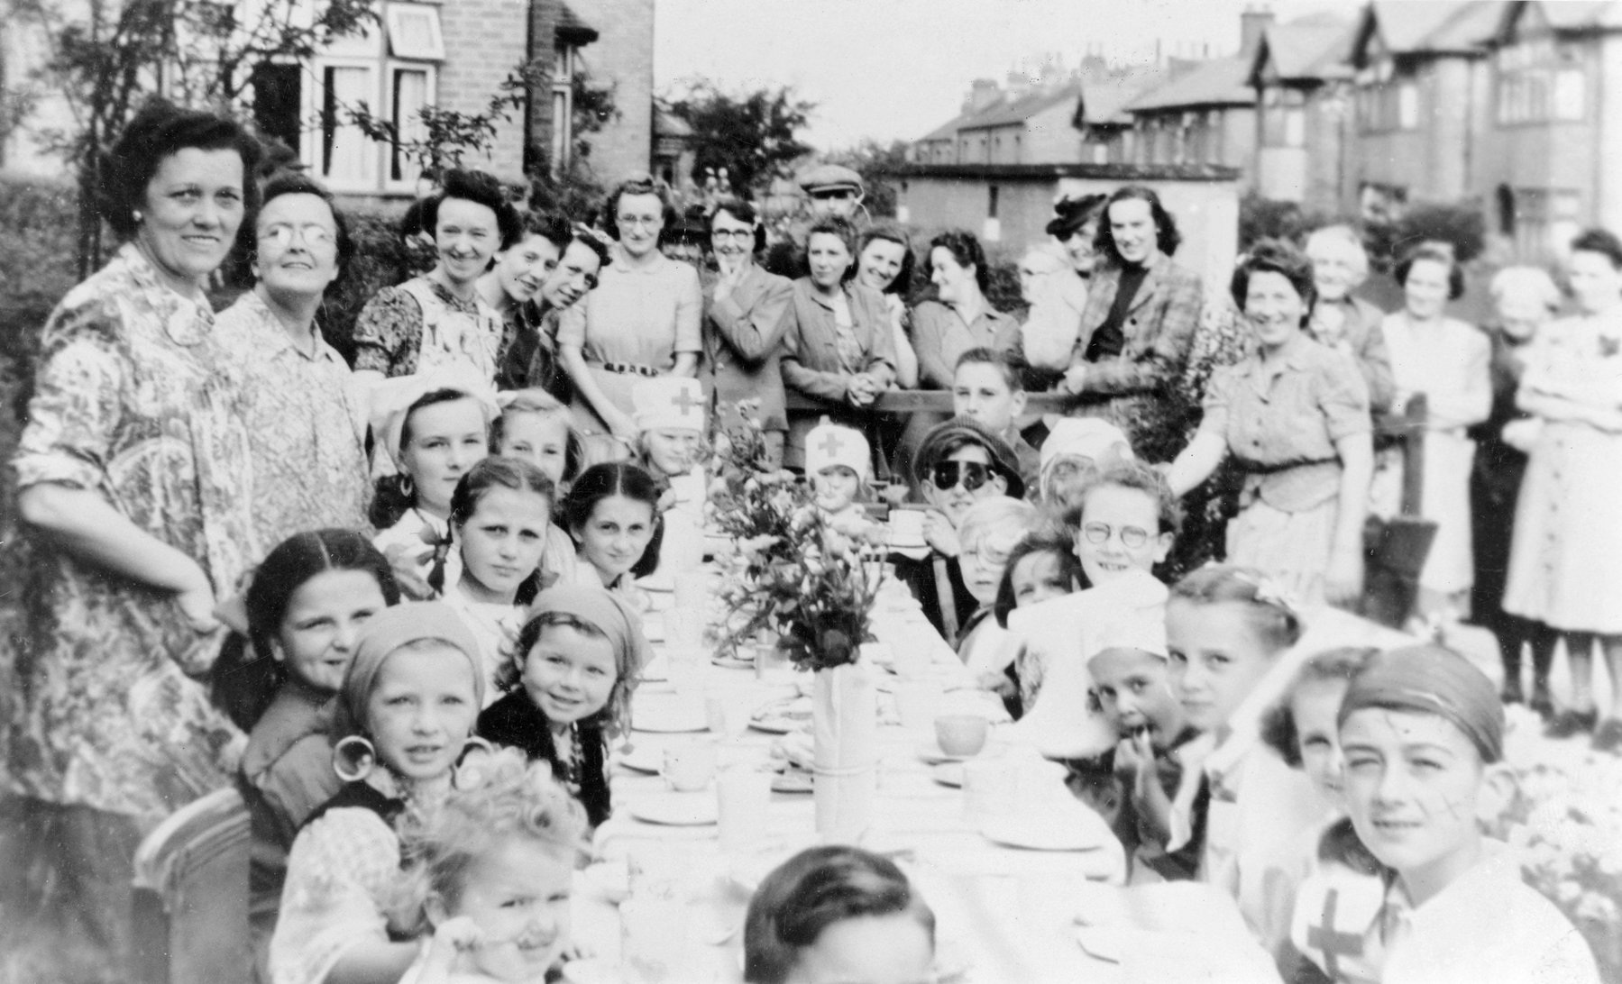
Street parties and celebrations all over the country - East Midlands - Nottingham
Street parties were held across the region.
Why do you think there are so few men in this photo?
Notes:
Nottingham
What can you see happening in this picture?
How many clues can you find that tell you this is an old photograph?
Why do you think there are so few men in this photo?
Lots of men were still overseas in the armed forces and did not return in time for VE Day. Lots of men had also been killed in battle. Street parties were held across the region. Many streets were decked out with red, white and blue bunting and flags.
Image: VE Day party, Park Avenue, Carlton, Nottingham, Nottinghamshire, May 1945, Heritage Image Partnership Ltd / Alamy Stock Photo

Slide 23
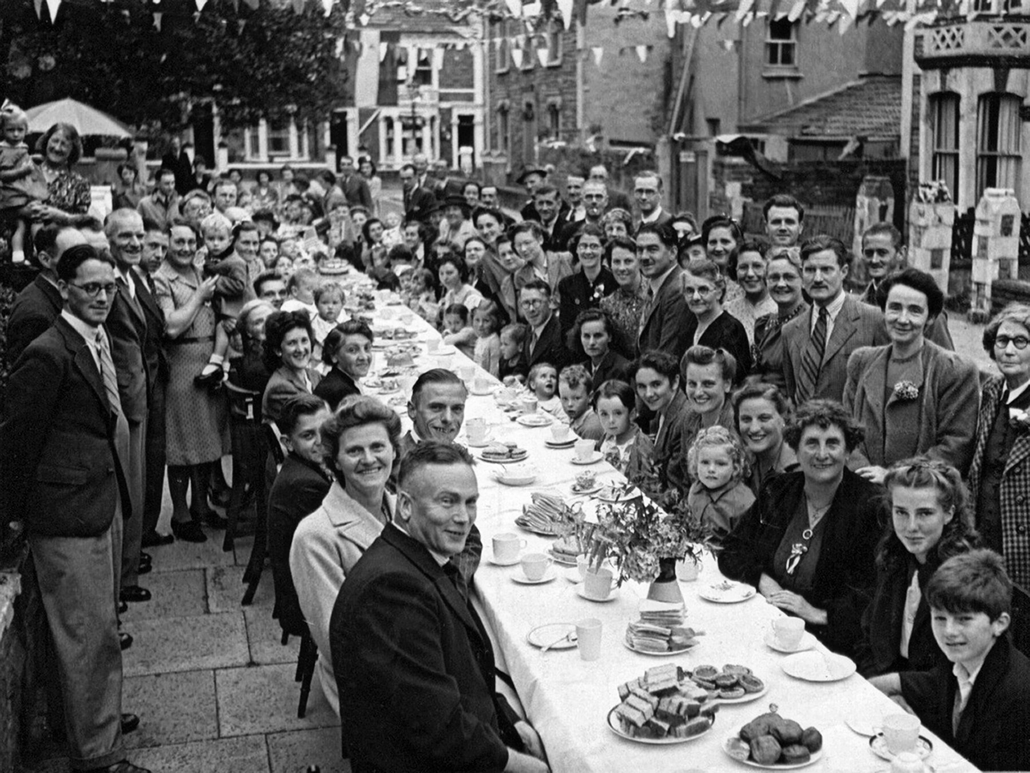
Street parties and celebrations all over the country – South West - Bristol
Streets were decked out with red, white and blue bunting and flags.
Why was the bunting red, white and blue?
Notes:
Bristol
What can you see happening in this picture?
How many clues can you find that tell you this is an old photograph?
Street parties were held across the region. Streets were decked out with red, white and blue bunting and flags to represent the colours of the Union Jack.
Image:
1940s Street Party In Bristol England UK, Coyote-Photography.co.uk / Alamy Stock Photo

Slide 24
Street parties and celebrations all over the country – South East – Brighton 1
What are the children wearing to celebrate?
What do you notice about the woman’s apron?
Notes:
Brighton
What can you see happening in this picture?
How many clues can you find that tell you this is an old photograph?
Why do you think there are so many flags?
Image: Royal Pavilion and Museums Brighton and Hove

Slide 25
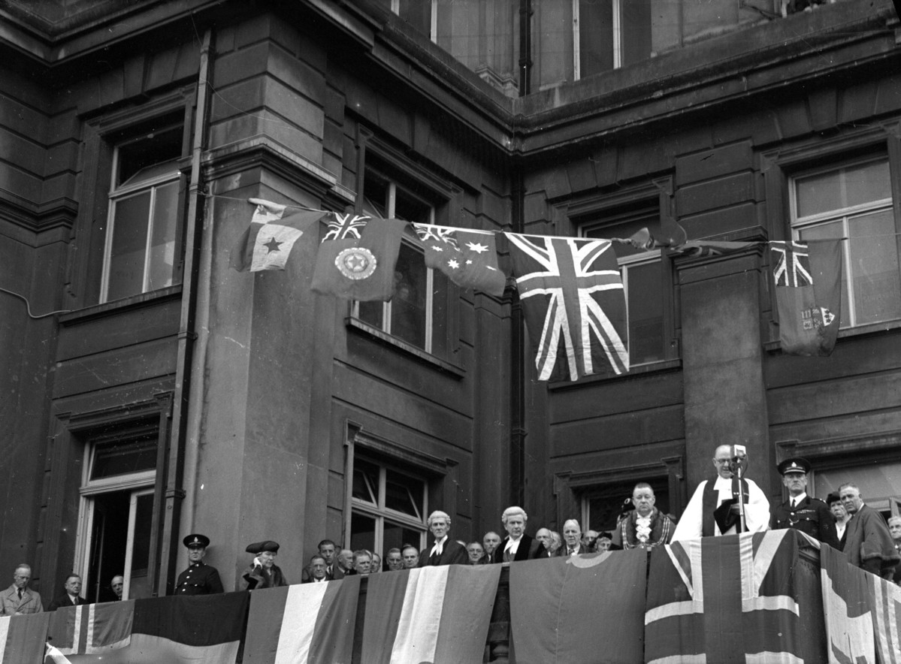
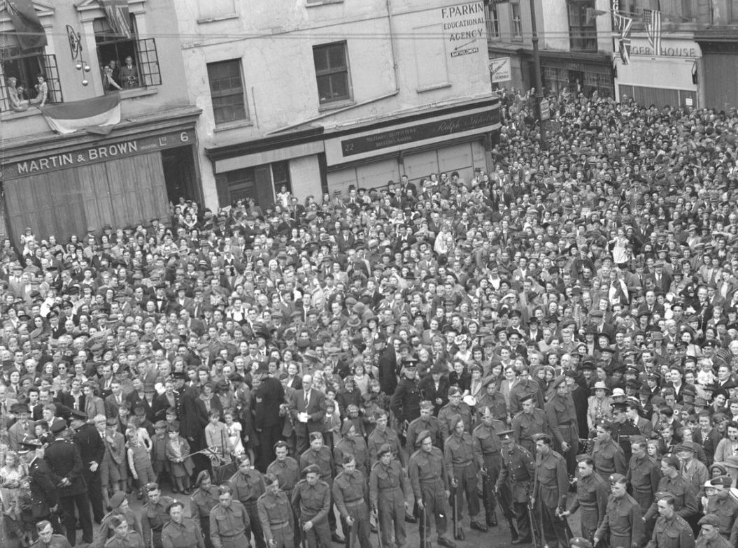
Street parties and celebrations all over the country – South East – Brighton 2
Crowds gathered outside the Town Hall in Brighton to witness the Mayor of Brighton on the flag-covered balcony giving a speech, proclaiming the end of the War in Europe.
What do you notice about the flags?
Notes:
Crowds gathered outside the Town Hall in Brighton to witness the Mayor of Brighton appearing on the flag-covered balcony and giving a speech proclaiming the end of the War in Europe.
Images: V.E. Day Proclamation, Brighton. May 1945. Royal Pavilion and Museums Brighton and Hove
https://dams-brightonmuseums.org.uk/assetbank-pavilion/action/viewAsset?id=20789&index=6&total=3840&view=viewSearchItem
https://dams-brightonmuseums.org.uk/assetbank-pavilion/action/viewAsset?id=20788&index=5&total=3840&view=viewSearchItem

Slide 26

Street parties and celebrations all over the country – North West - Manchester
What does the message on the flag mean? Who is the message for?
Can you count how many people are in this photo?
How many are men?
Where do you think the men are?
Notes:
Manchester
What can you see happening in this picture?
How many clues can you find that tell you this is an old photograph?
Why do you think there are so many flags?
Street parties were held across the region. Streets were decked out with red, white and blue bunting and flags to represent the Union Jack. Many men had been killed in battle or were in the armed forces and had not yet returned from overseas. The message is for the men that could not be at the celebration.
Image: A street party in the Newton Heath district of Manchester during VE Day celebrations, Tuesday 8th May 1945. Mirrorpix. natalie.jones@reachplc.com

Slide 27
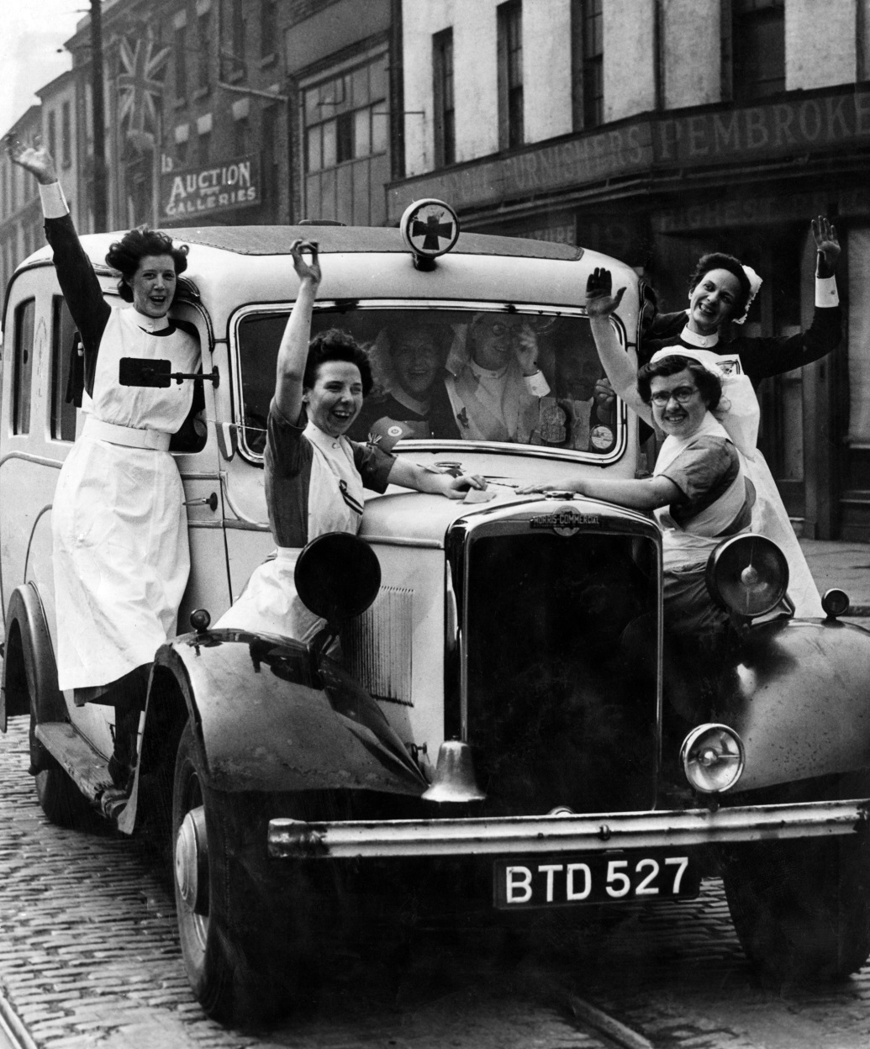
Street parties and celebrations all over the country – North West - Liverpool
Who might these nurses have been looking after at this time?
What do you think is happening in this picture?
Notes:
Liverpool
What do you think is happening in this picture?
natalie.jones@reachplc.com
Image: Jubilant nurses celebrate VE-Day in Liverpool. 8th May 1945. Mirrorpix

Slide 28
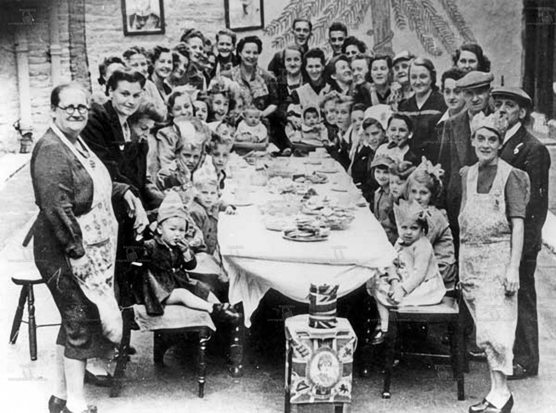
Street parties and celebrations all over the country – Yorkshire and Humber - Sheffield
Is this photograph similar to others of street parties in other parts of the country? What things are similar? What things are different?
This photograph was taken in 1945.
How many people in this photo might still be alive today?
Notes:
Sheffield
What can you see happening in this picture?
How many clues can you find that tell you this is an old photograph?
People brought their furniture into the street so they could all join round one big table and share the celebration with each other.
Why do you think there are so few men in the picture?
Street parties were held across the region. Streets were decked out with red, white and blue bunting and flags.
Image: Street Party in Rutland Square, Sheffield
Creative Commons: BY-NC-2.0 https://www.flickr.com/photos/philatkin/7538555214
Sheffield

Slide 29
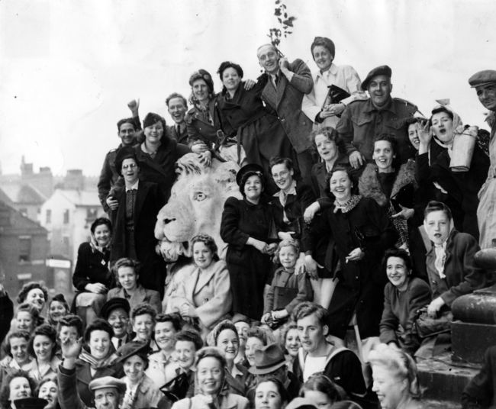
Street parties and celebrations all over the country – Yorkshire and Humber - Leeds
There are statues of lions outside the Town Hall in Leeds. Where do you think these people are celebrating?
During the war lights were kept low at night, so enemy planes couldn’t see where to drop bombs.
Why did these people want to celebrate with a bonfire?
Notes:
Leeds
A Victory Parade was held in Leeds on 13 May 1945, and some of the crowds managed to find themselves vantage points on the Town Hall steps, and on top of the lions, as you can see in the photo below. The weather was awful, with rain pouring from the heavens, but this did not dampen the exuberant spirits of the people, who also took to dancing in the streets.
A celebratory 'end of the war' bonfire. Many street parties would have gone on until late hours, and ended with a bonfire. After years of living with blackout conditions, when no-one was allowed to show any light whatsoever at night, a bonfire was a rare delight for young and old.
Images: Creative Commons BY-NC-SA
Crowds cling to the Town Hall lions to get a good vantage point to watch the parade - https://www.mylearning.org/resources/a-crowd-of-people-sitting-on-statues - © Yorkshire Post Newspapers
Street party in Leeds at the end of WW2 with a large bonfire, CC - https://www.mylearning.org/resources/street-party-in-leeds-at-the-end-of-ww2-with-a-large-bonfire

Slide 30
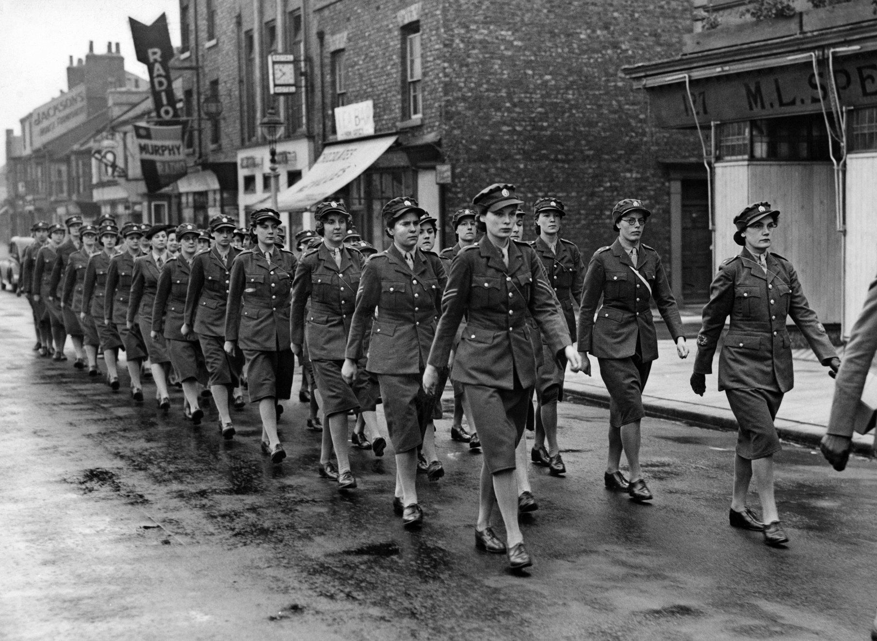
Street parties and celebrations all over the country – North Yorkshire - Teeside
A Victory Parade
What roles did women have during the war?
Why might these women be in uniform?
Notes:
Teeside
During the Second World War many women joined the services doing a variety of jobs such as driving vehicles, manning anti-aircraft guns and RADAR stations. Many women also worked in the Land Army doing farming work and in munitions factories and built planes, tanks and guns.
Image: Victory Day Parade in Teesside. 8th May 1945, Trinity Mirror / Mirrorpix / Alamy Stock Photo.

Slide 31
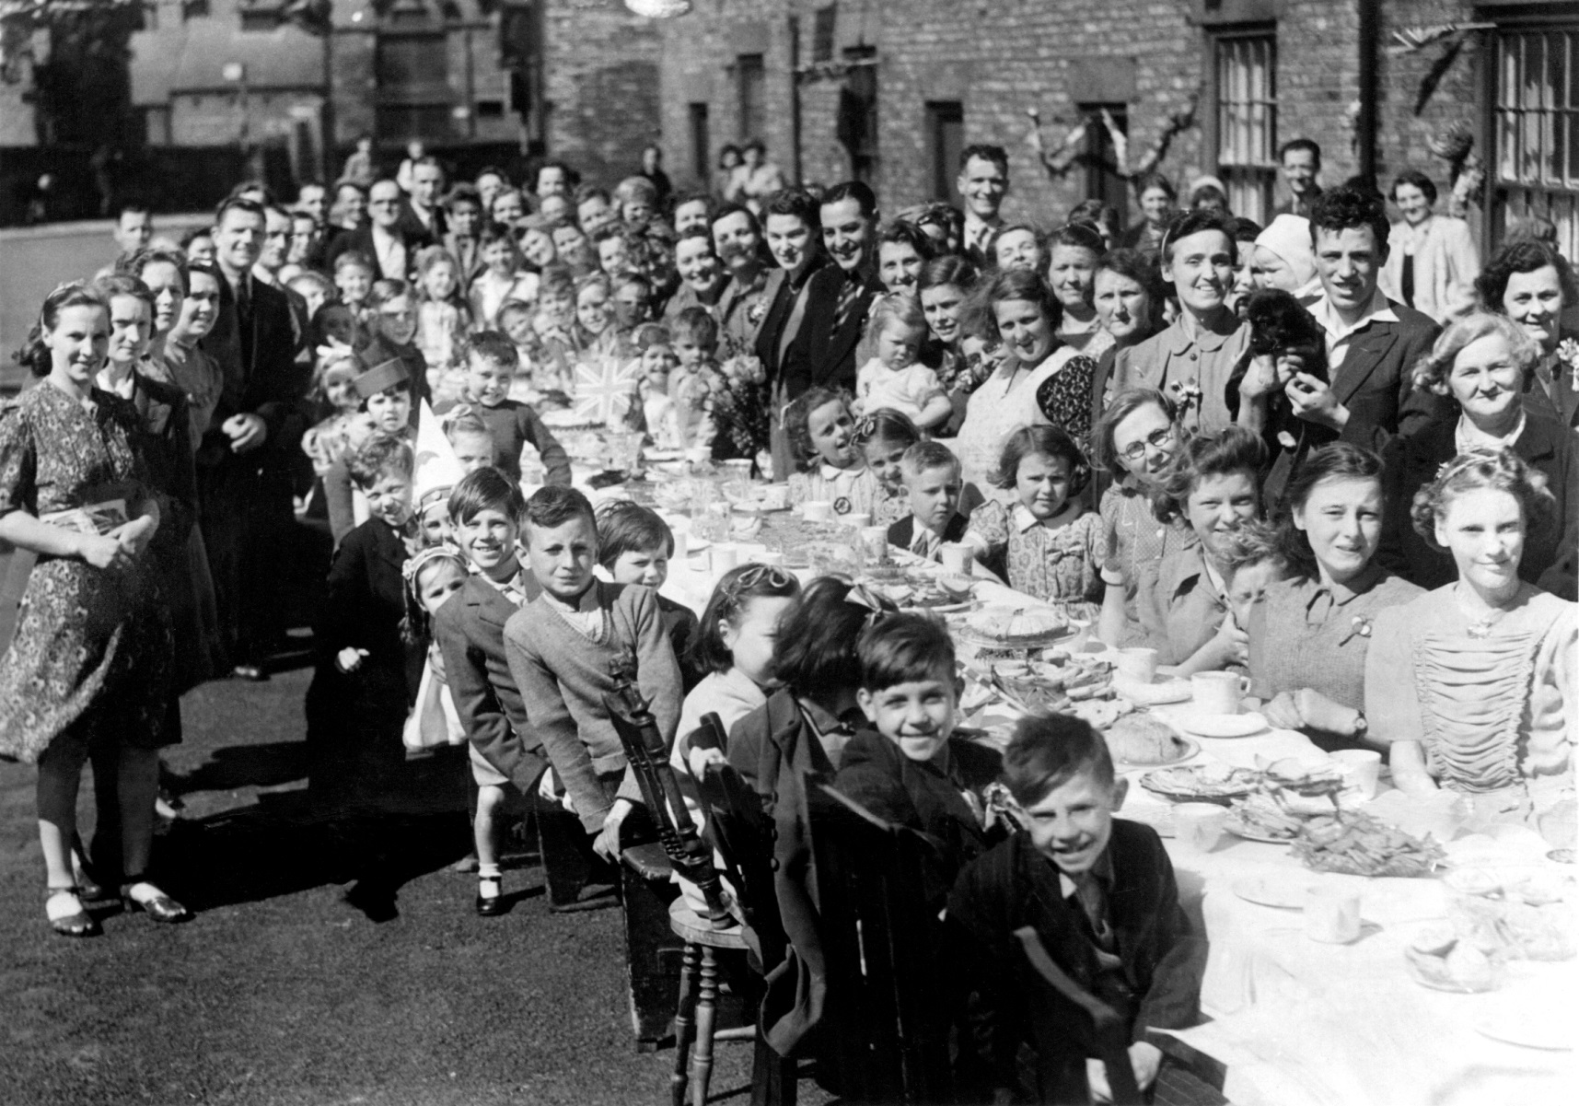
Street parties and celebrations all over the country – North East- Newcastle
Food was rationed during the war.
How do you think these people managed to fill the table with food for the children?
Look closely – what are they eating?
Notes:
Newcastle
What can you see happening in this picture?
How many clues can you find that tell you this is an old photograph?
People shared their food rations so they could have street parties together.
Image: VE Day celebrations and 'Victory Tea' at Lambert Square, Coxlodge, Newcastle. Mirrorpix
Permission: natalie.jones@reachplc.com

Slide 32
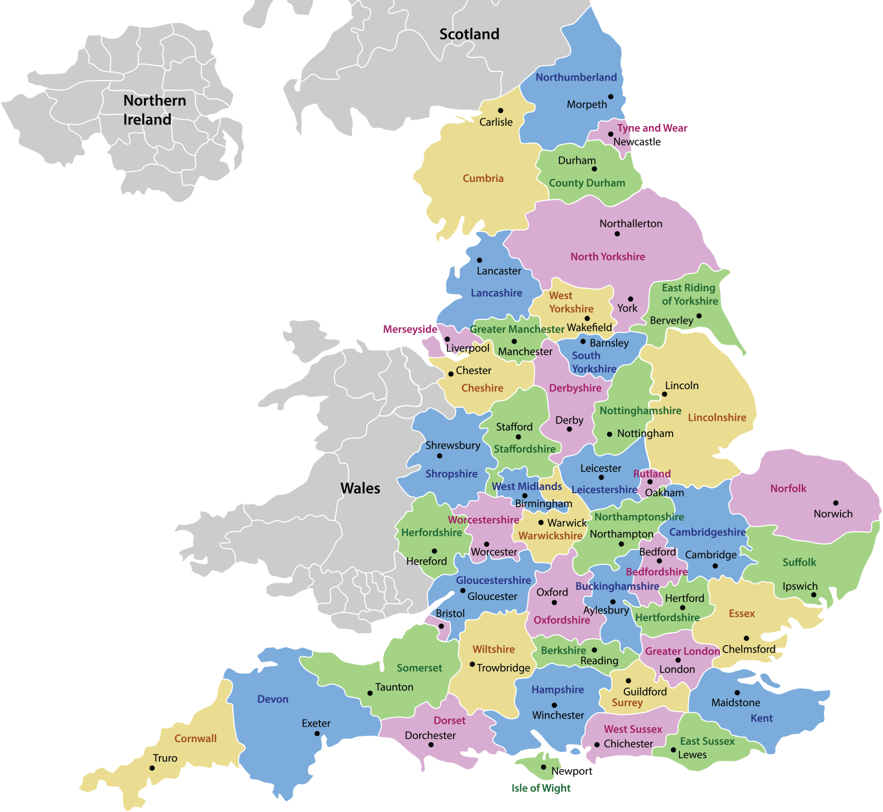
Map of England
Can you find all the places where the VE Day photographs in the previous slides were taken?
Who do you think took the photographs?
Why are many of the photographs we have of VE day from newspapers?
Notes:
VE Day was an important world-wide event. It was reported in the newspapers and on the radio, and in the cinemas, but televisions did not become popular (or affordable) until the 1950s.
Many people did not own a camera and so most photographs of this period of history were taken professionally for newspapers and magazines.
Print out this this slide (or copy and paste the map into a Word document and print it) to make a VE Day display with the photographs

Slide 33
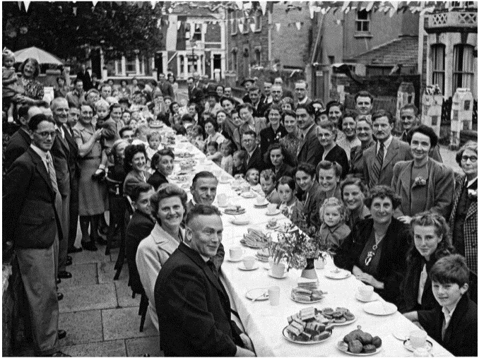

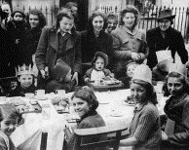
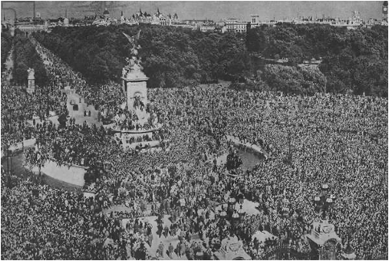
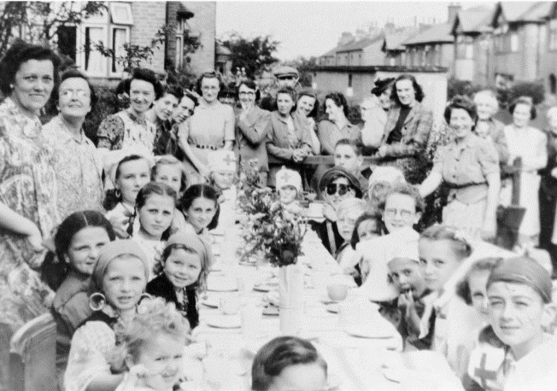
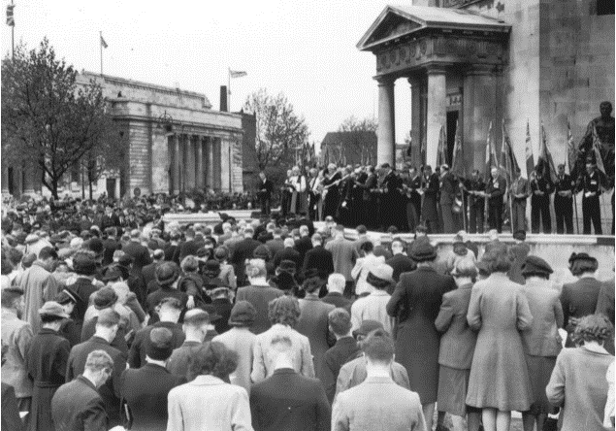
Activity: Print and cut out the photos 1
Bristol
London
Coventry
London
Nottingham
Birmingham
Notes:
Print out the slide or copy and paste the images into a word document and cut them out
Keep the headings so your remember which county each photograph is from

Slide 34
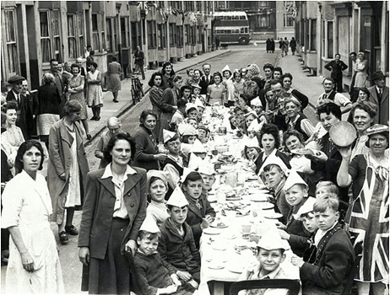
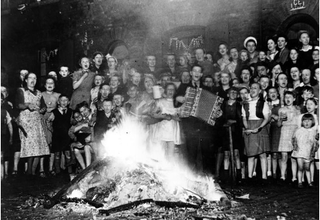
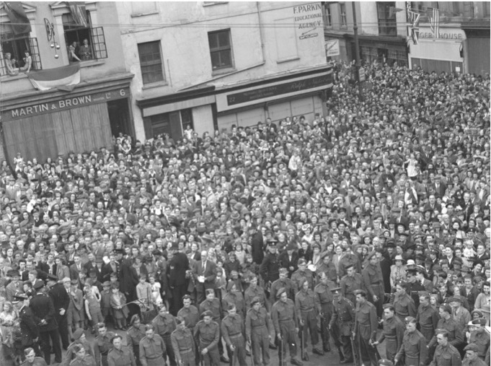
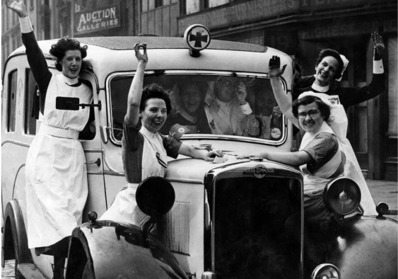
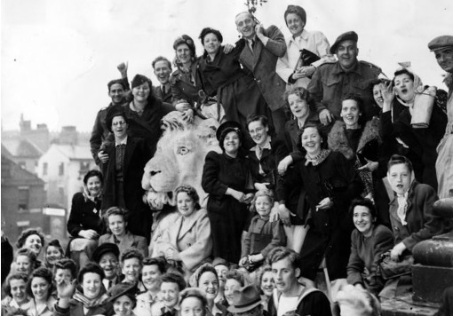
Activity: Print and cut out the photos 2
Leeds
Brighton
Manchester
Brighton
Liverpool
Leeds
Notes:
Print out the slide or copy and paste the images into a word document and cut them out
Keep the headings so your remember which county each photograph is from

Slide 35
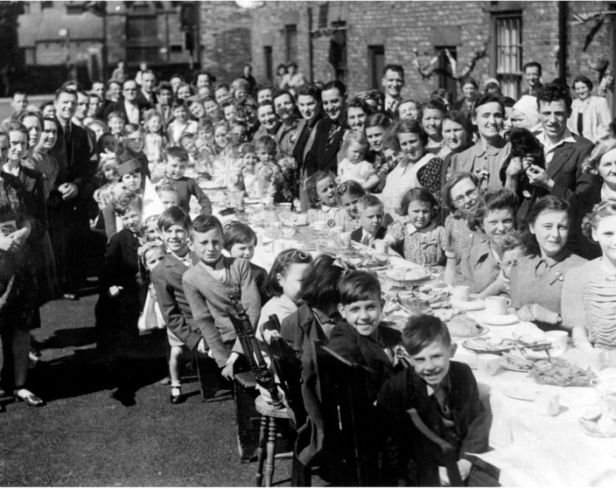
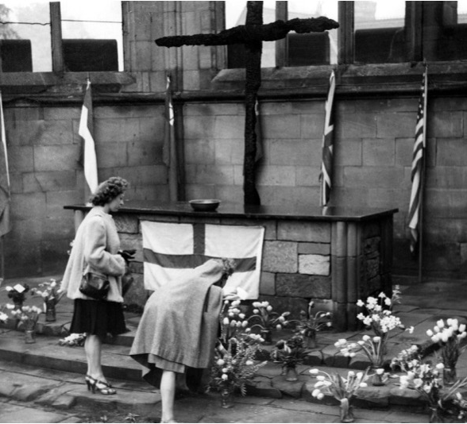
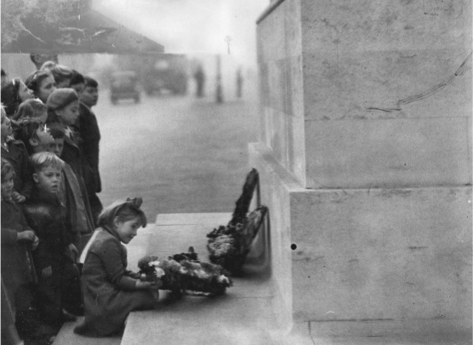

Activity: Print and cut out the photos 3
Newcastle
Coventry
London
Teesside
Notes:
Print out the slide or copy and paste the images into a word document and cut them out
Keep the headings so your remember which county each photograph is from

Slide 36
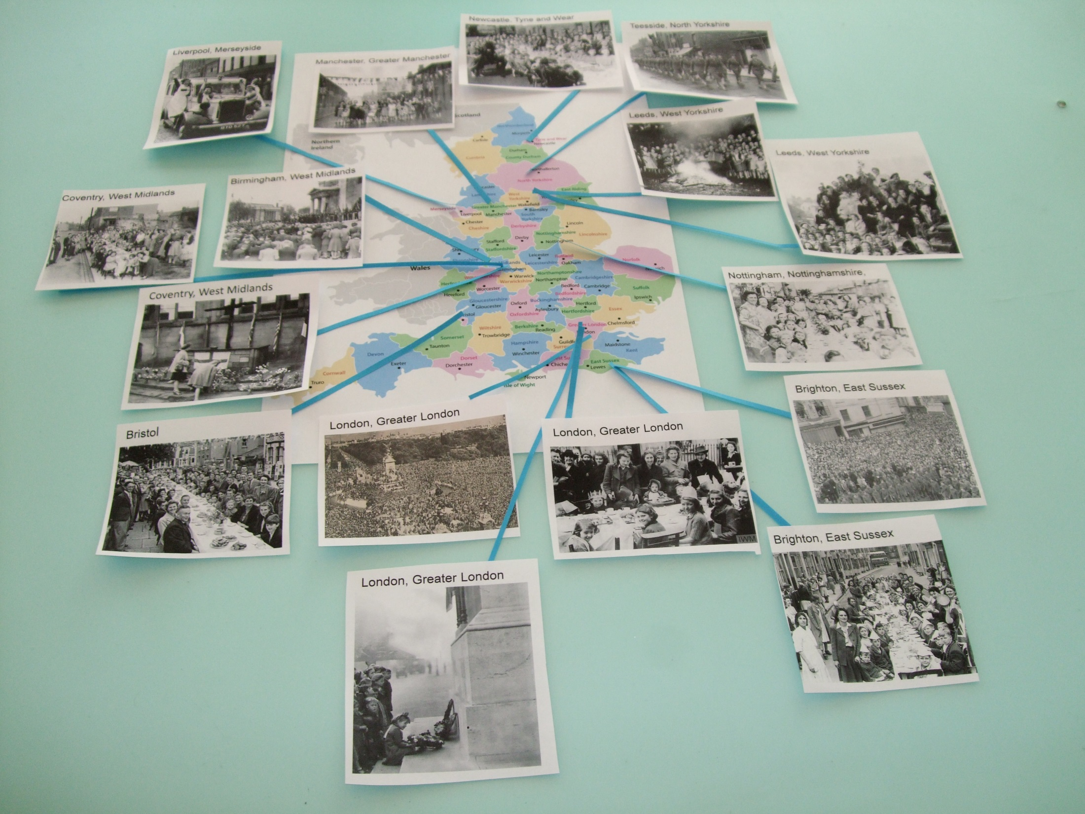
Locate the photographs on the map to make a VE Day display
Notes:
Locate the photographs on the map and make a VE Day display.
Street parties and commemoration events were held in every part of the country in thousands of streets and in most town and village centres. Here are just a few!

Slide 37
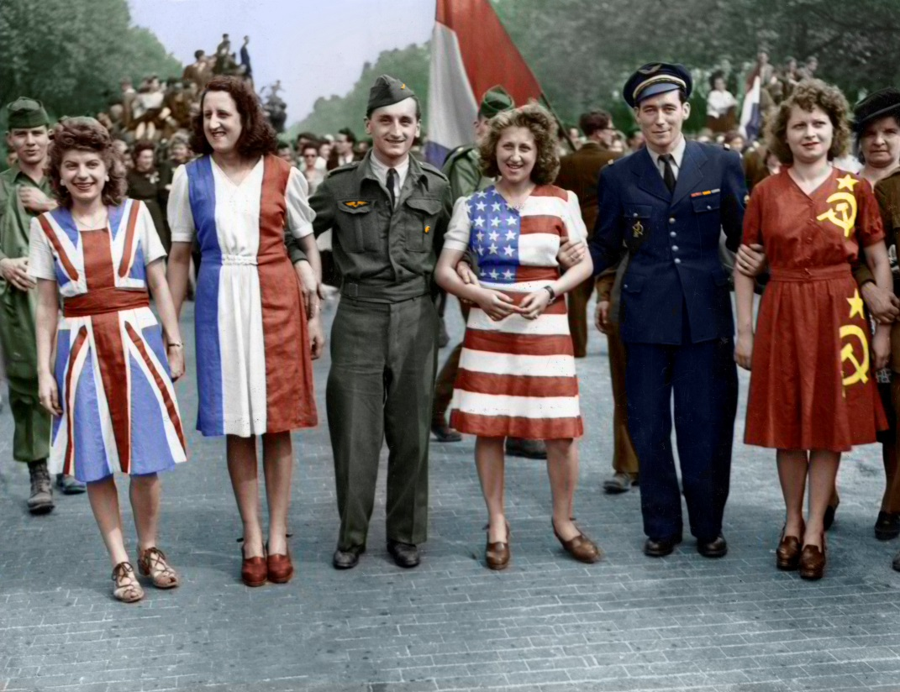
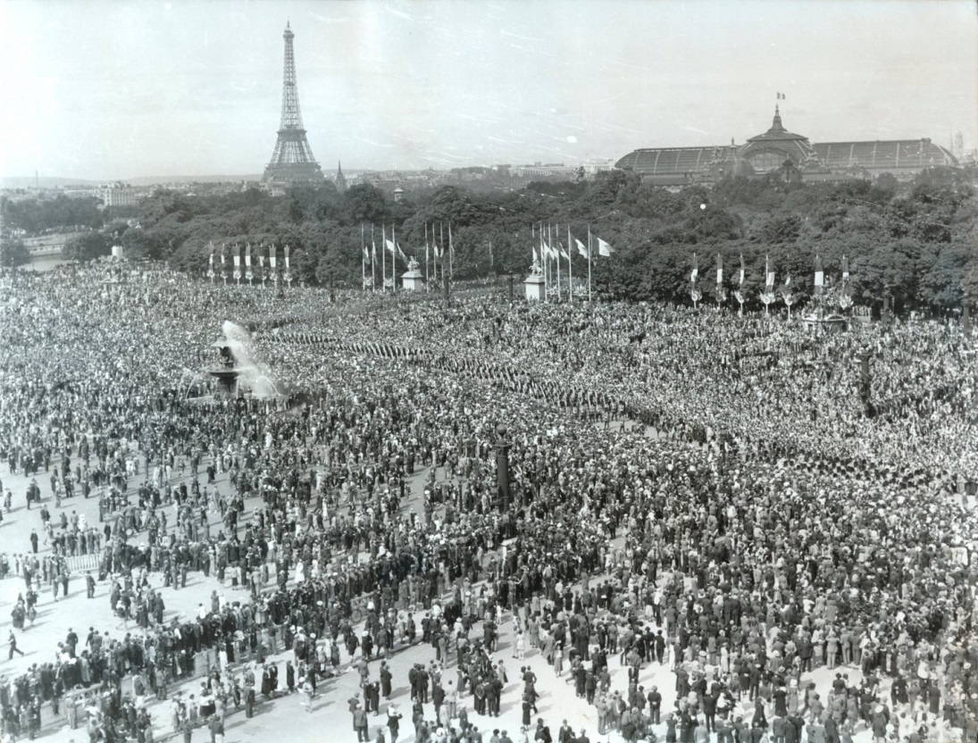
Around the World - Paris, France
How is the photograph below different from most others taken during the Second World War?
Which countries’ flags do these dresses represent?
People flock to the Champs Elysees in Paris to celebrate VE day.
Colour photographs from the Second World War were rare because the process was relatively new and more expensive.
Notes:
The were celebration events in all the Allied countries all over the world. Here are just a few examples
Thousands of people in France flocked to Paris to celebrate.
Images:
8 May 1945 on the Champs Elysees in Paris. Parisian women dressed in the colours of the Allies’ flags (Great Britain, France, United States and Russia) celebrate the victory announcement, © Usis-Dite/Bridgeman Images
Victory in Europe Day (Fête de la Victoire), Place de la Concorde, Paris, 8 May 1945, The Print Collector / Alamy Stock Photo

Slide 38
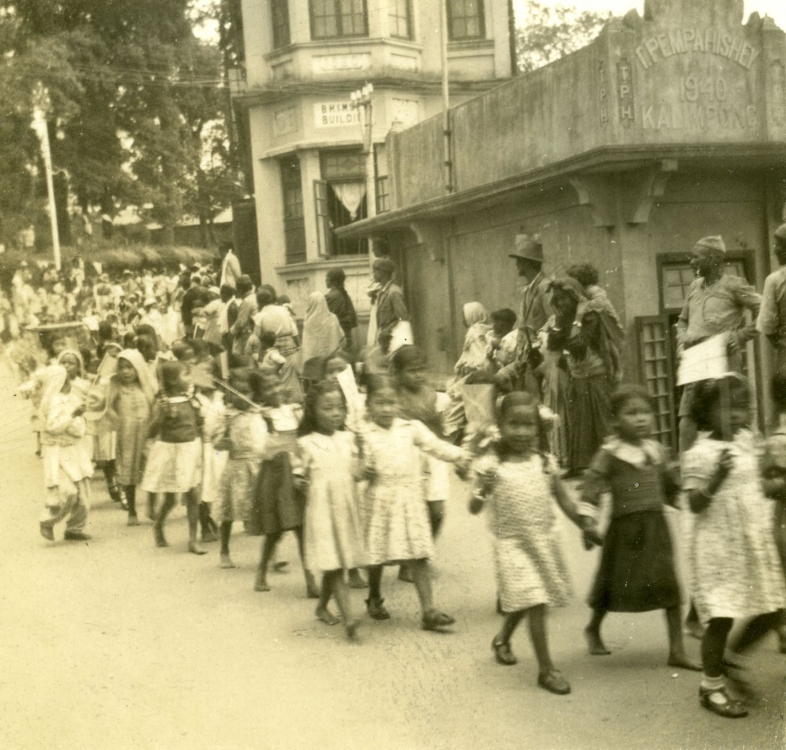
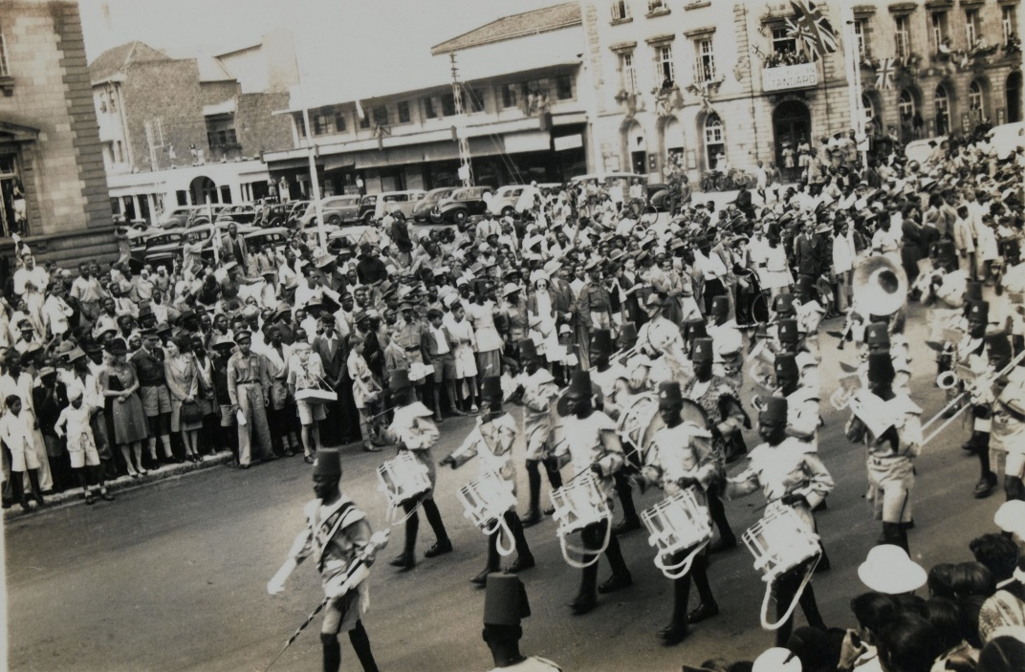
Around the World - India & Nairobi, Kenya
Children parade in Kalimpang, India
Crowds come to watch the VE day parade in Nairobi.
Notes:
Many men from the British Empire and Commonwealth countries had fought to help win the war, and many men were killed. The people in these countries had made a huge sacrifice and contribution to the war effort and they celebrated when the fighting in Europe had stopped.
Images:
Children walking during a parade in Kalimpang, India on VE Day 1945, Archive Image / Alamy Stock Photo
VE Day celebrations in Nairobi, National Army Museum, London/Bridgeman Images

Slide 39
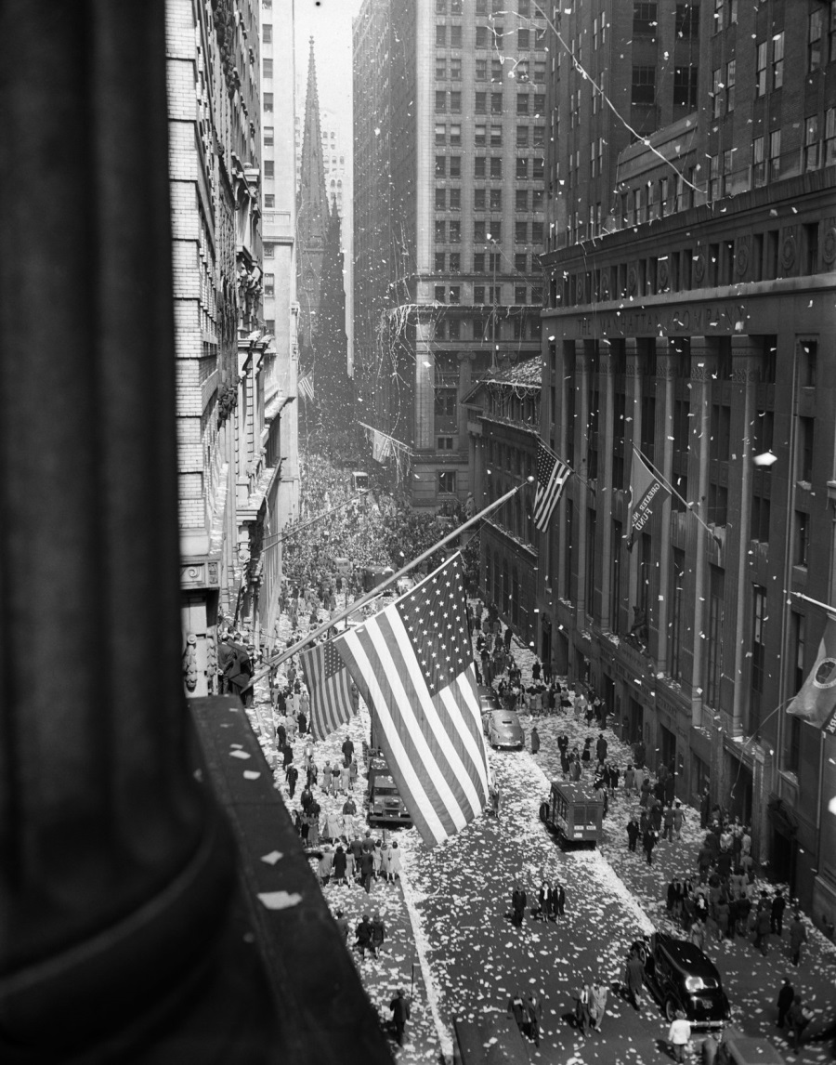
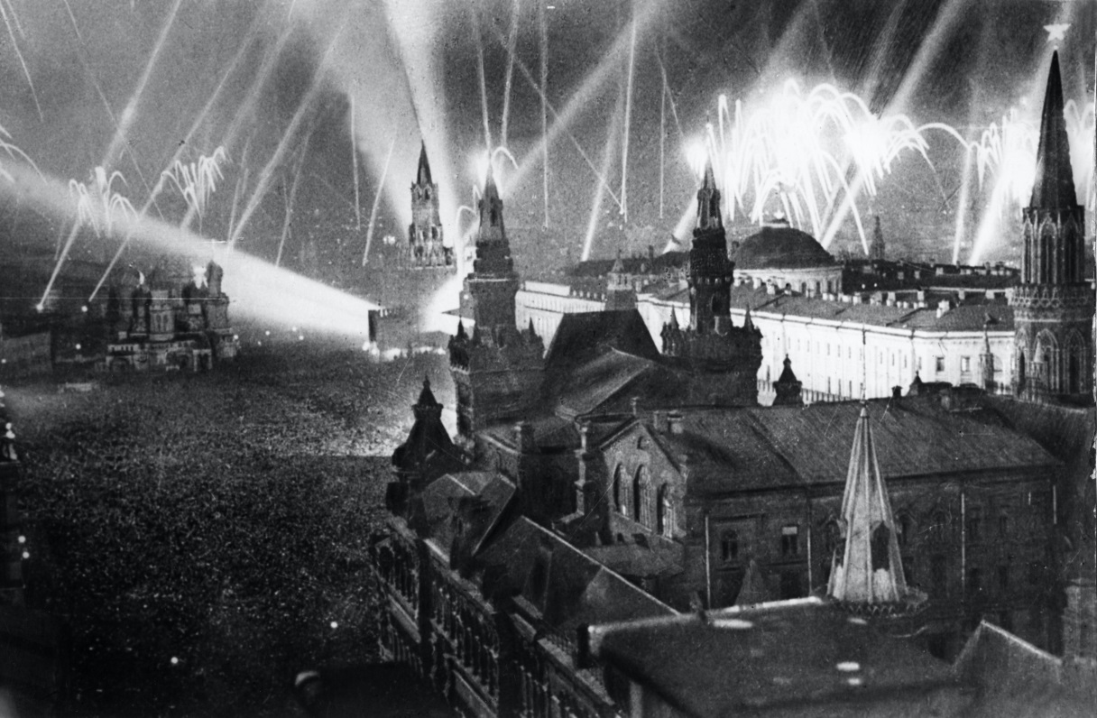
Around the World - New York, USA & Moscow, USSR
Fireworks over the Kremlin in Moscow.
How could you guess this photograph was taken in the USA?
Notes:
In the United States of America, the victory was tempered with the recent death of President Roosevelt, who had led his country through the war years. Despite this, there were still scenes of great rejoicing. In New York, 15,000 police were mobilised to control the huge crowds that had massed in Times Square.
In the Soviet Union, Fireworks were set off over the Kremlin in Moscow.
Images:
1945 aerial view of VE celebration on Wall Street, New York City, with flags and confetti flying, ClassicStock / Alamy Stock Photo
Fireworks over the Kremlin in Moscow on VE day 1945, Sovfoto/UIG/Bridgeman Images

Slide 40

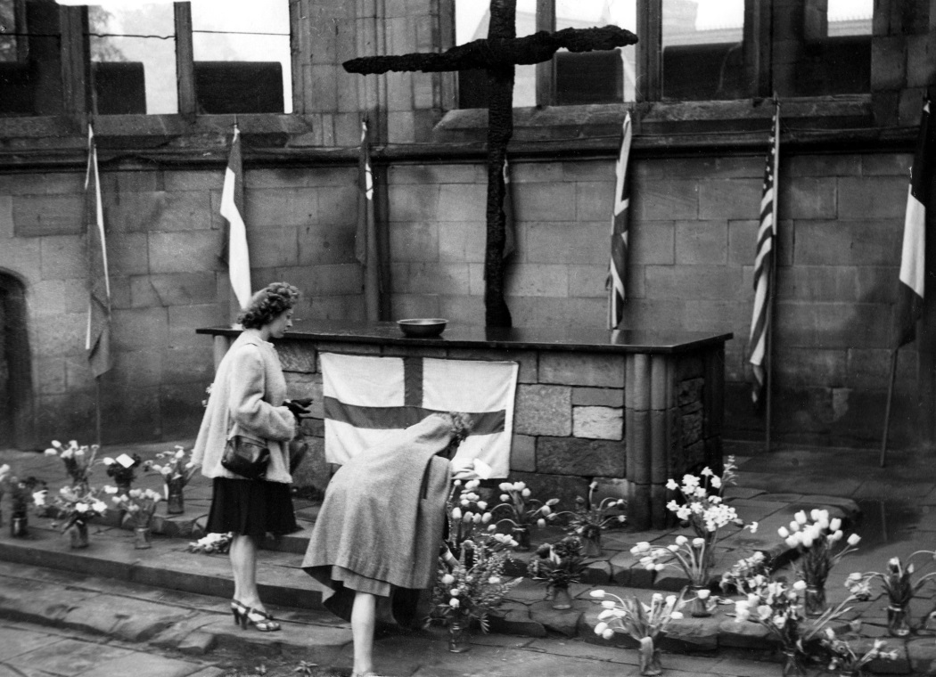
Remembering and commemorating – Coventry & London
Why do you think some people did not feel like celebrating?
Who do you think these children might be thinking about?
Notes:
Coventry
Not everyone celebrated VE Day.
It was also a moment of great sadness and reflection, as millions of people had lost their lives or loved ones in the conflict, and many, many more had suffered terrible injuries and hardship.
For many of the widows the war had produced, the noise and jubilation as people celebrated VE Day was too much to bear and not something they could take part in. Others worried about loved ones still fighting the war overseas.
Special services were held, including in the ruins of Coventry Cathedral. It was visited by thousands of people. Services, which were conducted by the Provost (the very Rev. R. T. Howard) and the Bishop of Coventry (Dr Neville Gorton), did not end until after midnight. The Cathedral remained open all night. Many people who had relatives in the war brought bunches of flowers and placed them in vases. Names were also put into the bowl that stands on the alter near to the cross of nails and the charred cross that stands in the sanctuary. Just as the service started a thunderstorm broke over the cathedral.
8th May 1945.
Image:
Coventry women place flowers in the sanctuary in the cathedral ruins in remembrance of their loved ones on VE Day. Mirrorpix
Children commemorate the end of WW2 in Europe VE Day by laying wreath at the Cenotaph in London May 1945, Trinity Mirror / Mirrorpix / Alamy Stock Photo

Slide 41
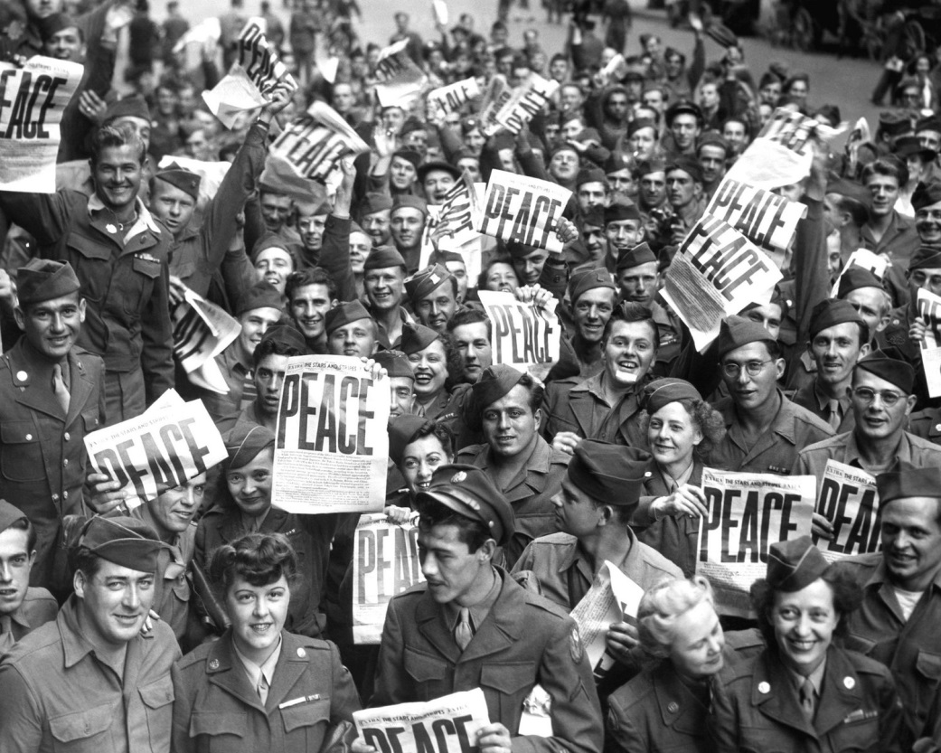
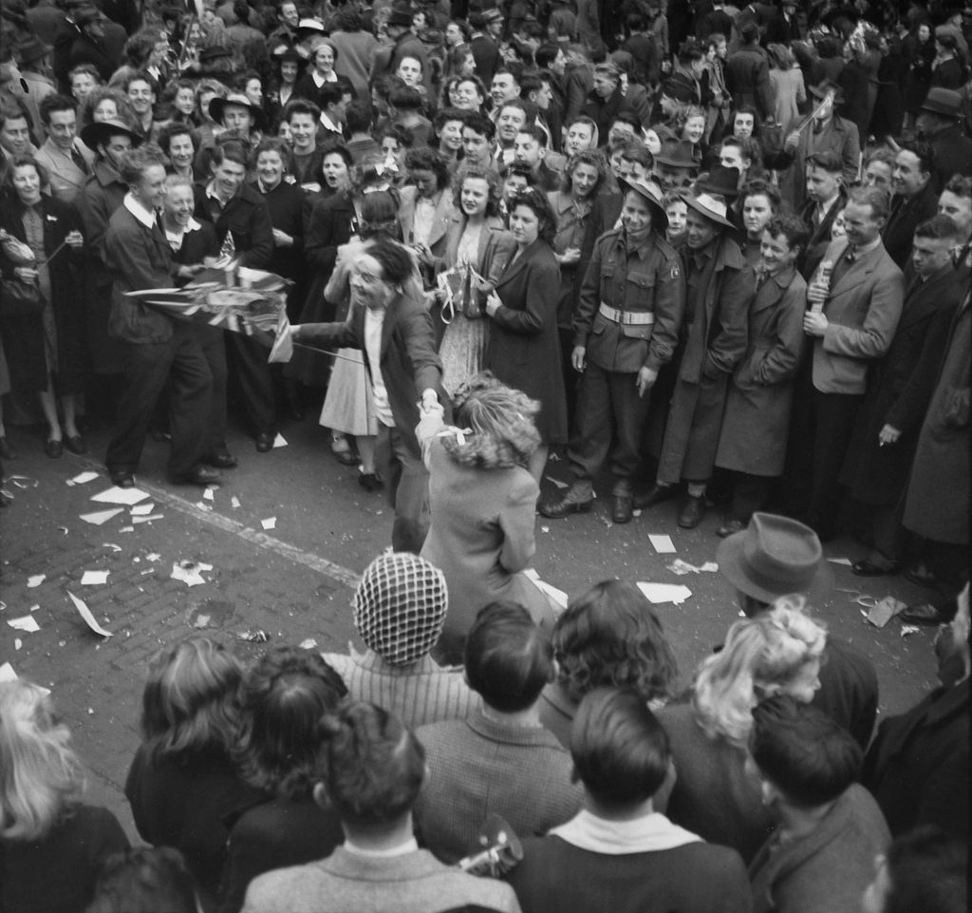
What is VJ day?
Japan surrendered on 14th of August 1945, known as VJ day - Victory over Japan. The war wasn’t over for everyone on VE day. Many servicemen continued to fight in East Asia and the Pacific for another 3 months against the Japanese Army.
Allied servicemen & women celebrate in Japan
People dancing on VJ day in Australia
Notes:
Japan and Australia
The War wasn’t over for everyone.
Many allied servicemen were transferred to East Asia and the Pacific, where fighting would continue for three more months.
On 14 August Japan’s leaders agreed to surrender and the War was finally over for everyone. 15 August 1945 became known as VJ – Victory over Japan - day. The final peace agreement was signed on 2nd September 1945, and World War II was officially over.
Images:
Allied service men and women celebrate VE day in Japan, Everett Collection Inc / Alamy Stock Photo
https://www.flickr.com/photos/australian-war-memorial/page2
Jitterbugging in Swanston Street, Melbourne
Id number: 112664
Date: 15 August 1945
Melbourne: Jitterbug dancing in Swanston Street during the Victory Pacific celebrations in the city streets.
Rights Info: No known copyright restrictions.
This photograph is from the Australian War Memorial's collection www.awm.gov.au
Persistent URL: www.awm.gov.au/collection/112664

Slide 42

Why did people build memorials?
Villages, towns and cities across Britain and the world, built memorials to remember the people who were killed in the Second World War.
War memorial Portsmouth, England
Notes:
Portsmouth
Villages, towns and cities across Britain and the world built memorials to remember the people who were killed in the Second World War.
Is there one near you? Link to HE resource…
Image: War memorial Portsmouth, Historic England
© Mr Mark Bardell. Source Historic England Archive ref: 474391

Slide 43

The Holocaust Memorial
Memorials have been built across the world.
This is the memorial to the murdered Jews of Europe, also known as The Holocaust Memorial, in Berlin, Germany.
Find out more about the Holocaust and the children who fled from
The Holocaust Education Trust
Further reading
Notes:
Germany
Memorials have been built across the world. This is The Memorial to the murdered Jews of Europe, also known as The Holocaust memorial, in Berlin, Germany.
In 1999, the German parliament decided to establish a central memorial site. The competition to design it was won by the New York architect Peter Eisenman. The memorial was ceremonially opened in 2005.
Image: Holocaust memorial, Berlinhttps://commons.wikimedia.org/wiki/File:Holocaust_Monument_Berlin.jpg

Slide 44

Discussion
Group discussion
Are there any other commemorations you know of?
Do you and your family have days when they remember someone special?
What kinds of things do you think we might celebrate and commemorate in the future?

Slide 45

United Nations
The United Nations is an organisation involving many countries of the world.
It was set up in 1945 to promote peace and to help prevent anything like the Second World War happening again.
Notes:
The United Nations is an organisation involving many countries of the world. It was set up in 1945, after the Second World War, to promote peace and to help prevent anything like the Second World War happening again.

Slide 46
Ideas for commemorating the anniversary of VE Day (8th May)
Create bunting using scraps of material, to capture the spirit of ‘Make Do and Mend’, representing the flags of all the allied countries - older children could add an appliqué ‘V’ for victory or dedicate their piece of bunting to a local civilian casualty
Create a local timeline of the war in your area
Make colourful ‘thankful’ wreaths or flags using biodegradable materials and place them on your doorstep or outside your school
Hold a virtual oral history/reminiscence session for local community elders via video-conferencing app
Do you have any family members/friends/neighbours who remember VE day – can you record any first hand accounts?
Notes:
2021 marked the 76th anniversary of VE Day. These are some suggested activities you could do to commemorate the day

Slide 47
Ideas for commemorating the anniversary of VE Day (8th May)
Design a memorial to local civilian casualties e.g. a garden of remembrance
Hold an assembly - this could include popular WW2 songs but also a recount of how your area was affected by the war and a roll call of the names of local people who died
Perhaps you could combine the commemoration of VE day with a commemoration event for the people who have died of Covid-19 and to celebrate all the key workers and acts of kindness in our communities
Notes:
2021 marked the 76th anniversary of VE Day. These are some suggested activities you could do to commemorate the day
Find more teaching resources at:
HistoricEngland.org.uk/Education

Slide 48

More resources
MORE RESOURSCES AT
HistoricEngland.org.uk/Education
contact@historicengland.org.uk

