Slide 1
How can we celebrate significant, local people and places: George Harrison, 12 Arnold Grove, Liverpool.
How can we celebrate significant, local people and places: George Harrison, 12 Arnold Grove, Liverpool.
Notes:
Image 1: Arnold Grove. © Historic England
Image 2: George Harrison, 1964 By EMI. - Billboard page 15 1 May 1965, EMI., © Public domain, via Wikimedia Commons - https://commons.wikimedia.org/w/index.php?curid=78379502

Slide 2
How can we celebrate significant, local people and places: George Harrison, 12 Arnold Grove, Liverpool.
Key Stage 2
To learn about significant historical events, people and places in their own locality
To study an aspect of history dating from a period beyond 1066 that is significant in the locality
To understand historical concepts such as significance, and to make connections and draw contrasts with previous learning
To understand the methods of historical enquiry, including how evidence is used rigorously to make historical claims

Slide 3
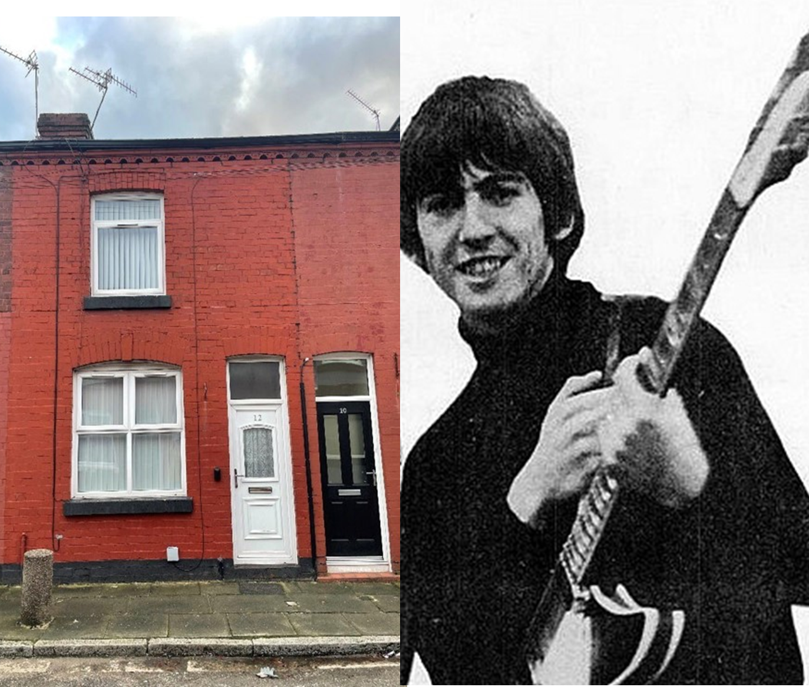
How to use this PPT
With the launch of the National Blue Plaques scheme, run by Historic England, this PowerPoint allows pupils to consider what makes a significant person. Pupils will then use a range of historical sources to find out more about George Harrison, of the Beatles, and 12 Arnold Grove Liverpool, his birthplace and the site of the third blue plaque in Historic England’s scheme. The use of local stories and topics is intended to make the past more relevant, real, accessible, and interesting, though George Harrison may also be considered a nationally and internationally significant figure, making this resource useful for schools across the country.
This PPT is designed to provide you with everything you need to teach your pupils about this topic. ​You will find information and discussion slides, as well as activities to do in class. You can use all, or some of the slides, and can edit them to meet the needs of your pupils.​ You will find additional notes and links to further resources underneath some of the slides.
Notes:
Image 1: Arnold Grove. © Historic England
Image 2: George Harrison, 1964 By EMI. - Billboard page 15 1 May 1965, EMI., © Public domain, via Wikimedia Commons - https://commons.wikimedia.org/w/index.php?curid=78379502

Slide 4
Key Question: How can we celebrate significant people and the places connected to them?
In this session we are going to find out about a local significant person from the past
We will…..
think about what makes someone from the past significant
explore what makes this local person significant
find out about an important place connected to this significant person
consider how we can celebrate our local significant person and the place connected to them.

Slide 5
What do we mean by significant?
The dictionary definition of significant is large or important enough to have an effect or to be noticed…

Slide 6
What makes a person historically significant?
Can you think of any significant people that you have learnt about in your lessons?
Did they:
make big changes in their lifetime?
make a lot of people’s lives better or worse?
change the way people think about something?
have a lasting impact on their locality, the country or the world?
set a really good/bad example to people about how to live and behave?
What made them significant?
Think

Slide 7
How can we find out about local significant people?
?
Ask people who might know about them
Use books and the internet to research them
Find buildings and places connected to them….

Slide 8
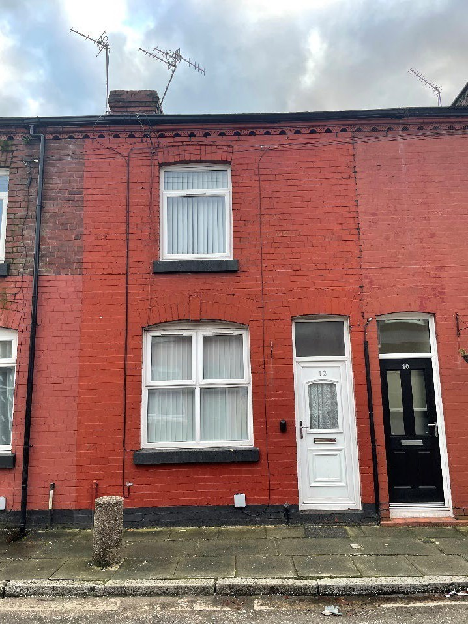
This is 12 Arnold Grove in Wavertree, Liverpool. It is connected to George Harrison; our local, significant person.
Investigate
Find Arnold Grove on Google Maps.
How many miles away is it from your school?
How long would it take you to walk or drive?
Would you say this building is local to your school?
Notes:
Image: Arnold Grove. © Historic England

Slide 9
What can a building tell us?
History detectives!
Complete the inference grid on the next page to explore what this building can tell you…..

Slide 10
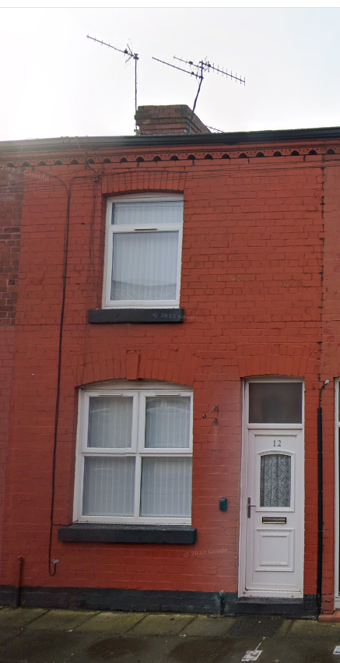
What can this building tell us?
What questions do you want to ask?
What can you infer? (I think…because…)
What can you see?
Notes:
Image: © Google Maps 2024

Slide 11
What can this building tell us?
(I think….because)
Notes:
Image: © Google Maps 2024

Slide 12
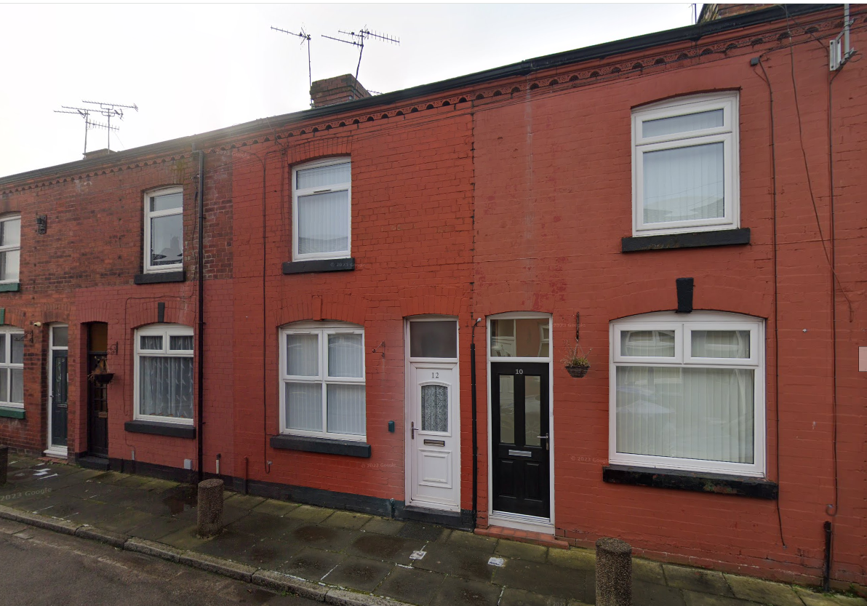
12 Arnold Grove
This is 12 Arnold Grove.
12 Arnold Grove looks like an ordinary terraced house, on an ordinary street in Liverpool.
But it is actually very special….
Terraced House - One of a row of three or more houses joined together.
Notes:
Basic info about types of house here https://www.primaryhomeworkhelp.co.uk/houses/modern.htm
Built 1890s
Image: © Google Maps 2024

Slide 13
12 Arnold Grove, Wavertree Liverpool
12 Arnold Grove was the childhood home of George Harrison.
He lived there from when he was born, on 25 February 1943, until he was 6 years old
Do you know anything about him?
Have you heard of George Harrison?
Arnold Grove in 1948
Notes:
Image: Source: Historic England Archive (Authorised use only) Ref: raf_13h_uk789_v_031 Date: 11 June 1941
In 1949 the family moved to 25 Upton Green in Speke, Liverpool. The family left Arnold Grove when they reached the top of the council housing list that they had been on for nearly 20 years.
Image: https://www.pinterest.co.uk/pin/296252481724843462/

Slide 14
What makes George Harrison a significant person from the past?
The Beatles:
Most people associate George Harrison with The Beatles. Many people say that The Beatles are one of the most successful and influential music bands of all time!
Ask
Ask a family member, or a teacher, if they know the names of the other Beatles.
Do they have a favourite?
The Beatles in 1964. George Harrison is the one on the right!
Notes:
More information:
https://kids.britannica.com/kids/article/the-Beatles/390013
Image: The Beatles, 1964 By EMI. - Billboard page 15 1 May 1965, EMI., © Public domain, via Wikimedia Commons - https://commons.wikimedia.org/w/index.php?curid=78379502

Slide 15
What makes George Harrison a significant person?
The Beatles:
The Beatles were popular all over the world and lead “the British invasion” of America.
In the 1960s, there was so much excitement about the band that people invented a new word to describe it – Beatlemania!
Over time their music style changed. They were influenced by lots of different music styles and in turn, influenced lots of other musicians.
They are still the best-selling band of all time!
Watch this clip about Beatlemania in Britain and America in the 1960’s. How would you describe it?
Watch this video about the styles of music that The Beatles played. How many are there?
Notes:
Clip about Beatlemania: https://www.youtube.com/watch?v=7mw1D3HTGng
Video about the style of music: https://www.youtube.com/watch?v=gYlE0OeJ7Nw

Slide 16
What else makes George Harrison significant?
Read the statements about George Harrison on the next slide.
Colour code them to show whether they are reasons that he is significant which link to….
His role in the Beatles
His contribution to music after The Beatles split up
His charity work
His involvement in film making

Slide 17
Why was George Harrison significant?
In 1978 GH set up his own film company, Handmade Films.
In 1988 George Harrison, along with other famous musicians Bob Dylan, Jeff Lynne, Tom Petty and Roy Orbison, formed a new “supergroup” called Travelling Wilburys. They sold many albums!
GH was the lead guitarist in the Beatles, but he could also play many other instruments including woodwind instruments like the harmonica and percussion instruments like the African drum.
GH often used his fame to raise money for charity.
GH was often known as “the quiet Beatle” but he made a very important contribution to the band.
GH wrote many successful Beatles songs and occasionally sung them too. Here Comes The Sun is one example.
GH was heavily influenced by Indian culture and music and lead The Beatles to explore this in their music and lifestyles. He introduced the band to the Indian instrument the sitar and encouraged them to do yoga
In 1973 George also set up the Material World Foundation which has raised money to support various charities such as Médicins Sans Frontières and Great Ormond Street Hospital.
Reasons George Harrison is significant which link to….
His role in the Beatles
GH set up the George Harrison Fund for UNICEF which continues to this day, providing support for children in need in Bangladesh and other countries around the world.
In 1971 GH organised the first major charity rock concert. The Concert for Bangladesh was held in New York to raise money for the people of Bangladesh who were suffering due to floods, famine and civil war in their country. Many famous musicians of
the time, took part.
When the Beatles broke up in the 1970s, GH continued to write music. He was the first Beatle to go on a solo tour and the first Beatle to top the singles and albums charts at the same time, as a solo artist.
His contribution to music after The Beatles split up
His charity work
GH’s film company released many famous films such as Monty Python’s Life of Brian and The Long Good Friday.
His involvement in film making

Slide 18
What else makes George Harrison significant?
His role in the Beatles | His charity work
GH was often known as “the quiet Beatle” but he made a very important contribution to the band. GH was the lead guitarist in the Beatles, but he could also play many other instruments including woodwind instruments like the harmonica and percussion instruments like the African drum. GH wrote many successful Beatles songs and occasionally sang them too. Here Comes The Sun is one example. GH was heavily influenced by Indian culture and music and led The Beatles to explore this in their music and lifestyles. He introduced the band to the Indian instrument the sitar and encouraged them to do yoga | GH used his fame to raise money for charity. In 1971 GH organised the first major charity rock concert. The Concert for Bangladesh was held in New York to raise money for the people of Bangladesh who were suffering due to floods, famine and civil war in their country. Many famous musicians of the time, took part. GH set up the George Harrison Fund for UNICEF which continues to this day, providing support for children in need in Bangladesh and other countries around the world. In 1973 George also set up the Material World Foundation which has raised money to support various charities such as Médicins Sans Frontières and Great Ormond Street Hospital.
Notes:
https://www.youtube.com/watch?v=wqvtCv_U8W4
George was known as The Quiet Beatle – He was given the nickname during a tour to the USA where had Strep Throat and had been told by doctors to speak as little as possible. George did appear fairly quiet and serious on stage but he was said to be very witty and found the nickname very amusing!
Throughout his life, George mastered 26 different instruments. His guitar, the sitar, four-string guitar, bass guitar, arp bass, violin, tamboura, dobro, swordmandel, tabla, organ, piano, moog synthesizer, harmonica, autoharp, glockenspiel, vibraphone, xylophone, claves, African drum, conga drum, tympani, ukulele, mandolin, marimba and Jal-Tarang. Rolling Stone magazine ranked George number 11 in their list of the 100 Greatest Guitarists of All Time
George's mother Louise introduced him to Indian music. He learned to play the Indian sitar and featuring the instrument on the Beatles’ Norweigian Wood is said to have opened the floodgates for Indian instrumentation in popular music.
George founded the idea of the fundraiser rock concert. Years before Bob Geldof’s Live Aid, Harrison with Indian sitar Player Ravi Shankar organized the 1971 Concert for Bangladesh at Madison Square Garden, a two part event. He invited massive names to come and play to raise money. Eric Clapton, Bob Dylan, Ringo Starr, Billy Preston, Badfinger and more took part. Profits from sales of the film and soundtrack of the concert continue to benefit the George Harrison Fund for UNICEF.

Slide 19
What else makes George Harrison significant?
His contribution to music after The Beatles split up | His involvement in film making
When the Beatles broke up in the 1970s, GH continued to write music. He was the first Beatle to go on a solo tour and the first Beatle to top the singles and albums charts at the same time, as a solo artist. In 1988 George Harrison, along with other famous musicians Bob Dylan, Jeff Lynne, Tom Petty and Roy Orbison, formed a new “supergroup” called Travelling Wilburys. They sold many albums! | In 1978 GH set up his own film company, Handmade Films. GH’s film company released many famous films such as Monty Python’s Life of Brian and The Long Good Friday.

Slide 20
How do people remember George Harrison?
George Harrison died in 2001, aged 58 years old. This is how some other famous people remember him:
George Harrison was one of the great Liverpudlians. He was a warm, peace-loving man who was more than just a talented musician. He was a deeply thoughtful and caring human being. He was a gentle and considerate member of The Beatles, the most talented group of individuals to come out of Liverpool.
Gerry Scott, former lord mayor of Liverpool
The music and the personalities of the band were the background of our lives. People will be very sad at his death. I think it's worth pointing out that he wasn't just a great musician and artist, he did an immense amount for charity as well, so he will be very, very sadly missed by people right round the world. Former Prime Minister, Tony Blair
George, along with the other three Beatles, really put Liverpool on the map in the 1960s. His name will forever be revered in Liverpool and probably throughout the world. Whenever you tell people, wherever you are in the world, that you come from Liverpool, they always mention, 'Ah, the home of the Beatles’ Bob Wareing, former MP for Liverpool West Derby
I think his most far-reaching effect on both pop music and culture in general was the fact that he introduced the idea that it was possible to take aspects of other cultures and insert them in Western pop. He was somebody who took the sitar, for example, seriously rather than treating it as some sort of fancy guitar. He went to India and studied it [...] and absorbed Indian culture while he was there. Alan Clayson, GH’s biographer
Consider
How do these memories add to your understanding of why George Harrison is a significant person?
Notes:
https://www.udiscovermusic.com/stories/george-harrison-tribute-quotes/#:~:text=%E2%80%9CGeorge%20has%20given%20so%20much,of%20it%20by%20knowing%20him.%E2%80%9D
https://www.theguardian.com/uk/2001/nov/30/thebeatles.music

Slide 21
Think back to what makes a person significant?
Did they:
make big changes in their lifetime?
make a lot of people’s lives better or worse?
change the way people think about something?
have a lasting impact on their locality, the country or the world?
set a really good/bad example to people about how to live and behave?
Why might we describe George Harrison as a significant person?

Slide 22
Why is 12 Arnold Grove a significant place?
12 Arnold Grove is significant because George Harrison lived as a child. It was here that he first became interested in music.
Analyse
We are going to use a number of sources to see what we can find out about 12 Arnold Grove and the surrounding area…..
12 Arnold Grove in 1972.
Courtesy of Liverpool Central Library and Archives.
Notes:
Image: Courtesy of Liverpool Central Library and Archives. 1972 NB: road sign says unadopted. This means that the council don’t have responsibility for things like potholes or street cleaning on the road.

Slide 23
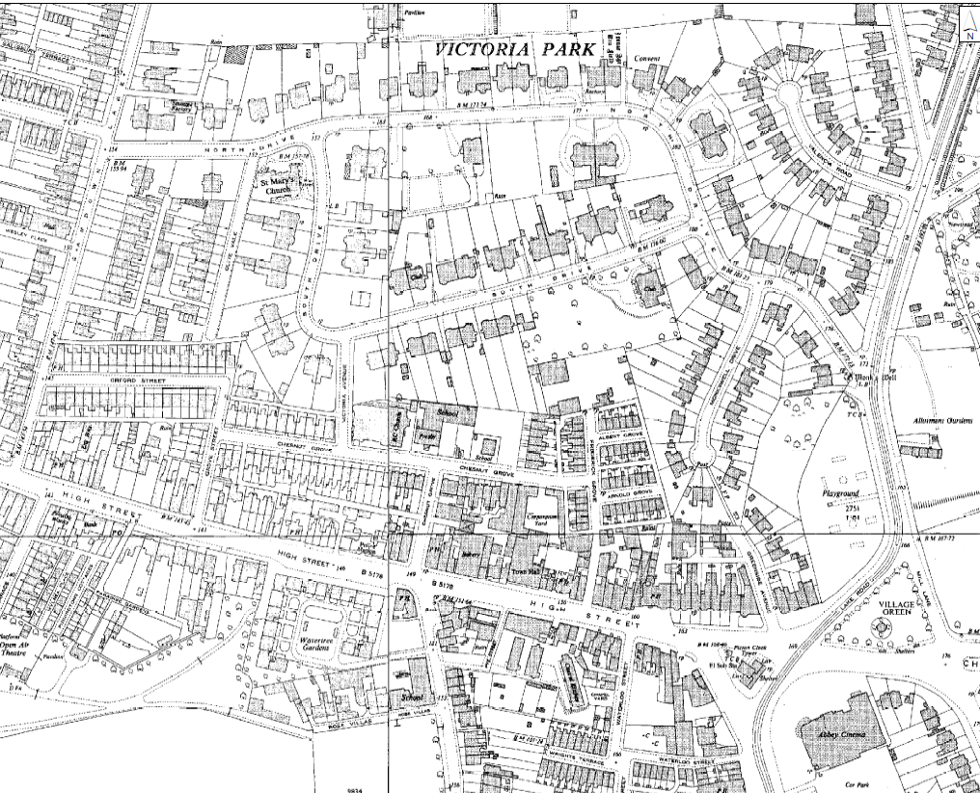
What can old maps tell us about Arnold Grove and the surrounding area?
The houses on Arnold Grove were built in the 1890s. They are almost 150 years old!
Can you find Arnold Grove on the maps provided on the following slides?
Look
When does Arnold Grove first appear on the maps?
Which map is dated closest to the 1940s when George was a child? What was the area like?
1954 map of Arnold Grove and surrounding area
Notes:
See “Maps of Arnold Grove” on Slides 24-29
George’s maternal grandparents, John French (1870–1937) and Louise French, née Woollam (1879–1948), lived in the adjacent road – initially at 11 Albert Grove and then at 9 Albert Grove from 1912 until their deaths, while George’s father had lived in Wavertree streets including Wellington Grove and Ash Grove.
Harrison’s seven years at no. 12 were happy ones, which he remembered with characteristic humour as a period of ‘relatives and absolutes’. It has already been noted that Harrison had many family connections with the Wavertree area – his mother lived in the adjacent street, Albert Grove, from her birth in 1911 until her marriage in 1931, and George regularly visited his grandmother at 9 Albert Grove until her death in 1948, using an alley which joined the two roads on the east. No. 12 Arnold Grove is the Liverpool house associated with George’s own family for the longest period of time (around 16 years, in all, from c. 1934 to 1950).
All the Harrison children were raised Catholic, and though George later moved away from organised religion, during the time he lived at Arnold Grove and in Speke he regularly attended services at the Our Lady of Good Help church on Chestnut Grove (where George was baptised and later confirmed).
It is notable that it is situated less than four miles from Lennon’s house on Menlove Avenue and less than three from McCartney’s former home in Forthlin Road,
Nb. George grew up during and in the aftermath of WW2 – Liverpool was heavily bomb damaged, there was the fear of more bombs, rationing etc. https://beatlesliverpoollocations.blogspot.com/2017/03/i-remember-arnold.html

Slide 24
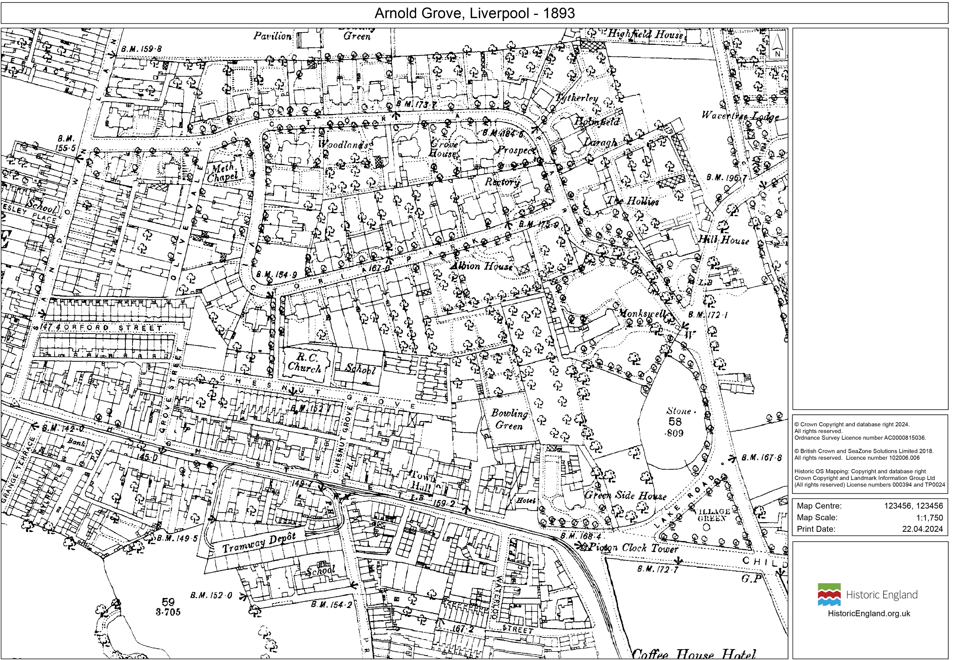
Arnold Grove 1893
Notes:
© Crown Copyright and database right 2024
All rights reserved.
Ordnance Survey Licence number AC0000815036.

Slide 25
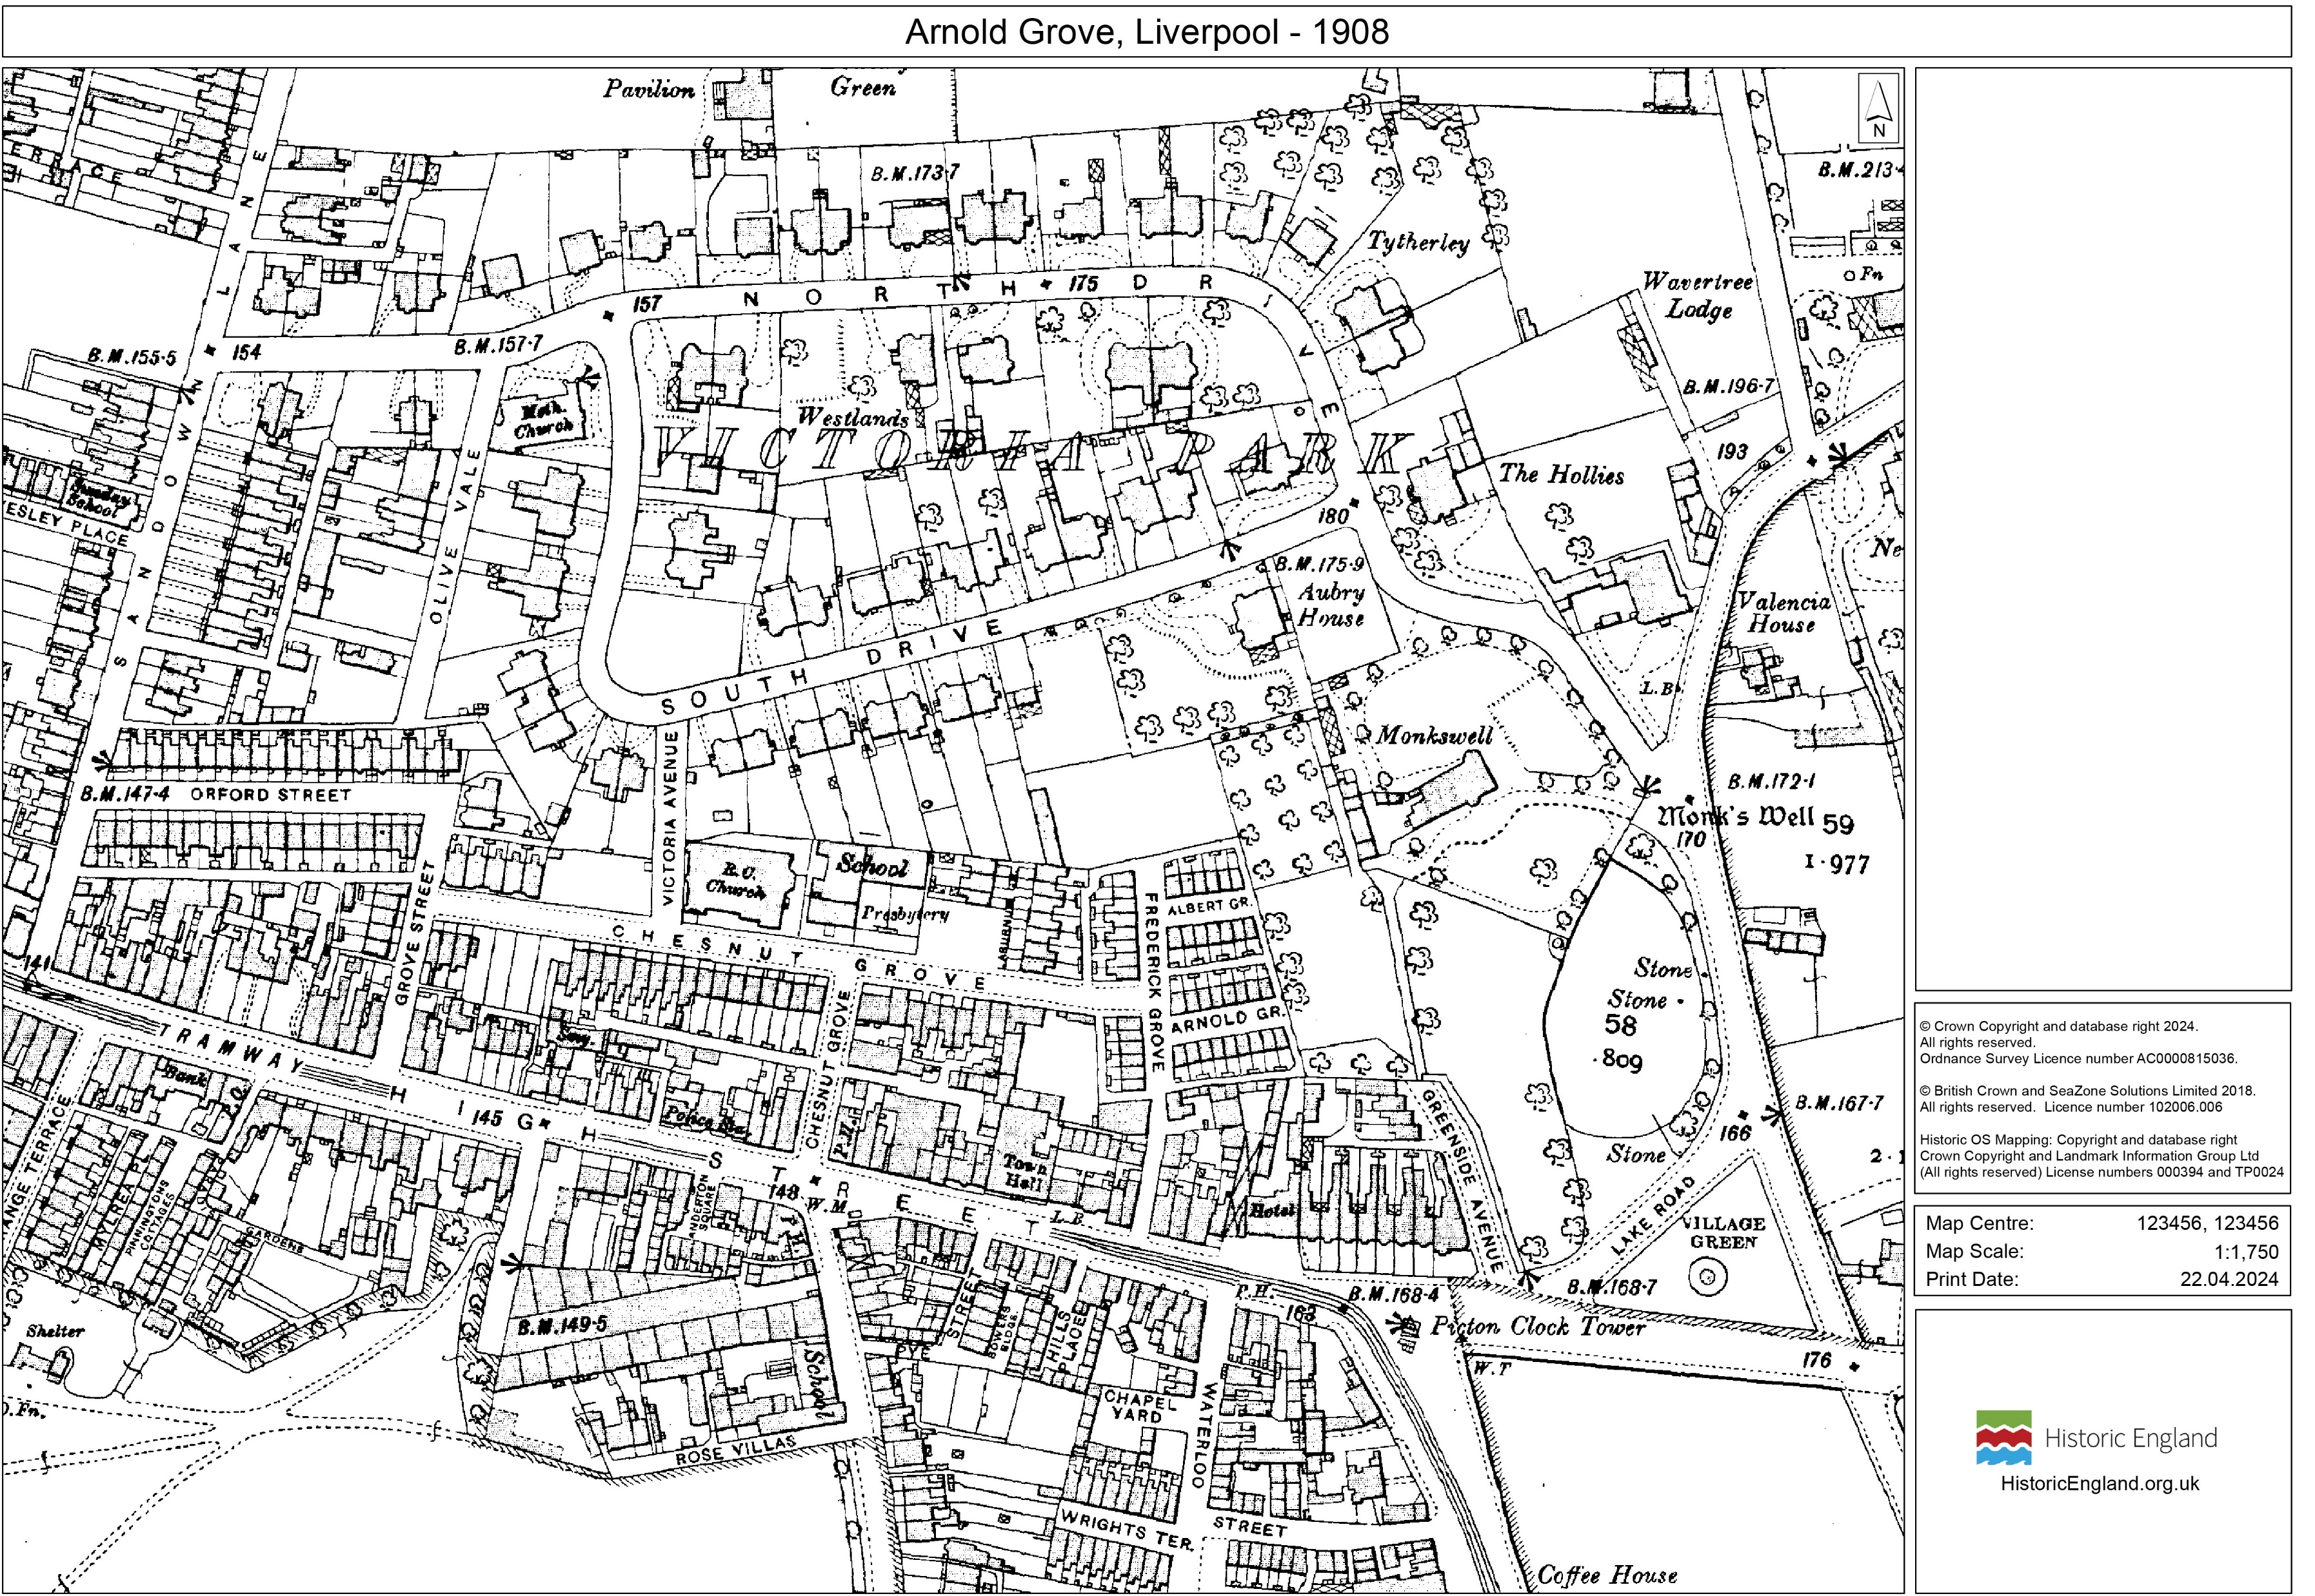
Arnold Grove 1908
Notes:
© Crown Copyright and database right 2024
All rights reserved.
Ordnance Survey Licence number AC0000815036.

Slide 26
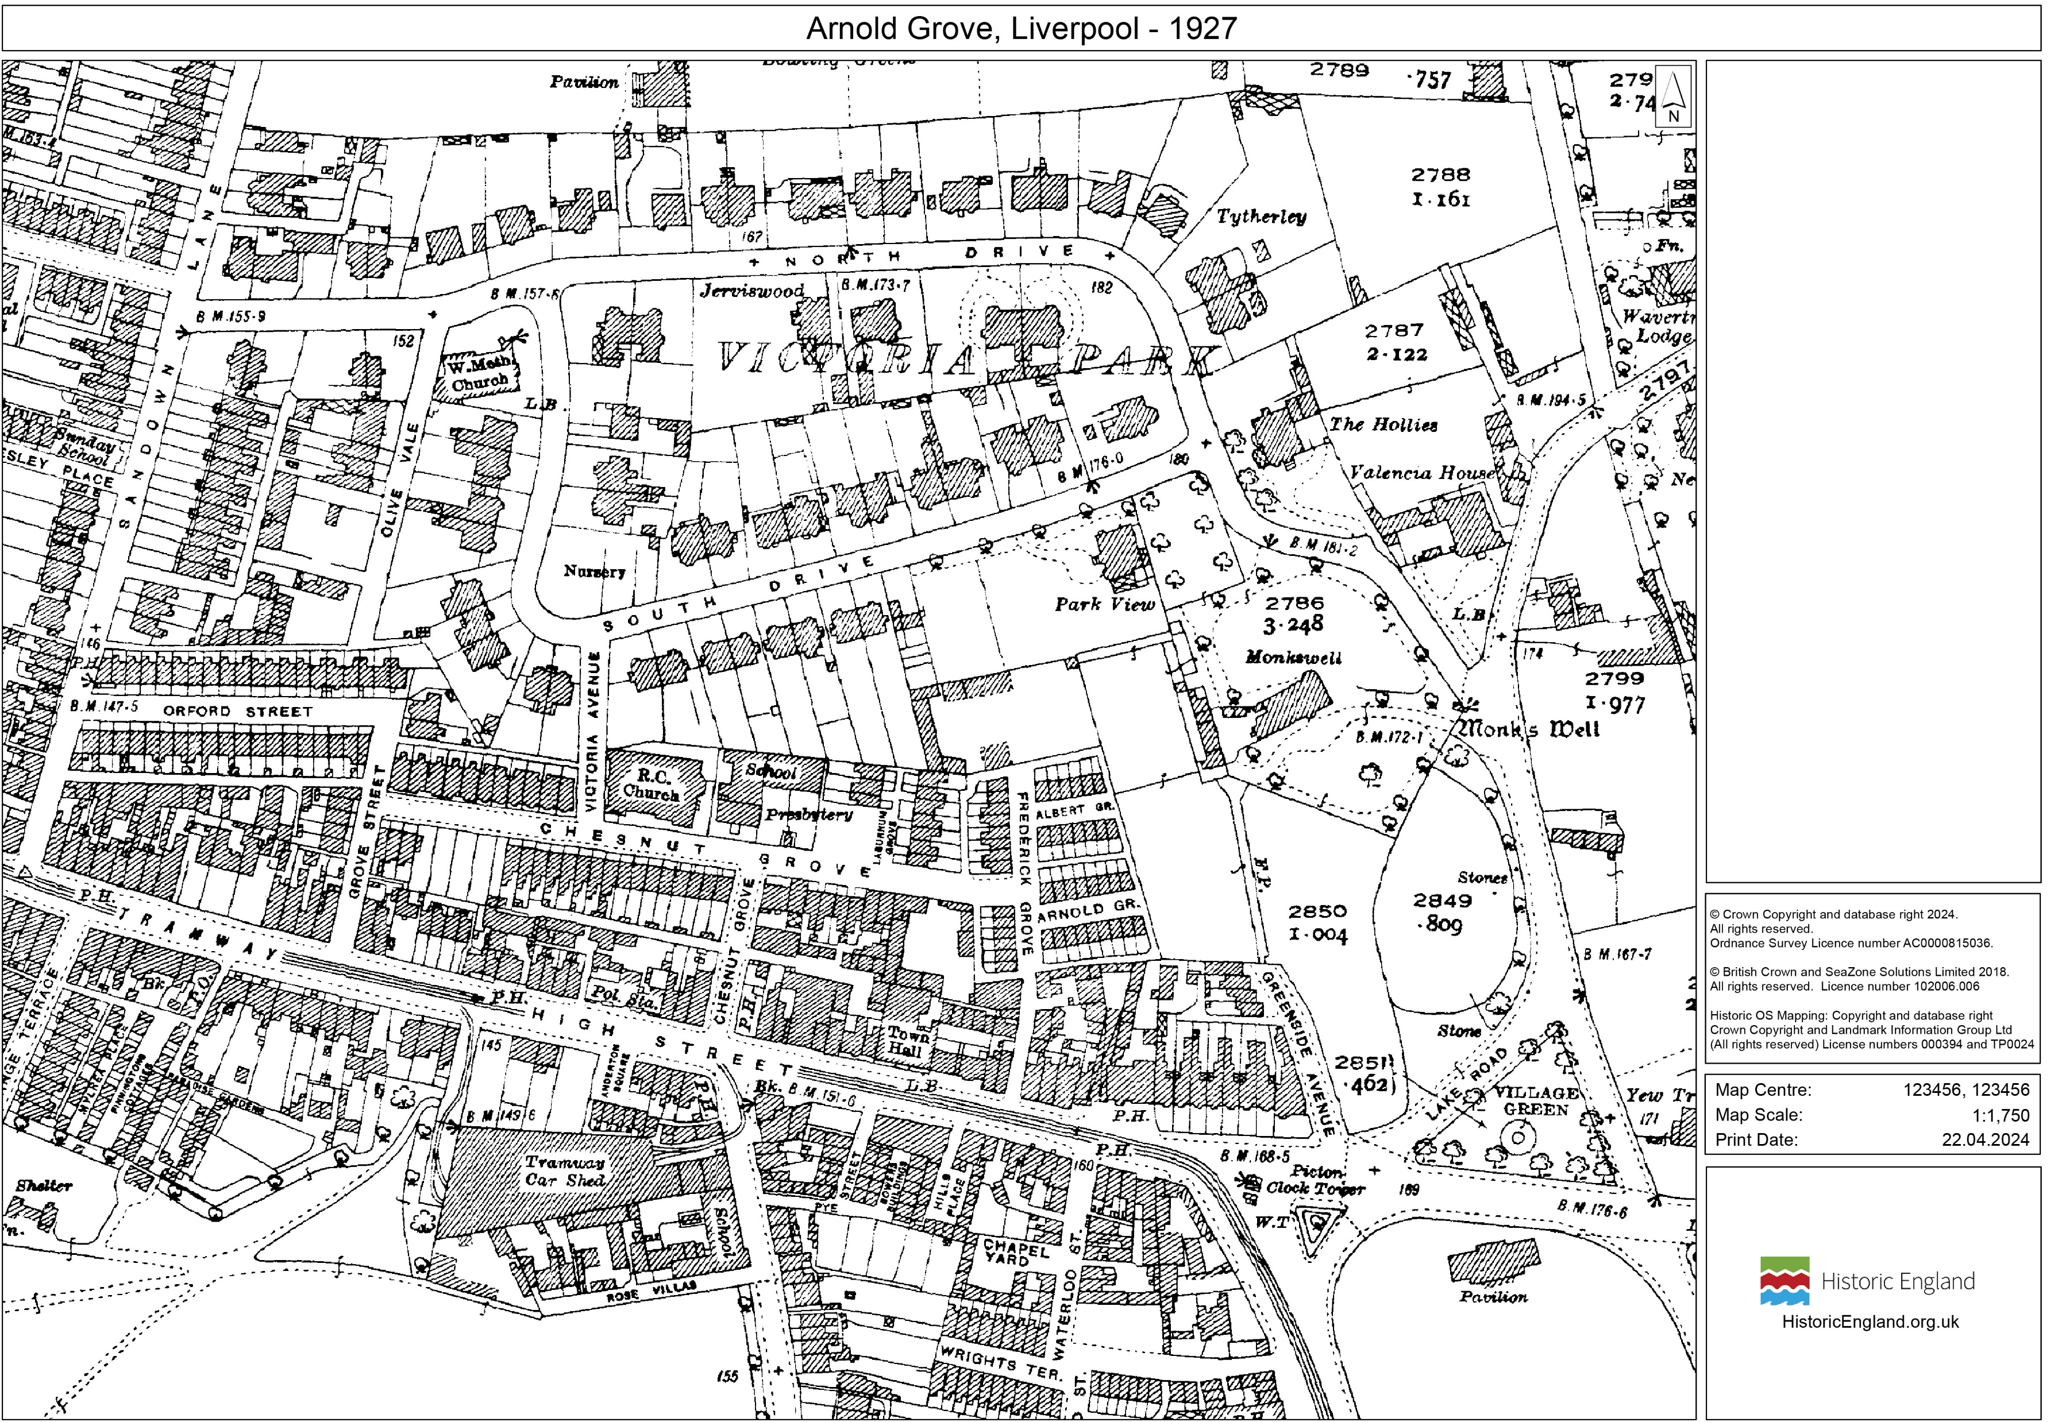
Arnold Grove 1927
Notes:
© Crown Copyright and database right 2024
All rights reserved.
Ordnance Survey Licence number AC0000815036.

Slide 27
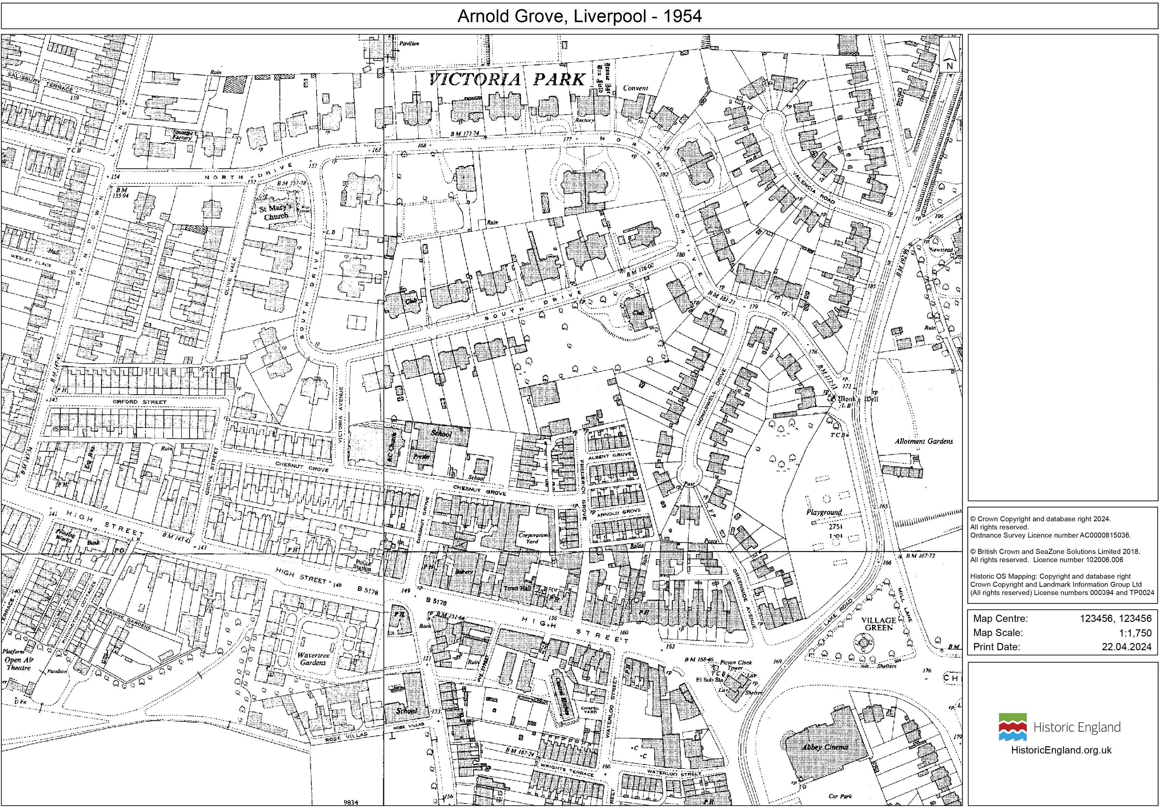
Arnold Grove 1954
Notes:
© Crown Copyright and database right 2024
All rights reserved.
Ordnance Survey Licence number AC0000815036.

Slide 28
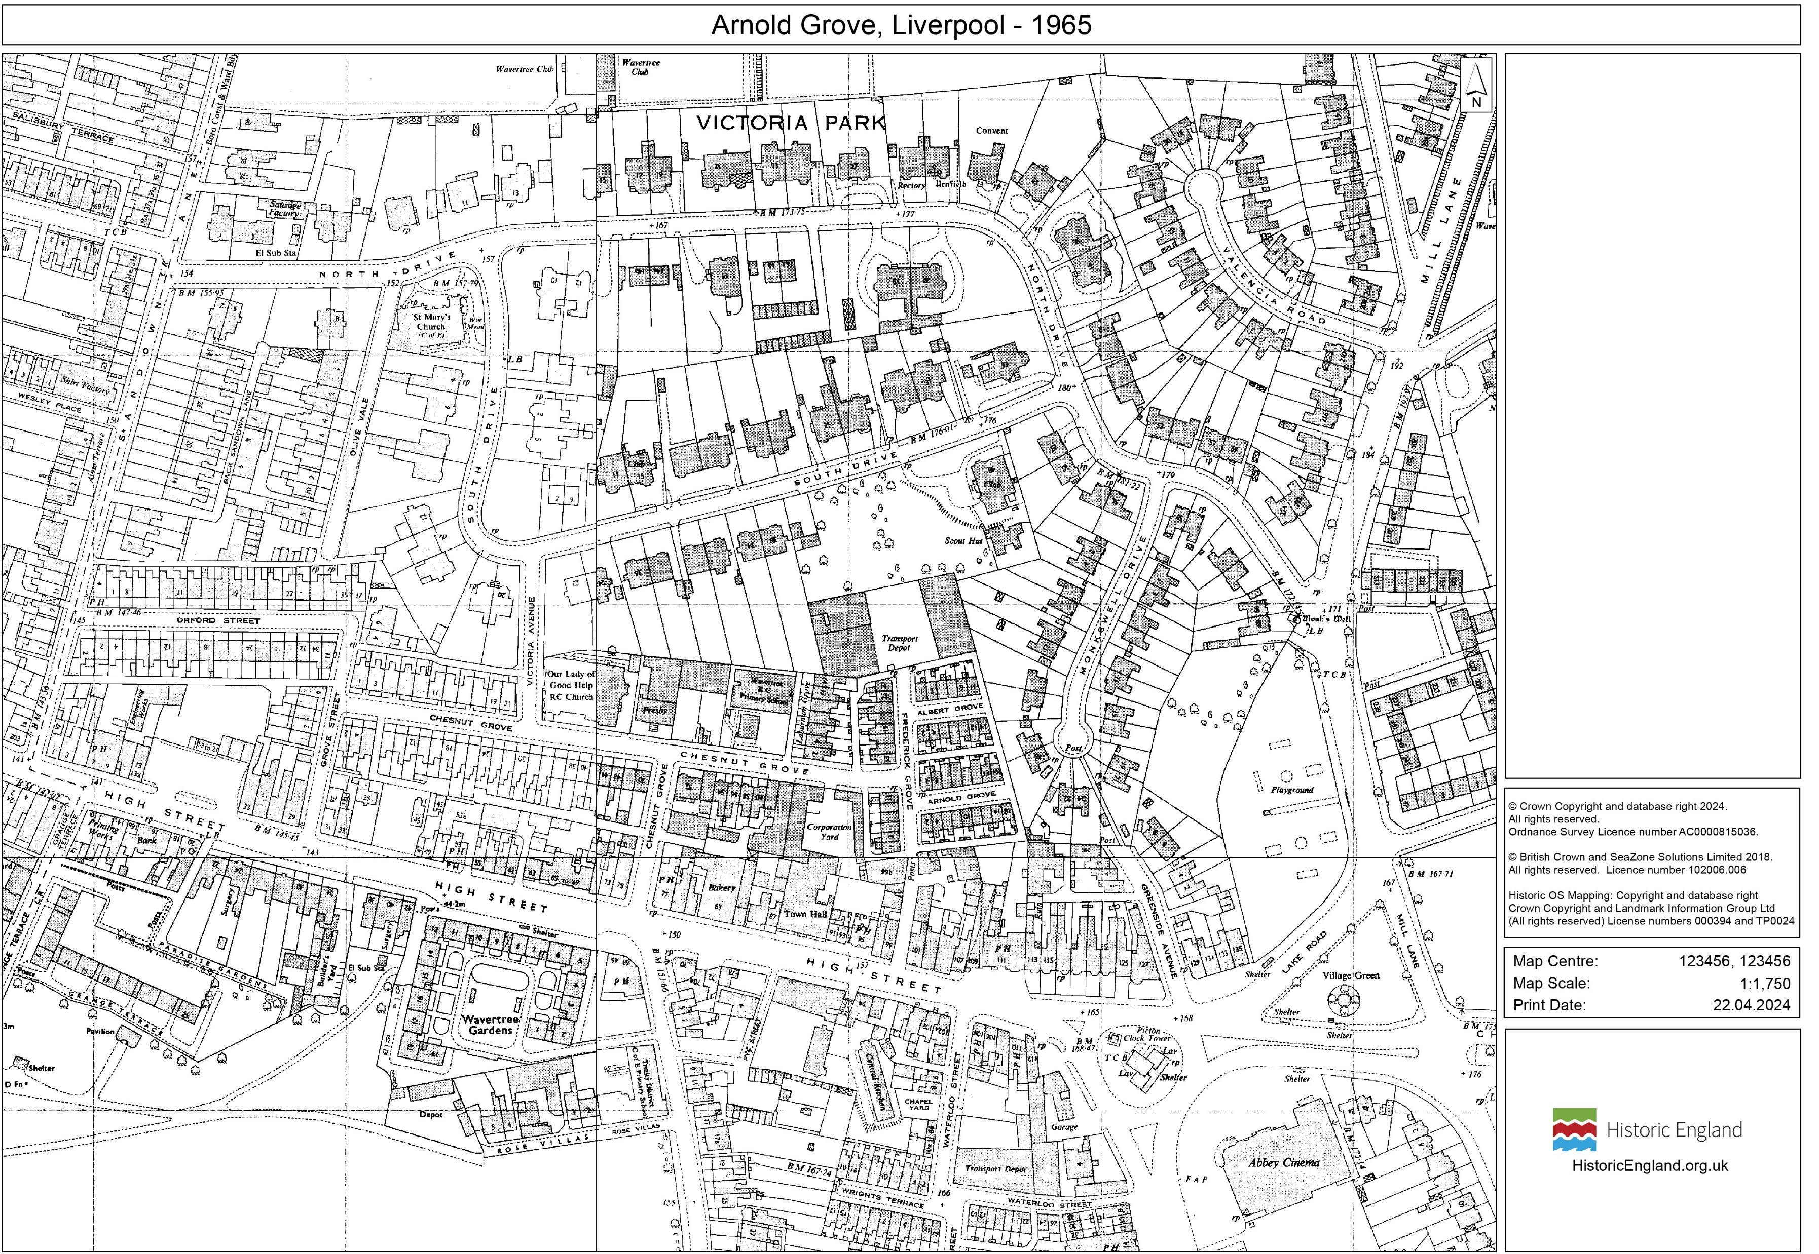
Arnold Grove 1965
Notes:
© Crown Copyright and database right 2024
All rights reserved.
Ordnance Survey Licence number AC0000815036.

Slide 29
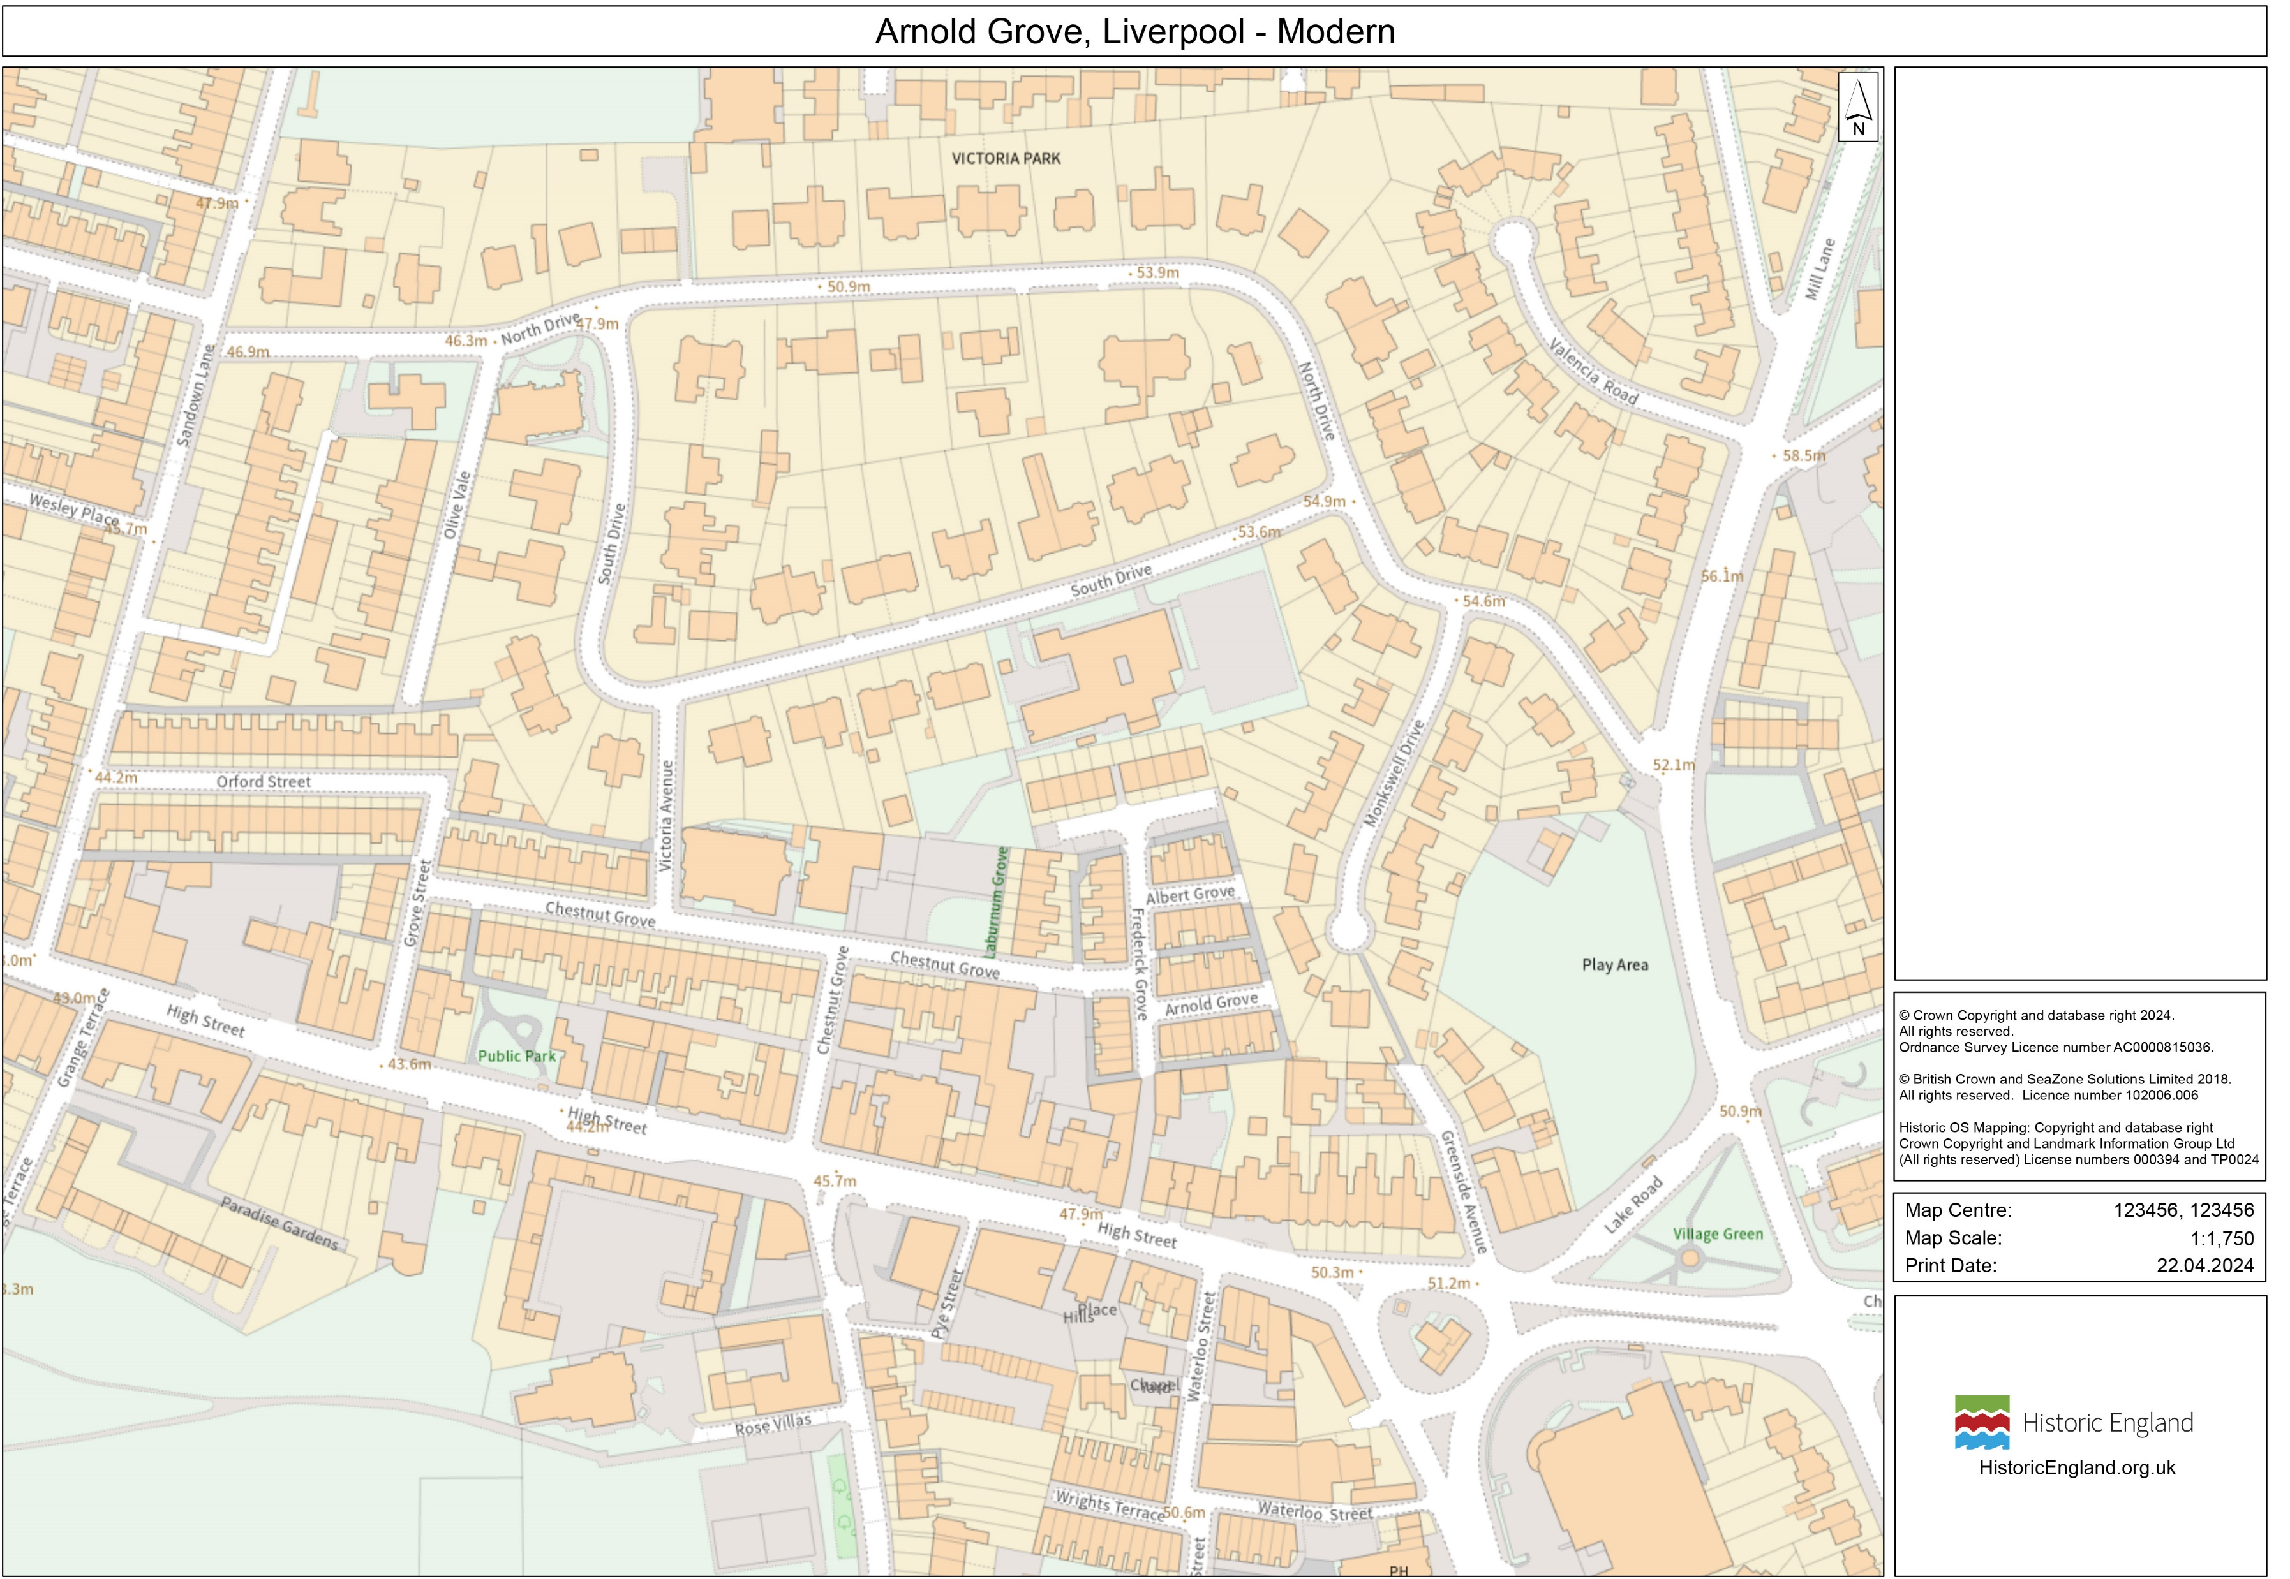
Arnold Grove Present Day
Notes:
© Crown Copyright and database right 2024
All rights reserved.
Ordnance Survey Licence number AC0000815036.

Slide 30
What can the 1939 Register tell us about 12 Arnold Grove when the Harrison family lived there?
George’s parents Harold and Louise moved into 12 Arnold Grove in 1934. They lived there until George was about six years old.
The 1939 Register was a survey of all the people living in Britain in 1939, on the eve of what would become the Second World War.
It was a bit like a census. It recorded the names of everyone living in each household, how old they were and what job they did.
Extract from 1939 Register for some of the houses on Arnold Grove
Examine
Notes:
1939 Register record is held by Find My Past
GH father, Harold, was a former ship's steward with the White Star Line, who came ashore in 1936 and found work 'on the buses': firstly as a conductor, then as a driver. His mother Louise (née French) came from a large, close-knit family of Irish origin. She was a Roman Catholic, but Harold was not. Louise's mother lived in Albert Grove, just around the corner from the Harrison's house, and George recalled regularly slipping out of the back door and along the 'jiggers' to visit his grandmother.
George also had one sister, Louise (16 August 1931 – 29 January 2023), and two brothers, Harold (born 1934) and Peter (20 July 1940 – 1 June 2007). There are two redacted (blacked out) entries on the 1939 register underneath Harold and Louise. These may be the entries for Louise and Harold junior who would have been born by this time.
Redacted entries: While searching you'll notice that some records are marked as 'officially closed'. This is down to privacy regulations preventing us from publishing records of anyone born less than 100 years ago and still alive. The Register was updated until 1991, meaning the record of anyone who died after 1991 might still be closed. https://www.findmypast.co.uk/blog/family-records/10-tips-for-searching

Slide 31
Extract from 1939 Register showing some of the houses on Arnold Grove
Can you find 12 Arnold Grove?
What can you find out about George’s family in 1939?
Why isn’t George listed?
Notes:
1939 Register record is held by Find My Past

Slide 32
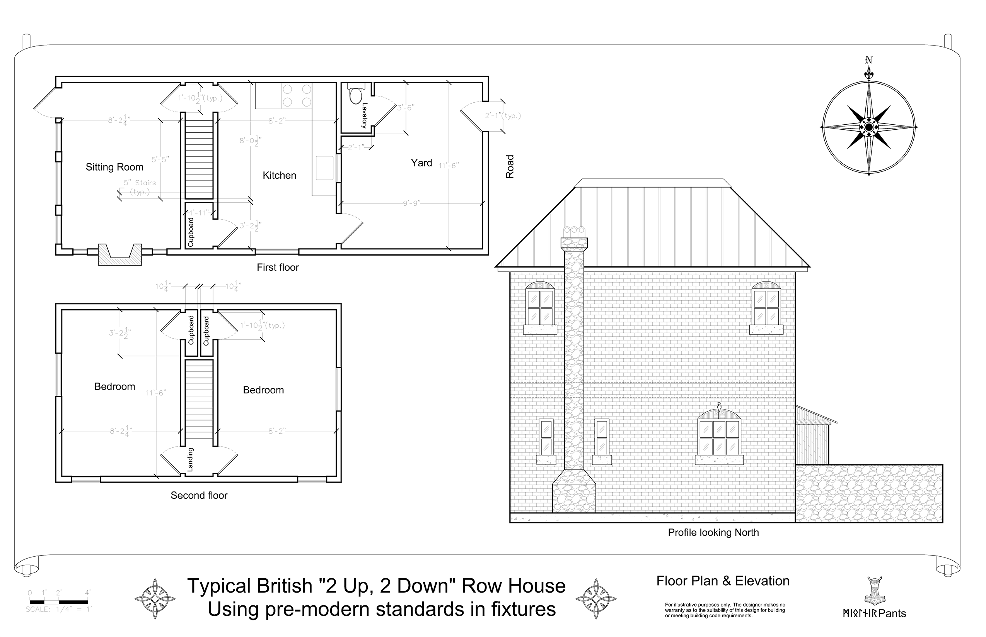
What can a diagram of a two up two down house tell us about what it was like to live on Arnold Grove when George Harrison was a child?
12 Arnold Grove was a two-up, two-down terraced house. The family rented the house. The rent was ten shillings a week.
Examine the diagram of a typical two up two down house on the next slide:
What does the diagram tell you about Arnold Grove?
How is this house similar and different to your house?
Can you spot any rooms that are missing?
Do you think George had his own bedroom?
Front door
Consider
Notes:
See “Cross Section of Two Up Two Down” on next slide
By MjolnirPants - Drawn in AutoCAD civil 2016, Public Domain, https://en.wikipedia.org/w/index.php?curid=58395775

Slide 33
Diagram of a typical two up two down house
What does the diagram tell you about Arnold Grove?
How is this house similar and different to your house?
Can you spot any rooms that are missing?
Do you think George had his own bedroom?
Notes:
By MjolnirPants - Drawn in AutoCAD civil 2016, Public Domain, https://en.wikipedia.org/w/index.php?curid=58395775

Slide 34
What can George and his family tell us about what it life on Arnold Grove when he was a child?
George Harrison often spoke about his time at Arnold Grove and in his 1980 auto biography, I, Me, Mine, he described the home. Other members of his family also have memoires of the house.
On the next slide you will find some of these memories.
In one colour underline information which helps you to understand what his home looked like.
In another colour underline information which helps you to understand how he, and others, felt about Arnold Grove.
Underline
Front cover of I, Me, Mine
Notes:
Image: © Alamy Ref: 2CHC6A8 Date: 15 June 2017
https://beatlesdaily.com/2017/03/24/george-harrisons-childhood-memories
https://beatlesliverpoollocations.blogspot.com/2017/03/i-remember-arnold.html
I, Me, Mine. George Harrison

Slide 35
Memories of Arnold Grove
Information which helps you to understand what his home looked like.
Information which helps you to understand how he, and others, felt about Arnold Grove.
The house was heated by a single coal fire in the kitchen and had a paved yard, where the family kept chickens and a zinc bath tub.
‘To look at, it is just like ‘Coronation Street’: no garden, door straight on to the street …an alley at the back… It was OK that house, very pleasant being little and it was always sunny in summer’.
Harrison’s sister-in- law Irene recalled that George’s parents were ‘so warm and brought you into everything. To go into their house was great’
“Our house was very small. Two up and two down – step straight in off the pavement, step right out of the backroom. The front room was never used. It had the posh lino and a three piece suite, was freezing cold and nobody ever went in it, we’d all huddled together in the kitchen, where the fire was, with the kettle on, and a little iron cooking stove.”
Pride of place in the front room, which the Harrisons kept ‘for best’ was a leather three piece suite (sofa) which Harry had arranged to have shipped back from America. A leather sofa was unheard of in Wavertree in those days and yet the Harrisons barely used it. The family lived in the back room, the kitchen with its red and blue floor tiles and a fire in the grate.
Inside, it was small but homely: on the ground floor there was a front sitting room (used only ‘for best’) and a rear kitchen (the hub of the house), while upstairs there were two bedrooms.
“My earliest recollection is of sitting on a pot at the top of the stairs, having a poop – shouting ‘finished!’”
Notes:
https://beatlesdaily.com/2017/03/24/george-harrisons-childhood-memories
https://beatlesliverpoollocations.blogspot.com/2017/03/i-remember-arnold.html
I, Me, Mine. George Harrison

Slide 36
How do we remember and celebrate significant people?

Slide 37
A Blue Plaque to George Harrison
Daphne’s plaque
We have learnt all about why George Harrison, and 12 Arnold Grove, are historically significant. To mark and celebrate George and his birthplace, on 24 May 2024, a blue plaque was placed on the wall outside 12 Arnold Grove.
What is a blue plaque?
Blue plaques are placed on buildings connected to significant people. Until 2024 there was an “official” Blue Plaque Scheme, which ran in London. Local councils and organisations also ran their own schemes. In Feb 2024 Historic England took responsibility for a national blue plaque scheme. Their plan is to place blue plaques across the country to celebrate “people throughout history who have made significant and positive contributions to human welfare or happiness.”
Daphne holding a baby
Notes:
Images from HE website

Slide 38
Why 12 Arnold Grove here?
The blue plaque on the external wall of 12 Arnold Grove is only the third blue plaque to be placed as part of Historic England’s new scheme!
Historic England say that blue plaques should be placed on buildings that “have had a significant influence in forming (a person’s) character or shaping their activities”.
Think
Why might you say that 12 Arnold Grove meets that description?
Notes:
Image: Arnold Grove. © Historic England
Other blue plaques are to Daphne Steele in Ilkley, West Yorkshire and Clarice Cliffe in Stoke on Trent
Of Harrison’s three Liverpool homes, one stands out clearly for commemoration: 12 Arnold Grove, Wavertree. Places of birth and death are always considered particularly significant when assessing plaque locations, and for Harrison – whose interest in spiritualism and karma is well known – the associations of 12 Arnold Grove were particularly poignant. In his book I Me Mine, George wrote of revisiting no. 12 with his wife Olivia and sitting outside ‘imagining 1943, nipping through from the spiritual world, the astral level, getting back into a body in that house. That really is strange when you consider the whole planet, and all the planets there may be on the physical level … how do I come to that family in that house at that time and who am I anyway?’. Harrison’s seven years at no. 12 were happy ones, which he remembered with characteristic humour as a period of ‘relatives and absolutes’. It has already been noted that Harrison had many family connections with the Wavertree area – his mother lived in the adjacent street, Albert Grove, from her birth in 1911 until her marriage in 1931, and George regularly visited his grandmother at 9 Albert Grove until her death in 1948, using an alley which joined the two roads on the east. No. 12 Arnold Grove is the Liverpool house associated with George’s own family for the longest period of time (around 16 years, in all, from c. 1934 to 1950).
George’s years at no. 12 saw his earliest interest in music, encouraged by his parents; he later recalled standing on a chair singing along with the songs he heard on the radio or played on his dad’s record player. George and his brother Peter ‘would play anything’ but strong influences of this time included Hoagy Carmichael. All the Harrison children were raised Catholic, and though George later moved away from organised religion, during the time he lived at Arnold Grove and in Speke he regularly attended services at the Our Lady of Good Help church on Chestnut Grove (where George was baptised and later confirmed). This strong sense of place meets the criteria of the Historic England plaques scheme, which states that a person should represent or have contributed to ‘the story of a place’, and that such a place should have had a significant influence in forming their character or shaping their activities. An interesting titbit of information has been relayed by Beatles tour guide Jay Johnson: it has long been a practice for stars staying at hotels to use pseudonyms at check in, to avoid identification by fans; Harrison apparently checked into hotels under the name ‘Arnold Grove

Slide 39
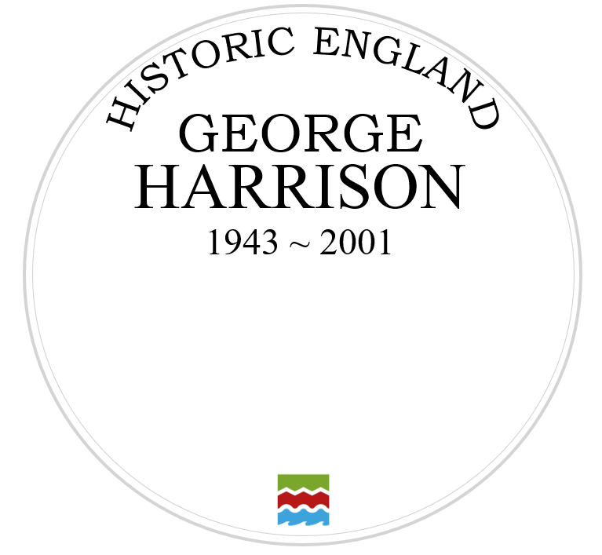
Your Task
On the template you have been given, design your own plaque celebrating why George Harrison is such a significant person. Make sure you….
1) Complete the sentence:
George Harrison is significant because….
You might like to write one or a couple of sentences.
Write
2) Draw a picture to illustrate your plaque. You might like to draw the inside or outside of Arnold Grove, using the descriptions from the previous slides for inspiration!
Draw

Slide 40
George Harrison Plaque

