Slide 1
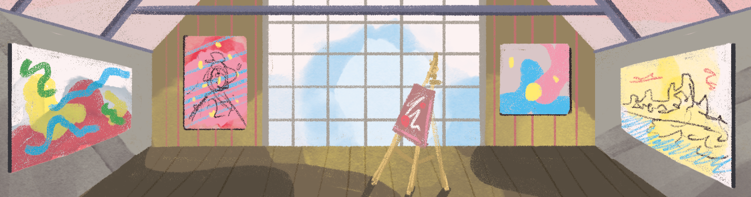
How school children can help with the Missing Pieces Project!
Notes:
All photos ©Historic England

Slide 2
What is the Missing Pieces Project?
Pigsty from early 1800s
The Missing Pieces Project is Historic England’s invitation to the public to share their pictures and stories of the unique, significant, and memorable places on the National Heritage List for England.
The Heritage List has almost 400,000 entries including everything from palaces and plague-crosses, piers and pig sties, cathedrals, windmills and fairground rides.
Scenic Railway (Rollercoaster) built in 1920 at Dreamland
Notes:
Image 1 – Pigsty from early 1800s, Rothley, Northumberland.
Image 2 – Scenic Railway (Rollercoaster) built in 1920 at Dreamland, Margate, Kent. It is the oldest surviving roller coaster in Britain and the second oldest in Europe.

Slide 10
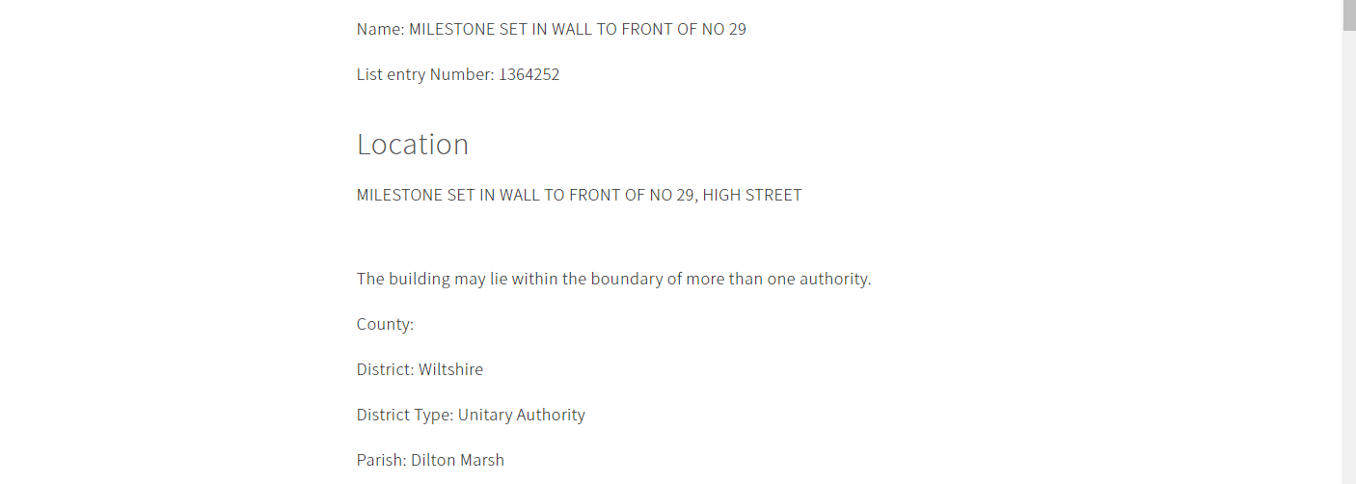
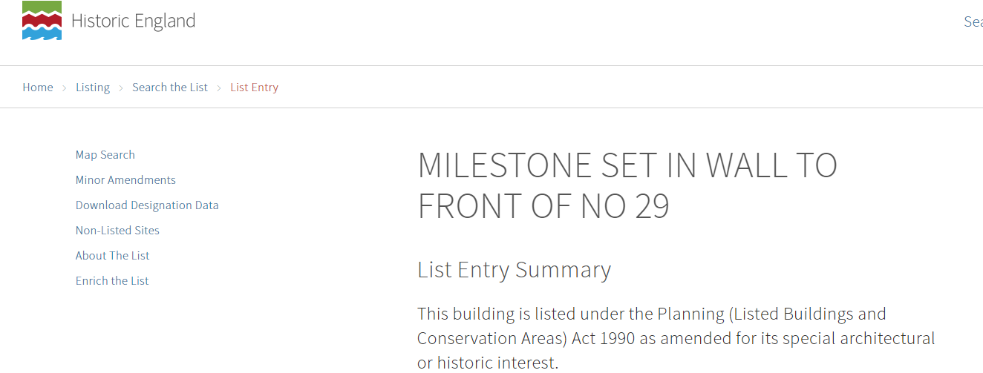
Help us find the missing pieces!
You can help
All over England are listed places with stories to tell: from buildings to battlefields, some on your doorstep, others just a day trip away. You can help us to add missing pieces to their stories.
Notes:
Use the 3 fly-in images to show the kind of thing you get on the website – and explain that ‘yes’ it does look a little intimidating/worthy – which is exactly why we want people to help bring it to life! There is currently a map to help you find the ‘listed’ building, but no photos of exactly what it looks like.

Slide 11
Help us find the missing pieces!
Every snapshot and story you add to the Missing Pieces Project is an important piece of the picture. And the more pieces of the picture we have, the better we can protect what makes these places special.
Missing Pieces

Slide 12
A missing piece that’s been added
Look
Notes:
A missing piece of the picture could be as simple as adding a photo and a few words of text. Obviously if you wanted to do/add more that’s fine too!

Slide 13
How you can join in
Get started in 3 easy steps!
Register
Use the Map Search & enter your school’s postcode to find your nearest Listing Building
Go out & visit it, take a photo and upload it.
Step 1
Step 2
Step 3
Go even further and make a whole class project about your local Listed Buildings!
AA Box in Porlock, Somerset
Notes:
Image:AA Box in Porlock, Somerset
This AA roadside assistance box is of the 1956-type. The AA was formed in 1905 to combat police persecution of early motorists – a group of cycle 'scouts' was established to patrol some of the most frequently travelled roads of the day. The scouts' role was to warn AA members of police speed traps ahead! The scouts were based in boxes such as this one.
Encourage pupils to become heritage ‘scouts’?

Slide 14
Register
Step 1
Notes:
Users must be over 16, so for younger pupils it would be up to the teacher/LSA to register.
It takes 5-10 minutes. Once registered you can e-mail EnrichingTheList@HistoricEngland.org.uk and ask them to change the name displayed on screen from your own to the name of your school/class if you want to – so that the pupils can see the work they’ve done. It means that when you upload an image/post a comment it’ll say Class 4, St Peter’s School etc., not Sarah Smith or who ever the person who registered is. It’s not essential, but might make it more rewarding for pupils and also in promoting the work to parents and governors too.

Slide 15
Use the Map Search
Step 2
Enter your school’s postcode to find listed places near you
https://historicengland.org.uk/listing/the-list/map-search
Notes:
Put in the postcode, hit search. Everything ‘listed’ will show up as a BLUE TRIANGLE – zoom in or out to find the nearest ones to your school.
Then click on any/all of them to see what they are – as in this case it may be the school itself is actually listed!

Slide 16
Use the Map Search
Step 2
Notes:
In this example there are 7 ‘listed’ places around the school

Slide 17
Use the Map Search
Step 2
Click on ‘View List Entry’
Notes:
When you click on a triangle to get a summary box – click on View List Entry to find out more

Slide 18
View Entry
Step 2
Click on ‘Comments and Photos’ to add to the list entry

Slide 19
Add comments and photos
Step 3
Sign in

Slide 20
Add comments and photos
Step 3
Enter your details or create an account

Slide 21
Add comments and photos
Step 3
Click on this button to add your comments, photos or videos

Slide 22
Think about what you want to post
Step 3
Think
Add comments (up to a maximum of 1000 characters) – try to be concise, relevant and friendly.
Add images (maximum of 4 per post)
Try not to include people’s faces, car licence plates etc. and make sure you’ve taken the photo standing on public land (the pavement).

Slide 23
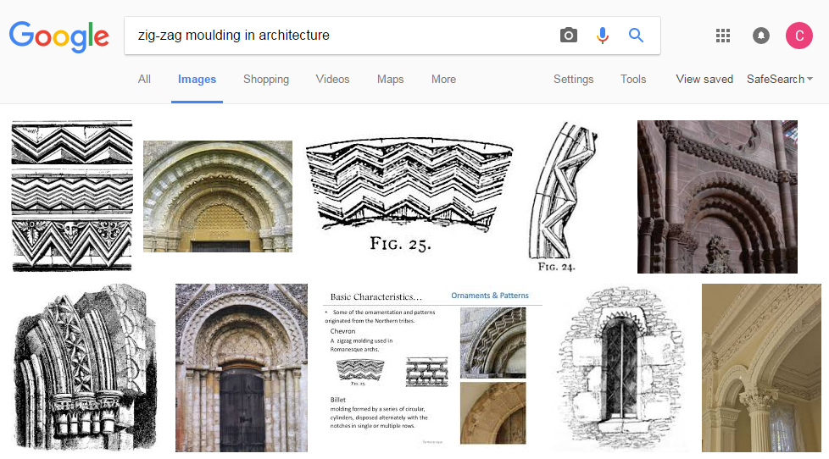
Think about what you want to post
Step 3
Notes:
As well as the whole building why not pick out some features that are mentioned in the ‘Details Section’ – although the architectural terms can look a little complicated, a quick search for images using a term is really helpful!

Slide 24
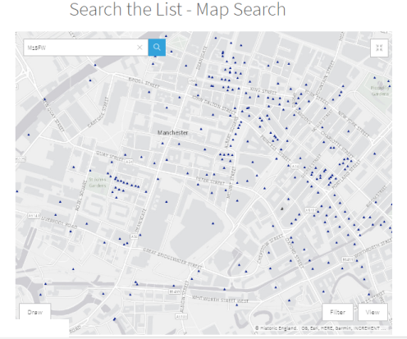
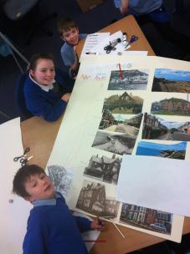
Adding missing pieces with your pupils
Activity idea
Create a heritage trail from a selection of listed buildings in your town/around your school
Take photos and see if the pupils can identify the buildings
Notes:
Once you’ve registered and ready to go there are many others ways you can use The List with your pupils. A heritage trail is great way to show pupils about their local heritage.

Slide 25
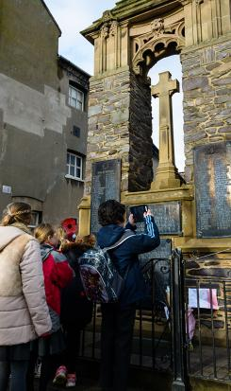
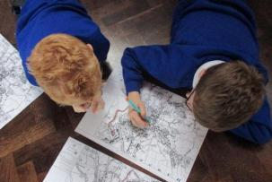
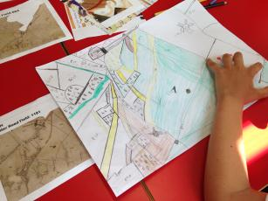
Ask pupils to take photos and create their own maps
Activity idea
Notes:
Set the challenge – here’s the map with a blue triangle marking a listed building – can we find a photograph it? Their own photos can then be uploaded to The Missing Pieces Project.

Slide 26
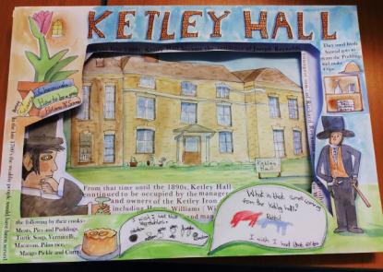
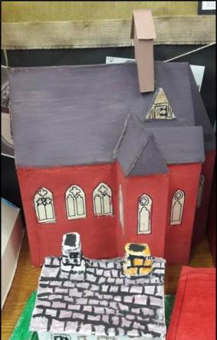
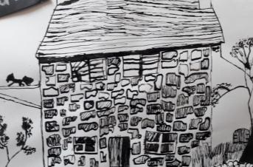
Ask pupils to draw, paint or make models of buildings
Activity idea
Scan or photograph them, and upload them to a List Entry to add missing pieces
Notes:
Once pupils have seen some of their local listed buildings ask them to pick their favourite. They can then draw it, paint it or even make a model of it. Photos or scans of their work can then be uploaded to The Missing Pieces Project – it doesn’t just have to be photographs of the listed building.

Slide 27
Provide some information about the building too
Ask the children to write statements about:
Why I like this building
What this building means to me
Why this building is important to where I live
Why should this building be protected
Write
Notes:
For younger pupils simply taking a photo or doing a piece of art work is plenty to add missing pieces of the picture. For older pupils however you might like to consider adding some additional information as well as just images. Above are just a few suggestions of how pupils might think about doing this.

Slide 28
Summary Notes
You must be over 16 years old to register to the Missing Pieces Project, so an adult must upload information on behalf of younger children
Once you have registered you will receive an email. You can reply to this email and request that your ‘contribution name’ (which will be your name) is replaced by your school/class name
e.g.
Instead of Contribution by : ‘Jenny Walker’ – change to ‘Cavendish Primary Y5’
You can only upload 1000 characters of text per listed building/structure, so it’s best to copy and paste text from Word and do a ‘word count’ – to check the number of characters
Adding the pupil's initials (or just first name) with their age to their statement/comments will help promote Pupil Voice e.g.
“The Town Hall is important to me because I visit it with my Gran’’. L Jones aged 10
Four images per list entry - so consider pupils working in groups on different buildings

Slide 29
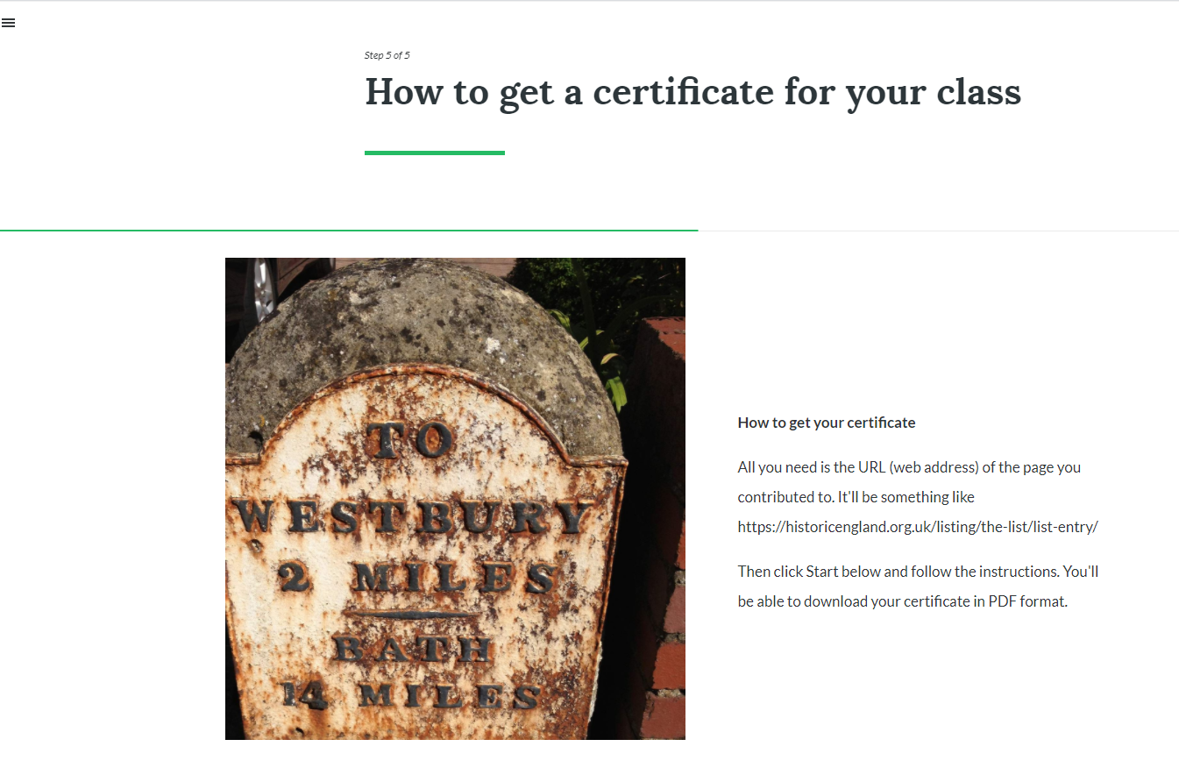
Use our online resource to create a certificate for your class
https://rise.articulate.com/share/rXVeNXtjhDqFnZ_YHTATDm9GqCARQgnR

Slide 30
Use our online resource to create a certificate for your class

Slide 31
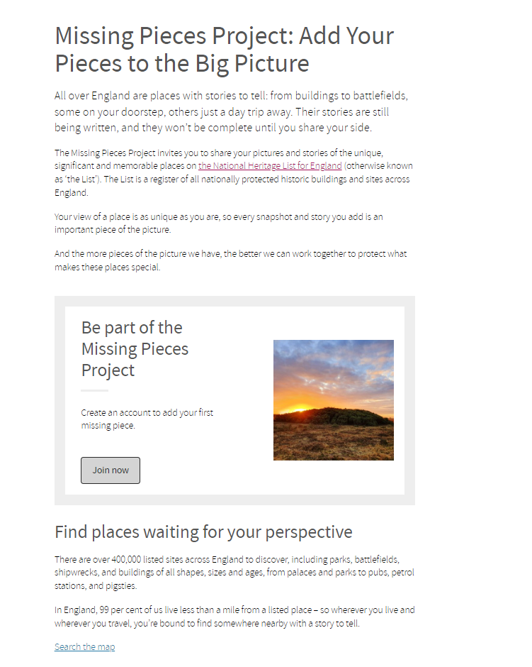
Find out more about: The Missing Pieces Project
https://historicengland.org.uk/MissingPieces
Notes:
Lots more information about ‘listing’ and the fact that it’s not just buildings – it’s archaeological sites, parks, gardens, battlefields and more…….

Slide 32
Find out more about: Listings
https://historicengland.org.uk/listing/what-is-designation/
Notes:
Lots more information about ‘listing’ and the fact that it’s not just buildings – it’s archaeological sites, parks, gardens, battlefields and more…….

Slide 33
Look after your local war memorial
https://historicengland.org.uk/services-skills/education/teaching-activities/doing-a-condition-survey-with-your-class-guidance-for-teachers
Notes:
As part of the Centenary of the First World War the public were called upon to help record the condition of our war memorials. There are around 100,000 war memorials in the UK. Information about their condition is being recorded on the War Memorials Online website, where anyone can upload information and photographs about any war memorial.

Slide 34
Find more great FREE teaching resources
https://historicengland.org.uk/services-skills/education/
Notes:
Lots more free resources for teachers

