Slide 1
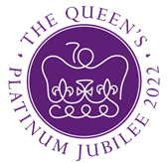
Queen Elizabeth II Platinum Jubilee
Story Map – North West Region Images
Key Stage 2: History & Geography
Learning Aims and Outcomes
Pupils understand more about the role of the Queen by exploring the Story Map of some of her visits to different places across England
Pupils learn about the Queen’s visits to significant places/events in their region of the country through her 70-year reign
Pupils develop a sense of place through mapwork
Pupils can identify regions of England and locate places in the region they live in
Pupils take part in celebrating a significant historical event
This learning resource supports the Historic England Platinum Jubilee Story Map & Platinum Jubilee Activities PPT
Notes:
This resource is intended to be used with the Historic England Jubilee Story Map which documents some of the many places the Queen has visited throughout her reign. Pupils are able to explore the pins on the map of their region of the country to find out about the significant buildings and events the Queen has visited. The Story Map contains information about the visit, a brief history of the building and images of the Queen and the building.

Slide 2
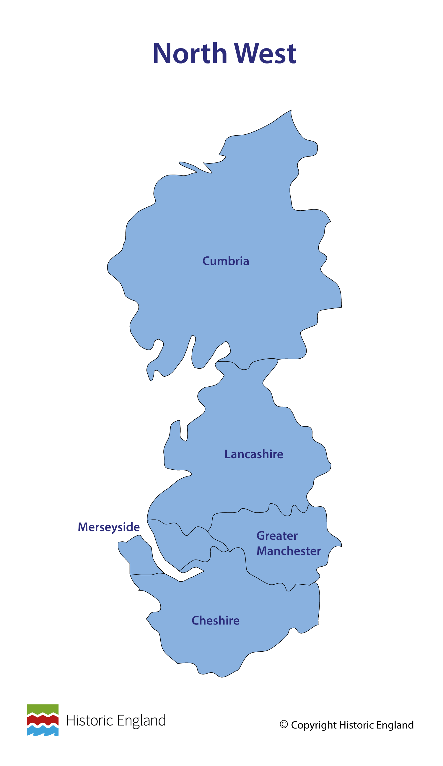
Notes:
Before following the link to your regional Story Map you may wish to discuss with pupils what counties are covered in your region.

Slide 3
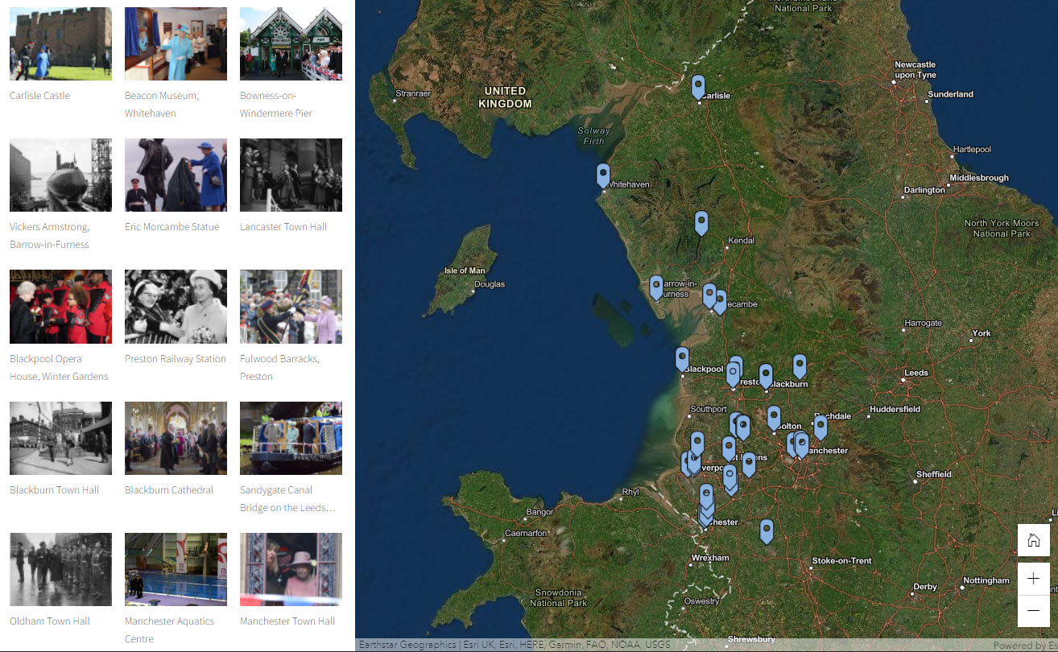
Notes:
Follow the link to your regional Story Map - https://storymaps.arcgis.com/stories/85d28487f88944caa0ff07acbd716093

Slide 4
Carlisle Castle
The Queen visited Carlisle Castle on 5 August 2002 as part of her Jubilee Tour of the UK.
Until the union of England and Scotland in 1603 Carlisle Castle was the principal fortress of England’s north-western border with Scotland. It is believed that the site was first occupied in AD72 when a large Roman fort, built of turf and timber, was established.
The first castle was built, over the Roman fort, by William II in the 11th century. It was subsequently rebuilt and then further developed from the 12th century onwards. Today it is designated as a Scheduled Monument.
Find out more on the National Heritage List.

Slide 5
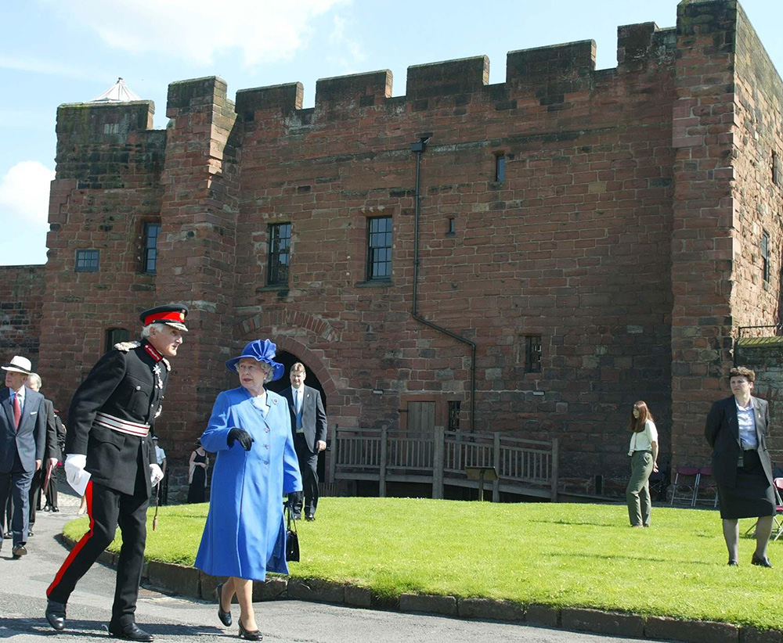
Notes:
The Queen talks to a man in a military uniform as they walk through the grounds of Carlisle Castle. © Alamy - G6041R – 5 August 2002

Slide 6
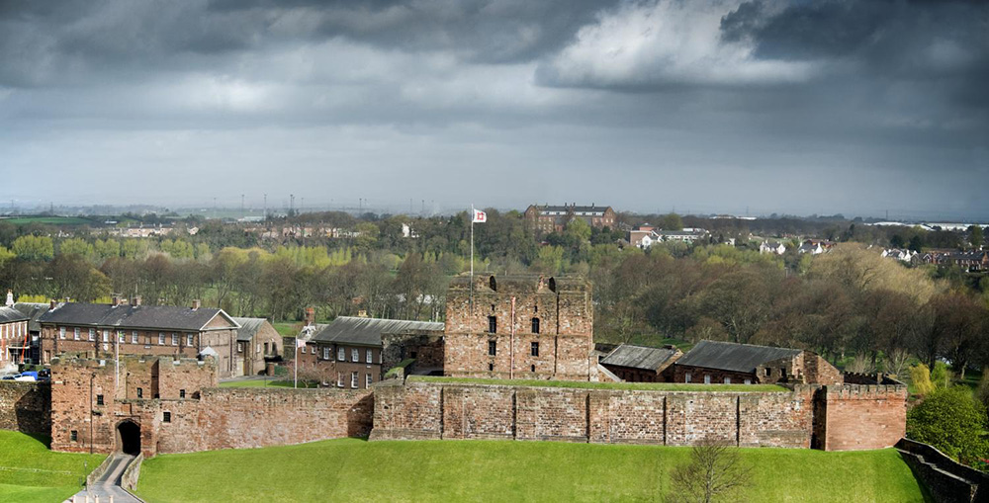
Notes:
A general view of Carlisle Castle, with its impressive red stone walls and buildings, under a dark and brooding sky. © Historic England Archive - DP066330 - 25 Apr 2008

Slide 7
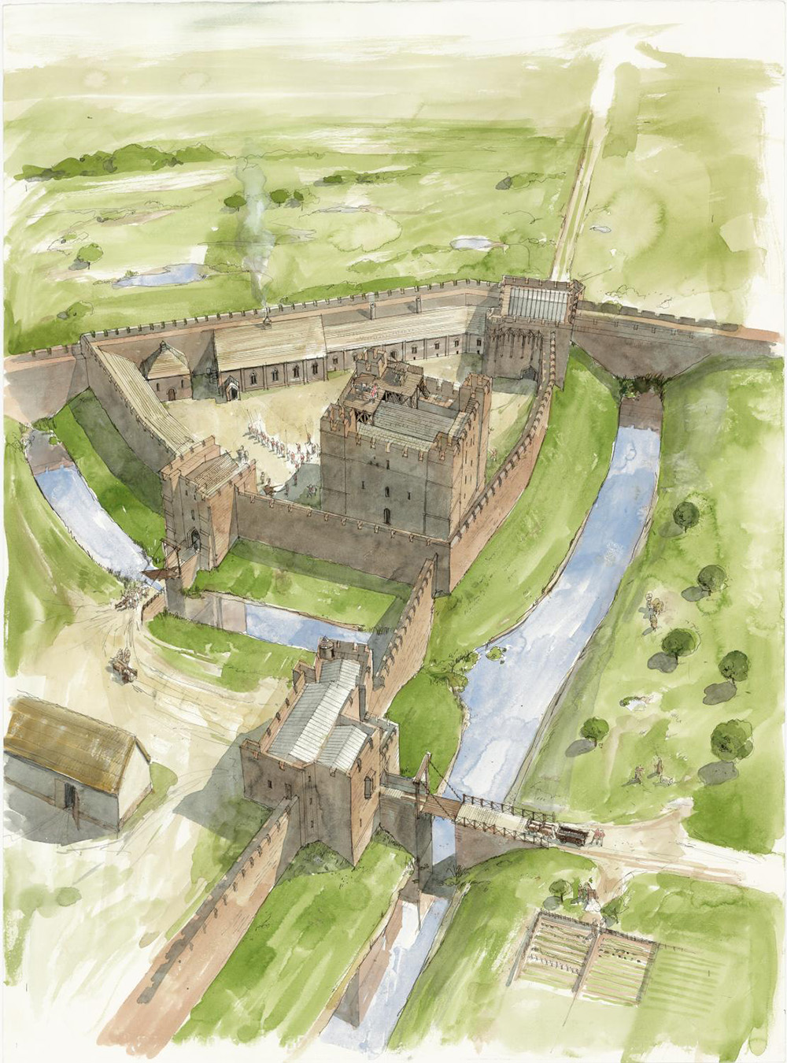
Notes:
A reconstruction illustration showing an aerial view of the Keep and inner bailey of Carlisle Castle as it may have appeared circa 1400, showing how both walls and moats were used to protect the castle. © Historic England Archive - IC021/002 - 18 Mar 2008

Slide 8
Beacon Museum, Whitehaven
The Queen visited Beacon Museum, in Whitehaven, on 5 June 2008 as part of a tour to mark the 100th anniversary of Whitehaven town and harbour.
The Beacon Museum originally opened in 1996 as a purpose-built museum to rehouse the Whitehaven Museum collection. The collection consists of over 30,000 artefacts including archaeology, geology, social history, decorative art and fine art linked to the area.
During her 2008 visit, the queen formally reopened the Beacon Museum which had undergone a multi-million pound refurbishment.
Find out more about The Beacon.

Slide 9
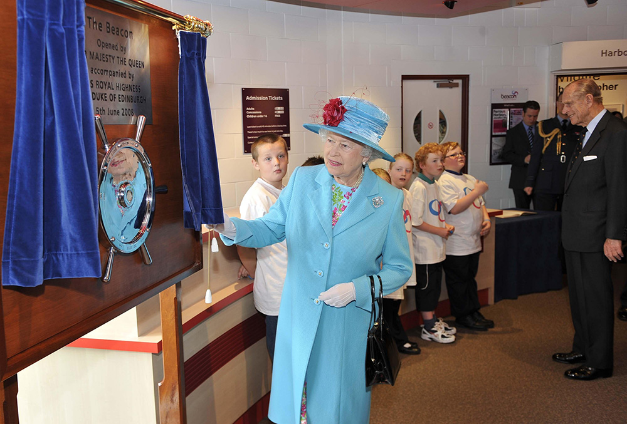
Notes:
The Queen opens a blue curtain to unveil a plaque, while Prince Philip talks to children in the background. © Alamy - GART6D – 5 June 2008

Slide 10
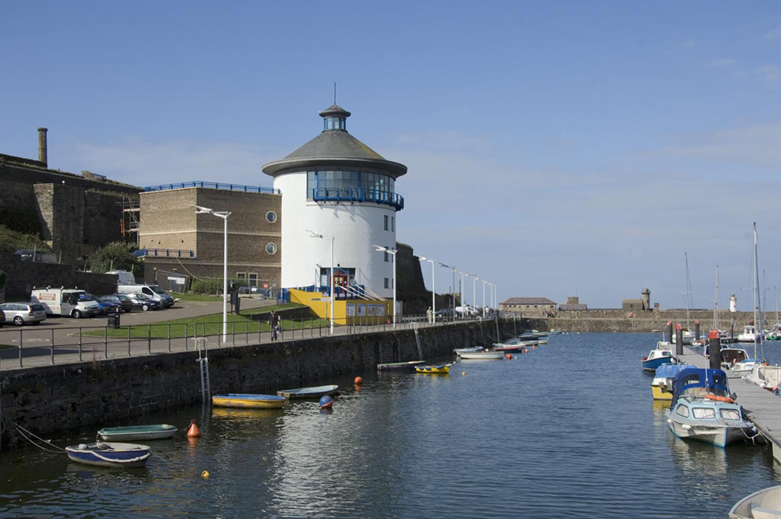
Notes:
A view, looking past moored boats, along the harbour walls with the striking white, circular building known as the Beacon. © Historic England Archive - DP044321 - 12 Sep 2007

Slide 11
Bowness-on-Windermere Pier
The Queen visited Bowness-on-Windermere pier on 16 July 2013 as part of a wider visit to South Lakeland.
The pier at Bowness is one of many stopping points on Lake Windemere, the largest natural lake in England. Windemere, until the late 18th century, was used primarily for the transportation of slate, timber and other goods.
The arrival of the railways in the mid-1800s, and the establishment of the first Steamer service on the lake, lead to a gradual increase in tourists into the area.
Find out more about the pier.

Slide 12
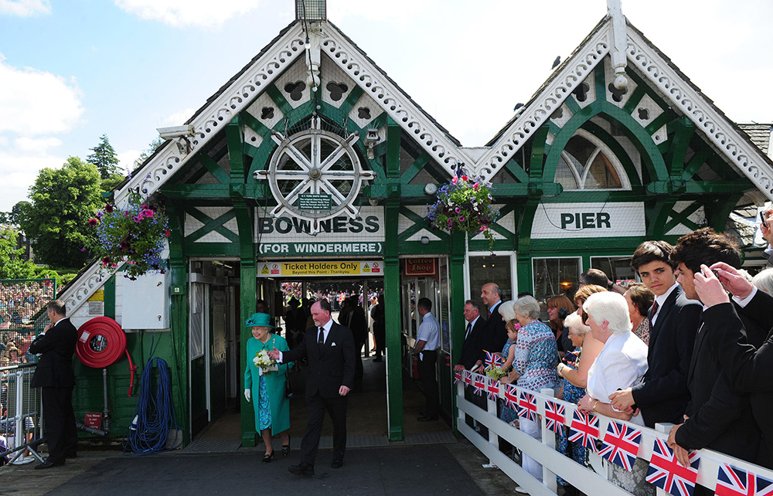
Notes:
The Queen, accompanied by a local dignitary, walks out on to Bowness Pier. There is a barrier, covered in Union Jack flags, down the centre of the pier and on the other side it wish-wishers look on smiling. © Alamy - G69C1T – 16 July 2013

Slide 13
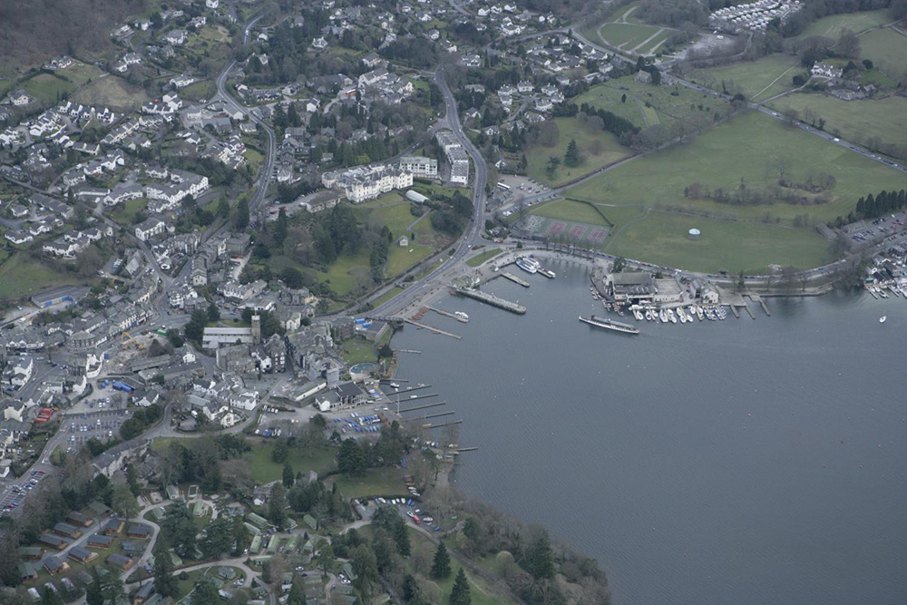
Notes:
A aerial view of Bowness on Windermere, showing the pier on the edge of lake Windermere. © Historic England Archive - 20543_001 – 10 April 2006

Slide 14
Vickers Armstrong, Barrow-in-Furness
The Queen visited Vickers Armstrong shipbuilding yard on 21 October 1960 to launch Britain’s first nuclear powered submarine, HMS Dreadnought. The launch took place on Trafalgar Day, the 155th anniversary of the Battle of Trafalgar.
Vickers Shipbuilding and Engineering Ltd was founded in 1871 as the Iron Shipbuilding Company. In 1897, Vickers & Sons bought the company and by the early 1900’s the yard was building large naval warships and armaments.
The company continued to grow and in 1927 merged with rival shipbuilder Armstrong Whitworth, leading to the creation of Vickers-Armstrongs Ltd.
The company has since gone through many mergers and name changes but the shipyard has continued to make craft for the Royal Navy, and later other navies around the world throughout the 20th and into the 21st century.
Find out more on the National Heritage List.

Slide 15
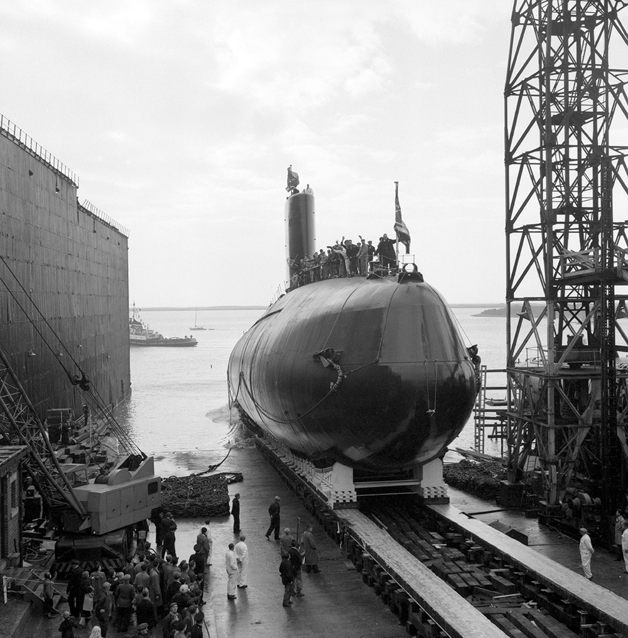
Notes:
A black and white image of a submarine, with people standing and waving on top of it, being launched off a slipway into the sea. © Alamy - GCTKH8 - 21 October 1960

Slide 16
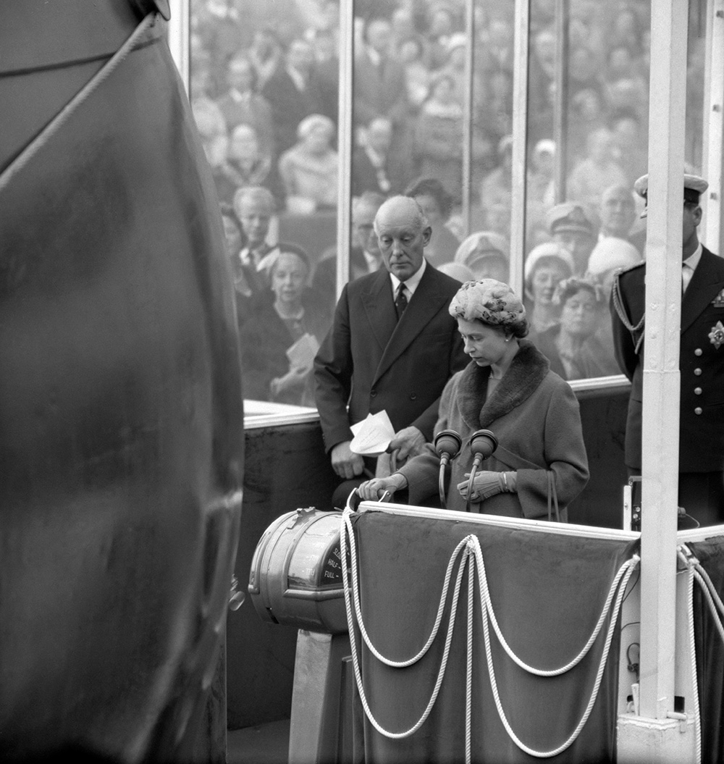
Notes:
A black and white image of the Queen pulling the lever to launch Britain's first nuclear-powered submarine, HMS Dreadnought, from the Vickers-Armstrong yard, a man in a suit and crowds stand behind her and the submarine's bow is in front of her. © Alamy - GCTKH7 - 21 October 1960

Slide 17
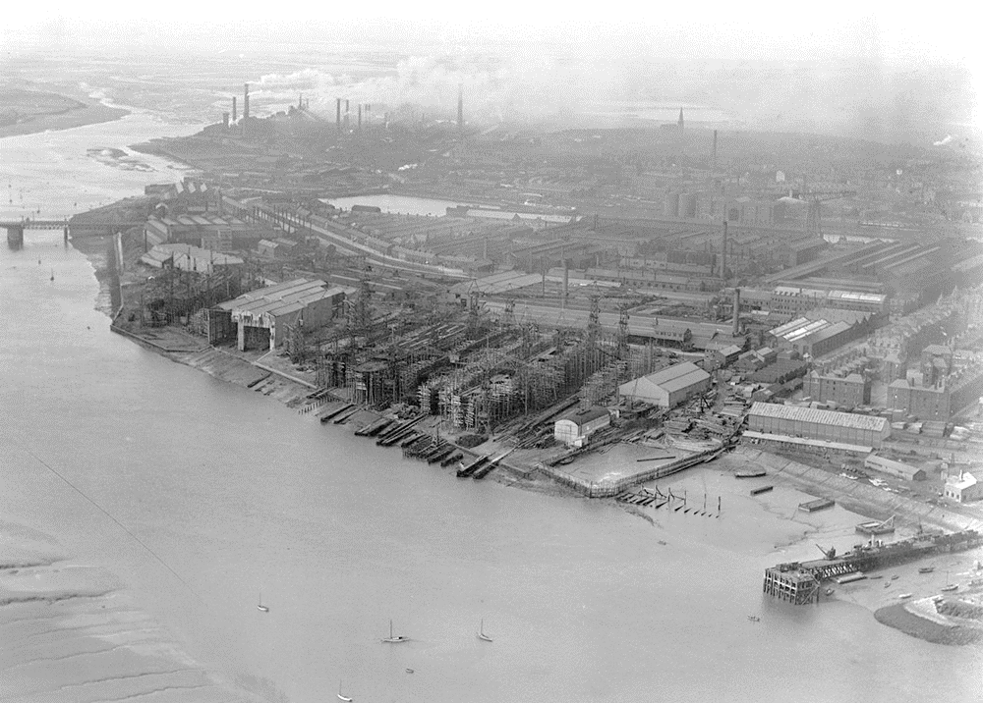
Notes:
A black and white aerial images showing the docks, slipways and buildings of the shipyard as they looked in 1920 and the vast area they covered. © Historic England Archive. Aerofilms Collection - EPW004068 – July 1920

Slide 18
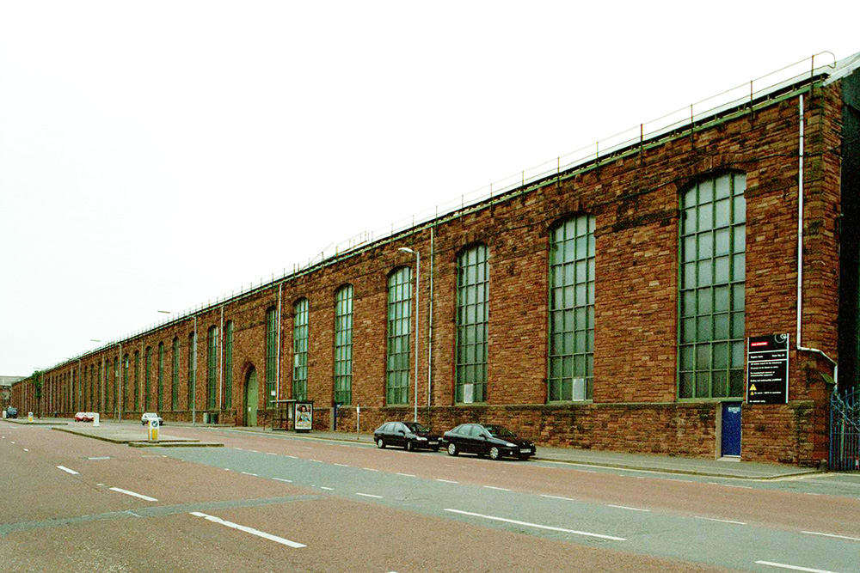
Notes:
A view of the massive single storey red brick Heavy Engineering Shop at Vickers Ship and Engineering Limited. © Mr CJ Wright. Source: Historic England Archive - IOE01/03818/26 - 13Jun 2001

Slide 19
Eric Morcambe Statue
The Queen unveiled a statue of comedian Eric Morecambe on the promenade at Morecambe on 23 July 1999.
Comedian Eric Morcambe’s (1926–1984) real name was John Eric Bartholomew but he took his stage name from his hometown of Morcambe, where his statue now stands. The statue depicts Eric Morecambe in one of his characteristic poses, first seen when he performed a routine to the song “Bring Me Sunshine”, with his comedy partner Ernie Wise. He has a pair of binoculars around his neck as he was a keen bird watcher.
Find out more about the Eric Morcambe Statue.

Slide 20
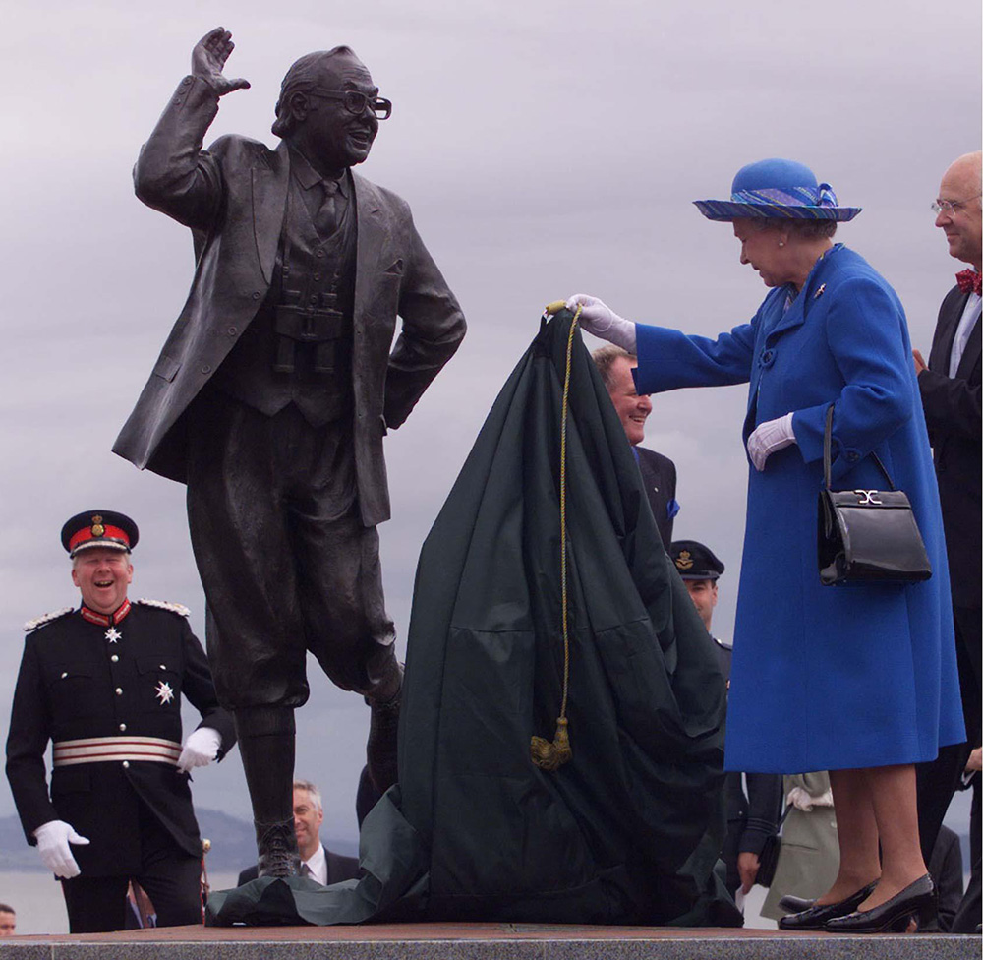
Notes:
The Queen holding a cloth that she has just removed to unveil a statue of Eric Morcombe, showing one of his typical poses from the song 'Bring me sunshine', whilst onlookers smile. © Alamy - G4NPAR - 23 July 1999

Slide 21
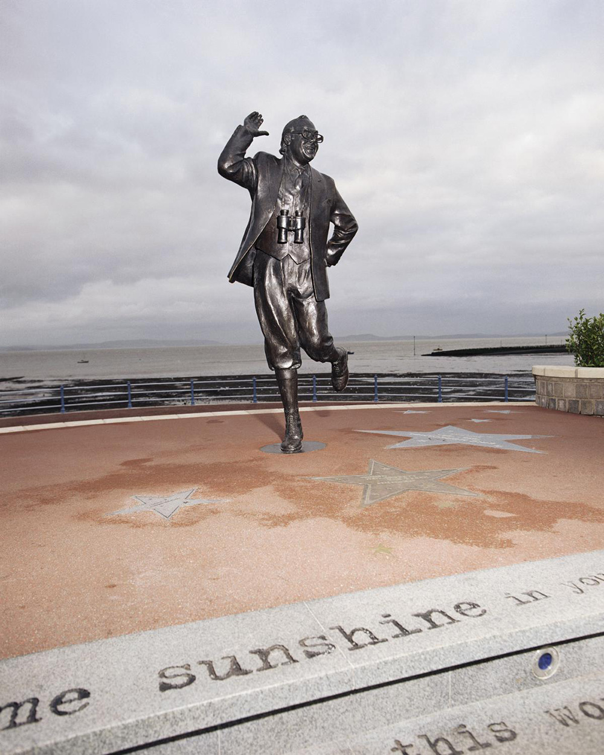
Notes:
A statue of Eric Morecambe in one of his characteristic poses, first seen when he performed a routine to the song “Bring Me Sunshine”, with his comedy partner Ernie Wise. He has a pair of binoculars around his neck as he was a keen bird watcher. © Historic England Archive - AA99/08584 - 27 Oct 1999

Slide 22
Lancaster Town Hall
The Queen visited Lancaster Town Hall on 13 April 1955. In this photo she can be seen leaving the town hall with the town's mayor at the time, Councillor B. Scott.
Lancaster Town Hall was officially opened on 27 December 1909. It was financed by Lord Ashton, a local businessman and industrialist, who had made his fortune after inheriting his father's oil cloth and linoleum business, Williamson’s.
Originally, the new town hall incorporated all the council's services and departments, as well as a police station, including cells, the magistrates court and a public hall, known as the Ashton Hall. Lancaster Town Hall is now a Grade II* listed building.
Find out more on the National Heritage List.

Slide 23
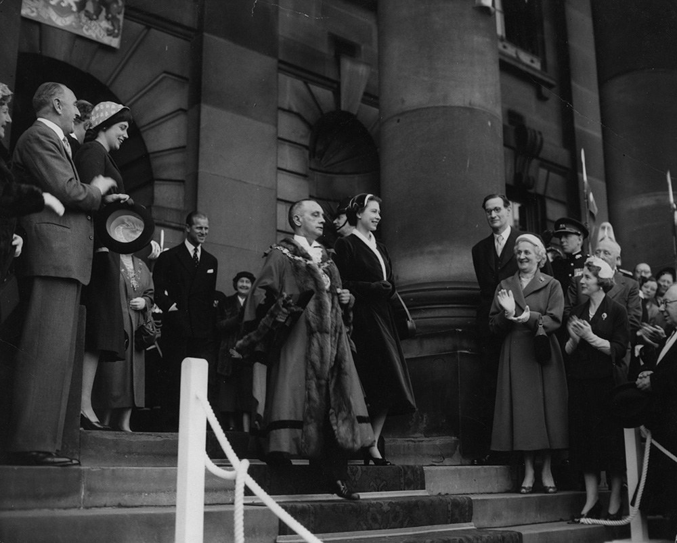
Notes:
A black and white image of the Queen and Councillor B. Scott walking down the steps of Lancaster Town Hall as well-wishers wave and cheer from the sides. © Alamy - G4P02C - 13 April 1955

Slide 24
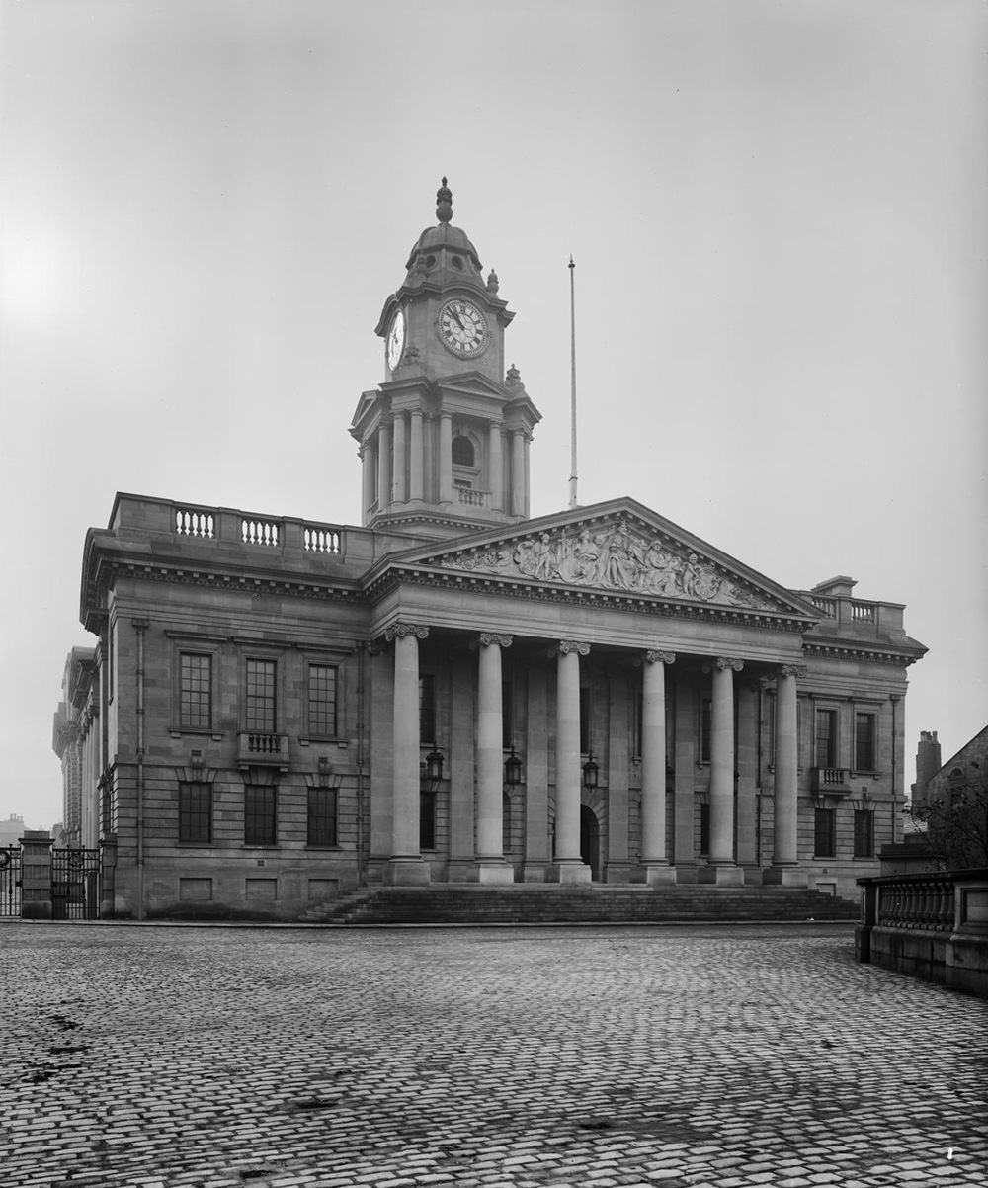
Notes:
A black and white image of the newly built Lancaster Town Hall from Dalton Square, clearly showing the impressive classical columns in front of the entrance. Source:Historic England Archive - BL20741/001 – 1909

Slide 25
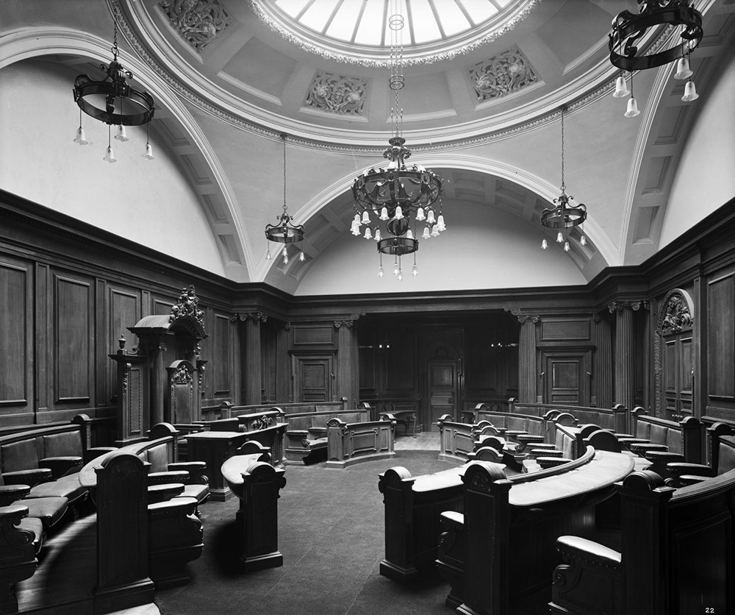
Notes:
A black and white view of the Council Chamber in Lancaster Town Hall, it shows the curved rows of seats and benches that form an oval shape. Source:Historic England Archive - BL20741/022 - 1909

Slide 26
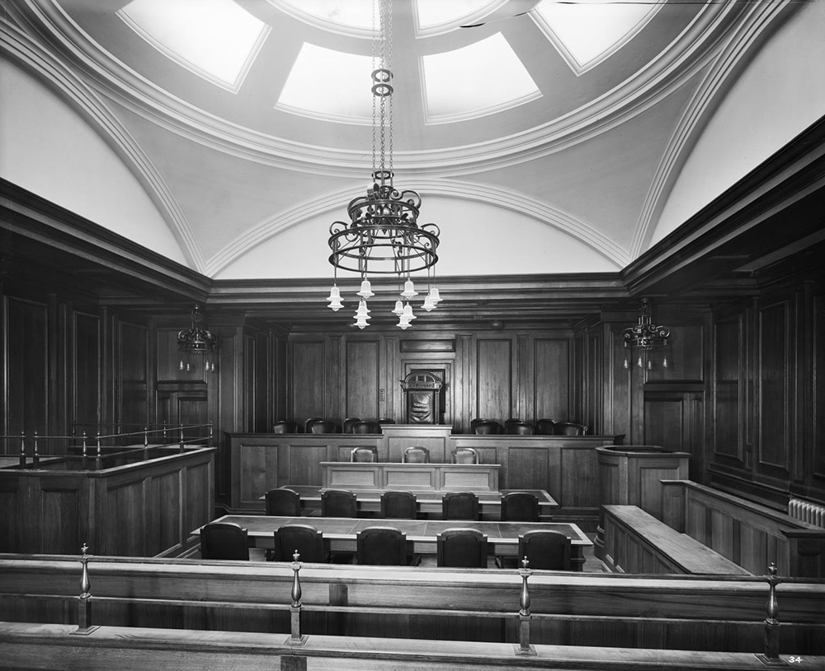
Notes:
A black and white image of the interior of the Magistrates' Courtroom inside Lancaster Town Hall, looking towards the dock and bench, with the magistrate's seat in the centre. Source:Historic England Archive - BL20741/034 - 1909

Slide 27
Blackpool Opera House, Winter Gardens
The Queen visited Blackpool Opera House on 7 December 2009 to attend the Royal Variety Performance. This wasn’t the only time she had travelled to Blackpool for the event - her visit in 1955 marked the first time the Royal Variety Performance was held outside London. The Royal Box was constructed especially for the occasion!
Blackpool Opera House is part of the Grade II* Winter Garden’s Complex. There has been a theatre on this site since 1889. The old one was demolished in 1938 to make way for the building which stands today.
At the time of its opening, June 1939, the current Opera House had the largest stage in the country. Today the theatre is one of the largest in Europe, seating nearly 3000 people!
Find out more on the National Heritage List.

Slide 28
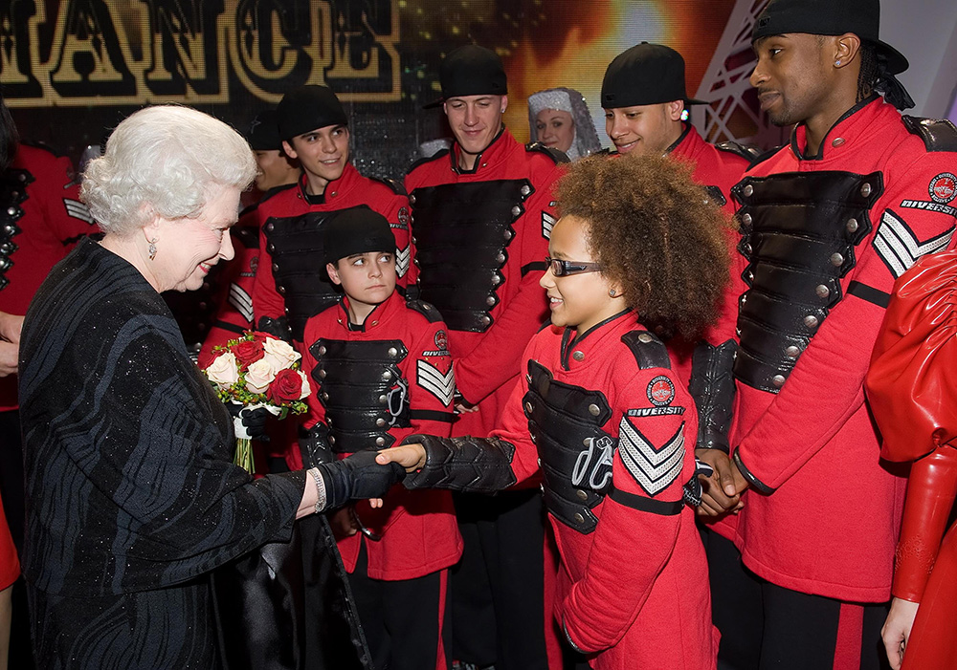
Notes:
The Queen meets Britain's Got Talent Winners, British dance group Diversity, dressed in their bright red uniforms. © Alamy - GC7K2X - 7 December 2009

Slide 29
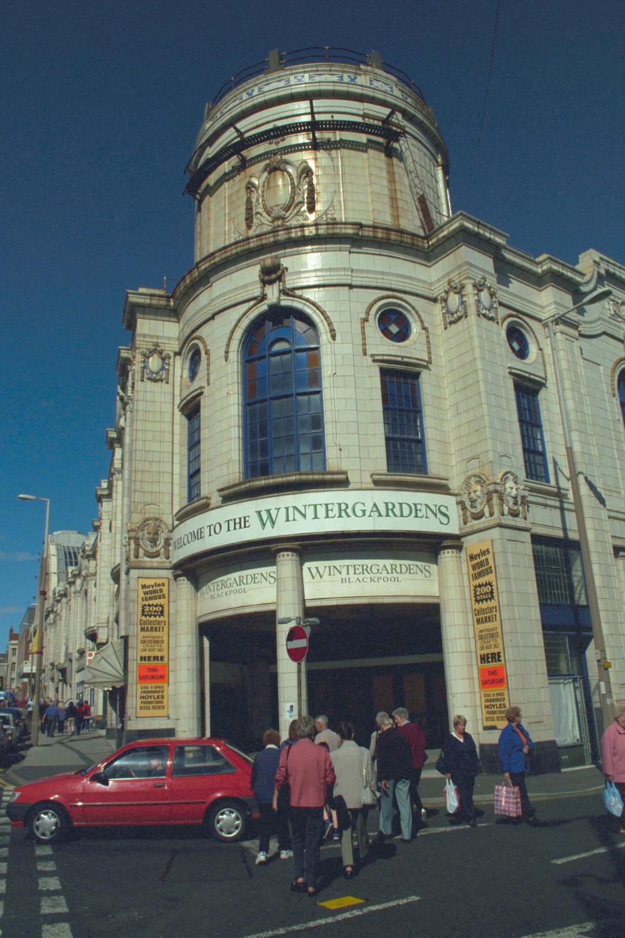
Notes:
A view of the beautiful tiled building of the Winter Gardens which contains the Opera House. © Mr G M Smith. Source: Historic England Archive - IOE01/01652/23 - 17 Sep 1999

Slide 30
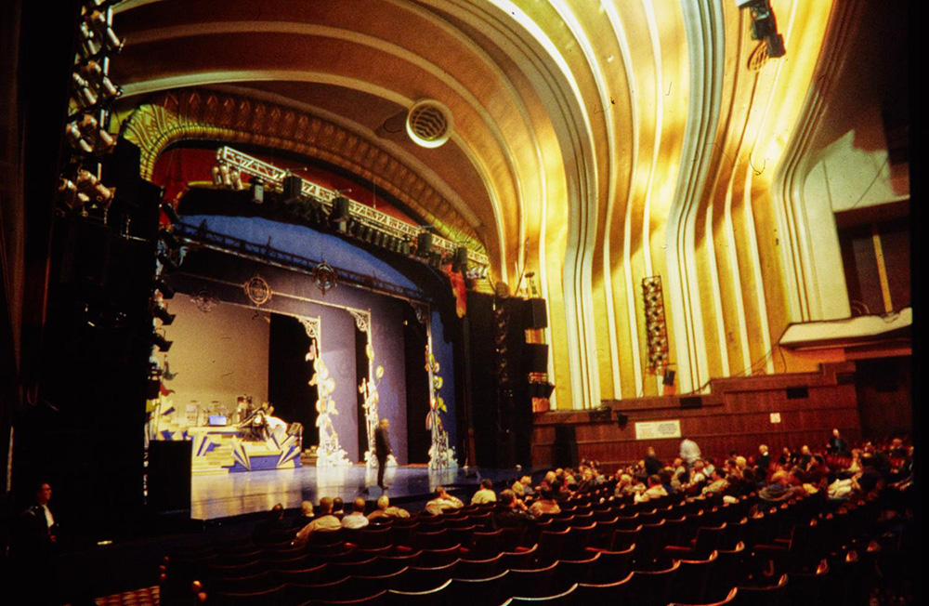
Notes:
A view looking across the auditorium towards the proscenium and stage in the Winter Gardens Opera House, showing people seated in the stalls. © Historic England Archive - NWC01/01/1196 - 1990 - 2007

Slide 31
Preston Railway Station
In May 1974 the Queen and Prince Philip boarded a train from Preston Railway station for a tour of the newly electrified British Railways Anglo-Scottish route, between Preston and Glasgow.
The Grade II listed Preston Railway station was built in 1880, by Cooper and Tullis of Preston, for the London and North Western and the Lancashire and Yorkshire Railway Companies. It was built to replace the former complex of separate platforms and offices. These had been built, by different railway companies, from 1838 onwards, when the first station was opened on this site by the North Union Railway.
Find out more on the National Heritage List.

Slide 32
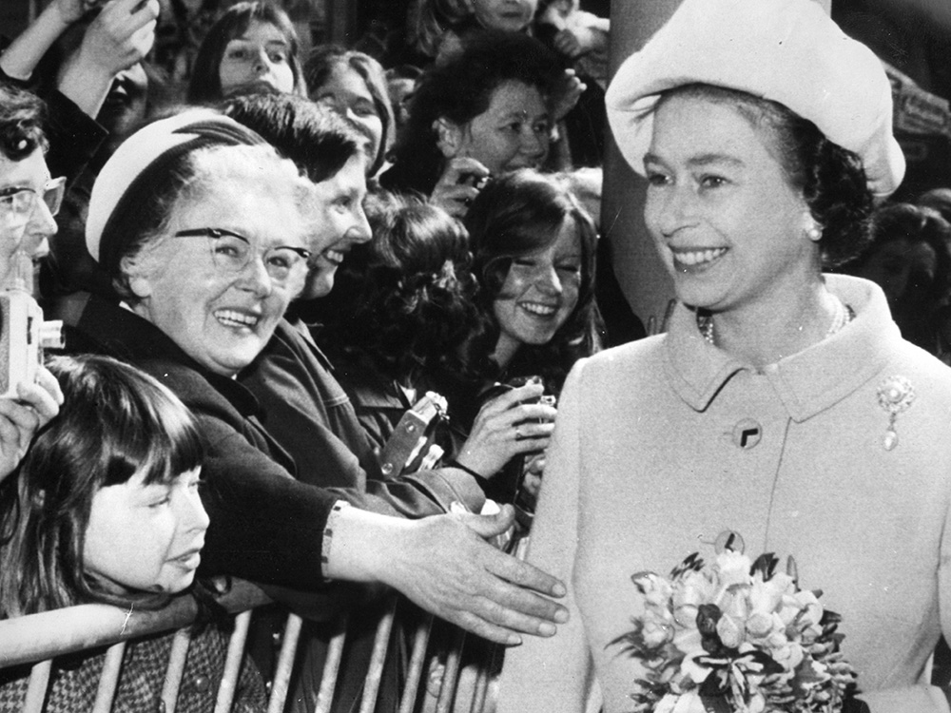
Notes:
Black and white image of the Queen being greeted by crowds outside Preston Railway Station. © Alamy - G79KRC - 7 May 1974

Slide 33
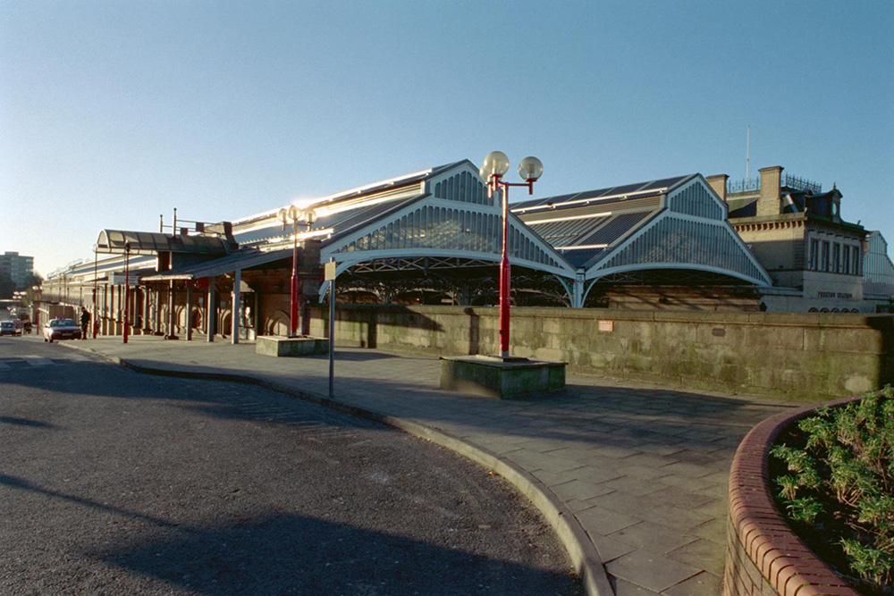
Notes:
View of the outside of the station showing the beautiful cast-iron canopies over the tracks. © Mr Mungo Gilchrist. Source: Historic EnglandArchive - IOE01/03580/01- 30 Jun 2001

Slide 34
Fulwood Barracks, Preston
The Queen visited Fulwood Barracks on 26 June 2008 in order to present new colours (flags) to the Duke of Lancaster's Regiment who are now based there.
The Grade II listed Fulwood Barracks were built, between 1842-1848, on part of the site of an old racecourse. The barracks were created in response to anxiety over recent Chartist riots and were originally home to the 2nd Battalion 60th Rifles.
The barracks are the most complete surviving example in England of the late eighteenth century concept of barracks design. They are also one of the earliest examples of including a church within a barracks.
As well as being home to the Duke of Lancaster’s Regiment, they also house the Lancashire Infantry Museum.
Find out more on the National Heritage List.

Slide 35
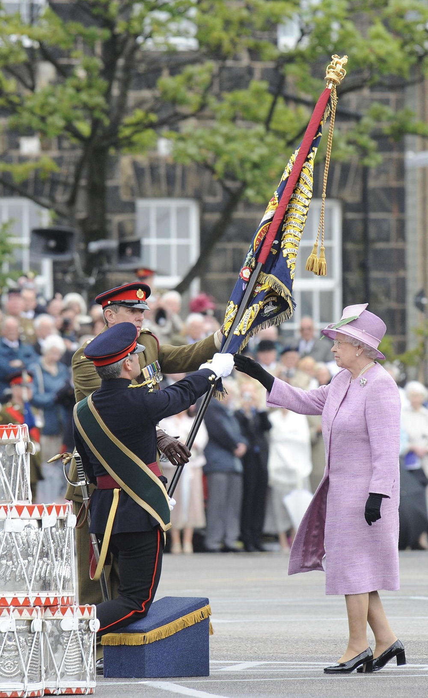
Notes:
The Queen presents new colours (flags) to the Duke of Lancaster's Regiment, Fulwood Barracks. She can be seen handing the flags over to two men in uniform. © Alamy - GAY82H - 26 June 2008

Slide 36
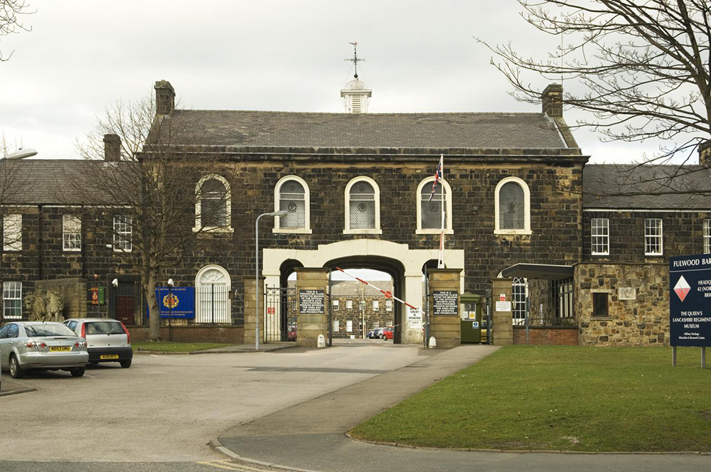
Notes:
A general view of the barracks entrance building, which is 2 storeys high, with a large entrance gate. © Historic England Archive - DP056219 - 17 Mar 2008

Slide 37
Blackburn Town Hall
The Queen visited Blackburn's Grade II listed Town Hall on the 14th April 1955.
Blackburn Town Hall was designed by James Patterson and built by Richard Hacking and William Stones. It was officially opened by the Mayor of Blackburn, William Hoole, on 3 October 1856 and the first royal visit was King George V in July 1913.
When it was built, the town hall was home to a police station with 18 cells, as well as a large assembly room, and a council chamber.
Find out more on the National Heritage List.

Slide 38
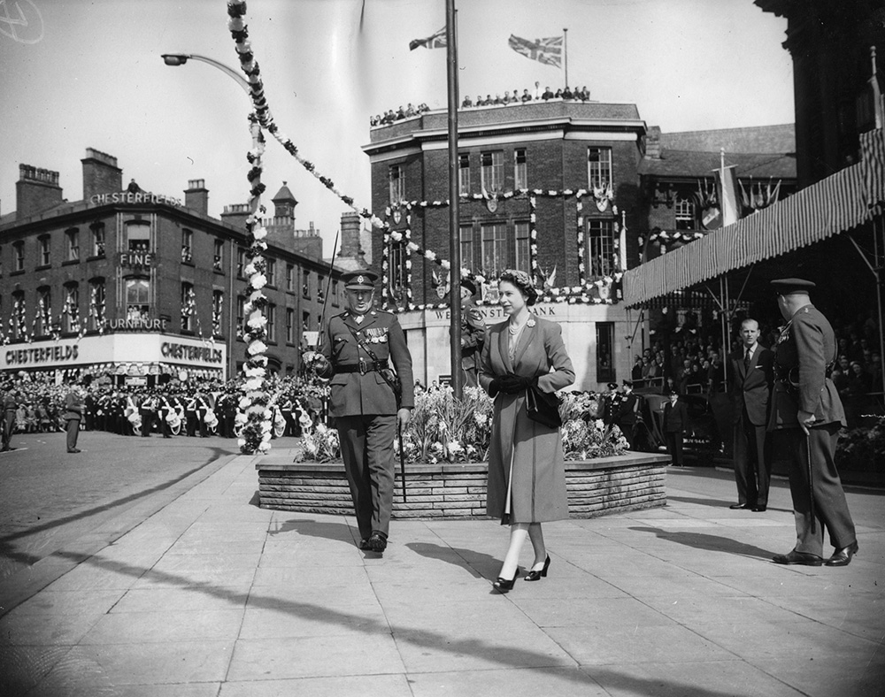
Notes:
A black and white photo showing the Queen walking with a man in uniform past crowds of people outside the Town Hall. The streets are decorated with bunting.© Alamy - G4P03E -14 April 1955

Slide 39
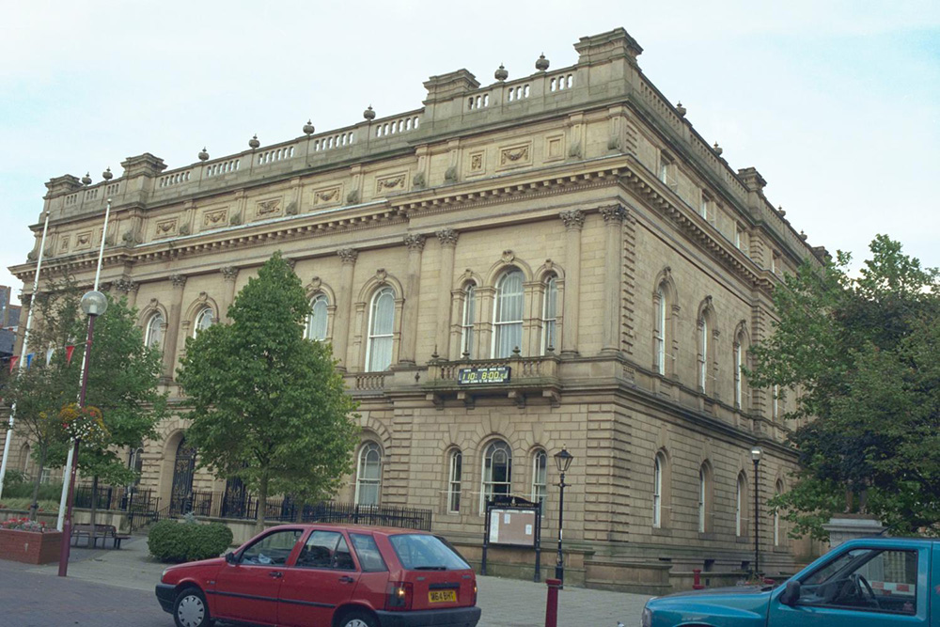
Notes:
A view of the outside of the stone built 3 storey Town Hall. © Mr R F Shaw. Source: Historic England Archive - IOE01/01668/14 - 12 Sep 1999

Slide 40
Blackburn Cathedral
The Queen visited Blackburn Cathedral on 17 April 2014 to take part in the traditional Royal Maundy Thursday service. She is seen in the image meeting, and handing out Maundy money, to members of the congregation.
Blackburn Cathedral was formerly the parish church of St Mary the Virgin. The building was consecrated in 1826 and became a cathedral in 1926, when the Diocese of Blackburn was created.
It is believed that the site is linked with early Christianity; the foundation is thought to date from the year 596. Blackburn Cathedral is a grade II* listed building.
Find out more on the National Heritage List.

Slide 41
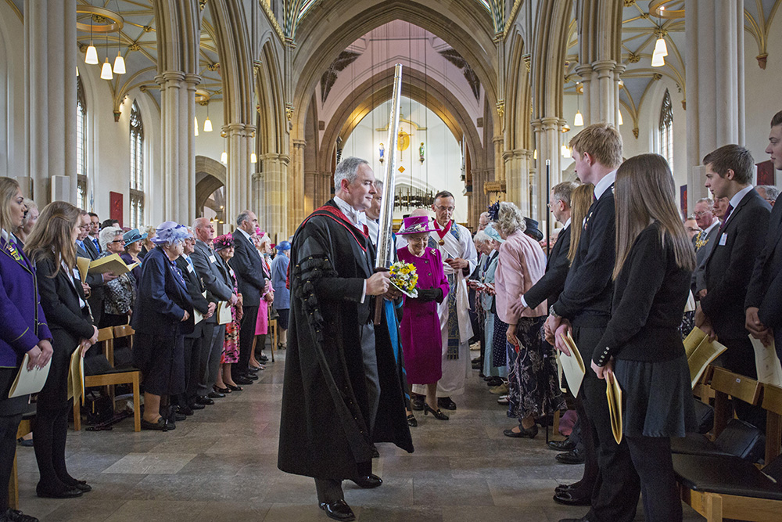
Notes:
The Queen, surrounded by local dignitaries, walks down the centre of the cathedral with people, including school children on either side. © Alamy - G712C0 – 17 April 2014

Slide 42
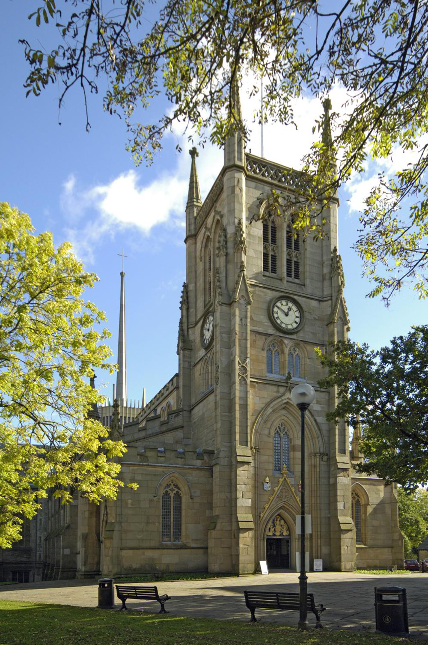
Notes:
A view from the west of the stone built cathedral. © Historic England Archive - DP033702 - 17 Oct 2007

Slide 43
Sandygate Canal Bridge on the Leeds Liverpool Canal
The Queen travelled on the Leeds Liverpool Canal, through Burnley, in May 2012 as part of her Diamond Jubilee Tour of the Northwest. She also visited Burnley FC for a performing arts show and took a tour around the Burnley College and UCLan campus.
The Sandygate Canal Bridge, seen in the second picture, is a listed structure on the Leeds Liverpool Canal in Burnley. It was built in the late 1700s by engineer Samuel Fletcher for the Leeds Liverpool Canal Company and is one of the few original canal bridges remaining in Burnley.
Find out more on the National Heritage List.

Slide 44
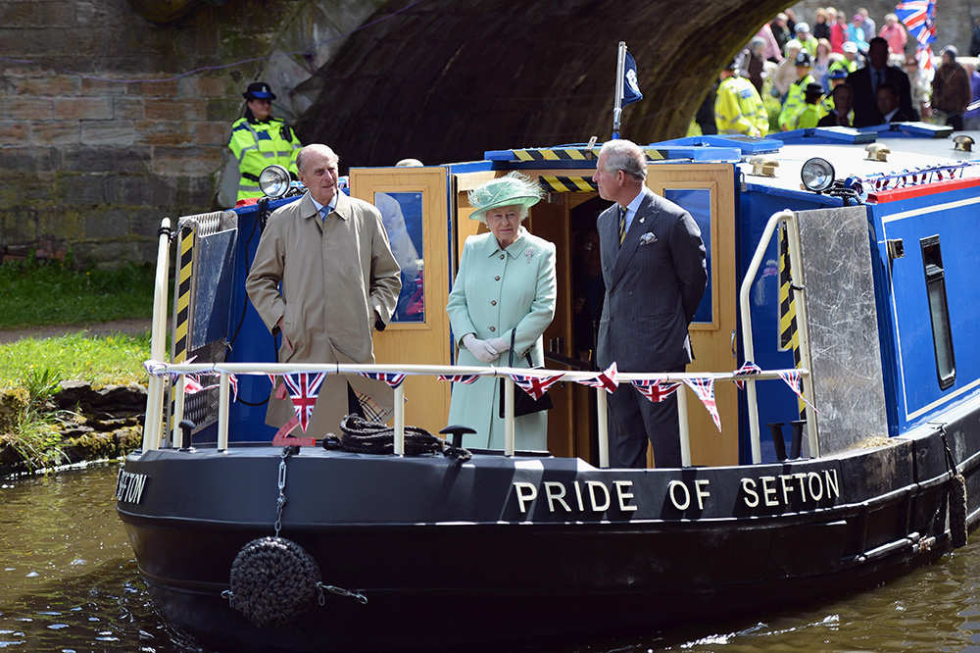
Notes:
The Queen and Prince Philip make their way along the Leeds and Liverpool canal. They are stood on the deck on the barge 'Pride Of Sefton', during a trip to Burnley. © Alamy - G562DC - 16 May 2012

Slide 45
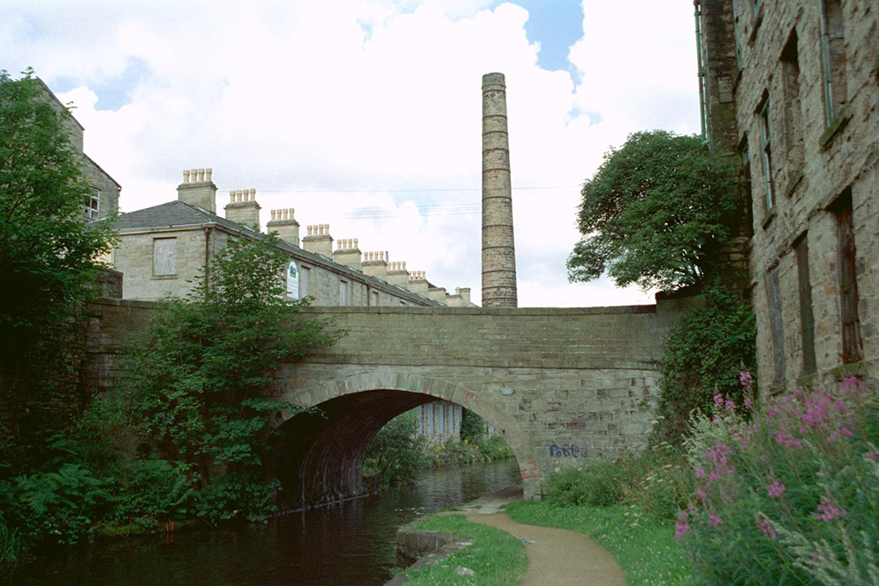
Notes:
The stone built Sandygate Bridge, with terraced houses and a mill tower in the background. © Mr Russ Hill. Source: Historic England Archive - IOE01/06873/17 - 6 Aug 2002

Slide 46
Oldham Town Hall
The Queen travelled to Oldham on 22 October 1954. She inspected a guard of honour on Yorkshire Street and visited the town hall.
Oldham Town Hall was designed by architect George Woodhouse. It was opened in 1841 and became the headquarters of the Municipal Borough of Oldham in 1849. It was extended in 1880 and Winston Churchill made his inaugural acceptance speech from the steps of the town hall when he was first elected as a Conservative MP in 1900.
Today Oldham Town Hall is a Grade II listed building and has been converted into a cinema.
Find out more on the National Heritage List.

Slide 47
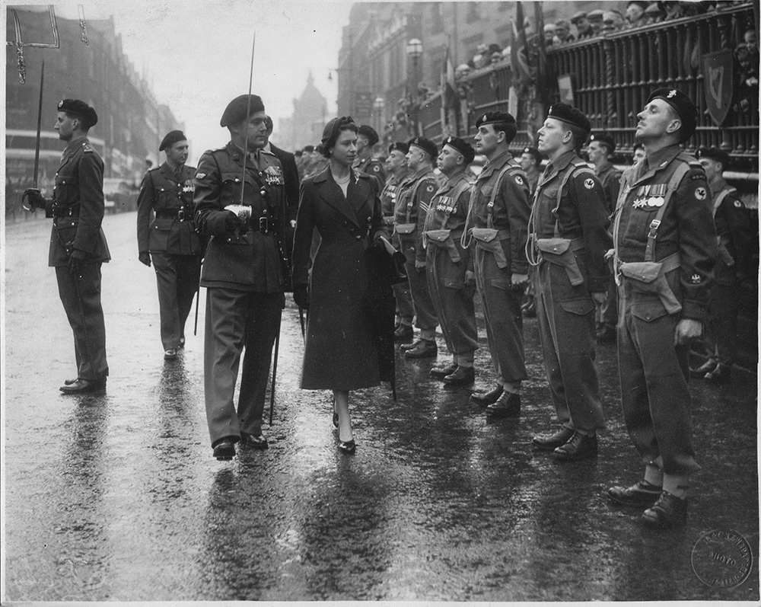
Notes:
A black and white image of the Queen walking past a line of soldiers in uniform, waiting to be inspected by her. 20028 - Images courtesy of Oldham Archives - Oct 1954

Slide 48
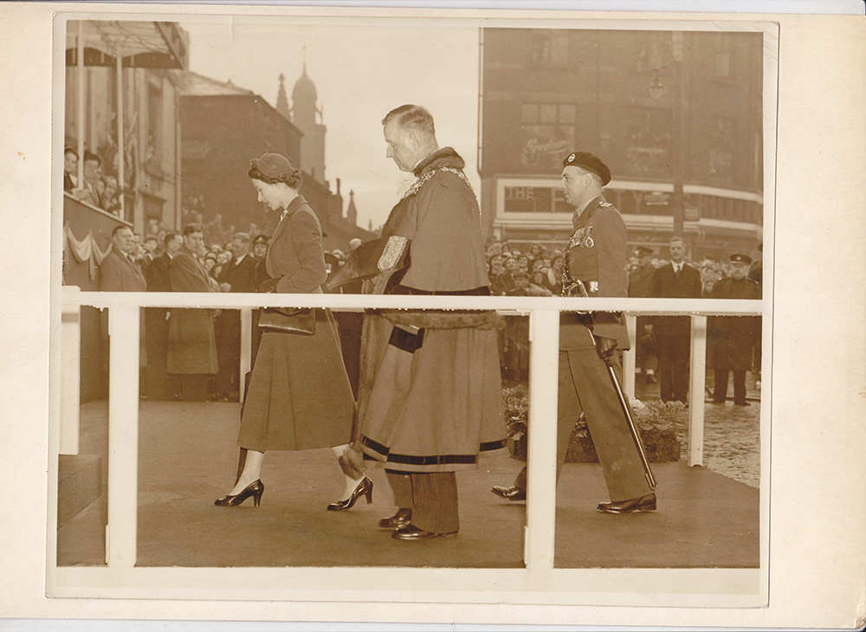
Notes:
A sepia image of the Queen, accompanied by local dignitaries, walking toward the entrance to Oldham Town Hall. 47540 - Image courtesy of Oldham Archives - Oct 1954

Slide 49
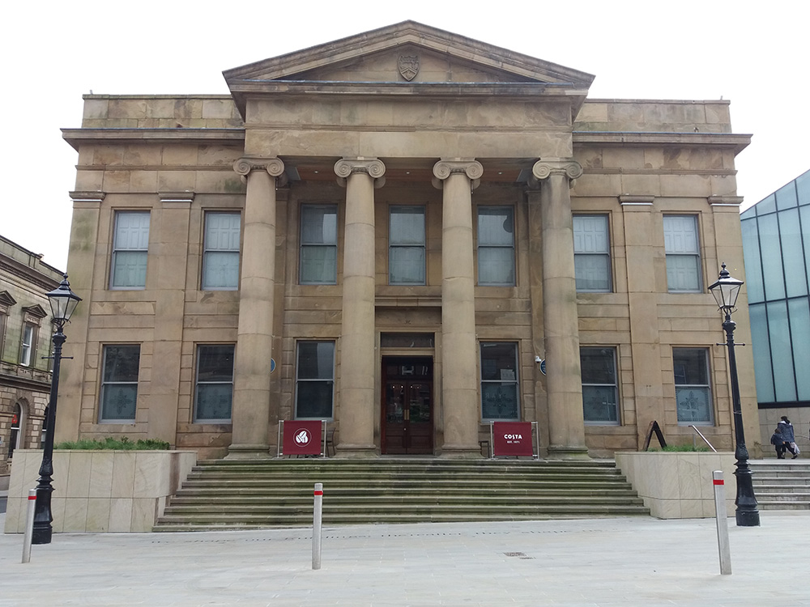
Notes:
A view of the classical front of Oldham Town Hall, showing the steps leading up to the impressive columns and pediment in front of the entrance. Lois Gyves, Historic England - 25 September 2017

Slide 50
Manchester Aquatics Centre
The Queen attended the official opening of the Manchester Aquatic Centre on 12 October 2000.
Manchester Aquatic Centre was purpose built for the Commonwealth Games, held in Manchester in 2002. The building was designed by FaulknerBrowns Architects. From the outside, the roof resembles a wave.
The centre is the home of the City of Manchester Aquatics Swim Team, as well as Disability Swimming and Water Polo athletes from the English Institute of Sport. All facilities are also open to the public.
Find out more about the Aquatics Centre.

Slide 51
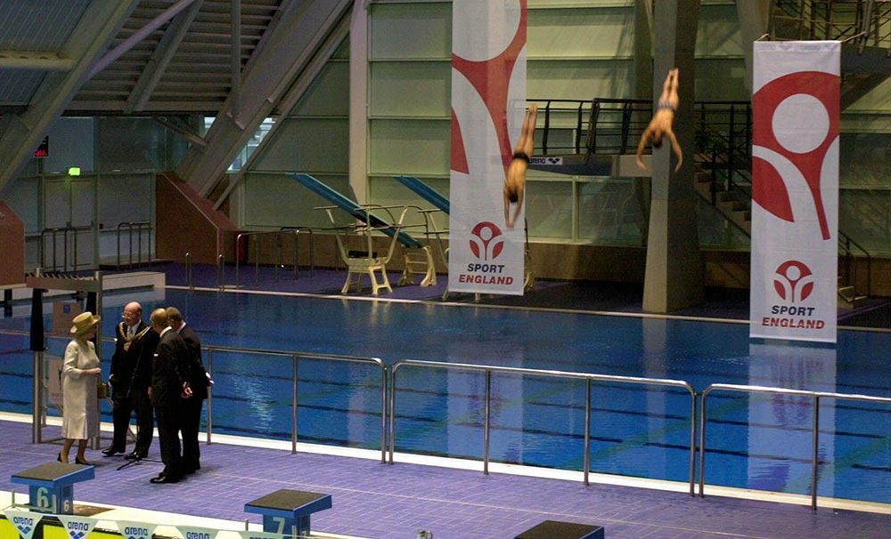
Notes:
The Queen talks to dignitaries next to the pool, whilst two divers plunge towards the pool behind her. © Alamy - 2D3189C - 12 October 2000

Slide 52
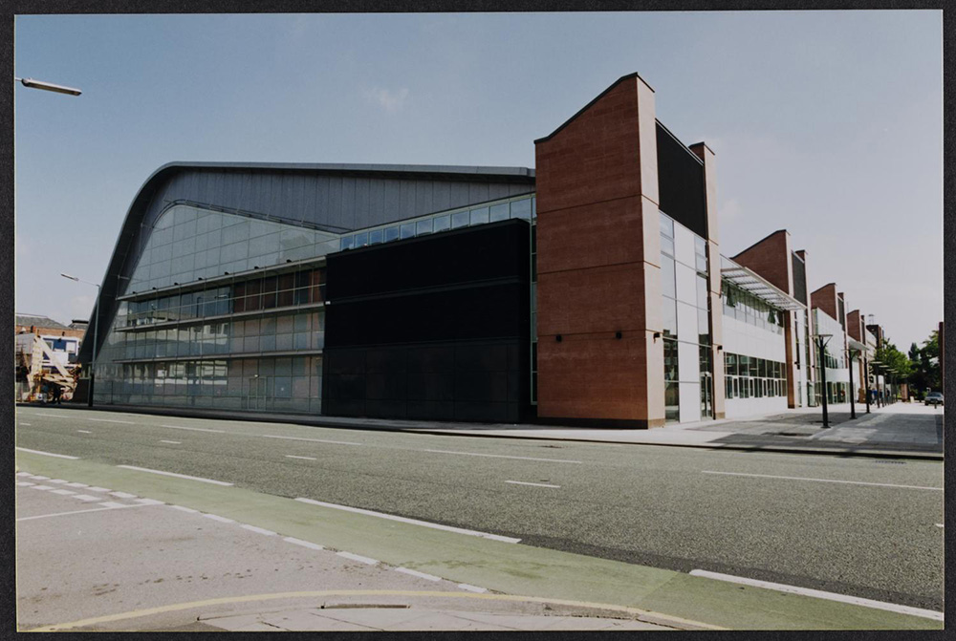
Notes:
The huge glass ended Manchester Aquatics Centre viewed from the south-west around the time of its completion. © Historic England Archive. John Laing PhotographicCollection - JLP01/20/003/12/001 - May 2000 - Sep 2000

Slide 53
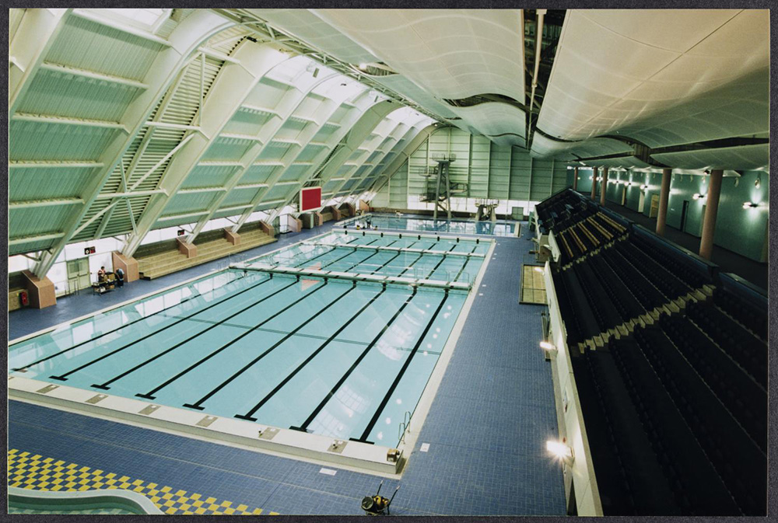
Notes:
A view looking over the competition pool towards, the diving pool, in the Manchester Aquatics Centre around the time of its completion. © Historic England Archive. John Laing PhotographicCollection - JLP01/20/003/12/005 - May 2000 - Sep 2000

Slide 54
Manchester Town Hall
The Queen visited Manchester Town Hall, on 23 March 2012, as part of a tour of the city to mark her Diamond Jubilee.
Manchester Town Hall is a Grade I listed building constructed between 1868 and 1877. A competition was held to design the building which was won by architect Alfred Waterhouse.
Perhaps the most iconic part of Manchester Town Hall is it’s 280 feet (85 m) tall bell tower. The clock mechanism was made by Gillet and Bland and was started on New Year's Day 1879.
Find out more on the National Heritage List.

Slide 55
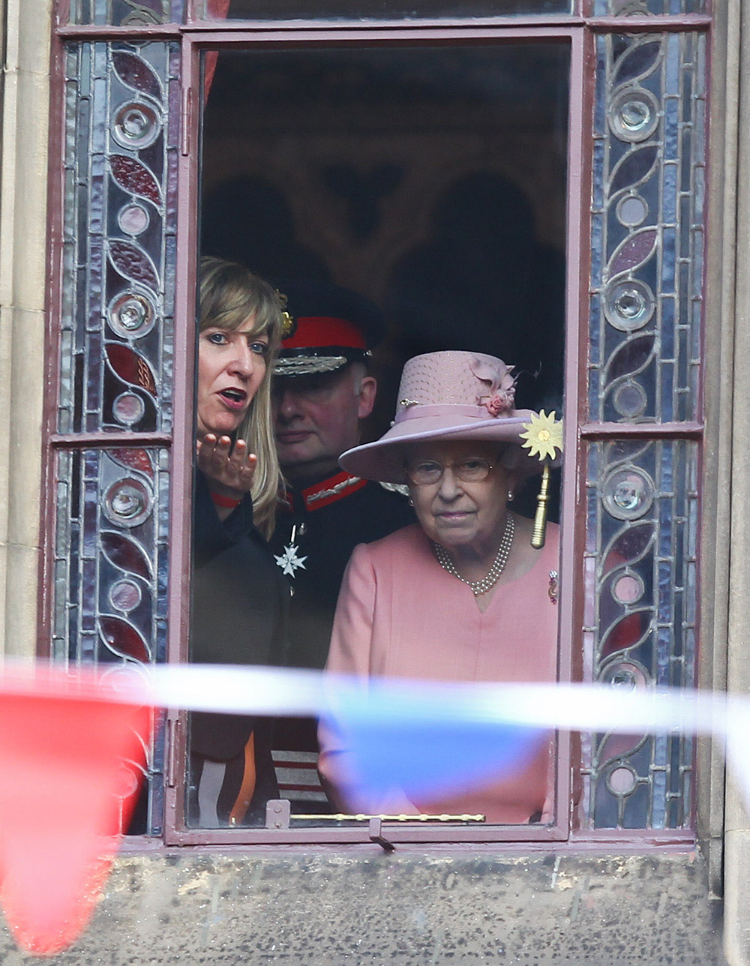
Notes:
The Queen looks out of a window decorated with stained glass from within the Town Hall. © Alamy - DH8J0G - 23 March 2012

Slide 56
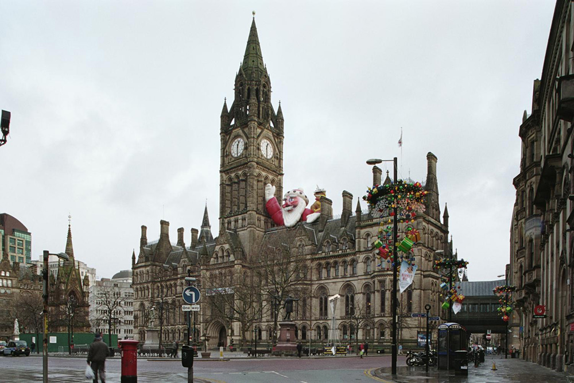
Notes:
A view across Albert Square of the beautiful Victorian Town Hall. The Hall and Square both still have Christmas decorations up, including a giant inflatable Santa waving from the roof of the Town Hall. © Mr Brian Lomas. Source: Historic England Archive - IOE01/16284/24 - 2 Jan 2007

Slide 57
The Lowry
The Queen visited Salford on 1 October 2000 to attend the opening of The Lowry.
The Lowry is named after the artist, L.S. Lowry (1887 – 1976). Lowry spent a significant portion of his life in Salford and much of his work depicts mill scenes and industrial landscapes from the city.
The Lowry houses two theatres, three art galleries and conference facilities. It was designed by Michael Wilford and Partners and the late Sir James Stirling.
Find out more about The Lowry.

Slide 58
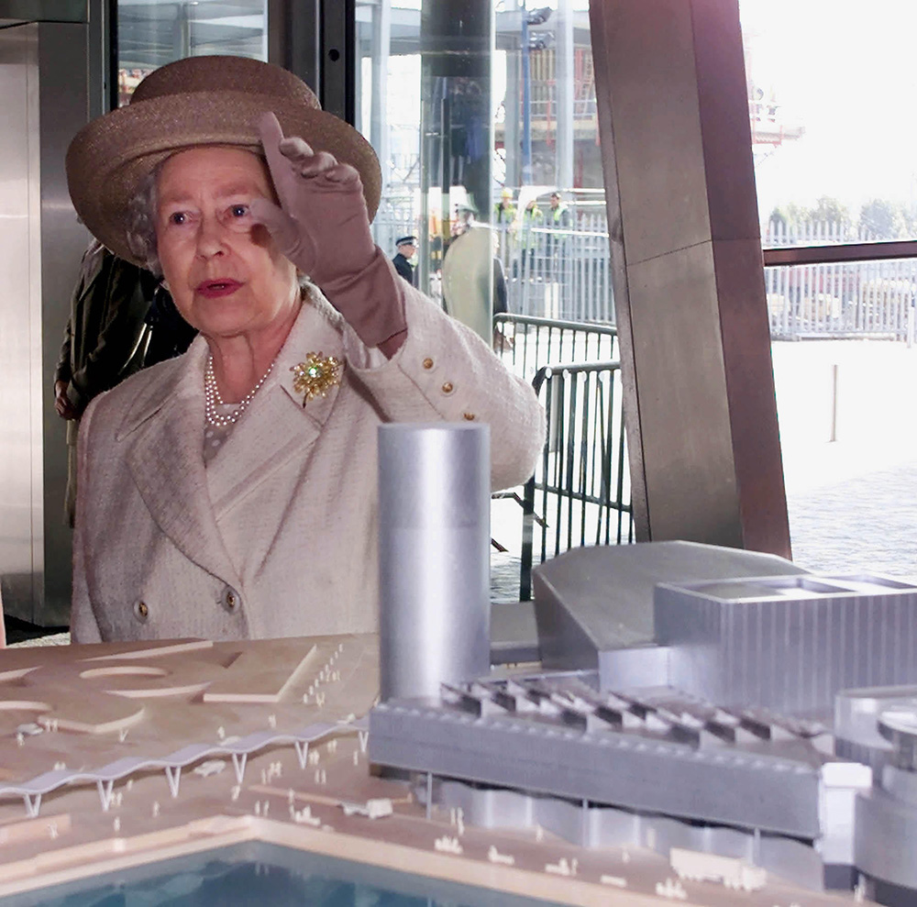
Notes:
The Queen stands next to a model of The Lowry within the Lowry centre. © Alamy - G561JA - 12 October 2000

Slide 59
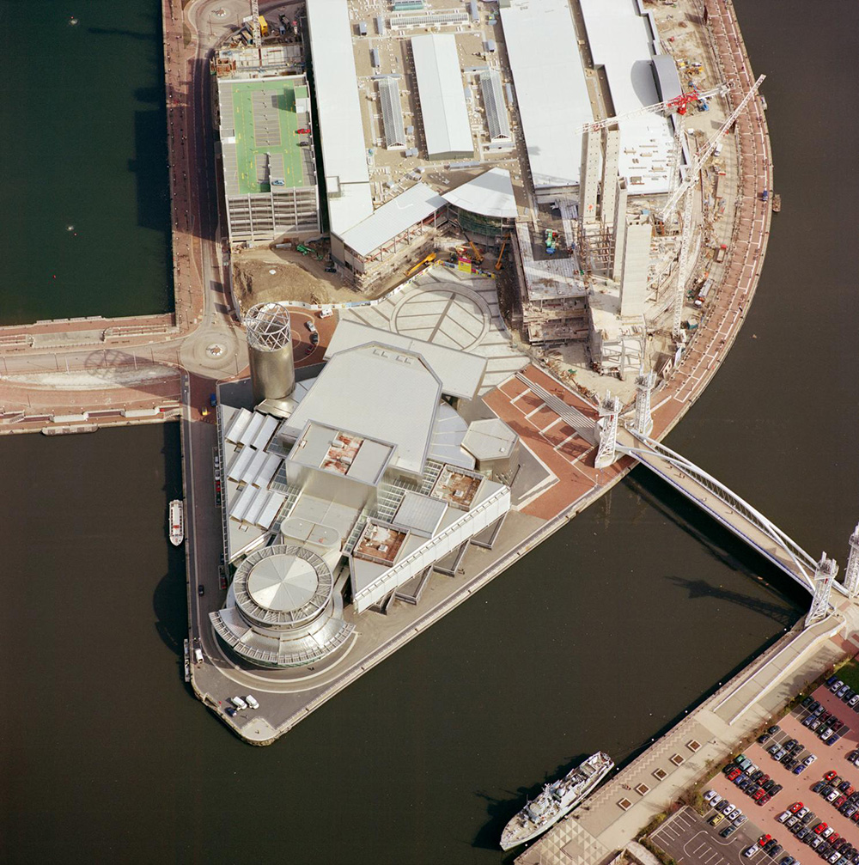
Notes:
An aerial view showing the newly built Lowry centre. © Copyright Historic England Archive - nmr 21156/01 - March 2001

Slide 60
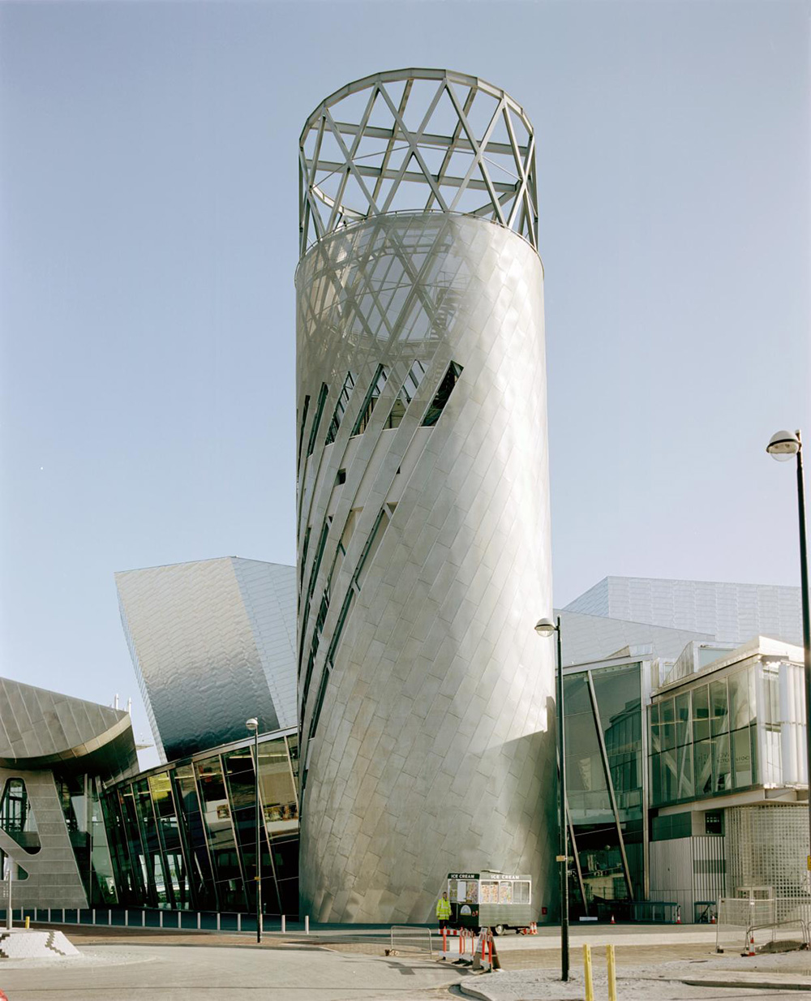
Notes:
A view showing the distinctive tower next to one of the entrances to The Lowry. © Historic England Archive - aa005813 - 24 May 2000

Slide 61
Bolton Market Hall
The Queen visited Bolton on 1 December 1988. She opened the newly refurbished and renamed Market Place Shopping Centre which was originally Bolton Market Hall.
Bolton Market Hall was first opened in December 1855. It was said at the time to be the largest covered market in the country.
The site has been modified several times over the course of its life but the hall itself, and the shops on the ground floor, are Grade II listed.
Find out more on the National Heritage List.

Slide 62
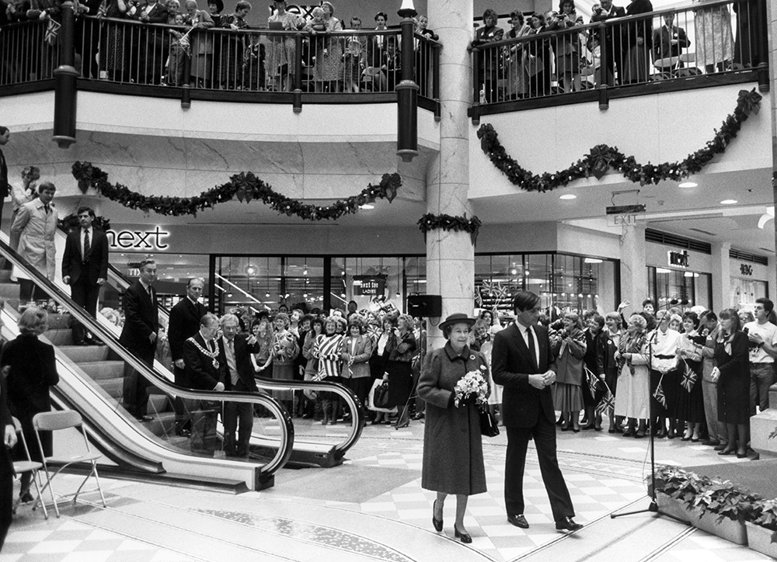
Notes:
A black and white image of the Queen standing next to an escalator within a shopping centre as crowds look on. © Alamy - EP2D66 - 1 December 1988

Slide 63
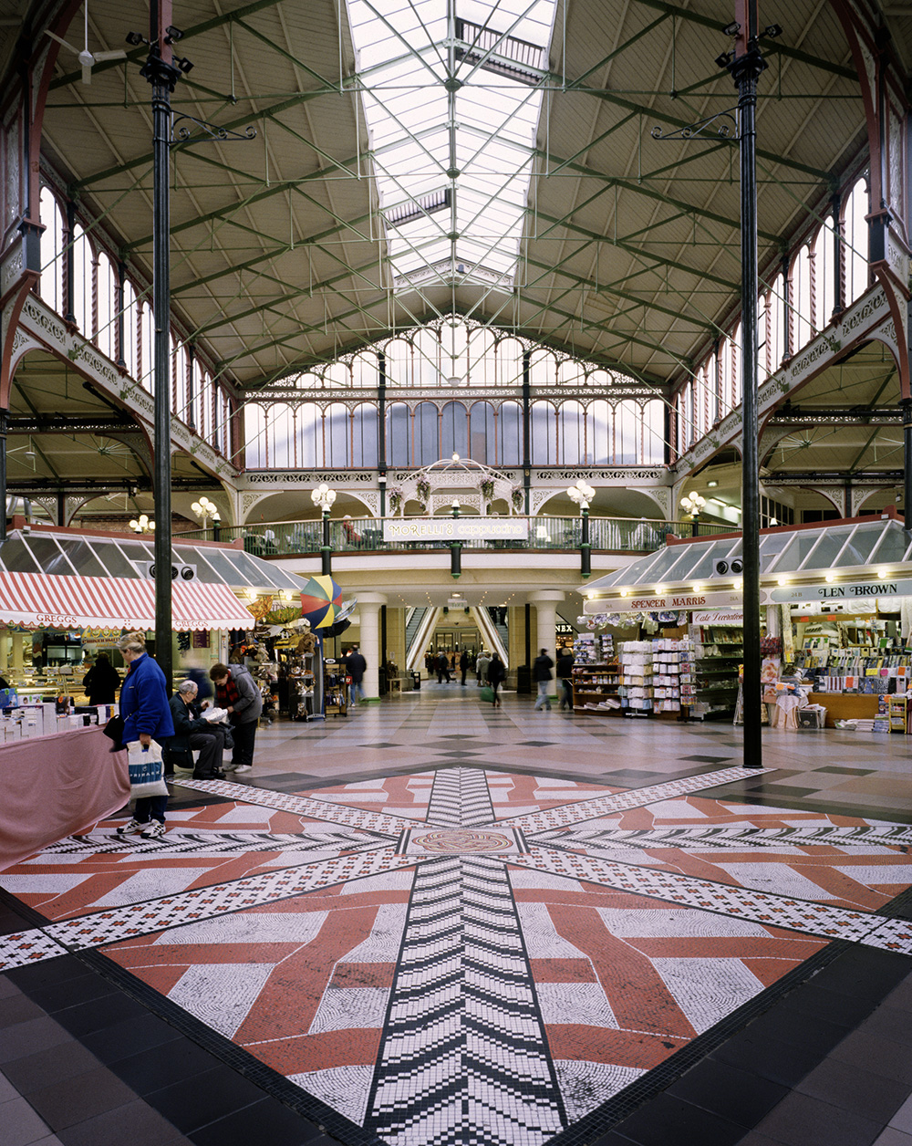
Notes:
A view across the Victorian style Market Hall looking towards the new Market Place Shopping Centre. © Historic England Archive - FF99/00398 - 27 Jan 2000

Slide 64
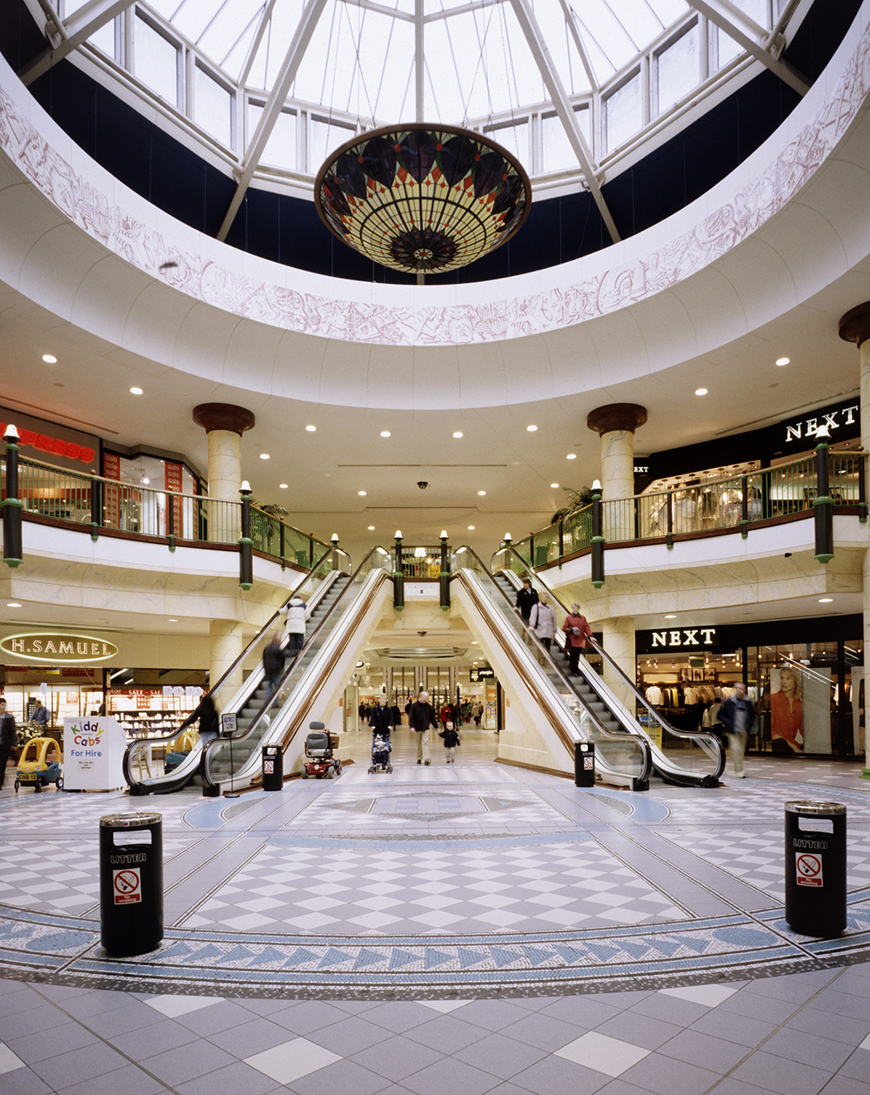
Notes:
A view of the ground floor atrium in the Market Place Shopping Centre, showing the elevators down from the first floor. © Historic England Archive - FF99/00401 - 27 Jan 2000

Slide 65
Trencherfield Mill
The Queen visited Trencherfield Mill in Wigan on 26 March 1986 as part of a royal visit to the area.
Trencherfield Mill was built as a cotton spinning mill, originally in 1822–23 by William Woods. The present building dates from 190 and is a Grade II listed building.
The steam engine at Trencherfields was one of the largest and, thought to be one of the finest, examples of its type. It could generate up to 2,500 horsepower which was used to power the machinery in the mill. The two sides of the engine were named after William Woods’ daughters; Helen and Rina.
Find out more on the National Heritage List.

Slide 66
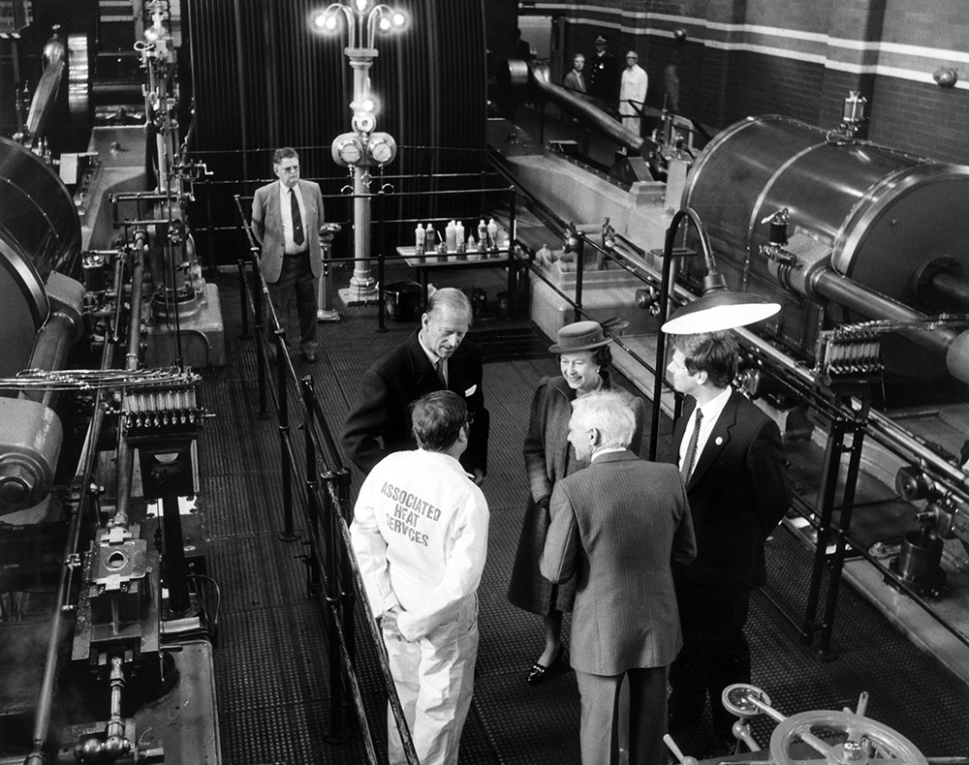
Notes:
The Queen and Prince Philip talk to staff in boilersuits, in front of big machines in the Engine Hall at Trencherfield Mill. © Alamy - EP2C5B - 26 March 1986

Slide 67
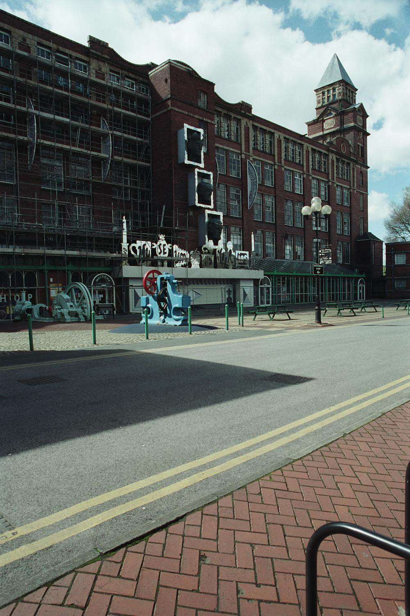
Notes:
A view of the 5 storey brick built mill, with a taller tower at one end. © Mr John Riley. Source: Historic England Archive Ref:IOE01/11404/03 Date: 1 SEP 2017

Slide 68
Wigan Pier
The Queen visited Wigan Pier on 21 March 1986 to open the newly regenerated Wigan Pier Complex.
The original "pier" at Wigan was a coal loading staithe, probably a wooden jetty, where wagons from a nearby colliery were unloaded into barges for transportation down the Leeds Liverpool Canal. It is thought that this pier was demolished in 1929.
In the 1980s, the canal warehouses around Wigan Pier were restored and put into use as a museum, exhibition hall and pub. Known as 'The Wigan Pier Quarter' the area is now designated as a Conservation Area.

Slide 69
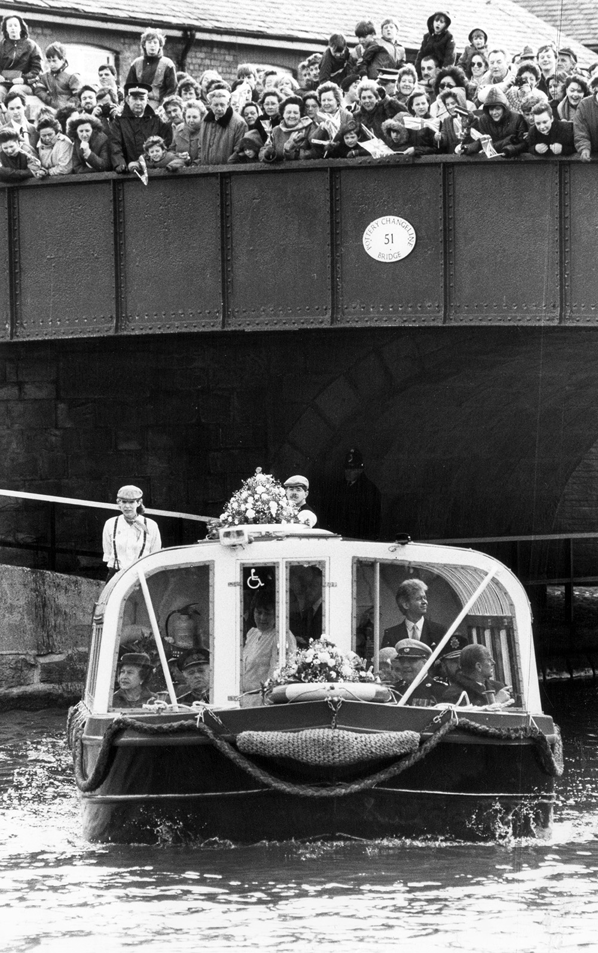
Notes:
The Queen and Prince Philip sailing on a barge on the canal heading to Wigan Pier, as crowds watch and wave from a bridge over the canal. © Alamy - EP2C3T - 21 March 1986

Slide 70
Notes:
View looking along the canal towards the warehouses alongside Wigan Pier. © Historic England Archive - DP006103 - 12 Apr 2005

Slide 71
Heinz Factory
The Queen visited the Heinz Factory in Wigan on 21 May 2009 to mark the factory’s 50th anniversary. This was her second visit to the site. Her first had been in June 1959, a few weeks after Heinz opened in Wigan.
The Heinz factory is one of the largest food factories in Europe and the largest Heinz factory in the world, producing 1.5-3 million tins of beans each day, as well as lots of other Heinz products.
Find out more about the history of Heinz.

Slide 72
Notes:
The Queen looks at a display of Heinz products, including tins of soup and baked beans, during a visit to the Heinz food factory in Wigan. © Alamy - GBNYY9 - 21 May 2009

Slide 73
Notes:
A view of the brick built Heinz factory. © Historic England Archive - op03064 - 1960 – 1969

Slide 74
Notes:
A view of the 3 storey, almost entirely glass walls or one part of the Heinz factory. © Historic England Archive - op03065 - 1960 - 1969

Slide 75
Aintree Racecourse
The Queen and the Queen Mother visited Aintree on 26 March 1955 to watch the Grand National. The royal party viewed the race from the box of Lord Derby and Lady Derby, in the background of this photo.
There has been a racecourse at Aintree since 1829, when the Second Earl of Sefton agreed to lease land to William Lynn, a local hotel owner, for the purposes of flat racing. Sefton was nicknamed “Lord Dashalong” due to his love of horse racing!
The racecourse is best known as the home of The Grand National which officially began in 1839 and is run annually in April. The County Stand at Aintree is a Grade II listed building.
Find out more on the National Heritage List.

Slide 76
Notes:
The Queen turns to laugh at her Mum, the Queen Mother, as they watch the 1955 Grand National at Aintree Racecourse. © Alamy - 2CHB0N8 - 26 March 1955

Slide 77
Notes:
Empty grandstands at Aintree Racecourse seen from the south-east, showing the Queen Mother Stand, the County Stand, and the Princess Royal Stand. © Historic England Archive - PLA01/02/0087 - 6 Jul 2005

Slide 78
Notes:
A black and white view of the jockey's Weighing Room, showing the large old fashion scales they have to stand on. © Crown Copyright. Historic England Archive Ref:BB97/02613 Date: 22 May 1997

Slide 79
St Andrew’s Garden Estate (“Bullring”)
The Queen visited Liverpool in July 1999 to carry out a number of engagements. One of these was a visit to the newly renovated tenements on the St. Andrew’s Gardens Estate, otherwise known as the Bullring.
The Bullring was built in 1935 as part of Liverpool council’s drive to replace slum housing in the city centre. Out of five multi storey dwellings built in the Liverpool at the time, the Bullring is the only one that remains. Today it is student housing and a Grade II listed building.
Find out more on the National Heritage List.

Slide 80
Notes:
The Queen leaving her car outside a large block of flats. © Alamy - G4N117 - 22 July 1999

Slide 81
Notes:
A view of a large block of flats (flats 1-32) on the St Andrew's Gardens Estate. © Mr David Cross. Source: Historic England Archive - IOE01/06439/29 - 23 Feb 2003

Slide 82
Liverpool Anglican Cathedral
The Queen visited Liverpool Anglican Cathedral on 26 October 1978, to take part in a Service of Thanksgiving and Dedication to mark the completion of the building after 74 years.
Liverpool Anglican Cathedral is Britain’s biggest Cathedral and took 74 years to build from the foundation stone being laid in 1904. A competition was held to design the cathedral and the winner, Giles Gilbert Scott, was only 22 and had never produced a building before!
The Anglican Cathedral in Liverpool was described by the poet Sir John Betjeman as “one of the great buildings of the world”. It is a Grade I listed building.
Find out more on the National Heritage List.

Slide 83
Notes:
The Queen at the Service of Thanksgiving and Dedication in Liverpool's Anglican Cathedral to mark the completion of the building after 74 years. Seated near her are the Archbishop of York, Dr Stuart Blanch, left, and the Dean of Liverpool, the Very Reverend Edward Patey. © Alamy - G4YAXT - 26 October 1978

Slide 84
Notes:
Black and white aerial view of the Anglican Cathedral still being built. © Historic England Archive (Aerofilms Collection) - EAW042533 – 18 April 1952

Slide 85
Notes:
A black and white image showing the cathedral still under construction with scaffolding on parts of it and a crane in the background. © Historic England Archive - AA98/04362 - 1945 - 1980

Slide 86
Birkenhead Town Hall
The Queen visited Birkenhead Town Hall on 11 July 1957.
The town hall in Birkenhead was completed in 1887. It was designed by local architect Charles Ellison as part of William Laird’s prestigious Hamilton Square development.
The Town Hall was located and designed to make it visible from Liverpool’s waterfront on the opposite side of the Mersey, emphasising Birkenhead’s civic pride to her neighbour. Birkenhead Town Hall is a Grade II* listed building.
Find out more on the National Heritage List.

Slide 87
Notes:
Black and white image of the Queen and Prince Philip outside Blackburn Town Hall, the Queen is wearing long white gloves and waving. © Alamy - 2HJ6D7X - 11 July 1957

Slide 88
Notes:
Black and white view of Birkenhead Town Hall, showing the classical columns of the portico at the front. Source:Historic England Archive - BL08733 - 9 Jun 1888

Slide 89
St Helens Town Hall
The Queen visited St Helens Town Hall on 20 October 1954. In the photograph she is accompanied by the Mayor, Councillor T Hignett, Prince Philp and the Mayoress, Miss Margaret Hignett, follow.
St Helens Town Hall was built in 1876. There had previously been a town hall on the same site, completed in 1839, but it was destroyed by fire in 1871.
Although St Helens Town Hall is not a listed building, there are two telephone kiosks flanking the entrance which are listed.
Find out more on the National Heritage List.

Slide 90
Notes:
A black and white image of the Queen accompanied by the Mayor, Councillor T Hignett, Prince Philip and the Mayoress, Miss Margaret Hignett, as the all walk down the steps leading out of the Town Hall. © Alamy – 2HHWA0G - 20 October 1954

Slide 91
Notes:
A black and white aerial view of the town centre and town hall as they looked in 1920. © Historic England Archive.AerofilmsCollection - EPW000262 – April 1920

Slide 92
Warrington Town Hall
The Queen visited Warrington on 2 November 1979. She was greeted by excited crowds on her arrival and later that day, visited Warrington Town Hall where she waved to the crowds from the balcony.
Warrington Town Hall was built in 1750. It was originally known as Bank Hall and was the home of Thomas Patten, an important merchant in the town. When it was built Bank Hall stood in open fields on the edge of the town, surrounded by landscaped gardens and with views of the River Mersey and the Cheshire countryside.
In 1870 the hall, and 13 acres of surrounding land, was sold to Warrington Borough Council. Almost all of the land was opened as Warrington's first public park in 1873.
Find out more on the National Heritage List.

Slide 93
Notes:
A black and white image of the Queen, Prince Philip and the Mayor walking up some steps into the Town Hall, with a huge crowd of well-wishers in the background. © Alamy - 2J0EER7 - 2 November 1979

Slide 94
Notes:
A general view of the Georgian styled Town all, the central part of which has a pale stone facade which is flanked by red brick to either side of it. © Historic England Archive - DP006080 - 24 May 2005

Slide 95
Notes:
A hand-coloured postcard of Town Hall Park, showing the railings, fountain and parkland in the foreground, with the Town Hall visible in the background. Source: Historic EnglandArchive - PC08933 - 1900 - 1920

Slide 96
The Royal Hotel, Runcorn
The Queen visited Runcorn on 31 July 1998. The building that she is standing outside in this image is the Royal Hotel in Runcorn, which is a Grade II listed building.
Dating from the late 18th Century, the Royal Hotel is Runcorn’s oldest public house. The building opposite the Royal was originally the town hall, then the police station with a court and cells. This building was restored and reopened by the queen during her visit in 1998.
Find out more on the National Heritage List.

Slide 97
Notes:
The Queen carefully checks the soot stained hand of chimney sweep Martin Cook, before agreeing to a hand shake. © Alamy - 2D2YX8C - 31 July 1998

Slide 98
Notes:
A view of the outside of the 3 storey brick built hotel with red signage and pretty hanging baskets. © Mr Peter Sargeant. Source: Historic England Archive - IOE01/07062/32 - 25 Aug 2002

Slide 99
Rocksavage Power Station
The Queen officially opened the Rocksavage Power Station at ICI's Runcorn plant on 31st July 1998. In the photograph she is escorted by Mr Carlos Riva, President and Chief Executive Officer of InterGen Energy at the time.
Rocksavage Power Station takes its name from a nearby Elizabethan Mansion, home of the Savage family who were important Cheshire landowners. The power station is a natural gas fired power plant which has the generating capacity of 810MW - enough to meet the needs of more than 800,000 households.
Find out more about Rocksavage Power Station.

Slide 100
Notes:
The Queen , escorted by Mr Carlos Riva, President and Chief Executive Officer, InterGen Energy, officially opens the new Rocksavage Power Station. © Alamy - 2D2YX8R - 31 July 1998

Slide 101
Notes:
An aerial view showing the site of the massive Power Station. © Historic England Archive - 35025_048 - 23 April 2021

Slide 102
Blue Planet Aquarium
The Queen visited Blue Planet Aquarium on 31 July 1998 to mark its opening.
When it was built, the Blue Planet Aquarium in Chester was the largest aquarium in the UK. It was designed, by Manchester-based architects, Buttress Fuller Alsop, to resemble the shape of a crashing wave. Today Blue Planet in Chester holds the biggest collection of sharks in Europe!
Find out more about the aquarium.

Slide 103
Notes:
The Queen and Prince Philip walk through an observation tunnel looking at the fish and other marine life swimming above them. © Alamy - G4ED18 - 31 July 1998

Slide 104
Notes:
Aerial view of the Blue Planet Aquarium on the edge of the Cheshire Oaks Outlet Centre. © Historic England Archive - 33152_019 - 26May 2017

Slide 105
Chester Zoo
The Queen enjoyed a visit to Chester Zoo on 17 May 2012. She took a trip on the Monorail, visited the new Rhino Paddock and unveiled a plaque at the zoo's entrance.
Chester Zoo was opened by George Mottershead in 1931. As a boy he was inspired by a visit to Belle Vue Zoological Gardens in Manchester and had, from that point onwards, dreamed of opening a site of his own.
Mottershead’s vision was that his attraction would be a zoo “with no bars.” He used moats and ditches as an alternative to Victorian style cages. Today the zoo is one of the most visited wildlife attractions in Britain, holding more than 70 species of animal.
Oakfield House, the original headquarters of Chester Zoo, now a restaurant, is a Grade II listed building.
Find out more on the National Heritage List.

Slide 106
Notes:
The Queen being given a tour of the new rhino paddock, the rhinos can be seen lying down in the back of the paddock. © Alamy - DJP31A - 17 May 2012

Slide 107
Notes:
View of Oakfield House, the original headquarters of Chester Zoo, with its elaborate gable ended roofs. © Mr Graham R. Heasman. Source: Historic England Archive - IOE01/15257/30 - 11 Sep 2006

Slide 108
Chester Cathedral
The Queen attended the Royal Maundy Service at Chester Cathedral on 3 June 1992. As part of the service, she distributed Maundy Money to pensioners who had been nominated by the local dioceses for contributions to their local church and community.
The site of Chester cathedral has been used as a place of worship since Saxon times. The oldest parts of the building that now stands, date to 1093, when it was first built by Benedictine Monks. Much of the Cathedral was then rebuilt in 1250 in a more dramatic, gothic style. Chester Cathedral is a Grade I Listed Building.
Find out more on the National Heritage List.

Slide 109
Notes:
The Queen and Prince Philip pose with members of the clergy and children holding posies of flowers. © Alamy - 2AXBJYN - 3 June 1982

Slide 110
Notes:
Black and white exterior view from the south-east of Chester Cathedral. Source: Historic England Archive - BB86/05572 - 1880 –1920

Slide 111
Notes:
Black and white aerial view of the Cathedral and its surrounding area, from the north-west. © Historic England Archive - WSA01/01/K0739 - 1930 – 1935

Slide 112
Notes:
Black and white view looking down St Werburgh Street at the tower of Chester Cathedral. © Historic England Archive - WSA01/01/C0829 - 1930 - 1960

Slide 113
Chester Racecourse
The Queen visited Chester Racecourse on 10 June 2010 to attend the Drumhead Service of Thanksgiving to mark the return of soldiers of 1st Battalion Royal Welsh from operations in Afghanistan.
Chester Racecourse is the oldest racecourse still in operation in the world. The first race was held there in 1539, with the consent of the Mayor of Chester, Henry Gee. It is thought that the term "gee-gees" originates from his name!
The site of Chester Racecourse was once underwater and, during the Roman Period it was a harbour used for trading vessels from all over the world.
Find out more about the history of the racecourse.

Slide 114
Notes:
The Queen posed for a group photo with the soldiers of 1st Battalion Royal Welsh regiment. © Alamy - GCJ4D8 - 10 June 2010

Slide 115
Notes:
An aerial view of the racecourse, showing how it is surrounded on one side by a river. © Historic England Archive (Aerofilmscollection) - EAR012313 - 12 May 1950

Slide 116
Leighton Hospital, Crewe
The Queen visited Crewe on 4 May 1972. Whilst there she formally opened the newly built Leighton Hospital. In the photograph you can see her visiting the children’s ward with Chief Nursing Officer, Susanna Lewis.
Built at a cost of £6 million, Leighton Hospital replaced older facilities at Crewe District Memorial Hospital, Crewe Works Hospital, the Linden Grange Maternity Hospital and Coppenhall Hospital in Crewe, as well as Nantwich Cottage Hospital and the Barony Hospital in Nantwich.
Find out more about Leighton Hospital.

Slide 117
Notes:
A black and white image of the Queen, accompanied by some nurses, talking children on the Children's Ward at Leighton Hospital. © Alamy - EP2CJA - 4 May 1972

Slide 118
Notes:
An image of the reception at Leighton Hospital. EspressoAddict / via WikiMedia Commons - 5 March 2009

