Slide 1
Queen Elizabeth II Platinum Jubilee
Story Map – South West Region Images
Key Stage 2: History & Geography
Learning Aims and Outcomes
Pupils understand more about the role of the Queen by exploring the Story Map of some of her visits to different places across England
Pupils learn about the Queen’s visits to significant places/events in their region of the country through her 70-year reign
Pupils develop a sense of place through mapwork
Pupils can identify regions of England and locate places in the region they live in
Pupils take part in celebrating a significant historical event
This learning resource supports the Historic England Platinum Jubilee Story Map & Platinum Jubilee Activities PPT
Notes:
This resource is intended to be used with the Historic England Jubilee Story Map which documents some of the many places the Queen has visited throughout her reign. Pupils are able to explore the pins on the map of their region of the country to find out about the significant buildings and events the Queen has visited. The Story Map contains information about the visit, a brief history of the building and images of the Queen and the building.

Slide 2
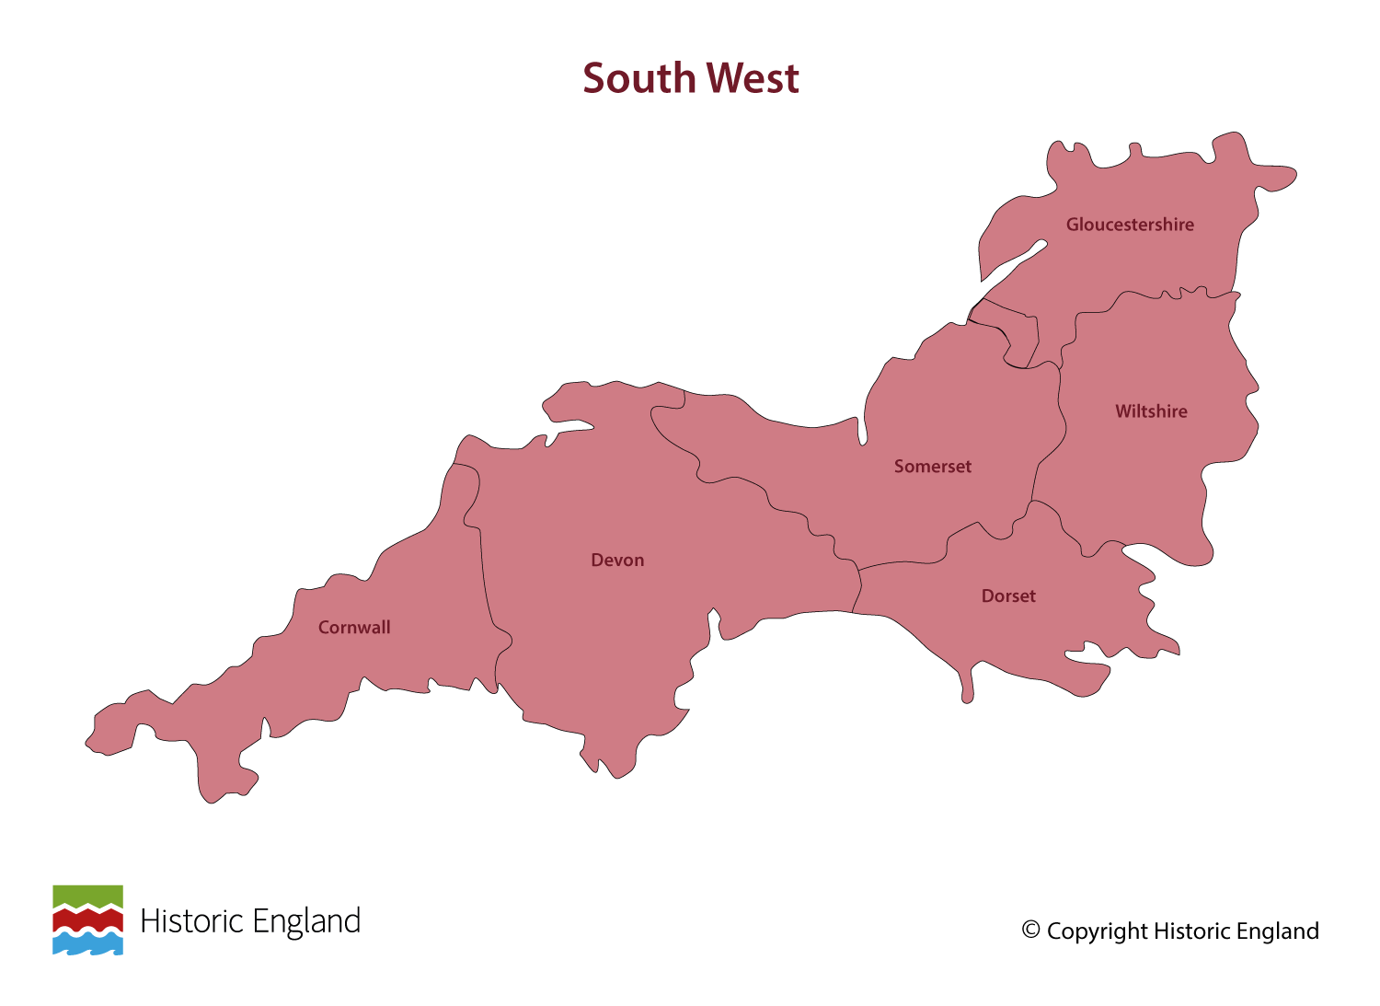
Notes:
Before following the link to your regional Story Map you may wish to discuss with pupils what counties are covered in your region.

Slide 3
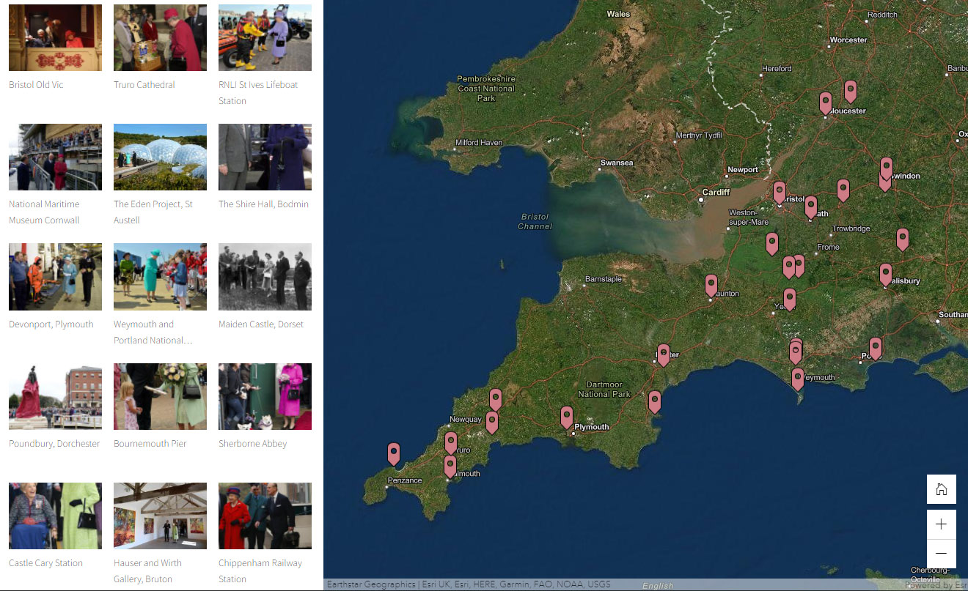
Notes:
Follow the link to your regional Story Map - https://storymaps.arcgis.com/stories/f203f178047e4c17a1fb038acd17e1c7

Slide 4
Bristol Old Vic
On 22 November 2012, as part of her Diamond Jubilee tour, the Queen and Prince Phillip visited the recently refurbished Bristol Old Vic theatre.
Opened on 30 May 1766, the Grade I listed Theatre Royal remained in continuous use for 25 years, surviving fire, rioting and bomb damage in the process, until it closed for refurbishment in 2016.
The theatre itself lies behind the Coopers Hall and was deliberately hidden away as theatres were still seen as somewhat disreputable establishments when it was first built. In that time over 7.5 million people have seen a theatre production at the Bristol Old Vic.
Find out more on the National Heritage List.

Slide 5
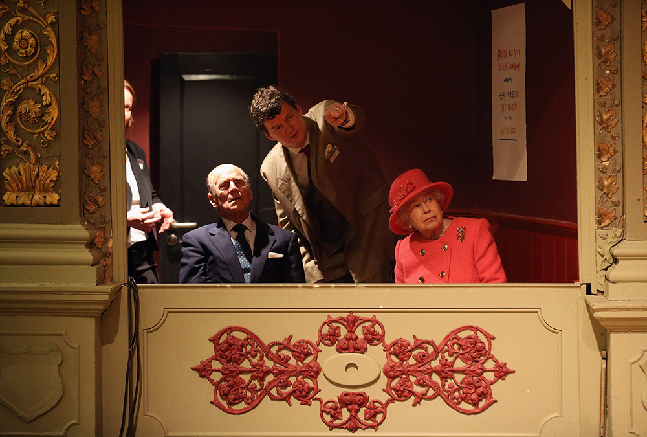
Notes:
The Queen and Prince Philip sat in the Royal Box at the Bristol Old Vic theatre. © Alamy - G5MHP1 - 22 November 2012

Slide 6
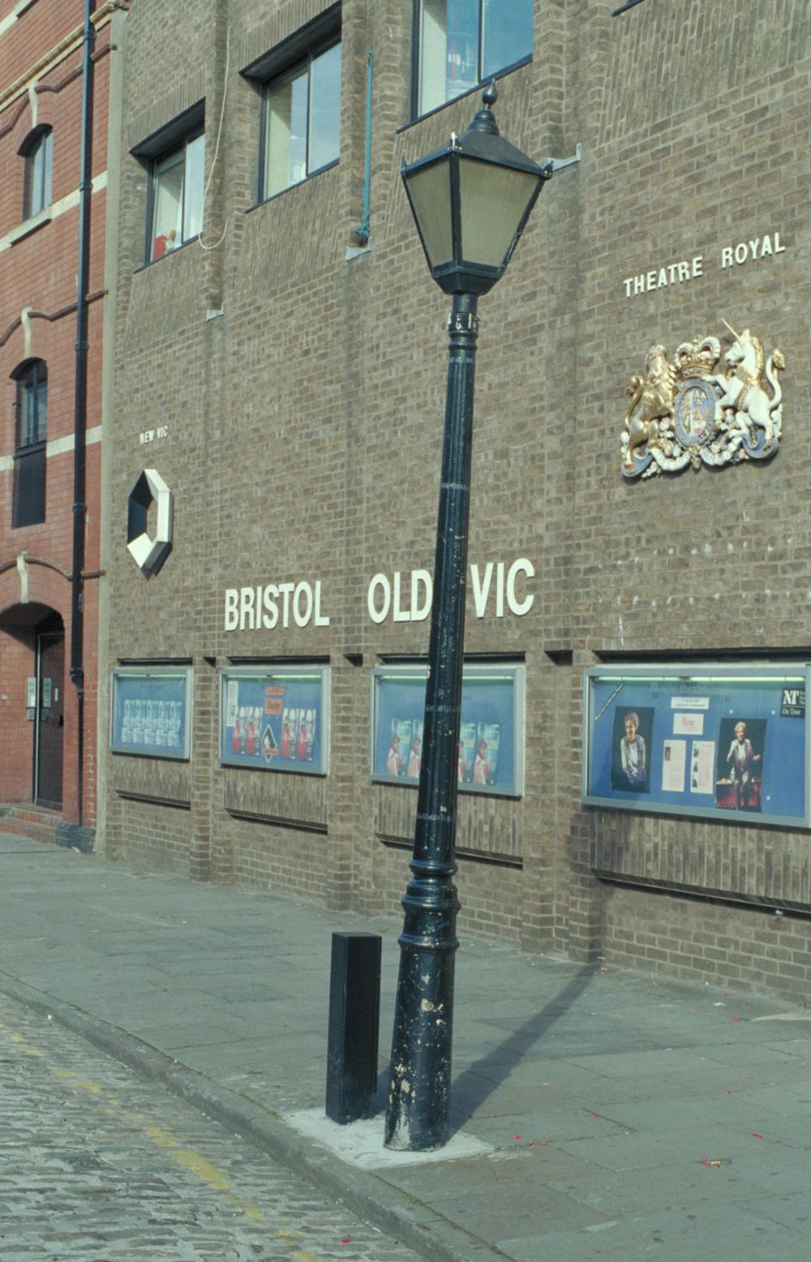
Notes:
The outside of the Old Vic Theatre with a series of posters advertising upcoming shows. © Mr Peter Frederick Rushby. Source Historic England Archive - IOE01/01552/07 - 22 Aug 1999

Slide 7
Truro Cathedral
As part of her Golden Jubilee tour, the Queen visited Truro Cathedral on 1 May 2002. She and Prince Phillip attended a lunch to commemorate the 125th anniversary of the diocese of Truro.
Although it looks every bit a medieval gothic cathedral, the Grade I listed Truro cathedral is a late Victorian/early Edwardian Gothic-revival building designed by JL Pearson and completed by his son FL Pearson.
It was the first cathedral to be built on a new site in England since Salisbury in 1220. The Twenty-First Century has seen extensive restoration work on the West Front, Towers and roof.
Find out more on the National Heritage List.

Slide 8
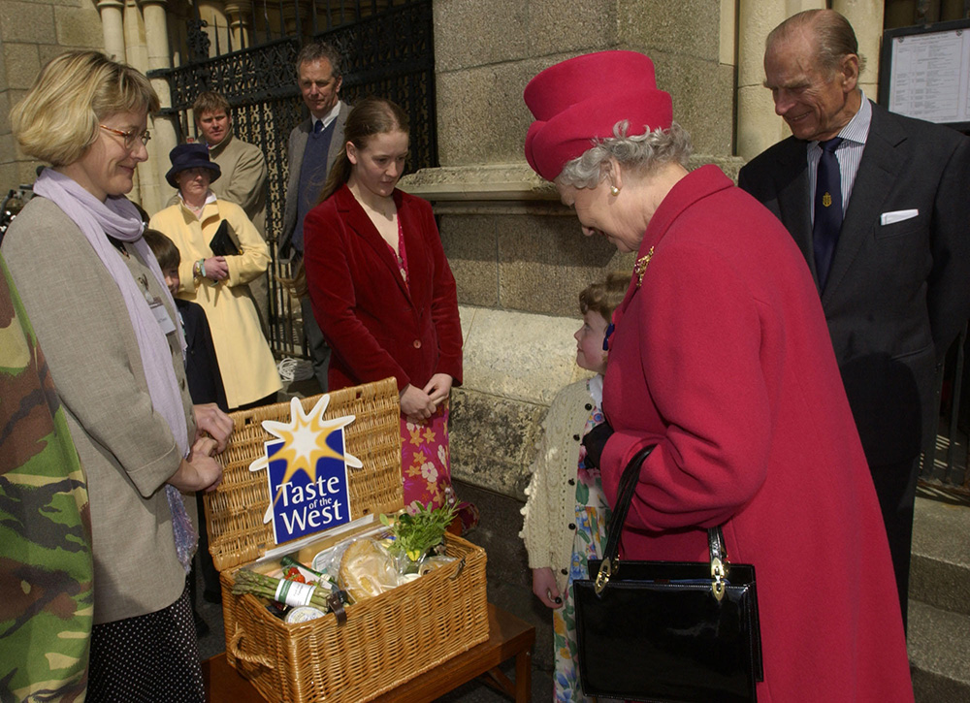
Notes:
The Queen admires a wicker hamper of regional produce outside Truro Cathedral. © Alamy - G5TP1W - 1 May 2002

Slide 9
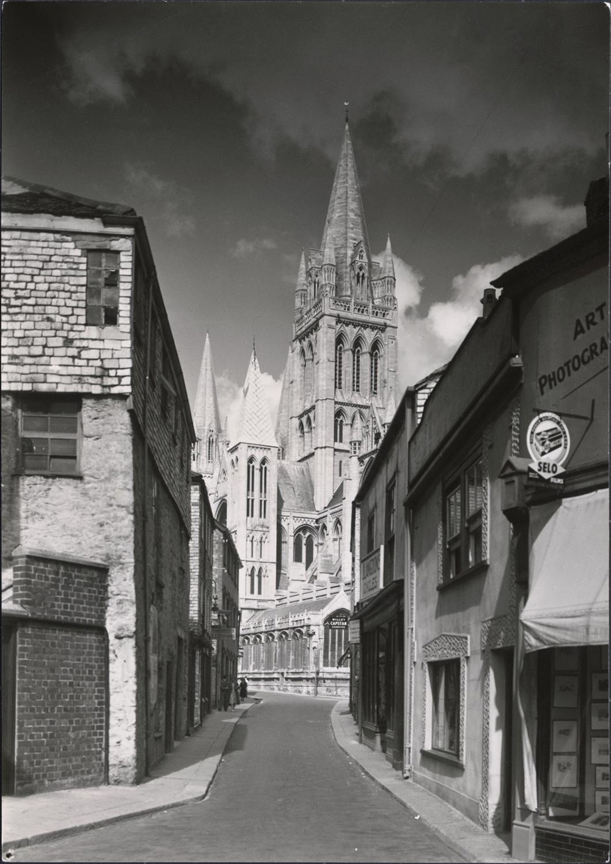
Notes:
A black and white view looking towards Truro Cathedral, from St Mary's Street, showing the cathedral towering above the buildings on St Mary's street. Source Historic England Archive - DIX02/01/001 - 1930 - 1939

Slide 10
RNLI St Ives Lifeboat Station
The Queen visited St Ives on 17 May 2013 as part of the Diamond Jubilee tour, unveiling a plaque at the boathouse before greeting the public on the harbourfront and visiting the Tate Gallery.
The St Ives Lifeboat Station was built in 1861 at a cost of £142. It is known that a lifeboat has been stationed at St Ives since at least 1840. The present boathouse was built in 1994 as the previous one was not big enough to accommodate the new Mersey class lifeboat.
In its history, 34 medals have been awarded to members of the St Ives lifeboat crew, 18 silver and 2 bronze.
Find out more about RNLI St Ives.

Slide 11
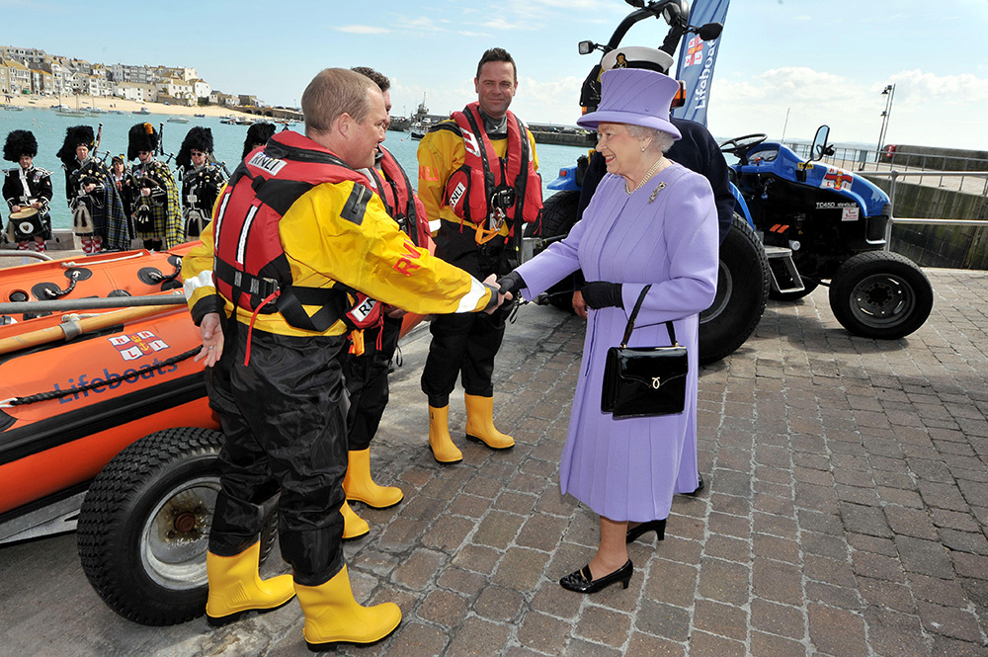
Notes:
The Queen shakes hands with members of the Lifeboat Crew who are dressed ready for action in their waterproof clothes and life-jackets. © Alamy - G63RGD - 17 May 2013

Slide 12
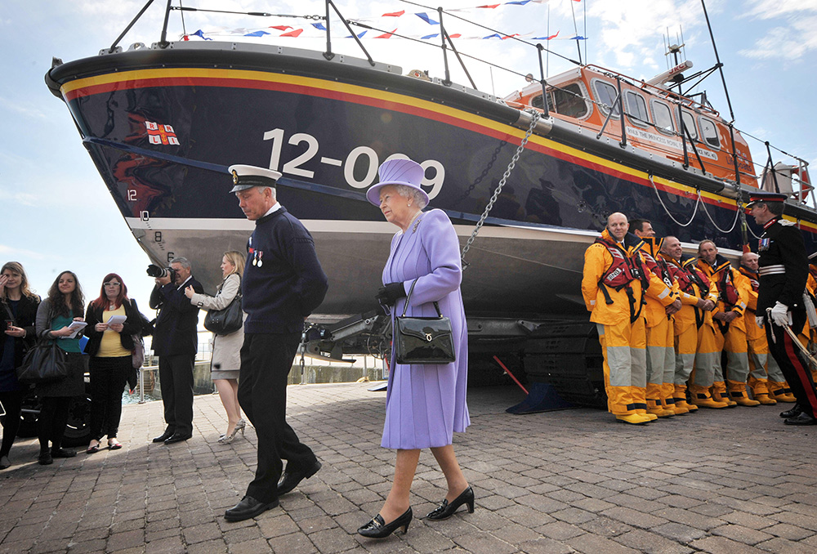
Notes:
The Queen is led past a lifeboat and it's crew. © Alamy - G63RHB - 17 May 2013

Slide 13
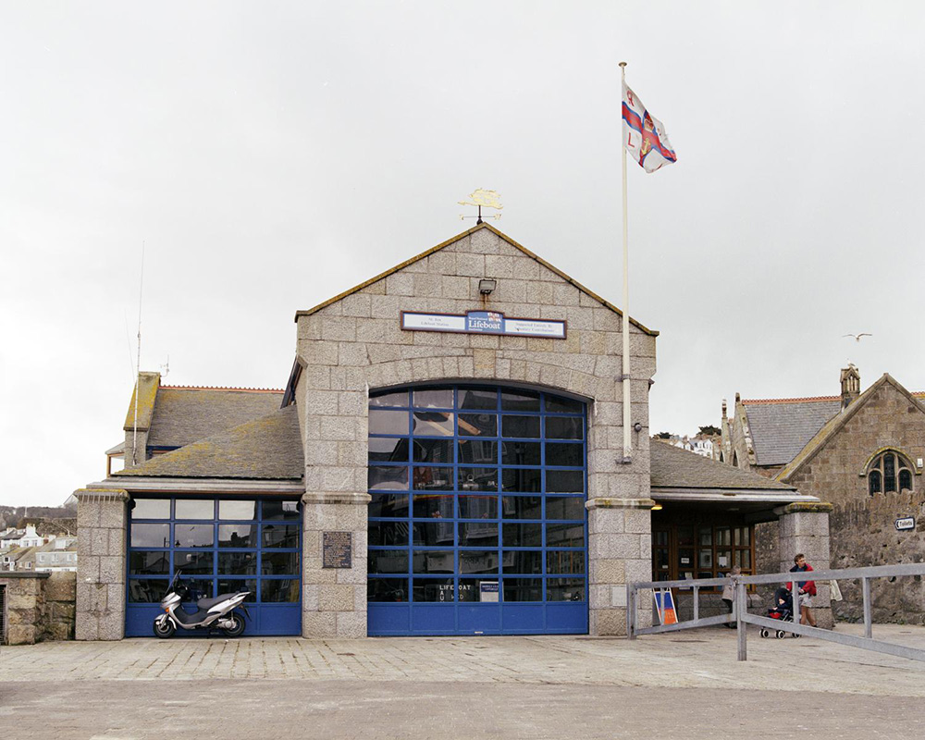
Notes:
A view showing the outside of the St Ives Lifeboat Station with it's very big windows with distinctive blue glazing bars. © Historic England Archive - AA052788 - 20 Apr 2005

Slide 14
National Maritime Museum Cornwall
The Queen visited the National Maritime Museum in Falmouth on 1 May 2002 as part of her Golden Jubilee tour. At the time the museum was still under construction.
The Museum was opened in 2003 on the site of former boatyards in Falmouth. It was built as an extension of the National Maritime Museum in Greenwich as a seafront site for housing their collection of small boats.
Find out more about the National Maritime Museum Cornwall.

Slide 15
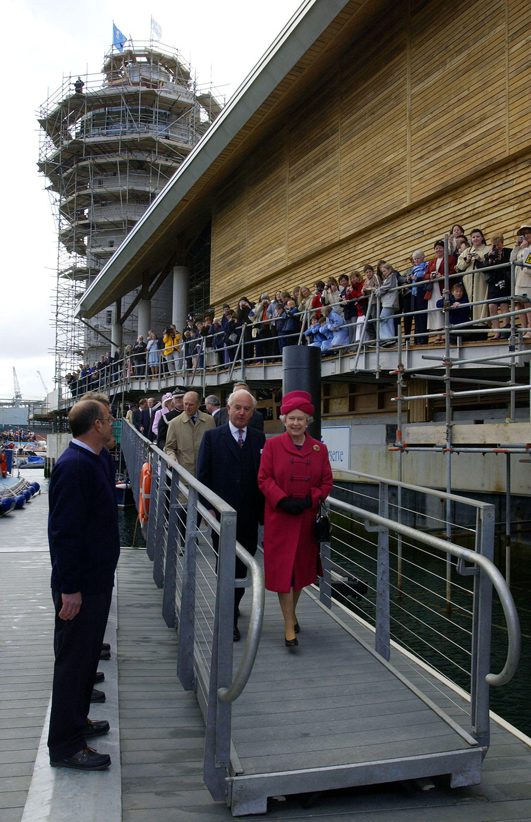
Notes:
The Queen walks past crowds gathered outside the National Maritime Museum. © Alamy - G5TP1P - 1 May 2002

Slide 16
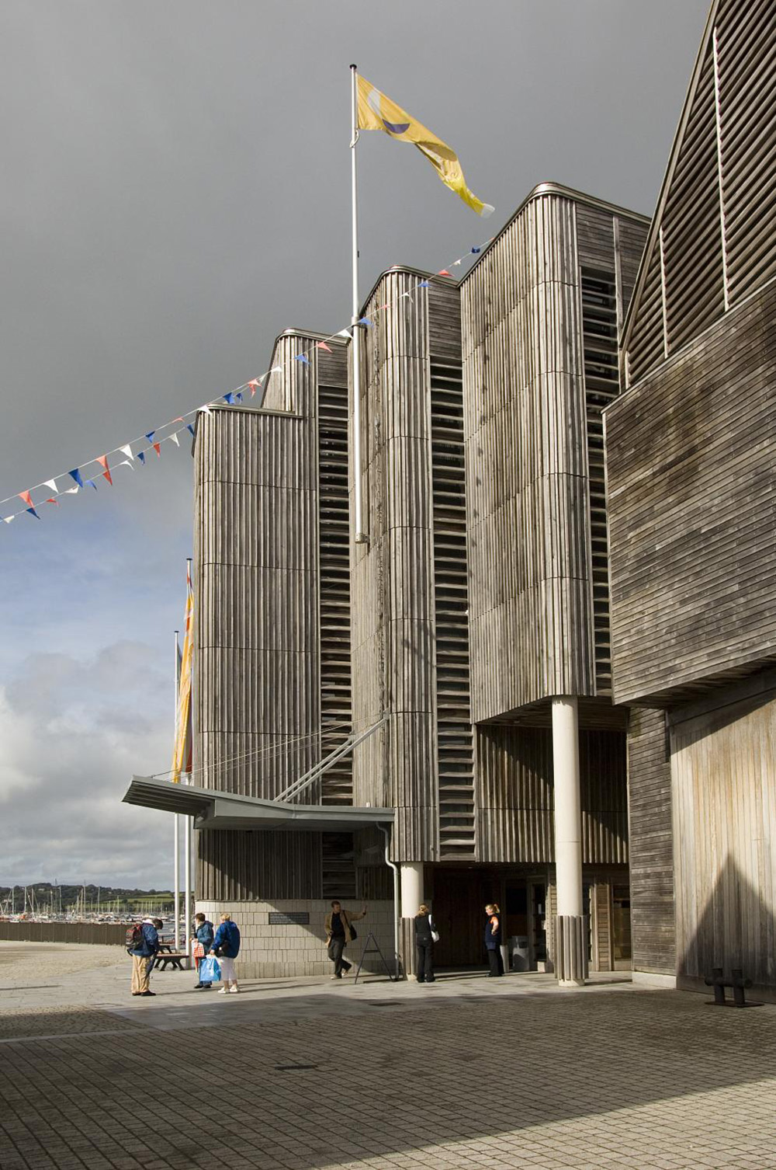
Notes:
A view of the modern National Maritime Museum showing it's distinctive wooden cladding. © Historic England Archive - DP024319 - 20 Sep 2007

Slide 17
The Eden Project, St Austell
The Queen visited the Eden Project on 1 June 2006 opening its new education building. She returned in June 2021 hosting the G7 World leaders.
The Eden Project opened for the first time in March 2001, built on the site of an exhausted clay pit just outside St Austell. It features giant ‘Biomes’ housing exotic plants from all over the world and has quickly become a world-famous visitor attraction in Cornwall.
Find out more about the Eden Project.

Slide 18
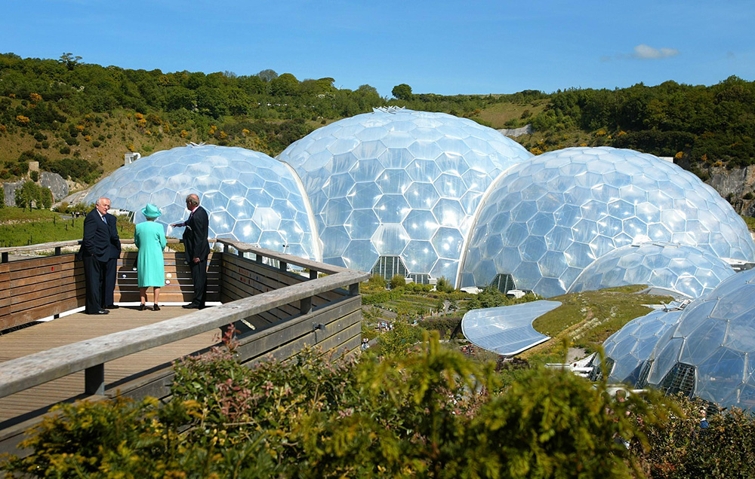
Notes:
The Queen looking out over the iconic 'Biomes' at the Eden Project. © Alamy - G9B9TF - 1 June 2006

Slide 19
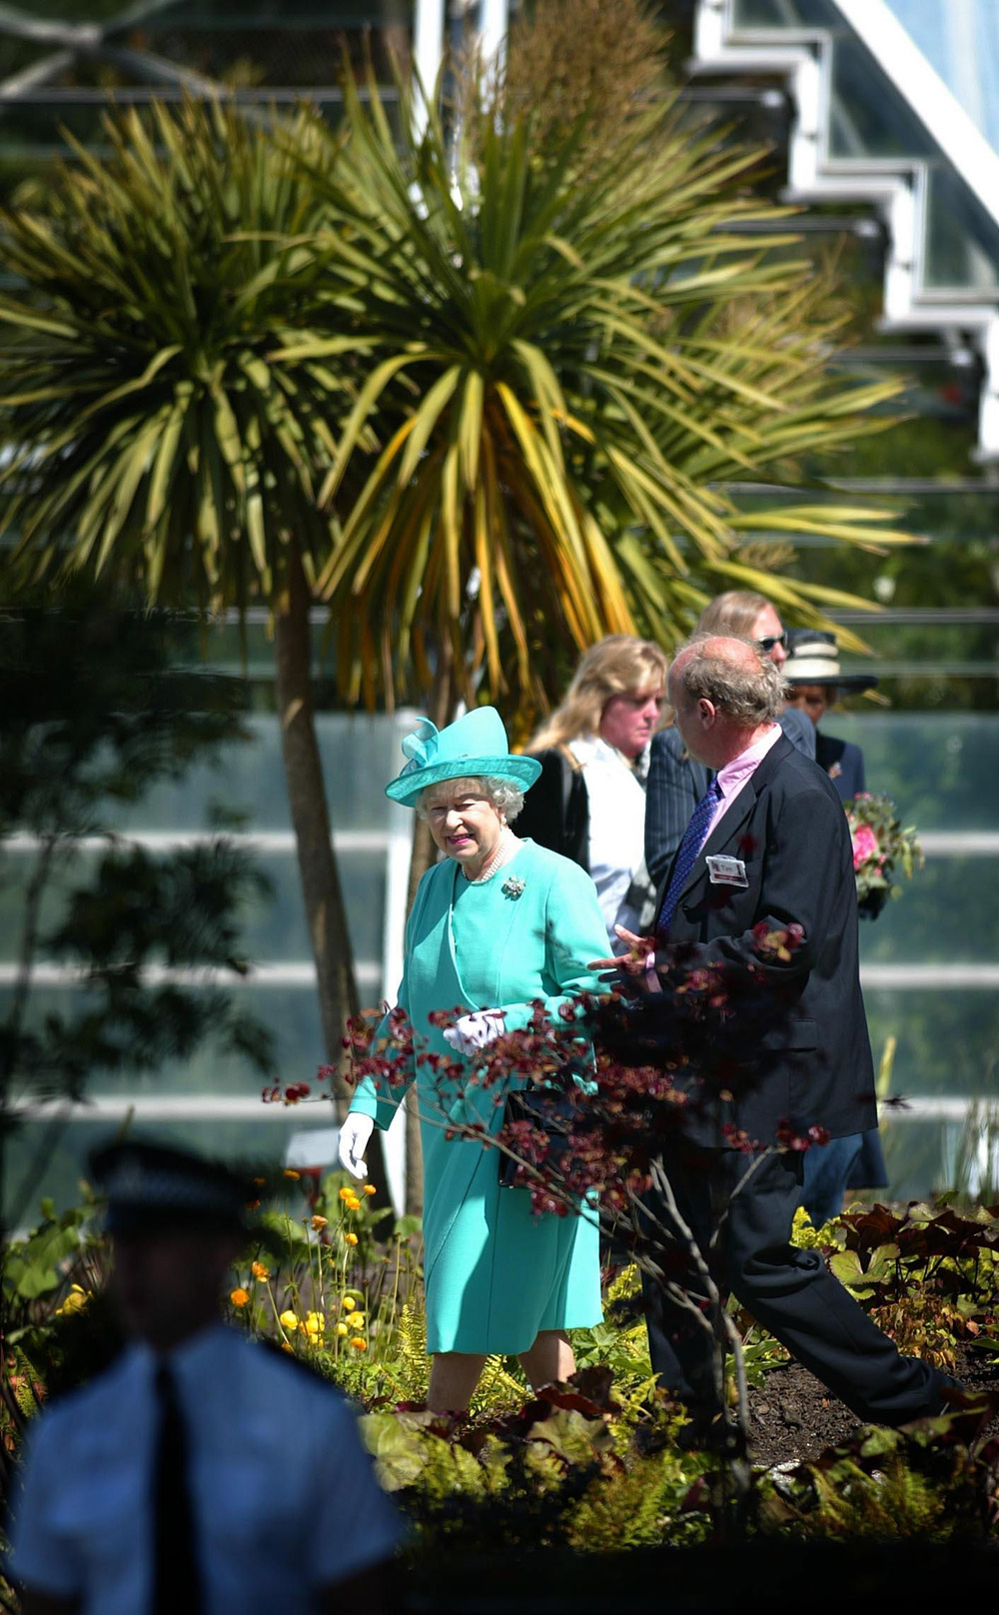
Notes:
The Queen being escorted past palm trees at the Eden Project. © Alamy - G9B9TE - 1 June 2006

Slide 20
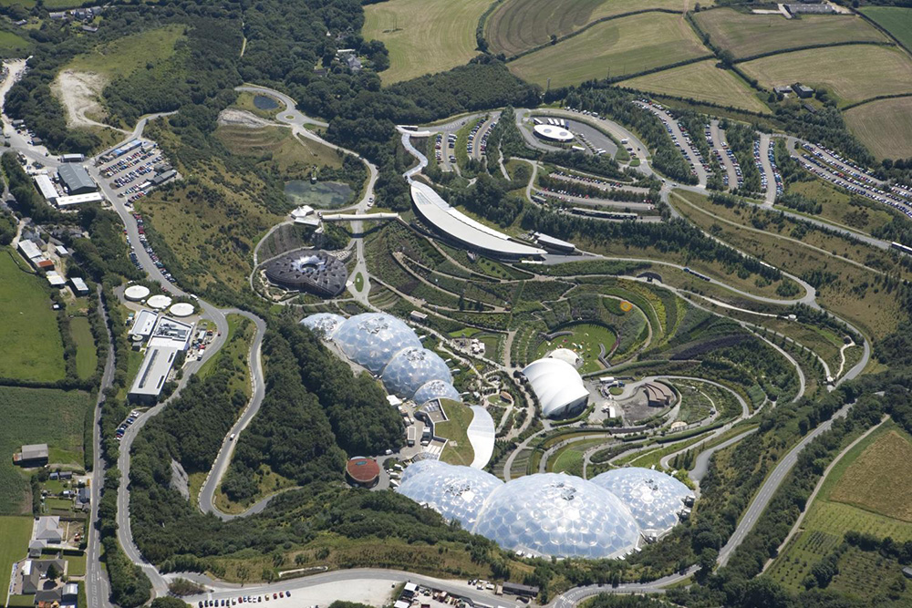
Notes:
An aerial view showing the whole of the Eden Project site, including it's iconic 'Biomes’. © Historic England Archive - 24646_008 - 31 Jul 2007

Slide 21
The Shire Hall, Bodmin
The Queen visited Bodmin on 8 June 2000 to open the new visitor attraction.
The Grade II* listed Shire Hall in Bodmin was the main courthouse in Cornwall from 1838 to 1988. It is now a visitor attraction with one of its courts restored to its original condition and the other converted to a visitor information centre.
Find out more on the National Heritage List.

Slide 22
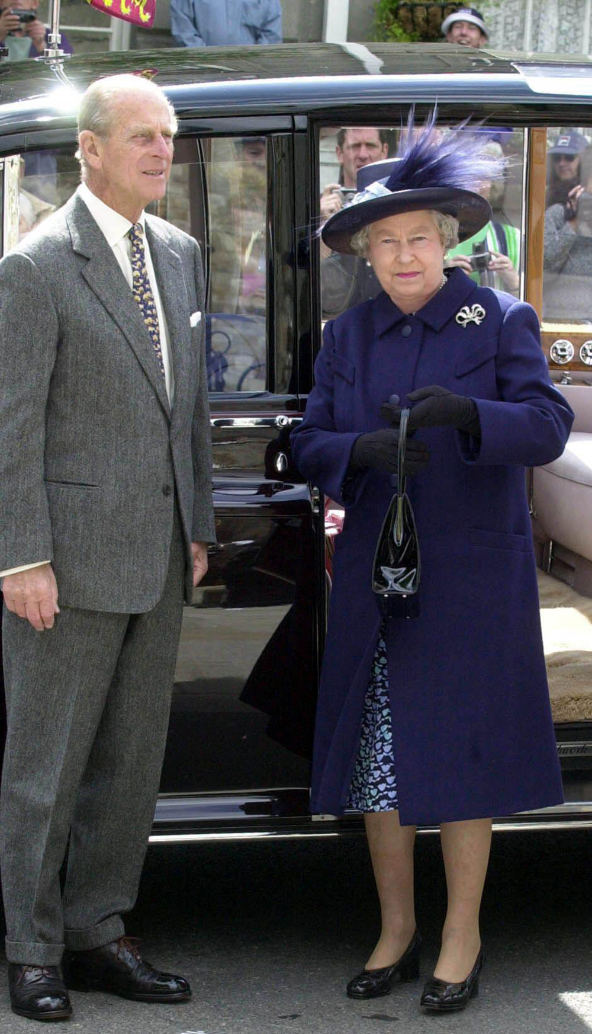
Notes:
The Queen and Prince Philip standing outside a car in Bodmin. © Alamy - 2D30YM0 - 8 June 2000

Slide 23
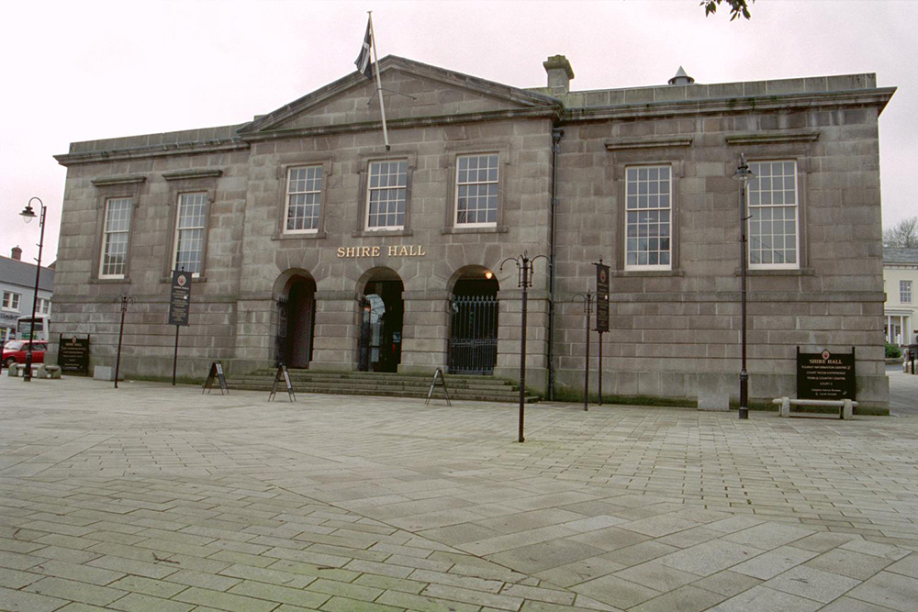
Notes:
A view of the stone built, impressive, Shire Hall. © Mr Charles A Perry. Source Historic England Archive -IOE01/03787/01 - 21 Mar 2001

Slide 24
Devonport, Plymouth
The Queen visited Devonport on 3 June 2010 making her second visit to HMS Ocean as the ship's sponsor - she officially named the helicopter carrier in 1998. She visited again on 20 March 2015 for a rededication ceremony.
The largest naval base in Western Europe, Devonport has been supporting the Royal Navy since 1691. The vast site covers more than 650 acres and has 15 dry docks, four miles of waterfront, 2 tidal berths and five basins.
The base employs 2,500 service personnel and civilians. It supports around 400 local firms and generates around ten per cent of Plymouth’s income.
Find out more on the National Heritage List.

Slide 25
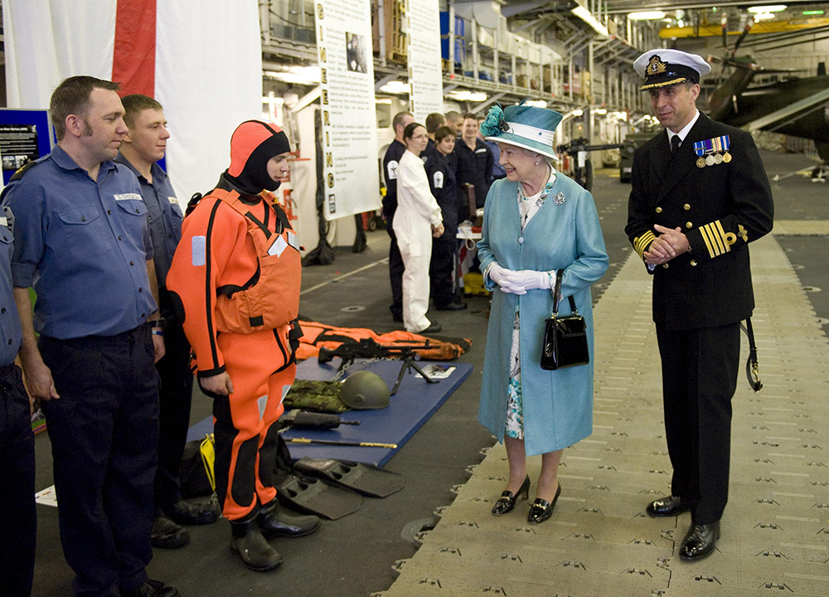
Notes:
The Queen and a navy office meet crew members in both ordinary blue and sea rescue orange uniforms. © Alamy - GCH2RR - 3 June 2010

Slide 26
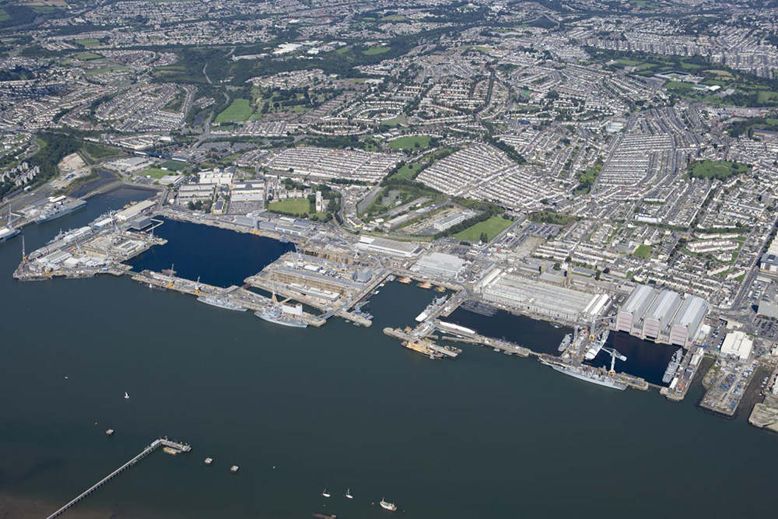
Notes:
Aerial views showing the naval docks at Devonport. © Historic England Archive - 26406_014 - 11 AUG 2009

Slide 27
Weymouth and Portland National Sailing Academy
The Queen visited Weymouth in June 2009 to open the new marina. The marina was built using 250,00 tonnes of Portland Stone to build a 875m long breakwater.
The Weymouth and Portland National Sailing Academy was created in time for the 2012 London Olympics as the sailing events were hosted in Weymouth.
Find out more about the National Sailing Academy.

Slide 28
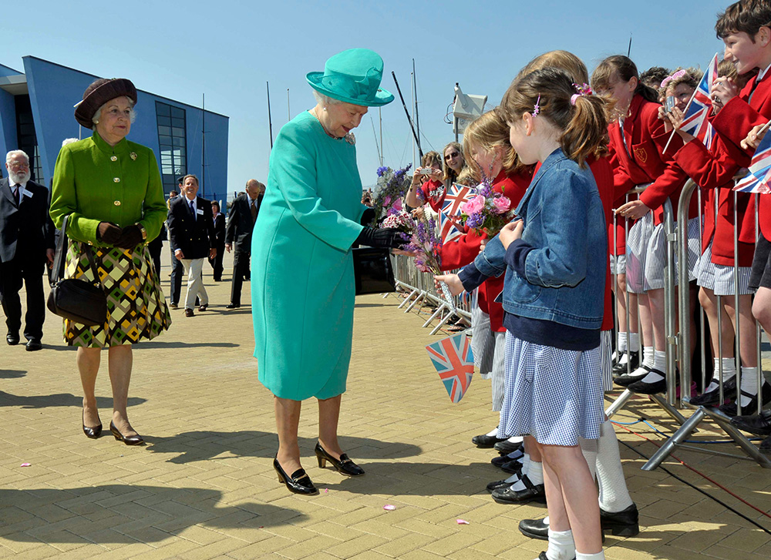
Notes:
The Queen greets children outside the National Sailing Academy. © Alamy - BCC258 - 2009

Slide 29
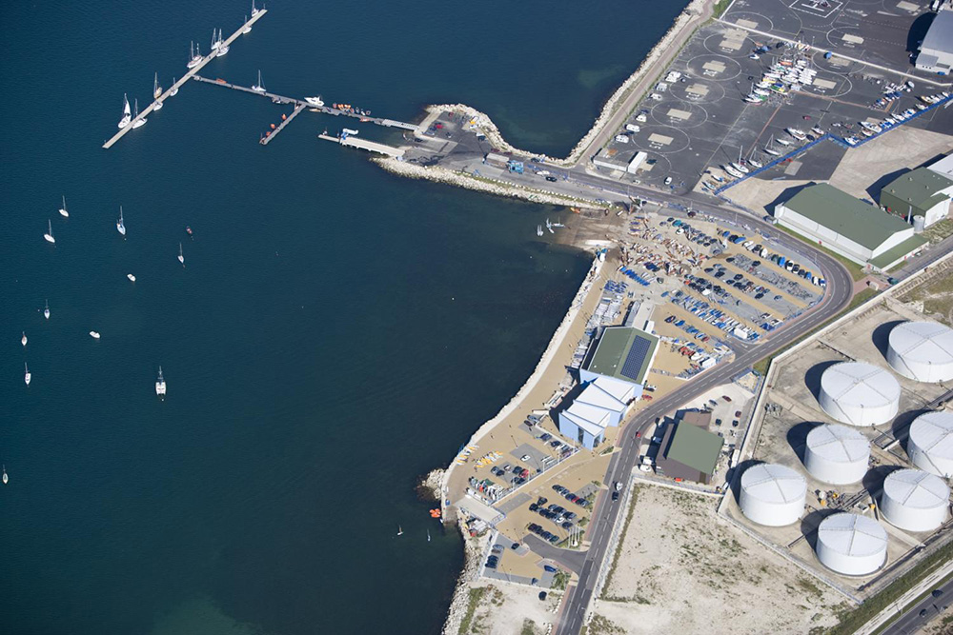
Notes:
Aerial view of the docks including the National Sailing Academy. © Historic England Archive - 24689_039 - 9 AUG 2009

Slide 30
Maiden Castle, Dorset
The Queen visited Maiden Castle on 3 July 1952 to see professor Sir Mortimer Wheeler’s archaeological excavation.
The scheduled monument now known as Maiden Castle is a multivallate (having two or more ramparts) hill fort dating from at least 500 years ago with extensive work dating from the late Iron Age (300 BC). It has been the subject of many archaeological excavations in the nineteenth and twentieth centuries.
It is also featured in the novels of Thomas Hardy who uses the name Mai Dun. It also famously features as a location for a scene in John Schlesinger’s 1967 film adaptation of ‘Far From the Madding Crowd’.
Find out more on the National Heritage List.

Slide 31
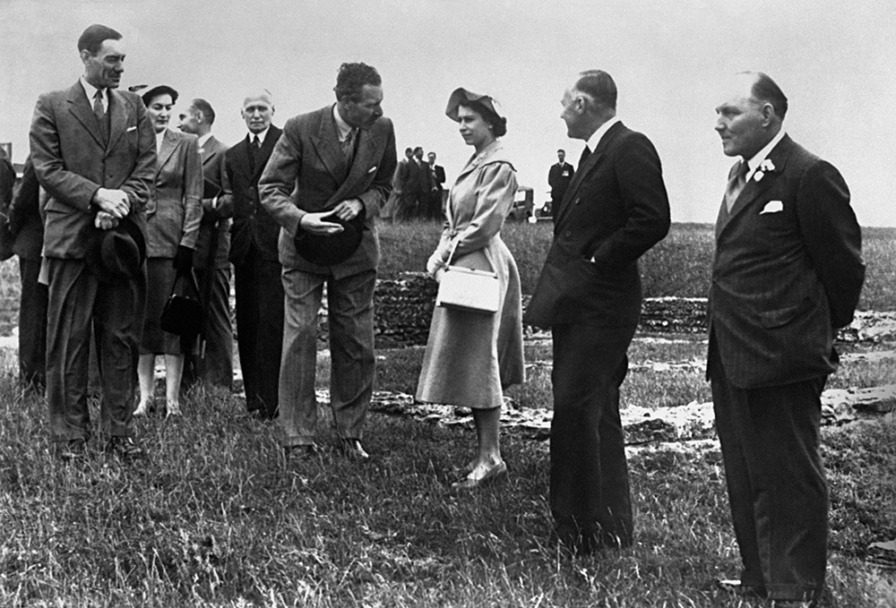
Notes:
A black and white photo of the Queen with a group of dignitaries inside the earthworks at Maiden Castle. © Alamy - G4N2D0 - 3 July 1952

Slide 32
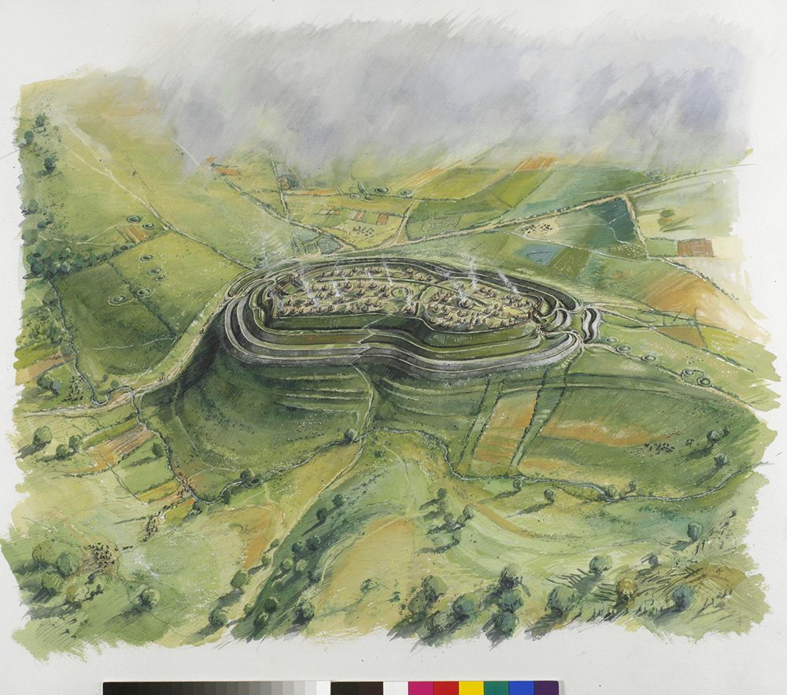
Notes:
A reconstruction drawing of how Maiden Castle hillfort might have looked during the Iron Age. © Historic England Archive - IC064_015 - Nov 2005

Slide 33
Poundbury, Dorchester
On 27 October 2016, the Queen visited Poundbury to unveil a statue of the Queen Mother in what is now, Queen Mother Square.
Poundbury is an experimental new town on the outskirts of Dorchester built on land owned by the Duchy of Cornwall. In 1987 architect Leon Krier was commissioned to start work on the plans and building work began on the site in 1993 and the initial development was expected to be complete in 2025.
Poundbury’s design is based upon traditional architectural styles and a ‘New Urbanist’ philosophy endorsed by Prince Charles.
Find out more about Poundbury.

Slide 34
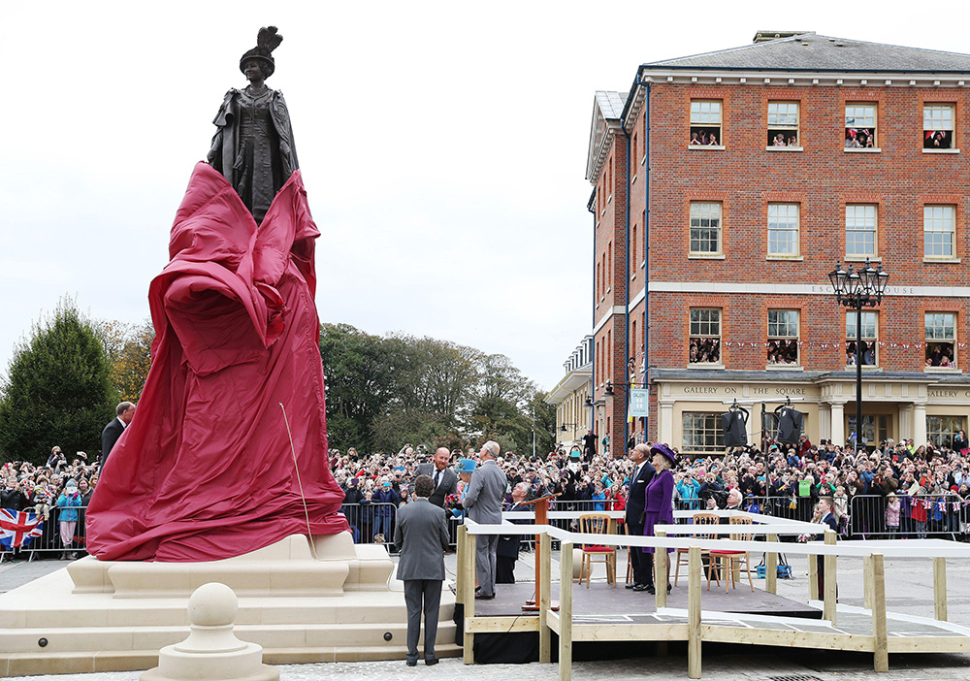
Notes:
The Queen unveiling a statue of the Queen Mother in the newly created Queen Mother Square. © Alamy - H6ECB8 - 27 October 2016

Slide 35
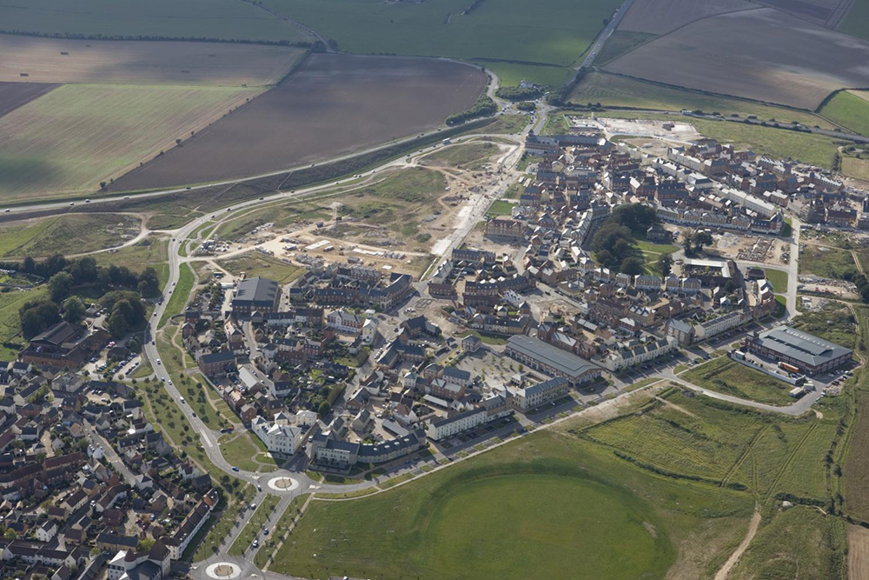
Notes:
An aerial view of the new town of Poundbury, showing some areas still under development. © Historic England Archive - 24726_042 - 18 SEP 2007

Slide 36
Bournemouth Pier
The Queen visited Bournemouth on 28 July 2004 also visiting the Lighthouse Arts Centre in Poole.
The first wooden pier in Bournemouth was built in 1856 but the current pier dates predominantly from the 1980s when the pier neck was reconstructed in concrete and the octagonal leisure complex was added.
At various times in its history the pier has been damaged by storms, waves and even the British Army, when much of it was demolished in 1940 as a precaution against German invasion.
Find out more about Bournemouth Pier.

Slide 37
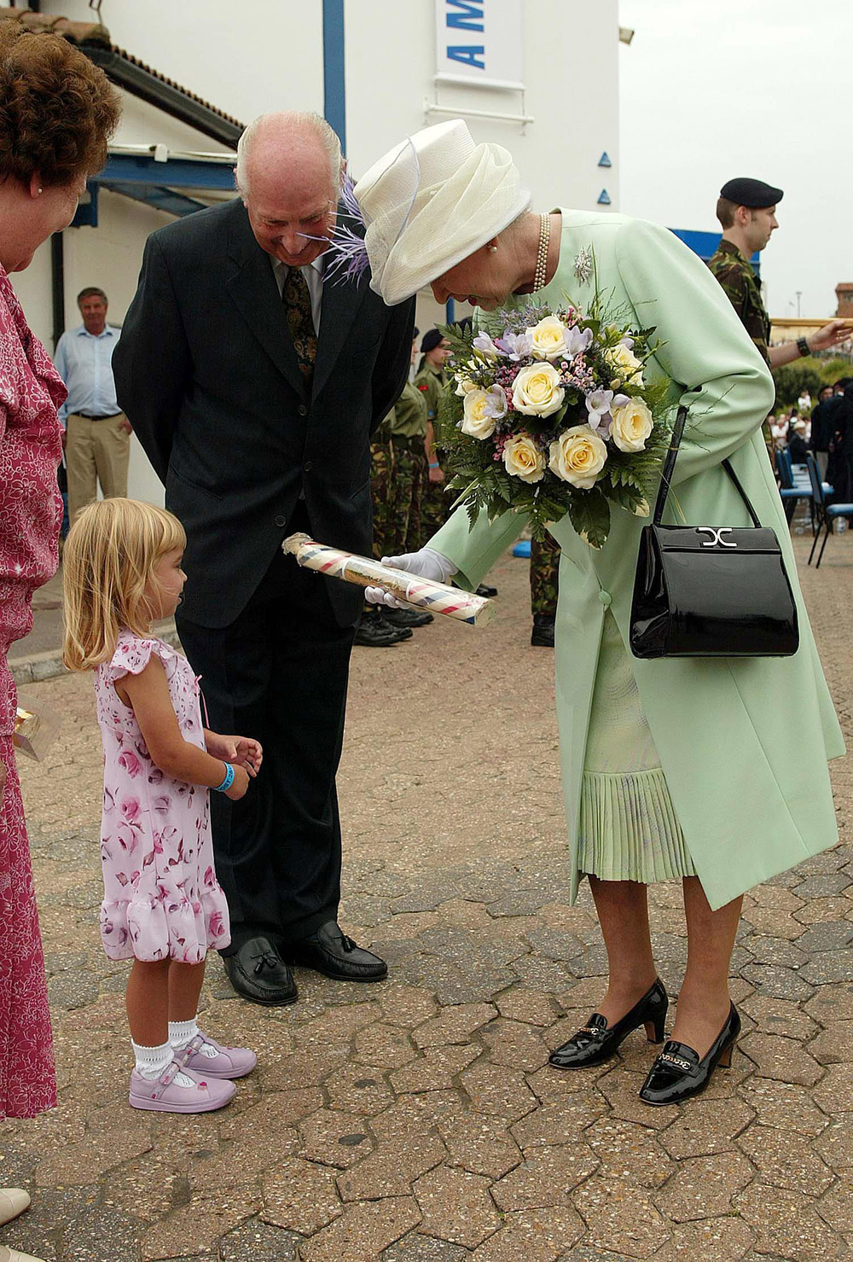
Notes:
The Queen being given a stick of rock by a small child. © Alamy - G73XM1 - 28 July 2004

Slide 38
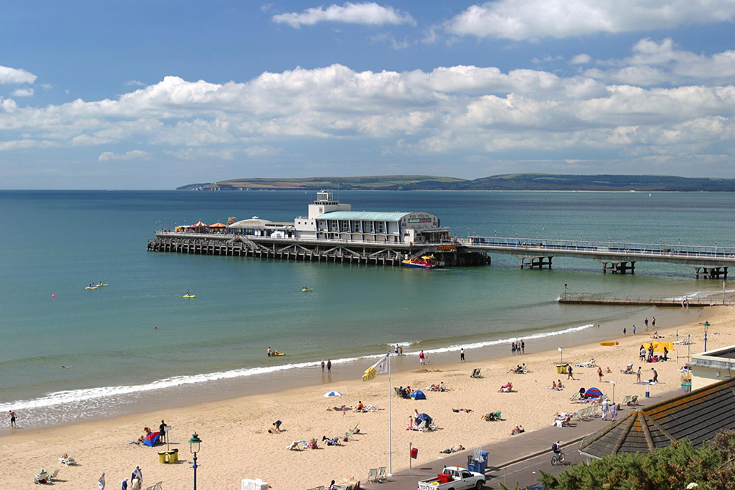
Notes:
A general view of the pier with people on the beach enjoying a sunny day. © Historic England Archive - DP001244 - 21 Jul 2005

Slide 39
Sherborne Abbey
The Queen visited Sherborne Abbey on the May 2012 as part of her Diamond Jubilee tour of the UK.
The Grade I listed Abbey Church of St Mary in Sherborne dates back to Saxon times with Norman and medieval additions as well as 19th and 20th century restorations.
Two Saxon kings, Ethelberht and Ethelbald are buried here and it is known that Sir Walter Raleigh worshipped in the church.
Find out more on the National Heritage List.

Slide 40
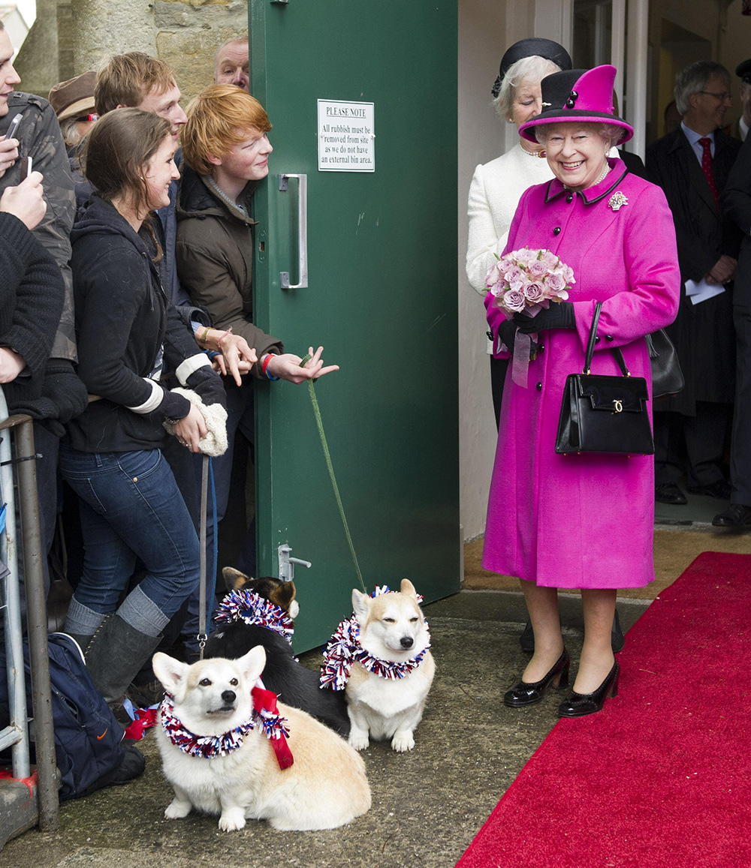
Notes:
The Queen being greeted by well-wishers, two of whom have Corgi dogs decorated in Jubilee flags and colours. © Alamy - 2E9JYRC - 5 February 2021

Slide 41
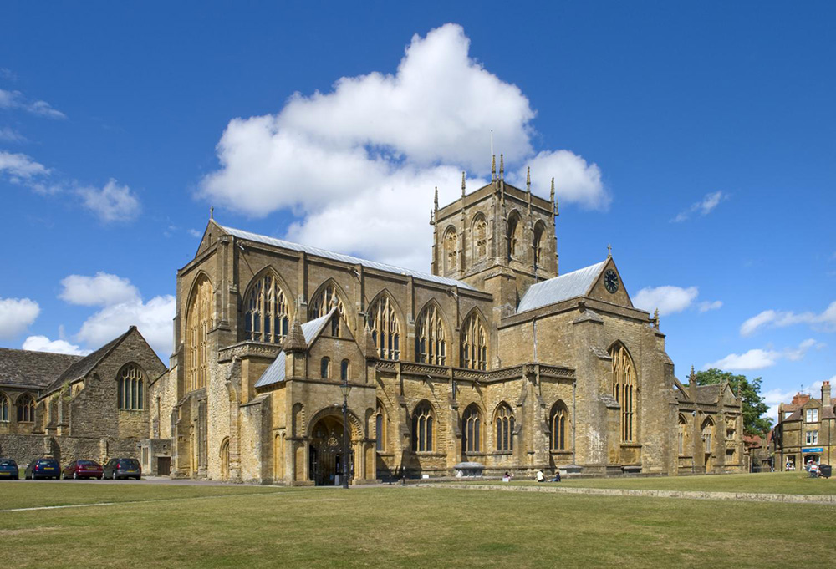
Notes:
General view showing the south side of Sherborne Abbey, taken looking over the green from the south-west. © Historic England Archive - DP114048 - 21 Jul 2010

Slide 42
Castle Cary Station
The Queen visited Castle Cary station on 28 March 2019 for the start of her visit to Somerset.
Castle Cary station was built in 1857 originally on the Wilts, Somerset and Weymouth Railway linking the Great Western Railway at Chippenham with Weymouth. By 1906 it was transformed from a station on a secondary route to a mainline station when a new more direct line was completed from London to Exeter that didn’t pass through Bristol.
On 3rd September 1942 a German bomber targeted the station demolishing the signal box - killing a signalman - and destroying the Station Hotel. It is also the main station for those attending the Glastonbury Festival.
Find out more about Castle Cary Station.

Slide 43
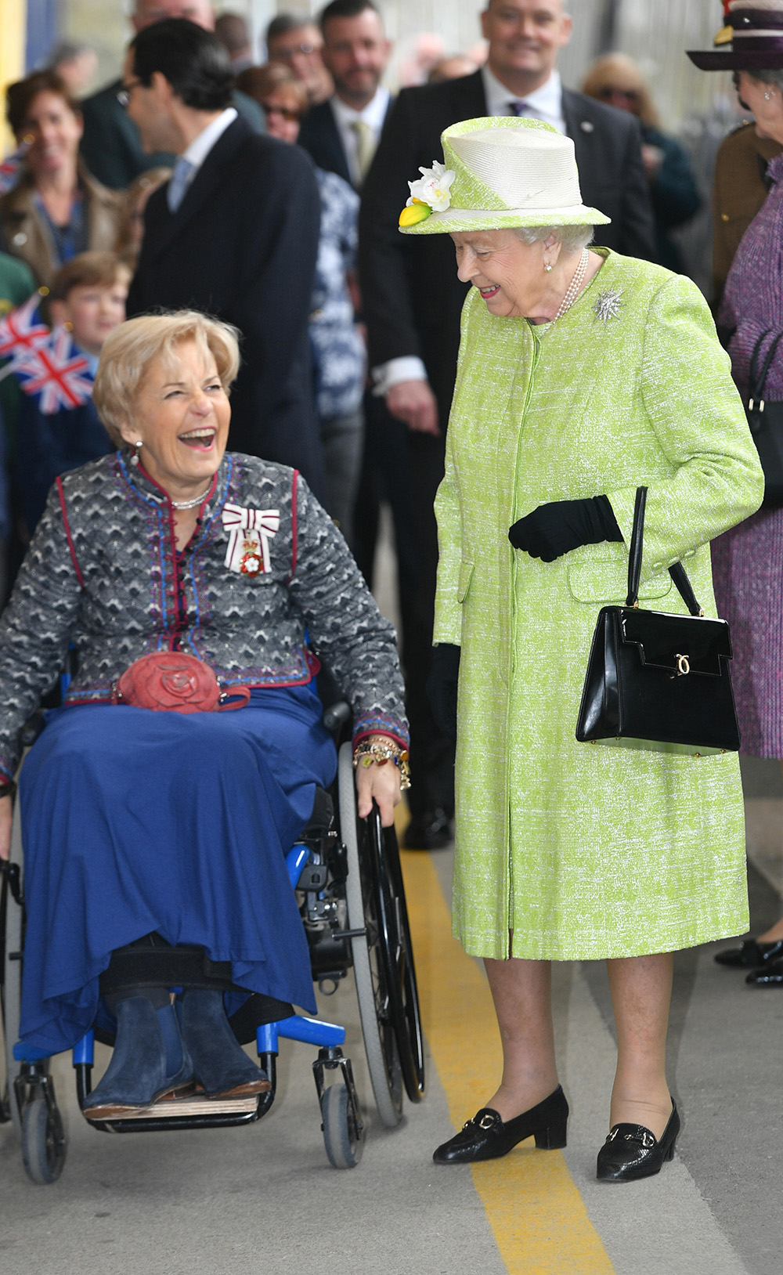
Notes:
The Lord Lieutenant of Somerset, Annie Maw talking to the Queen as she escorts her, in her wheelchair, along the station platform. © Alamy - T1PY61 - 28 March 2019

Slide 44
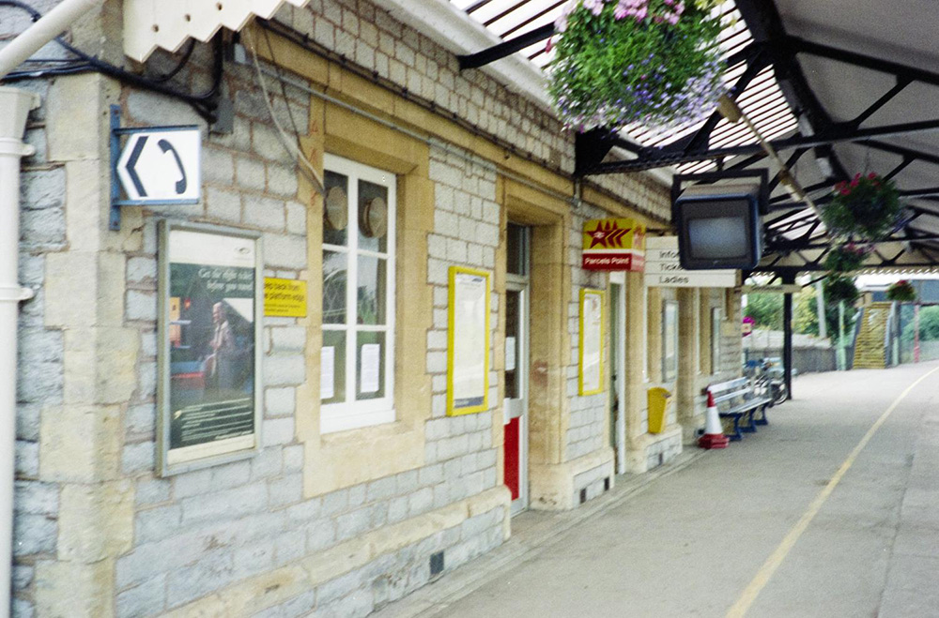
Notes:
A general view of Castle Cary station, showing the station building and platform one. © Historic England Archive - EHC01/314/47/11 - 2 Jun 1998

Slide 45
Hauser and Wirth Gallery, Bruton
The Queen visited the Hauser and Wirth gallery on 28 March 2019 as part of her visit to Somerset.
Hauser and Wirth is a fine art gallery that originated in Zurich in 1992 and now has outposts in London, New York, Los Angeles, Hong Kong, Monte Carlo, St Moritz and … Bruton.
The gallery is housed in the Grade II listed eighteenth century Durslade Farm Barn in the town.
Find out more on the National Heritage List.

Slide 46
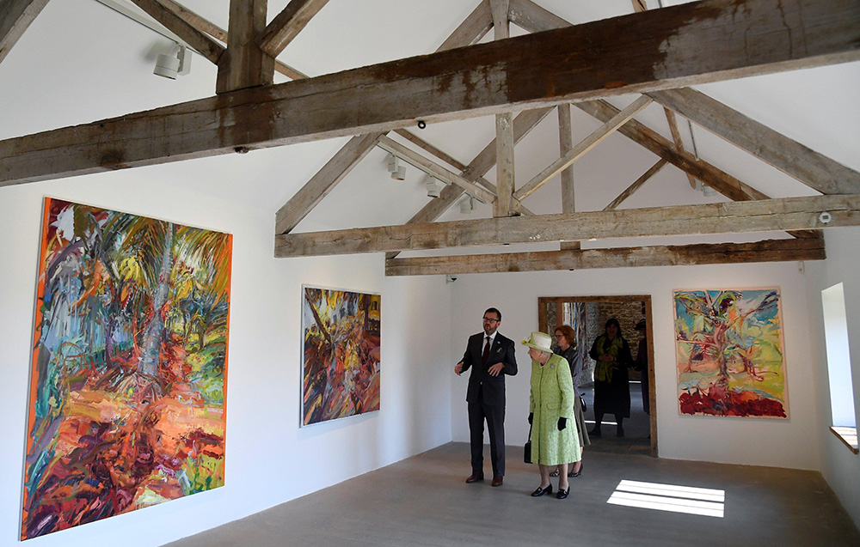
Notes:
The Queen being shown large, bright colourful paintings within an art gallery in a converted barn building. © Alamy - T1W0Y4 - 28 March 2019

Slide 47
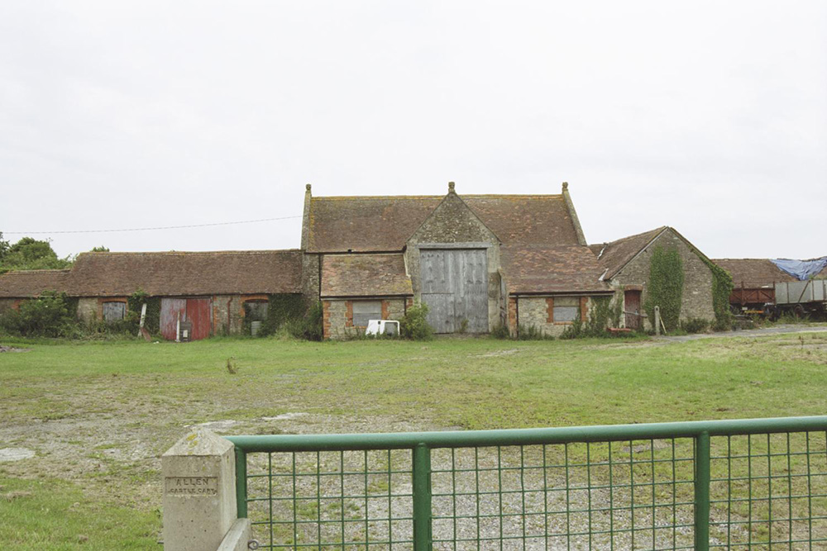
Notes:
Old farm barn, with massive wooden doors. © Mr John H. Sparkes. Source Historic England Archive - IOE01/12560/10 - 7 Jul 2004

Slide 48
Chippenham Railway Station
The Queen visited Calne, Chippenham and Malmesbury on 7 December 2001 on a tour postponed from March 2001 due to the outbreak of Foot and Mouth Disease.
The Grade II listed Chippenham Railway Station was opened in 1858 designed by Rowland Brotherhood. The Chippenham to Bath line was the final piece of the Great Western Railway to be completed by Isambard Kingdom Brunel on 30 June 1841 with the 1.83 mile long Box tunnel taking 2 ½ years to construct.
Find out more on the National Heritage List.

Slide 49
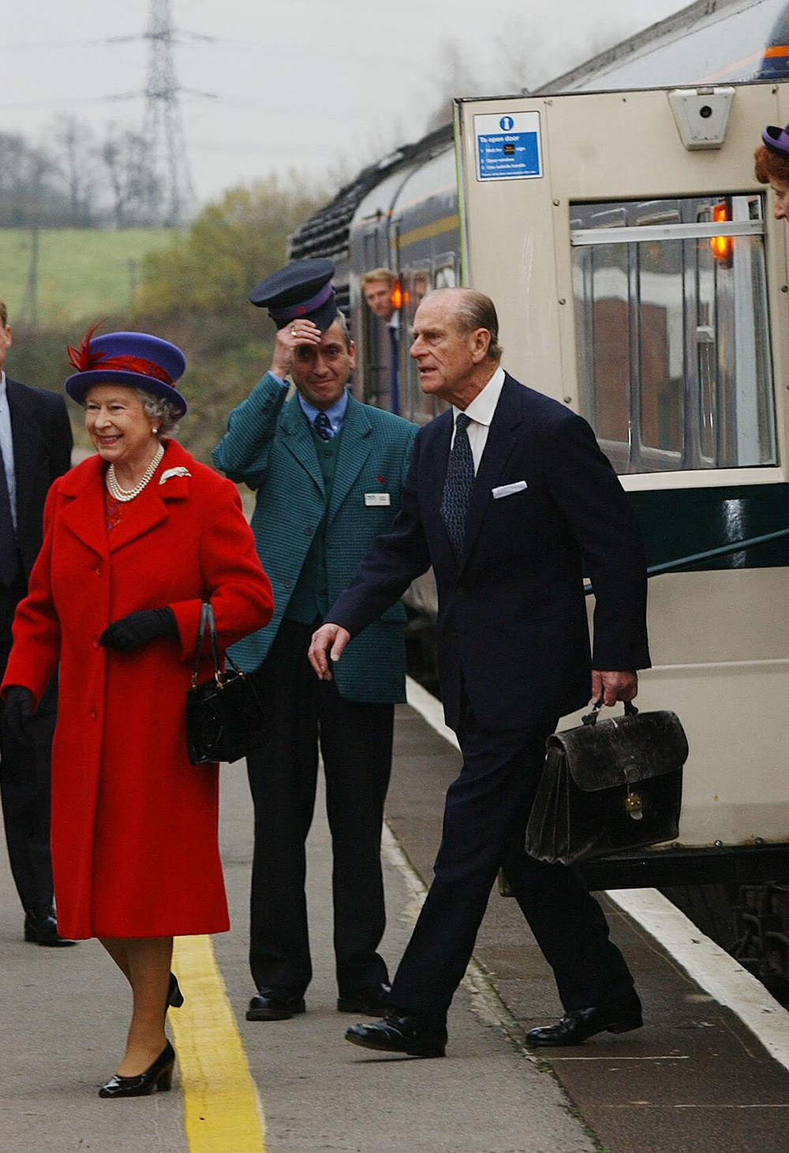
Notes:
A smiling Queen and Prince Philip step off a train as the train guard raises his hat to them. © Alamy - G5JJ5K - 7 December 2001

Slide 50
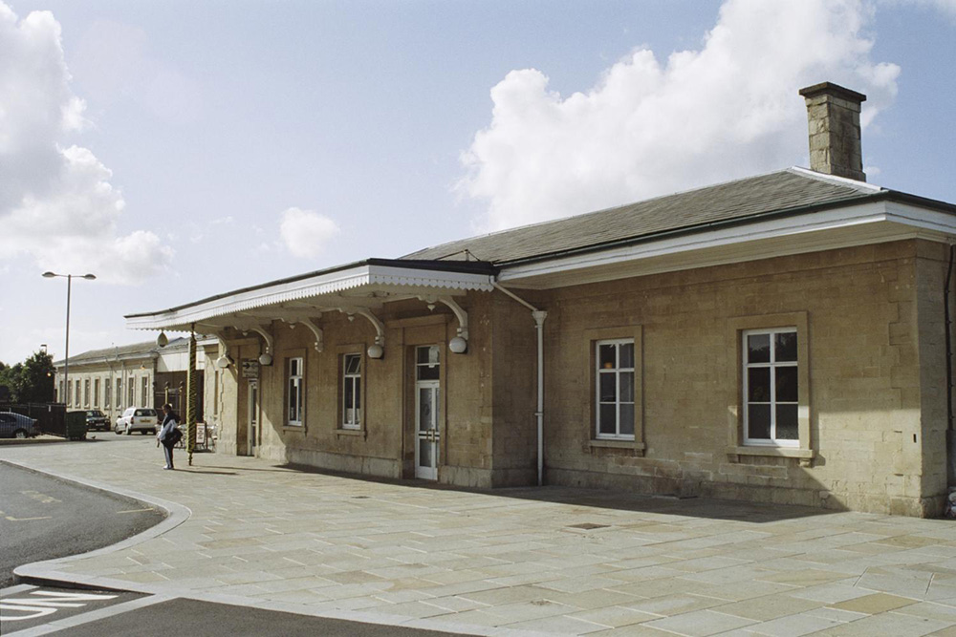
Notes:
The single storey train station built from honey coloured local bath stone. © Mr Adrian Exton. Source: Historic England Archive - IOE01/14443/10 - 27 Sep 2005

Slide 51
Bath Abbey
The Queen visited Bath on 2 May 2002 as part of her Golden Jubilee Tour.
There has been a place of worship on this site for over 1000 years. Bath was given Cathedral status in 1244 at the same time as Wells. Most of the Abbey as we recognise it today was built from 1499 onwards, replacing the Norman church which had fallen into disrepair.
From 1863, a major restoration of the Abbey commenced led by George Gilbert Scott (architect of the Albert Memorial and the Midland Hotel at St Pancras amongst other buildings) commenced.
Find out more on the National Heritage List.

Slide 52
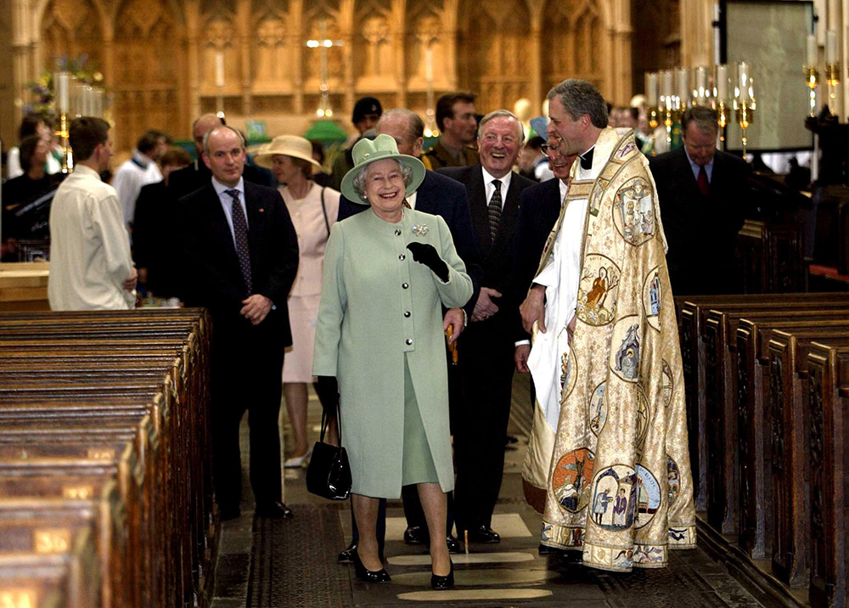
Notes:
The Queen smiles with the Rector of Bath Abbey, Reverend Simon Oberst and other dignitaries inside Bath Abbey. © Alamy - G5TR1K - 2 May 2002

Slide 53
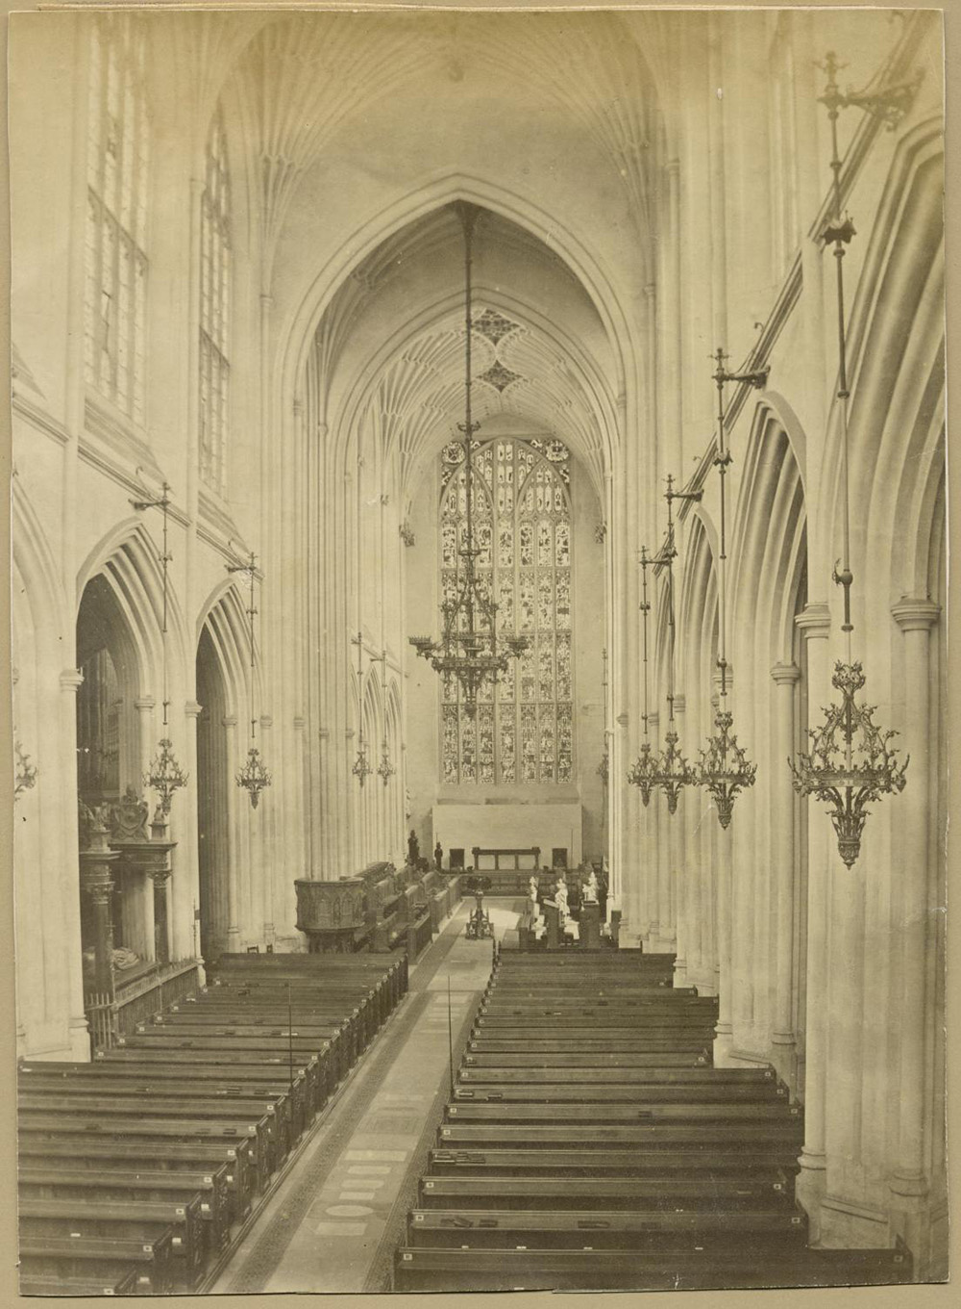
Notes:
Black and white view of the inside of Bath Abbey showing, pews, alter, arches and stained glass windows. Source Historic England Archive - RBO01/01/OP08813 - 1874 - 1930

Slide 54
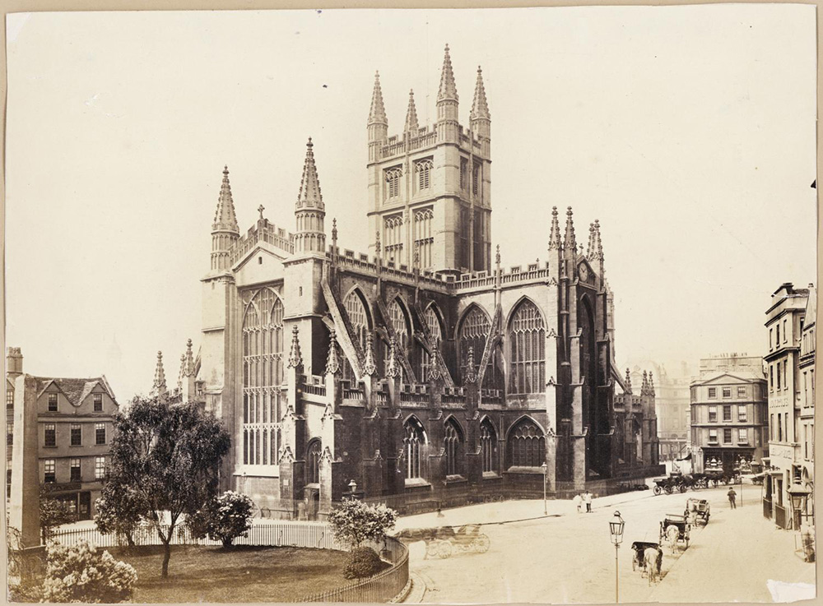
Notes:
A black and white image of Bath Abbey, taken from Orange Grove in the north-east, showing people and horse-drawn vehicle going about their day. Source Historic England Archive - RBO01/01/OP08814 - 1850 - 1900

Slide 55
Gloucester Guildhall
The Queen visited The Guildhall in Gloucester on 3 May 1955 to celebrate the 800th anniversary of King Henry II granting Gloucester’s City Charter.
The current Guildhall is the third guildhall on this site. It was built in 1892 replacing the previous one built in 1751. It was designed by George Hunt in the French Renaissance Style, featuring circular windows, Ionic pilasters and a central stone balcony.
The building was converted into office space in the late 20th Century when Gloucester City Council moved their meeting space to a building on the docks.
Find out more on the National Heritage List.

Slide 56
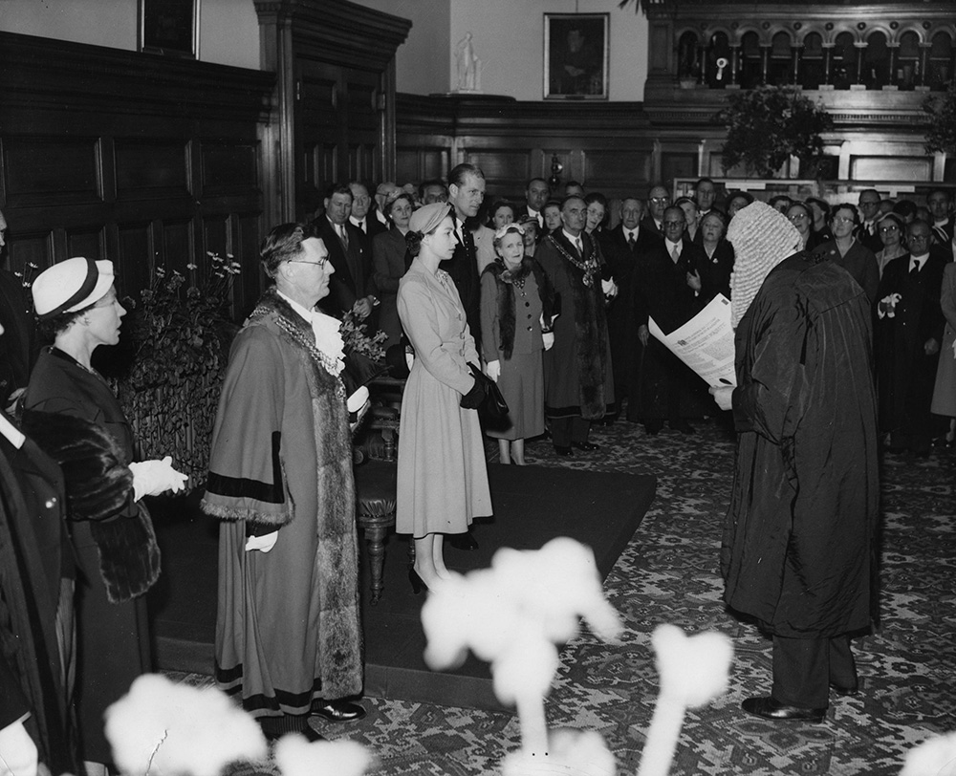
Notes:
The City Recorder, dressed in wig and robes, reads a loyal address of welcome to the Queen at the Guildhall in Gloucester. © Alamy - G4P05K - 3 May 1955

Slide 57
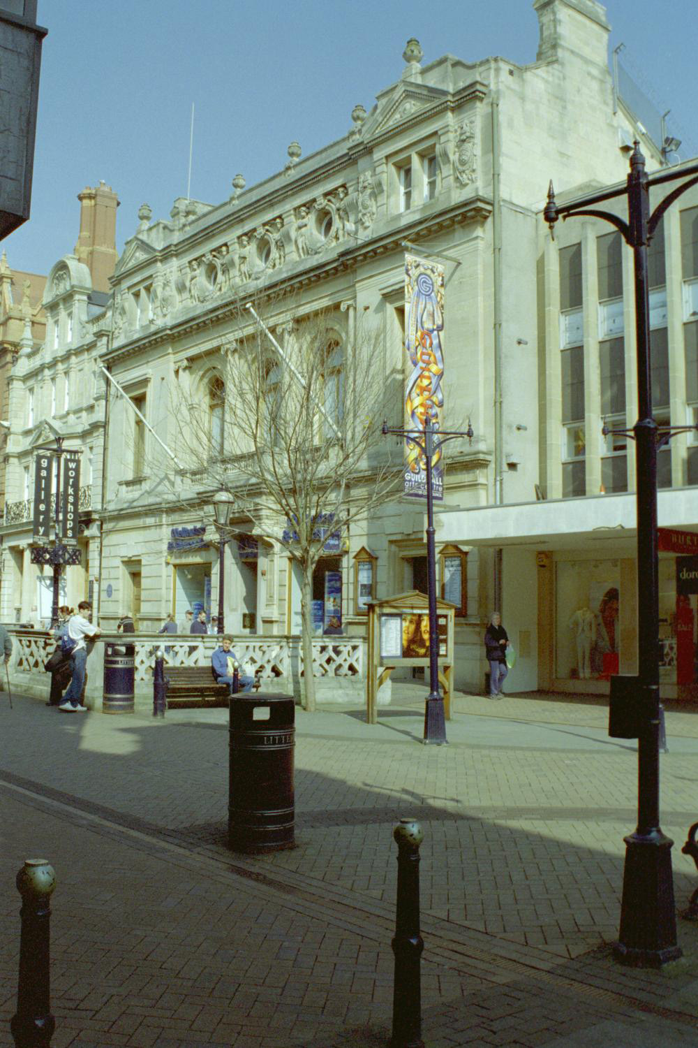
Notes:
A view of the outside of the stone built Guildhall. © Lorna Freeman. Source Historic England Archive - IOE01/01171/33 - 29 Mar 2002

Slide 58
Wroughton Airfield, Wiltshire
The Queen visited Wroughton Airfield on 23 July 1954 to present Colours to the 1st, 2nd and 4th battalions of the Royal Welch Fusiliers of which she is Colonel in Chief.
Wroughton Airfield was opened on 1 April 194 and was used for the assembly and storage of aircraft during the second world war. In 1972 it was handed over to the Royal Navy and became a Royal Naval Aircraft Yard. Since 1979, Wroughton has been used to store large objects from the Science Museum.
Find out more about Wroughton Airfield.

Slide 59
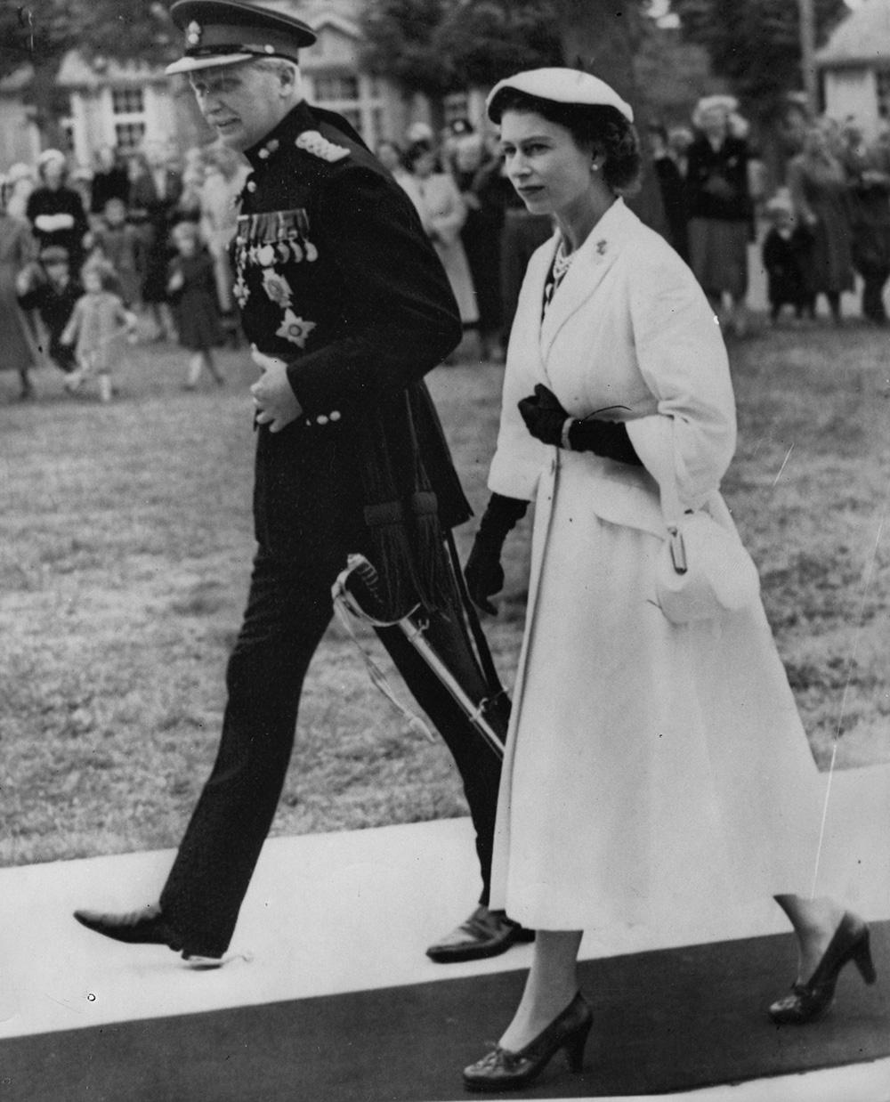
Notes:
The Queen walking alongside Lieutenant-General Sir Hugh Stockwell, who's in full military uniform. © Alamy - G4PMC1 - 23 July 1954

Slide 60
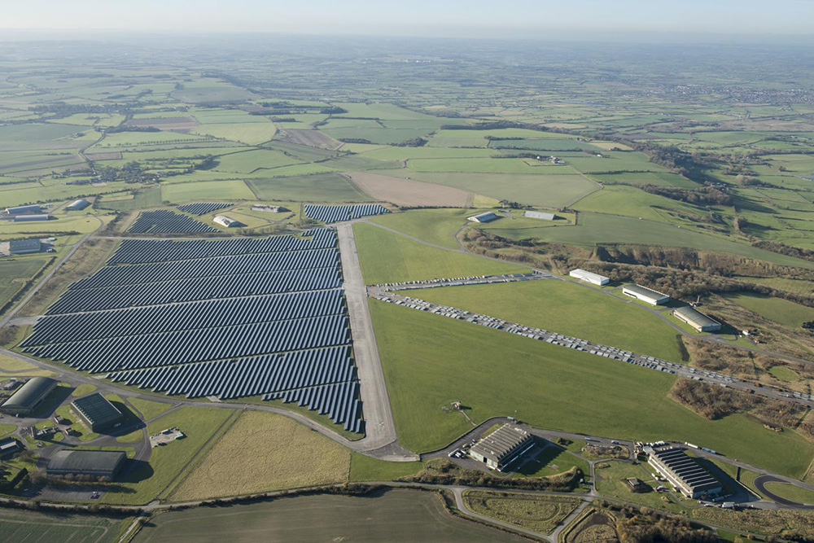
Notes:
Aerial view showing Wroughton Airfield - half of which is now covered with solar panels. © Historic England Archive - 33080_019 - 28 Nov 2016

Slide 61
Historic England Archive, Swindon
The Queen visited the Historic England Archive, then The National Monuments Record Centre, as part of a tour of Swindon on the 7 November 1997.
The Archive was originally the Chief Mechanical Engineer's and Drawing Office of the Great Western Railway Works (GWR). It was built in the 1840s, with additions in the 1870s and 1903-8.
The whole building is archaeologically and historically most interesting as the nerve centre of the GWR works. It was used by GWRs main designers Gooch, Armstrong, Dean, Churchward etc. It is where the Castles, Kings, Warships and other important classes, of both steam and diesel trains, were designed.
Find out more on the National Heritage List.

Slide 62
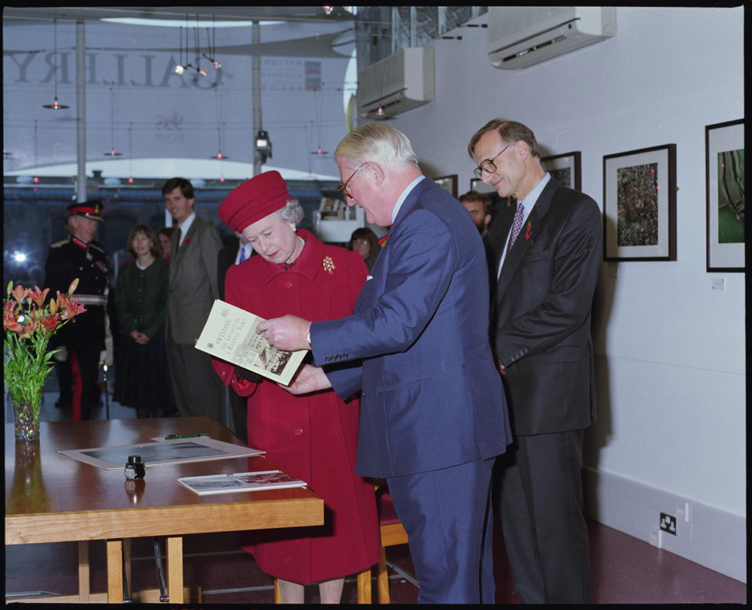
Notes:
The Queen, Being presented with a copy of "Swindon Legacy Of A Railway Town", By Lord Faringdon And Tom Hassall inside the National Monuments Record Centre. © Crown Copyright. Historic England Archive - AA97/07146 - 7 Nov 1997

Slide 63
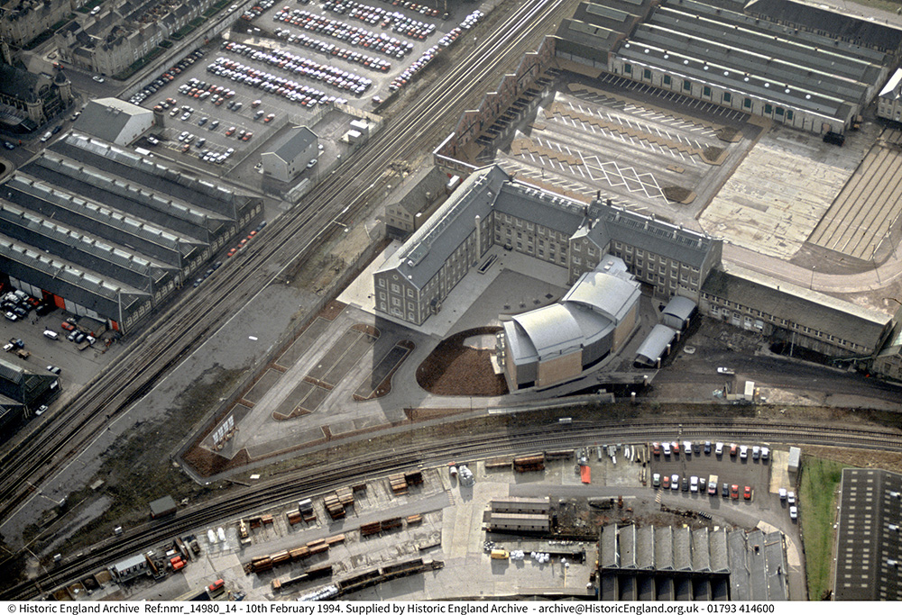
Notes:
Aerial view showing the newly completed archive building attached to the original Great Western Railway Drawing Office buildings. © Historic England Archive - nmr_14980_14 - 1 FEB 1994

Slide 64
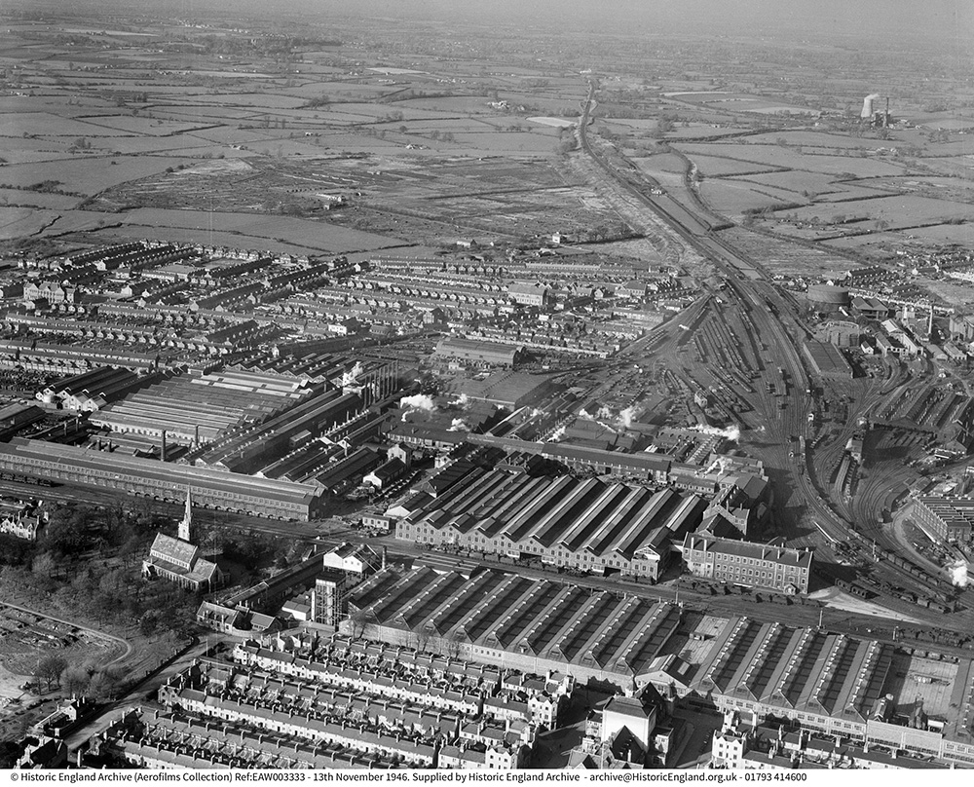
Notes:
Black and white aerial view of the Great Western Railway Works in 1946. © Historic England Archive - EAW003333 - 13th NOV 1946.

Slide 65
Church of St Ia, St Ives Harbour
The Queen visited St Ives Harbour on 17 May 2013 as part of her Diamond Jubilee tour. After unveiling a plaque at the RNLI Boathouse, she greeted the public on the harbourfront and then visited the Tate Gallery.
There are many listed buildings on the St Ives harbourfront, including the Grade I listed church of St Ia. The church was consecrated in 1434 and contains many beautiful features and objects including a sculpture donated by Barbara Hepworth.
St Ia was an Irish saint living in the 5th or 6th century who journeyed to Cornwall and was martyred in Hayle. She also gave her name to the town of St Ives.
Find out more on the National Heritage List.

Slide 66
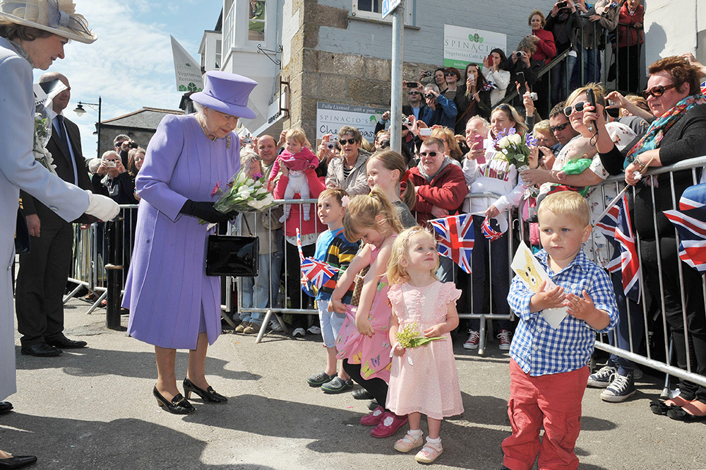
Notes:
The Queen is given flowers by a row of small children, who stand in front of crowds of well-wishers waving Union Jack flags. © Alamy - G63RHT - 17 May 2013

Slide 67
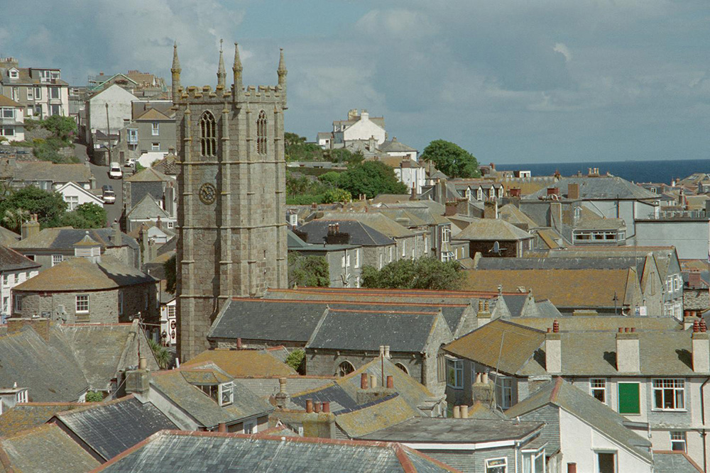
Notes:
A view across the rooftops of St Ives, showing the spire of the church of St Ia towering above them. © Mr Richard Clegg. Source: Historic England Archive - IOE01/03356/28 - 30 May 2001

Slide 68
Torquay Pavilion, Torquay Harbour
The Queen and Prince Phillip arrived in Torquay on 21 July 1988, as part of a visit to commemorate the 300th anniversary of the landing at Brixham Harbour of William of Orange, later to become William III.
There are many listed buildings in Torquay harbour including the Grade II listed Torquay Pavilion. The Pavilion was built in 1911 and had its official opening on Saturday 1 August 1912. The first concert was performed by the Torquay Municipal Orchestra.
In its 100 years has been a concert hall, an ice-skating rink, an amusement arcade and a shopping centre.
Find out more on the National Heritage List.

Slide 69
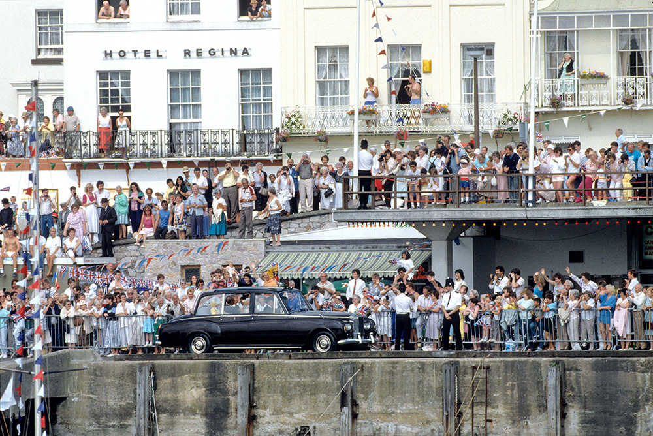
Notes:
The Queen drives in a car along the harbour in Torquay, as crowds of well-wishers lines the street above, many of them are waving. © Alamy – 2BGP45W - 21 July 1988

Slide 70
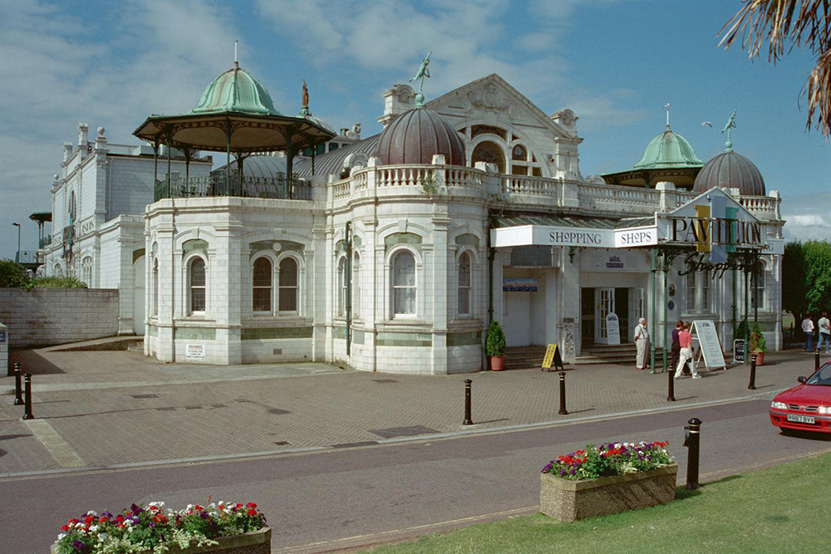
Notes:
A view of the elaborately styled Edwardian Pavilion buildings, with its green coloured copper domes clearly visible. © Mr Mike Thompson. Source: Historic England Archive - IOE01/08113/25 - 30 Jun 2001

Slide 71
Taunton Market
The Queen and Prince Phillip visited Taunton on the 2 May 2002 on the second day of a fifteen-day tour to celebrate her Golden Jubilee.
She first visited the farmers’ market that has been held in the Market Square in Taunton since 1999 in front of the Grade II* listed Market House. This was built in 1770 designed by amateur architect Coplestone Warre Bamfylde.
The central part of the buildings was originally had single storey arcaded open markets on either side of it, these can be seen in the aerial image from 1925. In 1932 they were replaced new 2 storey red brick wings joined to the central building.
Find out more on the National Heritage List.

Slide 72
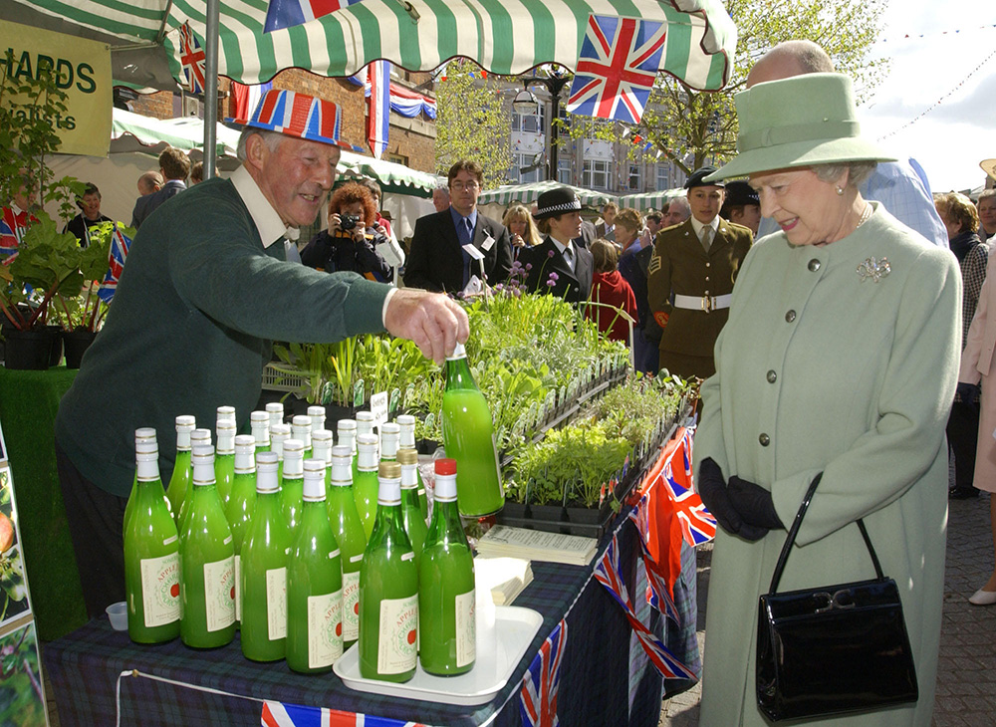
Notes:
The Queen smiles as a local market stall holder shows her bottles of local apple juice. © Alamy – G5TPAG - 2 May 2002

Slide 73
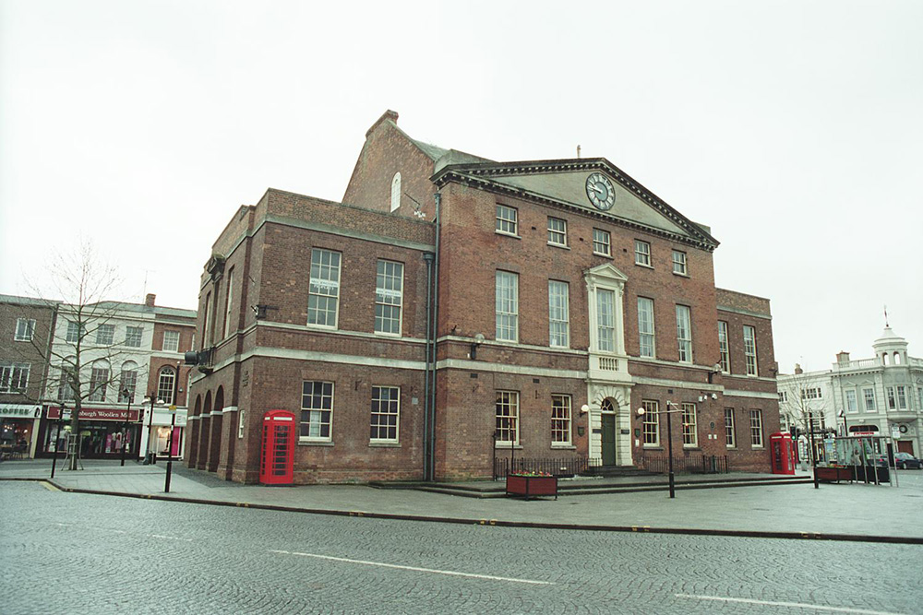
Notes:
A general view of the typically symmetrical red brick Market House. © Mr Michael Perry. Source: Historic England Archive - IOE01/11881/33 - 14 Mar 2004

Slide 74
Notes:
A black and white aerial view of the Market House in 1925, when it still had its original two market buildings attached to either side of it. © Historic England Archive. Aerofilms Collection - EPW013541 – June 1925

Slide 75
Market Place, Wells
The Queen and Prince Phillip visited Wells on the 2 May 2002 on the second day of a fifteen-day tour to celebrate her Golden Jubilee.
She visited the Market Place in the centre of Wells which has many listed buildings including the grade II* listed market cross. A market cross has marked the site of the market in the city for centuries. This particular version of the cross was made in 1797 replacing an older cross and water fountain.
She also met balloonists Andy Elson and Colin Prescot who broke the World Endurance Record for any Non-Stop Sub-Orbital Flying Machine, flying over 12,000 miles from Spain to the Pacific in 18 days.
Find out more on the National Heritage List.

Slide 76
Notes:
The Queen smiles as she talks to two men in space suits in Well market place as crowds, Prince Philip and other dignitaries look on. © Alamy – G5TPMW - 2 May 2002

Slide 77
Notes:
A view of the beautiful ornate stone built Market Cross in the centre of Wells market place. © John Boothroyd. Source: Historic England Archive - IOE01/03211/35 - 30 Apr 2001

Slide 78
The Corridor, Bath
The Queen visited Bath on 9 August 1973 to commemorate 1000 years since the first king of all England, King Edgar was crowned in Bath Abbey. She did a walkabout around the town, seen here passing The Corridor.
The Grade II listed Corridor in Bath, dating from 1825, is one of the world’s earliest shopping arcades. The original roof was glazed with coloured glass. It was altered in the 1870s and this is when the present shopfronts date from.
It had to undergo extensive repair and refurbishment in the 1970s after being damaged by an IRA bomb on 9 December 1974.
Find out more on the National Heritage List.

Slide 79
Notes:
A black and white image of the Queen, holding a bunch of flowers, and the Mayor of Bath as walk past a crowd of well-wishers. The background can be seen the entrance to The Corridor Shopping Arcade. © Alamy – G79KB1 - 9 August 1973

Slide 80
Notes:
A view of the ornate entrance to the Georgian shopping arcade known as The Corridor. © Lorna Freeman. Source: Historic England Archive - IOE01/12543/16 - 26 Sep 2004

Slide 81
Notes:
A view of the ornate shop fronts inside the Georgian shopping arcade known as The Corridor. © Mr Michael Perry. Source: Historic England Archive - IOE01/13443/30 - 4 Nov 2004

Slide 82
The Bridge Inn, Topsham
The Queen visited the Bridge Inn in Topsham on 27 March 1998 to mark the centenary of the same family running the pub. It was her first ever official visit to a pub.
This historic Grade II listed inn is largely 18th Century made mainly from local stone, although the brewhouse is traditional Devon cob.
The pub has been run by four generations of the same family since 1897 and the interior of the pub retains many of its 19th century fixtures and fittings.
Find out more on the National Heritage List.

Slide 83
Notes:
The Queen, holding a bottle of beer, stands next to the Caroline Cheffers-Heard and another man stands behind the bar. © Alamy – G4A6GG - 27 March 1998

Slide 84
Notes:
A view showing the outside of the pub that is painted at light pink colour. © Alamy – BPMPXX - 30 August 2010

Slide 85
Cheltenham Racecourse
The Queen visited Cheltenham racecourse on 13 March 2003 to unveil a bronze bust of the Queen Mother on Gold Cup Day.
There has been a racecourse at Cheltenham since 1815. In 1829 Cheltenham’s Parish Priest preached about the evils of horseracing, which led in the coming years to race meetings being disrupted and the grandstand being burnt to the ground!
In 1831 the racecourse was moved to Prestbury Park, where it remains today. A steeplechase was added in 1898 and the Gold Cup race was introduced in 1924.
Find out more about Cheltenham Racecourse.

Slide 86
Notes:
The Queen unveils a bronze bust of the Queen Mother at Cheltenham racecourse as crowds look on. © Alamy – G68HHN - 13 March 2003

Slide 87
Notes:
An aerial view of the racecourse and its buildings. © Historic England Archive - 33281_009 – 30 November 2016

Slide 88
Lucknow Barracks, Tidworth
The Queen visited the Lucknow Barracks in Tidworth on the 3 March 2017 to commemorate St David’s Day with soldiers from the Royal Welsh Regiment. She also met one of two regimental goats at the barracks.
Lucknow barracks were completed in 1905 with the nearby Tidworth Military Hospital completed in 1907. It is now home to the first Division of the Royal Welsh Regiment.
Many of the military buildings at Tidworth are now Grade II listed, including the carefully designed Officer’s Mess at Jellalabad Barracks. It is a key building within the important army complex at Tidworth.
Find out more on the National Heritage List.

Slide 89
Notes:
The Queen reviews members of The Royal Welsh Regimental Family and one of two regimental goats at Lucknow Barracks. © Alamy - HRMJP0 - 3 March 2017

Slide 90
Notes:
An aerial view showing the expanse of military barracks and buildings in Tidworth. © Historic England Archive - 26915_001 – 6 April 2011

Slide 91
Notes:
A close up aerial view of the Lucknow Barracks complex at Tidworth military camp. © Historic England Archive - 26915_043 – 6 April 2011

Slide 92
Salisbury Cathedral
The Queen smiles as she takes a walkabout inside Salisbury Cathedral on 1 May 2012 , as part of a two-day visit to the South West of England for the Diamond Jubilee tour of the UK.
The foundations of the cathedral were laid on 25 April 1220. It was completed in just 38 years and is regarded as one of the leading examples of Early English Gothic architecture. The spire was added in 1330 and at 123m is the tallest cathedral spire in England.
Salisbury Cathedral is also home to the best preserved of only four surviving original Magna Carta documents from 1215, which it displays in the Chapter House.
Find out more on the National Heritage List.

Slide 93
Notes:
The Queen smiles as she takes a walkabout inside Salisbury Cathedral in Salisbury accompanied by another lady, whilst in the background a school child is making hand gestures like they are He-Man! © Alamy - G54AAE - 1 May 2012

Slide 94
Notes:
A black and white aerial view of the magnificent cathedral in its setting with the Cathedral Close. Source: Historic England Archive - WSA01/01/10847A – 1935

Slide 95
Notes:
A black and white view of the impressive West Front, lined with statues of saints, and the spire towering over it in the background. Source: Historic England Archive - WSA01/01/10820 – 1935

Slide 96
Notes:
A black and white view looking up at the amazing stone fan-vaulted ceiling and stained glass windows of the Chapter House at Salisbury Cathedral. Source: Historic England Archive - WSA01/01/10869 - 1935

