Slide 1
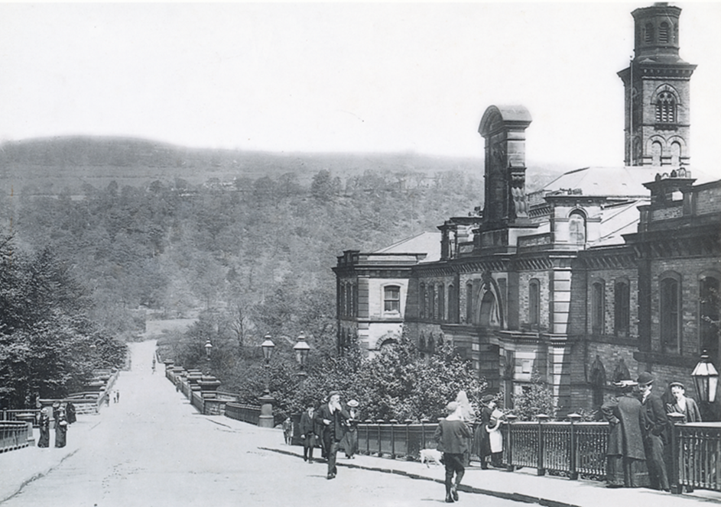
Lesson Three
Creating Saltaire Village
Photograph courtesy of Saltaire Collection
Notes:
Key lesson components:
In and on: Pupil ideas of what’s needed in a town
Starter: Recap on reasons Bradford was so unhealthy
Development: Explore Salt’s motivation by examining what he built in Saltaire. Slide 6 gives an introduction/overview. Pupils will need to draw or be provided with a good-sized version of the table. Examine each feature in turn, using the question/activity prompts to promote discussion and thinking, allowing time for pupils to fill in each section of the chart. Model the first row of the chart on the Dining Hall.
Optional quiz activity.
Plenary: Pupils hypothesise about Salt’s motives.

Slide 2
Creating Saltaire Village
Aims
To enable pupils to:
understand Salt’s vision for creating the village of Saltaire village
know the key features incorporated into the village and ways in which they benefited the workers and how Salt differed to other employers at the time
know which features were of special importance to Titus Salt

Slide 3
Key lesson components
In and on: Pupil ideas of what’s needed in a town.
Starter: Recap on reasons Bradford was so unhealthy.
Development: Explore Salt’s motivation by examining what he built in Saltaire. Pupils will need to draw or be provided with a good-sized version of the table. Examine each feature in turn, using the question/activity prompts to promote discussion and thinking, allowing time for pupils to fill in each section of the chart. Model the first row of the chart on the Dining Hall.
Plenary: Pupils hypothesise about Salt’s motives. Optional quiz activity.

Slide 4
What buildings would you include in a village or town?
Photograph courtesy of Saltaire Collection
Notes:
Think-pair-share. Feedback. Pupils could write their ideas down or draw maps of their model villages. Discuss the reasons behind their choices.

Slide 5
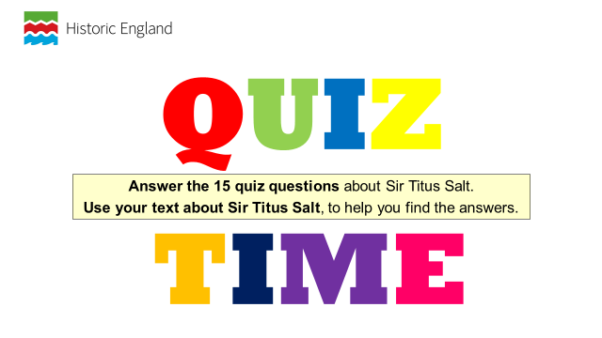
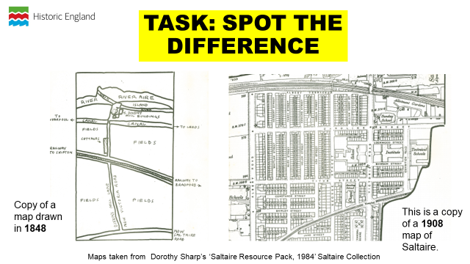
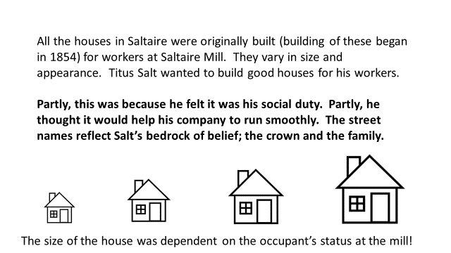
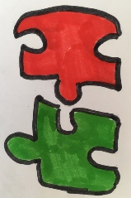
Salt and Saltaire
Learning Intention:
To use a range of primary and secondary sources to analyse the significance of Titus Salt and his vision for Saltaire.
Sources and pictures (some hand drawn by Rachel Wood on behalf of Saltaire Collection) to only be used for educational purposes. Courtesy of Saltaire Collection www.saltairecollection.org.
Notes:
Share the learning intention (To use a range of primary and secondary sources to analyse the significance of Titus Salt and his vision for Saltaire) and the VAK planner. Explain to pupils that they will be doing different types of activities throughout the lesson and using different learning styles so that everyone gets the chance to do something that they like.
Learning outcomes:
All children will be able to see how Saltaire changed from 1848 to 1908. They will be able to think about the buildings that they would include in their model village and give reasons why. They will see the buildings, which Titus Salt included in the village, think of some of the things that have happened over the years in Saltaire, read a biography of Titus Salt and be able to retrieve answers to some questions about him.
Most children will be able to see the reasons why some of the buildings could be seen as being good for Titus Salt’s business and some could be seen as being good for society. They will be able to think about how they would tell the stories of Saltaire and find answers to questions about Titus Salt, using some evidence to support their answers.
Some children will be able to come up with reasons why Titus Salt was a philanthropist and some for how he was a capitalist. They will create stories that are imaginative but that also reflect true events within Saltaire and be able to answer questions, supporting their ideas with evidence.
Resources that you will need:
Maps of Saltaire.
Differentiated versions of the biography. One version can be printed off and used like an independent reading booklet.
Copies of the photograph of the mausoleum.

Slide 6
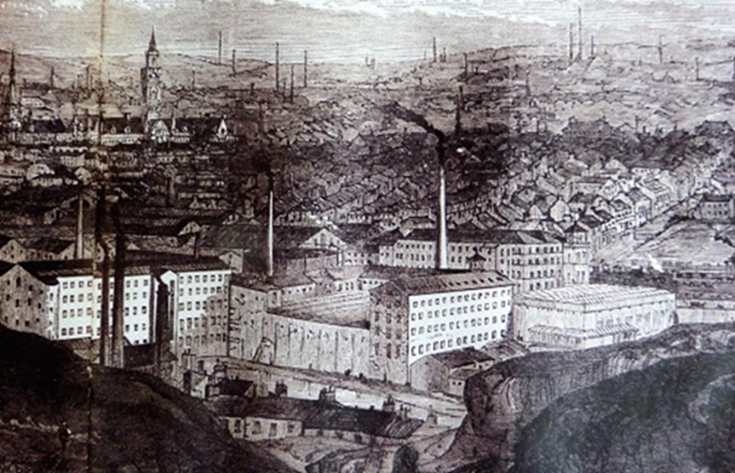
Can you remember what Bradford was like?
By 1850, the population was 103,000 with 129 spinning mills.
The living and working conditions of the workers was terrible.
Houses were cramped and unhealthy.
The town was polluted with smoke, there was no street cleaning or sanitation.
The average age at death was just 14 years 2 months.
Salt knew about the problems and diseases caused by bad housing. He was determined to build a better place for his workers.
Photograph courtesy of Saltaire Collection
Notes:
Re-cap from Lesson 1

Slide 7
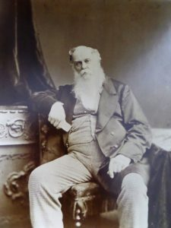
Salt’s vision
Salt’s 3,000 workers were initially transported from Bradford by train, so he knew about the problems caused by bad housing and was determined to build a better place for his workers.
He wanted to build a whole village with everything his workers would need all in one place.
He wanted to meet all of the education, social, health and leisure needs of the workers who lived in his village.
Shortly after the opening of the mill celebrations in 1853 he began work on his vision of creating a new industrial community.
He would call his village Saltaire.
Photograph courtesy of Saltaire collection
Notes:
Conclude by explaining that the idea was to build a model village.

Slide 8
What did Salt build and why?
Feature | How it benefited Salt’s workers | Did it also benefit Salt?
The Dining Hall
Workers Housing
Almshouses
Shops
Saltaire (Robert’s) Park
Schools
Victoria Hall
Hospital
Church and chapel

Slide 9
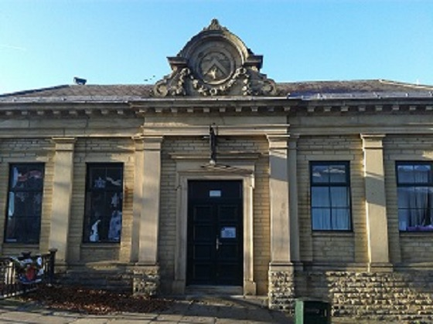
The Dining Hall
A dining hall was first to be built. It provided cheap meals to those workers who had to travel to the mill, before the houses were built.
It is situated opposite the main mill and was once connected by a tunnel under the road (this has now been blocked off).
Above the door is the Salt coat of arms, which Salt invented Salt after he was made Baronet in 1869 ( and was therefore entitled to an official coat of arms) . They appear on other buildings in Saltaire too.
Photograph courtesy of Saltaire Collection
Notes:
Workers benefited from good-quality affordable meals.
Salt gained loyalty and healthier workers who were more efficient and likely to stay at Salts Mill

Slide 10
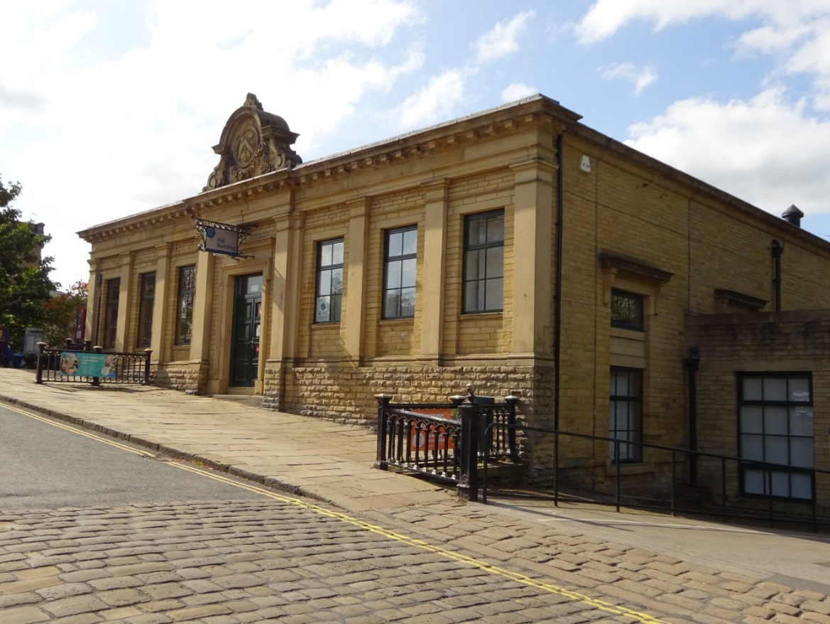
The Dining Hall today
The Dining Hall is currently fully occupied by Shipley College, which owns the building.
Photograph : Julie Edwards Historic England

Slide 11
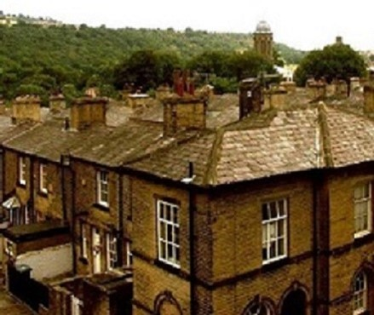
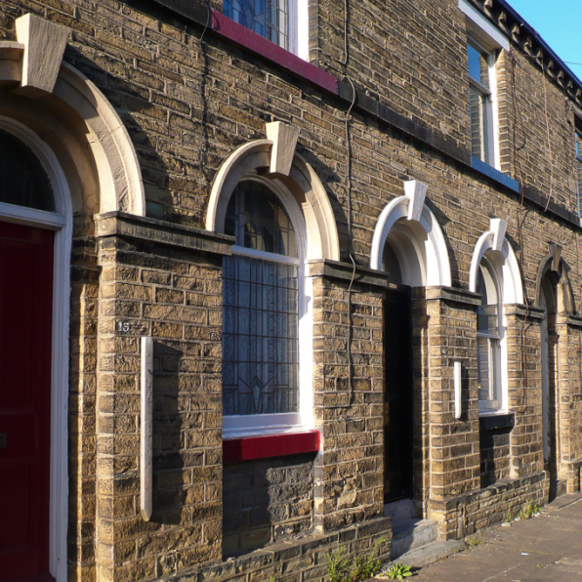
Workers Housing
Salt started building houses for his workers in 1854, eventually building over 800 homes.
The houses varied in size and appearance. Some were ‘two-up two-down’ terraces, others were larger homes with gardens for the managers.
Each house had……..
Photographs courtesy of Saltaire Collection

Slide 12
Workers Housing
Each house had:
a good supply of fresh water;
a good drainage system and own (outside) toilet;
access to air and light;
a shared ash pit (a dump for rubbish);
gas from the gasometer;
a back alley so that rubbish could be removed more easily.
TASK : How would each of these features have helped to make the houses good places to live?
Photographs courtesy of Saltaire Collection
Notes:
a good supply of fresh water – most householders had to carry water to the house, so very difficult to keep clean;
a good drainage system and own (outside) toilet – sewage was the main way cholera and dysentery spread;
access to air and light – both reduce levels of bacteria and viruses (recent Covid advice);
a shared ash pit (a dump for rubbish) -
gas from the gasometer – mostly used for lighting and cooking;
a back alley so that rubbish could be removed more easily – keeps down vermin and germs.

Slide 13
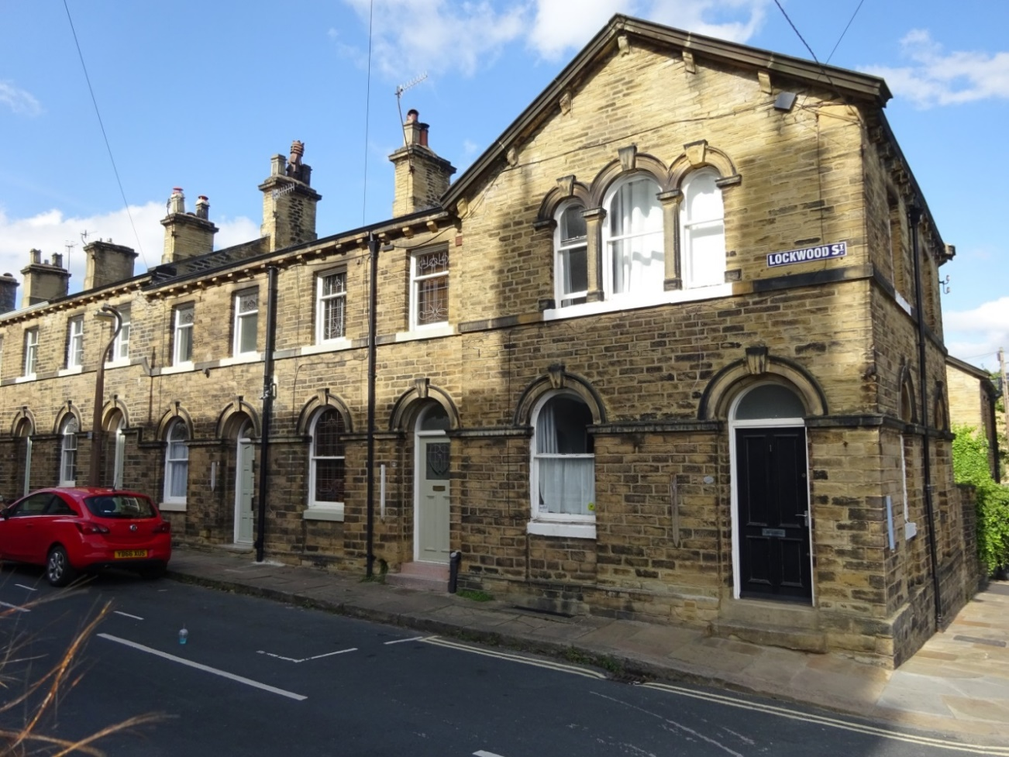
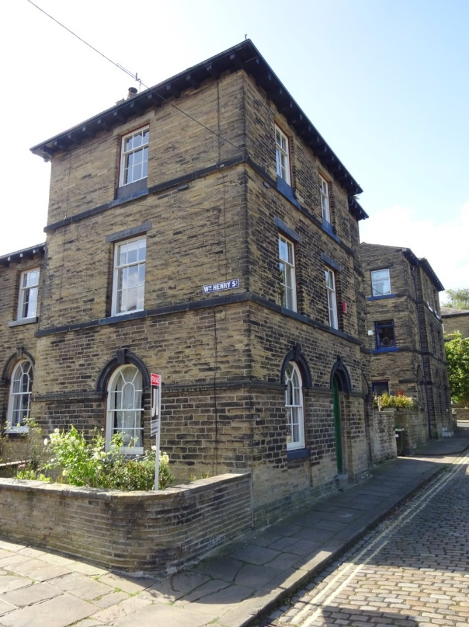
Workers Housing
House B
House C
House A
TASK : Match up the different houses in the photographs with the people who lived in them:
A manager or foreman; A temporary visitor or worker; A worker at Salts Mill
Photographs, Julie Edwards, Historic England.
Notes:
House A: A worker at Salts Mill
House B: A manager or foreman
House C: A temporary visitor or worker
The downside of Saltaire was social control. Foremen lived in the bigger houses like House B. They would enforce the strict ban on alcohol, as well as ensuring good time-keeping and good behaviour generally. Ordinary workers lived in a standard terraced house, like House A and visitors/temporary works stayed in rooms/flats and a separate block like House C in the photograph.

Slide 14
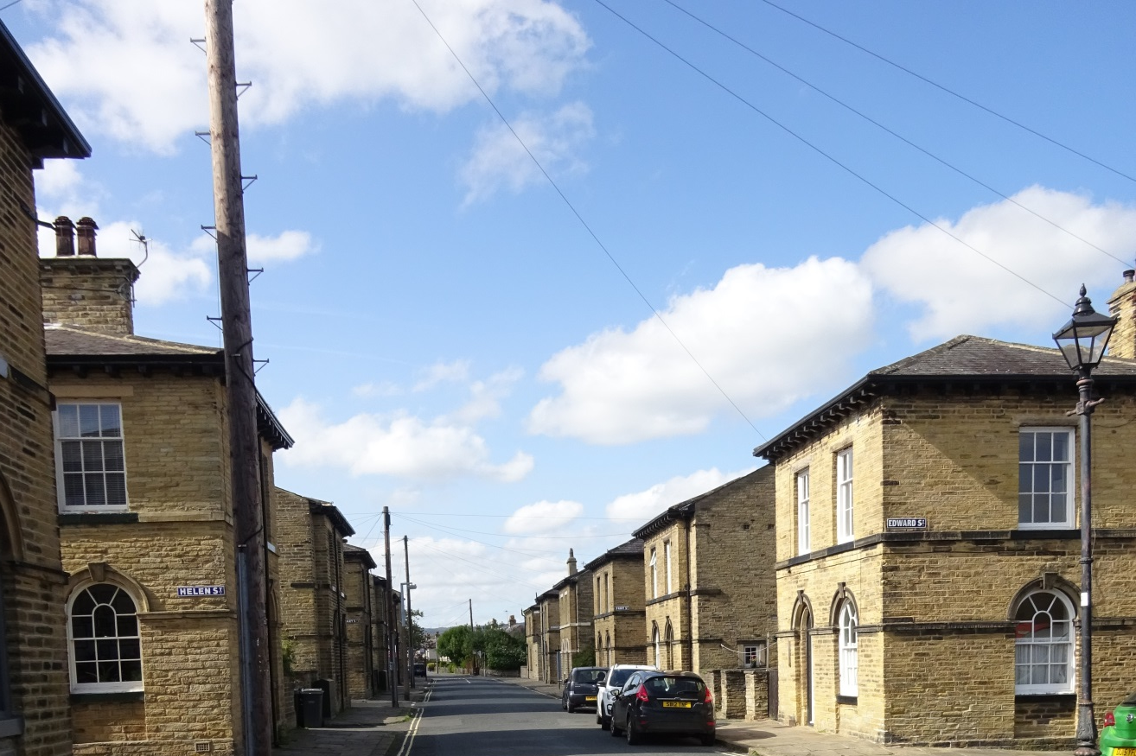
Workers Housing
TASK
Which aspect of healthy
housing is shown here:
a good supply of fresh water;
a good drainage system and own
(outside) toilet;
access to air and light;
a shared ash pit (rubbish dump);
gas from the gasometer;
a back alley so that rubbish could
be removed more easily?
Photograph, Julie Edwards, Historic England
Notes:
Access to air and light – the street is relatively wide and not blocked off at the ends by cramming in more houses to form a courtyard.

Slide 15
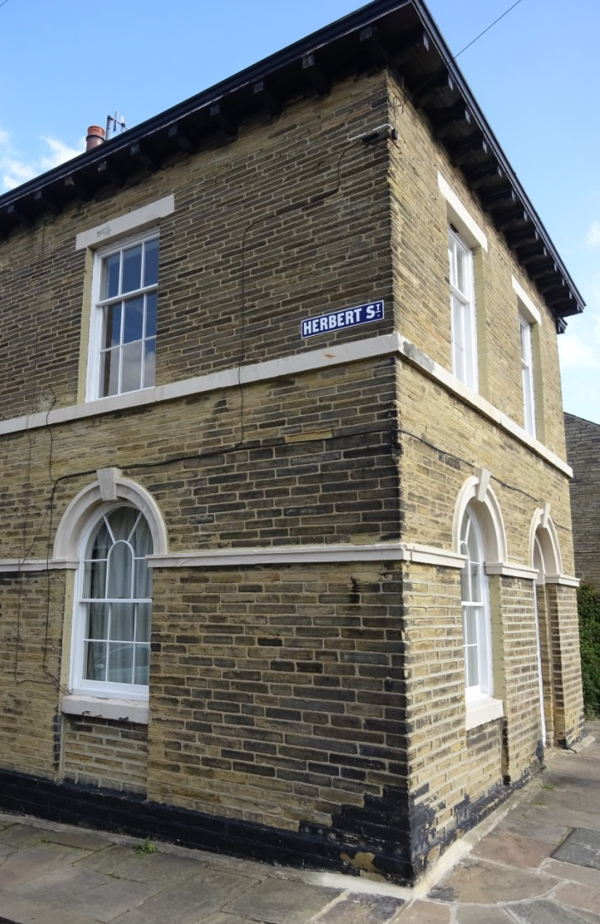
Workers Housing
Albert Terrace
Caroline Street
Lockwood Street
Mawson Street
Ada Street
Helen Street
Mary Street
Henry Street
Victoria Road
Fanny Street
TASKS
How did Salt name some of his streets?
Why do you think he did this/what does it tell us about Salt?
Whitlam Street
Albert Road
Herbert Street
Edward Street
Amelia Street
George Street
William Street
Titus Street
Photographs: Julie Edwards Historic England
Notes:
Caroline was Salt’s wife and most of the streets were named after his children. He also named them after members of the Royal family and the architects who built Saltaire - Lockwood and Mawson.

Slide 16
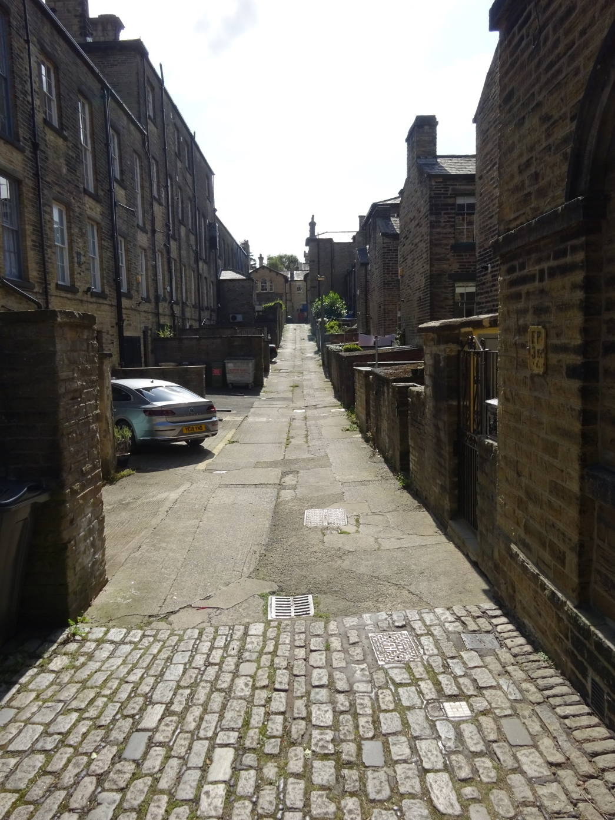
Workers Housing
TASK
Which aspect of healthy
housing is shown here:
a good supply of fresh water;
a good drainage system and own
(outside) toilet;
access to air and light;
a shared ash pit (rubbish dump);
gas from the gasometer;
a back alley so that rubbish could
be removed more easily?
Photograph: Julie Edwards Historic England
Notes:
A back alley so that rubbish could be removed more easily.

Slide 17
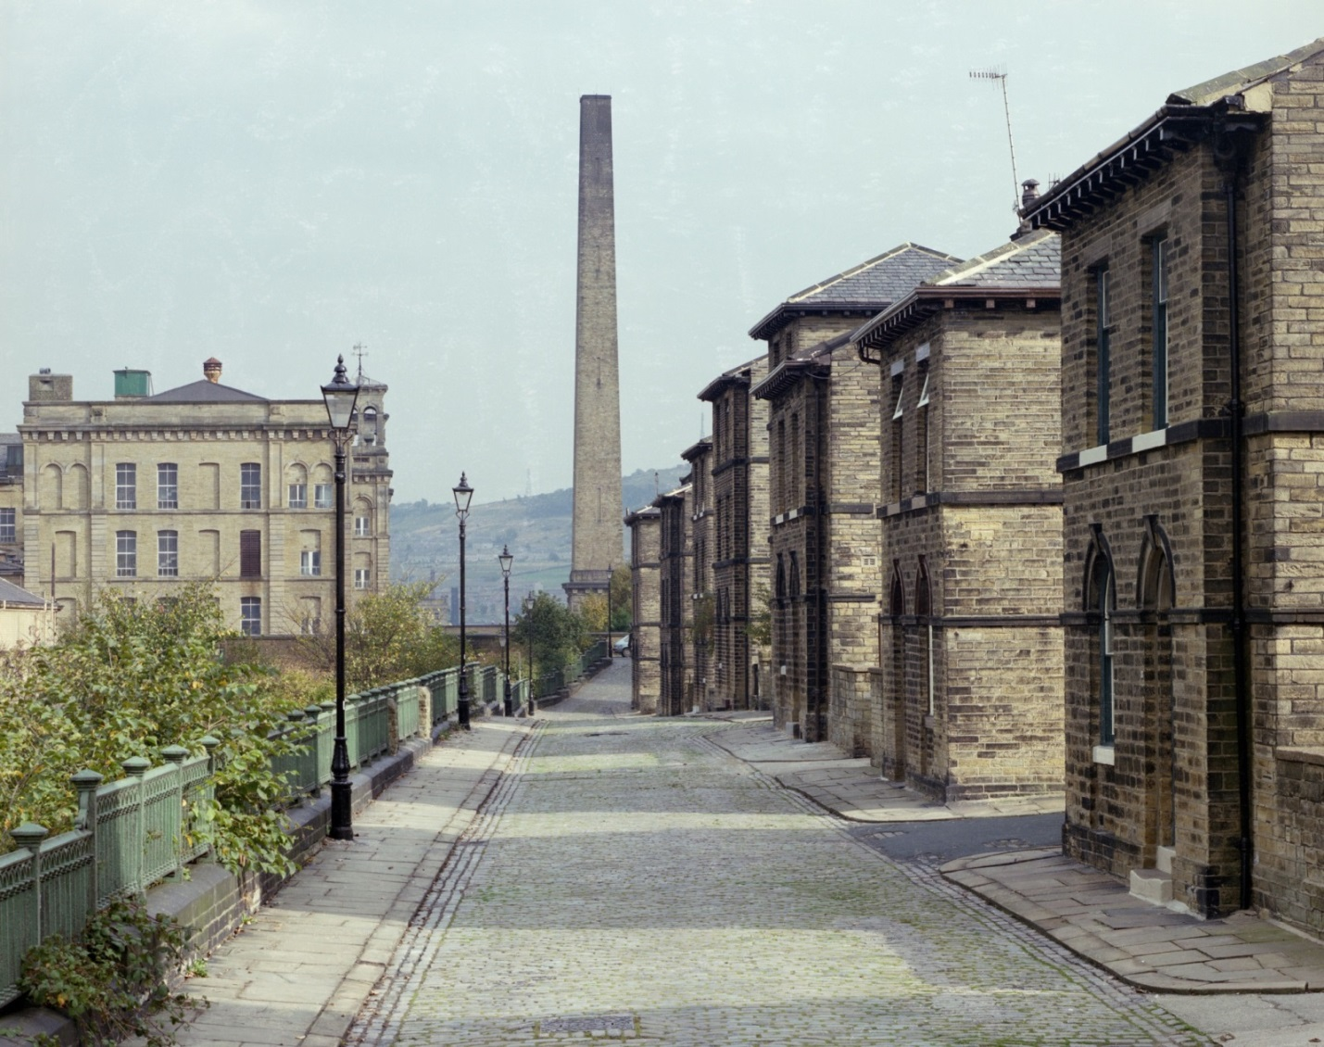
Workers Housing
TASK
Which aspect of healthy
housing is shown here:
a good supply of fresh water;
a good drainage system and own
(outside) toilet;
access to air and light;
a shared ash pit (rubbish dump);
gas from the gasometer;
a back alley so that rubbish could
be removed more easily?
Photograph: Historic England Archive Ref: bb87/05049 Taken July 1986.
Notes:
Access to air and light – a wide main street with relatively wide side streets.

Slide 18
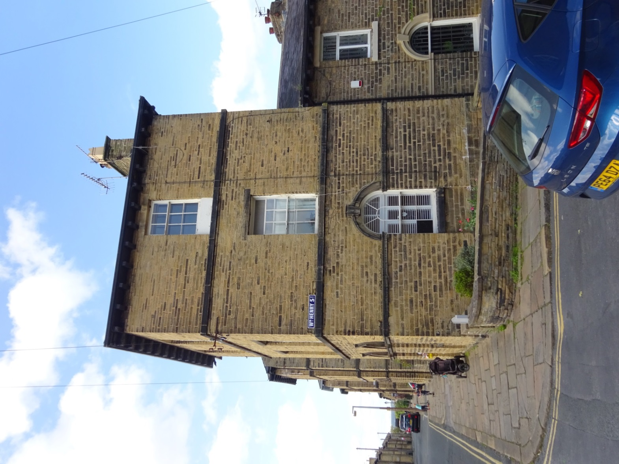
Workers Housing
Buildings at the end of the terraces were three storeys high and were designed to be boarding houses.
Photographs: Julie Edwards Historic England

Slide 19
Almshouses
In 1868, 45 Almshouses were built at the end of Victoria Road.
These houses were rent free and given to people on the basis of their age, illness or infirmity.
They also received a small weekly pension (giving alms means giving money to help poor people) .
Each house had an oven, boiler and pantry, together with a single bedroom.
Photograph: Crown Copyright. Historic England Archive Ref: aa039285 Taken November 1998.
TASK What does this idea of giving alms suggest about Titus Salt?
Notes:
It is evidence for Salt’s paternalism as these people had no further economic value to him. It was at a time when there was no state pension and many elderly or ill people ended up living in a workhouse.

Slide 20
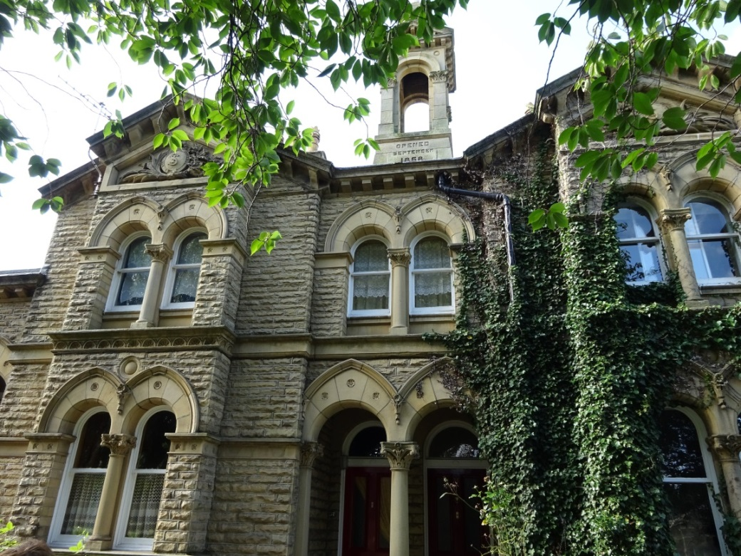
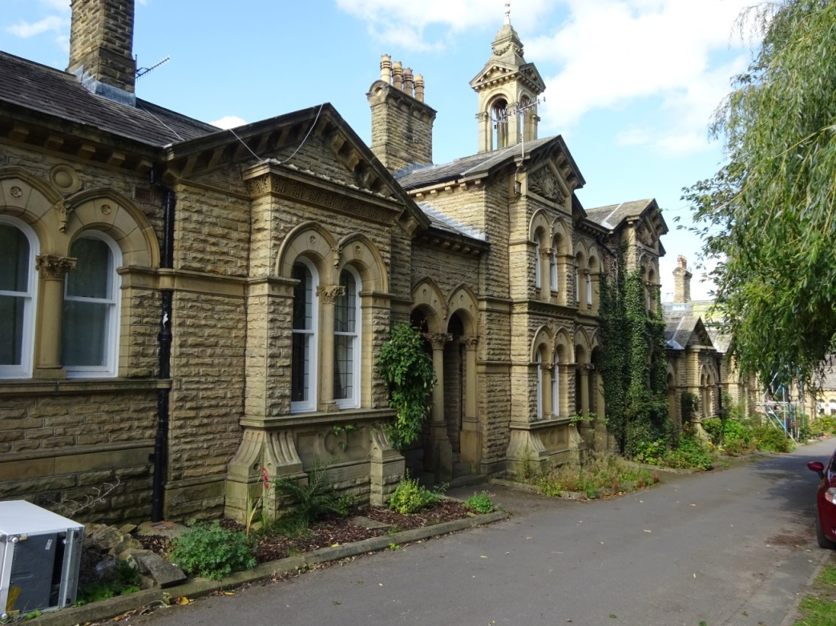
Almshouses today
Photographs : Julie Edwards Historic England
TASK
In 2001 the Almshouses were refurbished by Bradford council and are now fully occupied again. What does this tell us?
2. They have the initials ‘TS’ to the left and ‘CS’ to the right. What do they stand for? What does this tell us?
Notes:
To have survived so well, the Almshouses must have been built to a good standard.
The initials suggest a desire from Titus (TS) & Caroline (CS), his wife, to leave a mark as a kind, generous & successful couple.

Slide 21
Shops
In 1854, Saltaire had 14 shops.
These included a grocers, a chemist, a post office, a butchers and a range of other hardware and retail facilities.
TASK
Unlike other towns and villages the thing missing from Saltaire was public houses (pubs), which Salt refused to allow. Why do you think Salt did this?
Photograph courtesy of Saltaire Collection
Notes:
With long working hours, local shops were much more convenient than travelling to Bradford. With no fridges, daily shopping was the norm. Salt did not sell to his workers through a truck shop to make extra profits, which was something many other mill owners did at this time.

Slide 22
Victoria Road – Then & Now
Photograph courtesy of Saltaire Collection
Photograph: Julie Edwards Historic England
TASK What similarities and differences do you notice?
Notes:
You could even bring it up on Google Street View and take a virtual walk along it to compare it to the old photo.
https://www.google.com/maps/@53.838269,-1.7895975,3a,75y,209.64h,87.84t/data=!3m6!1e1!3m4!1sX79zgO2YM_wm86mm5QWzoQ!2e0!7i16384!8i8192

Slide 23
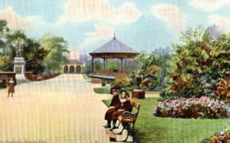
Outdoor leisure: Saltaire Park
Saltaire was surrounded by countryside, but there was no green space in Saltaire itself. So a large park, designed by William Gay, was opened on the 25th July 1871 .
The park hosted a variety of leisure activities including archery, croquet, a cricket field and had a number of ‘pavilions’.
The river was widened to make it suitable for swimming and boating and a boathouse was built on the opposite bank.
Drawing of Saltaire Park. Saltaire Collection
TASK What benefits would the people using the park gain?

Slide 24
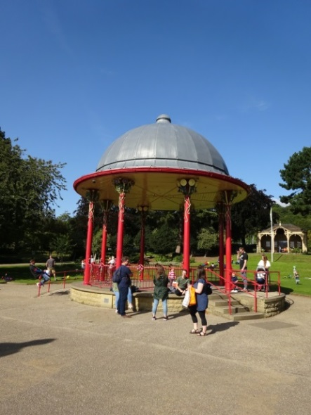
Outdoor leisure: Roberts Park
In 1920 the name changed to Roberts Park when Sir James Roberts, the then owner of Saltaire, gifted the park to the local authority.
TASK
What benefits would the people using the park gain?
The Bandstand Today
Photograph Julie Edwards, Historic England

Slide 25
Park Rules
TASK
Sum up the park’s rules in three adjectives.
Make sure that you can explain your choices.
Notes:
Read/print the rules more clearly from this link: https://www.saltairecollection.org/wp-content/uploads/Park-rules.jpg

Slide 26
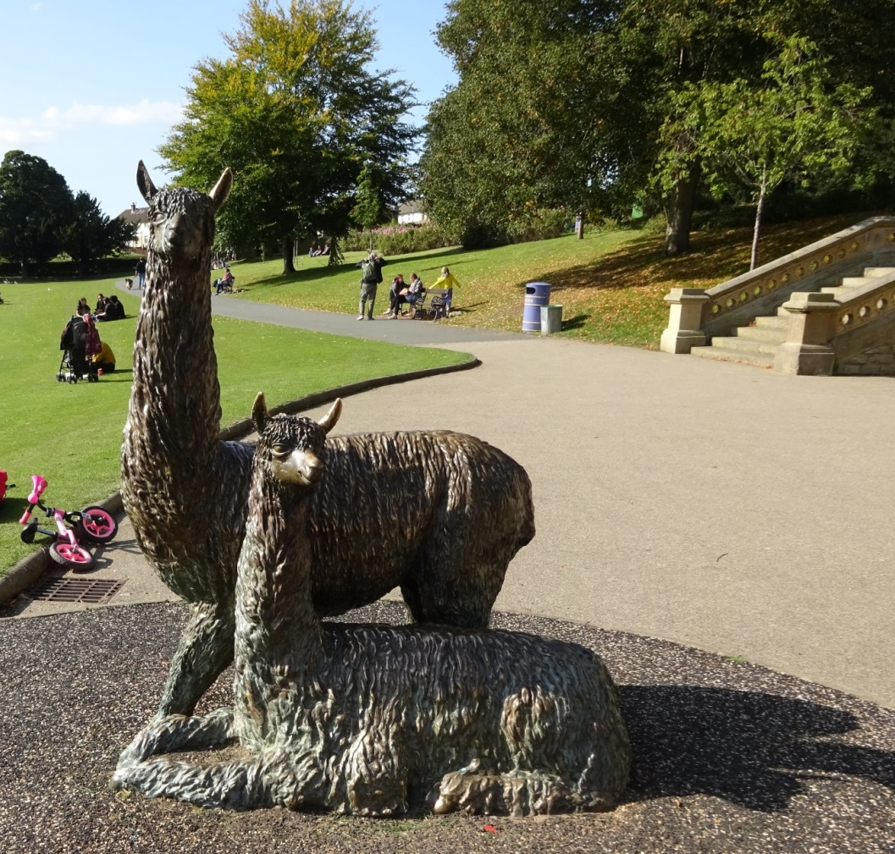
The Bronze Statues
These statues are made of bronze and are outside the Half Moon Cafe in the park.
TASK
Which animal do they show?
Why do you think they are on display
in the park?
Photograph: Julie Edwards Historic England
Notes:
Alpaca wool helped Salt to make the fortune which helped him to build Saltaire.

Slide 27
Schools
Schools
Salt built factory schools which could accommodate 750 pupils.
He made sure that they had facilities ahead of their time such as classrooms with central heating, gas lighting and fitted cupboards.
Playgrounds at the rear of the schools included covered areas for use in bad weather.
In February 1878 a separate elementary school on Albert Road, Saltaire (Albert Road Board School – now Saltaire Primary School) was opened for the younger children.
The Factory School now known as Salt Building – is now part of
Shipley College.
Photograph courtesy of Saltaire Collection

Slide 28
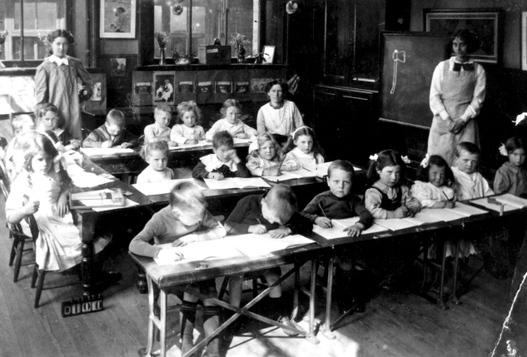
A typical school room
TASK
The children in this photograph are learning ‘the three Rs’. Can you work out which subjects they are learning
How would learning these subjects help the children's lives?
How would his future workers learning these subjects help Titus Salt?
Photograph courtesy of Saltaire Collection
Notes:
The schooling was only in the basics of reading, writing and arithmetic.
With the basics the children could read for pleasure. Some could study further while working or become pupil teachers, eventually teachers.
A literate workforce was easier to train and give instructions to.

Slide 29
Victoria Hall on Victoria Road
Salt wanted his adult workers to have the means for ‘self-improvement’.
He built the Saltaire Club and Institute in 1871 (now Victoria Hall ).
Inside was a reading room, library, laboratory, chess and draughts rooms, smoking room, billiard room, bagatelle room, lecture theatre, classrooms, a gymnasium and a rifle drill room.
Photograph courtesy of Saltaire collection
TASK
Devise a better name for Victoria Hall which sums up its role in Saltaire.

Slide 30
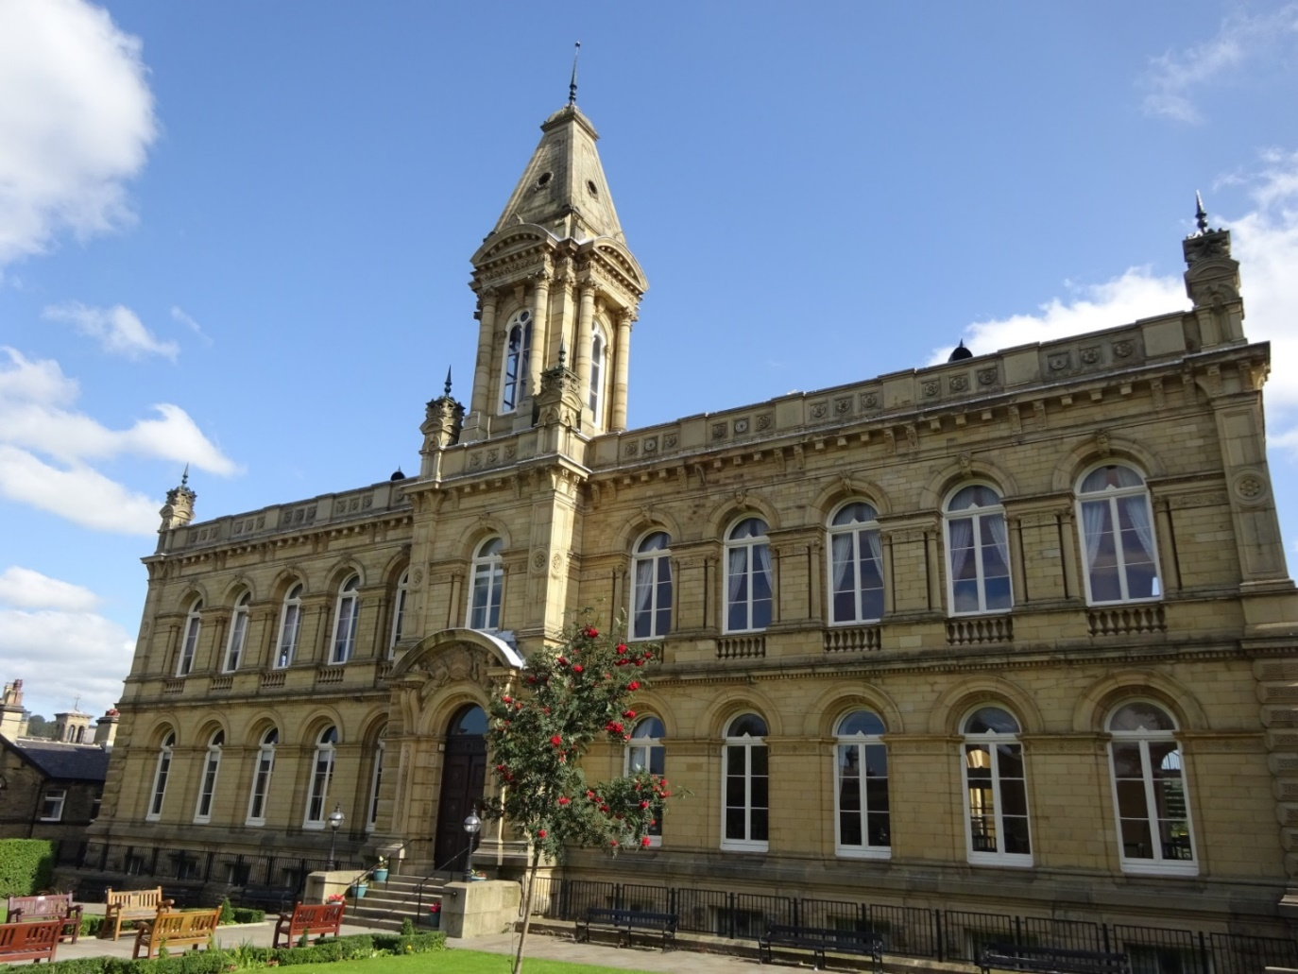
Victoria Hall on Victoria Road Today
Victoria Hall now functions as a rather grand Village Hall.
The rooms are available to hire and it has a licence to conduct marriages.
Photograph: Julie Edwards Historic England

Slide 31
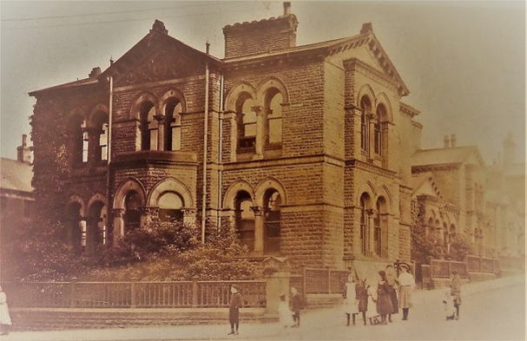
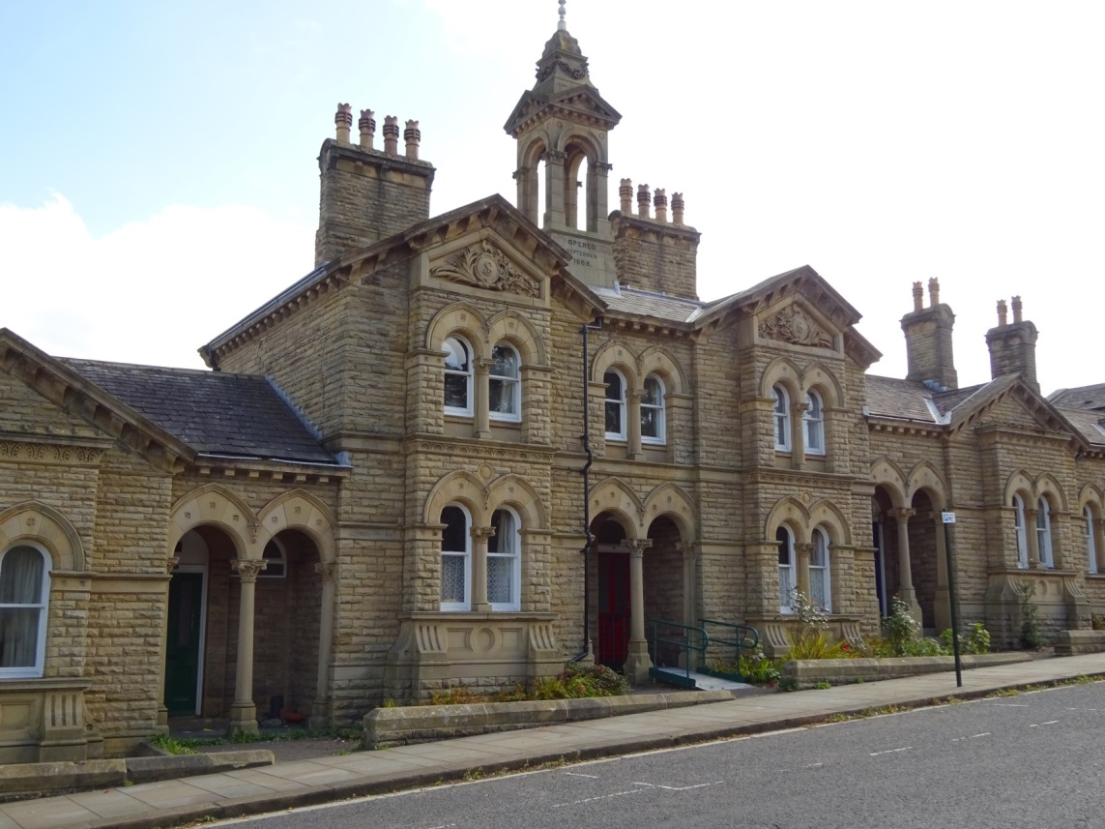
Hospitals
Salt built a hospital for his workers when they were sick, so they did not have to travel to Bradford.
Photograph courtesy of Saltaire collection
Photographs: Julie Edwards Historic England

Slide 32
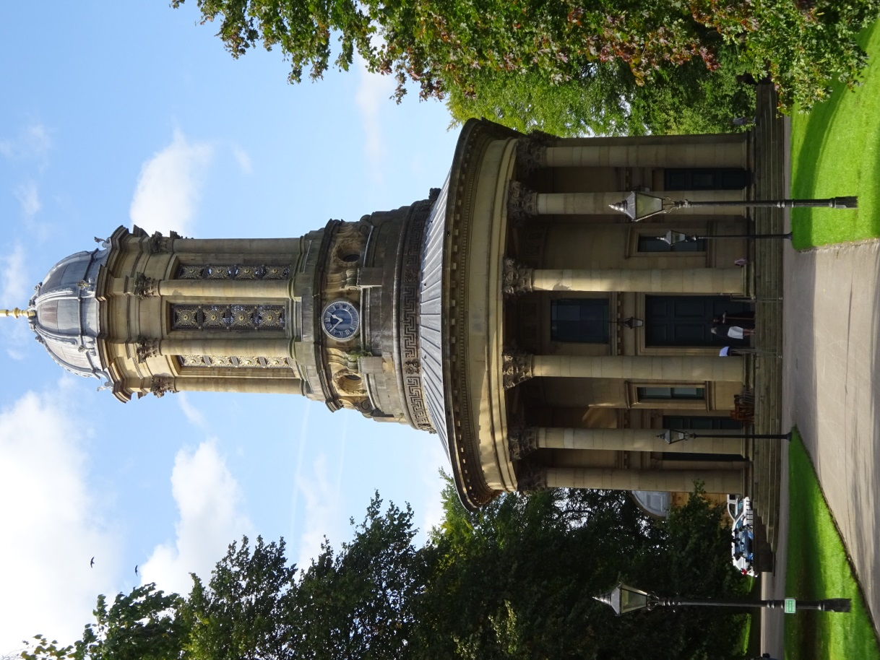
Church & Chapels
A new Congregational Church was opened in April 1859.
It has many architecturally and historically important features.
Its is now a Grade 1 listed building.
Photograph: Julie Edwards Historic England

Slide 33
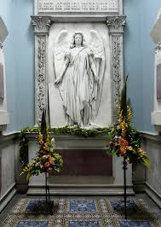
Titus Salt’s later life
Titus retired in 1861.
In 1869, he was made a Baronet, he became Sir Titus Salt .
By 1871, 4,390 people lived in the village.
Titus Salt died on 29th December 1876.
Thousands of people lined the streets to watch his funeral carriage pass.
His coffin was laid to rest in the Mausoleum at the Congregational Church in Saltaire.
TASKS
Why do you think Titus Salt is buried there?
Why do you think so many people went to watch his funeral procession?
Photograph courtesy of Saltaire Collection

Slide 34
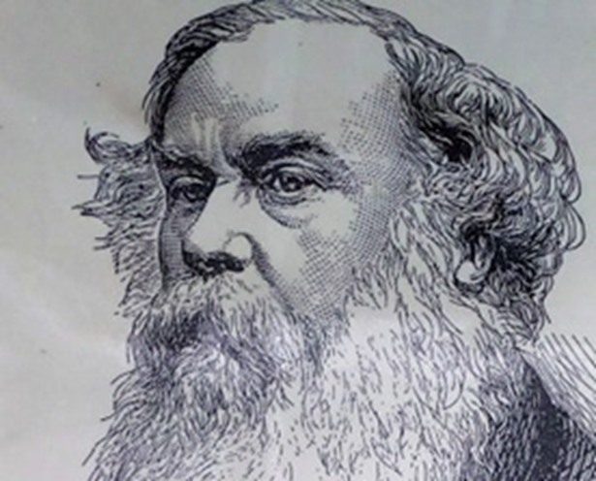
What’s Sir Titus Salt thinking?
Complete the following:
The main reason that I built Saltaire was to ……….
Another very important reason was to ……….
I also built Saltaire to ………. (and) ……….
Photograph courtesy of Saltaire Collection
Notes:
The key debate is whether Salt’s motives were primarily paternalistic or based on making profit.
Salt may also have acted from a sense of Christian duty, have wanted to leave something for posterity (he was rather dour in ‘real life’) or to have aspired to ape the upper classes.

Slide 35
QUIZ
TIME
TASK: Answer the 15 quiz questions about Sir Titus Salt.
Use your text about Sir Titus Salt, to help you find the answers.
Notes:
Download the quiz: https://www.saltairecollection.org/wp-content/uploads/Quiz-questions.pdf
Finish the lesson with ‘Quiz time’ where children will answer 15 questions (independently, pairs or groups) about Titus Salt and Saltaire by looking at the biographies and retrieving the information from there as well as recalling the information from the lesson (there are 3 differentiated versions of the biography). All the resources mentioned can be downloaded here: https://www.saltairecollection.org/schools/primary-school-resources/lesson-ideas-for-primary-schools/pre-visit-learning-resources-ks2/
Staff to circulate and point to/ highlight areas of the text where the children can find the answers. Feedback the answers as a whole class and address any misconceptions.

