Slide 1
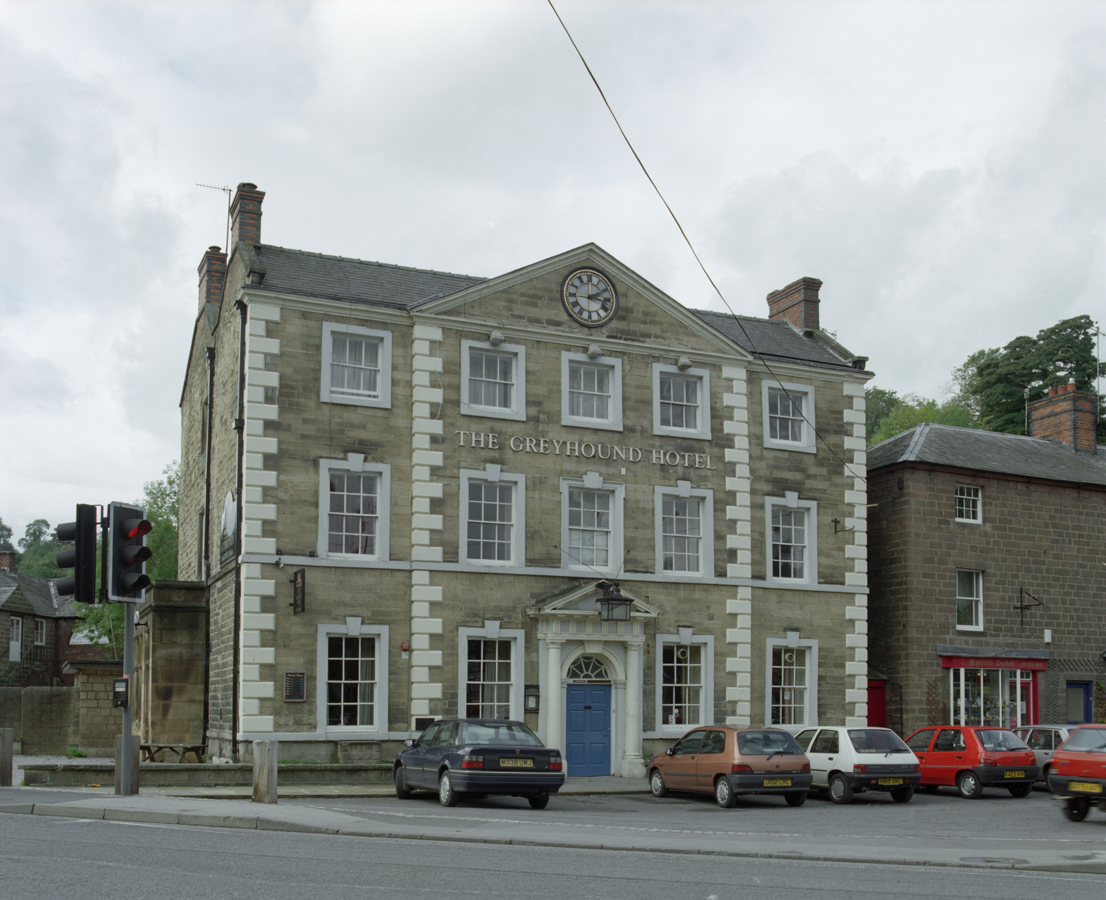
What can we learn about shapes by looking at a building? 1
What can we learn about shapes by looking at a building?
Notes:
Image: © Crown Copyright. Historic England Archive Ref: AA039342 Date: Nov 1998 - https://historicengland.org.uk/images-books/photos/item/AA039342

Slide 2
What can we learn about shapes by looking at a building? 2
Key Stage 1: Art and Design & Maths
Learning Aims and Outcomes
Identify differences in shapes, patterns and decoration in buildings and relate these to the purpose of the building
Ask the children to look for shapes and patterns in a building and think about why they were chosen
List words about the shape, pattern and decoration of buildings

Slide 3


Building Shapes 1
Look at the building carefully.
What shapes can we find on a building?
Look
Notes:
Image: © Crown Copyright. Historic England Archive Ref: AA039342 Date: Nov 1998 - https://historicengland.org.uk/images-books/photos/item/AA039342

Slide 4
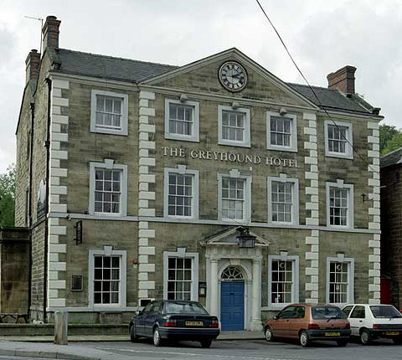
Building Shapes - circles
Can you find 1 circle?
Use your finger to trace around the shape.
Look
Notes:
Image: © Crown Copyright. Historic England Archive Ref: AA039342 Date: Nov 1998 - https://historicengland.org.uk/images-books/photos/item/AA039342

Slide 5
Whole page colour picture

Slide 6
Whole page black and white picture
Notes:
Image: © Crown Copyright. Historic England Archive Ref: AA039342 Date: Nov 1998 - https://historicengland.org.uk/images-books/photos/item/AA039342
This Print Out page can be used for pupils to draw the shapes on themselves.

Slide 7

Building Shapes – circles - ANSWER
Did you find it?
Notes:
Image: © Crown Copyright. Historic England Archive Ref: AA039342 Date: Nov 1998 - https://historicengland.org.uk/images-books/photos/item/AA039342

Slide 8
Building Shapes - triangles
Can you find 2 triangles?
Use your finger to trace around the shape.
Look
Notes:
Image: © Crown Copyright. Historic England Archive Ref: AA039342 Date: Nov 1998 - https://historicengland.org.uk/images-books/photos/item/AA039342

Slide 9
Building Shapes - triangles - ANSWER
Did you find them?
Notes:
Image: © Crown Copyright. Historic England Archive Ref: AA039342 Date: Nov 1998 - https://historicengland.org.uk/images-books/photos/item/AA039342

Slide 10
Building Shapes - squares
Can you find 5 big squares?
Use your finger to trace around the shape.
Look
Notes:
Image: © Crown Copyright. Historic England Archive Ref: AA039342 Date: Nov 1998 - https://historicengland.org.uk/images-books/photos/item/AA039342

Slide 11
Building Shapes - squares - ANSWER
Did you find them?
Notes:
Image: © Crown Copyright. Historic England Archive Ref: AA039342 Date: Nov 1998 - https://historicengland.org.uk/images-books/photos/item/AA039342

Slide 12
Building Shapes - rectangles
Can you find 9 big rectangles?
Use your finger to trace around the shape.
Look
Notes:
Image: © Crown Copyright. Historic England Archive Ref: AA039342 Date: Nov 1998 - https://historicengland.org.uk/images-books/photos/item/AA039342

Slide 13
Building Shapes - rectangles - ANSWER
Did you find them?
Notes:
Image: © Crown Copyright. Historic England Archive Ref: AA039342 Date: Nov 1998 - https://historicengland.org.uk/images-books/photos/item/AA039342

Slide 14
Building Shapes – semi-circles
Can you find 1 semi-circle?
Use your finger to trace around the shape.
Look
Notes:
Image: © Crown Copyright. Historic England Archive Ref: AA039342 Date: Nov 1998 - https://historicengland.org.uk/images-books/photos/item/AA039342

Slide 15
Building Shapes - semi-circles - ANSWER
Did you find it?
Notes:
Image: © Crown Copyright. Historic England Archive Ref: AA039342 Date: Nov 1998 - https://historicengland.org.uk/images-books/photos/item/AA039342

Slide 16

ACTIVITY: Can you match the shapes with their names? 1
Circle
Square
Triangle
Rectangle
Semi-circle
Think

Slide 17
ACTIVITY: Can you match the shapes with their names? 2
Circle
Square
Triangle
Rectangle
Semi-circle

Slide 18
ACTIVITY: Can you match the shapes with their names? 3
Rectangle
Circle
Semi-circle
Square
Triangle

Slide 19

ACTIVITY: Using these shapes, can you now design and draw a new building?
Draw

Slide 20

Extension / Further Work

Slide 21

What materials are buildings made of? 1
Slate
Glass
Brick
Stone
Notes:
Image: © Crown Copyright. Historic England Archive Ref: AA039342 Date: Nov 1998 - https://historicengland.org.uk/images-books/photos/item/AA039342

Slide 22
What materials are buildings made of? 2
Slate
Glass
Brick
Stone
Notes:
Image: © Crown Copyright. Historic England Archive Ref: AA039342 Date: Nov 1998 - https://historicengland.org.uk/images-books/photos/item/AA039342

Slide 23
What materials are buildings made of? 3
Brick
Slate
Glass
Stone
Notes:
Image: © Crown Copyright. Historic England Archive Ref: AA039342 Date: Nov 1998 - https://historicengland.org.uk/images-books/photos/item/AA039342

Slide 24
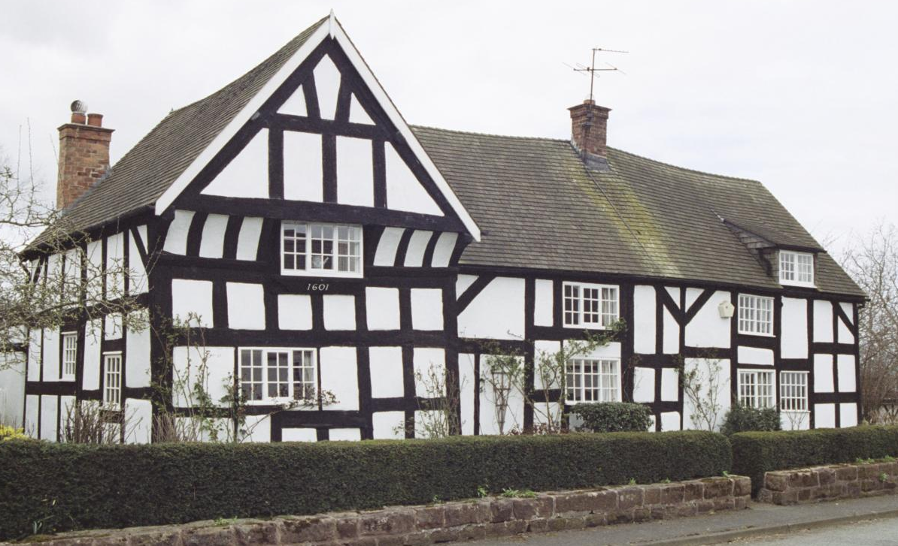
Can you do the same with this building? 1
Timber Frame
Brick
Plaster Panel
Slate
Notes:
Image: © Dr R. A. Brierley. Source: Historic England Archive Ref: IOE01/14637/29 Date: 12 Apr 2006 - https://historicengland.org.uk/images-books/photos/item/IOE01/14637/29

Slide 25
Can you do the same with this building? 2
Timber Frame
Brick
Plaster panel
Slate
Notes:
Image: © Dr R. A. Brierley. Source: Historic England Archive Ref: IOE01/14637/29 Date: 12 Apr 2006 - https://historicengland.org.uk/images-books/photos/item/IOE01/14637/29

Slide 26
Can you do the same with this building? 3
Brick
Slate
Timber Frame
Plaster Panel
Notes:
Image: © Dr R. A. Brierley. Source: Historic England Archive Ref: IOE01/14637/29 Date: 12 Apr 2006 - https://historicengland.org.uk/images-books/photos/item/IOE01/14637/29

Slide 27
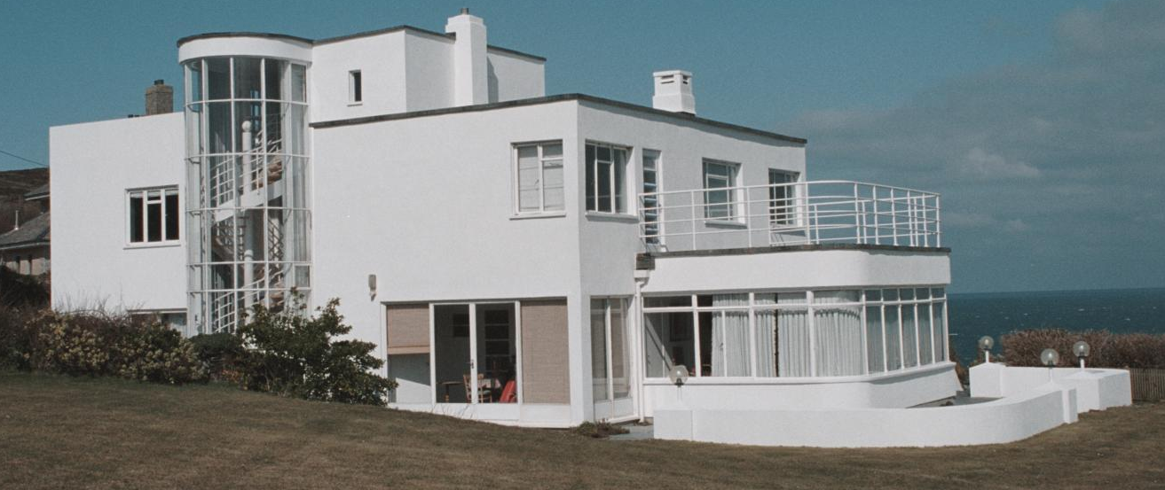
Can you do the same with this building? 4
Steel Frame
Concrete
Glass
Notes:
Image: © Mr John Midgley. Source: Historic England Archive Ref: IOE01/16264/03 Date: 23 Mar 2007 - https://historicengland.org.uk/images-books/photos/item/IOE01/16264/03

Slide 28
Can you do the same with this building? 5
Steel Frame
Concrete
Glass
Notes:
Image: © Mr John Midgley. Source: Historic England Archive Ref: IOE01/16264/03 Date: 23 Mar 2007 - https://historicengland.org.uk/images-books/photos/item/IOE01/16264/03

Slide 29
Can you do the same with this building? 6
Concrete
Glass
Steel Frame
Notes:
Image: © Mr John Midgley. Source: Historic England Archive Ref: IOE01/16264/03 Date: 23 Mar 2007 - https://historicengland.org.uk/images-books/photos/item/IOE01/16264/03

