Slide 1
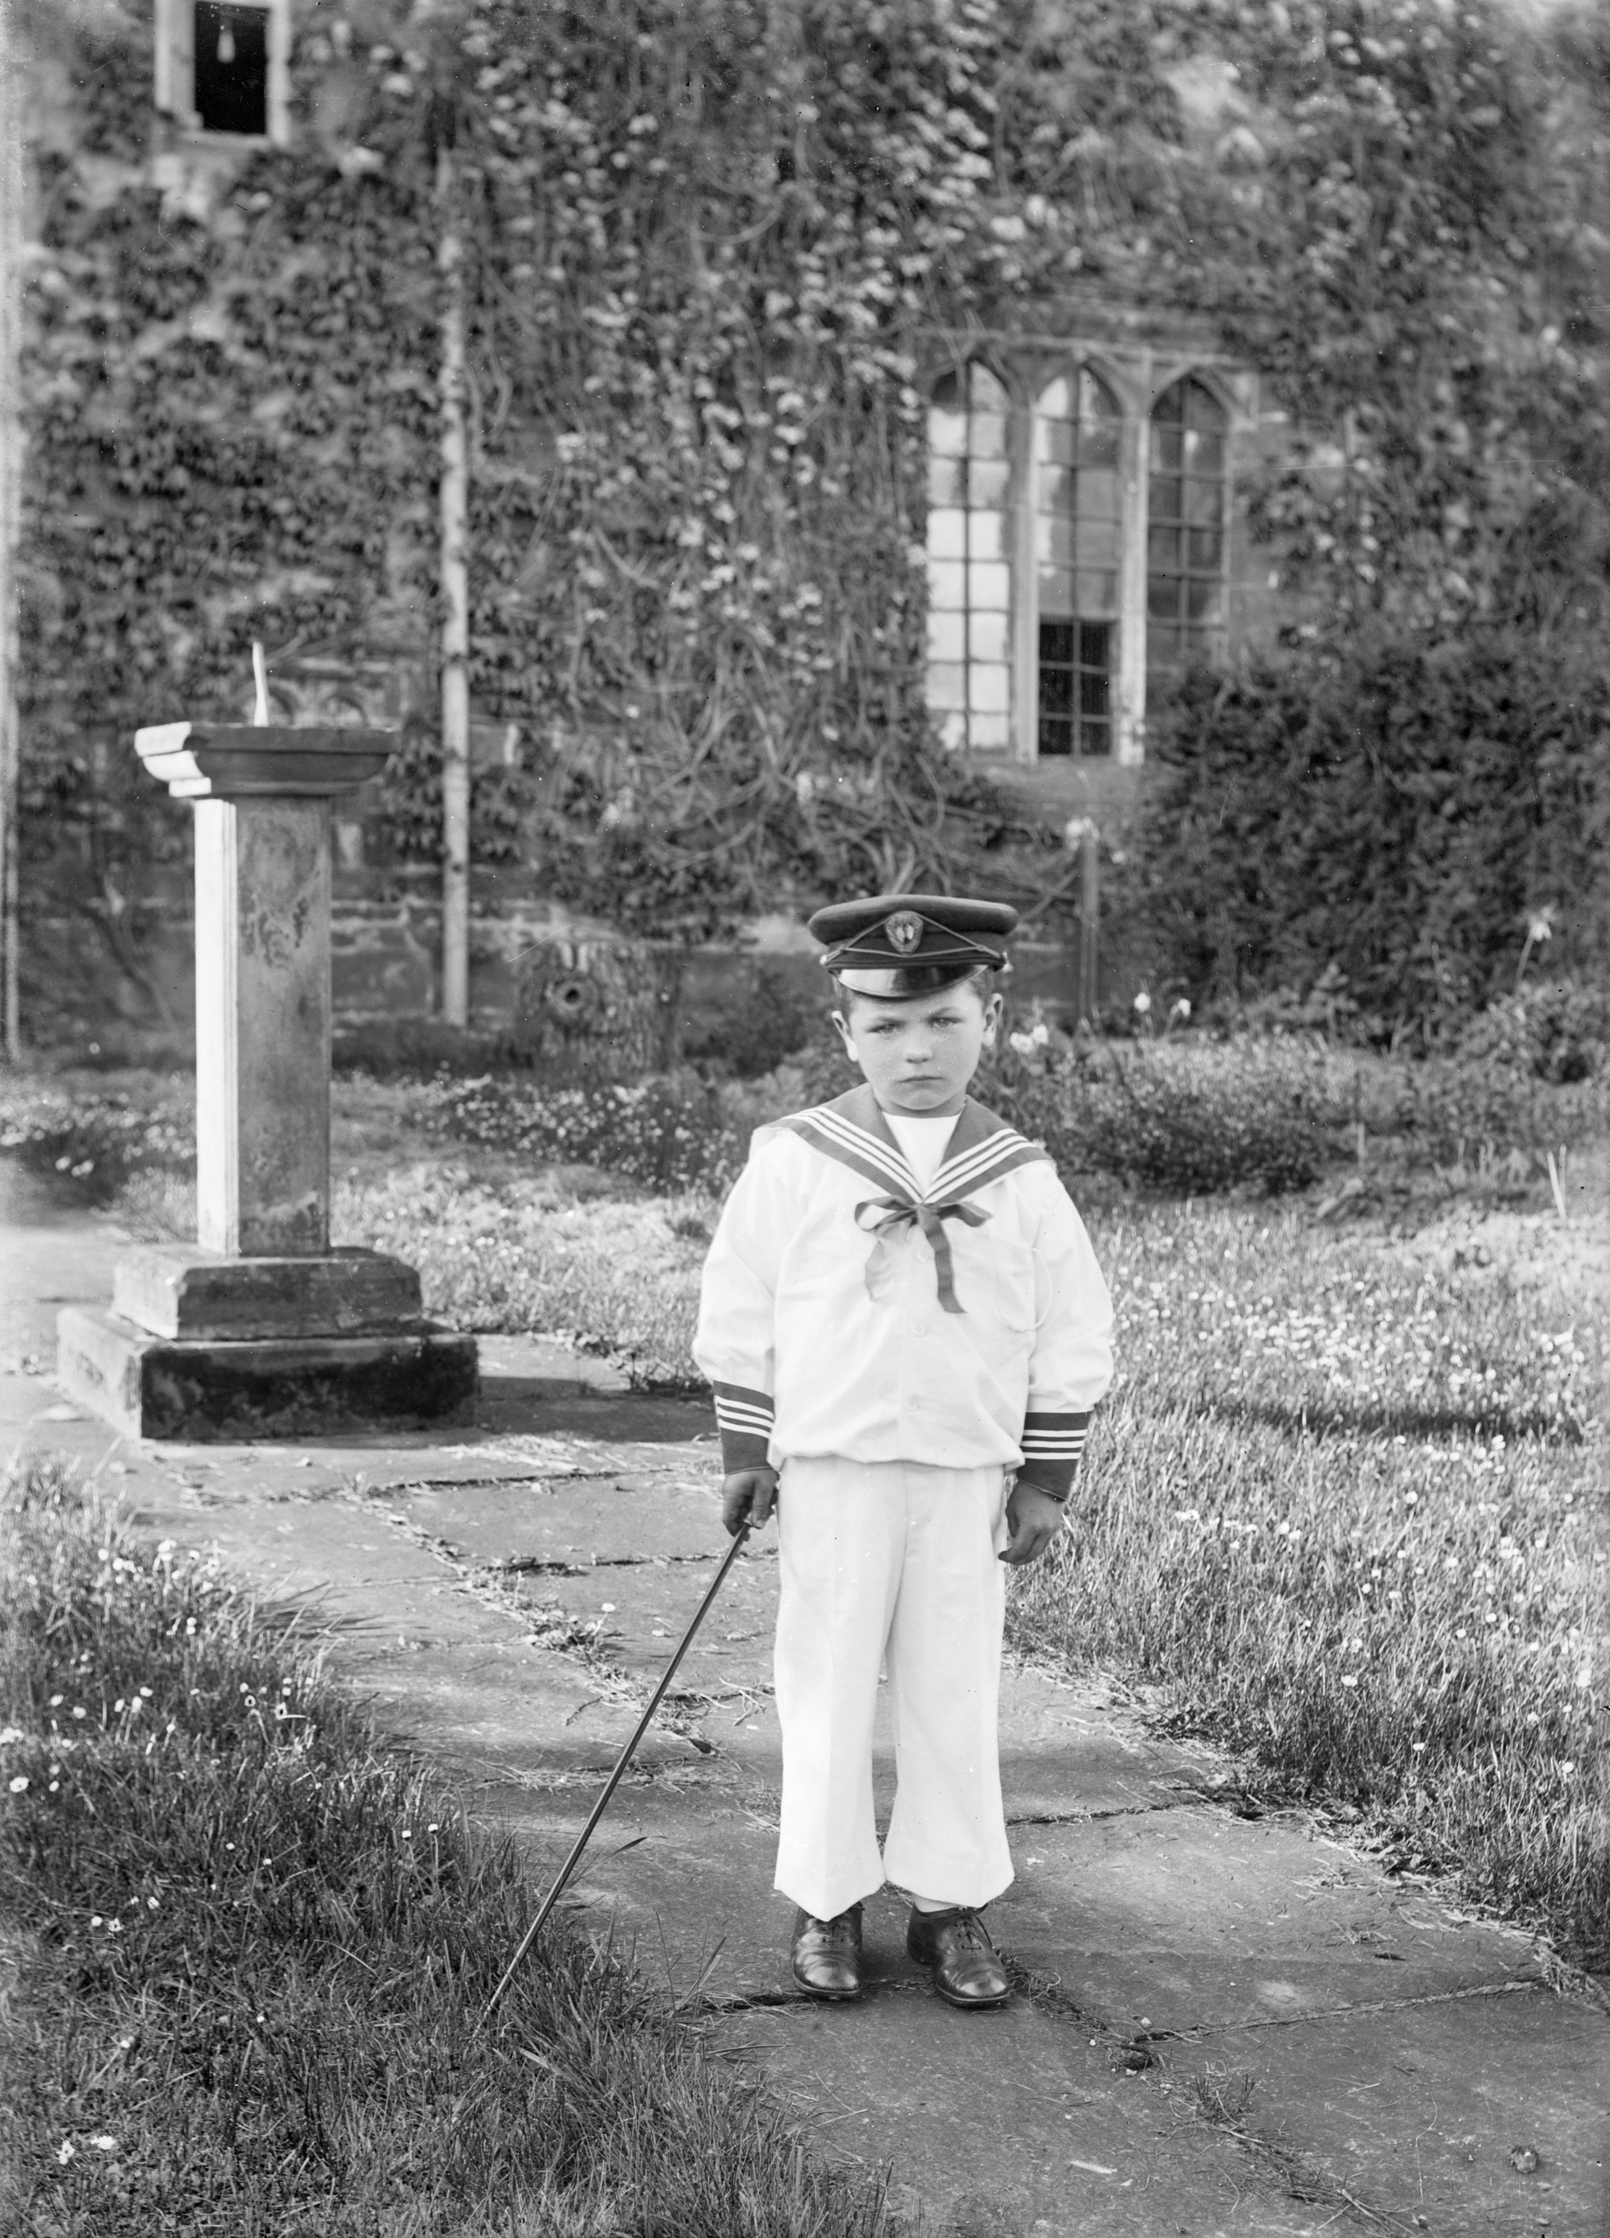
What do you think happened just before this photograph was taken?
What do you think happened just before this photograph was taken?
Notes:
Source: Historic England Archive Ref: BB98/10803 Date: 1901 - https://historicengland.org.uk/services-skills/education/educational-images/portrait-fawsley-1261

Slide 2
What do you think happened just before this photograph was taken? 1
Key Stage 2: Art
Learning Aims and Outcomes
Make drawings and paintings using the visual clues from given images
Comment on differences in the messages given by part of an image compared with messages from the whole image
Suggest ideas about why the images were made and what they show about the objects in them
Say what they think and feel about images

Slide 3
Exploring Photos
This photo of a little boy was taken in 1901.
That means he was born at the same time as your Great Great Great Grandparents!
Look carefully at the photo and describe all the different things that you can see.
Now focus on the little boy - how do you think he is feeling?
Notes:
Source: Historic England Archive Ref: BB98/10803 Date: 1901 - https://historicengland.org.uk/services-skills/education/educational-images/portrait-fawsley-1261

Slide 4
Print out photo of little boy
Notes:
Source: Historic England Archive Ref: BB98/10803 Date: 1901 - https://historicengland.org.uk/services-skills/education/educational-images/portrait-fawsley-1261

Slide 5






How does the little boy feel?
angry
worried
confused
Happy
sad
Impatient
Notes:
Source: Historic England Archive Ref: BB98/10803 Date: 1901 - https://historicengland.org.uk/services-skills/education/educational-images/portrait-fawsley-1261

Slide 6


Before you decide for sure, did you know…..
Victorians wore their best clothes for photographs
You had to stand completely still for at least a minute!
Victorians only took photographs on special occasions
This might be his first ever photograph

Slide 7

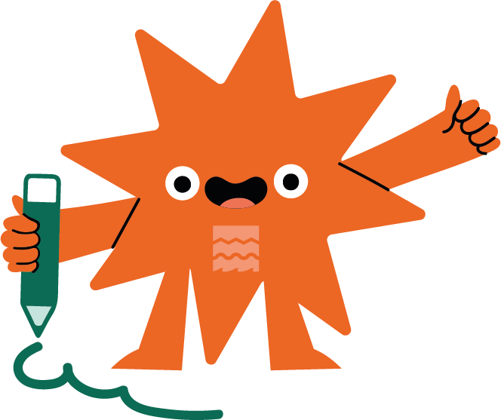

ACTIVITY
DRAW what you think the little boy might have been doing just before this photograph was taken
Crying?
Playing inside?
Playing in the garden?
Having a tantrum!
Worrying?
Draw
You can use speech or thought bubbles to help explain your picture.

Slide 8
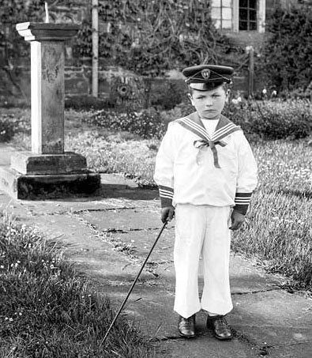
What do you think happened just before this photo was taken?
Try and imagine what might have been happening just before this photograph was taken.
Draw what you think happened in the empty box. You can use speech or thought bubbles to help explain your picture.

Slide 9

Extension / Further Work

Slide 10
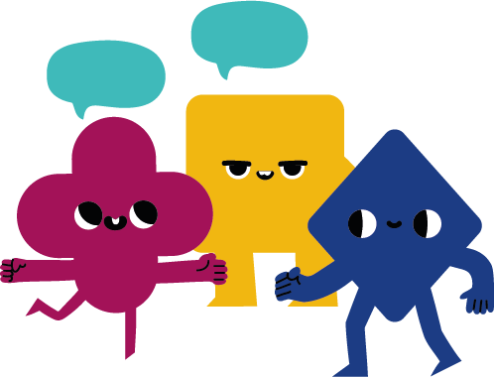
QUESTION: Why was he having his photo taken? Why do we take photos?
Try and think of as many different reasons as you can for taking a photograph today.
Do you think the Victorians would have had the same reasons?
Discuss your answers.
Group discussion

Slide 11
Why did Victorians take photos?
The Victorians were just like us in many ways they took photographs on special days too:
Birthdays
Christenings
Engagements
Marriages...
Bet you didn't know they also took pictures to…

Slide 12
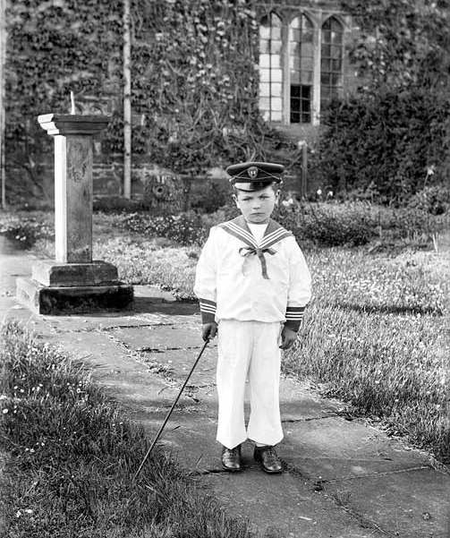
…celebrate boys wearing trousers!!!
Why? Because boys wore skirts up to the age of 5.
Then they were put into their first pair of trousers or breeches as they were called. These photos were known as 'Breeching Portraits‘.
Notes:
Find more teaching resources at: HistoricEngland.org.uk/Education

