Slide 1
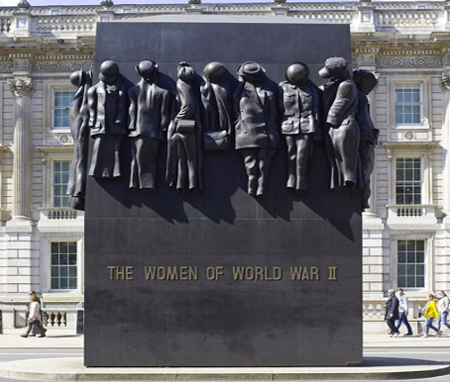
How did the Second World War change the lives of women on the Home Front?
How did the Second World War change the lives of women on the Home Front?
Notes:
Image: Andrew Shiva / Wikipedia

Slide 2
How did the Second World War change the lives of women on the Home Front? 11
Key Stage 3: History
Learning Aims and Outcomes
Students will develop skills in interpreting sources to identify changes to women’s lives
Students will be making inferences about the changes that women experienced
Students will use their source analysis to create a review of the Monument to the Women in the Second World War.
Notes:
Relates to: World War Two, Women’s History
This PPT relates to the Teaching Activity: How did the Second World War change the lives of women on the Home Front?

Slide 3

The Second World War 1
What predictions can you make about how the lives of women changed during the Second World War?

Slide 4

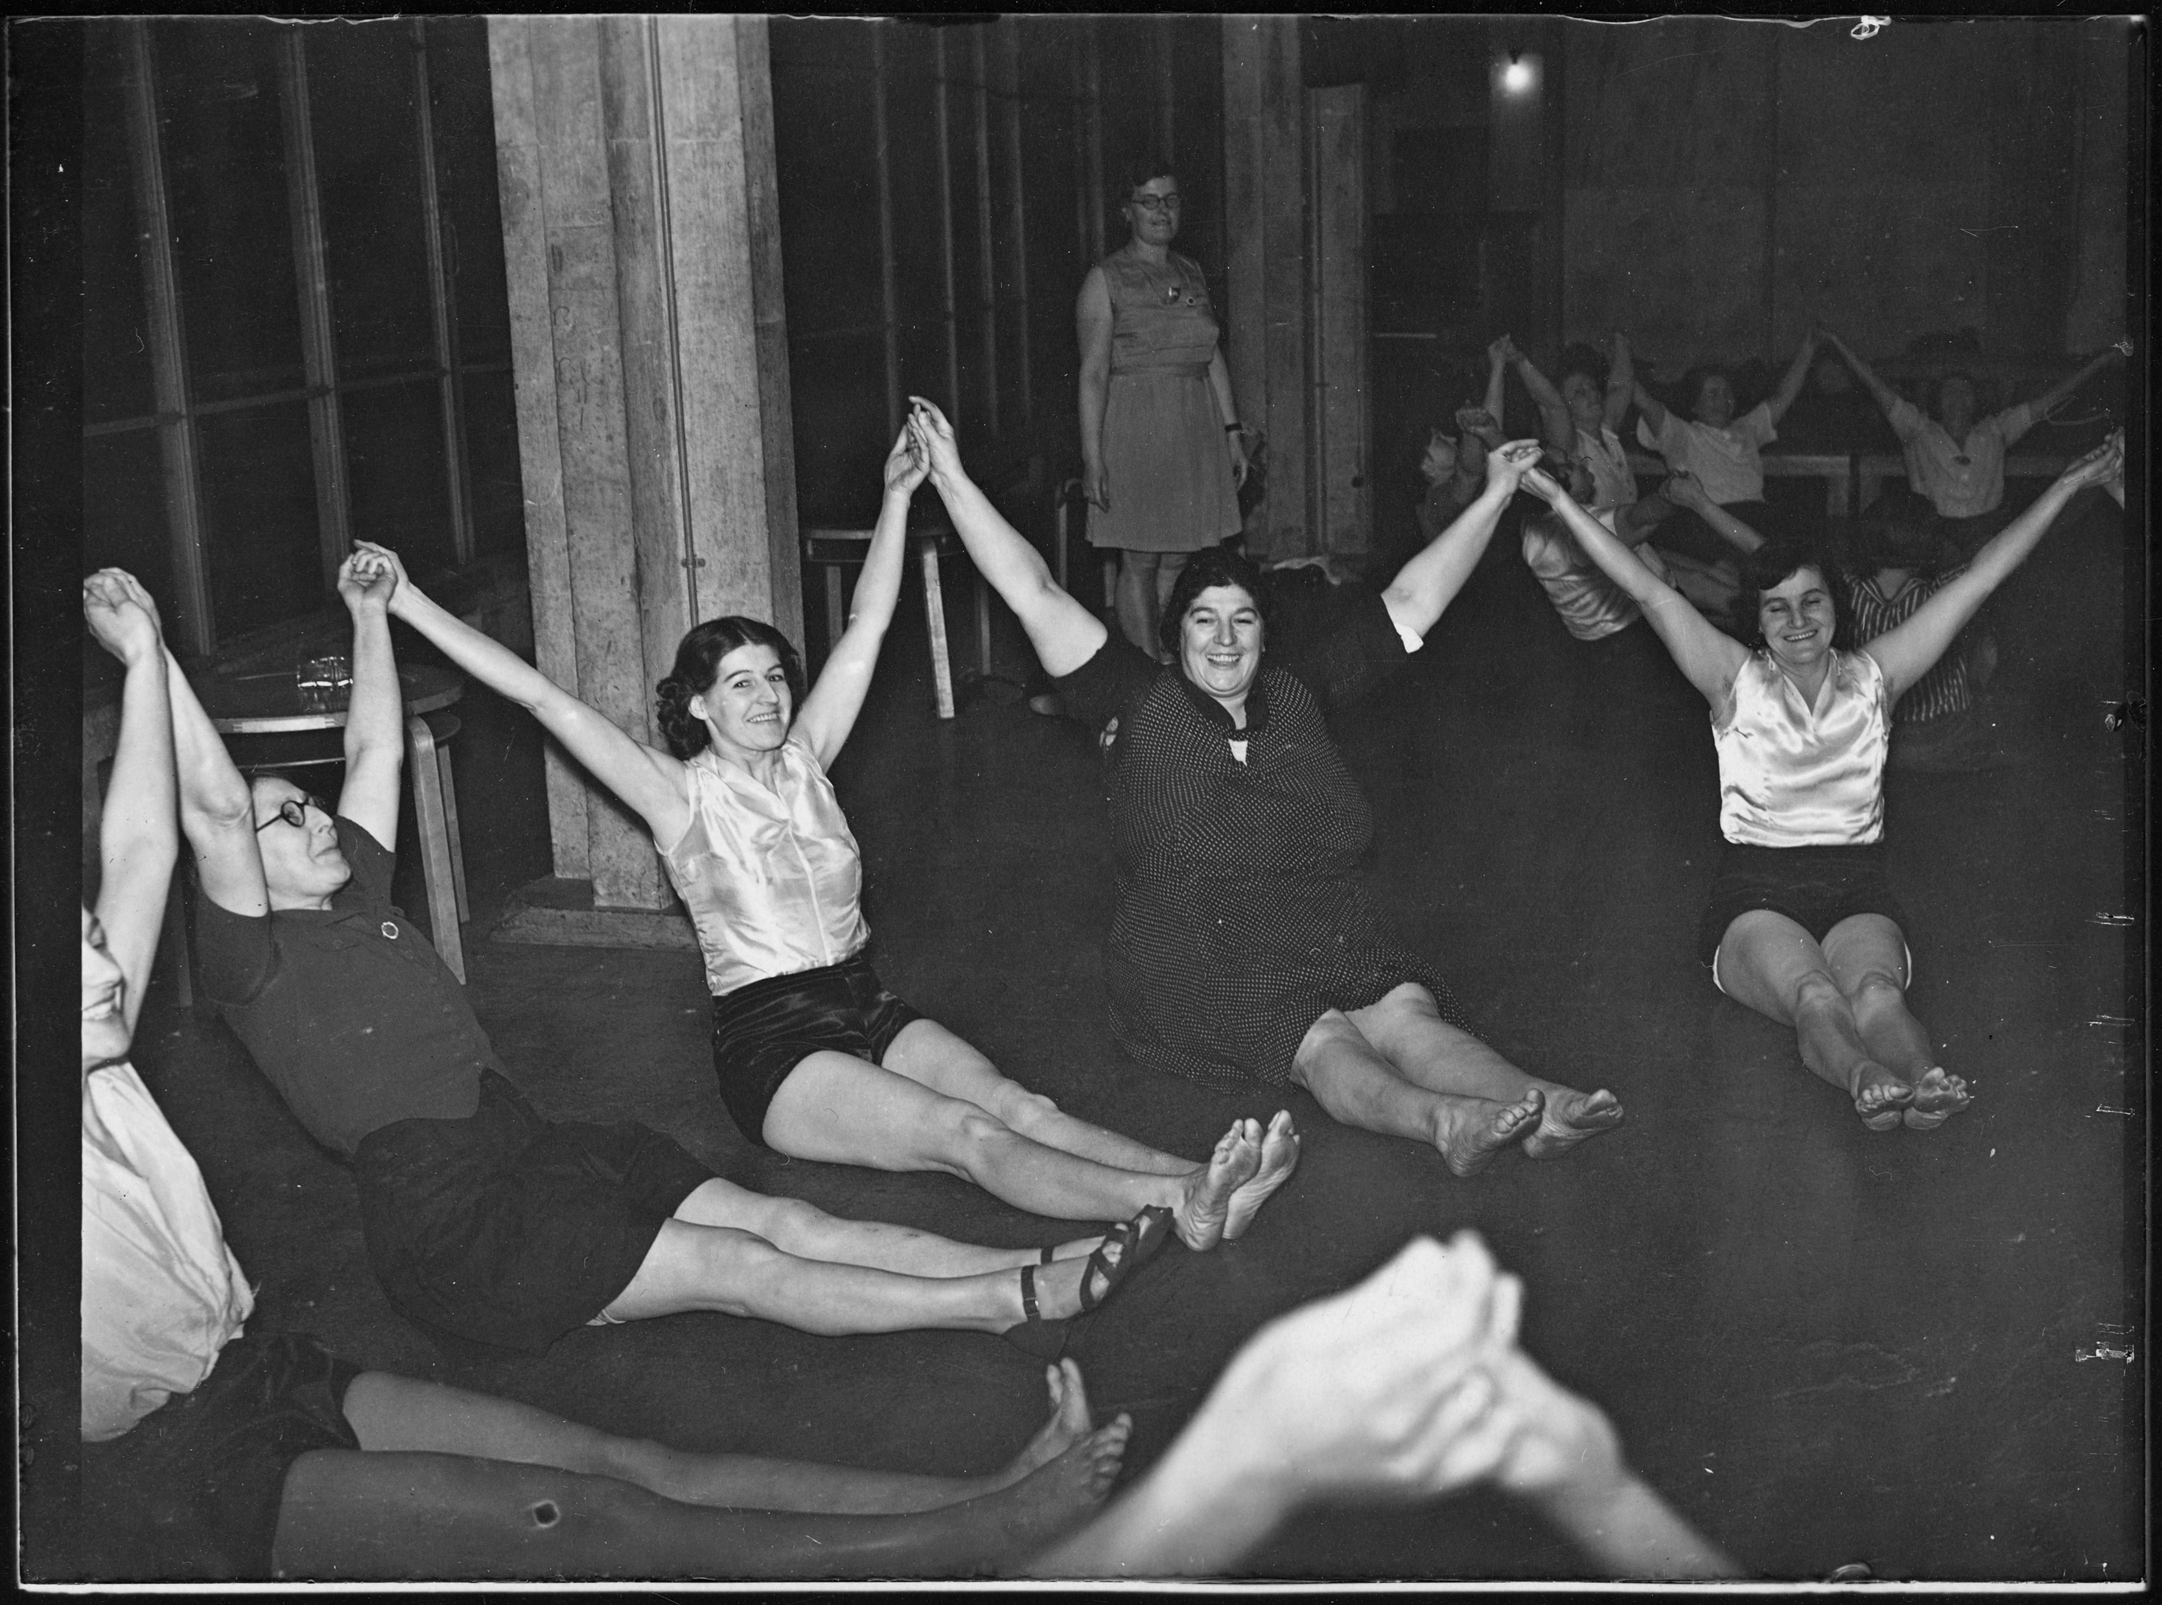



The Second World War 2
What?
Why?
Where?
How?
Notes:
Teacher notes: get pupils to construct questions about the image for example: What are they doing? What is the purpose of the group? Why is a woman watching over them? Where is this group based? Where is the building? How does it link to war? How important were these women?
Image: Source: Historic England Archive Ref: MED01/01/0040 Date: 31 Oct 1938 - https://historicengland.org.uk/images-books/photos/item/MED01/01/0040

Slide 5
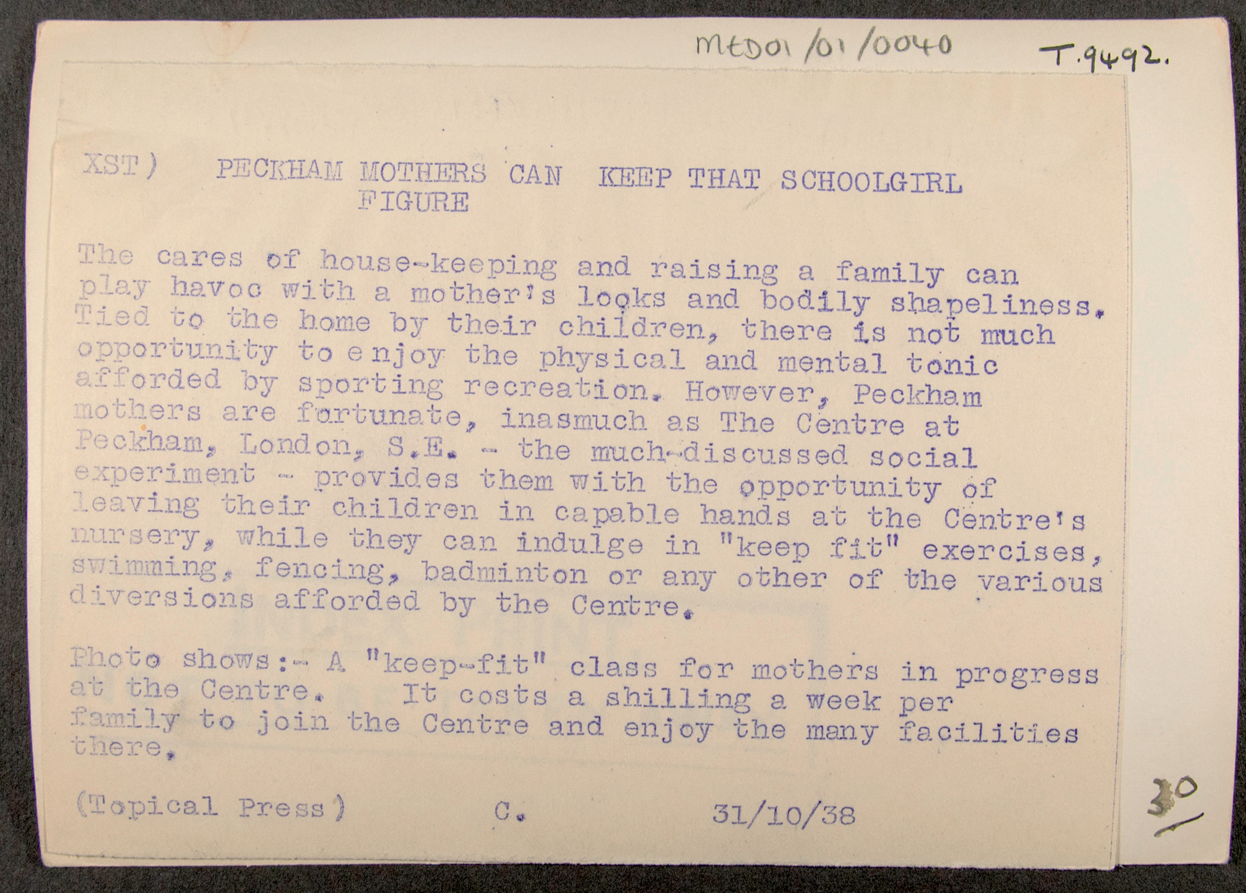
Image Caption
Notes:
This is the original caption that was written to go with the photograph.
Extra information:
The Pioneer Health Centre, Peckham, was opened in 1926. The founders aimed to discover factors contributing to positive health, rather than simply an absence of illness, and attempted to maintain the health of the local population. Due to its popularity with Peckham’s community, the Centre moved to a purpose-built building in 1935. The new building “represented a revolutionary idea and design”; built with the principle that movement and visibility must not be impeded it featured few doors and was made largely of glass. A swimming pool was at its centre and the Centre also provided a gym and dance hall. The Centre created a large amount of national and international interest. Members underwent a medical examination once a year, and were monitored throughout the year as they participated in events at the Centre. With the establishment of the NHS in 1948, the Centre struggled to be accepted by policy-makers despite the positive support it had achieved. The Centre closed in 1950 but its ideals inspired further projects in the field of social biology.

Slide 6
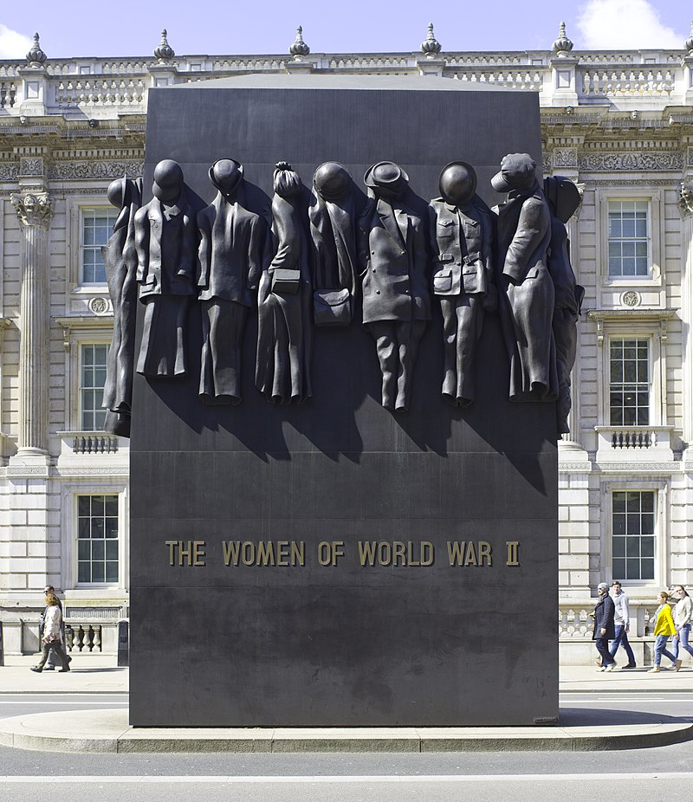
Ladies in Peckham 1
How might this photo link to the ladies in Peckham?
Notes:
Ask students to speculate about this image. For further information on the monument visit http://www.raiseyourhats.co.uk/the-monument/
Image: Andrew Shiva / Wikimedia Commons - https://commons.wikimedia.org/wiki/File:UK-2014-London-Monument_to_the_Women_of_World_War_II_(1).jpg

Slide 7
Ladies in Peckham 2
What was beginning to happen in 1938?
This is a “keep fit” group for mothers living in Peckham, South London.
They were part of a social experiment which involved mothers being able to drop their children off at a childcare facility and then have some time to exercise. All quite normal today but very unheard of in 1938.
These women would soon experience a very different life. Just a year later the British people found themselves at war.
Notes:
Ask students to speculate about this image. For further information on the monument visit http://www.raiseyourhats.co.uk/the-monument/
Image: Source: Historic England Archive Ref: MED01/01/0040 Date: 31 Oct 1938 - https://historicengland.org.uk/images-books/photos/item/MED01/01/0040

Slide 8
Women on the Home Front 1
Using the sources, we are going to find out a bit more about women in the war and what they did on the Home Front.
You are going to focus on three questions:
What can you learn from the source?
Which group of women does it refer or link to?
What impact might the war have had on these women?
Notes:
Use the worksheet provided on the next slide for students to complete this activity

Slide 9


Women on the Home Front 2
Write
Source | What can you learn from the source? | Which group of women does it refer or link to? | What impact might the war have had on these women?
1
2
3
4
5
6
7
8
Notes:
Worksheet

Slide 10
Women on the Home Front 3
Source | What can you learn from the source? | Which group of women does it refer or link to? | What impact might the war have had on these women?
1
2
3
4
5
6
7
8

Slide 11
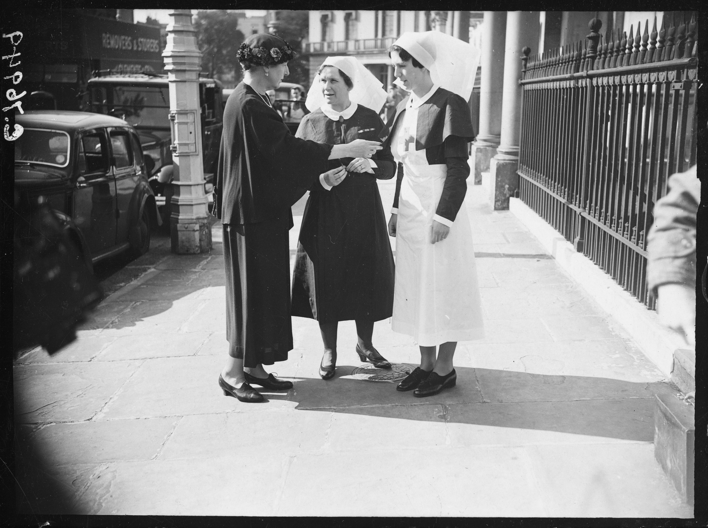
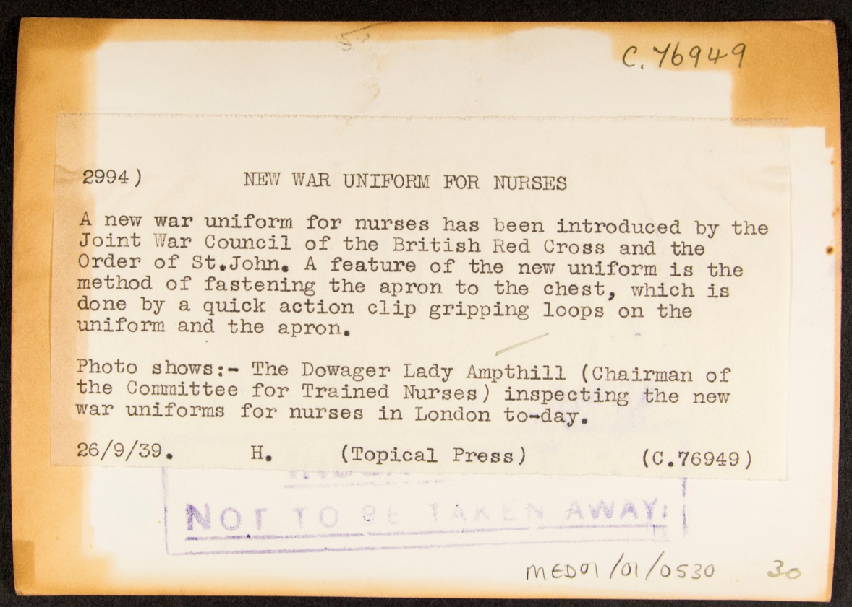
Example
Notes:
Women are recognised for their war efforts. Uniforms made easier to use/wear during the war, affected nurses. Little impact on women but made work easier.
Image: Source: Historic England Archive Ref: MED01/01/0530 Date: 26 Sep 1939 - https://historicengland.org.uk/images-books/photos/item/MED01/01/0530

Slide 12
Women on the Home Front - EXAMPLE
Source | What can you learn from the source? | Which group of women does it refer or link to? | What impact might the war have had on these women?
1 | Nurses were given new uniforms for the war. | Nurses | War effort was recognised. Work made easier due to design of uniform (shows need to work fast and effectively).
2
3
4
5
6
7
8
Write
Notes:
NB: More than one group of women may be affected in some photos

Slide 13
Source 1
Notes:
Women are recognised for their war efforts. Uniforms made easier to use/wear during the war, affected nurses. Little impact on women but made work easier.
Image: Source: Historic England Archive Ref: MED01/01/0530 Date: 26 Sep 1939 - https://historicengland.org.uk/images-books/photos/item/MED01/01/0530

Slide 14

Additional image information 1
New war uniform for nurses, Greater London
At the start of the Second World War a new war uniform for nurses was introduced by the Joint War Council of the British Red Cross and the Order of St.John.
A feature of the new uniform was the method of fastening the apron to the chest, using a quick action clip gripping loops on the uniform and apron.
Here The Dowager Lady Ampthill (Chairman of the Committee for Trained Nurses) is inspecting the new war uniforms for nurses in London.

Slide 15
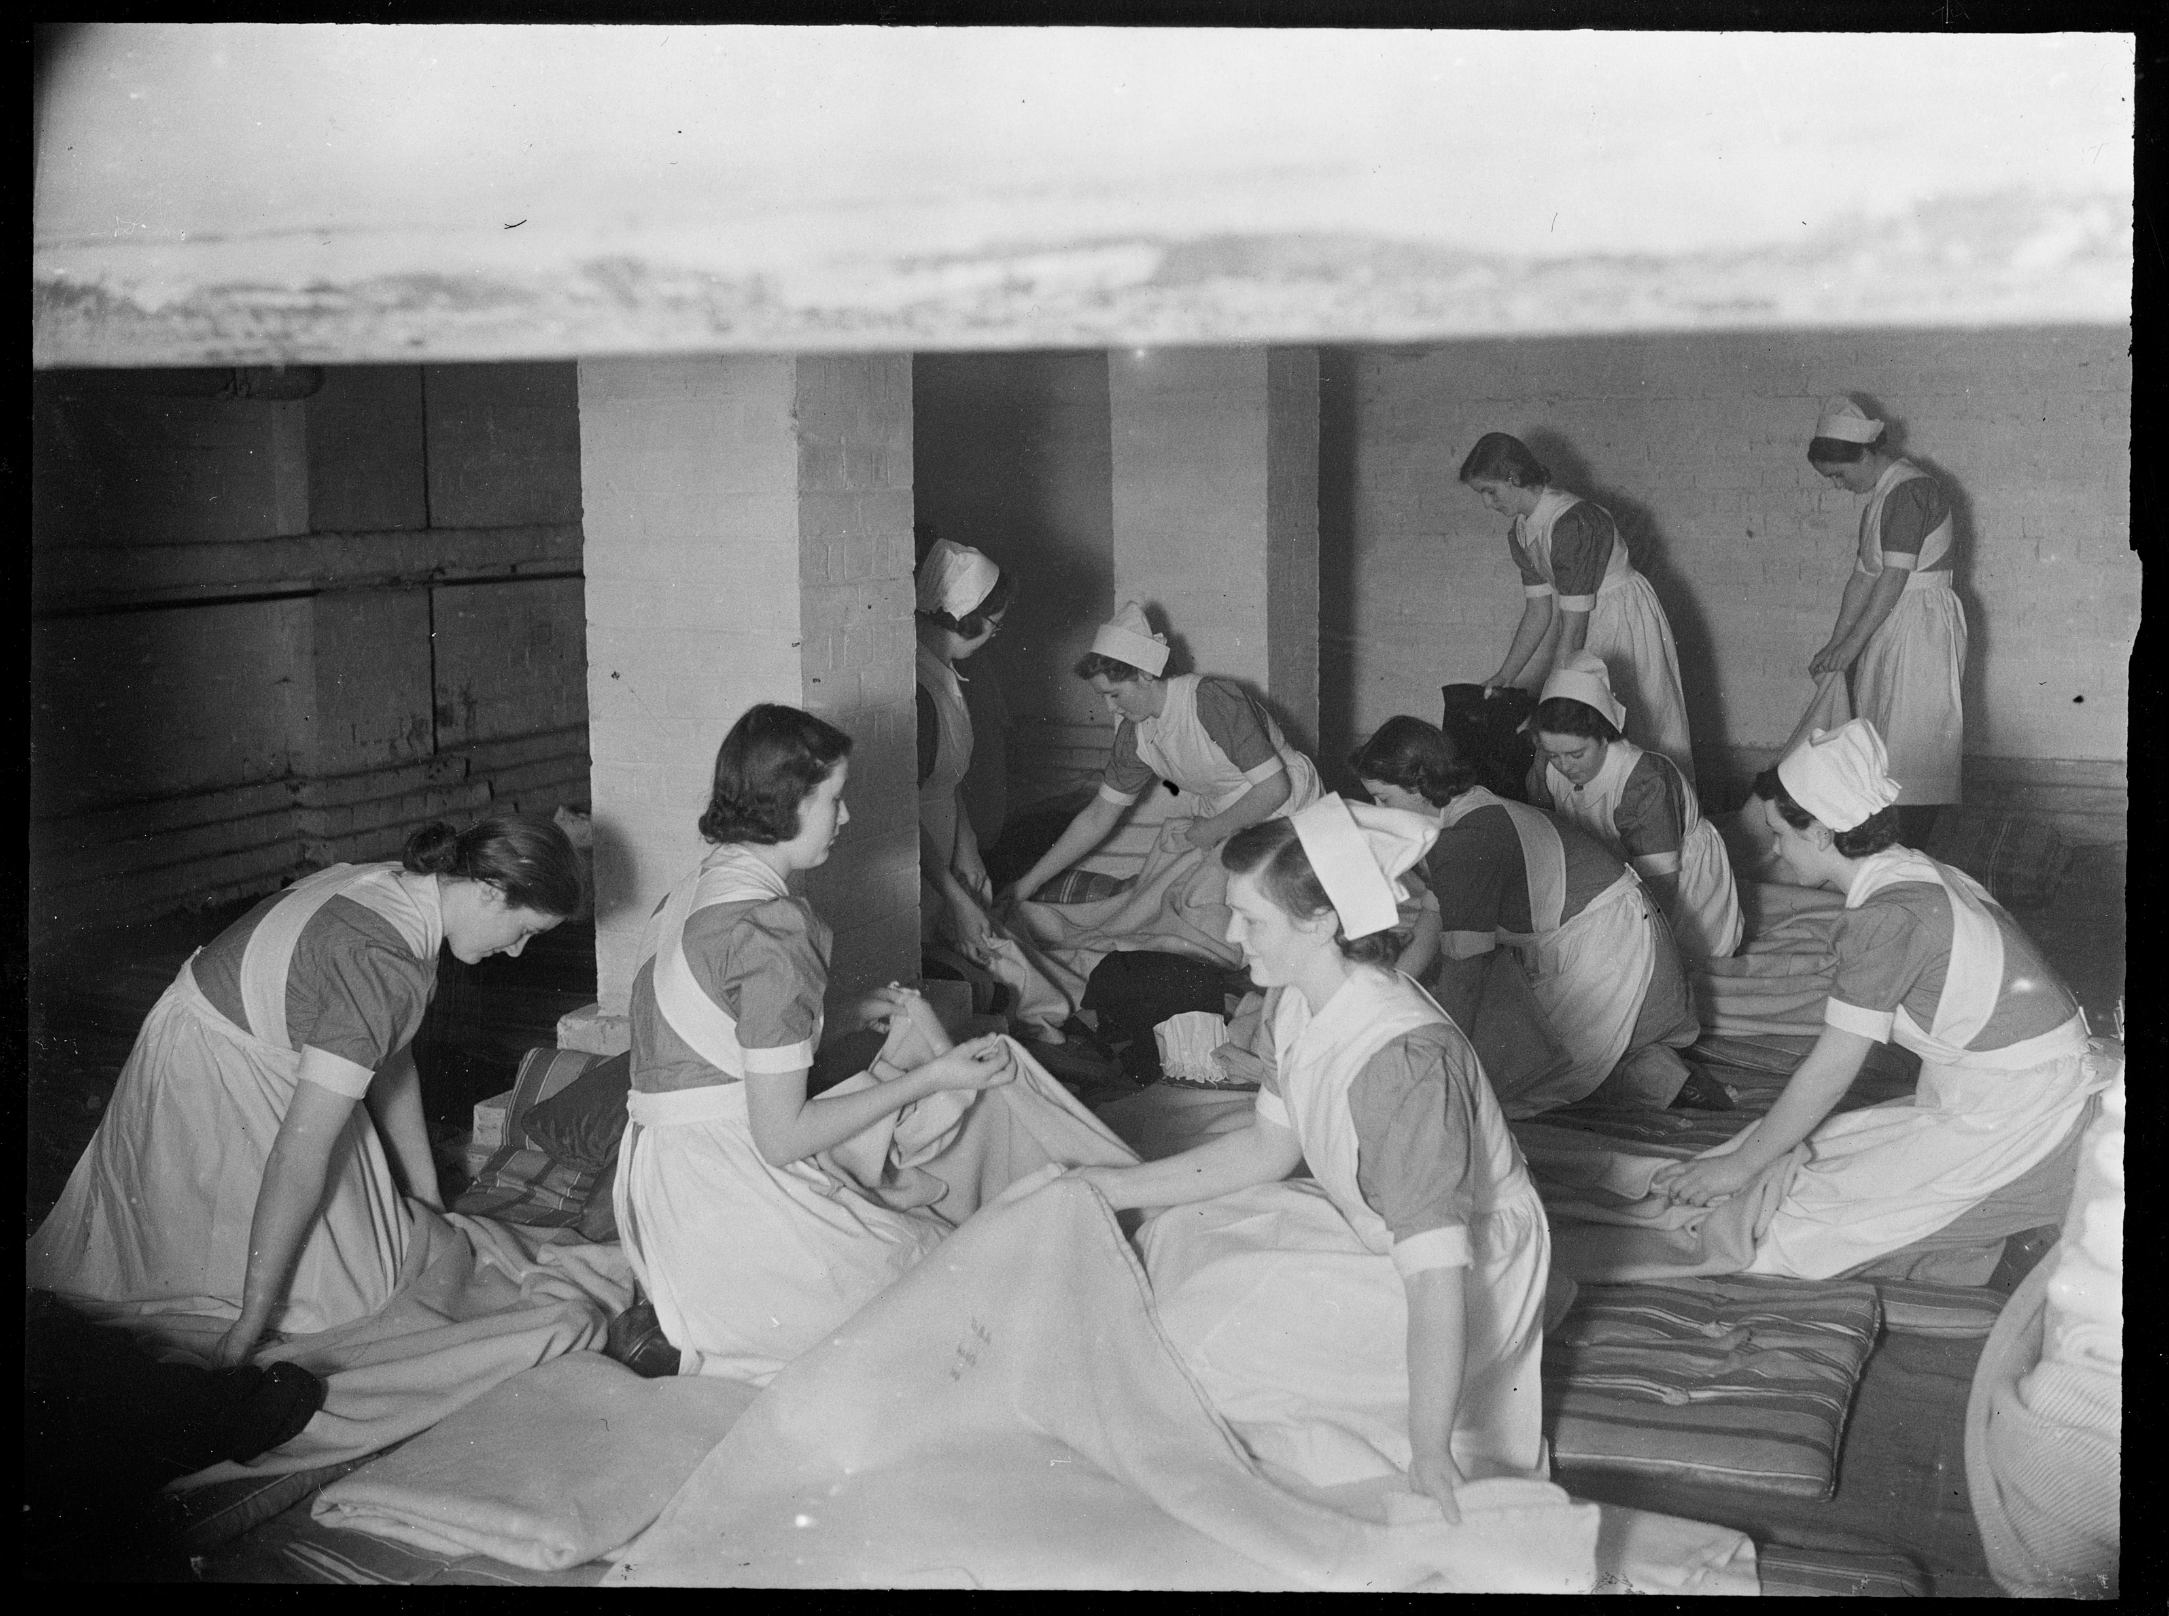
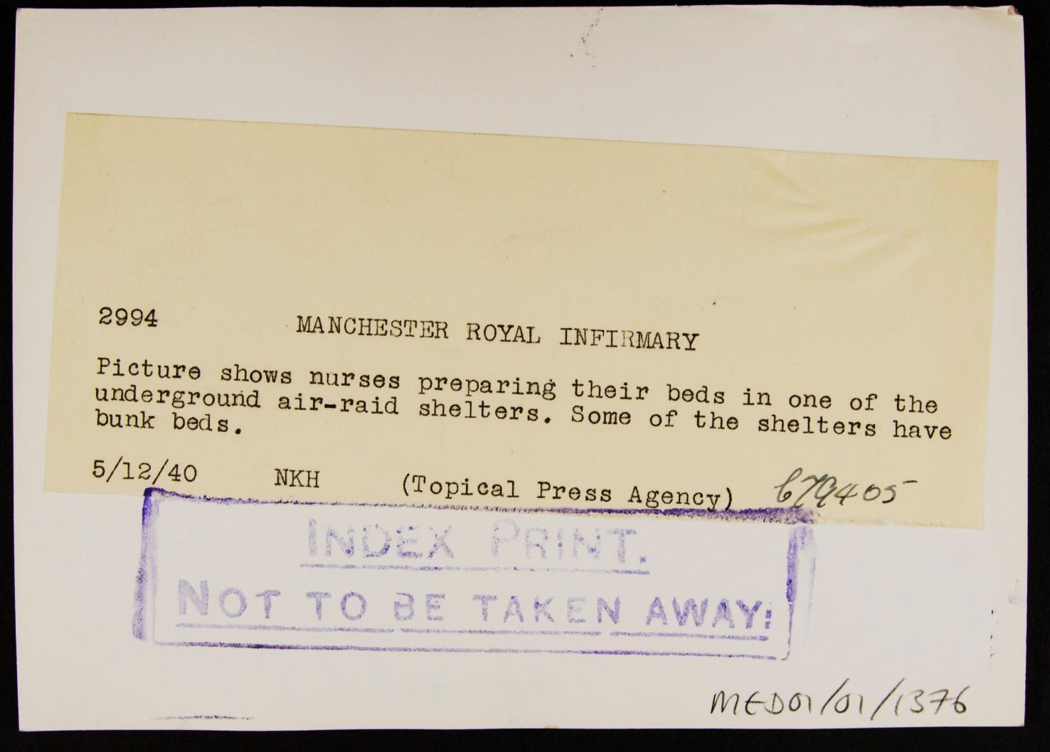
Source 2
Notes:
Nurses had to prepare for the blitz as well as everyone else, affects nurses, little impact on women but shows the difficult circumstances of life at the time.
Image: Source: Historic England Archive Ref: MED01/01/1376 Date: 5 Dec 1940 - https://historicengland.org.uk/images-books/photos/item/MED01/01/1376

Slide 16
Additional image information 2
Nurses making beds on the floor in an underground air raid shelter, Manchester Royal Infirmary, Oxford Road, Manchester, Greater Manchester
Nurses preparing their beds in one of the underground air raid shelters. Manchester Royal Infirmary was damaged twice by bombing in the Second World War , in October and December 1940.
Part of the nurses’ home was damaged by bombing in October 1940; nurses had been in air raid shelters in the basement and so no one was hurt. The tower of the teaching block was damaged, and many windows were blown out during air raids in December 1940. The teaching block soon collapsed, and extensive demolition followed.

Slide 17
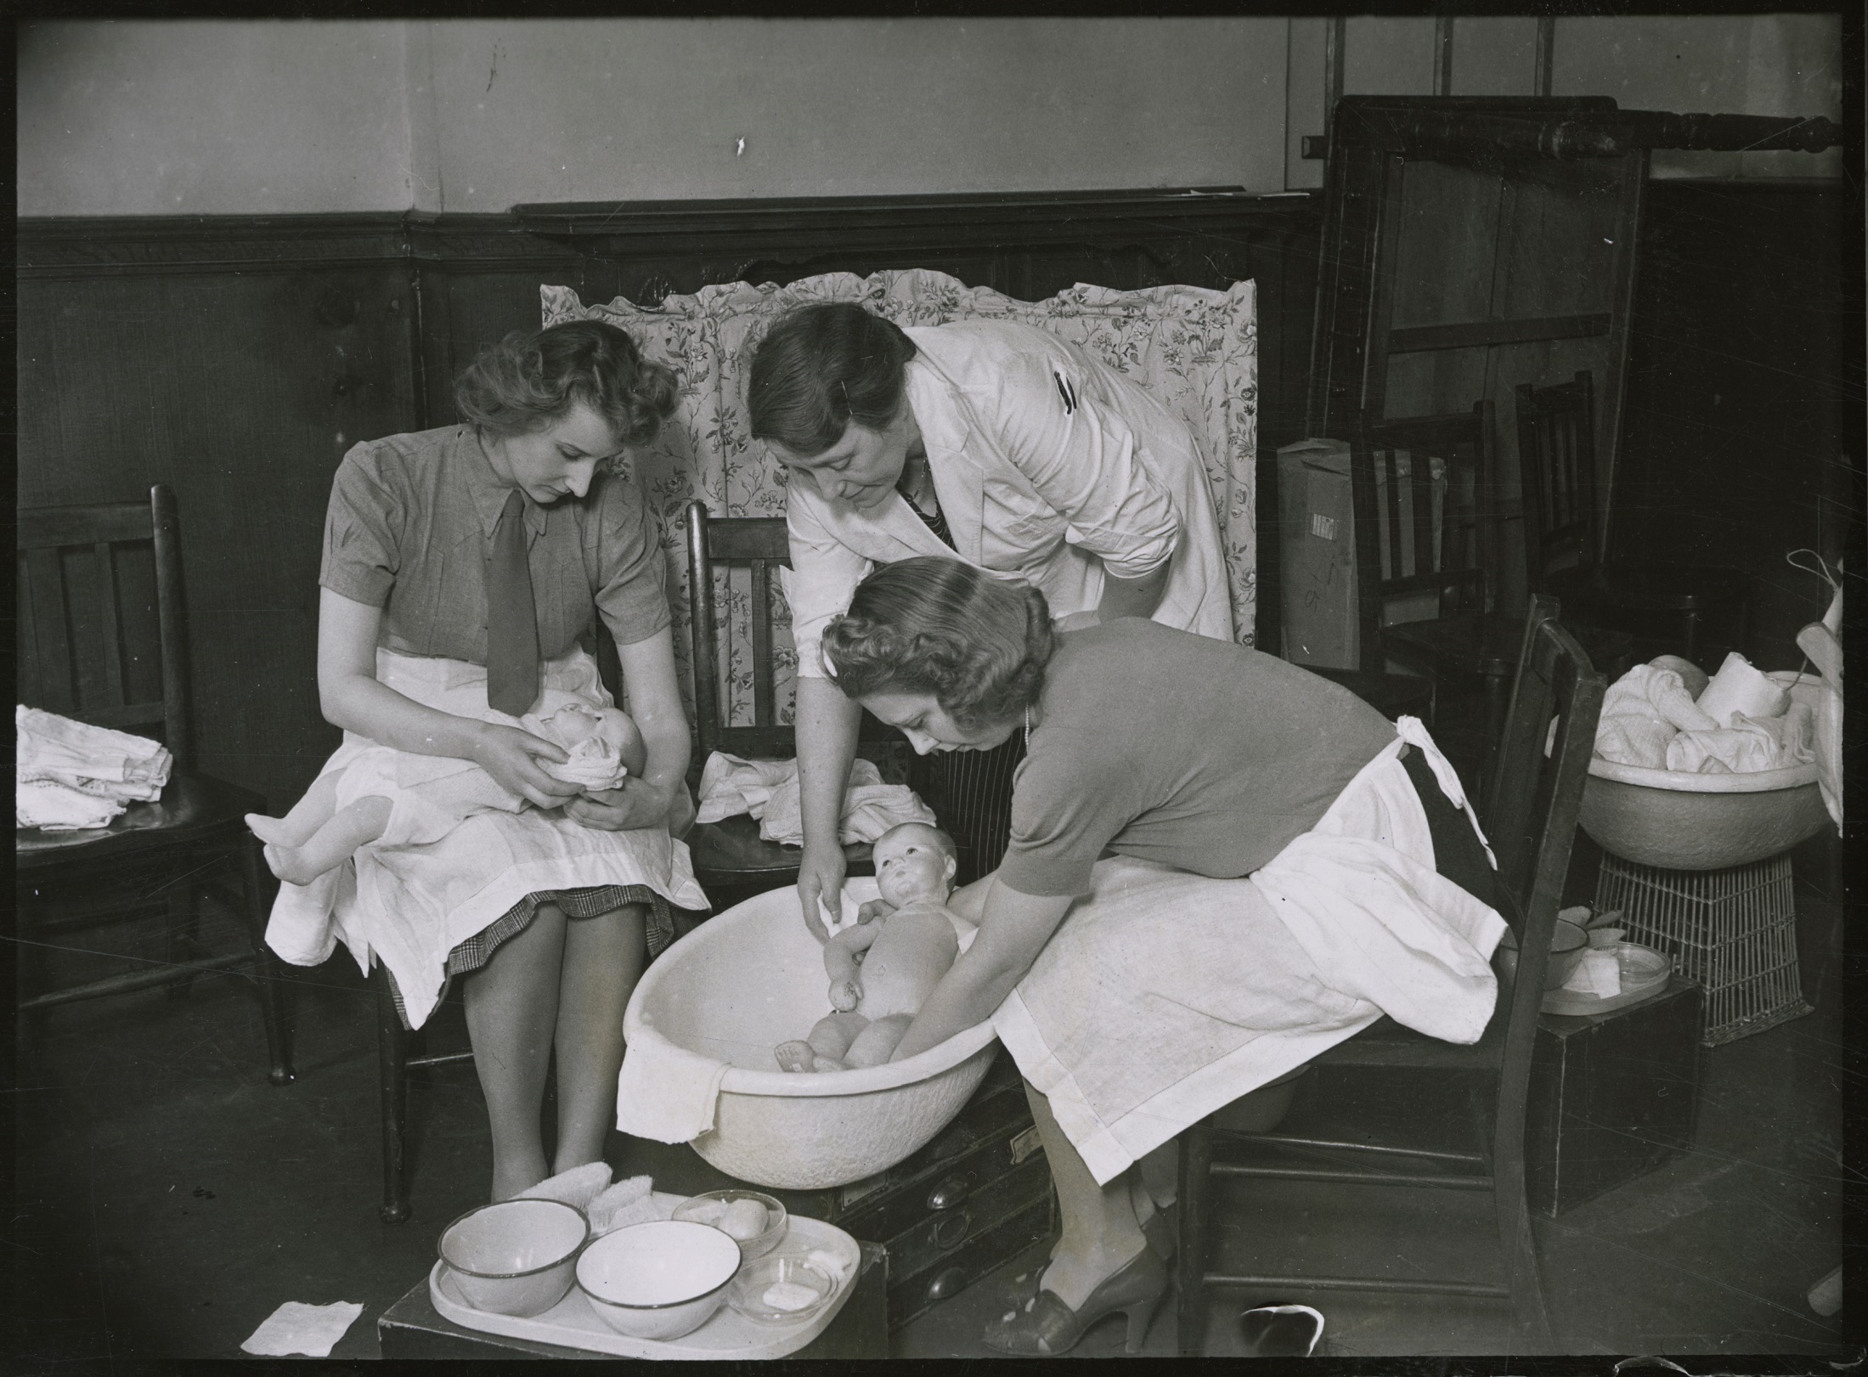
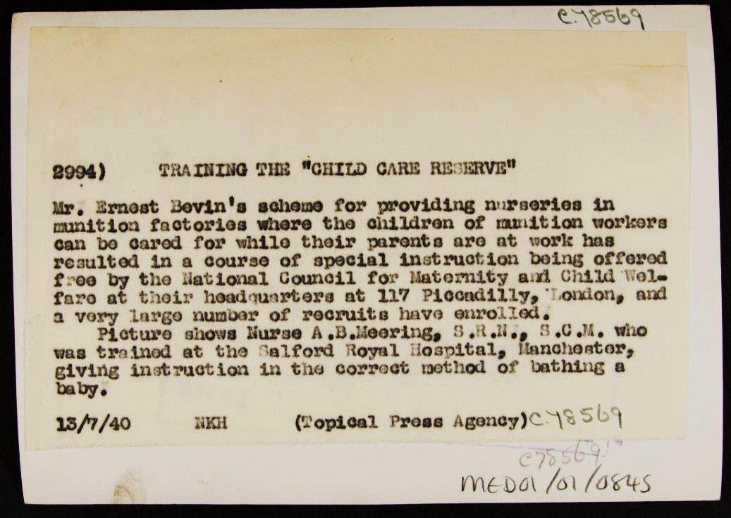
Source 3
Notes:
Women were trained to become nursery workers, affected young women with career aspirations, also shows affects on working mothers, made life easier for working mothers, and developed new careers and opportunities for women in the childcare industry.
Image: Source: Historic England Archive Ref: MED01/01/0845 Date: 13 Jul 1940 - https://historicengland.org.uk/images-books/photos/item/MED01/01/0845

Slide 18
Additional image information 3
Training the “Child Care Reserve”, National Council for Maternity and Child Welfare, 117 Piccadilly, Westminster, Greater London.
A woman using a model to practise how to carry a baby while another woman places a pillow in a cot ready to put the baby to bed. Ernest Bevin’s scheme for providing nurseries in munitions factories, so the children of munitions workers could be cared for while their parents were at work resulted in creation of free courses on child care.
Short training courses for the Child Care Reserve consisted of twelve lectures and demonstrations on “child management”, lasting two weeks. Candidates, who could be aged 18-55, then had to pass an examination and complete 50 practical hours of work in an institution. The short training courses did not provide qualifications for a future career, nor was the course a guarantee of employment. The Child Care Reserve was established to be called upon in the event of widespread air-raid damage, and to work in nurseries connected with munitions factories.

Slide 19
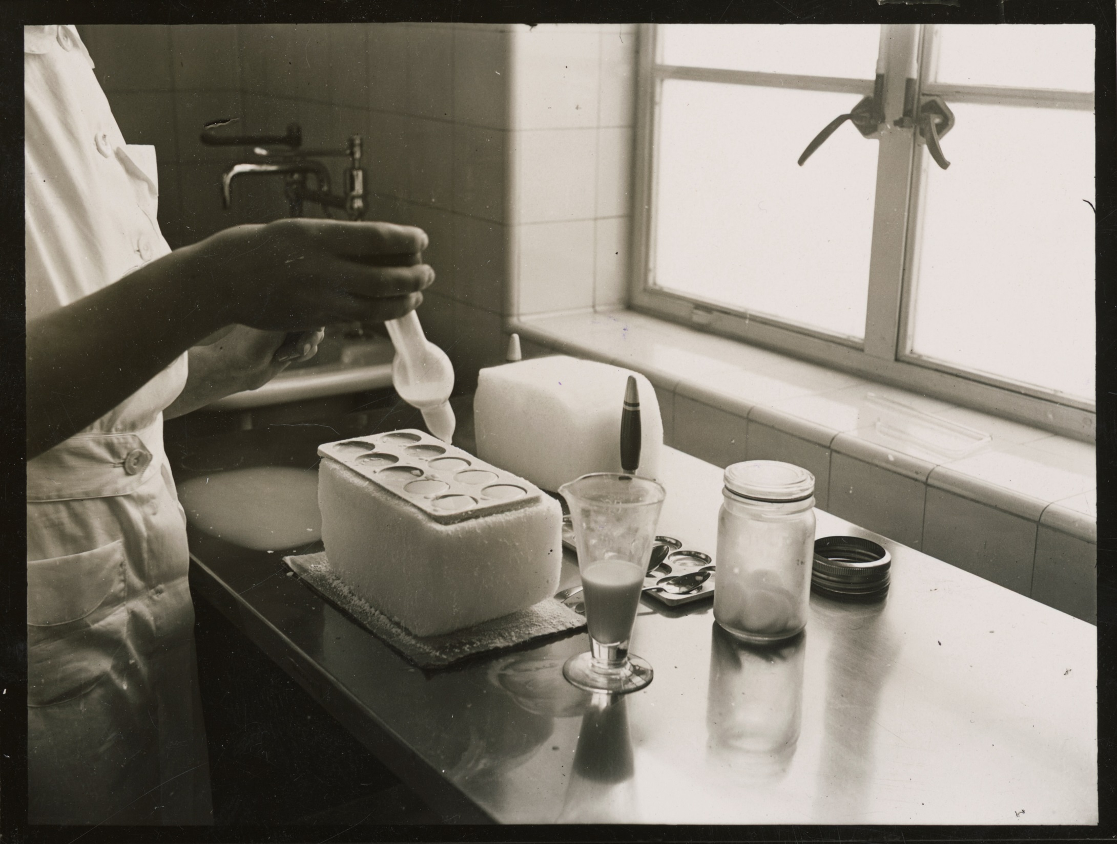
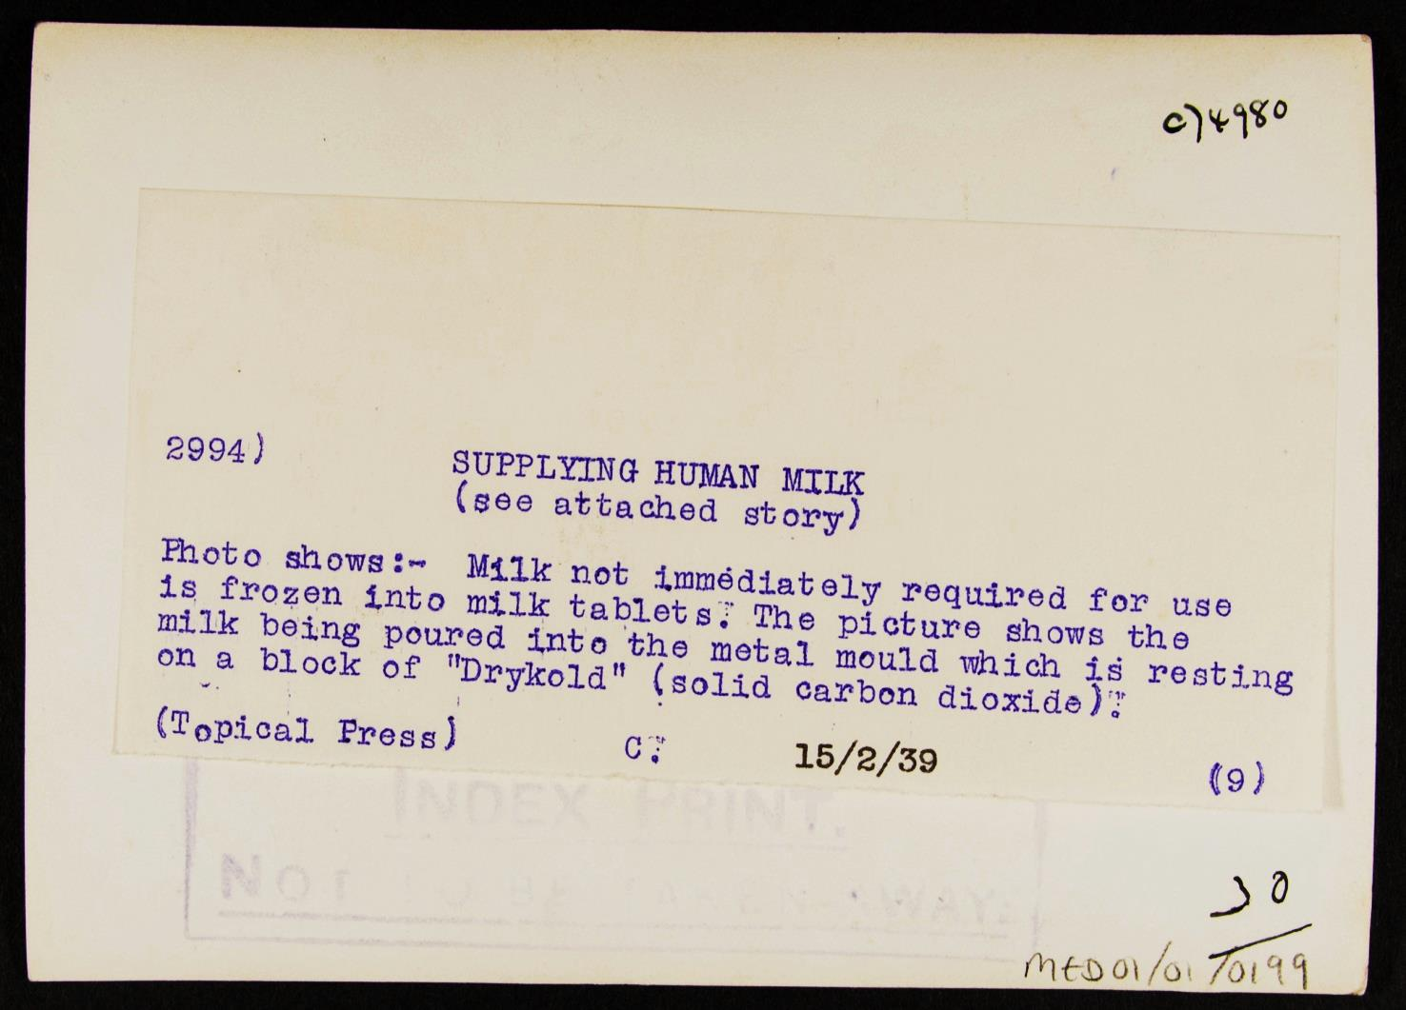
Source 4
Notes:
New mothers were expected to return or start work despite having a newborn baby. Storage of milk was so that mothers could go to work and leave a young baby – bottle feeding. This is a hard source, but it shows the development of the idea towards working mothers and leaving the baby at home/nursery.
Image: Source: Historic England Archive Ref: MED01/01/0199 Date: 15 Feb 1939 - https://historicengland.org.uk/images-books/photos/item/MED01/01/0199

Slide 20
Additional image information
Freezing breast milk, Queen Charlotte's Maternity Hospital, Goldhawk Road, Hammersmith, Greater London.
Milk that was not immediately required for use was frozen into milk tablets. The picture shows the milk being poured into the metal mould which is resting on a block of “Drykold” (solid carbon dioxide) to freeze it for later use. The Human Milk Bureau was established in 1939 and is now the oldest continuously operating milk bank in the world.
The need for human milk was recognised after the birth of quadruplets in St Neot’s in 1935, with breast milk being delivered to their home daily, and following urgent calls for milk. The milk was obtained only from nursing mothers recommended by medical officers and was thoroughly tested. The milk bank provided breast milk to preterm and sick babies, and milk could be dispatched almost immediately to any part of the country. The milk bank now operates from Queen Charlotte’s and Chelsea Hospital and serves neonatal units in London and the Greater London area.

Slide 21
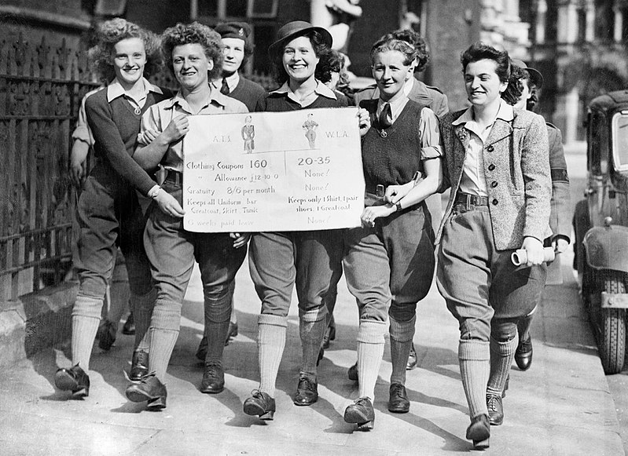

Source 5
700 Land Army girls from all parts of the country voicing their grievances at a meeting held in Caxton Hall, London demanding equal pay for equal work.
Notes:
This image was created and released by the Imperial War Museum on the IWM Non Commercial Licence. Photographs taken, or artworks created, by a member of the forces during their active service duties are covered by Crown Copyright provisions. Faithful reproductions may be reused under that licence, which is considered expired 50 years after their creation.
Photo taken from: https://commons.wikimedia.org/wiki/File:The_Women%27s_Land_Army_in_Britain_during_the_Second_World_War_HU63784.jpg

Slide 22
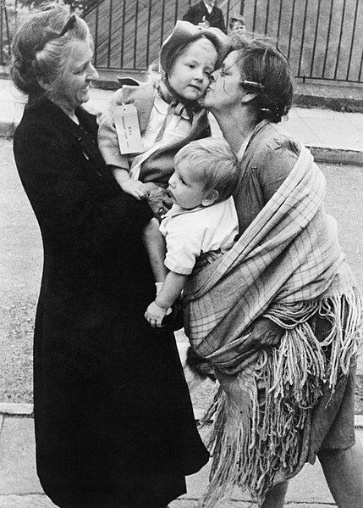
Source 6
The Civilian Evacuation Scheme in Britain during the Second World War. Evacuees return home to London. Photo shows villagers saying goodbye to the children they adopted for the war.
Notes:
Photo taken from : http://www.iwm.org.uk/collections/item/object/205020931
This image was created and released by the Imperial War Museum on the IWM Non Commercial Licence. Photographs taken, or artworks created, by a member of the forces during their active service duties are covered by Crown Copyright provisions. Faithful reproductions may be reused under that licence, which is considered expired 50 years after their creation.

Slide 23
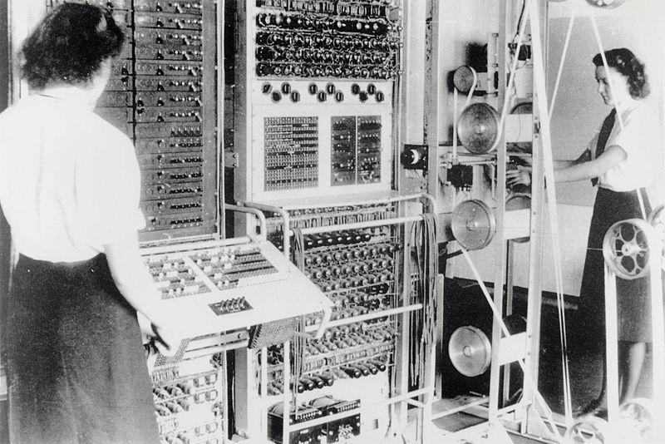
Source 7
About 8,000 women worked in Bletchley Park, the central site for British cryptanalysts during the Second World War . Women constituted roughly 75% of the workforce there.
Notes:
https://commons.wikimedia.org/wiki/File:Colossus.jpg
This work created by the United Kingdom Government is in the public domain. This is because it is one of the following:
It is a photograph taken prior to 1 June 1957; or
It was published prior to 1967; or
It is an artistic work other than a photograph or engraving (e.g. a painting) which was created prior to 1967.
HMSO has declared that the expiry of Crown Copyrights applies worldwide

Slide 24
Ladies in Peckham 3
Look again at the Monument to the Women of the Second World War .
What can you see?
Different clothing?
But why?
Notes:
Ask pupils what the different clothes represent? For further information on the monument visit https://en.wikipedia.org/wiki/Monument_to_the_Women_of_World_War_II
Image: Andrew Shiva / Wikimedia Commons - https://commons.wikimedia.org/wiki/File:UK-2014-London-Monument_to_the_Women_of_World_War_II_(1).jpg

Slide 25
Ladies in Peckham 4
There are 17 individual sets of clothing and uniforms around the sides, symbolising the hundreds of different jobs women undertook in World War Two.
These outfits include uniforms as worn by the Women's Land Army, Women's Royal Naval Service, a nursing cape, a police overall and a welding mask.
Notes:
Teacher notes:
Link back to the sources pupils have gone through to make the connections between the different women identified in the sources. Discuss with them how it is hard to study the experience of women in the war due to its diversity etc. so we can only get a snapshot of the past and what life was really like.
Image: Andrew Shiva / Wikimedia Commons - https://commons.wikimedia.org/wiki/File:UK-2014-London-Monument_to_the_Women_of_World_War_II_(1).jpg

Slide 26

Summary
Not everyone liked this monument, some criticised it because it was faceless. But what do you think about the monument and the way it represents women in the war? Use the questions below to explain your ideas about the monument.
What do you think about the monument?
How does it represent women in the war?
Why do you think they focused on clothing rather than faces?
Would you add or remove anything to the Monument and why?
Justify

Slide 27
The Second World War
In one word, how would you describe women’s lives in the Second World War?
Banned words: changing, hard-working, different.
Notes:
By adding banned words to the plenary, this will help students to use more developed vocabulary.
Homework – design your own version of monument to the women of the Second World War

Slide 28

More resources
MORE RESOURSCES AT
HistoricEngland.org.uk/Education

