Slide 1
Spotting evidence of the Second World War on 1940s aerial photographs
TEACHERS GUIDE
Spotting evidence of the Second World War on 1940s aerial photographs

Slide 2
Spotting evidence of the Second World War on 1940s aerial photographs 1
Key Stage 2 & 3
Learning Aims and Outcomes
To develop historical enquiry skills by using aerial photographs as primary sources
To gain an overview of how the Second World War impacted life in Britain/on the Home Front
To understand how the Second World War affected pupils’ local area
To compare local evidence with the national picture
This PowerPoint relates to the following Teaching Activity: https://historicengland.org.uk/services-skills/education/teaching-activities/ww2-impact-on-1940s-aerial-photos
Notes:
This guide gives a brief description and examples of the different types of Second World War features that can be identified on 1940s aerial photographs.
It is designed to be used alongside our Aerial Photo Explorer or Local History Packs as part of a KS2 or KS3 Local History Study
The following slides are designed to help you identify any Second World War features on the 1940s aerial photographs shown on our Aerial Photo Explorer or in a Local History Pack.
You can then use the examples of different types of feature on these slides to compare those found in your locality with those found across the whole country.
You can also use the examples shown with pupils to help them understand how the Second World War impacted life in Britain.

Slide 3
How to use this PPT
This guide briefly describes (and provides examples of) the different types of Second World War evidence found in 1940s aerial photographs.
It can be used with our Aerial Photo Explorer or if you have one of our Local History Packs. Use it as part of a KS2 or KS3 Local History Study. It will help pupils learn about the impact of the Second World War in their local area.

Slide 4
Using Aerial Photographs
You can find additional information about using aerial photographs as part of our free Starting a local study online interactive course.
Watch our Using Aerial Photos and Maps video to help you to get the most out of any aerial photographs you might use with your students.
Notes:
https://vimeo.com/866830745

Slide 5
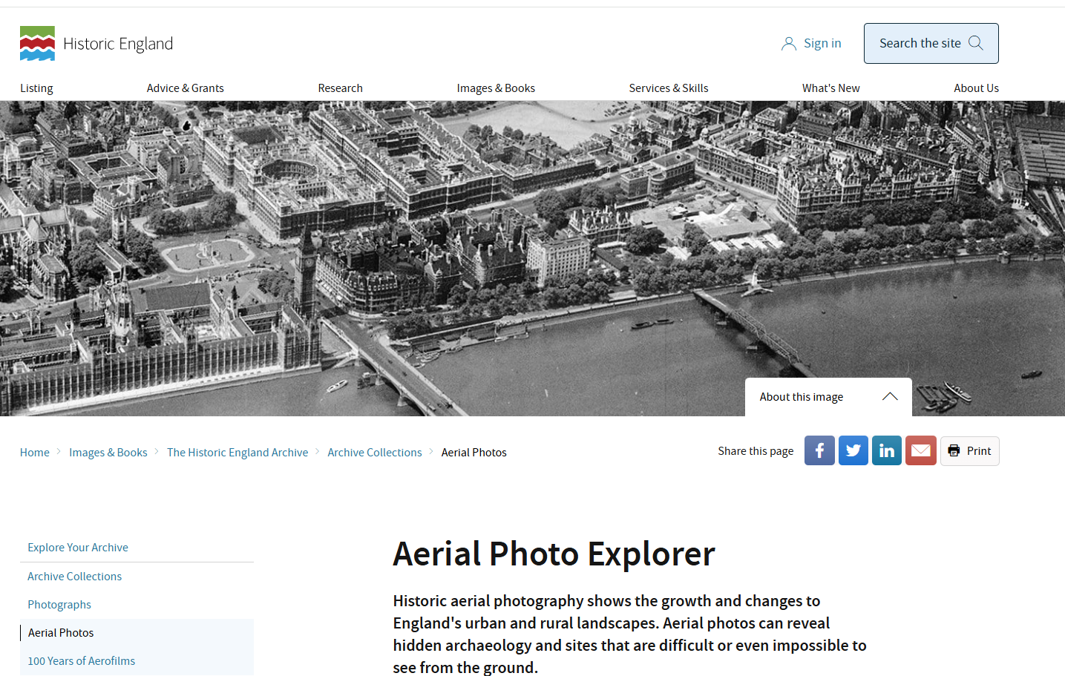
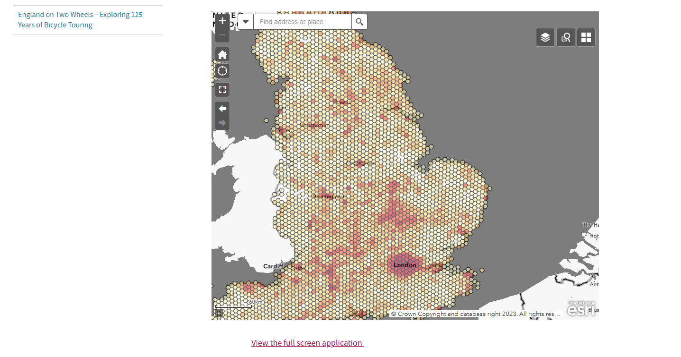
Visit the Aerial Photo Explorer
Historic England have made over 400,000 aerial photos available to view for free online.
They date from the 1920s to the present day.
Thousands of them relate to the Second World War, providing a major source of primary evidence about life on the Home Front.
Notes:
Visit the Aerial Photo Explorer: https://historicengland.org.uk/images-books/archive/collections/aerial-photos/

Slide 6
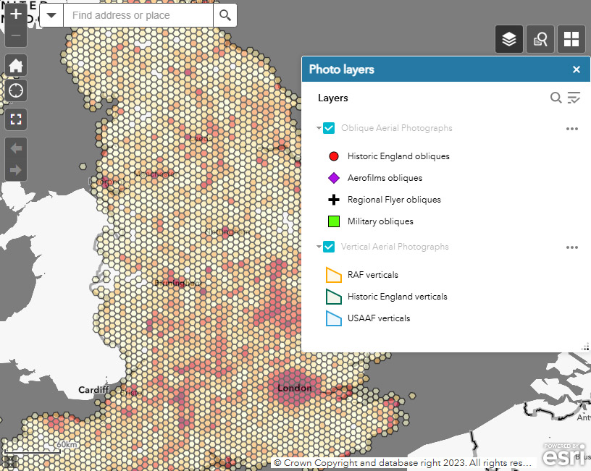
Using the Aerial Photo Explorer 1
To search specifically for Second World War photos we recommend turning off/unticking the Oblique Aerial Photographs layer.
The ‘orange’ RAF and ‘blue’ USAAF tiles are most likely to date from the 1940s.
After searching these you may wish to turn the obliques back on, to look at the ‘green’ military obliques.
Notes:
Select the ‘layers’ icon and un-tick the ‘Oblique photographs’ box.
This means you will only see vertical aerial photos – like most of those shown in this PPT. This is because most of the oblique photos on the Aerial Photo Explorer are NOT from during the Second World War, whereas most of the RAF Verticals on the site are from the 1940s or the war.
You can go back later a re-tick the ‘Oblique photographs’ box to see all the photos for your area.

Slide 7
Using the Aerial Photo Explorer 2
Put in your school’s postcode to find the closest aerial photographs.
Notes:
Put in your school’s postcode to see what RAF Veritcal aerial photos there are.

Slide 8
Using the Aerial Photo Explorer 3
Click on the screen to be able to browse through all the photos that are covered by that particular spot.
The number in the top-left of the pop-up tell you how many images there are.
The arrow lets you scroll through them.
Click on any image to have it open as a larger version in a new tab.
Notes:
Put in your school’s postcode to see what RAF Veritcal aerial photos there are.

Slide 9
Using the Aerial Photo Explorer 4
Click on the photo or the ‘expand’ link to be able to zoom in even further to see the detail on the photo.
Hover the cursor over the bottom of the photo to see the date it was taken.
Now compare your local photos to those shown on the following slides.
How many Second World War features you can spot?
Notes:
This allows you to see the whole image, which you can then look at to see if any of the Second World War features shown on the following slides feature on your local photos.

Slide 10
Air raid shelters 1
In 1938 the Air Raid Precautions Act together with the following year’s Civil Defence Act, legally obliged government, local authorities and places of work to formulate plans to protect civilians from enemy attack.
On the outbreak of the Second World War in September 1939, the Ministry for Home Security was created with Sir John Anderson as Home Secretary and Minister of Home Security. The Ministry was responsible for all central and regional civil defence organisations.
He gave his name to the most well known type of domestic shelter – the Anderson Shelter. 2,300,878 Anderson shelters had been issued by September 1940, many free of charge to poorer families. Due to their size and the fact they were often covered in soil they are unlikely to be seen on aerial photos.

Slide 11
Air raid shelters 2
However, probably the most common type of structure built was the 50-person public shelter; it is thought that some 16,747 were built in the Leeds area alone. Because of their size and location, in the middle of urban streets and parks, these are the most likely to be visible on aerial photographs from the 1940s.
From May 1945 the civil defence organisation was stood down. The demolition of the vast majority of the 50-person public shelters commenced virtually as soon as the local authorities obtained permission. Many stood on public roads, pavements and back lanes, forming hazards to vehicles and pedestrians.

Slide 12
‘50 person’ public shelters
Plan view of inside
the shelter
Side view of outside of the shelter
Plan view of inside
the shelter
Side view of outside of the shelter

Slide 13
Air raid shelters in urban streets - Wavertree, Liverpool (& Barrage Balloon tether site) 1
Notes:
Image: raf_106g_uk_626_rs_4165 – 10th August 1945 - Historic England Archive (RAF photography) - https://historicengland.org.uk/images-books/archive/collections/aerial-photos/record/raf_106g_uk_626_rs_4165

Slide 14
Air raid shelters in urban streets - Wavertree, Liverpool (& Barrage Balloon tether site) 2
Close-up showing air raid shelters (yellow) in the middle of urban streets of terraced houses.
The red circle is a Barrage Balloon tether site – see slides 50-54 for more information.
Notes:
Close-up of slide 4 with features highlighted. See Slides 50-54 for more information about Barrage Balloons
Image: raf_106g_uk_626_rs_4165 – 10th August 1945 - Historic England Archive (RAF photography). - https://historicengland.org.uk/images-books/archive/collections/aerial-photos/record/raf_106g_uk_626_rs_4165
Yellow = air raid shelters
Red = Barrage Balloon tether site

Slide 15
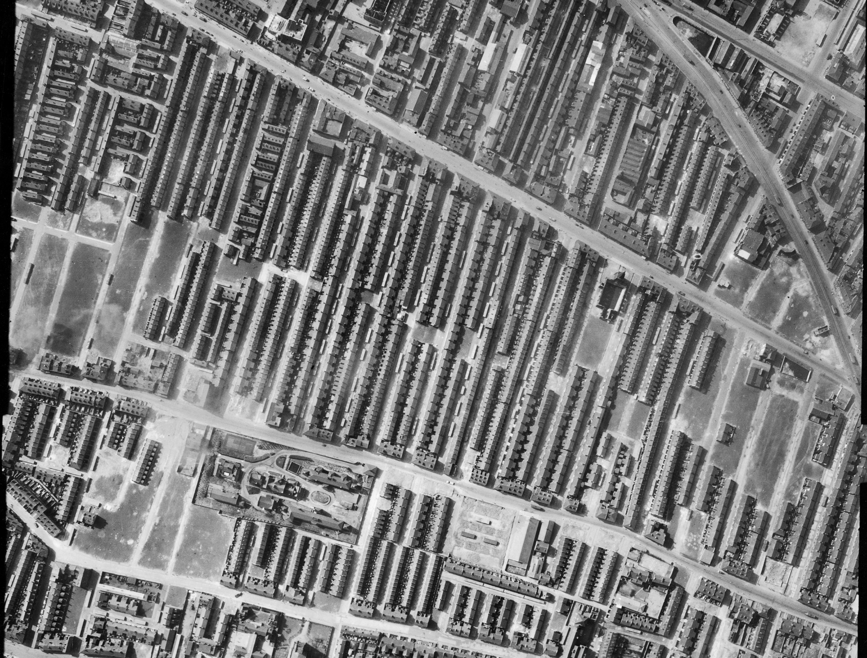
Air raid shelters in urban streets - Everton, Liverpool (& bomb-damaged sites of terraced houses) 1
Notes:
Image: raf_3g_tud_uk_107_vp2_5184 – 1st April 1946 - Historic England Archive (RAF photography) - https://historicengland.org.uk/images-books/archive/collections/aerial-photos/record/raf_3g_tud_uk_107_vp2_5184

Slide 16
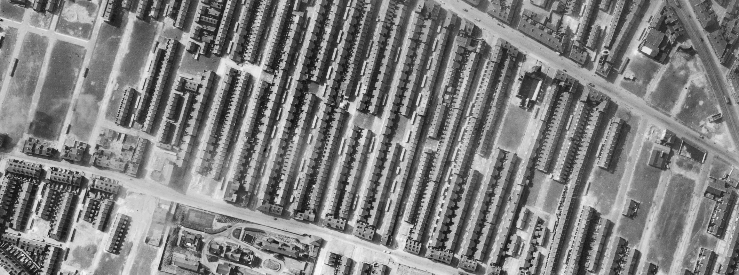
Air raid shelters in urban streets - Everton, Liverpool (& bomb-damaged sites of terraced houses) 2
Close-up showing air raid shelters (yellow) in the middle of urban streets of terraced houses.
The red shapes show areas of bomb damage – see slides 55-60 for more information.
Notes:
Close-up of slide 6 with features highlighted
Image: raf_3g_tud_uk_107_vp2_5184 – 1st April 1946 – Historic England Archive (RAF photography). - https://historicengland.org.uk/images-books/archive/collections/aerial-photos/record/raf_3g_tud_uk_107_vp2_5184
Yellow = air raid shelters
Red = bomb damaged sites

Slide 17
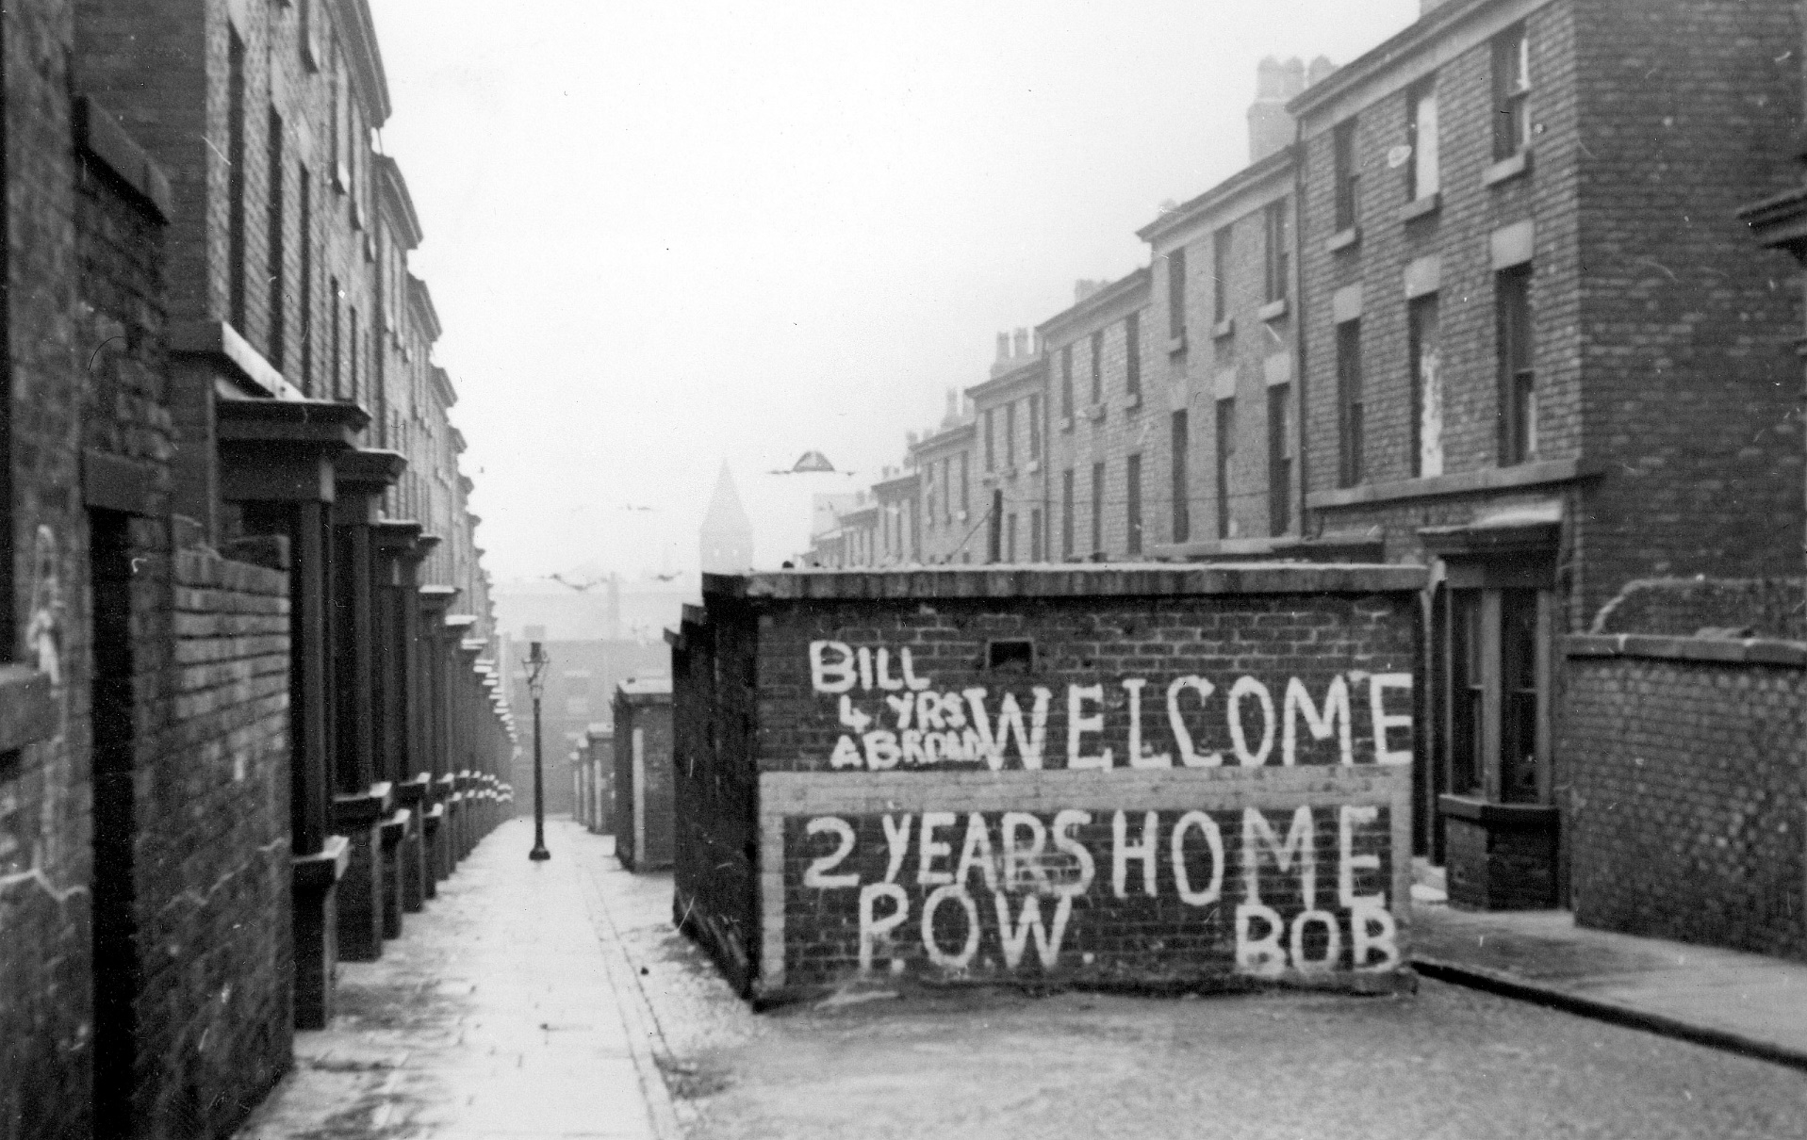
Air raid shelters in urban streets - Paddington, Liverpool
These street shelters were built during World War Two to provide protection for the people of Liverpool during the Blitz.
Here they have had welcome home messages painted on them for returning soldiers.
Notes:
These street shelters were built during World War Two to provide protection for the people of Liverpool during the Blitz. Here they have had welcome home messages painted on them for returning soldiers.
Image: BB88_07273 ©Historic England Archive c1945

Slide 18
Airfields 1
The British Army was using hot air balloons from 1890, while airships were under development from around 1911. The first flight by a British Army aeroplane took place in 1908 when Col S F Cody flew at Farnborough (Hampshire). In 1910 a permanent flying school and factory was opened at Larkhill, on Salisbury Plain (Wiltshire).
About 250 flying stations or aerodromes existed in 1918, this increased to 740 during the Second World War, including those used by the Americans. Many aerodromes, which were subject to rebuilding in the inter-war period, were front-line operational bases which played a part in the Battle of Britain (1940) or the strategic bomber offensive (1940-1945).
Notes:
Find more information in
Historic Military Aviation Sites: Conservation Guidance https://historicengland.org.uk/images-books/publications/historic-military-aviation-sites/
Nine Thousand Miles of Concrete: A Review of Second World War Temporary Airfields in England https://research.historicengland.org.uk/Report.aspx?i=15802

Slide 19
Airfields 2
Types of aerodrome varied considerably, from operational stations to training bases; from bomber aerodromes to home defence or fighter use. Almost all were built to standard Air Ministry designs.
Airfields were increasingly given concrete runways for all-weather flying: the scale of the wartime construction enterprise in this area was vast. It is estimated that in the first 5 years of the war the total area of concrete laid in building new airfields was equivalent to building a 9,000-mile-long, 30-foot-wide road from London to Beijing!
Vast amounts of short-lived hutted accommodation was put up at airfields during the Second World War. Most of this no longer survives but can be identified through aerial photographs, documentation and archaeology.
Notes:
Find more information in
Historic Military Aviation Sites: Conservation Guidance https://historicengland.org.uk/images-books/publications/historic-military-aviation-sites/
Nine Thousand Miles of Concrete: A Review of Second World War Temporary Airfields in England https://research.historicengland.org.uk/Report.aspx?i=15802

Slide 20
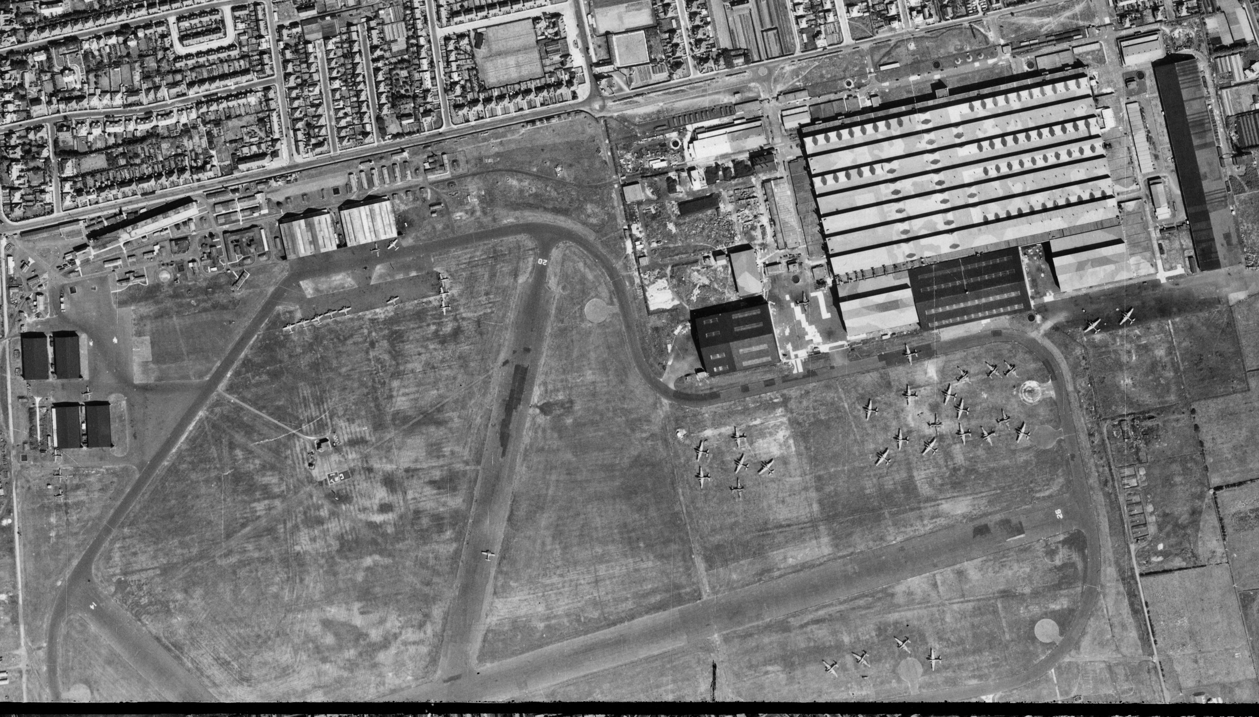
Blackpool Airfield – now Blackpool Airport
Notes:
Image: raf_106g_uk_625_rs_4061 – 10th August 1945 - Historic England Archive (RAF photography) - https://historicengland.org.uk/images-books/archive/collections/aerial-photos/record/raf_106g_uk_625_rs_4061

Slide 21
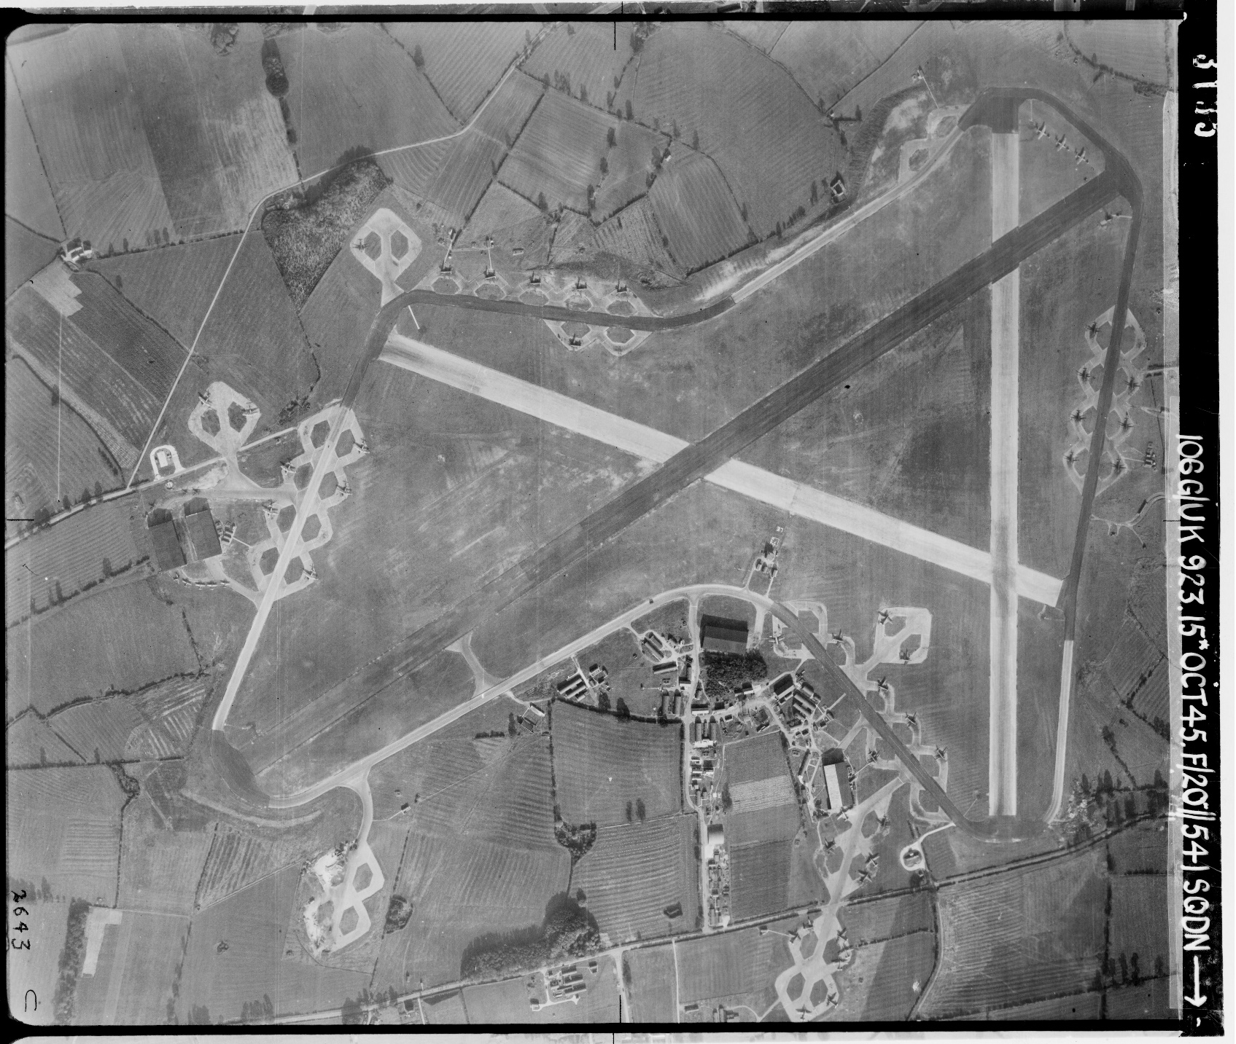
Leicester Airfield – now Leicester Airport 1
Notes:
Image: raf_106g_uk_923_rp_3135 – 15th October 1945 - Historic England Archive (RAF photography) - https://historicengland.org.uk/images-books/archive/collections/aerial-photos/record/raf_106g_uk_923_rp_3135

Slide 22
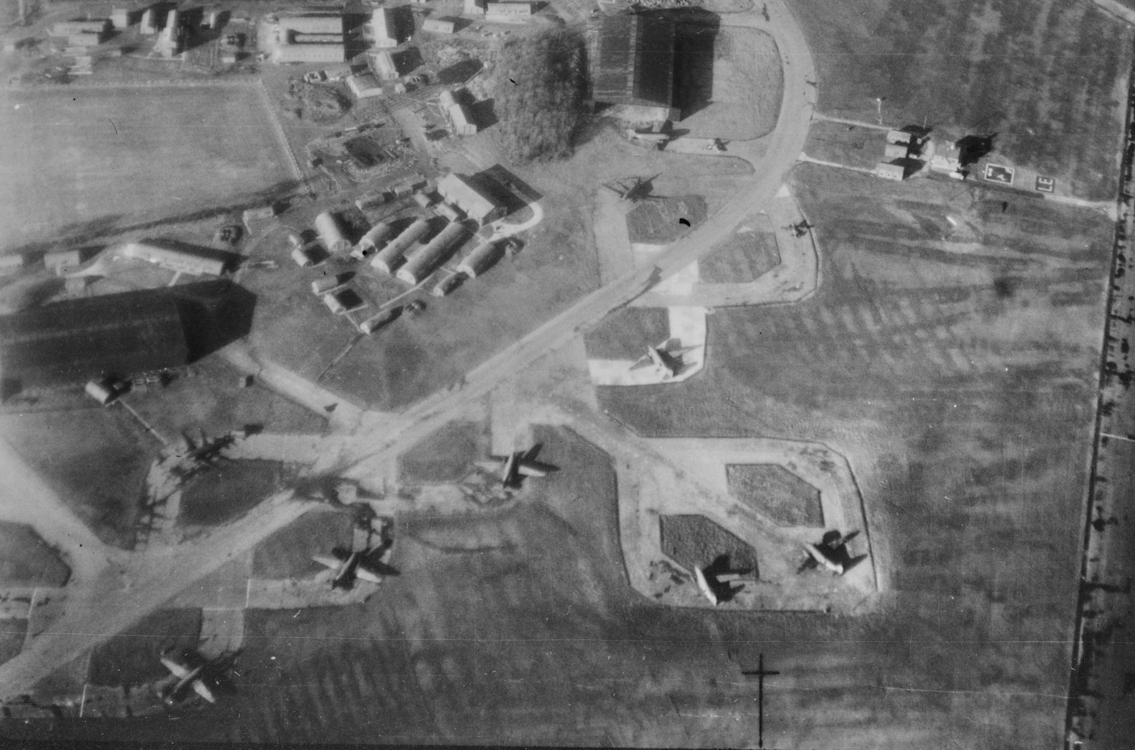
Leicester Airfield – now Leicester Airport 2
Notes:
Image: raf_106g_la_68_po_0018 - 4th December 1944 - Historic England Archive (RAF photography) - https://historicengland.org.uk/images-books/archive/collections/aerial-photos/record/raf_106g_la_68_po_0018

Slide 23
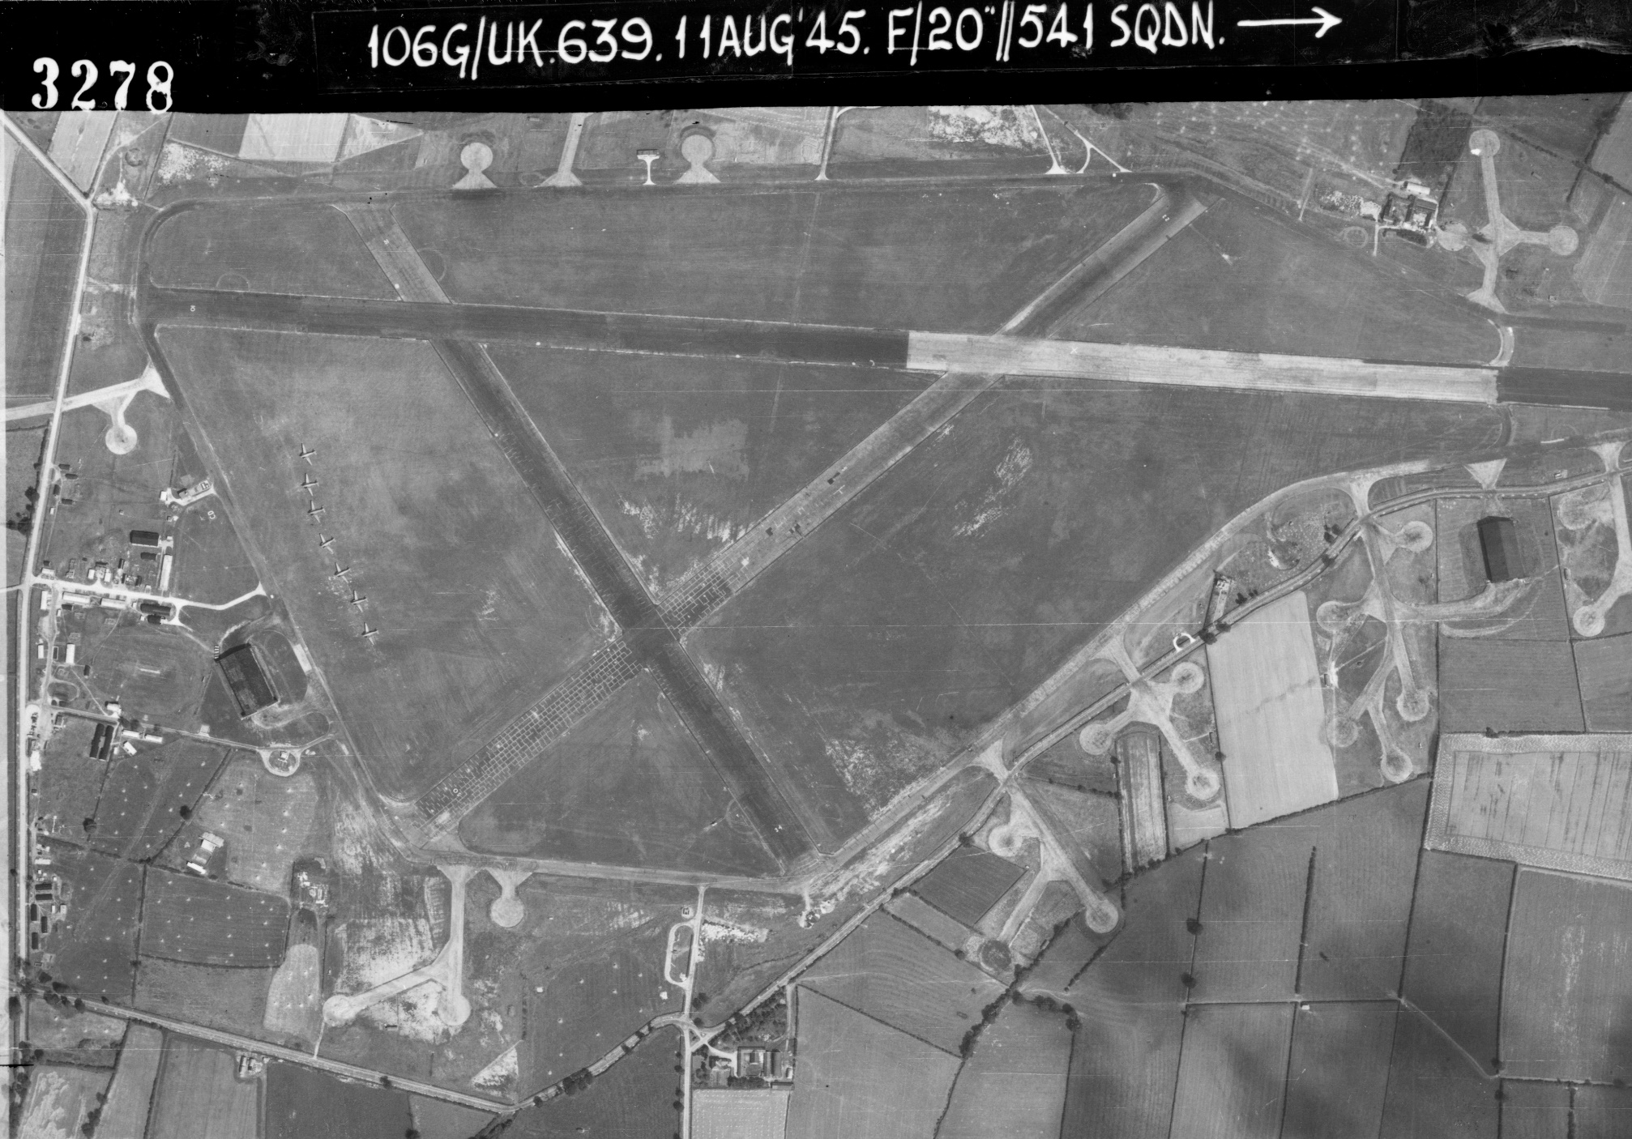
Diseworth Airfield – now East Midlands Airport
Notes:
Image: raf_106g_uk_639_rp_3278 – 11th August 1945 - Historic England Archive (RAF photography) - https://historicengland.org.uk/images-books/archive/collections/aerial-photos/record/raf_106g_uk_639_rp_3278

Slide 24
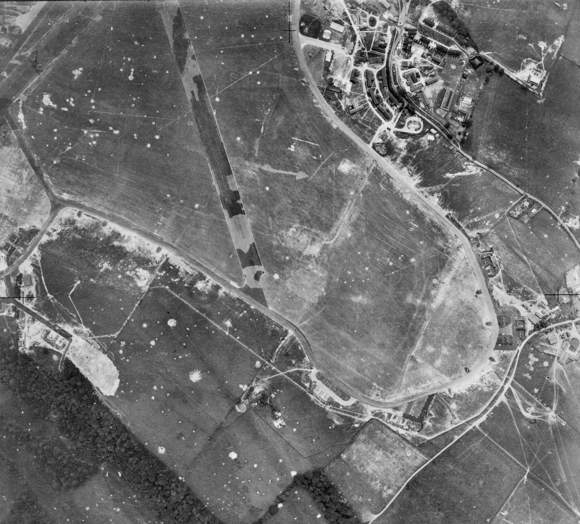
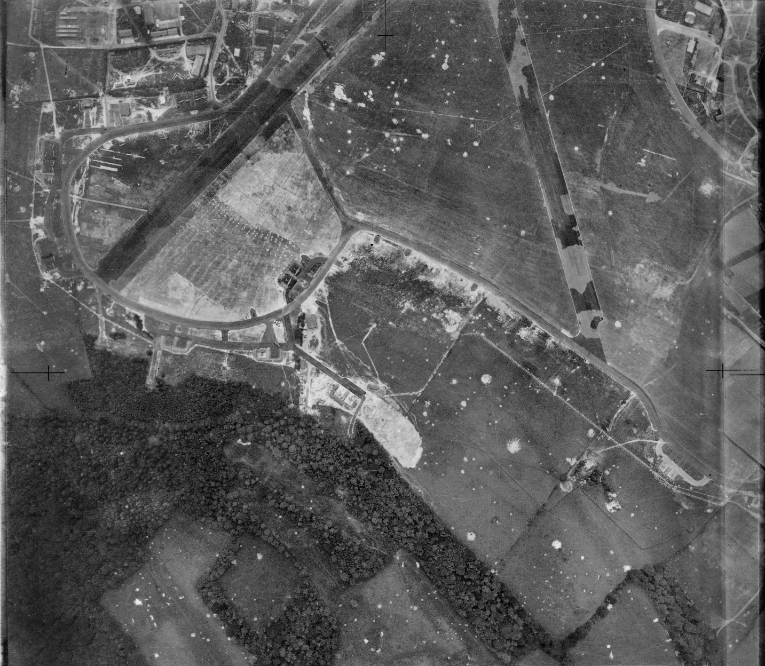
Biggin Hill Airfield – now London Biggin Hill Airport
Notes:
Image: raf_241_ac9_v_0072 & raf_241_ac9_v_0073 – 27th June 1941 - Historic England Archive (RAF photography) https://historicengland.org.uk/images-books/archive/collections/aerial-photos/record/raf_241_ac9_v_0072 & https://historicengland.org.uk/images-books/archive/collections/aerial-photos/record/raf_241_ac9_v_0073
Note the camouflage paint on the runways to try and disguise them.

Slide 25
Allotments 1
At the start of the Second World War Britain imported around three quarters of its food by ship. Attacks on these ships at the start of the war created a shortage in the supply of food to Britain.
In October 1939 the government launched its Dig For Victory campaign to encourage people to grow more fruit and vegetables to help meet the short fall. As well as people’s gardens there was also a move to turn public parks, golf courses and any other suitable spaces into allotments and help the ‘war effort’
"We want not only the big man with the plough but the little man with the spade to get busy this autumn. Let 'Dig for Victory' be the motto of everyone with a garden,“ Rob Hudson, Minister for Agriculture, in October 1939.
Notes:
Find more information at - https://heritagecalling.com/2017/04/13/allotmentitis-how-britain-dug-for-victory/

Slide 26
Allotments 2
In January 1940 the government also introduced rationing, making it even more important for people to try to grow their own food.
Through out the campaign monthly gardening guides were issued, along with a large selection of leaflets – available free on request – to help people make the most of their allotment. A large number of these leaflets are available to download at: https://dig-for-victory.org.uk/growing-advice/dig-victory-leaflets-ww2/, if you have school veg patch why not download some and try out their techniques for the best vegetables!
Notes:
Find more information at - https://heritagecalling.com/2017/04/13/allotmentitis-how-britain-dug-for-victory/

Slide 27
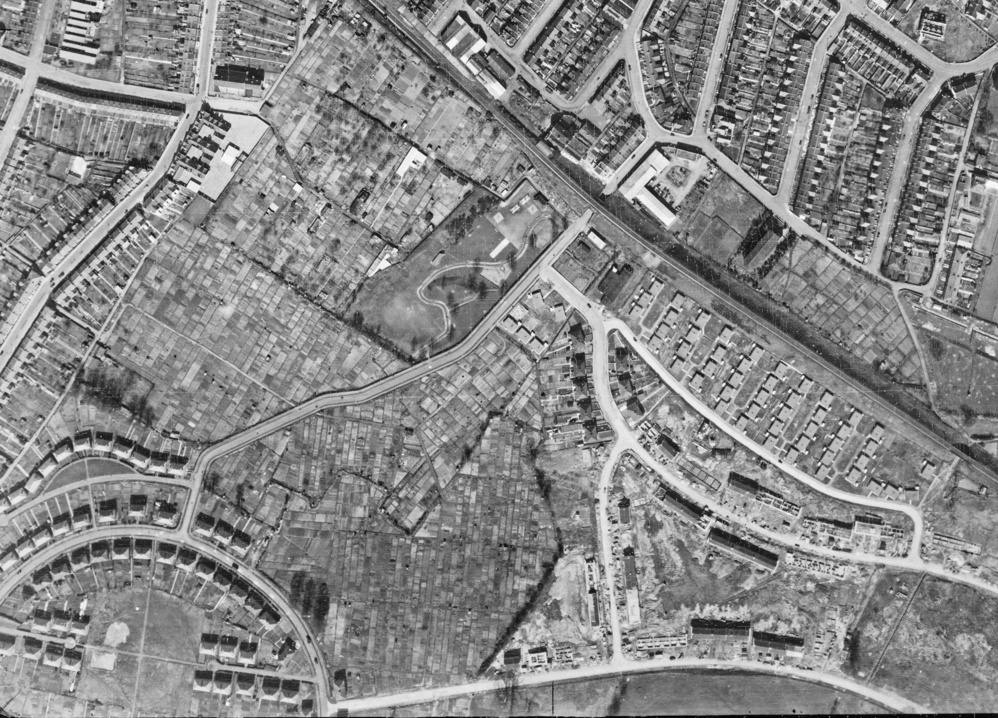
Allotments – Oldfield Park, Bath (& pre-fab housing)
Huge area of allotments (yellow) in the middle of suburban housing estates.
The red areas show pre-fab houses – see slides 84-87 for more information.
Notes:
Image: raf_cpe_uk_1988_v_5172 – 12th April 1947 - Historic England Archive (RAF photography) - https://historicengland.org.uk/images-books/archive/collections/aerial-photos/record/raf_cpe_uk_1988_v_5172
Yellow = allotments
Red = pre-fab housing

Slide 28
Anti-aircraft (AA) sites 1
One of the more significant developments in the evolution of warfare was the start of strategic bombing in World War II. This significance was reflected by the resources invested in defence, both in terms of personnel and the sites on which they served.
During World War II, the number of people in Anti-aircraft Command (AA Command) reached a peak of 274,900 men. Additional to this were the women soldiers of the Auxiliary Territorial Service (ATS), who served on AA gun sites from summer 1941, and the Home Guard who manned many sites later in the war.
Anti-aircraft gun sites divide into three main types: those for heavy guns (HAA sites, clearly visible on aerial photos), light guns (LAA sites, rarely visible on aerial photos) and batteries for firing primitive unguided rockets (ZAA sites, clearly visible on aerial photos). Mobile gun units were also deployed towards the end of the war to help counter the V1 & V2 rocket attacks in the South East.

Slide 29
Anti-aircraft (AA) sites 2
The Anti-aircraft (AA) guns were used not only for destroying enemy aircraft but, more importantly, to keep all enemy aircraft at a high altitude and to deter them from flying on the straight and even course necessary for accurate bombing.
Another important function of AA guns was to indicate the position of enemy aircraft to their own fighters. Often, when an enemy plane was out of range, the guns would fire one or two rounds to burst as near as possible, simply to draw our own fighter’s attention to the enemy.
HAA sites contained big guns with the function of engaging high flying strategic bombers, hence their location around the south and east coasts, and close to large cities and industrial and military targets. Of all the gun sites, these were the most substantially built. There were a variety of designs, but those for 4 or 8 guns were the most common and form the most distinctive shapes on aerial photos.

Slide 30
Anti-aircraft (AA) sites 3
As well as the four or eight gun emplacements, with their holdfast mountings for the guns, other components of a gun site will generally include operational buildings such as a command post, radar structures including the radar platform, on-site magazines for storing reserve ammunition, gun stores and generating huts, usually one of the standard Nissen hut designs.
Domestic buildings for the military personnel stationed there were also a feature of HAA gun sites. These often included huts, ablutions blocks, offices, stores and amenities drawn from a common pool of approved structures. Sites were often also provided with structures for their close defence in case of invasion/ground attacks. Pillboxes are the most common survival of these, though earthwork defences (mounds and ditches) were also used.
The layout of HAA gun sites was distinctive, but changed over time, for example to accommodate the introduction of radar from December 1940, women soldiers from summer 1941, and eight gun layouts from late 1942. Where present, these features can be used to help date the construction of HAA sites on aerial photos.

Slide 31
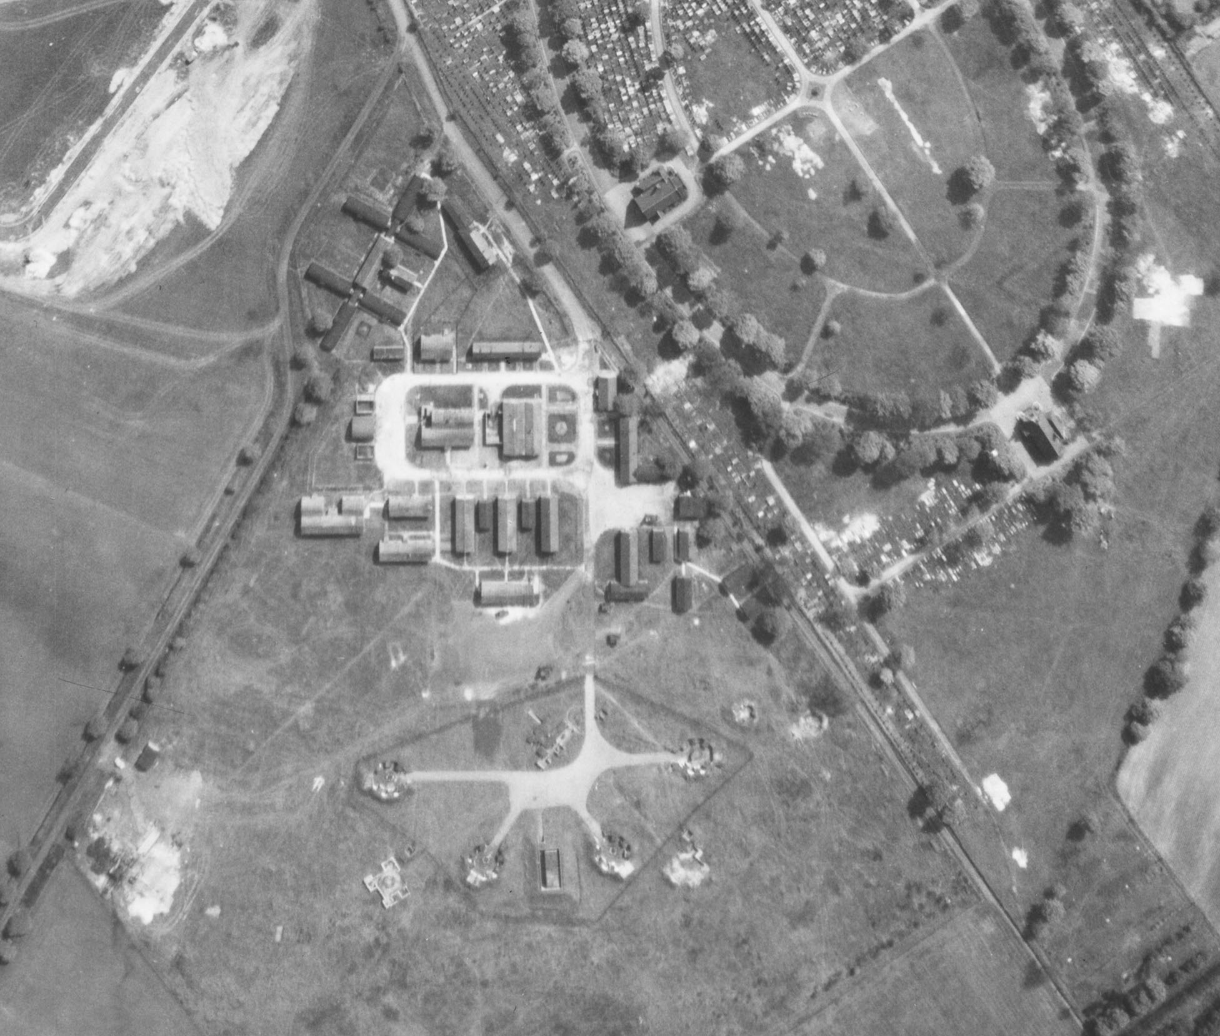
HAA site – Barton Moss, Salford – H1
Additional operational buildings
Standard 4 Gun
Emplacement
Notes:
Image: raf_82_784_vp1_0129 – 13th May 1953 - Historic England Archive (RAF photography) - https://historicengland.org.uk/images-books/archive/collections/aerial-photos/record/raf_82_784_vp1_0129

Slide 32
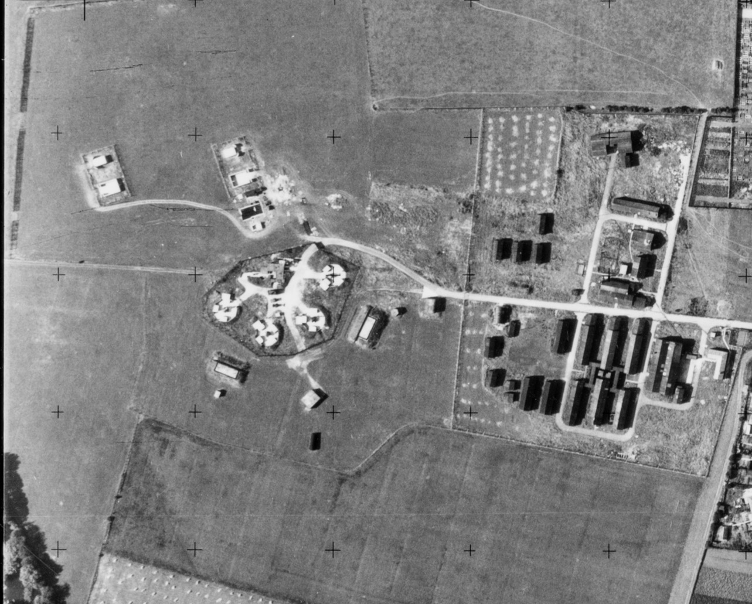
HAA site – Grangetown, Middlesbrough
Standard 4 Gun
Emplacement
Additional operational buildings
Notes:
Image: os_52r49_v_040 – 23rd August 1952 - Historic England Archive (Ordnance Survey photography)

Slide 33
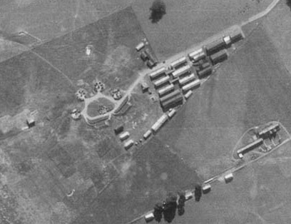
HAA site – Filton, Bristol
Standard 4 Gun
Emplacement
Additional operational buildings
Notes:
Image: raf_hla_313_rv_0606 – 29th September 1941 - Historic England Archive (RAF photography) - https://historicengland.org.uk/images-books/archive/collections/aerial-photos/record/raf_hla_313_rv_0606

Slide 34
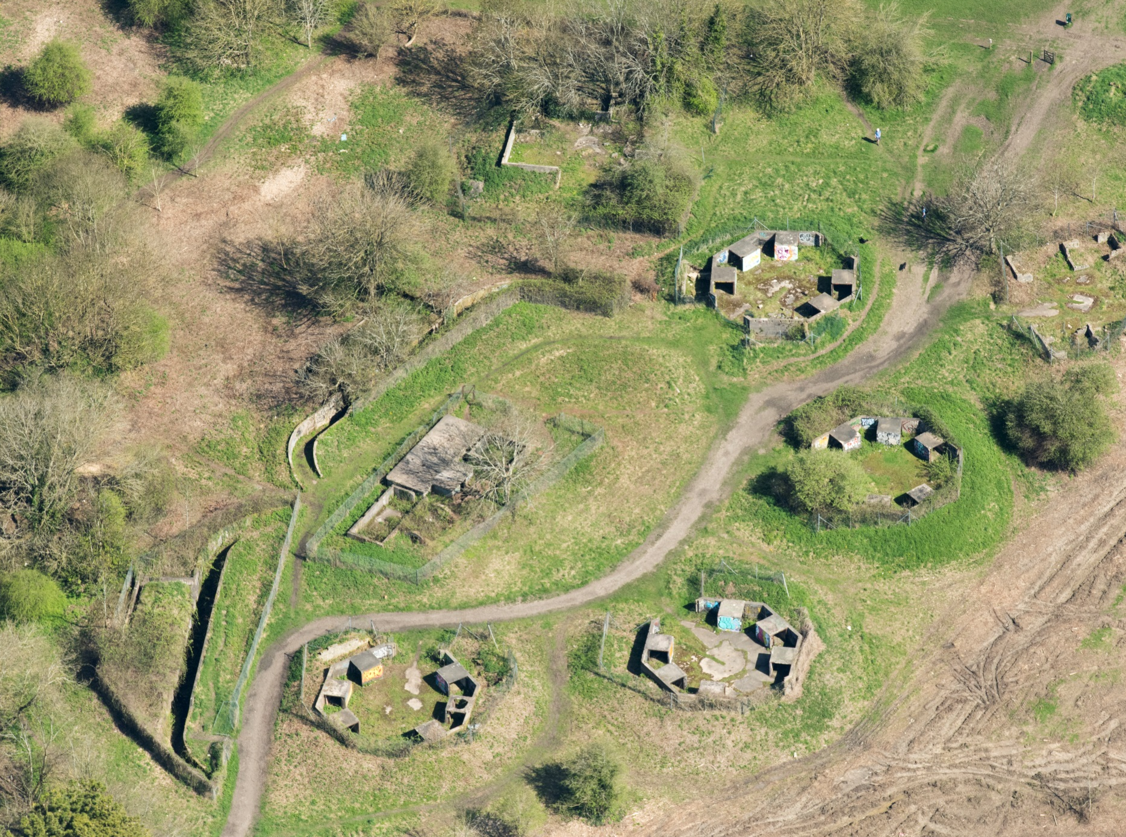
HAA site – Pur Down, Bristol B6
Standard 4 Gun
Emplacement
Notes:
Image: 33483_024 – 19th April 2018 - ©Historic England Archive - https://historicengland.org.uk/images-books/archive/collections/aerial-photos/record/33483_024

Slide 35
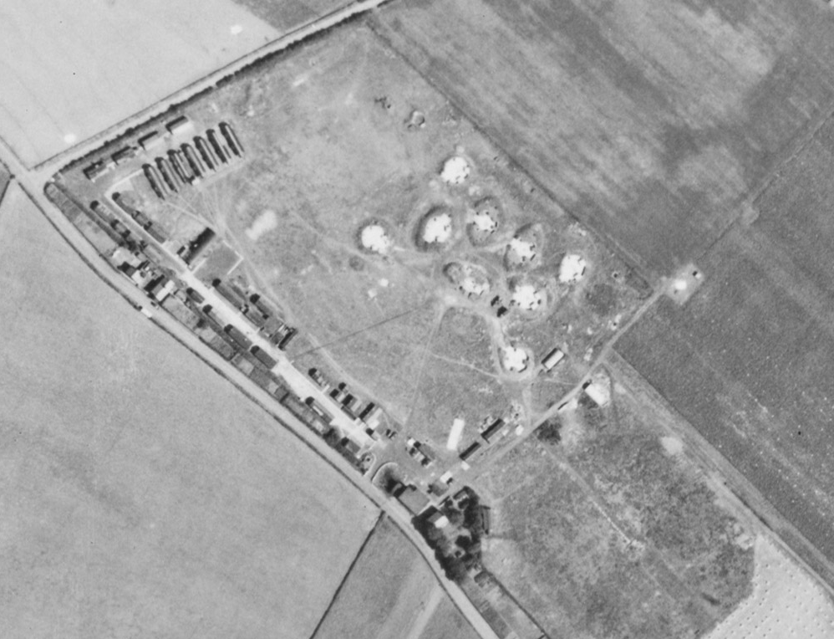
HAA site – Kirkby, Mersey H8
Standard 8 Gun
Emplacement
Additional operational buildings
Notes:
Image: raf_106g_uk_623_rs_4196 – 10th August 1945 - Historic England Archive (RAF photography) - https://historicengland.org.uk/images-books/archive/collections/aerial-photos/record/raf_106g_uk_623_rs_4196

Slide 36
Rocket Anti-aircraft sites (ZAA) 1
50 ZAA battery sites are known to have been constructed in World War II. The ZAA rocket battery and control buildings were part of a sophisticated system aimed at diverting hostile air attacks away from city centre or military targets, whilst at the same time drawing enemy bombers to within range of other anti-aircraft fire.
They were often used in conjunction with lighting decoys. The lighting decoys, known as QL sites, attempted to simulate city lights, black-out conditions and included devices to mimic the flickering lights of railway marshalling yards as seen from the air. If the decoy was considered to have been successful in attracting aircraft then pre-prepared fires (known as Starfish or QF sites) were electrically ignited to create the illusion of targets having been set alight and convince the German bombers that they had been successful!

Slide 37
Rocket Anti-aircraft sites (ZAA) 2
The rockets were laid out in a grid pattern (often 8x8 or 64 rockets). Each rocket was mounted on to a concrete base and could be rotated/pointed according to the required direction. Once loaded each rocket could only be fired once. The aim being to fire all the rockets at once.

Slide 38
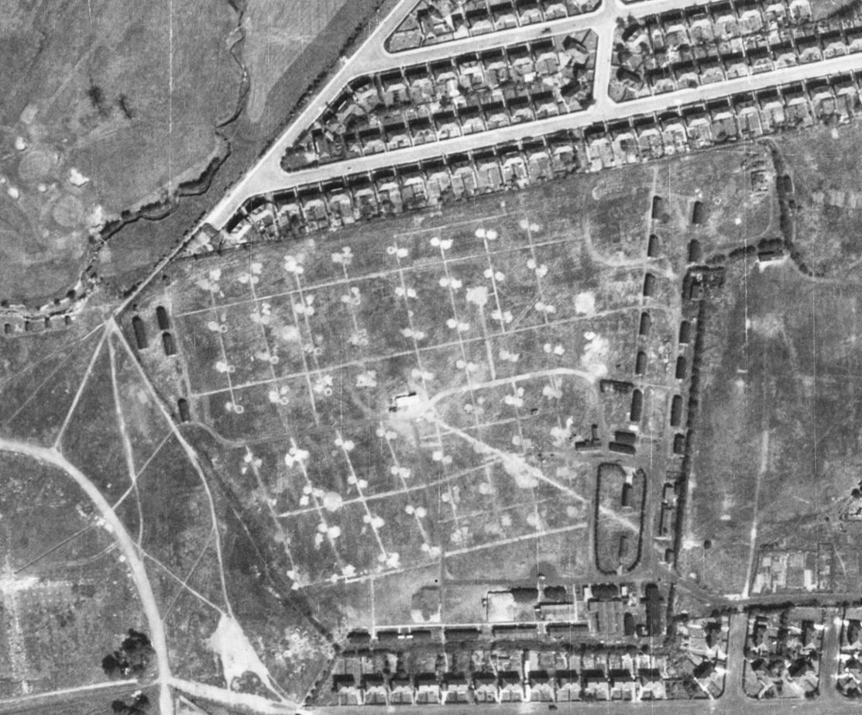
ZAA site – Radcliffe Park, Salford (ZH1)
Notes:
Image: raf_106g_uk_622_rp_3332 - 10th August 1945 - Historic England Archive (RAF photography) - https://historicengland.org.uk/images-books/archive/collections/aerial-photos/record/raf_106g_uk_622_rp_3332

Slide 39
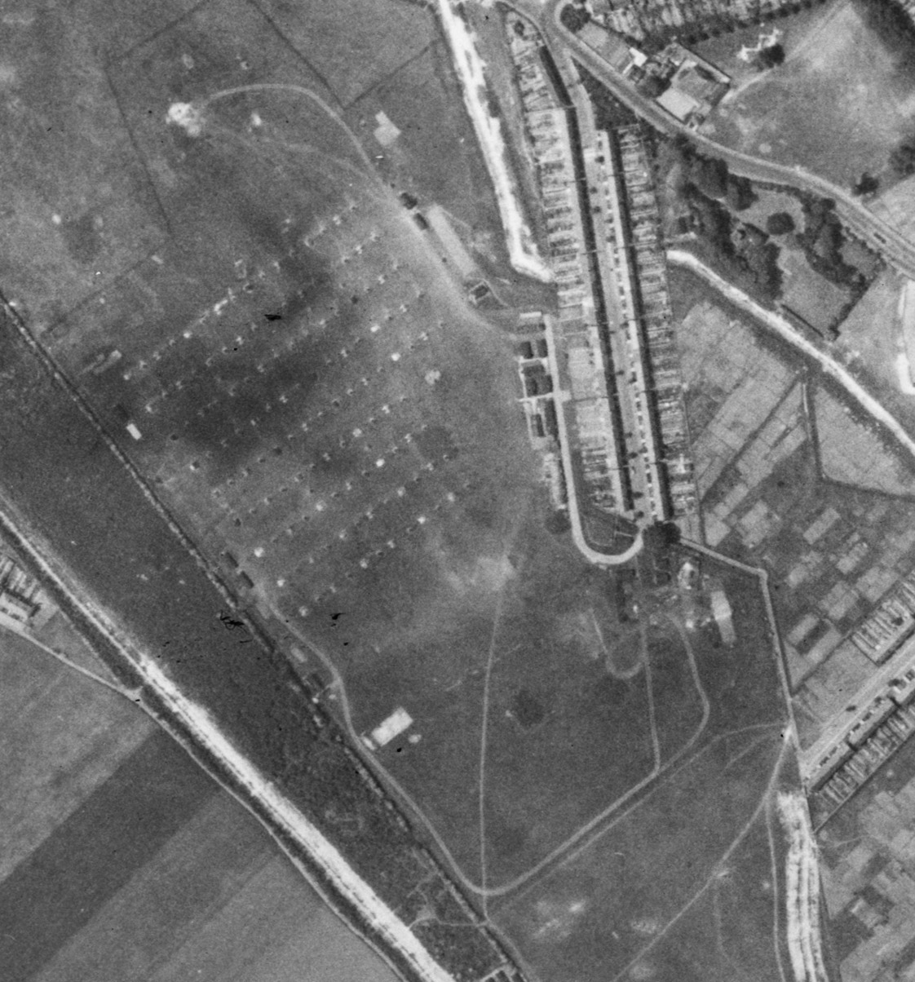
ZAA site – Gillingham, Kent 1
Notes:
Image: us_7gr_loc348_fs_2055 – 27th May 1944 - Historic England Archive (USAAF photography) - https://historicengland.org.uk/images-books/archive/collections/aerial-photos/record/us_7gr_loc348_fs_2055

Slide 40
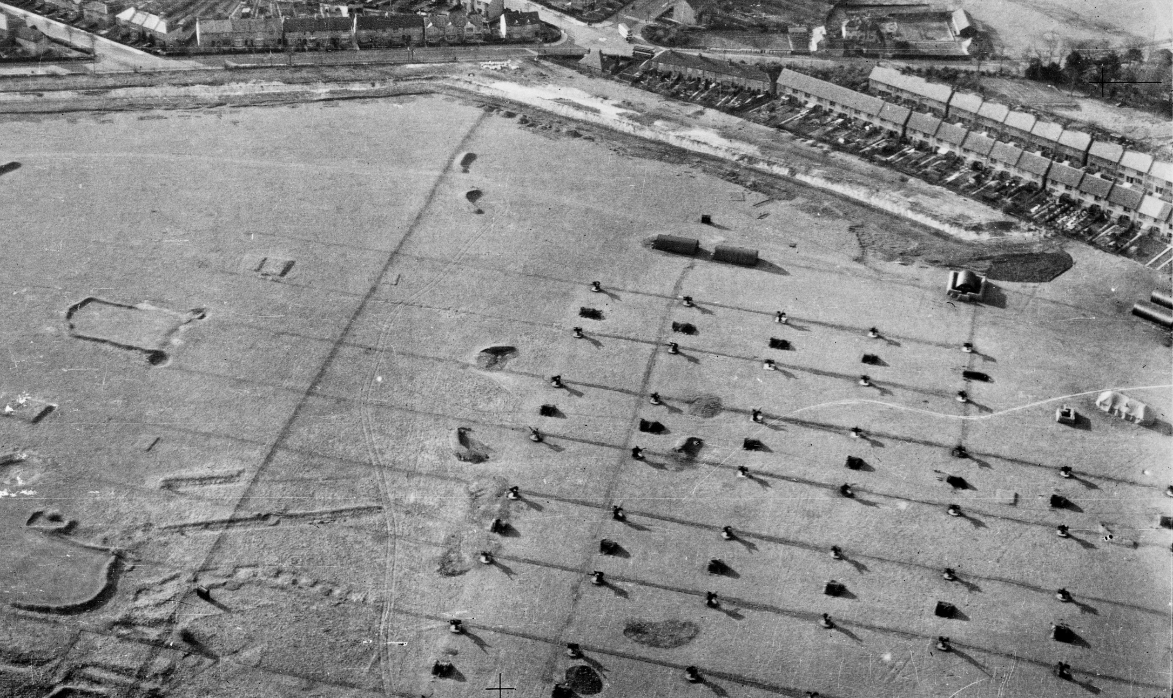
ZAA site – Gillingham, Kent 2
Notes:
Image: raf_26_uk_920_po_0006 – 23rd March 1942 - Historic England Archive (RAF photography)

Slide 41
Light (LAA) & mobile Anti-aircraft sites 1
Light Anti-aircraft (LAA) sites used a range of weapons in defence against lower flying aircraft. They had a particularly wide distribution around the south and east coasts and close to cities, industrial and military targets, such as airfields.
Of all the gun sites, these were the least substantial and have left behind the least remains. Nearly 1,250 LAA gun sites are recorded as having been built during World War II.
Around 50 of these have some remains surviving, though at only around 40 sites are these thought sufficient to provide an understanding of their original form and function. Surviving examples are therefore sufficiently rare to suggest that all 40 examples are of national importance.

Slide 42
Light (LAA) & mobile Anti-aircraft sites 2
Mobile anti-aircraft sites were mostly associated with Operation Diver. This was Anti-aircraft Command’s attempt to defeat the V1 flying-bomb, the first of Nazi Germany’s ‘retribution’ weapons, whose attacks dominated the home front in the final year of the Second World War.
Beginning in the week of D-Day, the flying bomb battle lasted for nine months. In that time the men and women of AA Command became a massed, mobile army, shifting a vast carpet of guns to meet the V1’s changing lines of attack. Along with the RAF’s fighter aircraft and the larger air defence system, their mission was to prevent a single flying bomb from reaching London, or any other British city.

Slide 43
Mobile Anti-aircraft site – Wye, Kent 1
Standard 4 Gun
Emplacement
Despite being mobile and only temporarily on a site they still used the ‘standard’ 4 gun emplacement layout.
Notes:
(note the trucks covered in camouflage netting against the nearby hedge and barns)
Image: mso_1416_s372h54_po_02 – 6th August 1941 - Historic England Archive (RAF photography)

Slide 44
Mobile Anti-Aircraft site – Wye, Kent 2
Notes:
Close-up of mobile guns being put together/taken apart, a soldier on the right can be seen with a gun barrel over his shoulder.
Image: mso_1416_s372h54_po_02 – 6th August 1941 - Historic England Archive (RAF photography)

Slide 45
Anti-glider (landing) trenches
The increased use of aircraft during the Second World War not only increased the threat from bombing, but also of invasion.
Therefore open areas were considered vulnerable to invasion from the air: a landing by paratroopers, glider-borne troops or powered aircraft which could land and take off again. Any open area with a straight length of 500 yards (460 m) or more within five miles (8 km) of the coast or an airfield was considered vulnerable.
Anti-invasion defences were therefore built in vast numbers. One of the main types being zig-zag trenches dug into open areas to prevent aircraft from landing or taking off. They also made the landing of paratroopers potentially more hazardous.
In some areas concrete or wooden posts, even old cars, were used to create obstacles in these open areas and deter enemy landings.

Slide 46
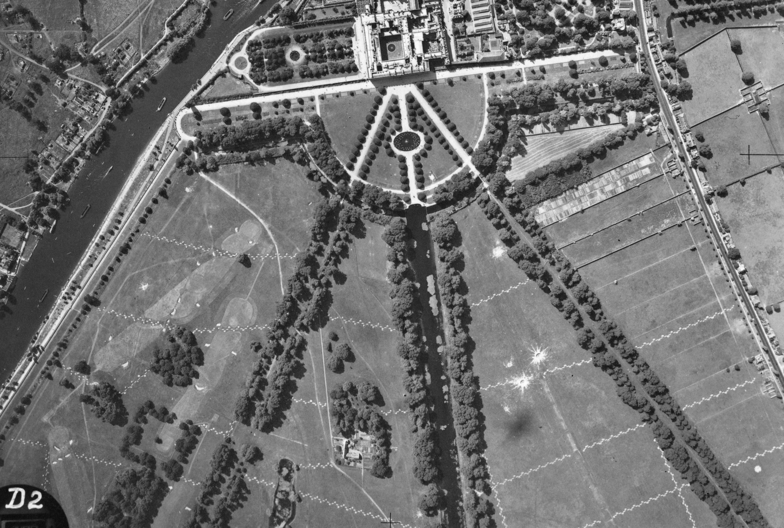
Anti-glider trenches – Hampton Court, London (& bomb craters too!)
Huge area of zig-zag anti-glider trenches (yellow) in the open parkland in front of Hampton Court.
The red areas show bomb craters – see slides 55-60 for more information.
Notes:
Image: raf_241_ac10_v_0041 – 29th June 1941 - Historic England Archive (RAF photography) - https://historicengland.org.uk/images-books/archive/collections/aerial-photos/record/raf_241_ac10_v_0041
Yellow = anti-glider trenches
Red = bomb craters

Slide 47
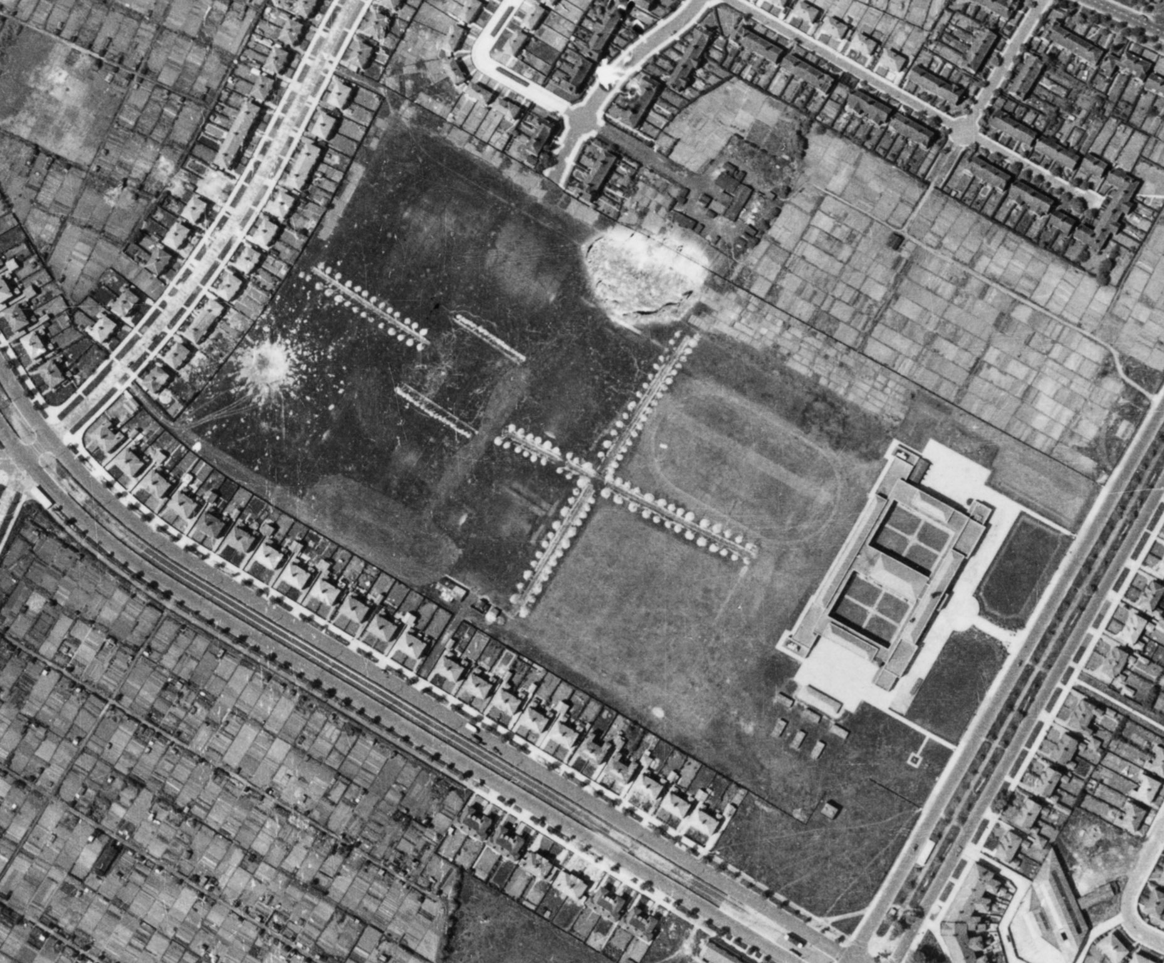
Anti-glider trenches – Childwall, Liverpool (& a bomb crater too!)
Small area of anti-glider trenches (yellow) in the open playing fields in front of a school.
The red area shows a bomb crater – see slides 55-60 for more information.
Notes:
Image: raf_13h_uk789_v_0002 – 11th June 1941 - Historic England Archive (RAF photography) - https://historicengland.org.uk/images-books/archive/collections/aerial-photos/record/raf_13h_uk789_v_0002
Yellow = anti-glider trenches
Red = bomb crater

Slide 48
Barracks
Military buildings can be divided into the operational and the ancillary (commonly known in the military as ‘the teeth and the tail’): buildings for fighting, and buildings for living and working.
Vast amounts of short-life hutted accommodation was built in the Second World War, most of which no longer survives but which can be identified through documentation and archaeology.
However, some army camps have continued in use, with early examples of prefabricated hutting being repeatedly modernised and upgraded to suit modern needs.
Notes:
Find out more about military buildings at: https://historicengland.org.uk/images-books/publications/dlsg-military/heag123-military-structures-lsg/

Slide 49
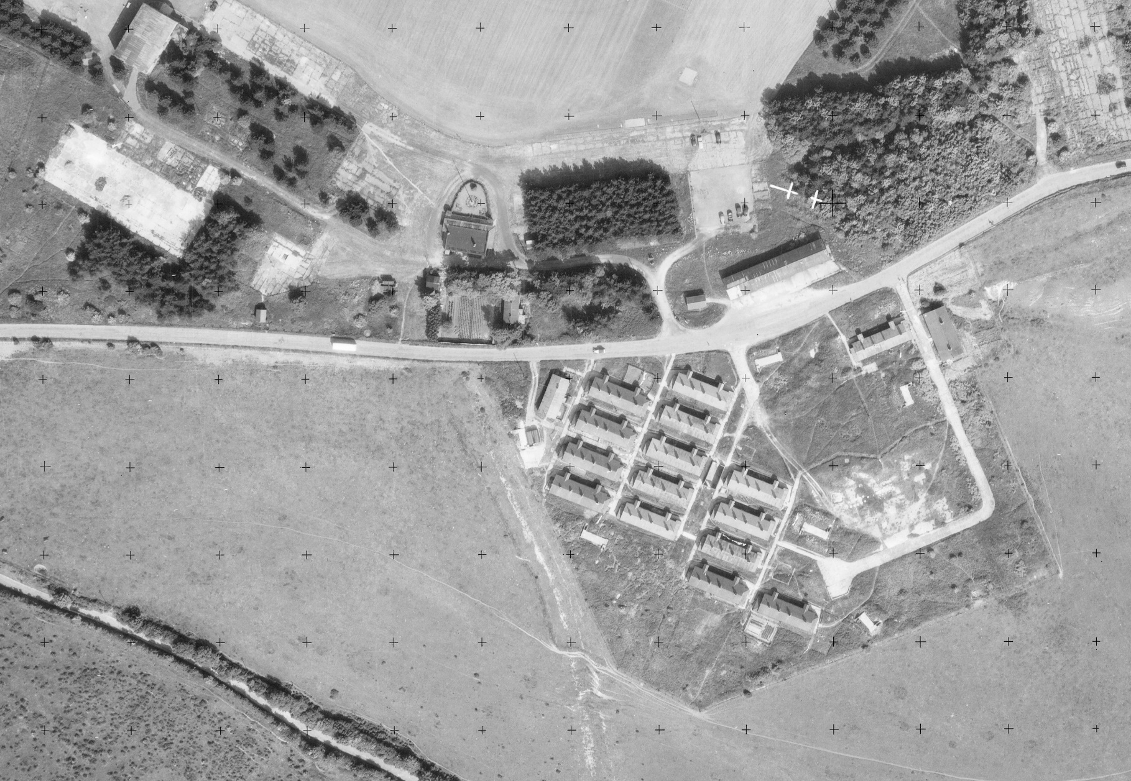
Army Barracks – Dover, Kent
Notes:
Image: os_53t77_v_032 – 10th June 1953 - Historic England Archive (Ordnance Survey photography) - https://historicengland.org.uk/images-books/archive/collections/aerial-photos/record/os_53t77_v_032

Slide 50
Barrage Balloons 1
The use of hydrogen-filled barrage balloons as anti-aircraft devices had been developed towards the end of World War I, in order to provide some protection for London from low-level air attack.
The balloons were held to the ground using heavy steel cables. It is the cables that were the main defence as any aircraft flying into the cable would be badly damaged, preventing them from carrying out their mission. This also that meant that by using the balloons all approaching aircraft would have to fly higher than the balloons to avoid the cables, thus making it harder for them to accurately drop their bombs/carry out their intended mission.

Slide 51
Barrage Balloons 2
By the end of 1938, it was evident that barrage balloons would form an important part of any future defence of Britain, and thus a separate Balloon Command was formed on 1 November 1938. Training was carried out at Balloon Training Units (BTU); by the time of their closure in November 1943, the BTUs had trained around 5,000 RAF balloon operators, the same number of WAAFs, and around 12,000 operators and drivers. 18 balloon depots were established around the country, between 1938 and 1940.
From 1939 to 1945 barrage balloons formed an important part of the country's anti-aircraft defences, guarding strategic military and manufacturing sites, as well as towns and cities.

Slide 52
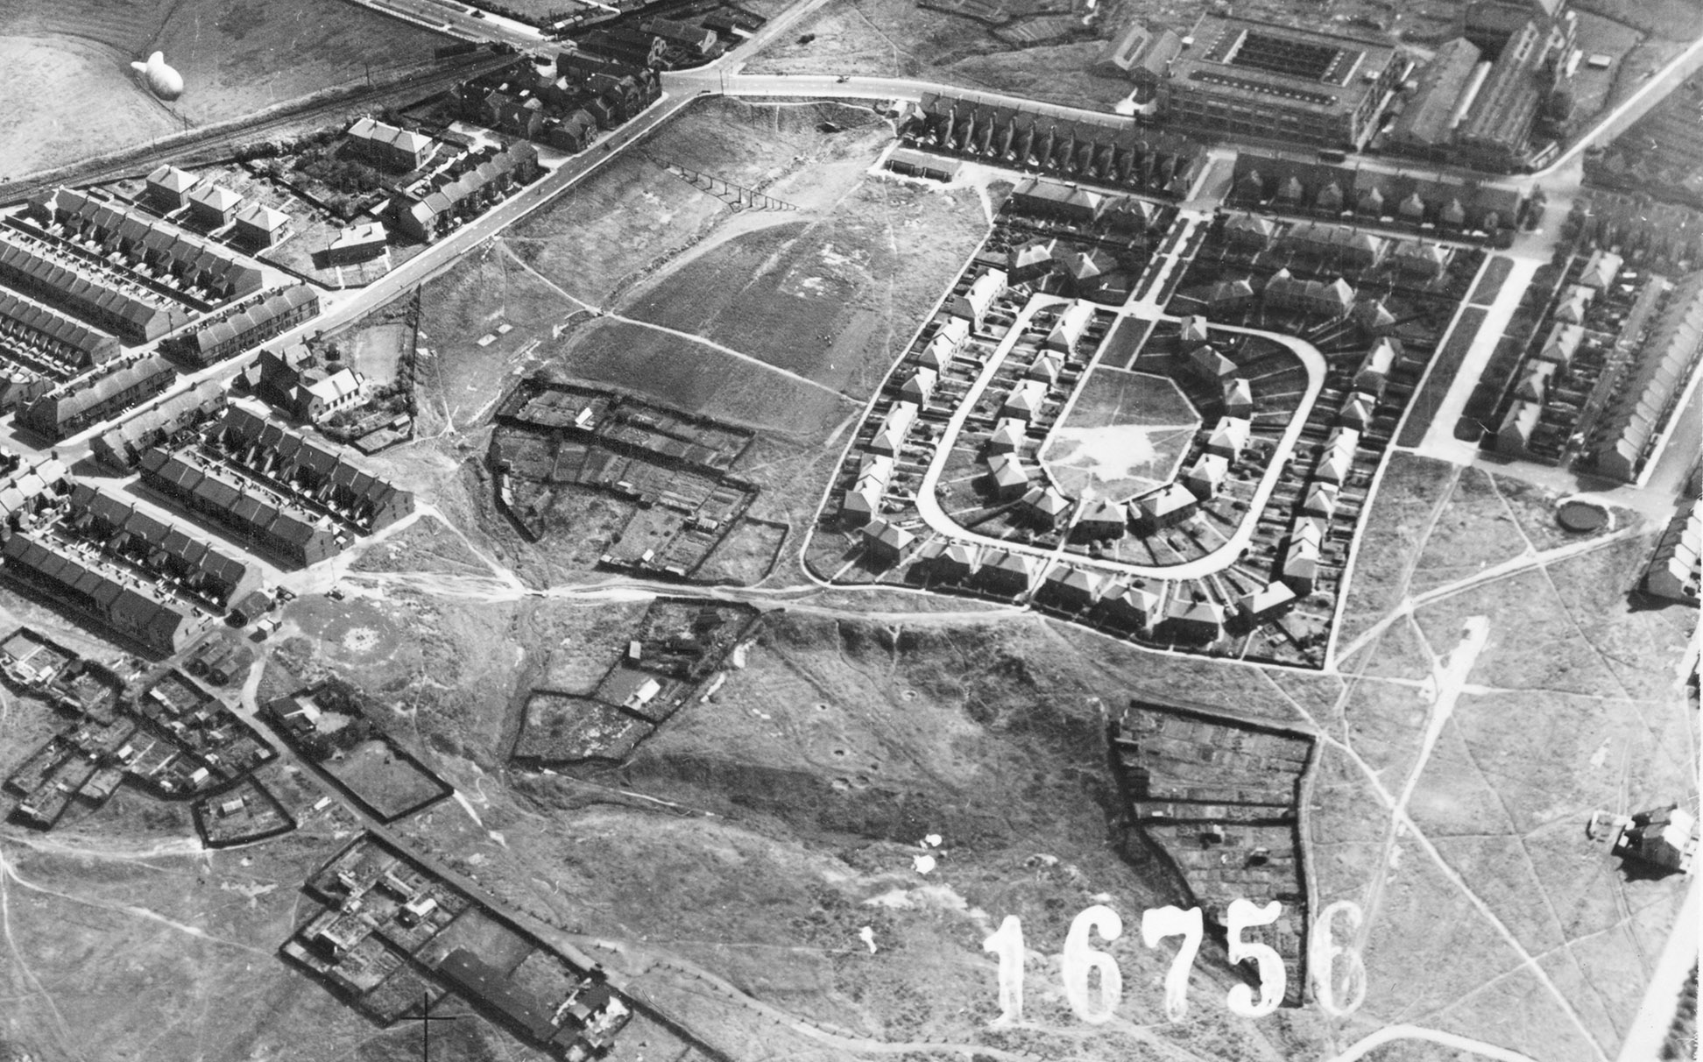
Barrage Balloon – Wardley, Gateshead (Barrage balloon and tether site, plus Emergency Water Supply)
A Barrage Balloon (yellow) and its tether site (orange) amongst suburban housing. The steel cables between the two are too fine to be seen on the photo.
The red area shows an Emergency Water Supply – see slides 66-67 for more information.
Notes:
Image: mso_1cu_16000_o_16756 – 23rd August 1943 - Historic England Archive (RAF photography) - https://historicengland.org.uk/images-books/archive/collections/aerial-photos/record/mso_1cu_16000_o_16756
Yellow = barrage balloon
Red = emergency water supply
Orange = tether site

Slide 53
Barrage Balloon – Willington Quay, North Tyneside (Barrage balloons and tether sites)
Barrage Balloons (yellow) and their tether sites (orange) on the quayside. The steel cables between the two are too fine to be seen on the photo.
Notes:
Image: raf_fno_129_fp_1067 – 1st September 1942 - Historic England Archive (RAF photography) - https://historicengland.org.uk/images-books/archive/collections/aerial-photos/record/raf_fno_129_fp_1067
Yellow = barrage balloon
Orange = tether site

Slide 54
Barrage Balloon on its tether site – Wavertree, Liverpool
A Barrage Balloon (yellow) on the ground attached to its tether site (orange) before the steel cables have been unwound to allow it to rise up into the air.
Notes:
Image: raf_13h_uk789_v_031 – 11th June 1941 - Historic England Archive (RAF photography) - https://historicengland.org.uk/images-books/archive/collections/aerial-photos/record/raf_13h_uk789_v_031
Yellow = barrage balloon
Orange = tether site

Slide 55
Bomb Damage 1
The heavy and frequent bombing raids carried out over Britain in 1940 and 1941, known as the Blitz, began with raids on London on 7 September 1940. In September 1940 alone, 5,300 tonnes of high explosives were dropped on London in just 24 nights. The Germans were intent on destroying morale before their planned invasion of Britain. Industrial sites and civilian centres from Plymouth to Liverpool and Portsmouth to Hull were also targeted by the Luftwaffe, the German air force, during the war.
An RAF directive in February 1942 had authorised, for the first time, the targeting of civilian areas in Germany. Air Marshall Sir Arthur (‘Bomber’) Harris, Commander-in-Chief RAF Bomber Command, wrote in his memoirs that the main reason he chose the port city of Lübeck as the first target was: ‘…to learn to what extent a first wave of aircraft could guide a second wave to the aiming point by starting a conflagration.’ The city lacked defences, and in the firestorm 300 residents were killed and almost 1,000 injured, whilst the historic centre was severely damaged.
Notes:
Find out more at https://historicengland.org.uk/whats-new/features/second-world-war-and-blitz/ and https://heritagecalling.com/2019/07/04/englands-historic-cities-under-attack-the-baedker-raids-1942/

Slide 56
Bomb Damage 2
Between late April and late June 1942, the Luftwaffe deliberately targeted Britain’s historic towns and cities, causing widespread destruction, hundreds of deaths and thousands of injuries. These raids were a direct retaliation for the RAF bombing of the historic German city of Lübeck two months earlier on 28/29 March.
The main targets were Exeter, Bath, Norwich, York and Canterbury. These cites were chosen because Baron Gustav Braun von Sturm, a Nazi propagandist, reputedly suggested bombing significant historic sites listed in the Baedeker Guides: a 19th century set of travel guides published by the Karl Baedeker firm. This spate of bombing became known as the ‘Baedeker Raids’.
Notes:
Find out more at https://historicengland.org.uk/whats-new/features/second-world-war-and-blitz/ and https://heritagecalling.com/2019/07/04/englands-historic-cities-under-attack-the-baedker-raids-1942/

Slide 57
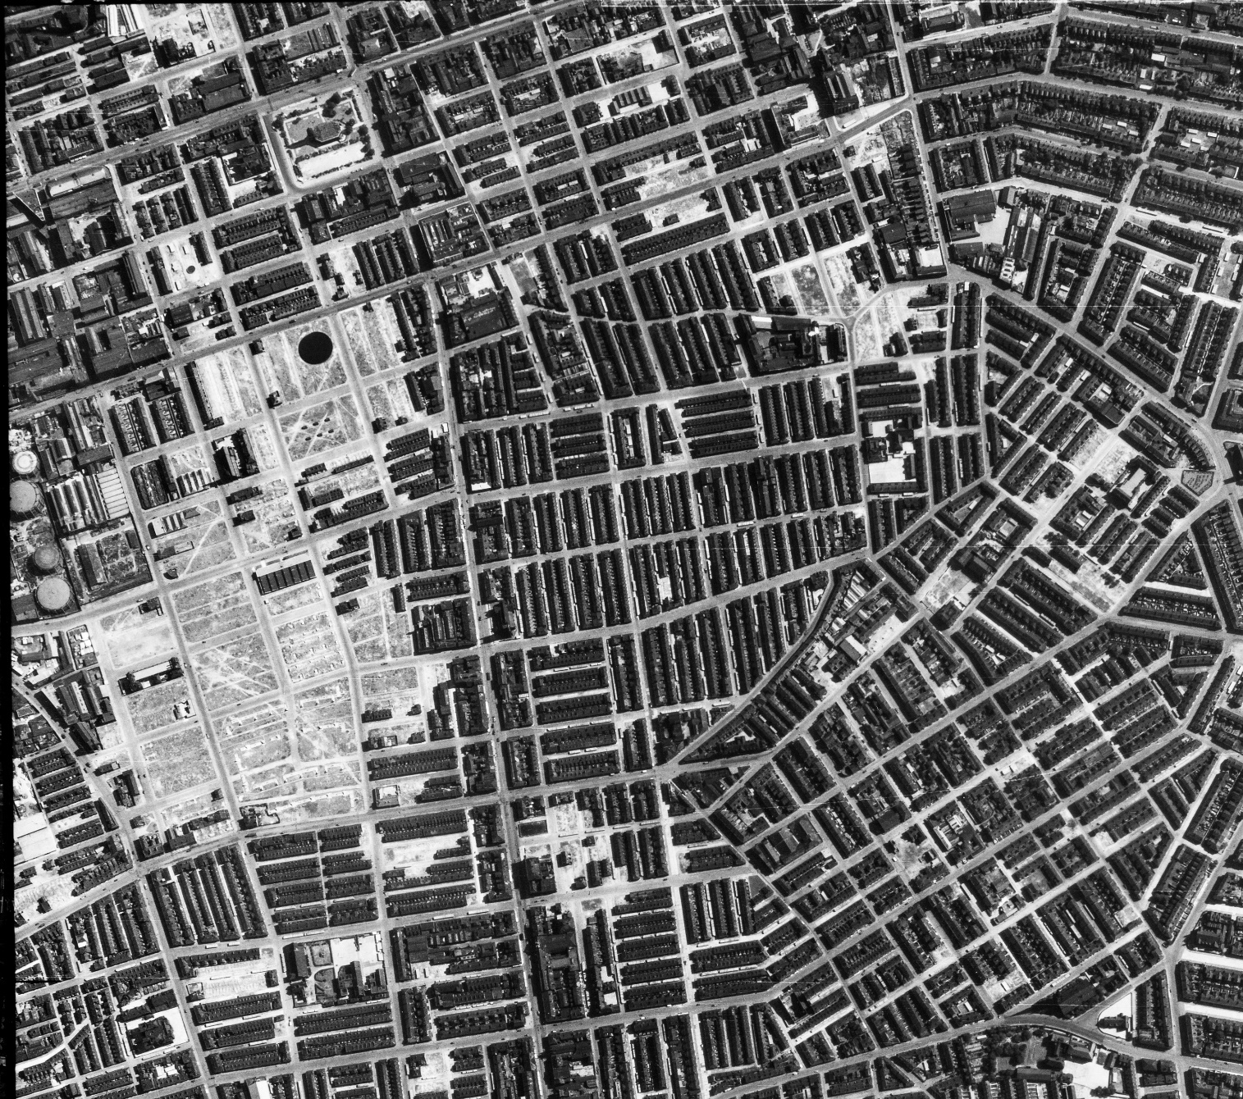
Bomb damage – Rolls Crescent, Manchester
All the areas that look ‘white’ are areas of demolition caused by bomb damage
Notes:
(All the areas that look ‘white’ are areas of demolition caused by bomb damage) - https://historicengland.org.uk/images-books/archive/collections/aerial-photos/record/raf_106g_uk_622_rs_4375
Image: raf_106g_uk_622_rs_4375 – 10th August 1945 - Historic England Archive (RAF photography)

Slide 58
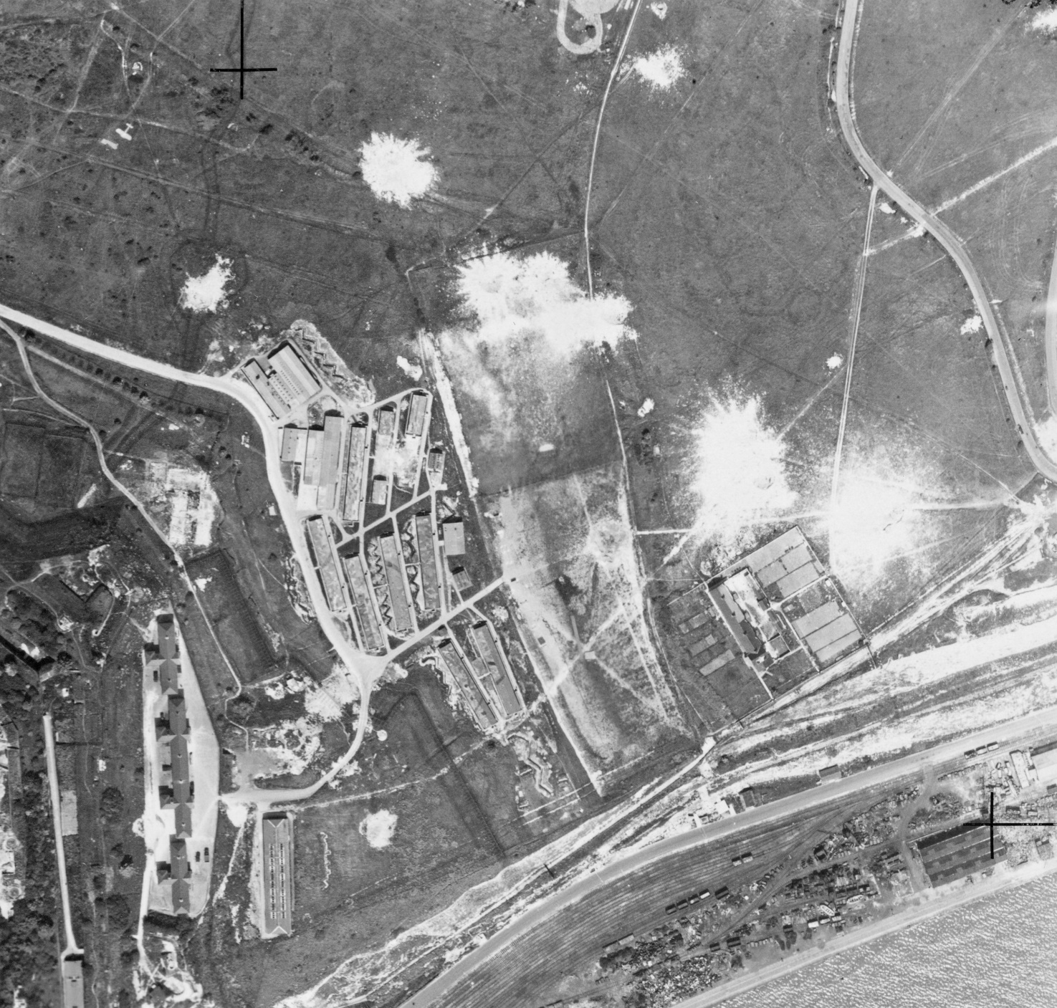
Bomb damage craters – Dover, Kent
Notes:
Image: raf_hla_565_v_6099 – 2nd June 1942 - Historic England Archive (RAF photography) - https://historicengland.org.uk/images-books/archive/collections/aerial-photos/record/raf_hla_565_v_6099

Slide 59
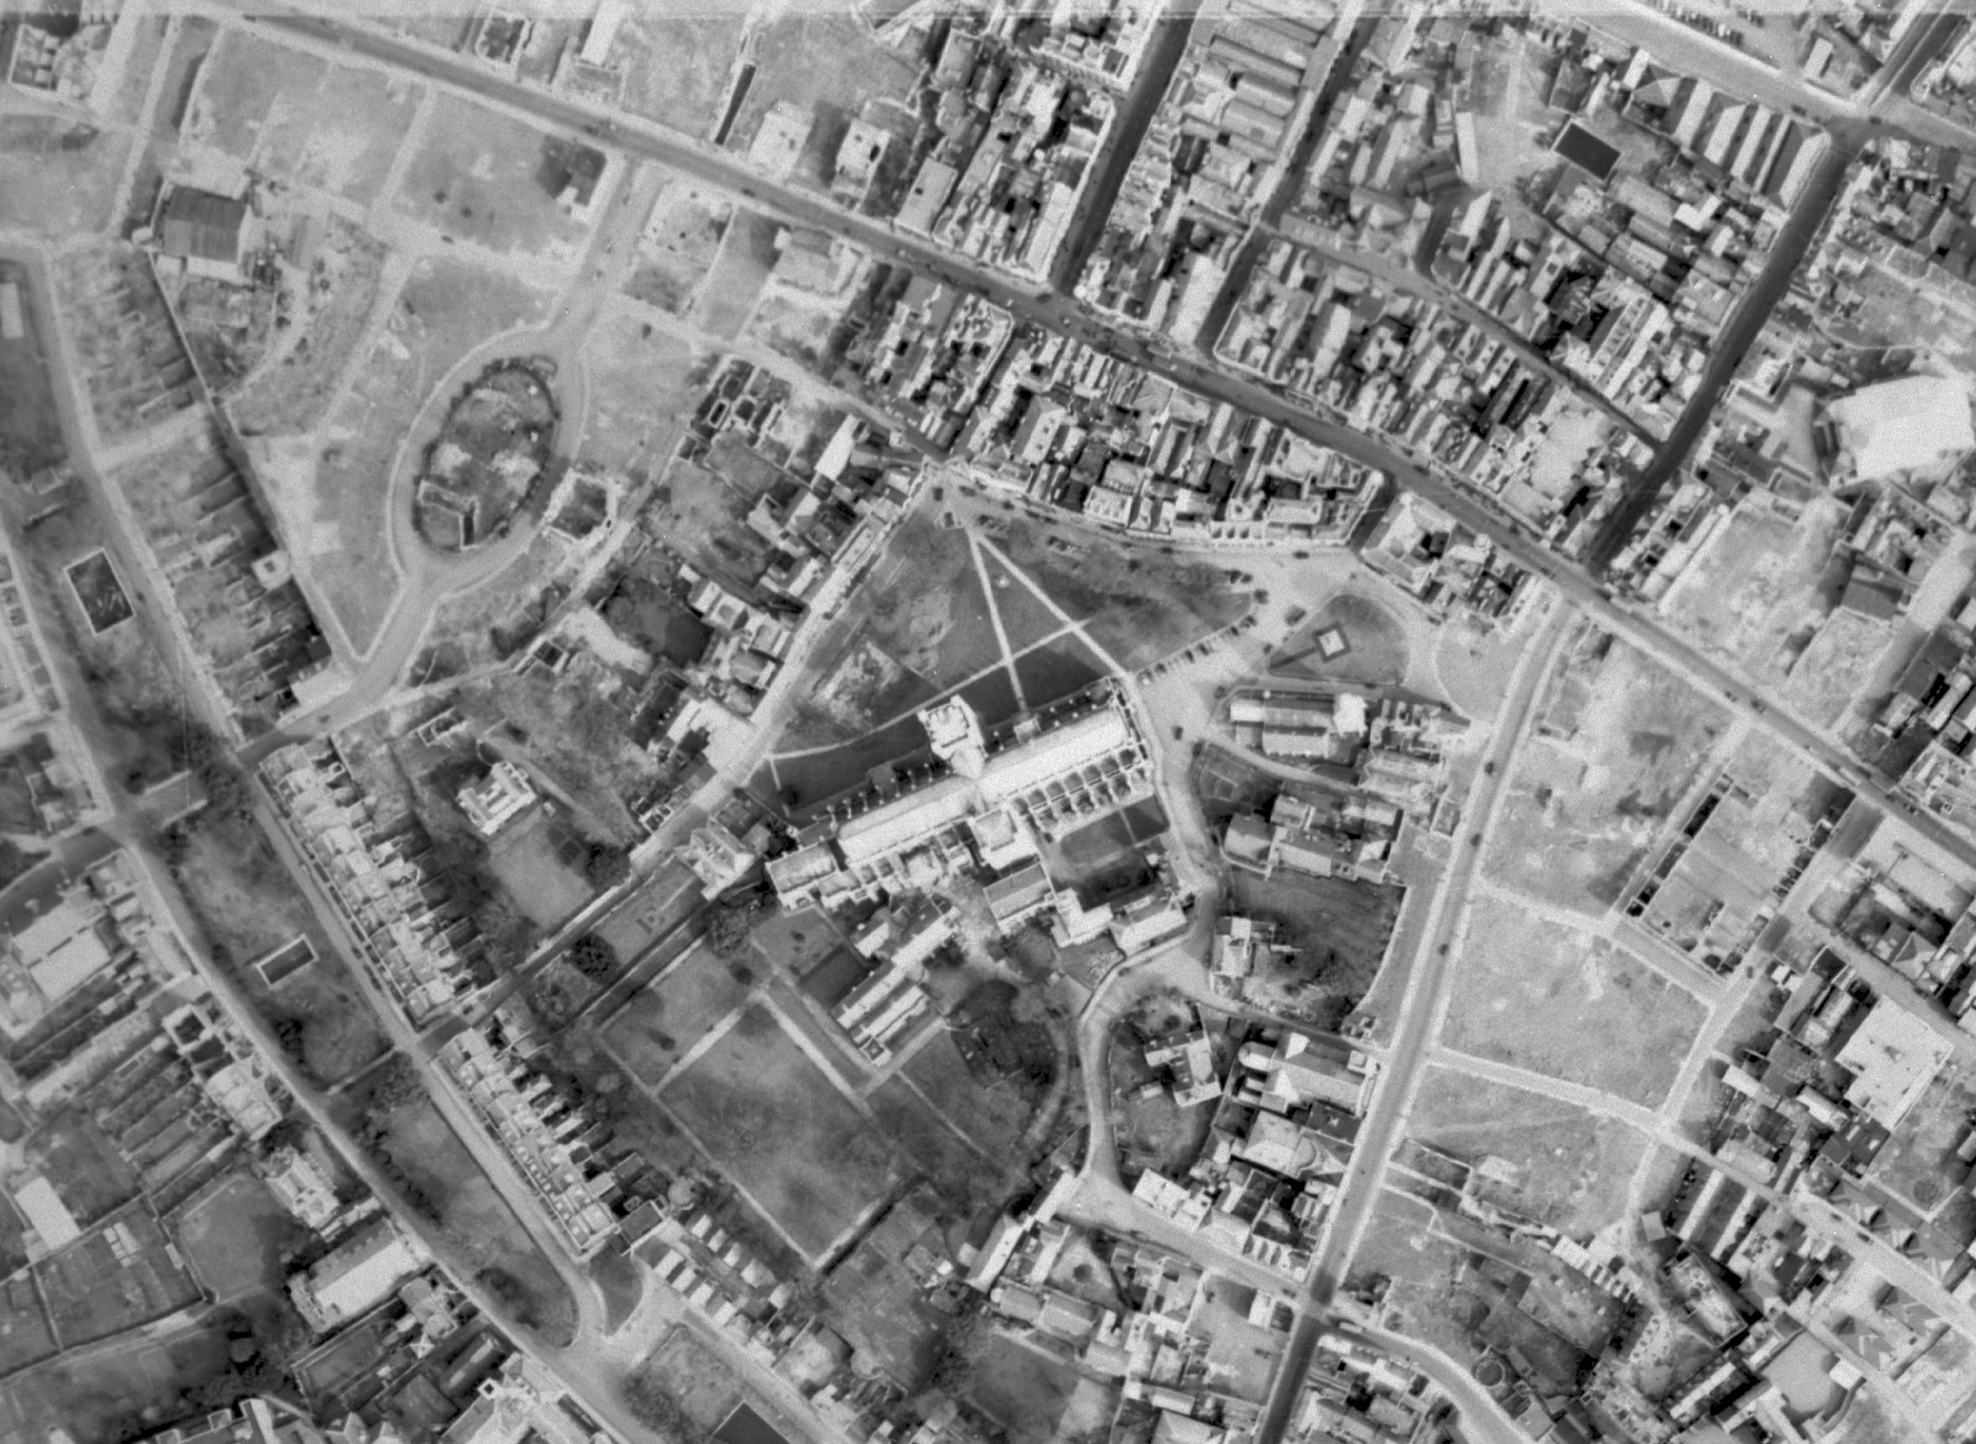
Areas of bomb damage around Exeter Cathedral, Devon
All the areas that look ‘paler’ are areas of demolition caused by bomb damage, as can been clearly seen on the next slide.
They show in stark contrast to the high density of buildings in the rest of the photo.
Notes:
Image: raf_106g_uk_1273_v_5037 – 23rd March 1946 - Historic England Archive (RAF photography) - https://historicengland.org.uk/images-books/archive/collections/aerial-photos/record/raf_106g_uk_1273_v_5037

Slide 60
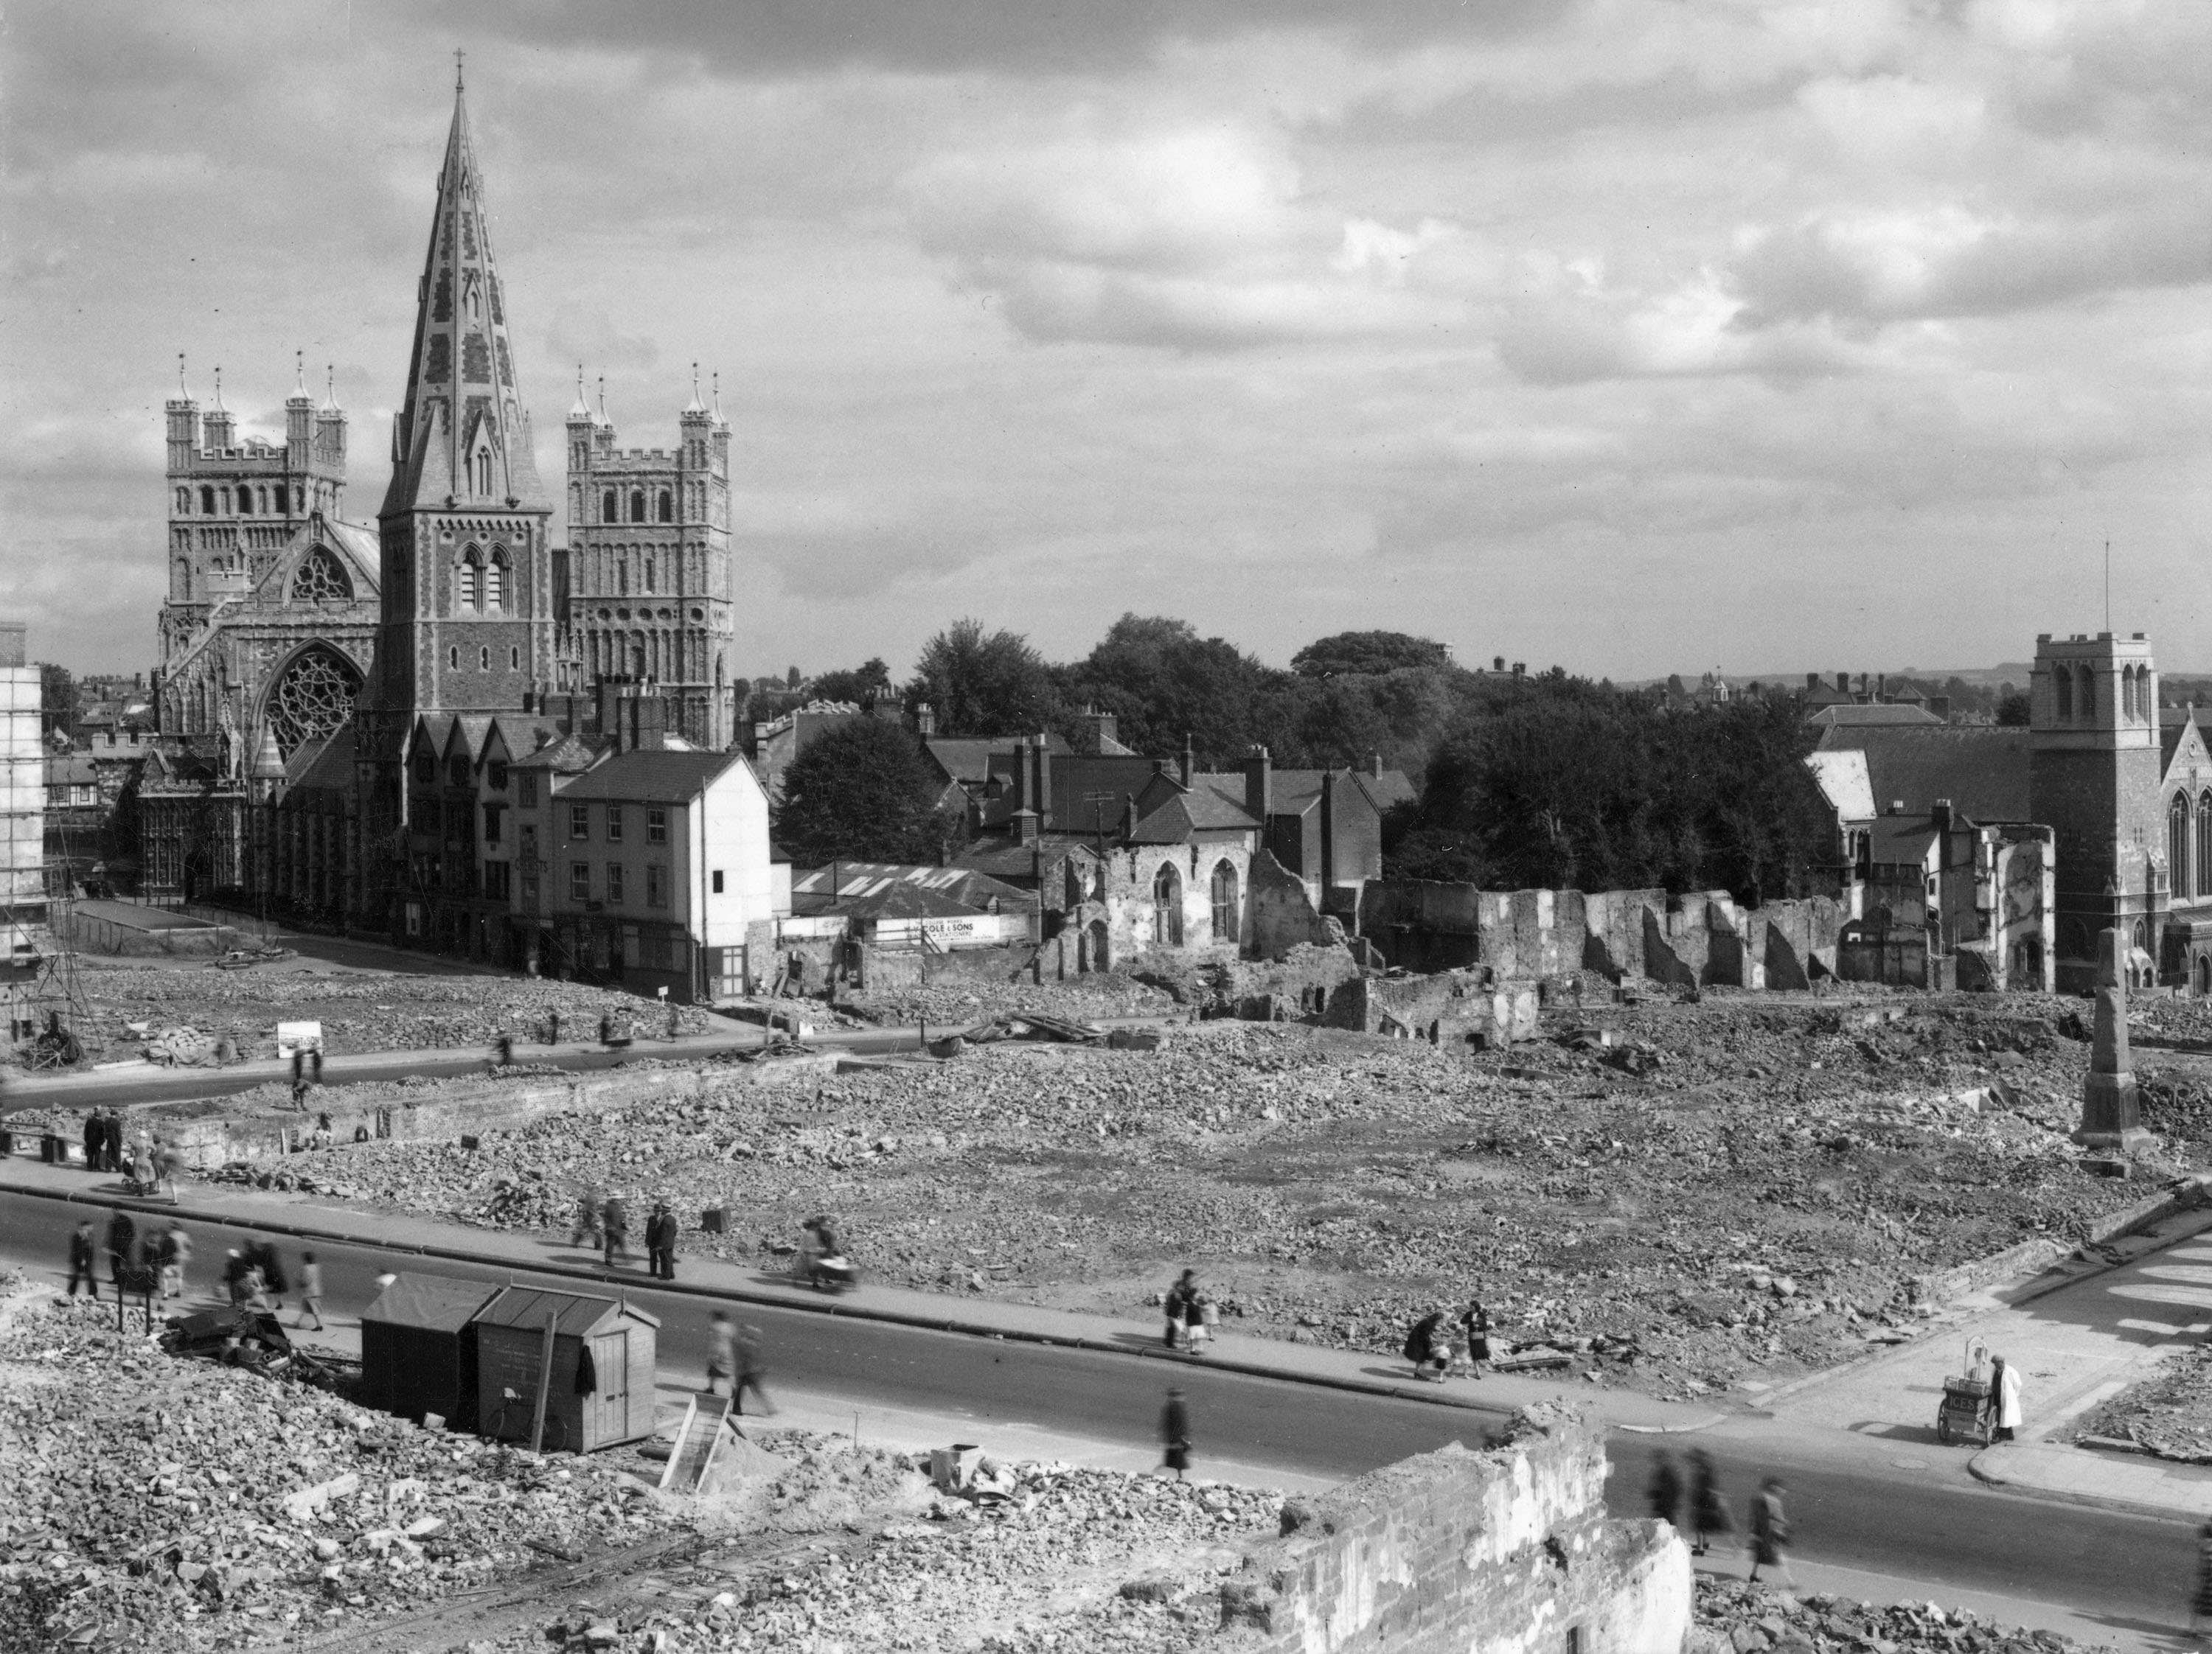
Area of bomb damage around Exeter Cathedral, Devon
Notes:
Image: RBO01_12_OP07079 – 1942 - © Reproduced by permission of Historic England Archive - https://historicengland.org.uk/images-books/photos/item/RBO01/12/OP07079

Slide 61
Camouflage Buildings 1
The British Army School of Camouflage was founded in 1916 and based in London’s Kensington Gardens. The school explored methods of deceiving the enemy on the Western Front.
However, it was the threat of targeted bombing attacks on Britain by the Luftwaffe (the German air force) in the Second World War (1939-1945) that led the British military to use the concealment and deceit of camouflage in more sophisticated and strategic ways.
In some cases, the aim was to deceive an enemy aircraft as it approached from several miles away: from such a distance, camouflage – which appears very basic when viewed from directly above – stopped a potential bombing target standing out.
Notes:
Find out more at https://heritagecalling.com/2019/10/07/the-story-of-camouflage-during-the-second-world-war/

Slide 62
Camouflage Buildings 2
Camouflage training manuals were widely issued and all military personnel received basic training. Virtually everything of military significance in Britain was camouflaged, including vehicles and even entire airfields.
Enormous amounts of camouflage netting were used in Britain during the Second World War. It was made by cutting up short lengths of green and khaki sacking strips and attaching them to mesh. The netting created patterned shadows, blending into the surrounding environment and made whatever was hidden underneath difficult to spot from the air.
Notes:
Find out more at https://heritagecalling.com/2019/10/07/the-story-of-camouflage-during-the-second-world-war/

Slide 63
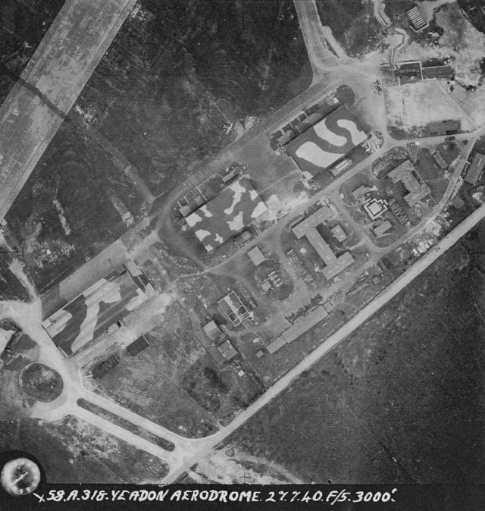
Camouflaged aircraft hangars and ‘fake painted hedge’ RAF Yeadon (now Leeds Bradford Airport), Yorkshire
The very large aircraft hangars (yellow) have had their roof painted with camouflage patterns.
A black line painted across the runway (red) has also been added to resemble a hedge, from the air, to break up the distinctive large pale stretches of runway.
Notes:
Image: raf_58a_45_v_0318 – 27th July 1940 - Historic England Archive (RAF photography) - https://historicengland.org.uk/images-books/archive/collections/aerial-photos/record/raf_58a_45_v_0318
Yellow = Aircraft hangers
Red = fake painted hedge

Slide 64
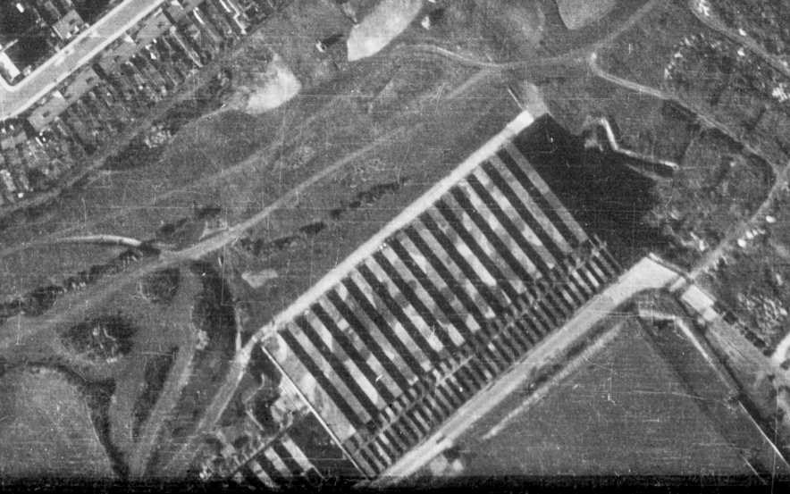
Camouflaged factory – Luton, Bedfordshire
This large factory (yellow) has had its roof painted with camouflage patterns.
Notes:
Image: raf_cpe_uk_1779_rs_4386 – 10th October 1946 - Historic England Archive (RAF photography) - https://historicengland.org.uk/images-books/archive/collections/aerial-photos/record/raf_cpe_uk_1779_rs_4386

Slide 65
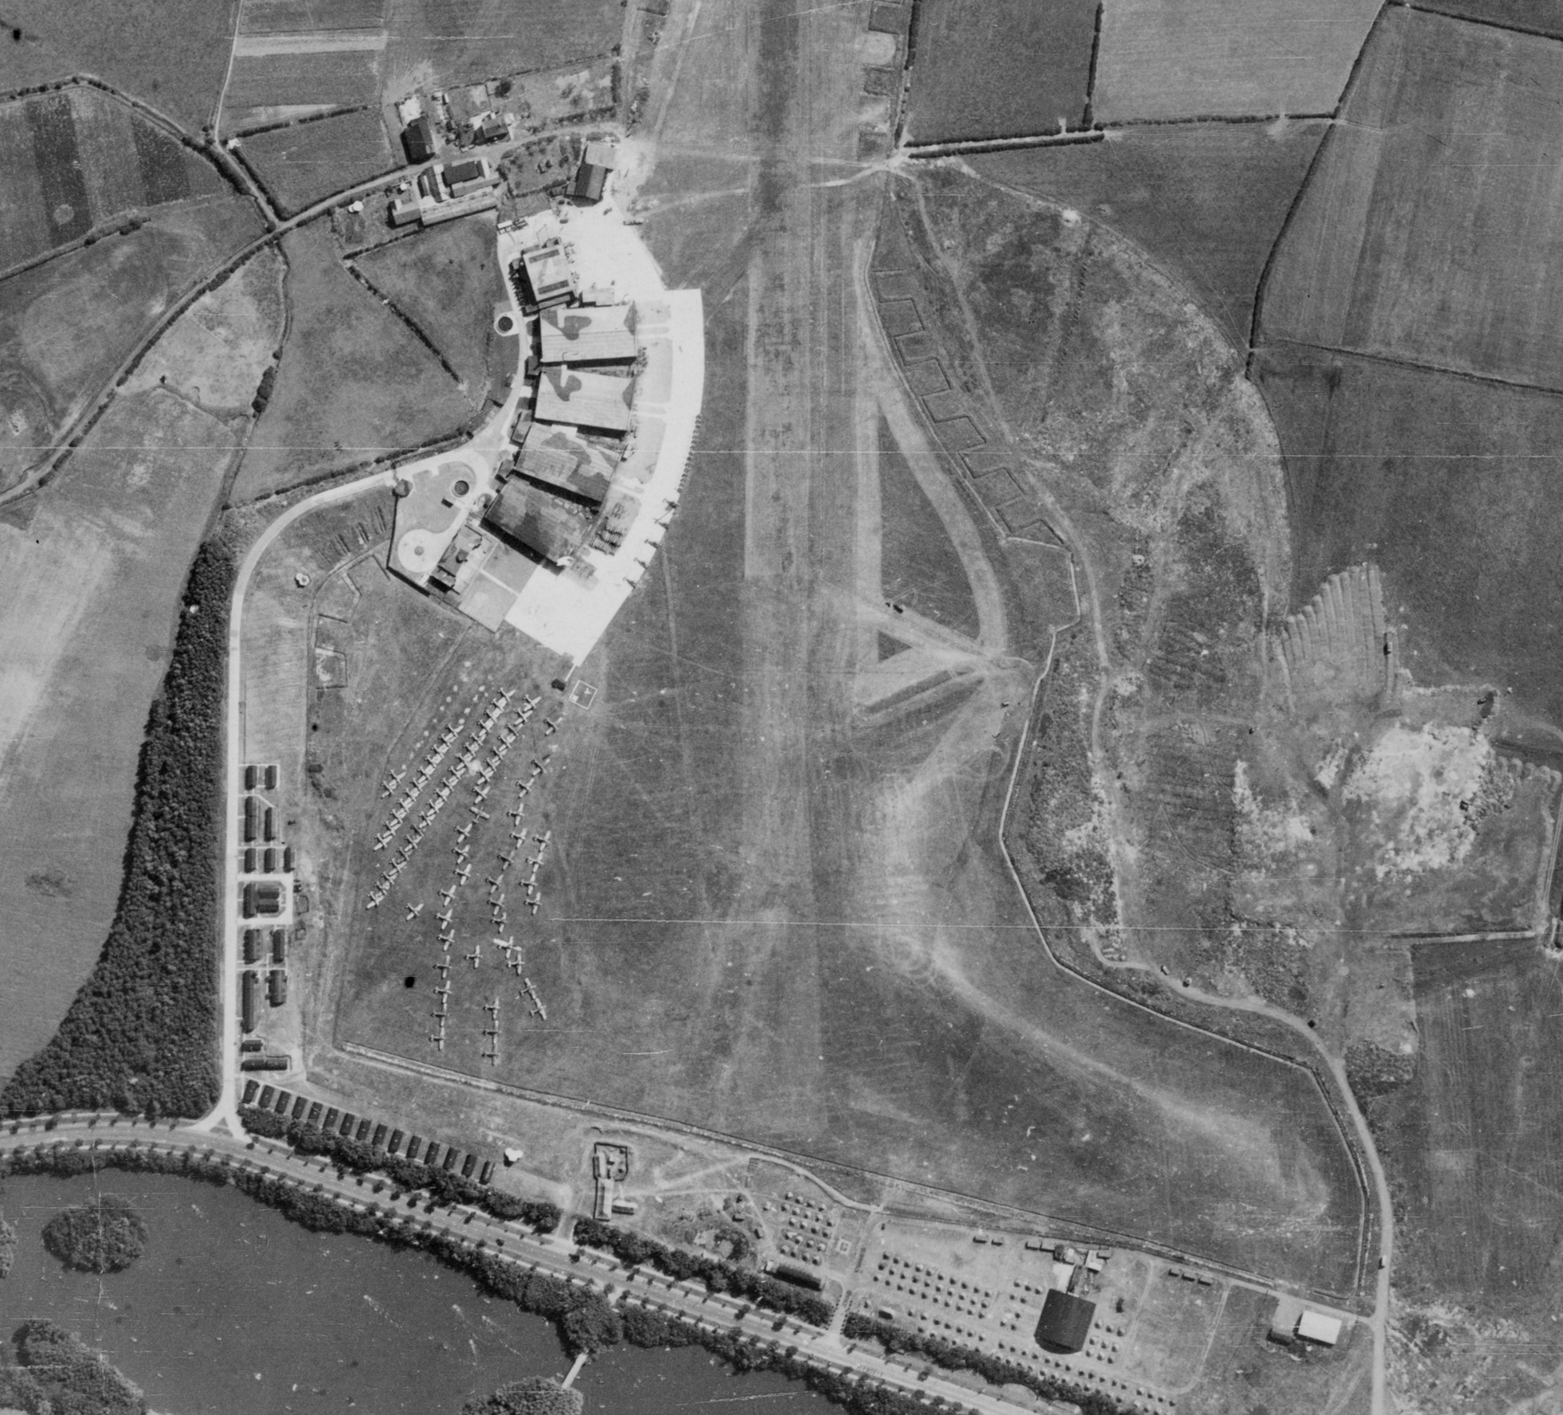
Camouflaged aircraft hangars – Stanley Park, Blackpool
The very large aircraft hangars (yellow) have had their roof painted with camouflage patterns.
Notes:
Image: raf_106g_uk_625_rp_3022 – 10th August 1945 - Historic England Archive (RAF photography) - https://historicengland.org.uk/images-books/archive/collections/aerial-photos/record/raf_106g_uk_625_rp_3022

Slide 66
Emergency Water Supplies
The provision of emergency water supplies (EWS) to help with the rapid extinguishing of fires was an essential component of Civil Defence.
A wide variety of designs and materials were used in their construction including rubber, corrugated steel, and pre-fabricated steel panel tanks (Braithwaite tanks).
Most would leave little or no trace, being equally easy to assemble or dismantle. Most surviving tanks are at factories and remain in use. The basements of demolished bombed buildings were also pressed into use as static water tanks.

Slide 67
EWS tanks – Longton, Stoke-on-Trent
The large number of factories and densely populated urban housing in Stoke-on-Trent meant the need for quick access to water, to put out fires caused by bombing,was essential, hence the large number of EWS tanks (yellow) visible on the photo.
Notes:
Image: raf_106g_uk_646_rs_4163 – 11th August 1945 - Historic England Archive (RAF photography) - https://historicengland.org.uk/images-books/archive/collections/aerial-photos/record/raf_106g_uk_646_rs_4163

Slide 68
Hospitals 1
The Emergency Hospital Service (EHS) was established at the outbreak of World War II. The service had to deal with the ‘normal’ population of sick people while freeing- up capacity to deal with injuries attributed to air raids or other attacks.
One of the mains aims of the EHS was to create the anticipated 300,000 extra beds in hospitals for civilian casualties and all sick service personnel.
Notes:
Information from and find out more at: https://www.bgs.org.uk/resources/as-we-once-were-the-wartime-emergency-medical-service-and-the-future-nhs-2

Slide 69
Hospitals 2
They came up with three main ways of doing this:
Sending patients home. On the declaration of a state of emergency, all hospitals, even some mental ones, were to discharge those patients no longer in urgent need of hospital treatment as well as moving patients from larger general hospitals in danger areas to more distant hospitals. These moves would free about 100,000 beds within 24 hours.
Additional beds. An extra 100,000 beds were created by ‘crowding’: putting extra beds into existing wards. Some private homes were equipped and converted for EHS use.
Building hutted accommodation. This would be on existing hospital sites and would provide an extra 40,000 beds. The wards would be 144 feet long and 24 feet wide with kitchen, sluice room, two bathrooms, four WCs, sister’s duty room, linen room and the main ward. This would be 108 feet long and would provide 36 beds. This ‘temporary’ accommodation remained in use for many years after the war and is clearly visible on many aerial photographs.
Notes:
Information from and find out more at: https://www.bgs.org.uk/resources/as-we-once-were-the-wartime-emergency-medical-service-and-the-future-nhs-2

Slide 70
Hospitals 3
These measures would, it was calculated, would provide an extra 290,000 beds. To support the system, casualty bureaux were set up to collect information about admissions, deaths, discharges etc. By March 1941 over 80% of hospitals were included in the EHS scheme.
The service paved the way for separate and competing institutions to come together as part of the National Health Service.
Additional hospital camps were also created by the US military to treat their own personal. American units used some standing hospitals in host or occupied countries, but many were a collection of tents or Nissen huts, 20ft by 40ft corrugated tin semi-cylinders. In England, Nissen-hut hospital complexes were often placed on estate grounds, and had concrete floors, flush toilets, clean water, and were heated by coal-burning stoves.
Notes:
Information from and find out more at: https://www.bgs.org.uk/resources/as-we-once-were-the-wartime-emergency-medical-service-and-the-future-nhs-2

Slide 71
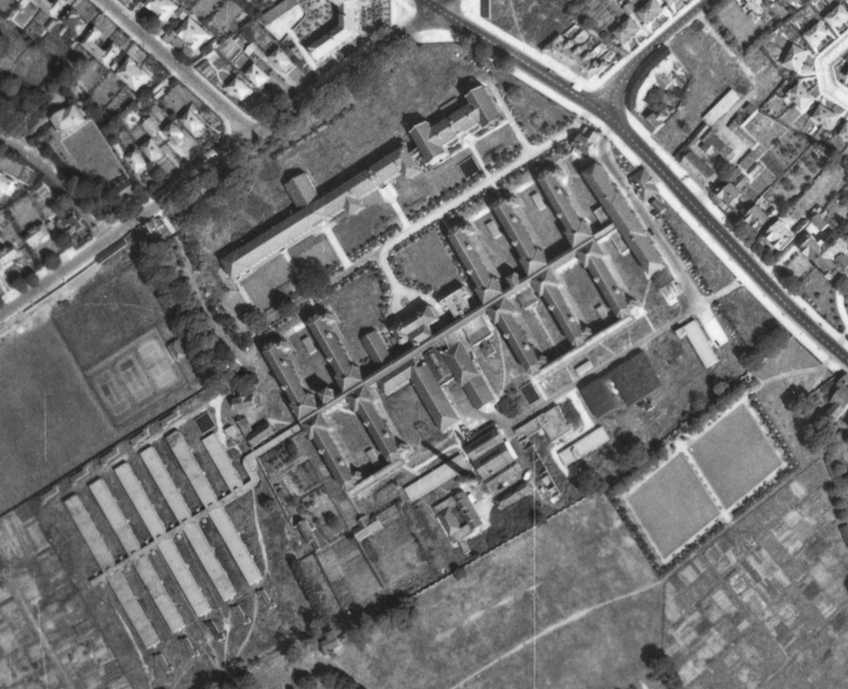
Additional Hospital Buildings – Alder Hey, Liverpool
Additional ‘hutted accommodation’ added to Alder Hey hospital.
Notes:
Image: raf_106g_uk_626_rs_4195 – 10th August 1945 - Historic England Archive (RAF photography) - https://historicengland.org.uk/images-books/archive/collections/aerial-photos/record/raf_106g_uk_626_rs_4195

Slide 72
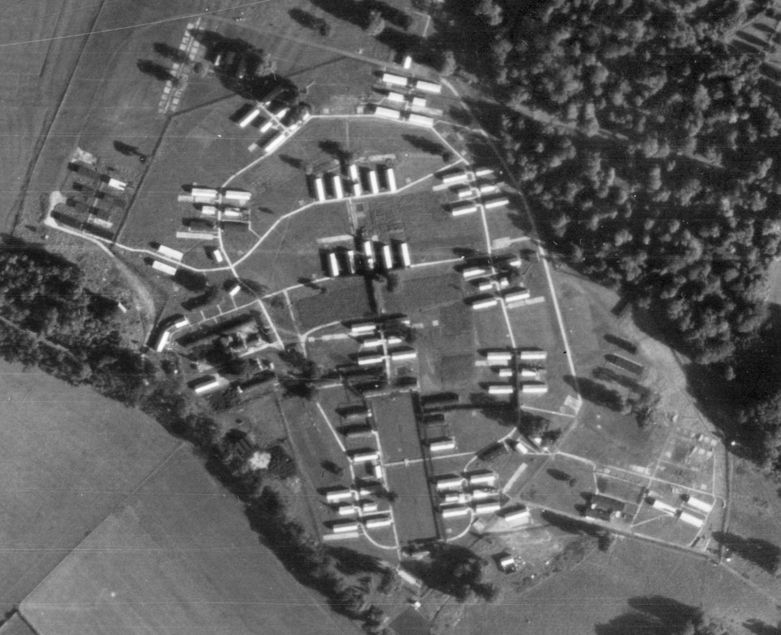
Military Hospital (later PoW camp) – Lydiard Park, Swindon
US military hospital camp in the grounds of Lydiard House, which are now known as Lydiard Park.
Notes:
Image: raf_106g_uk_1721_rp_3128 – 6th September 1946 - Historic England Archive (RAF photography) - https://historicengland.org.uk/images-books/archive/collections/aerial-photos/record/raf_106g_uk_1721_rp_3128

Slide 73
Munitions Sites 1
From 1941 onwards a million-plus British women worked in munitions factories until victory in 1945. They worked round the clock, seven days a week in perilous conditions on the production line.
They helped to make the bullets, the bombs, the tanks, the spare parts and the weaponry that the country needed so badly. Without their effort, the outcome of the war could have been very different indeed.
Unlike others in the Forces or the Home Front they were not distinguished by a uniform, so secret was the nature of wartime munitions work. They were not allowed to tell anyone where they worked. Yet the danger they faced each day in the factories and even on their way to work during night time bombing raids in the blackout was huge.
Notes:
Information taken from and find out more about women workers in WW2 munitions factories at: https://www.express.co.uk/news/uk/421425/Meet-the-bomb-girls-A-new-book-tells-how-a-secret-army-helped-win-the-Second-World-War

Slide 74
Munitions Sites 2
At a munitions site safety rules and regulations dominated everything. Every person working on the factory floor risked their health and their life working with highly toxic chemicals. One tiny mistake could blow everyone up and wreck Britain's war effort. Each day carried the risk of sudden, accidental explosions, causing disfigurement, blindness, loss of limbs or worse.
As well as factories where the munitions were made, there were also depot sites all across the country where the munitions were then stored. This was so they were ready to be used by or transported to the troops who needed them.
Notes:
Information taken from and find out more about women workers in WW2 munitions factories at: https://www.express.co.uk/news/uk/421425/Meet-the-bomb-girls-A-new-book-tells-how-a-secret-army-helped-win-the-Second-World-War

Slide 75
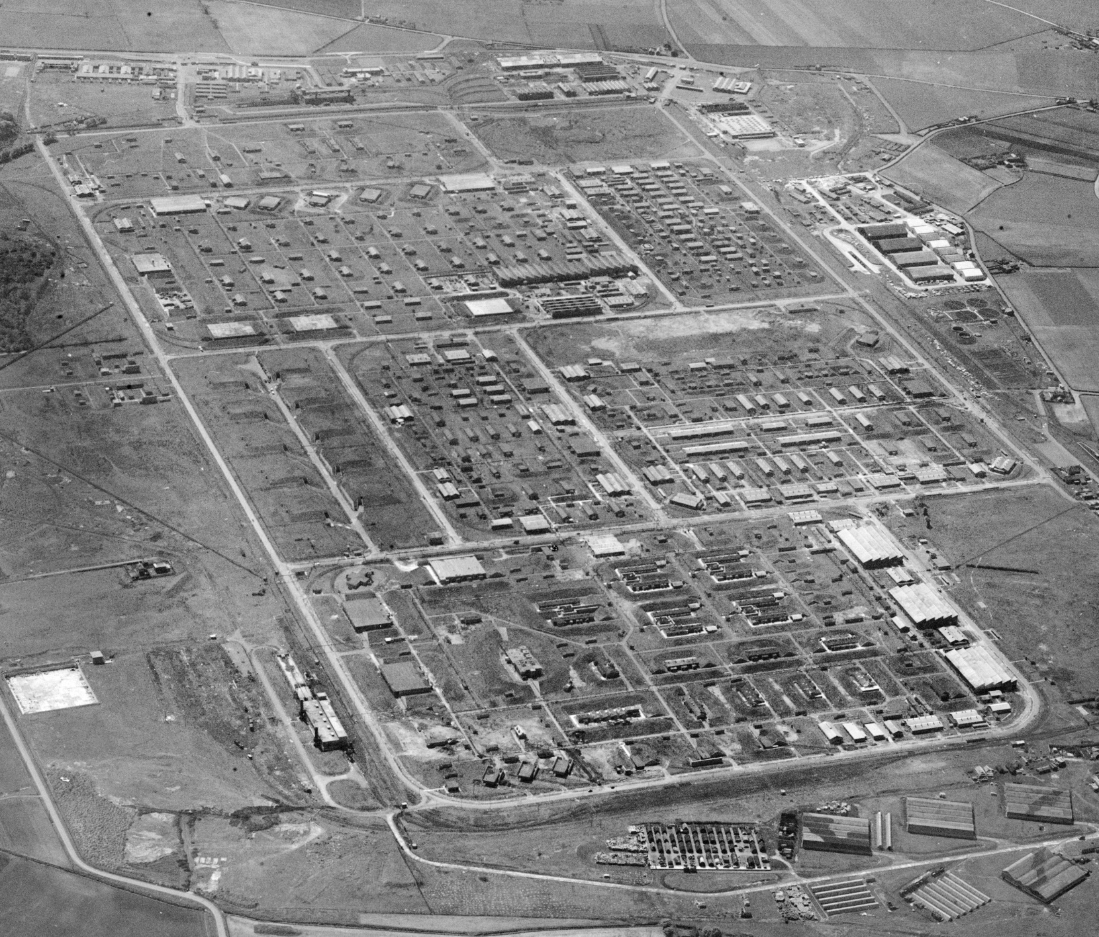
Royal Ordnance Factory (Filling Factory No.7) – Kirkby
When completed ROF Kirkby had more than 1,000 buildings, 18 miles of roads, 23 miles of railway lines along with a station, 200 houses for key workers and a YWCA hostel to house 1,000 women.
Notes:
Image: EAW005653 – 15th May 1947 - © Historic England Archive (Aerofilms Collection) - https://historicengland.org.uk/images-books/archive/collections/aerial-photos/record/EAW005653

Slide 76
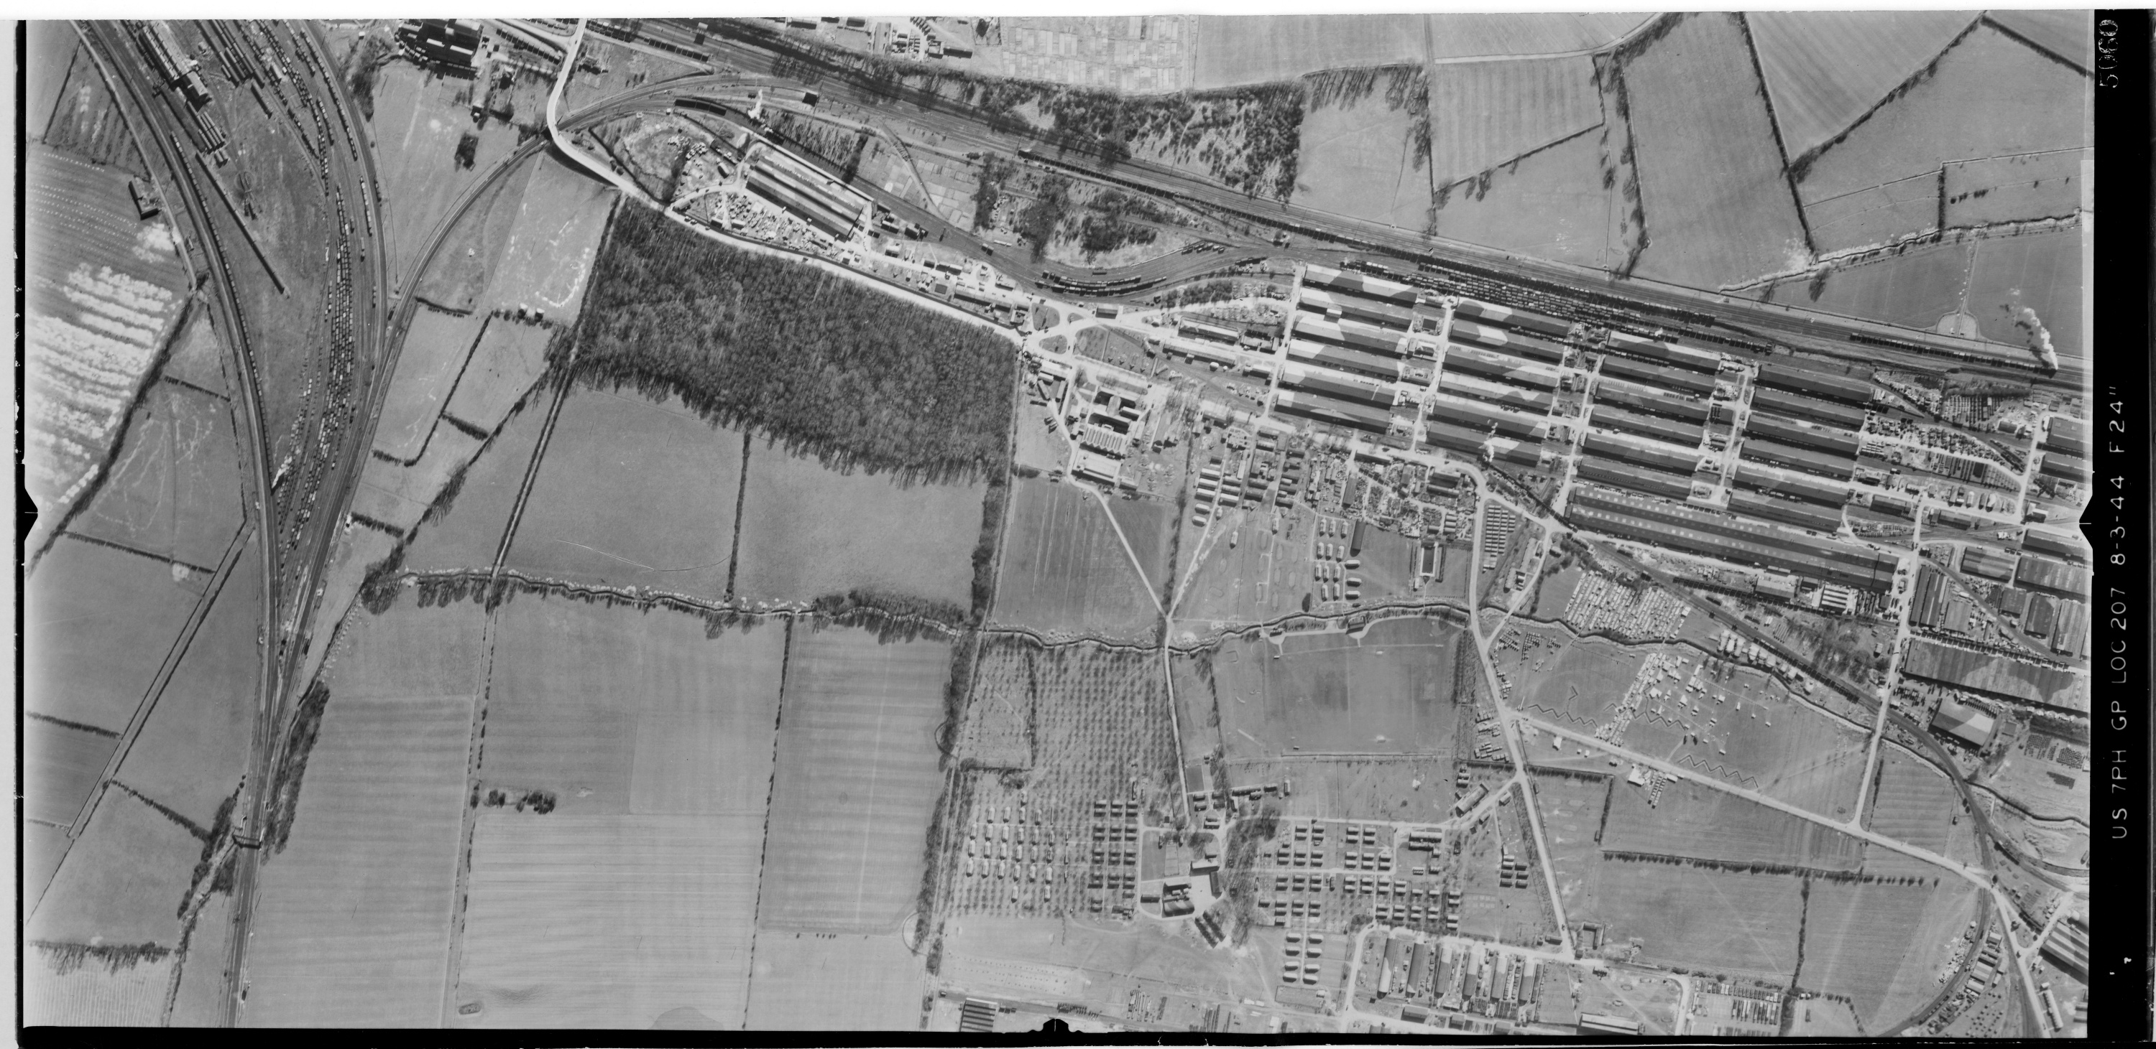
Royal Army Ordnance Corps Depot – Didcot, Oxfordshire
The depot is so large it can’t all be seen in the photo. Note it’s location next to a major railway junction to assist in the transport of munitions and other supplies.
Notes:
Image: us_7ph_gp_loc207_v_5060 – 8th March 1944 - Historic England Archive (RAF photography) - https://historicengland.org.uk/images-books/archive/collections/aerial-photos/record/us_7ph_gp_loc207_v_5060

Slide 77
Prisoner of War (PoW) Camps 1
Contrary to popular belief, most Second World War PoW camps were not purpose-built, and many were in requisitioned country houses, cotton mills, disused airfields, military camps, ordnance depots, anti-aircraft gun sites and military hospitals; some were even in unfinished housing estates.
Purpose-built PoW camps did not become a feature of the British landscape until late 1942, with the arrival of Italian PoWs taken during the North African campaign. They built the majority of the so-called ‘standard’ camps during late 1942 and early 1943, woth PoWs living under canvas until the accommodation huts were built.
Each Prisoner of War camp was allocated an official number during World War II within a prescribed numerical sequence, ranging from Camp 1 (Grizedale Hall, Ambleside) through to Camp 1026 (Raynes Park, Wimbledon).

Slide 78
Prisoner of War (PoW) Camps 2
Such a camp was designed to house 750 prisoners, and consisted of a guards’ compound at the entrance, a 6-acre prisoners’ compound with about 35 huts, a sewage plant, a playing field and vegetable gardens.
Guard towers were not a common feature, only occurring where prisoners were sorted and classified, or where they were considered ardent Nazis.
After 1944 and particularly following the surrender of Germany, many camps were hard pressed to hold the number of prisoners taken; additional accommodation was provided in bell tents erected within the prisoners’ compound.

Slide 79
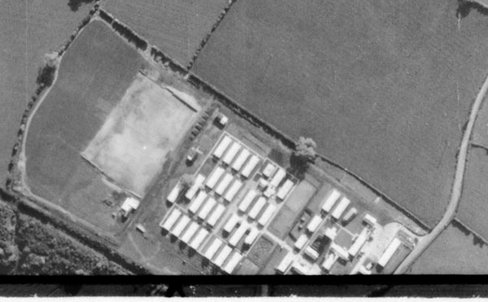
St Martin’s POW Camp – nr Gobowen, Shropshire
A ‘Standard’ type, Working Camp
Notes:
Image: raf_106g_uk_1517_rs_4392 – 17th May 1946 - Historic England Archive (RAF photography) - https://historicengland.org.uk/images-books/archive/collections/aerial-photos/record/raf_106g_uk_1517_rs_4392
‘Standard’ type, German Working Camp

Slide 80
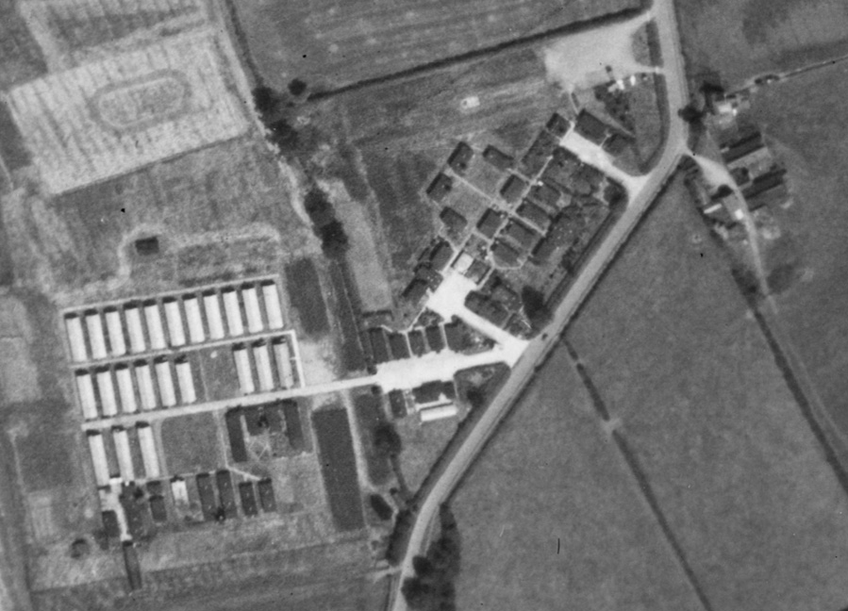
Harrington POW Camp – Harrington, Market Harborough
A ‘Standard’ type, Working Camp
Notes:
Image: raf_541_602_rs_4220 Historic England Archive (RAF photography) - https://historicengland.org.uk/images-books/archive/collections/aerial-photos/record/raf_541_602_rs_4220
‘Standard’ type, German Working Camp

Slide 81
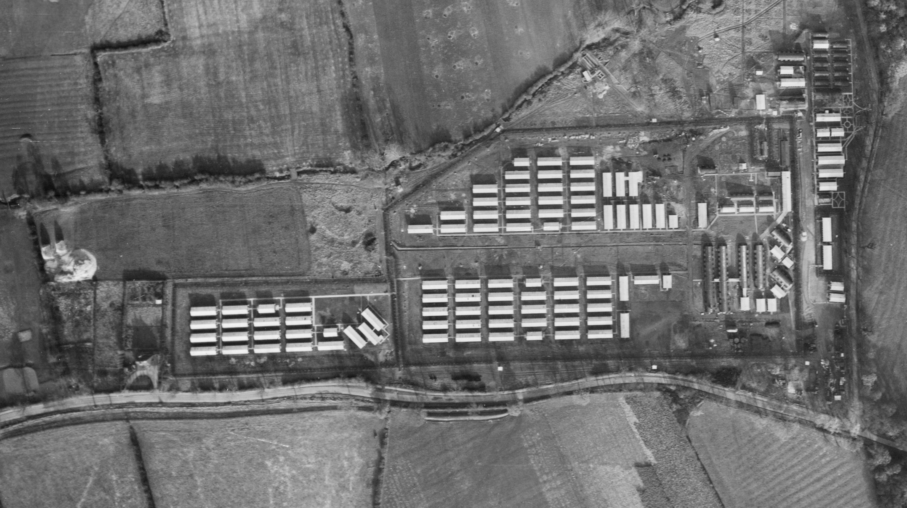
Shady Lane POW Camp – Evington, Leicester
A ‘Base Camp’
Notes:
Image: raf_106g_uk_1011_fv_7123 Historic England Archive (RAF photography) - https://historicengland.org.uk/images-books/archive/collections/aerial-photos/record/raf_106g_uk_1011_fv_7123
Base Camp

Slide 82
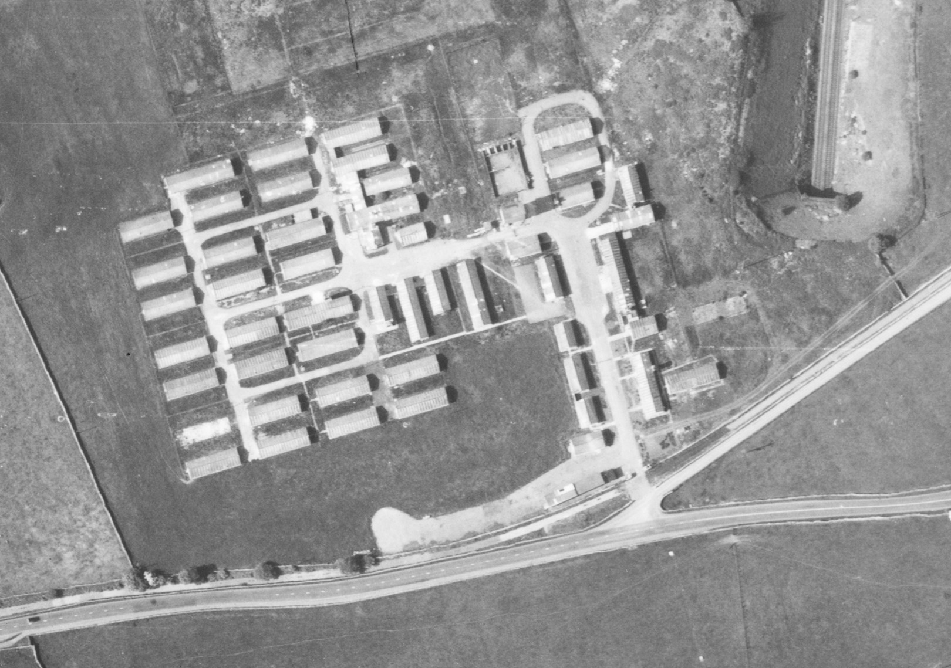
Overdale POW Camp – Skipton
A ‘Standard’ type, Working Camp
Notes:
Image: raf_540_1322_f22_0094 – 3rd June 1954 - Historic England Archive (RAF photography) - https://historicengland.org.uk/images-books/archive/collections/aerial-photos/record/raf_540_1322_f22_0094
‘Standard’ type, German Working Camp

Slide 83
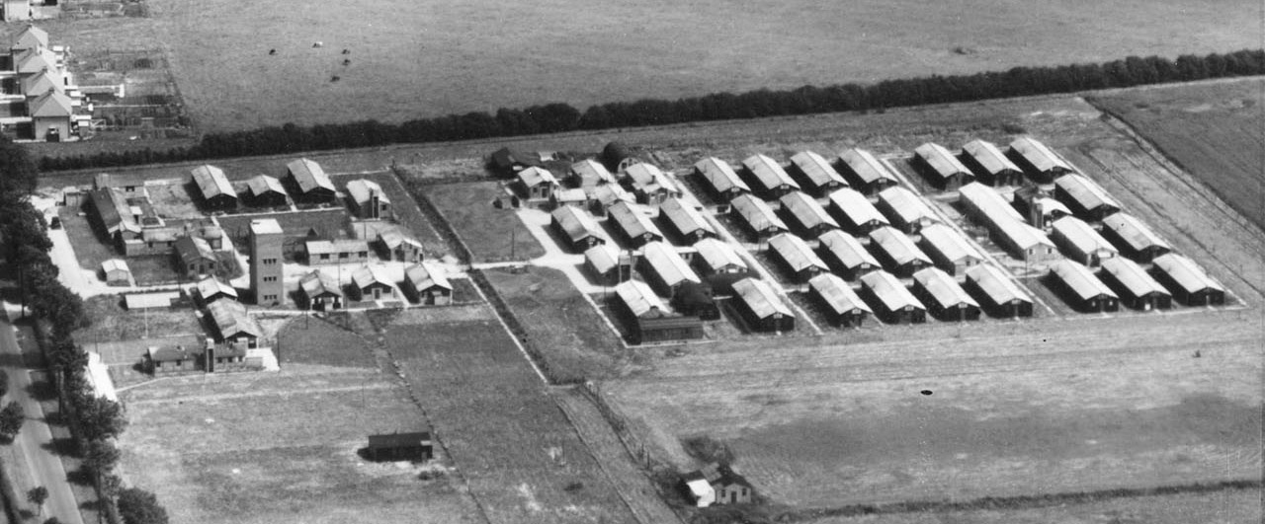
Stamford POW Camp – Stamford
A ‘Standard’ type, Working Camp
Notes:
Image: raf_540_62_sffo_0074 – 22nd July 1948 - Historic England Archive (RAF photography) - https://historicengland.org.uk/images-books/archive/collections/aerial-photos/record/raf_540_62_sffo_0074
‘Standard’ type, German Working Camp

Slide 84
Pre-Fabricated Houses 1
Pre-Fabricated Houses, known as “prefabs” were temporary homes that were pre-built (fabricated) in a factory, hence their name. This was so that they could be quickly and easily assembled on site, ready for people to start living in them.
They were built to rehouse those who had lost their homes during the Blitz or servicemen coming back from the war and their young families. More than 156,000 were built all over the country in 1946 and 1947.
Notes:
Find out more at: https://heritagecalling.com/2018/07/24/5-things-you-didnt-know-about-prefabs/

Slide 85
Pre-Fabricated Houses 2
Prefabs were planned as early as 1942, three years before the end of the Second World War. In 1942, Churchill’s government had created the Burt Committee named after Sir George Burt. Its aim was to come up with a quick, efficient and modern answer to the looming housing crisis. They came up with a sort-of ideal floor plan of a one-storey bungalow with two bedrooms, inside toilets, a fitted kitchen, a bathroom and a living room. The prefabs would be detached houses, surrounded by a garden to encourage dwellers to grow fruit and vegetables and would have a coal shed.
The public was impressed. A lot of people who lived in big cities like London, which had been heavily bombed, were used to living in shared flats or houses with toilets outside and no hot water. Suddenly they discovered little houses with all the mod cons, which also enjoyed a lot of light and offered the possibility to have a garden all around. Young families mainly coming from working-class backgrounds would have the opportunity to live in a detached house, with a fitted kitchen with a fridge!
Notes:
Find out more at: https://heritagecalling.com/2018/07/24/5-things-you-didnt-know-about-prefabs/

Slide 86
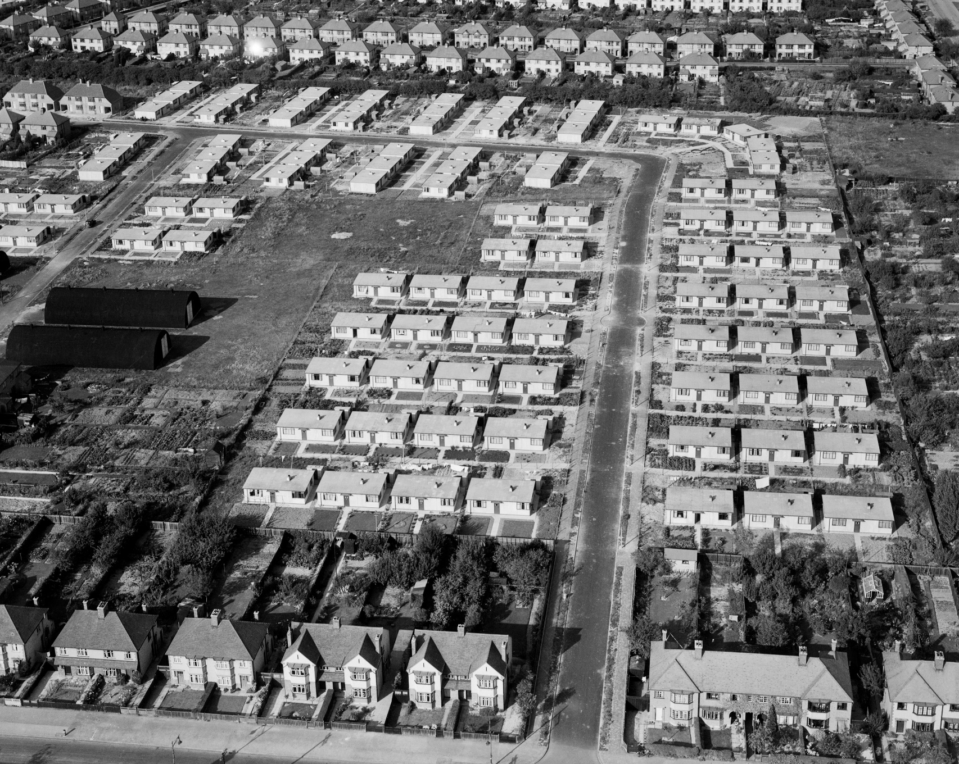
Pre-fabs – Lichfield Road, Cambridge
The single storey pre-fabs (yellow) can be seen in between the usual two storey houses on either side.
Notes:
Image: EAW002930 – 1st October 1946 - © Historic England Archive (Aerofilms Collection) - https://historicengland.org.uk/images-books/archive/collections/aerial-photos/record/EAW002930

Slide 87
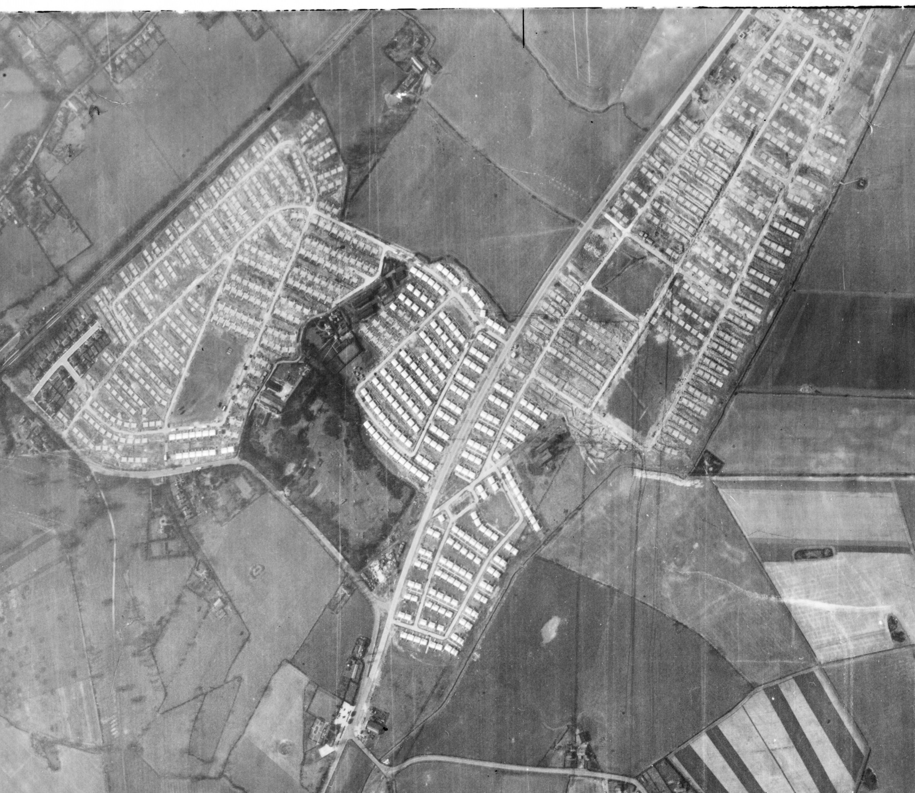
Pre-fab estates – Netherley, Liverpool
Every single little white ‘square’ is a brand new pre-fab house.
Notes:
Image: raf_cpe_uk_1996_fp_1044 – 13th April 1947 - Historic England Archive (RAF photography) - https://historicengland.org.uk/images-books/archive/collections/aerial-photos/record/raf_cpe_uk_1996_fp_1044

Slide 88
Seafront Defences
Anti-tank obstacles, known colloquially as dragon’s teeth, were built along beaches that were potentially a landing place for German forces in the event of the invasion of Britain.

Slide 89
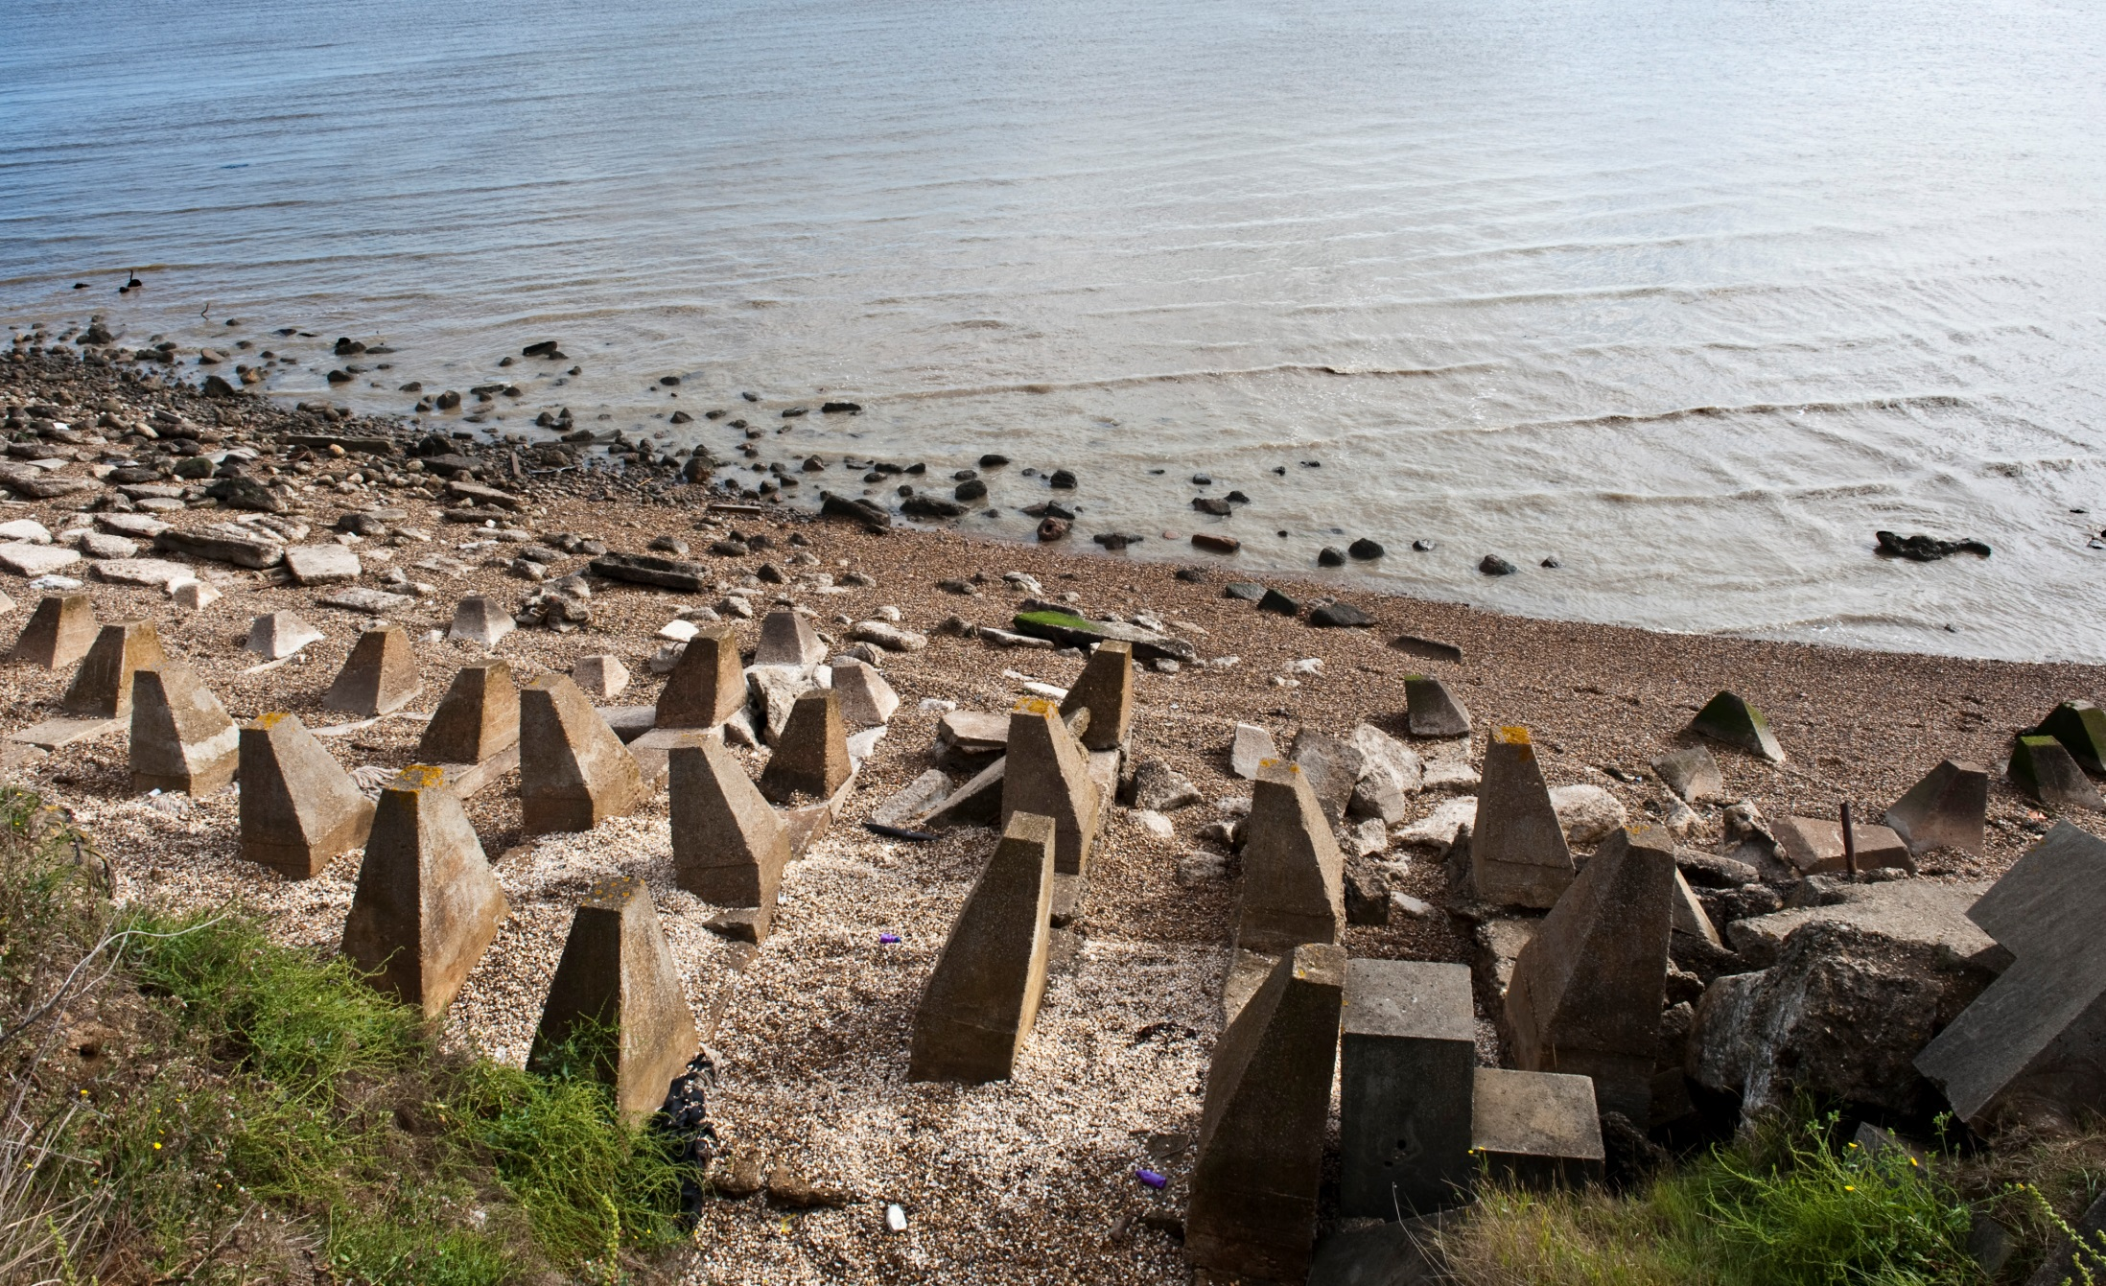
‘Dragon’s Teeth’ – Isle of Grain, Kent
Notes:
Image: DP076219 – 30th July 2009 - Historic England Archive - https://historicengland.org.uk/images-books/photos/item/DP076219

Slide 90
Anti-invasion obstacles – Scarborough, North Yorkshire
Notes:
Image: raf_4h_br42_b_v_0092 – 1st August 1940 - Historic England Archive (RAF photography) - https://historicengland.org.uk/images-books/archive/collections/aerial-photos/record/raf_4h_br42_b_v_0092

Slide 91
Search Light Battery
During the Second World War searchlights were manned by the Royal Artillery and were under the control of the Army's Anti-Aircraft Command. They formed part of a system for detecting enemy aircraft linking locator devices (initially using sound or heat, but eventually using radar), searchlights and anti-aircraft guns (see earlier slide). The locators sent information to the searchlights and guns, which together then tracked and 'locked on' to the approaching aircraft. The idea being the lights would spot the aircraft and the guns would destroy it.
The need for more accurate spotting of enemy aircraft was essential in trying to reduce the amount of ammunition used to destroy the aircraft. In 1940 it took an average of 20,000 rounds of ammunition to down a single enemy aircraft! This needed to be reduced and the use of radar and searchlights was seen as vital to doing this.
Searchlight sites typically comprised small ring-ditchs to provide the crew with shelter during an air raid, a predictor emplacement for calculating the height and range of targets, a light anti-aircraft machine gun pit, a generator and hutted accommodation for the crew.
Notes:
Find out more at: http://www.skylighters.org/howalightworks/

Slide 92
Search Light Battery – Childwall, Liverpool
Hutted accommodation
Standard ring-ditch layout
Notes:
Image: raf_13h_uk789_v_0001 – 11th June 1941 - Historic England Archive (RAF photography) - https://historicengland.org.uk/images-books/archive/collections/aerial-photos/record/raf_13h_uk789_v_0001

Slide 93
Search Light Battery – Bedford
Hutted accommodation
Standard ring-ditch layout
Notes:
Image: raf_ac207_v_5050 – 24th February 1943 - Historic England Archive (RAF photography) - https://historicengland.org.uk/images-books/archive/collections/aerial-photos/record/raf_ac207_v_5050

Slide 94
Using the Aerial Photo Explorer 5
Having looked at the ‘Vertical’ RAF photos, go back to the ‘Layer’ tab turn on the ‘Obliques’ layer.
Then look for any green squares or purple diamonds that will show you historic oblique photos too – repeat the process of looking for evidence of the Second World War
Notes:
Re-tick the ‘Oblique photographs’ box to see all the photos for your area.

